Slide 1
Nagorik Seba
A ward-level civic complaint platform for Bangladesh — report local problems with photos, track every status change, and rate the resolution.
Nagorik Seba • Ward-level civic complaint platform for Bangladesh
Notes:
Open by naming the domain, not the stack. Nagorik Seba means 'citizen service' - it is a ward-level civic complaint platform for Bangladesh City Corporations.
The one-line pitch: a resident reports a broken road with a photo and a map pin, gets a reference code, watches every status change, and rates the result. The ward councilor can see the same data aggregated.
I built it end to end - design, code, tests and docs - and I will show it running rather than only describing it.

Slide 2
The Problem
Citizens face broken roads, waterlogging, and missed garbage collection every day
Complaints made by phone or in person disappear — no reference number, no tracking
Authorities have no ward-level data: which areas wait longest, which departments lag
Result: zero accountability, zero transparency, repeated complaints about the same issue
Notes:
The everyday version of this problem: a pothole gets reported three times by phone and nothing happens any of them, because nobody wrote anything down.
Three concrete failures. One, the complaint vanishes - no reference number, so no way to check. Two, the authority has no ward-level view, so they cannot tell which areas are being neglected. Three, the resident gives up, and the problem stays.
The root cause is not that people do not complain. It is that the loop is never closed, so accountability never forms.

Slide 3
Project Objectives
Let residents submit geo-tagged complaints with photos and track them by reference code
Give officers a clear workflow: verify → assign → start work → resolve with proof photo
Enforce resolution deadlines (SLA) with automatic escalation when breached
Publish a public heatmap and ward scoreboard — transparency without leaking privacy
Keep the system secure, test-covered, and deployable on a single server
Notes:
Five objectives, and each one maps to something you will see running today.
Submit geo-tagged complaints and track them by reference code. Give officers a real workflow. Enforce deadlines with automatic escalation. Publish a heatmap and scoreboard without leaking privacy. Keep it test-covered and deployable on one server.
The last one is the honest engineering constraint - a single City Corporation budget does not buy a cluster, so the system has to be genuinely operable by one person.

Slide 4
Who Uses the System
Citizen — submits complaints, tracks timeline, rates resolution, reopens if unsatisfied
Department Officer — verifies reports, assigns work, starts and resolves with proof photos
Ward Councilor — monitors ward dashboard, verifies reports, receives SLA escalations
Admin — manages municipalities, wards, departments, users, and SLA policies
Anonymous visitor — views the public heatmap and ward scoreboard, no login needed
Notes:
Five roles, and the anonymous visitor is a deliberate design choice.
The citizen is the only person who can reopen. The department officer does the field work and cannot act on a complaint assigned to someone else. The ward councilor monitors and receives escalations. Admin manages reference data and the SLA matrix.
The anonymous visitor gets the heatmap and the scoreboard with no account at all - that is what makes transparency meaningful, because scrutiny should not require trust in the operator.
One correction worth making explicitly: tracking your own complaint does require signing in. There is no anonymous tracking endpoint.

Slide 5
Complaint Lifecycle
SUBMITTED → VERIFIED → ASSIGNED → IN_PROGRESS → RESOLVED → CLOSED
Every change goes through one guarded service: row lock, version check, audit row, notification
Illegal moves are rejected (e.g. resolving before assignment) — the state machine cannot be bypassed
Citizens rate 1–5 to close; unhappy citizens reopen (priority jumps to HIGH, deadline halves)
Silent for 7 days after resolution? The system auto-closes the complaint (new in this release)
Notes:
Walk the happy path first, then the two paths that make it trustworthy.
SUBMITTED through CLOSED. Citizens rate 1-5 to close; unhappy citizens reopen, which pushes priority to HIGH and halves the deadline. A complaint left silent for 7 days after resolution auto-closes.
The next slides turn this from a diagram into the actual state machine, including what happens on an illegal transition.

Slide 6
Key Features
Photo complaints with map-pin location, auto-matched to the correct ward (PostGIS)
Reference code (e.g. NS-2026-000123) on every complaint; tracking is tied to the signed-in citizen account
Smart routing: category match → least-loaded officer → nearest office, always explained
Proof-photo resolution, citizen ratings, and full reopen history per attempt
SLA deadlines per category/priority, breach detection, and escalation to councilors
Admin panels for municipalities, users, and SLA policies + ops runbooks
Notes:
Features, grouped by what they buy the user.
For the citizen: photo evidence, a map pin that auto-resolves the ward, a stable reference code, ratings and reopen history. For the officer: explainable routing and proof-photo resolution. For the ward: SLA deadlines with automatic escalation to the councilor. For everyone: the public heatmap and scoreboard.
To be precise on one point: the reference code is how you track a complaint, but you do sign in to do it. There is no anonymous tracking.

Slide 7
Part 2
System Design & Implementation
How the platform is built — and why it is built that way.
Notes:
Transition into the build. From here it is architecture, stack, data model, security and the SLA engine.
The next two slides are the two diagrams that matter most: how the code is arranged, and how a complaint moves through the system.

Slide 8
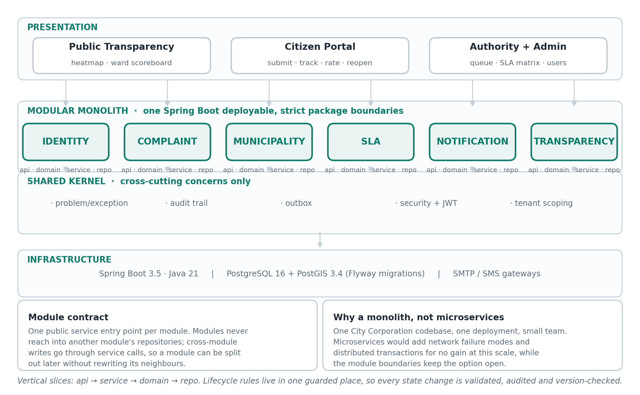
Architecture: Modular Monolith
One Spring Boot deployable, six bounded modules, and a shared kernel that stays deliberately small.
Notes:
One deployable, but the packages are not a free-for-all.
Six domain modules - identity, complaint, municipality, SLA, notification, transparency - each with its own api/domain/service/repo slice. They talk through service calls, never by reaching into another module's repositories.
The shared kernel at the bottom is the discipline: problems, audit trail, outbox, security and tenant scoping live there because every module genuinely needs them. Anything that only one module needs stays inside that module.
Why a monolith: one City Corporation, one deployment, a team of one working with AI assistance. Microservices would buy network failure modes and distributed transactions and cost us nothing in return. The module boundaries are what keep a future split cheap.

Slide 9
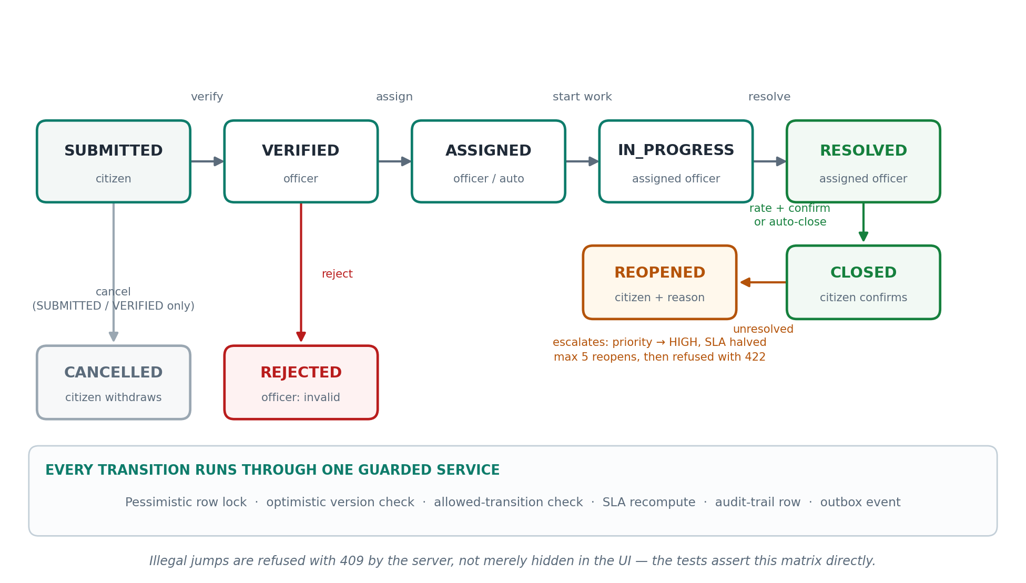
Complaint Lifecycle: One Guarded State Machine
Every transition is validated server-side, audited, and version-checked - illegal jumps return 409.
Notes:
This is the heart of the system, so it is worth pausing on.
Happy path: SUBMITTED, VERIFIED, ASSIGNED, IN_PROGRESS, RESOLVED, CLOSED. Each arrow is a separate handler.
Two things make this trustworthy. First, only the assigned officer can start or resolve work - sign in as the wrong officer and you get 403. Second, every transition runs through one guarded service: pessimistic row lock, optimistic version check, allowed-transition check, SLA recompute, audit row, outbox event.
REOPENED is the interesting one. The citizen gives a reason, priority jumps to HIGH, the SLA is recalculated at half the hours, and a councilor escalation goes out with it. There is a hard budget of five reopens, then a 422.
And nothing here is UI-only courtesy. The tests assert this exact matrix against the server, so an illegal jump fails even if you craft the request by hand.

Slide 10
Architecture: Modular Monolith
One deployable app, strict module boundaries: identity, complaint, municipality, SLA, notification, transparency
Shared kernel only for cross-cutting code (security, outbox, storage, time)
Why not microservices? Team of one + AI pair — a monolith is cheaper to run and easier to test
PostgreSQL 16 + PostGIS for maps, Flyway for versioned migrations, Thymeleaf pages + Leaflet maps
Notes:
The architecture slide in words, now that you have seen the diagram.
Six module boundaries and one rule: modules never read each other's repositories. That is what makes the monolith a design decision rather than a staging accident.
The stack is deliberately boring in the good way - Java 21 on Spring Boot 3.5, PostgreSQL 16 with PostGIS for the geospatial work, Flyway so the schema is versioned code rather than somebody's memory, Thymeleaf plus Tailwind and Leaflet on the front. Thymeleaf was chosen over a SPA because this is a form-and-workflow application, not a consumer product - server-rendered pages keep the attack surface smaller and the deployment a single artifact.

Slide 11
Technology Stack
Java 21 + Spring Boot 3.5 (Web, Data JPA, Security, Validation, Mail, Actuator)
PostgreSQL 16 + PostGIS 3.4 — ward boundaries, point-in-polygon, heatmap queries
Flyway (schema as code), Hibernate Spatial, JWT (jjwt), Apache Tika (upload checks)
Thymeleaf + Tailwind + Leaflet frontend; Testcontainers for real-database tests
Maven build, Docker for local DB, deployable to Render/Railway + Neon
Notes:
Nothing exotic here, which is the point. Spring Boot for the framework, JPA plus Hibernate Spatial for the PostGIS types, jjwt for tokens, Apache Tika for upload content sniffing rather than trusting file extensions.
Testcontainers is the one I would highlight: the test suite starts a real PostgreSQL with PostGIS in Docker and runs against it. Mocking a database would have hidden exactly the bugs I care about - the concurrency tests and the point-in-polygon ward resolution both depend on real database semantics.
Deploys to Render or Railway with a managed Postgres. One container, one database, no cluster.

Slide 12
Data Model Highlights
Shared-schema multi-tenancy: every record carries its municipality
Complaints: reference code, status, PostGIS location, optimistic-lock version
Append-only transition log — the full timeline of who did what, when
Resolution attempts: every resolve → rate/reopen cycle preserved, never overwritten
SLA policies, instances and breaches + transactional outbox for reliable notifications
Notes:
Three modelling decisions worth calling out.
Multi-tenancy is shared-schema with a municipality discriminator on every record. Simpler than schema-per-tenant and adequate because the tenant count is small and known.
The transition log is append-only. Resolution attempts are never overwritten - each resolve and rate or reopen cycle is preserved, which is what lets the citizen see the real history and what makes disputes auditable.
Complaints carry an optimistic-lock version alongside the PostGIS location and the reference code. The version is what makes concurrent updates detectable instead of silently lossy.

Slide 13
Security & Privacy
JWT access tokens (15 min) + rotating refresh tokens; reuse detection revokes the whole family
Account lockout after 5 failed logins; bcrypt-12 passwords; role-based access on every endpoint
Public heatmap snaps coordinates to ~100 m grids and never exposes names, phones, or addresses
Uploads: magic-byte type checks, 10 MB cap, EXIF/GPS stripped (incl. WebP), random storage keys
Rate limits on login, registration, submissions, and the public map
Notes:
The security posture, in order of how much it actually buys.
Access tokens live 15 minutes; refresh tokens rotate on every use, and if a refresh token is presented twice the whole family is revoked - that is how you detect a stolen token being used alongside the legitimate one.
Passwords are bcrypt at strength 12, and five failed logins locks the account.
Two privacy decisions I would defend: uploads are checked by magic bytes rather than extension, capped at 10 MB, and stripped of EXIF including GPS, with random storage keys so a photo URL cannot be enumerated. And the public heatmap only ever exposes a ~100 m grid.
Known weakness, stated plainly: rate limits are in-memory, so they are per-server and reset on restart. That is fine for one instance and wrong for two - Redis is the fix.

Slide 14
SLA Engine & Notifications
Each complaint gets a deadline from its category + priority (e.g. ROADS/NORMAL → 48 h)
Hourly scanner claims overdue items with SKIP LOCKED — safe on multiple servers
Level-1 breach notifies the ward councilor; deeper breaches escalate to municipal admin
Status changes fan out through a transactional outbox: SMS via Twilio, email via SMTP, in-app rows
Outbox relay retries with backoff; health endpoint reports DOWN if delivery lags past 10 minutes
Notes:
The SLA engine is the piece that turns a deadline into real enforcement.
Each complaint gets its deadline from category and priority - ROADS at NORMAL is 48 hours, at CRITICAL it is 12. Every category and priority combination has two escalation thresholds as well, so a breach at 36 hours notifies the ward councilor and the full 48 escalates further.
An hourly scanner finds overdue complaints and claims them with FOR UPDATE SKIP LOCKED. That one clause is what makes it safe to run two app instances without double-processing.
Notifications leave through a transactional outbox: the intent is written in the same transaction as the status change, then delivered after commit, with retries and backoff. A health endpoint reports DOWN if delivery lags past ten minutes, so a silently broken SMS gateway becomes a visible incident instead of a mystery.

Slide 15
Part 3
Verification & Results
Proof the system works — and an honest account of its limits.
Notes:
Verification and results.
What follows: the demo path, what I personally built, the problems that cost the most time, and an honest list of limitations. I would rather you hear the limits from me than find them in the code.

Slide 16
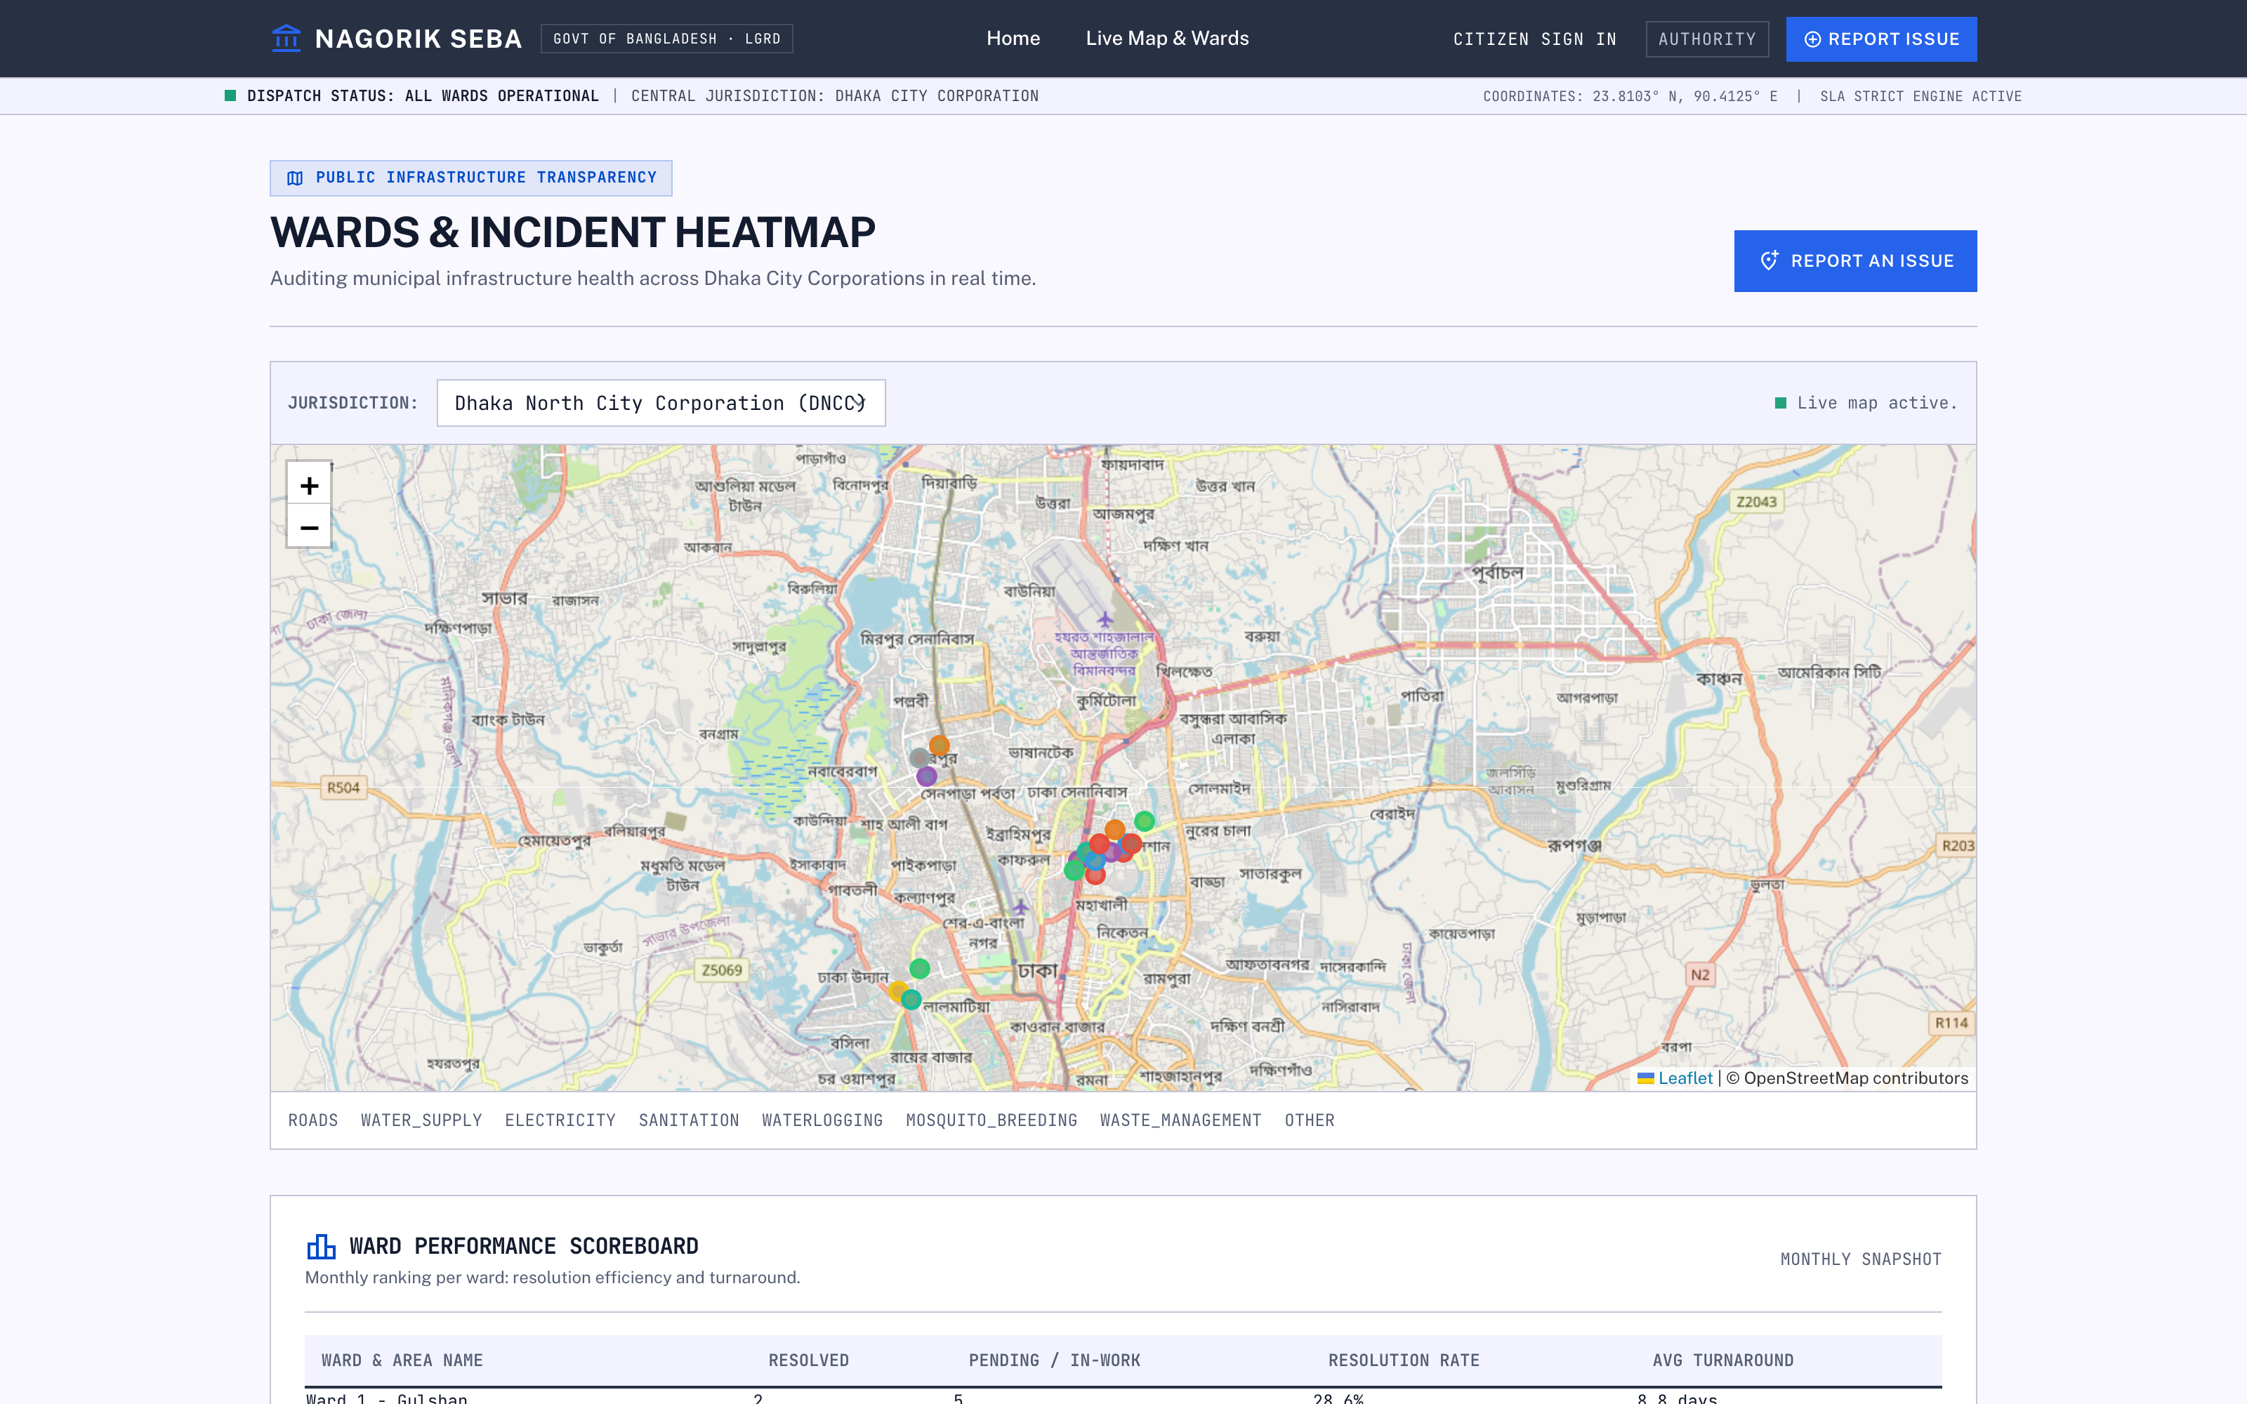
The System Running — Public Transparency
No login required: the heatmap grid and ward scoreboard are served to anonymous visitors.
What you are seeing
Ward boundaries are real PostGIS polygons; each dot is a complaint auto-matched to its ward by point-in-polygon.
The public heatmap snaps coordinates to a ~100 m grid, so no individual complaint location is recoverable.
The scoreboard ranks wards by resolution rate and average turnaround - the transparency layer that makes authorities accountable.
No login, no names, no addresses.
Live ward heatmap + monthly scoreboard (/wards)
Notes:
Let me show the transparency layer first, because it needs no account.
The map is Leaflet over OpenStreetMap with real PostGIS ward polygons. The coloured dots are complaints, matched to their ward automatically by point-in-polygon.
The privacy decision is the important part. The public endpoint snaps every coordinate to roughly a 100 metre grid before returning it, and returns no names, phones or addresses. You can see that a ward has a cluster of problems; you cannot see whose house it is.
Below the map, the scoreboard ranks wards by resolution rate and turnaround time. That is the accountability lever - a ward that never resolves anything becomes visible.

Slide 17
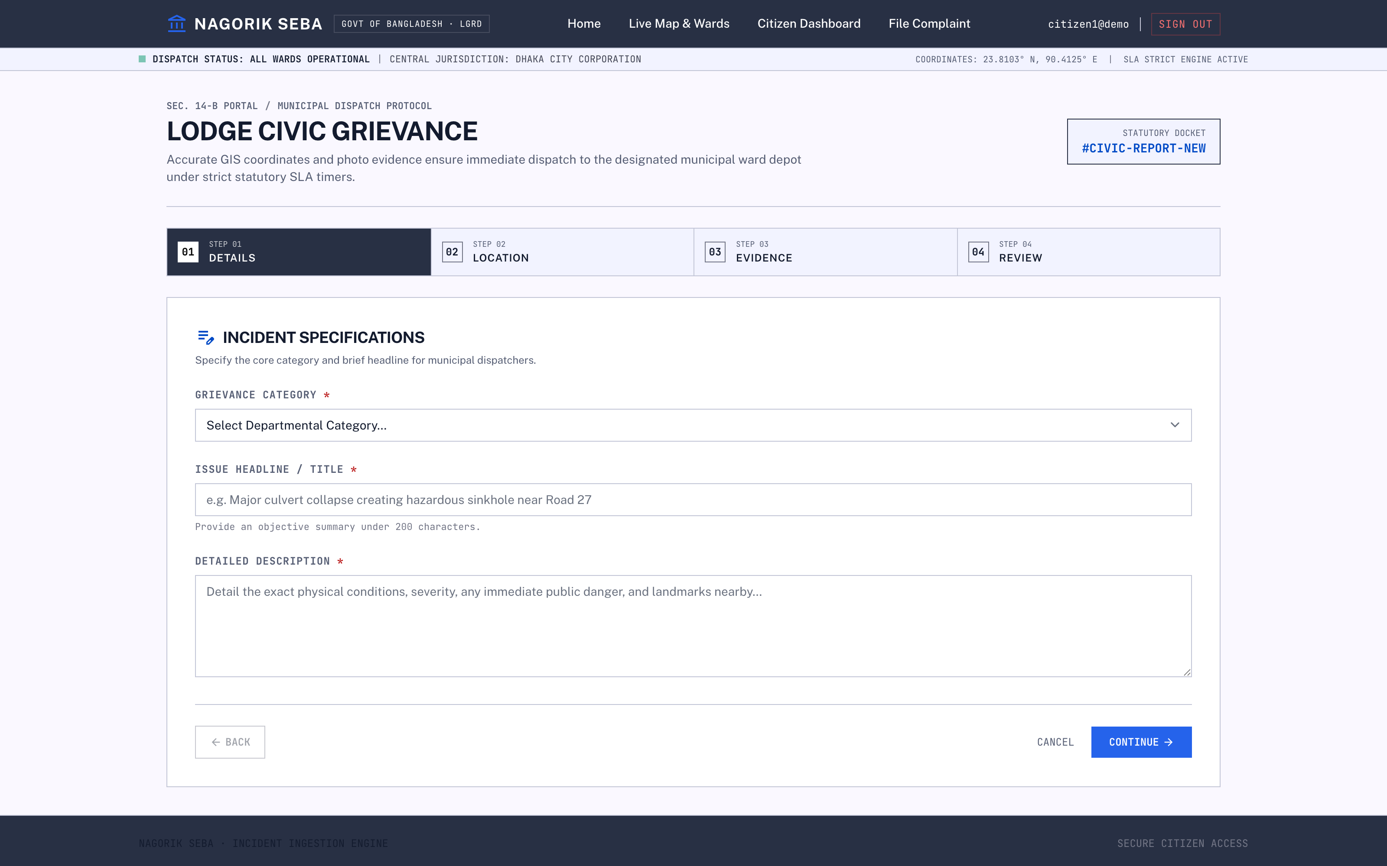
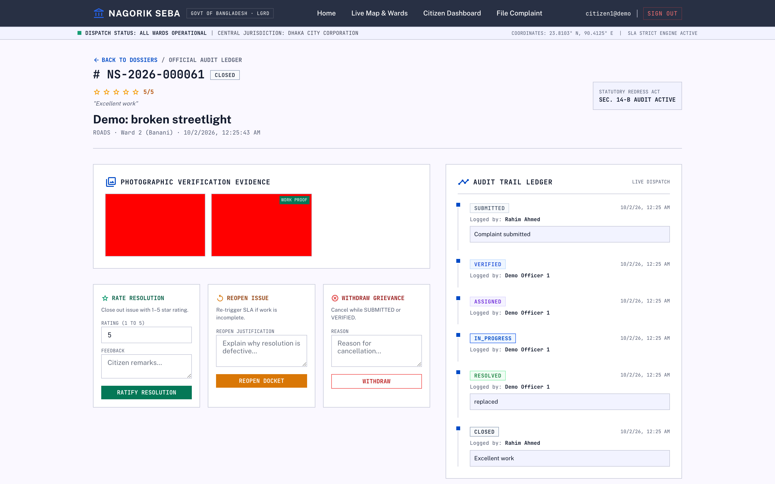
Citizen Side — File, Track, Rate
Geo-tagged submission with photo evidence, then a full audit trail the citizen can follow.
Complaint wizard: category, title, description
Audit trail: every status change, who did it, when
Notes:
Left: the submission wizard. Category drives routing, the description is validated, and the citizen drops a map pin - the server resolves that pin to a ward with PostGIS, so the citizen never picks a ward by hand. Photos are optional but strongly encouraged.
Right is the part that matters after submission: the audit trail. Every transition is recorded with actor and timestamp - submitted, verified, assigned, in progress, resolved, closed. Resolution attempts are appended, never overwritten.
The citizen rates 1-5 to confirm, or reopens with a reason. Rating is what closes the loop, and it is what feeds the ward scoreboard.

Slide 18
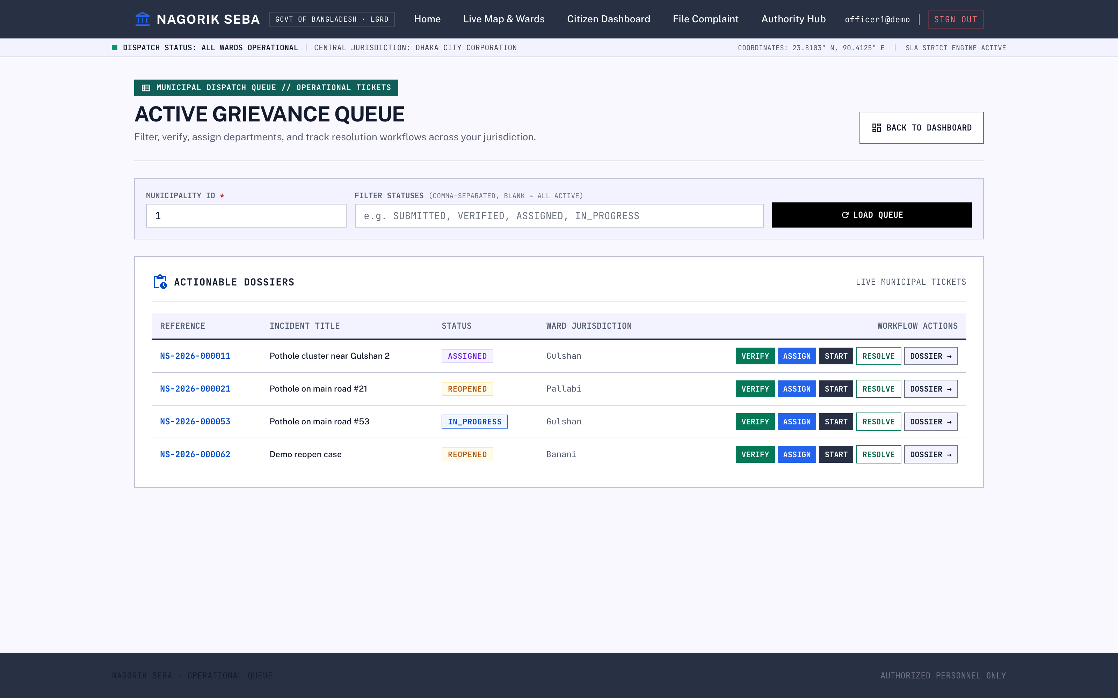
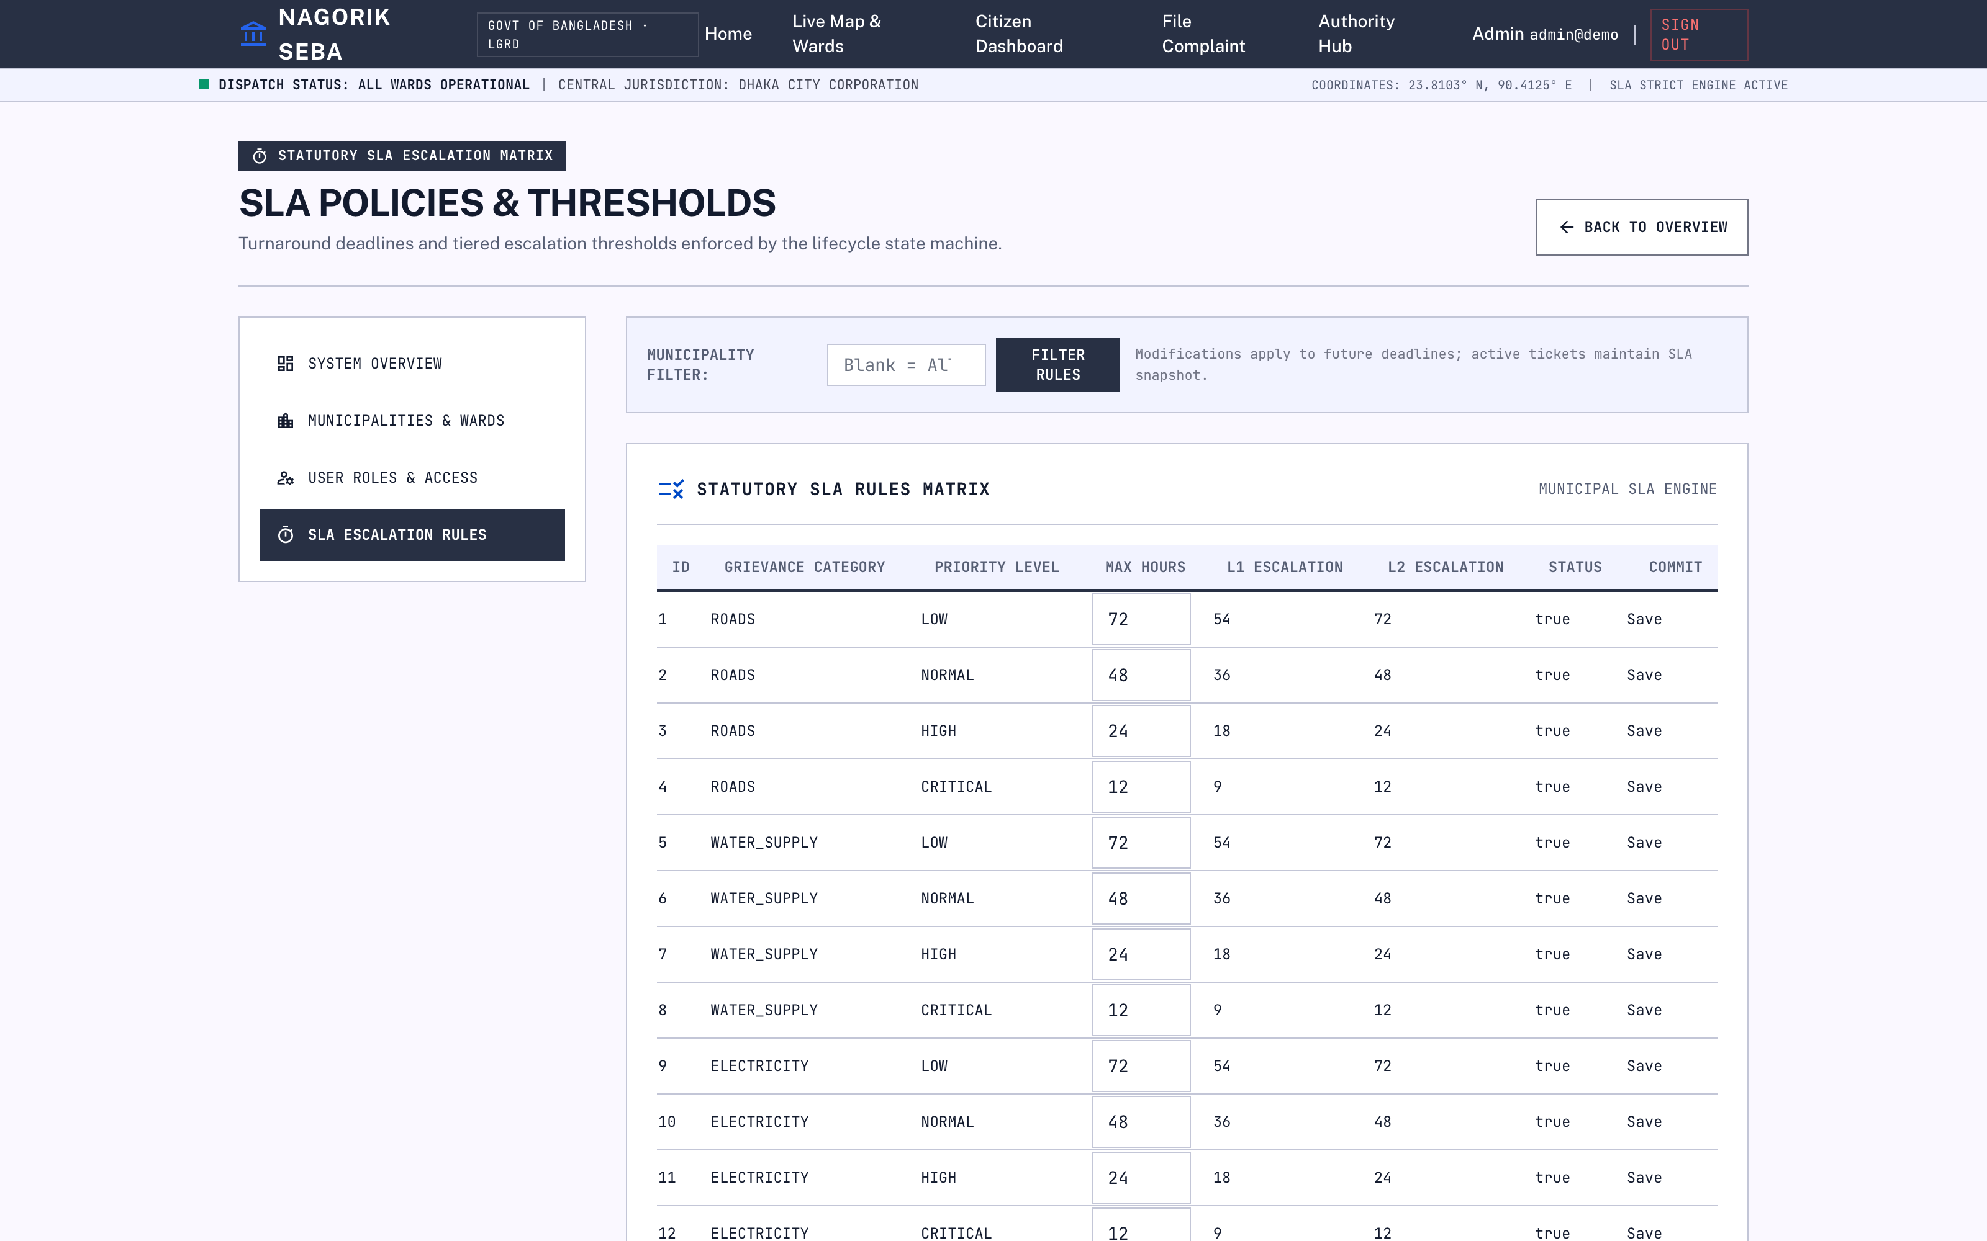
Authority Side — Queue and SLA Control
Officers work a filtered queue; admins tune the SLA matrix that generates every deadline.
Officer queue: verify, assign, start, resolve
Admin SLA matrix: hours + L1/L2 escalation thresholds
Notes:
Left: the officer queue. Filter by municipality and status, then act - verify, assign, start work, resolve with a proof photo.
Routing is explainable rather than a black box: category match first, then least-loaded officer, then nearest office. The UI always shows why a complaint landed where it did.
Right: the admin SLA matrix. Every category and priority combination has max hours plus two escalation thresholds - ROADS/NORMAL is 48 hours, CRITICAL is 12. These rows are what generate deadlines, so editing them is a governance action, not a cosmetic one. Edits apply to future deadlines; in-flight tickets keep their snapshot.

Slide 19
Testing & Quality
96 automated tests, all green: lifecycle matrix, concurrency races, auth attacks, privacy, SLA, outbox
Testcontainers run every test against real PostgreSQL + PostGIS — no fake database
Definition of done per phase: full build green, zero TODOs, handoff document written
Manual smoke tests per role: citizen submit → officer resolve → citizen rate, heatmap, admin edits
Notes:
The tests are the strongest evidence I can offer, so a little detail on what they cover.
96 tests, all green, across 16 classes. The lifecycle matrix asserts allowed and forbidden transitions directly. Concurrency tests fire competing claims at one complaint. Auth tests cover lockout, refresh-token reuse detection and cross-role access. Privacy tests assert that the public endpoints leak no PII. There are dedicated SLA and outbox suites.
Every one of them runs on a real PostgreSQL with PostGIS via Testcontainers - no H2, no mocked repositories. H2 would have passed while the real queries failed.
Definition of done per phase was: full build green, zero TODOs left behind, handoff document written.

Slide 20
Limitations & Future Work
SMS/email senders activate only with provider credentials — otherwise log-only mode
Rate limits are in-memory (single server); Redis-backed limits planned
Admin pages use cookie-carried JWT — a proper session login is future work
Next: Bengali SMS templates live, photo deduplication, officer mobile app, analytics dashboard
Notes:
I would rather list the limits than have you find them.
SMS and email activate only when provider credentials are present; without them the system runs in log-only mode, which is correct but means I have not demonstrated real delivery.
Rate limiting is in-memory and therefore per-server. Redis is the obvious fix.
Admin pages carry the JWT in a cookie. That works, but a proper session login with server-side revocation would be better.
Next steps, in priority order: Bengali SMS templates, photo deduplication so the same pothole piled up is not five tickets, an officer mobile app since field staff are on phones, and a proper analytics dashboard over the transparency snapshots.

Slide 21
Demo Walkthrough — Two Minutes, End to End
All demo passwords are demo1234 unless noted. Sign in at /login with the one-click buttons.
1. Citizen files a complaint — citizen1@demo
Land on /citizen/complaints/new, pick ROADS, drop the map pin in Banani, submit. Note the reference code that comes back — that is the tracking handle.
2. Officer works it — officer1@demo (ROADS)
Open /authority/queue, enter municipality 1, LOAD QUEUE. Verify, assign to yourself, start work, then resolve with a proof photo.
3. Citizen rates or reopens — citizen1@demo
Open the reference code, rate 1-5 to close. Had it been poor, reopen instead: priority escalates to HIGH and the SLA is recalculated at half the hours.
4. Show the public layer — no login
Open /wards: the complaint is on the heatmap and the ward scoreboard has already moved. Sign in as admin@demo to show the SLA matrix and user admin.
Gotcha worth naming: signing in as the wrong officer and pressing Start Field Work correctly returns 403. That guard is the point — but pick the officer who matches the category on screen so the demo flows.
Notes:
This is the click path. All demo accounts use demo1234 except the two legacy accounts.
Step one, file as citizen1@demo. Use ROADS so that the officer in step two is the right match. The reference code returned is the tracking handle.
Step two, officer1@demo handles ROADS in Dhaka North. Municipality id 1, load the queue, then verify, assign, start, resolve.
Step three, back to the citizen to rate or reopen.
Step four, drop the login entirely and show the public heatmap and scoreboard - the complaint is already there.
One thing I will flag rather than hide: if you sign in as the wrong officer, Start Field Work returns 403. That is correct behaviour, it is just not what you want mid-demo.

Slide 22
My Contribution
Sole author of the repository — design, implementation, testing, and documentation.
62 commits, one author. Roughly 23,000 lines across Java, SQL, JavaScript and templates.
Backend — 165 Java files, ~13,000 lines
Modular monolith across identity, complaint, municipality, SLA and notification, with a guarded lifecycle state machine.
Geo pipeline: PostGIS ward polygons, point-in-polygon ward resolution, and a privacy-safe heatmap grid.
SLA engine with an hourly SKIP LOCKED breach scanner and a transactional outbox so notifications survive a crash mid-send.
Tests & data — 96 automated tests, all green
16 test classes, ~3,900 lines, running on real PostgreSQL + PostGIS via Testcontainers rather than mocks.
Six Flyway migrations carrying the schema as code, including the ward-boundary GeoJSON load.
Frontend — 18 JS modules + Thymeleaf pages, CSP-safe with nonced inline scripts.
A bug found while preparing this deck: the citizen dashboard called toLocaleDateString with timeStyle, which is not valid for that method — the list failed to render. Fixed and verified.
Notes:
I want to be precise about what is mine here: this is a solo repository, 62 commits, one author - me. I used AI pair programming throughout, and I own the architecture, the implementation, the tests and the docs.
Backend is 165 Java files, about 13,000 lines. Tests are 16 classes and roughly 3,900 lines against a real PostGIS database. Six Flyway migrations carry the schema as code.
I also want to mention something concrete rather than just a number. While assembling screenshots for this deck I hit a real bug: the citizen dashboard called toLocaleDateString with a timeStyle option, which that method does not accept. The API returned fine, so the stat cards rendered while the complaint list silently failed. I traced it, fixed it to toLocaleString, and verified all 23 rows now render. It is a small bug, but it is a fair illustration of why I test the UI rather than assuming.

Slide 23
Challenges & Lessons Learned
The decisions that cost the most time, and what they taught me.
Concurrent officers on one complaint
Two officers claiming the same ticket produced lost updates. Fixed with a pessimistic row lock plus an optimistic version check, so the second writer fails loudly instead of overwriting.
Notifications must not be lost
Sending SMS inline meant a mail failure rolled back the whole complaint. Moved to a transactional outbox: write the row in the same transaction, deliver after commit, retry with backoff.
Multi-server safety without a broker
The SLA scanner uses SELECT ... FOR UPDATE SKIP LOCKED so two app instances scanning at once cannot double-process an overdue complaint.
Demo data that fought back
Inherited inactive authority accounts kept winning the lowest-id tie-break, so every auto-assigned ROADS complaint landed on an account nobody could sign into. Seeded inactive accounts are now skipped by auto-assignment.
Public transparency vs. privacy
Raw complaint coordinates would have made individual homes identifiable. Snapping the public heatmap to a ~100 m grid made the feature usable without exposing anyone.
Honest scope
An earlier draft of this deck claimed you could follow a complaint without logging in. There is no anonymous tracking endpoint — the API returns 401. Corrected here rather than demonstrated.
Notes:
Four things cost me real time, and I would keep all four.
Concurrency: two officers claiming one ticket caused lost updates. The fix was a pessimistic row lock combined with an optimistic version check, so the loser of the race gets a clear failure instead of silently overwriting the winner.
Notification reliability: sending SMS inside the request meant a gateway hiccup rolled back a successfully-filed complaint. The transactional outbox fixed it — the intent is written in the same transaction as the status change and delivered afterwards with retries.
Demo data: legacy inactive officer accounts kept winning the lowest-id tie-break, so every auto-assigned ROADS complaint went to an account nobody could sign in with. That is exactly the kind of bug that only shows up when you actually run the demo.
And last, the honest one: an earlier draft of this deck said you could track a complaint without logging in. There is no such endpoint. I corrected the slide instead of demonstrating it.

Slide 24
Thank you!
Nagorik Seba — report it, track it, rate it.
Questions & live demo welcome.
Notes:
Close on the one-line pitch: report it, track it, rate it.
Three things to take away. The loop is closed - a complaint has a reference code, an enforced deadline, and a rating. Accountability is structural, not cultural - the SLA scanner and the ward scoreboard do the work, so good intentions are not load-bearing. And the privacy decision was deliberate - public transparency at ~100 m grid resolution, no anonymous access to individual complaints.
Happy to take questions, and the demo is live if you want to click through it.

