Slide 1
Detection of Ocular disease using Transfer and Federated Learning
Group No : 27
CSE 707
By
23366010 Bushra Rafia Chowdhury
23366028 Sadia Tasnim
23366032 Labib Hasan Khan
CSE 707 Course Instructor
Mr. Annajiat Alim Rasel
Senior Lecturer, Department of CSE
BRAC University
ST - Mehnaz Ara Fazal
RA - Md Sabbir Hossain

Slide 2
Outline
Introduction
Problem Statement
Motivation
Dataset
Overall Architecture
Model Comparison
Transfer Learning
Hyper parameter used
Result analysis
Limitation
Future Work

Slide 3
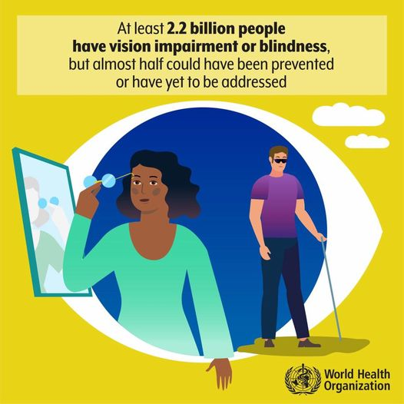
Introduction
Ocular diseases (e.g., glaucoma, diabetic retinopathy, macular degeneration)
Global impact on vision impairment and blindness
Importance of early detection and intervention

Slide 4
Problem Statement
Motivation
Automated methods may lack accuracy, requiring human validation.
Concerns about patient confidentiality and privacy.
Limited availability of diverse datasets for ocular diseases.
Rapid and automatic detection of ocular diseases
Reducing the ophthalmologist’s workload
Prevents vision damage of patients.

Slide 5
Objectives
Develop a Transfer Learning Model: Leveraging pre-existing knowledge for efficient detection.
Implement Federated Learning: Addressing privacy concerns through decentralized training.
Enhance Accuracy: Reducing reliance on human validation for more reliable results.
Dataset Diversification: Overcoming limited availability with augmentation and collaboration.

Slide 6
Literature Review 01 :
Introduces an approach based on deep learning for ocular disease diagnosis.
Utilizes advanced image categorization algorithms, including VGG-19, on the ODIR dataset with 5000 retinal images.
Dataset exhibits significant class imbalance, addressed by transforming the multiclass classification into a binary task.
VGG-19 training based on binary classifications yields high accuracy:
98.13% for normal vs. pathological myopia.
94.03% for normal vs. cataract cases.
90.94% for normal vs. glaucoma cases.

Slide 7
Literature Review 02 :
Proposes a deep learning-based system for reliable and cost-effective early diagnosis of ocular diseases.
Utilizes the ODIR dataset with annotations by trained human readers.
Model, leveraging computer vision and deep learning, demonstrates proficiency in detecting abnormalities from high-resolution fundus images.
Achieves peak accuracy of 93% for individual diseases and 83% for multiple diseases.

Slide 8
Literature Review 03 :
Introduces four deep learning-driven models for precise ocular tumor detection.
Employs cutting-edge image categorization algorithms (MobileNetV2, Resnet-34, VGG-16, EfficientNet) on the ODIR dataset with 5000 fundus images.
VGG-16 achieves 97.23% accuracy, Resnet-34 90.85%, MobileNetV2 94.32%, and EfficientNet 93.82% accuracy.
Models are positioned to contribute to the development of a system for prompt ocular disease diagnosis.

Slide 9
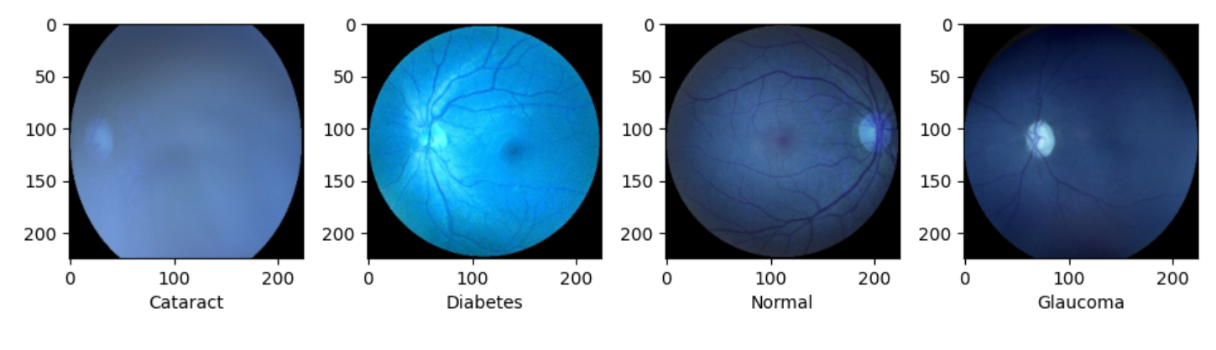
Dataset
ODIR (Ocular Disease Intelligent Recognition) 2019
A structured ophthalmic database of around 5000 patients from China
Contains: Age , Color fundus photographs of both eyes & Diagnostic keywords from doctors.
Categories: normal (N), diabetes (D), cataract (C), glaucoma (G)
Figure : Sample Images from Dataset

Slide 10
Dataset Class Distribution
Type | Class Size | Encoded Label
Normal | 2873 | 0
Cataract | 293 | 1
Diabetes | 1608 | 2
Glaucoma | 284 | 3

Slide 11
Overall Architecture
Dataset Augmentation
Manually encode labels
Train-validation-Test
Federated Average
Transfer Learning Architecture

Slide 12
Model Comparison
Model Name | Accuracy (%) | Time elapsed
EffecientNet V2 | 78.12 | 161.3s
EffecientNet V1 | 76.21 | 60.6s
MobileNet V2 | 72.23 | 164.5 s
Resnet50V2 | 66.51 | 164.7
Inception V3 | 65.73 | 163.6s

Slide 13
EfficientNetV2B1
Included Fused-MBConv new convolutional blocks
Combined MBConv and simpler 3x3 convolutions
Has 8.2 million parameters
Higher accuracy

Slide 14
Transfer Learning
Reusing a pretrained model on a different dataset
Adding new layers on top of the existing model
EfficientNet model was pre-trained on imagenet dataset.

Slide 15
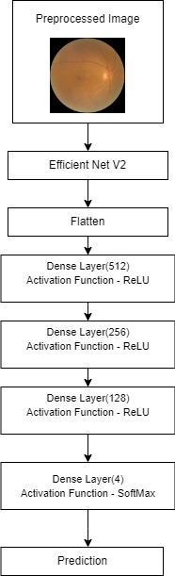
Transfer Learning Model Architecture
EfficientNet V2 B1
Flatten Layer
3 Dense Layer
1 output layer with softmax function
4 probable outputs
Figure : Model Architecture

Slide 16
Model Hyperparameters
Hyper Parameters | Value
Epoch | 20
Batch Size | 32
Loss function | sparse categorical cross_entropy_loss
Optimizer | Adam
Pooling Layer | Max

Slide 17
Result Analysis
Epoch | Accuracy
1 | 65.60
4 | 78.30
7 | 90.11
10 | 93.16
13 | 94.53
17 | 95.93
20 | 95.58

Slide 18
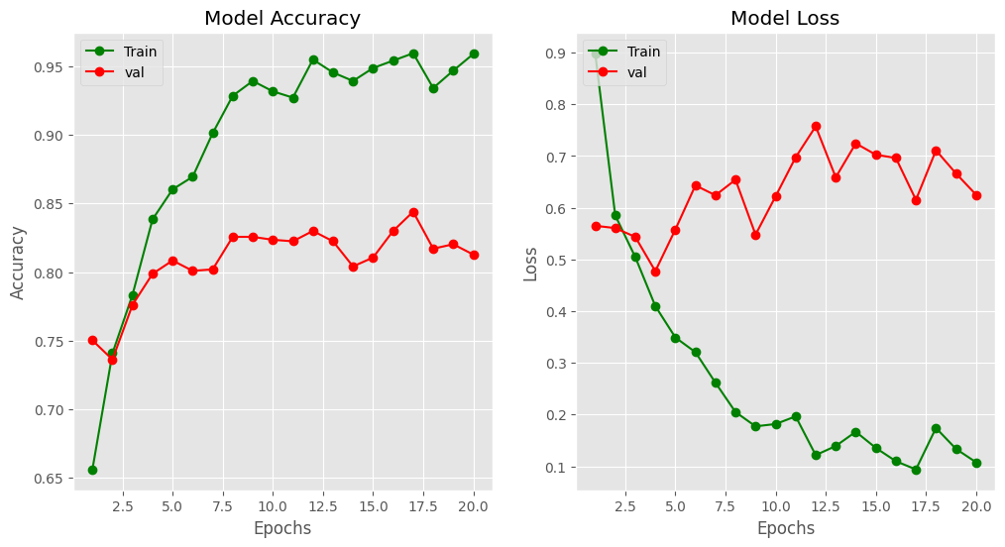
Result Analysis

Slide 19
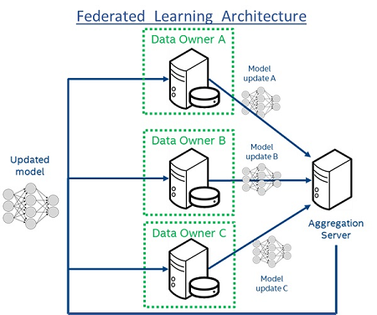
Federated Learning

Slide 20
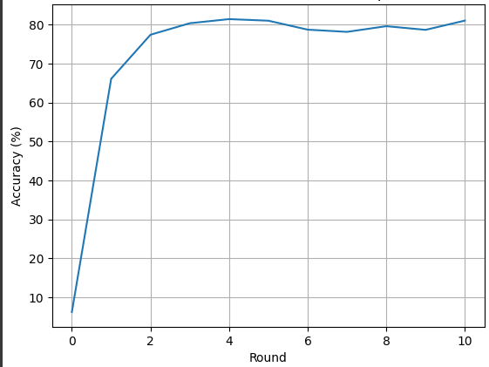
Federated Average Performance

Slide 21
Limitation
Medical dataset is private
Data cleaning & labeling
Compute and bandwidth availability

Slide 22
Future Work
XAI
Ensemble Learning
Application

Slide 23
Thank You

