Slide 1
Detection of Ocular disease using Transfer and Federated Learning
Group No : 27
CSE 707
By
23366010 Bushra Rafia Chowdhury
23366028 Sadia Tasnim
23366032 Labib Hasan Khan
CSE 707 Course Instructor
Mr. Annajiat Alim Rasel
Senior Lecturer, Department of CSE
BRAC University
ST - Mehnaz Ara Fazal
RA - Md Sabbir Hossain

Slide 2
Outline
Introduction
Problem Statement
Motivation
Objectives
Literature Review
Plans to implement
Overall Architecture
Potential Challenges
Application

Slide 3
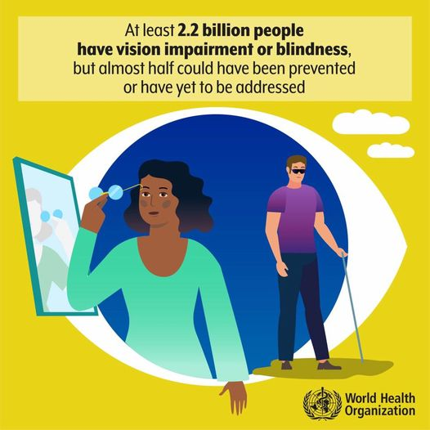
Introduction
Ocular diseases (e.g., glaucoma, diabetic retinopathy, macular degeneration)
Global impact on vision impairment and blindness
Importance of early detection and intervention

Slide 4
Problem Statement
Rapid and automatic detection is essential.
Ophthalmologists face a substantial workload.
Automated methods may lack accuracy, requiring human validation.
Concerns about patient confidentiality and privacy.
Limited availability of diverse datasets for ocular diseases.

Slide 5
Motivation
Urgency to revolutionize ocular disease detection.
Timely intervention for preventing vision damage.
Alleviating the workload of ophthalmologists for improved patient care.
Enhancing the efficiency and reliability of detection methods.

Slide 6
Objectives
Develop a Transfer Learning Model: Leveraging pre-existing knowledge for efficient detection.
Implement Federated Learning: Addressing privacy concerns through decentralized training.
Enhance Accuracy: Reducing reliance on human validation for more reliable results.
Dataset Diversification: Overcoming limited availability with augmentation and collaboration.

Slide 7
Literature Review 01 :
Introduces an approach based on deep learning for ocular disease diagnosis.
Utilizes advanced image categorization algorithms, including VGG-19, on the ODIR dataset with 5000 retinal images.
Dataset exhibits significant class imbalance, addressed by transforming the multiclass classification into a binary task.
VGG-19 training based on binary classifications yields high accuracy:
98.13% for normal vs. pathological myopia.
94.03% for normal vs. cataract cases.
90.94% for normal vs. glaucoma cases.

Slide 8
Literature Review 02 :
Proposes a deep learning-based system for reliable and cost-effective early diagnosis of ocular diseases.
Utilizes the ODIR dataset with annotations by trained human readers.
Model, leveraging computer vision and deep learning, demonstrates proficiency in detecting abnormalities from high-resolution fundus images.
Achieves peak accuracy of 93% for individual diseases and 83% for multiple diseases.

Slide 9
Literature Review 03 :
Introduces four deep learning-driven models for precise ocular tumor detection.
Employs cutting-edge image categorization algorithms (MobileNetV2, Resnet-34, VGG-16, EfficientNet) on the ODIR dataset with 5000 fundus images.
VGG-16 achieves 97.23% accuracy, Resnet-34 90.85%, MobileNetV2 94.32%, and EfficientNet 93.82% accuracy.
Models are positioned to contribute to the development of a system for prompt ocular disease diagnosis.

Slide 10
Plans on How to Implement:
Data Partitioning:
Divide the ocular dataset across participating devices in a privacy-preserving manner.
Implement transfer learning to leverage pre-trained models on general image data.
Federated Learning Architecture:
Design a federated learning architecture to facilitate model training across multiple devices.
Develop a secure communication protocol for model updates.

Slide 11
Overall Architecture
Dataset Augmentation
Manually encode labels
Train-validation-Test
Federated Average
Transfer Learning Architecture
‹#›

Slide 12
Transfer Learning in Medical Imaging:
Adaptation of a model from one task to a related task
Applied in medical imaging for tasks like rare ocular diseases
Utilizes pre-trained models on large datasets (e.g., ImageNet)
Fine-tuning for specific medical imaging tasks with limited labeled data

Slide 13
Federated Learning Benefits
Privacy-Preserving Collaboration: Ensures sensitive patient information is not exposed.
Compliance: Adheres to data protection regulations.
Effective Utilization: Each participating device contributes to the model's learning process.

Slide 14
Potential Challenges
Data Heterogeneity
Privacy Concerns
Communication Overhead
Model Interpretability
Limited Local Resources
Adaptability to Evolving Conditions

Slide 15
Application of Distributed Computing Systems in Ocular Disease Detection: Federated Learning
Data Privacy and Security:
Utilize DCS to train models without centralizing sensitive patient data.
Enable local model updates without sharing raw data, ensuring privacy compliance.
Collaborative Learning:
Distribute the training process across various devices, allowing models to learn from diverse datasets.
Enable collaboration among healthcare institutions without the need for centralized data storage.
Real-time Analysis:
Leverage the computational power of distributed systems to perform real-time analysis of ocular images.
Enable quick decision-making and timely intervention for patients.

Slide 16
List-of-References:
Ting, D. S. W., et al. (2019). "Deep learning in ophthalmology: The technical and clinical considerations." Progress in Retinal and Eye Research, 72, 100759.
McMahan, H. B., et al. (2017). "Communication-Efficient Learning of Deep Networks from Decentralized Data." arXiv preprint arXiv:1602.05629.
Gulshan, V., et al. (2016). "Development and validation of a deep learning algorithm for detection of diabetic retinopathy in retinal fundus photographs." JAMA, 316(22), 2402-2410
Smith, A., et al. (2018). "Federated Learning: Strategies for Improving Communication Efficiency." arXiv preprint arXiv:1610.05492.
Shin, H. C., et al. (2016). "Deep Convolutional Neural Networks for Computer-Aided Detection: CNN Architectures, Dataset Characteristics, and Transfer Learning." IEEE Transactions on Medical Imaging, 35(5), 1285-1298.
Kairouz, P., et al. (2019). "Advances and Open Problems in Federated Learning." arXiv preprint arXiv:1912.04977.
Litjens, G., et al. (2017). "A survey on deep learning in medical image analysis." Medical Image Analysis, 42, 60-88.

Slide 17
Thank You

