Slide 1





CLOUD COMPUTING
Crypto Watch
Presented by
Abrar Al-Sagheer and Labiba Islam

Slide 2

Crypto Watch is a web application that provides on-demand information about the state of Crypto Currency market. We used AWS cloud services to make it distributed and scalable application.
Summary

Slide 3

Cryptocurrencies are digital currencies that are secured by cryptography. existing Cryptocurrencies are not backed by central governments or authorities. Many cryptocurrencies are decentralized networks based on blockchain technology with no single authority controlling or manipulating them
Introduction
VISION
Crypto Watch system provides information about the latest price fluctuations in cryptocurrencies.
VALUES
Crypto Watch is very user friendly and visualises the results in an easy to consume manner. It utilises a number of AWS services to add value like sending personalised messages to the users with their chosen language as well as store retrieved data in scalable AWS storage.

Slide 4
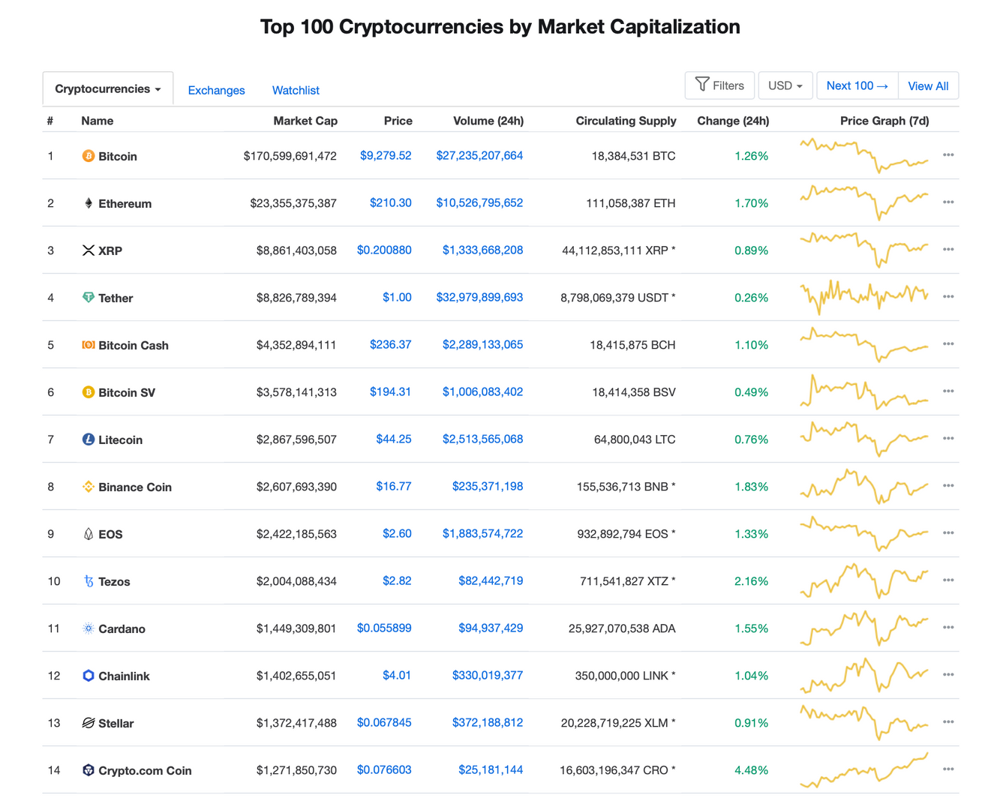
Related work
CoinMarketCap WEBSITE PROVIDES DETAILS ABOUT OVER 1000 CRYPTOCURRENCIES AND IS NOT FOR CASUAL USERS.

Slide 5
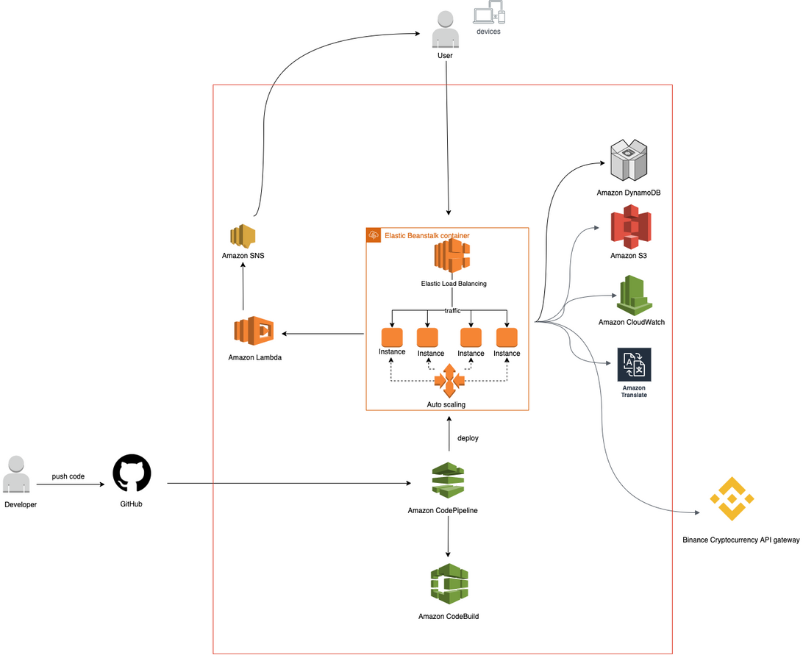
High Level Architecture
AWS Cloud Native application

Slide 6


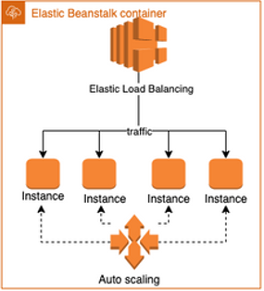

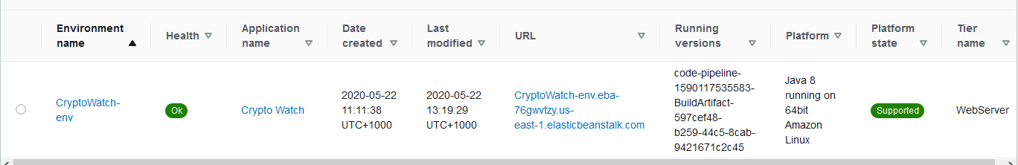
Implementation
Create the Elastic Beanstalk Environment for the Web Application with up to 4 instances

Slide 7

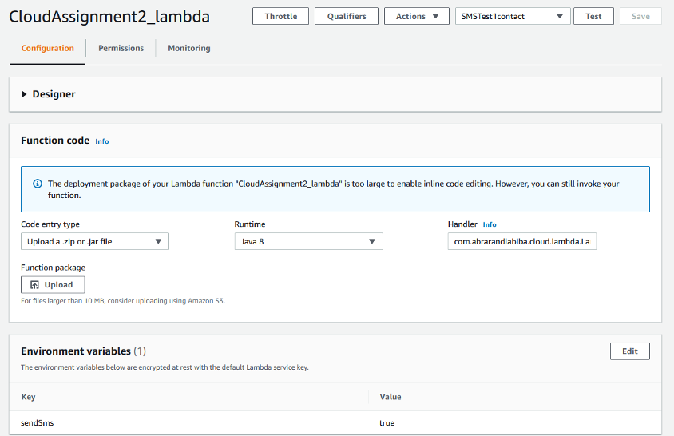
Implementation
Create the Lambda function for SMS notification

Slide 8
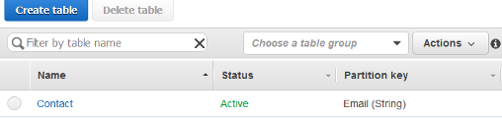
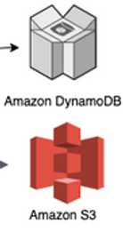
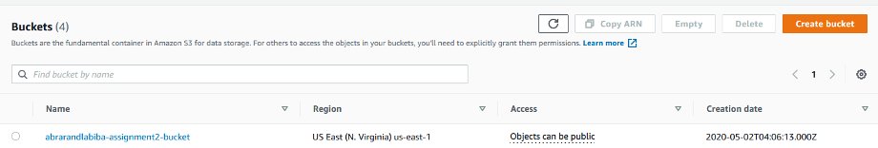
Implementation
Create DynamoDB Contact Table
and S3 Bucket

Slide 9
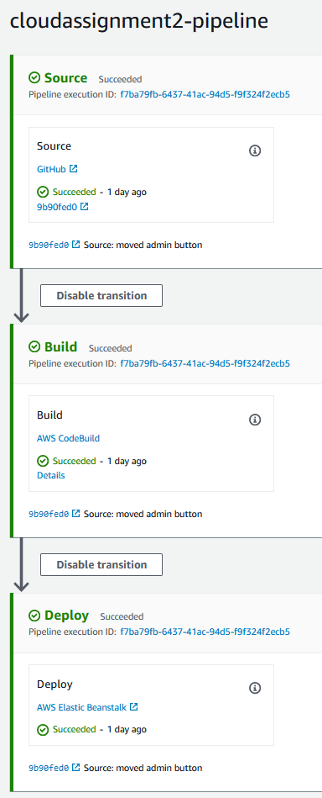

Implementation
Create CodePipeline and CodeBuild for automatic Build and Deployment

Slide 10
Questions?

