Slide 1
Autism Help Desk
Salvi Farhavi
15.01.04.142
Labiba Ibant
15.01.04.143
Md.Muhtasim Jawad
15.01.04.146
1/14/2018
Group:2
1

Slide 2
Entity-Relationship Diagram (ERD)
A model that shows logical relationships and interaction among system entities.
Provides an overall view of the system.
Works as a blueprint for creating physical data structure.
Elements of ERD :
Entities
Relationships
Attributes

Slide 3
Names of Entity Sets
User
Child
Supervisor
Institution Info
Institution Type
Symptoms
Mini Games
Scheduler
Video Category
Video Guide

Slide 4
Attributes and their data types of entity
User :
User id [int]
Username [nchar(20)]
Password [nchar(20)]
DateOfCreation [date]
Supervisor :
Id(FK from user) [int]
Name [varchar(50)]
Phone [nchar(11)]
Address [varchar(50)]
Email [varchar(50)]
Relation with child [nchar(20)]

Slide 5
Attributes and their data types of entity
Child :
User_id(FK from user) [int]
Name [varchar(50)]
Age [int]
Gender [nchar[7]]
Condition [nchar[10]]
Institution Type :
Id [int]
Name [nchar(10)]

Slide 6
Attributes and their data types of entity
Institution Info :
Id(FK from institution type) [int]
Mail [varchar(50)]
Location [varchar(MAX)]
Contact no [nchar(7)]
Person in charge [nchar(20)]
Symptom :
Id [int]
Description [varchar(MAX)]
Type [nchar(20)]
Stage [nchar(20)]

Slide 7
Attributes and their data types of entity
Mini Games :
Game Id [int]
Name [nchar(30)]
Score [int]
Play time [float]
Scheduler :
Serial [int]
Time [time(7)]
Date [date]
Description [varchar(MAX)]

Slide 8
Attributes and their data types of entity
Video Category :
Cat id [int]
Name [nchar(20)]
Video Guide :
Cat_id(FK from video category) [int]
Summary [varchar(50)]
Link [varchar(MAX)]
Related link [varchar(MAX)]

Slide 9
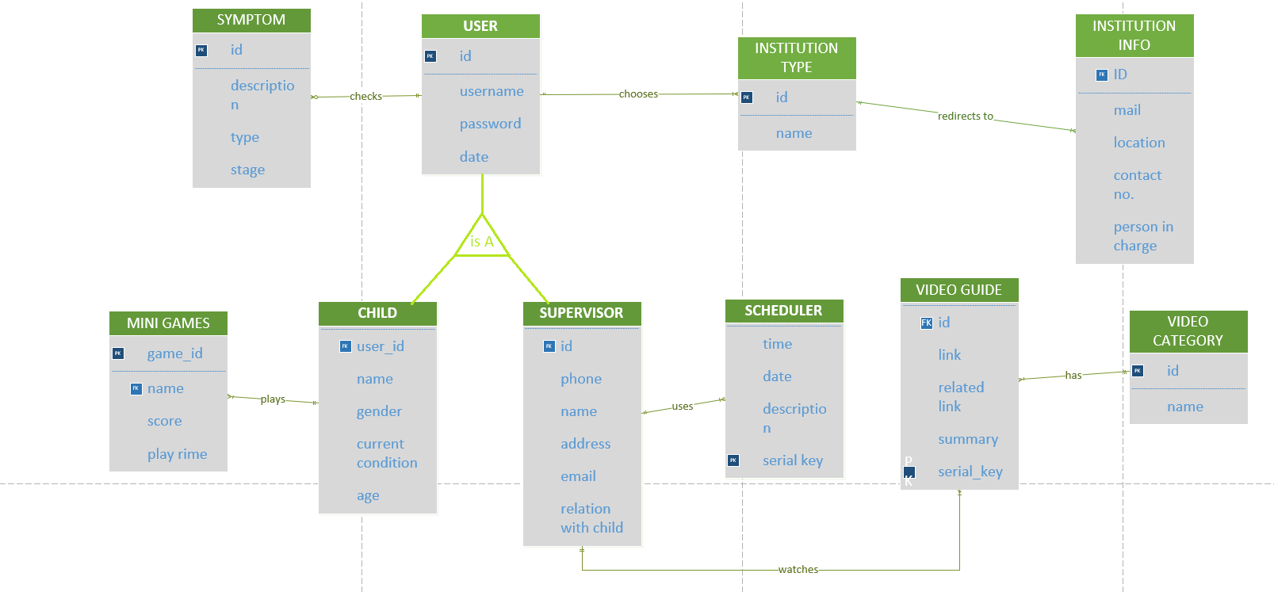
Entity-Relationship Diagram (ERD)
1/14/2018
Group:2
9

Slide 10
Conclusion
ERD is just as important as all the other parts of the whole project structure.In almost every project,database is a common and important part for organizing and safe keeping of app data which is beneficial for both user and developer and ERD helps to shape up an ideal database structure.

