Slide 1
HR AI API
AI-Powered Resume Parsing and Candidate Ranking API
MCA Final Year Project | Labib Rizvi | Qollabb
Resume Parsing
NLP Preprocessing
Candidate Ranking
REST API
A secure backend system that converts unstructured resumes into ranked, explainable candidate decisions.

Slide 2
Problem Statement
Manual resume screening is slow, inconsistent, and difficult to audit.
Recruiters need more than keyword search.
Project objective
Large resume volumes create repetitive manual work.
Skills, experience, and education are hidden in unstructured documents.
Shortlisting may vary from reviewer to reviewer.
HR tools need structured JSON results, not only uploaded files.
Create an API that processes resumes, extracts key skills, and ranks candidates for jobs using AI/NLP models.
Practical output
A backend workflow for candidate records, job postings, resume parsing, ranking results, and API logs.
AI-Powered Resume Parsing and Candidate Ranking API | 2

Slide 3
Objectives and Scope
What the project delivers inside the recruitment workflow.
Database design
API endpoints
NLP pipeline
Users, candidates, jobs, resumes, skills, rankings, and logs.
Authentication, upload, CRUD modules, ranking, health, and stats.
Text extraction, cleaning, sections, keywords, contacts, and experience.
AI integration
Testing
Documentation
Structured resume extraction and explainable candidate scoring.
Validation, auth, uploads, parsing status, and ranking responses.
Endpoint formats, database schema, workflow, and future scope.
AI-Powered Resume Parsing and Candidate Ranking API | 3

Slide 4
System Architecture
Express routes coordinate storage, security, NLP, and AI services.
Route Modules
NLP Service
HR User / External Tool
Express REST API
JSON Results
SQLite Database
AI Service
Middleware: Helmet, CORS, JSON parser, rate limiter, request logger, JWT/API-key authentication
AI-Powered Resume Parsing and Candidate Ranking API | 4

Slide 5
Database Design
Eight core tables keep the API normalized and auditable.
users
candidates
job_postings
resumes
HR accounts, roles, API keys
Candidate profile and status
Open roles and skill requirements
Uploaded files and parsed data
skills
candidate_skills
ranking_results
api_logs
Global skill taxonomy
Many-to-many skill mapping
Scores and recommendations
Request audit trail
Indexes support resume lookup, parse status filtering, job ranking results, score sorting, candidate skills, and logs.
AI-Powered Resume Parsing and Candidate Ranking API | 5

Slide 6
API Endpoint Modules
The backend is organized around recruitment tasks.
Auth
POST /auth/register, POST /auth/login, GET /auth/me
Candidates
GET /candidates, POST /candidates, PATCH /candidates/:id
Jobs
GET /jobs, POST /jobs, PATCH /jobs/:id
Resumes
POST /resumes/upload, GET /resumes/:id, POST /resumes/:id/reparse
Ranking
POST /ranking/job/:jobId/rank-candidate/:cid, GET /ranking/job/:jobId/results
Access control
Integration ready
JWT bearer tokens and X-API-Key headers protect API usage. Role checks restrict admin and recruiter actions.
JSON request and response formats make the system suitable for dashboards and external HR tools.
AI-Powered Resume Parsing and Candidate Ranking API | 6

Slide 7
Resume Parsing and Ranking Flow
The project separates deterministic preprocessing from AI reasoning.
Upload File
Extract Text
Clean + Detect Sections
AI Parse
Sync Candidate Skills
Rank Against Job
Preprocessing extracts raw text from PDF, DOCX, and TXT files.
AI returns skills, education, experience, certifications, and summary.
Ranking stores overall, skill, experience, education, and keyword scores.
Recommendations and interview questions make results explainable.
AI-Powered Resume Parsing and Candidate Ranking API | 7

Slide 8
Testing Strategy
Validation covers the full workflow from auth to leaderboard retrieval.
Unit testing
Integration testing
System testing
Text cleaning, contact extraction, keyword extraction, and experience estimation.
Routes working with SQLite, middleware, upload handling, parsing status, and result persistence.
Register, create candidate, create job, upload resume, parse resume, rank candidate, view leaderboard.
Unauthorized request returns 401
Wrong password returns 401
Unsupported file type is rejected
Valid resume returns 202 processing
Ranking without parsed resume returns 422
Leaderboard sorts by score descending
AI-Powered Resume Parsing and Candidate Ranking API | 8

Slide 9
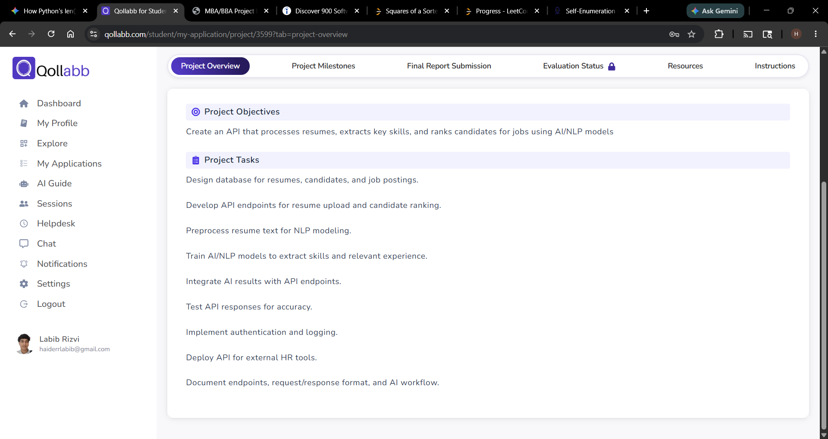
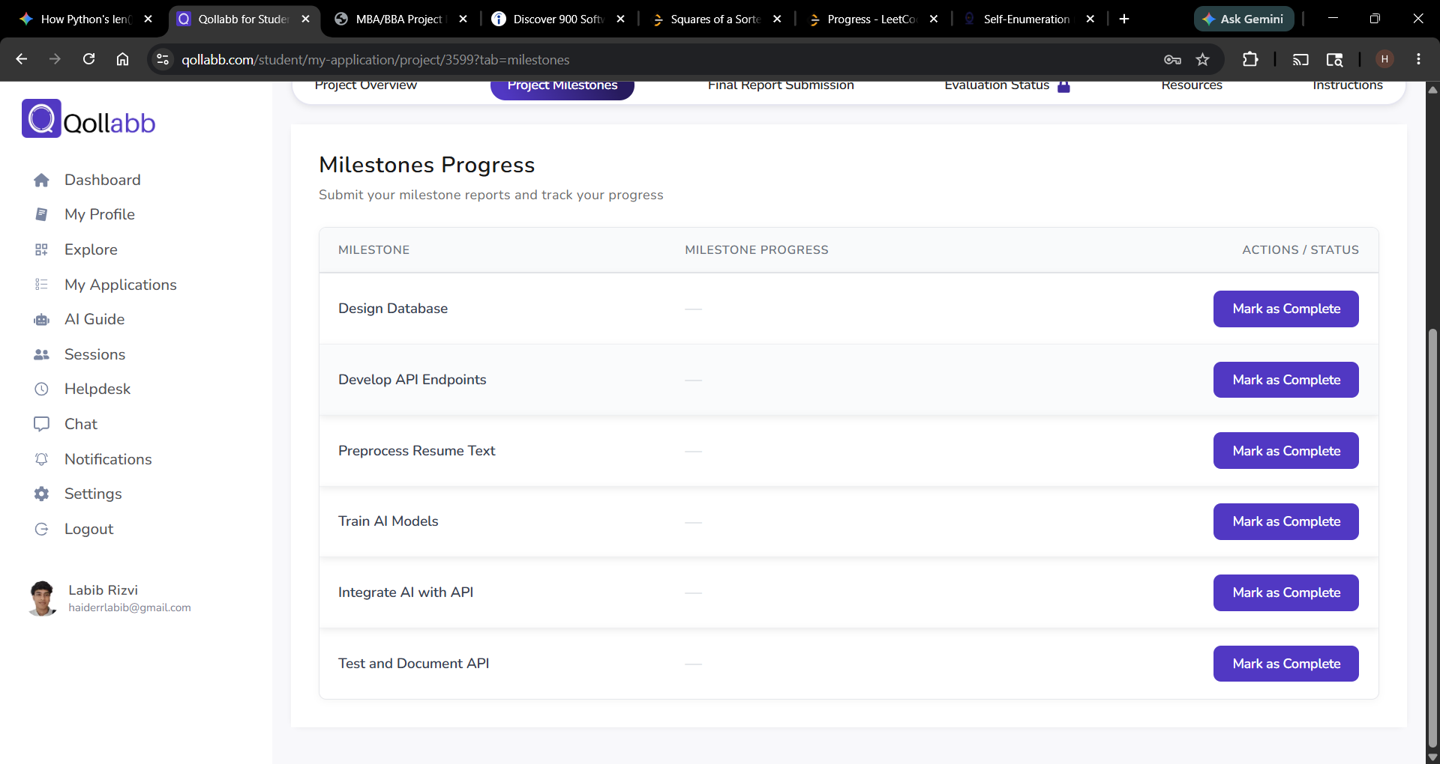
Qollabb Milestones and Submission
The academic workflow matches the implementation stages.
Project overview confirms the core objective and tasks.
Milestones track database design, endpoints, preprocessing, AI integration, and testing.
AI-Powered Resume Parsing and Candidate Ranking API | 9

Slide 10
Results and Discussion
The output is a working backend foundation for AI-assisted recruitment.
8
5
3
2
database tables
main API modules
resume file types
auth methods
Resume data becomes structured candidate intelligence.
Job-specific ranking is stored with explainable score components.
Audit logging and middleware improve operational visibility.
The API can be connected to a future recruiter dashboard.
AI-Powered Resume Parsing and Candidate Ranking API | 10

Slide 11
Future Enhancements
The project can grow from API prototype to deployable HR product.
Web dashboard
Cloud deployment
Background queue
Recruiter UI for uploads, rankings, and analytics.
PostgreSQL/MySQL, environment secrets, hosted API.
Reliable parsing jobs for larger resume volume.
OCR support
Fairness audit
OpenAPI docs
Scan image-based resumes and older PDF files.
Evaluate ranking explanations and reduce bias risk.
Interactive API documentation for third-party users.
AI-Powered Resume Parsing and Candidate Ranking API | 11

Slide 12
Thank You
AI-Powered Resume Parsing and Candidate Ranking API
Questions and Discussion
Labib Rizvi | MCA Final Year Project | Qollabb

