Slide 1

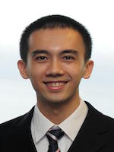
Silvio Savarese, Stanford
Carsten Steger, MVTec GmbH
Jianxiong Xiao, Princeton
Tinne Tuytelaars, KU Leuven

