Slide 1


Making a Shallow Network Deep: Growing a Tree from Decision Regions of a Boosting Classifier
Ignas Budvytis*, Tae-Kyun Kim*, Roberto Cipolla
* - indicates equal contribution

Slide 2
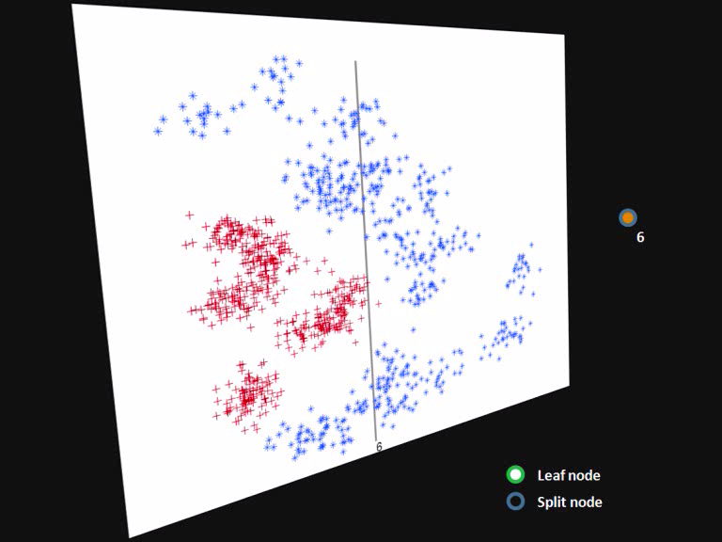

Slide 3

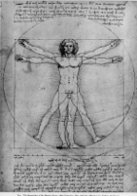






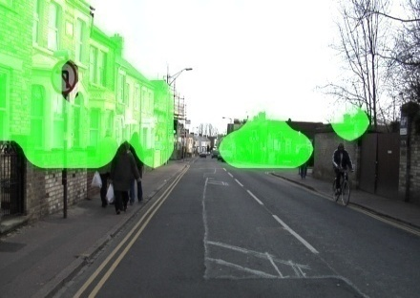
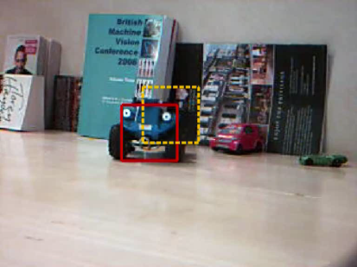
Introduction
Aim – improved classification time of a learnt boosting classifier
Shallow network of boosting classifier converted into a “deep” decision tree based structure
Applications
Real time detection and tracking
Object segmentation
Design goals
Significant speed up
Similar accuracy
BMVC 2010, Budvytis, Kim, Cipolla, University of Cambridge
2/22

Slide 4
Speeding up a boosting classifier
Creating a cascade of boosting classifiers
Robust Real-time Object Detection [Viola & Jones 02]
Single path of varying length
“Fast exit” [Zhou 05]
Sequential probability ratio test [Sochman et. al. 05]
Multiple paths of different lengths
A binary decision tree implementation of a boosted strong classifier [Zhou 05]
Feature sharing between multiple classifiers
Sharing visual features [Torralba et. al 07]
VectorBoost [Huang et. al 05]
Boosted trees
AdaTree [Grossmann 05]
Strong classifier
Weak classifier
BMVC 2010, Budvytis, Kim, Cipolla, University of Cambridge
3/22

Slide 5





Brief review of boosting classifier
Aggregation of weak learners yields a strong classifier
Many variations of learning method and weak classifier functions.
Anyboost [Mason et al 00] implementation with discrete decision stumps
Weak classifiers: Haar-basis like functions (45,396 in total)
Strong classifier
Weak classifier
BMVC 2010, Budvytis, Kim, Cipolla, University of Cambridge
4/22

Slide 6
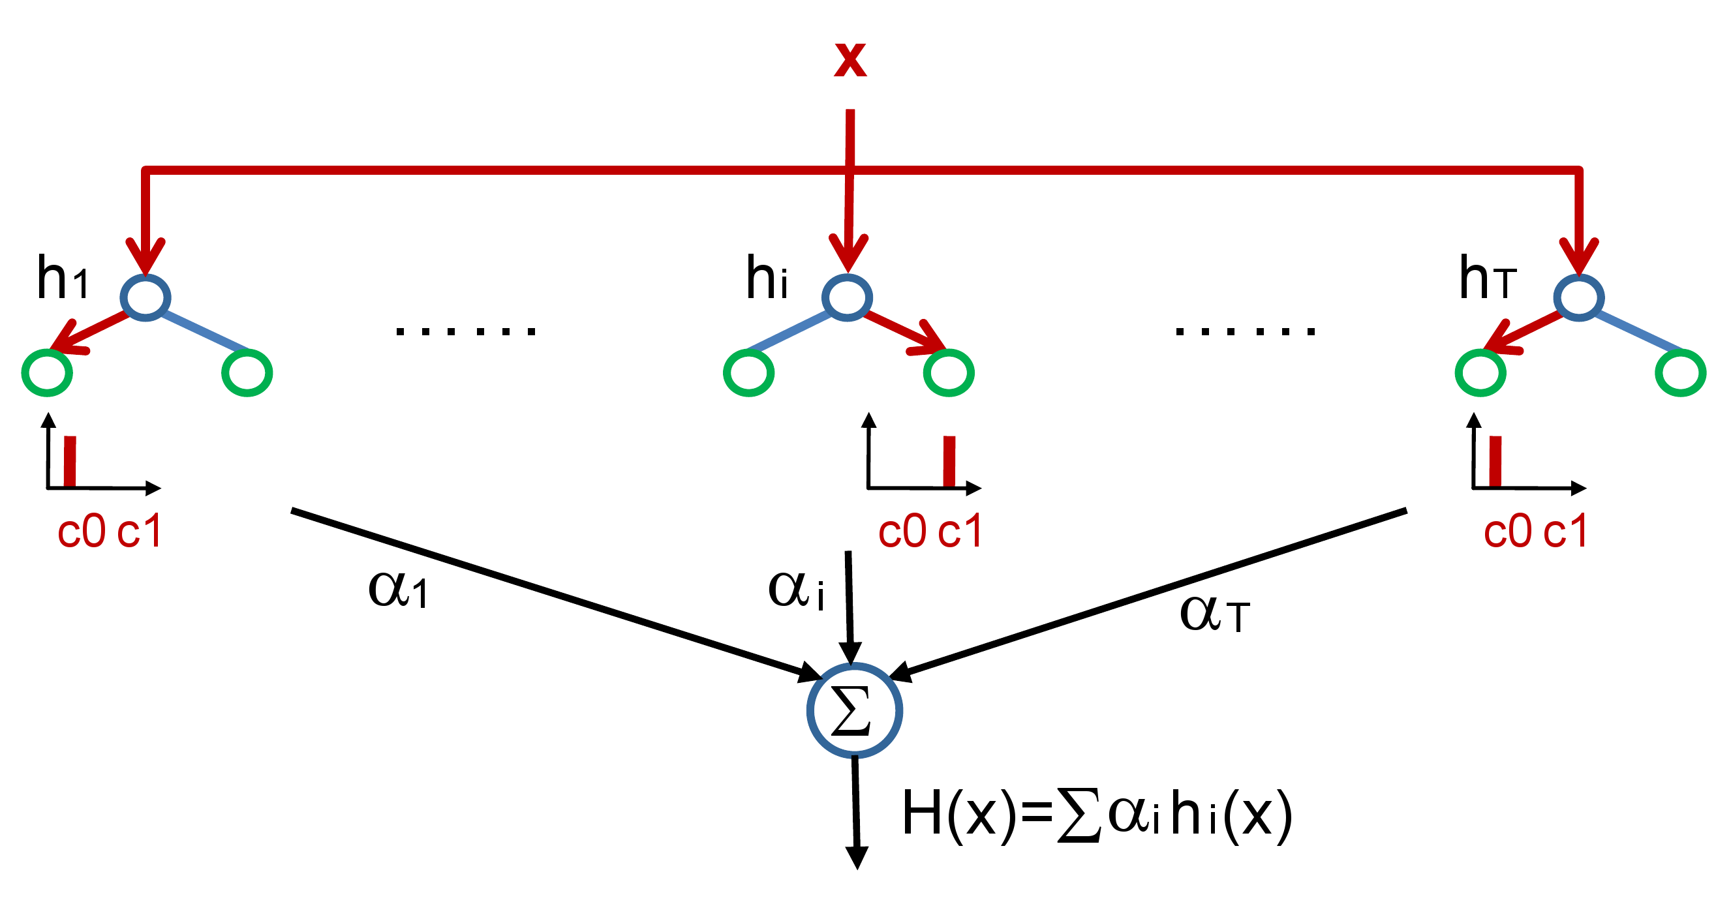
Brief review of boosting classifier
Smooth decision regions
BMVC 2010, Budvytis, Kim, Cipolla, University of Cambridge
5/22

Slide 7

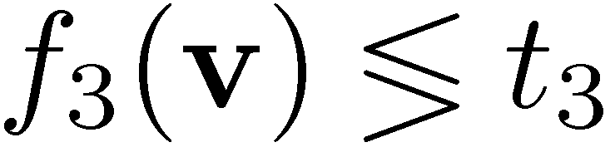
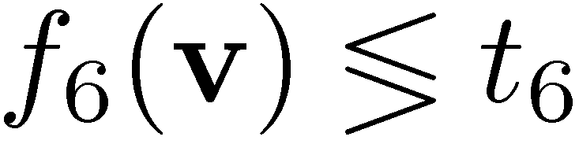


Brief review of decision tree classifier
feature vector v
split functions f_{n}(v)
thresholds t_{n}
Classifications P_{n}(c)
v
leaf nodes
split nodes
1
≥
3
2
<
4
5
6
7
<
8
9
10
11
12
13
≥
14
15
16
17
category c
Slide taken and modified from Shotton et. al (2008)
BMVC 2010, Budvytis, Kim, Cipolla, University of Cambridge
6/22

Slide 8
Brief review of decision tree classifier
v
Short classification time
1
≥
3
2
<
4
5
6
7
<
8
9
10
11
12
13
≥
14
15
16
17
category c
BMVC 2010, Budvytis, Kim, Cipolla, University of Cambridge
7/22

Slide 9
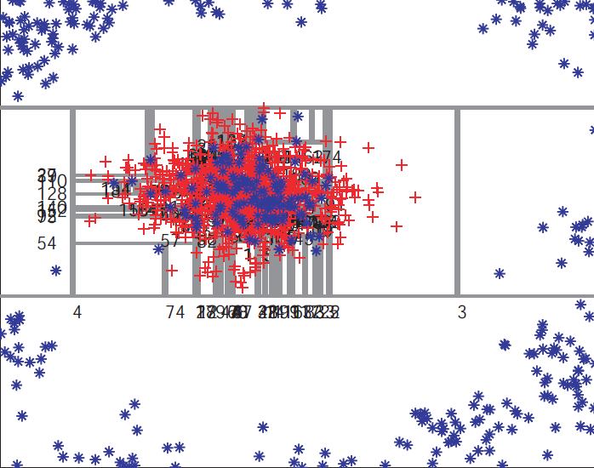
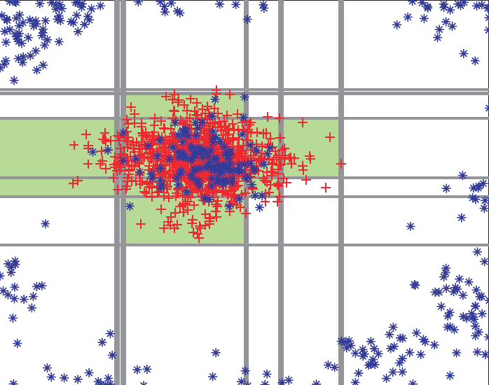
Boosting Classifier vs Decision Tree
Preserving (smooth) decision regions for good generalisation
Short classification time
Decision tree
Boosting
BMVC 2010, Budvytis, Kim, Cipolla, University of Cambridge
8/22

Slide 10
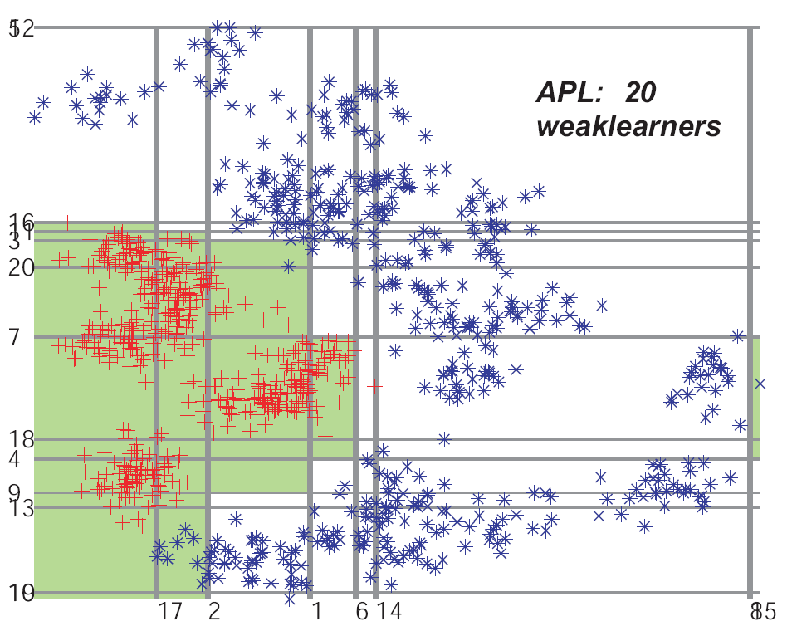
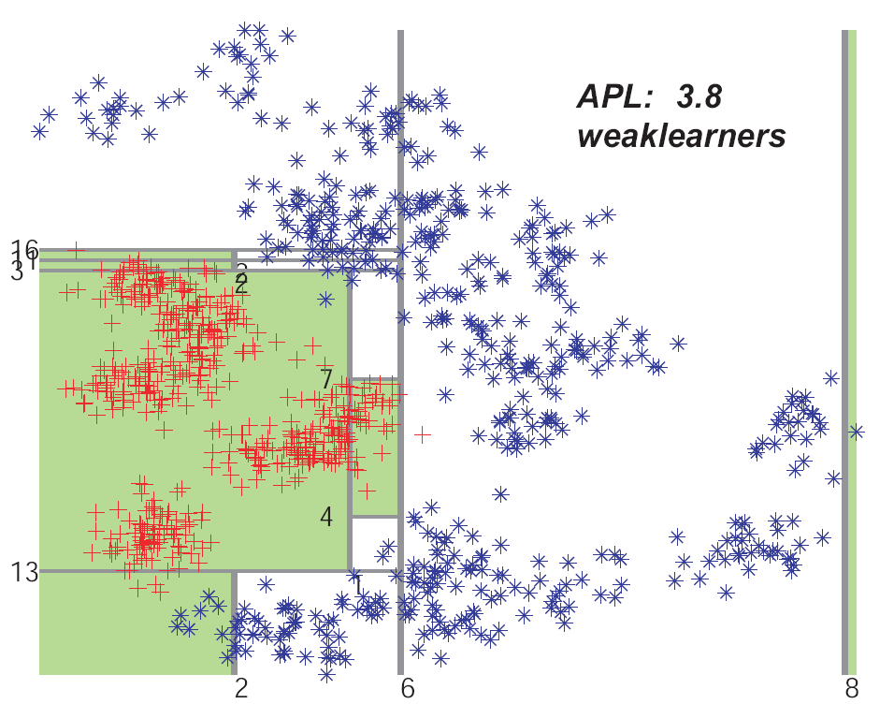
Converting boosting classifier to a decision tree – Super Tree
Preserving (smooth) decision regions for good generalisation
Short classification time
2
8
16
2
3
6
7
11
1
13
4
2
Boosting
Super tree
BMVC 2010, Budvytis, Kim, Cipolla, University of Cambridge
9/22

Slide 11
Boolean optimisation formulation
For a learnt boosting classifier
split a data space into 2^{m} primitive regions by m binary weak-learners.
Code regions R_{i} i=1,..., 2^{m} by boolean expressions.
Data space as a boolean table
Data space
1
W1
 | W1 | W2 | W3 | C
R1 | 0 | 0 | 0 | F
R2 | 0 | 0 | 1 | F
R3 | 0 | 1 | 0 | F
R4 | 0 | 1 | 1 | T
R5 | 1 | 0 | 0 | T
R6 | 1 | 0 | 1 | T
R7 | 1 | 1 | 0 | T
R8 | 1 | 1 | 1 | X
R6
0
R5
R2
R1
0
W2
R7
R4
1
R3
1
0
W3
BMVC 2010, Budvytis, Kim, Cipolla, University of Cambridge
BMVC 2010, Budvytis, Kim, Cipolla, University of Cambridge
10/22

Slide 12
Boolean optimisation formulation
Boolean expression minimisation by optimally joining the regions of the same class label or don’t care label.
A short tree built from the minimised boolean expression by placing more frequent variables at the top.
Data space as a boolean table
Data space as a tree
Data space
1
W1
 | W1 | W2 | W3 | C
R1 | 0 | 0 | 0 | F
R2 | 0 | 0 | 1 | F
R3 | 0 | 1 | 0 | F
R4 | 0 | 1 | 1 | T
R5 | 1 | 0 | 0 | T
R6 | 1 | 0 | 1 | T
R7 | 1 | 1 | 0 | T
R8 | 1 | 1 | 1 | X
W1
R6
0
0
1
R5
R2
W2
T
R1
0
W2
1
0
1
R5,R6,R7,R8
R7
R3
R4
F
W3
1
0
R1,R2
0
1
W3
F
T
don’t care
R3
R4
BMVC 2010, Budvytis, Kim, Cipolla, University of Cambridge
11/22

Slide 13
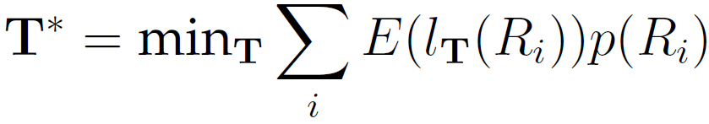
Boolean optimisation formulation
Optimally short tree is defined in terms of average expected path length of data points as
where region prior p(R_{i})=M_{i}/M.
Constraint: tree must duplicate the decision regions of the boosting classifier
BMVC 2010, Budvytis, Kim, Cipolla, University of Cambridge
12/22

Slide 14
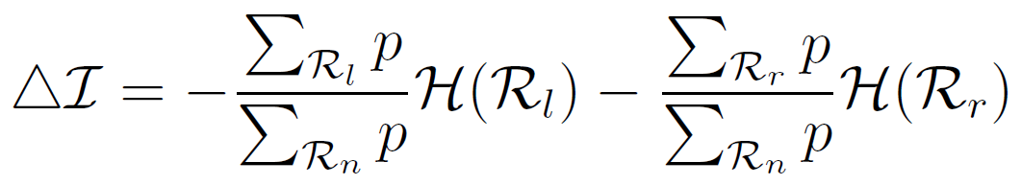
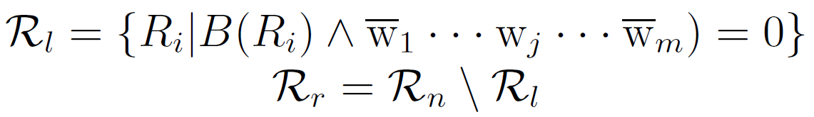
Growing a Super Tree
Regions of data points R_{i} taken as input s.t. p(R_{i})>0
A tree grown by maximising the region information gain
Where
Key ideas
Growing a tree from the decision regions
Using the region prior (data distribution).
Region prior p
Entropy H
Weak learner w_{j}
Region set R_{n}
at node n
BMVC 2010, Budvytis, Kim, Cipolla, University of Cambridge
13/22

Slide 15
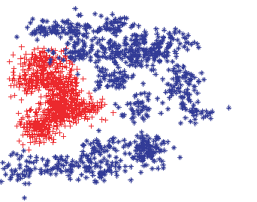
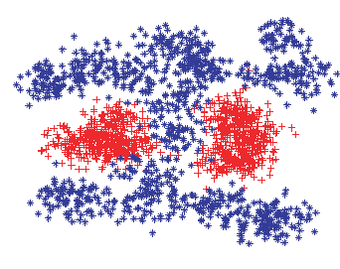
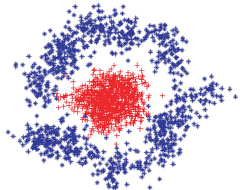
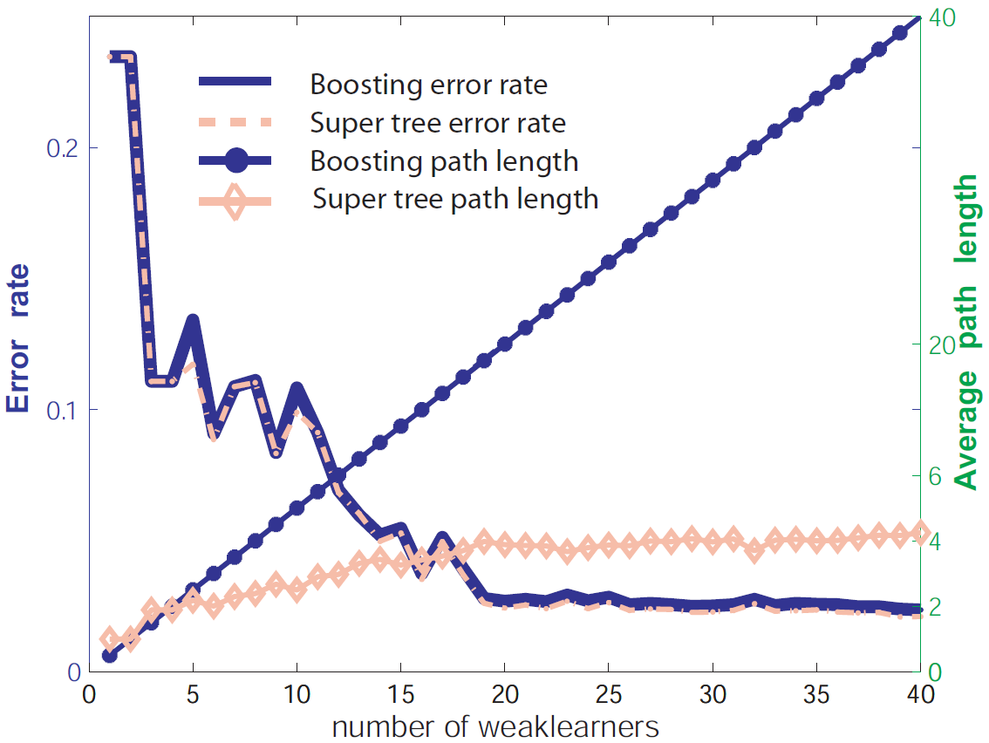
Synthetic data exp1
Examples generated from GMMs
BMVC 2010, Budvytis, Kim, Cipolla, University of Cambridge
14/22

Slide 16
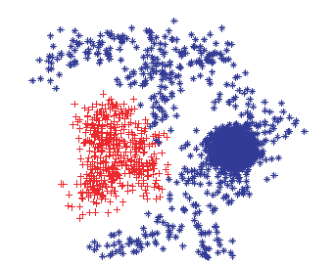
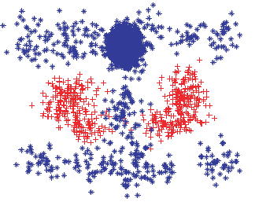
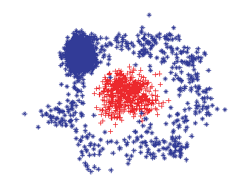
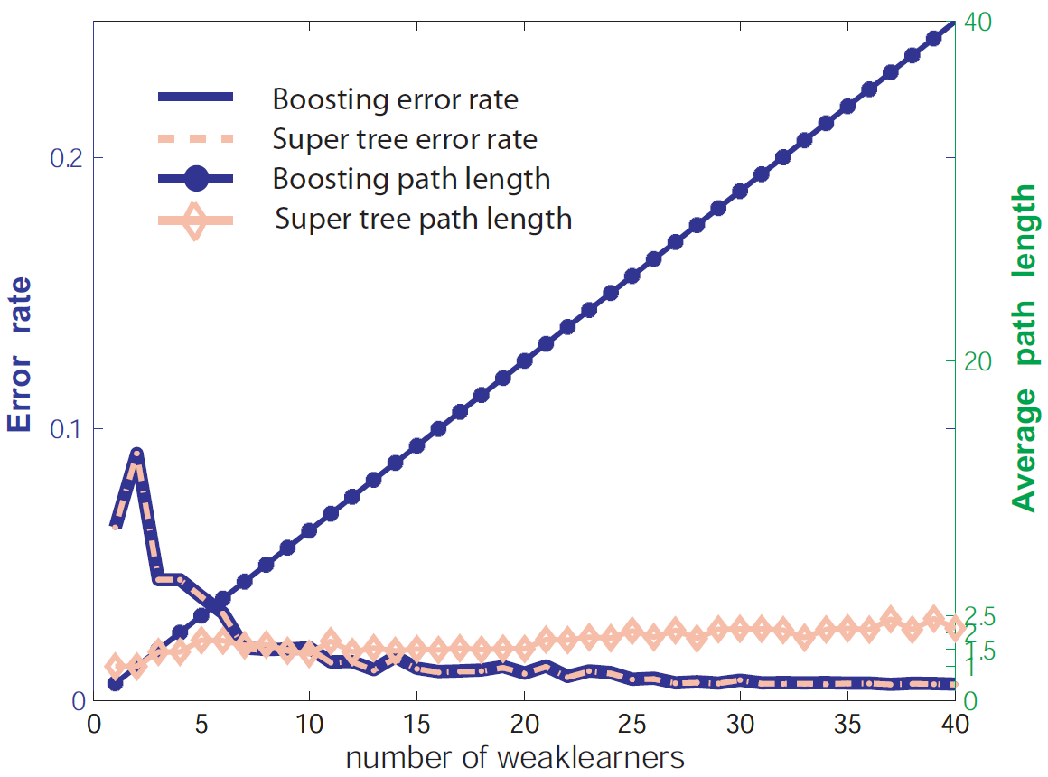
Synthetic data exp2
Imbalanced cases
BMVC 2010, Budvytis, Kim, Cipolla, University of Cambridge
15/22

Slide 17
Growing a Super Tree
When number of weak learners is relatively large, too many regions of no data points maybe assigned to different class labels from the original ones
Solution:
Extending regions
Modifying information gain:
 | W1 | W2 | W3 | W4 | W5 | Sum | C
Weight | 1.0 | 0.8 | 0.7 | 0.5 | 0.2 | 3.2
Region | 1 | 0 | 1 | 1 | 0 | 1.2 | 1
Boundary region | 1 | 0 | 1 | 0 | 0 | 0.2 | 1
Extended region | 1 | x | 1 | x | x | 0.2-3.2 | 1
“dont’ care” variable
BMVC 2010, Budvytis, Kim, Cipolla, University of Cambridge
16/22

Slide 18
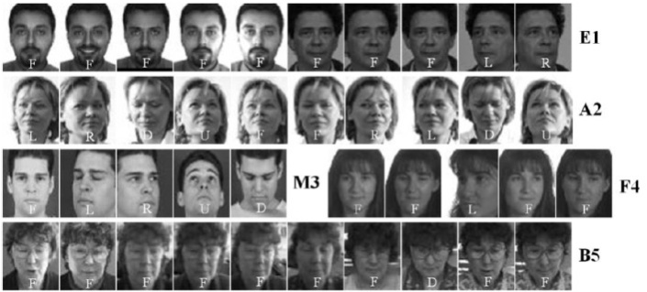














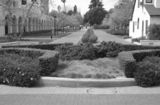
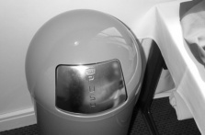

Face detection experiment
Training set: MPEG-7 face data set (11,845 faces)
Validation set (for boostrapping): BANCA face set (520 faces) + Caltech background dataset (900 images)
Total number: 50128
Testing set: MIT+CMU face test set (130 images of 507 faces)
21,780 Harr-like features
BMVC 2010, Budvytis, Kim, Cipolla, University of Cambridge
17/22

Slide 19
Face detection experiment
The proposed solution is about 3 to 5 times faster than boosting and 1.5 to 2.8 times faster than [Zhou 05], at the similar accuracy.
Total test data points = 57507
 | Boosting |  |  | Fast Exit [Zhou 05] |  |  | Super Tree
No. of weak learners | False positive | False negative | Average path length | False positive | False negative | Average path length | False positive | False negative | Average path length
20 | 501 | 120 | 20 | 501 | 120 | 11.70 | 476 | 122 | 7.51
40 | 264 | 126 | 40 | 264 | 126 | 23.26 | 231 | 127 | 12.23
60 | 222 | 143 | 60 | 222 | 143 | 37.24 | 212 | 142 | 14.38
BMVC 2010, Budvytis, Kim, Cipolla, University of Cambridge
18/22

Slide 20
Face detection experiment
For more than 60 weak-learners a boosting cascade is considered.
Total test data points = 57507
 | Boosting |  |  | Fast Exit [Zhou 05] |  |  | Super Tree
No. of weak learners | False positive | False negative | Average path length | False positive | False negative | Average path length | False positive | False negative | Average path length
100 | 148 | 146 | 100 | 148 | 146 | 69.28 | 145 | 152 | 15.1
200 | 120 | 143 | 200 | 120 | 143 | 146.19 | 128 | 146 | 15.8
 | Fast Exit Cascade
No. of weak learners | False positive rate | False negative rate | Average path length
100 | 144 | 149 | 37.4
200 | 146 | 148 | 38.1
Super Tree
“Fast Exit”
Class A
Class A
Class B
BMVC 2010, Budvytis, Kim, Cipolla, University of Cambridge
19/22

Slide 21

Experiments with tracking and segmentation by ST
BMVC 2010, Budvytis, Kim, Cipolla, University of Cambridge
20/22

Slide 22
Summary
Speeded up boosting classifier without sacrificing accuracy
Formalized the problem as a boolean optimization task
Proposed a boolean optimisation method for a large number of binary variables (~60)
Proposed a 2 stage cascade to handle almost any number of weak learners (binary variables)
BMVC 2010, Budvytis, Kim, Cipolla, University of Cambridge
21/22

Slide 23
Questions?
BMVC 2010, Budvytis, Kim, Cipolla, University of Cambridge
22/22

