Slide 1
chekpoint
How does the web work?
What do you need to be a web developper?
What did you choose to learn web developper?

Slide 2
How does the web work?
Web servers and web browsers communicate via HTTP
HTTP ensures that all parts of the web page are delivered
Web browser decides how these items are displayed

Slide 3
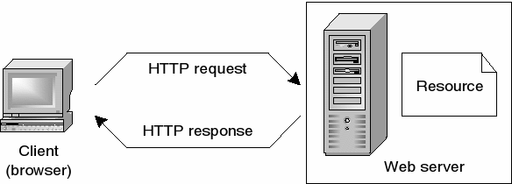

Slide 4
- have a number of personal skills. - a natural curiosity. - an appetite for the web and a strong ability to adapt.
What do you need to be a web developer?

Slide 5
-There Are Web Dev Jobs Available -It’s Creative and Fun -You Can Work at an Awesome Tech Company
What did you choose to learn web developper?

