Slide 1
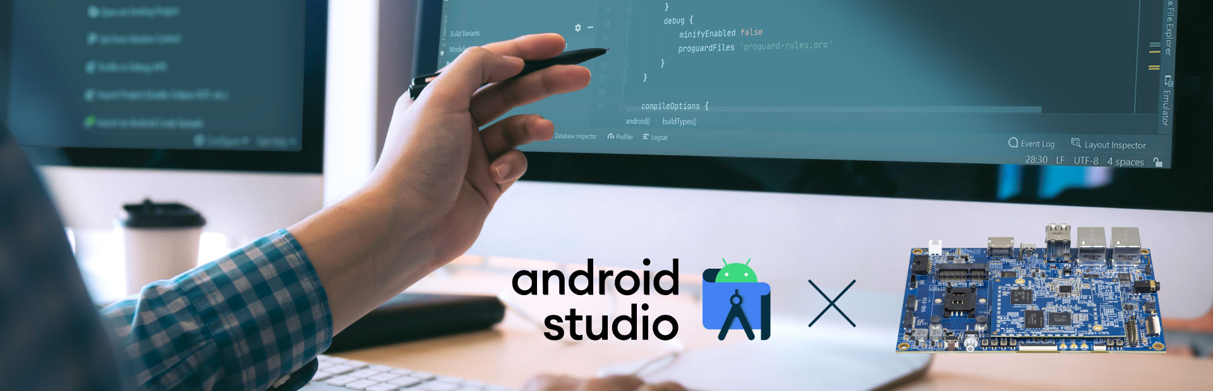
Android Application
Project Name: Class Routine Maintainer App For Android
Team Members:
1. Samanta Mostafa Chooyan (200101089)
2. Rohul Amin (200101093)
3. Nafis Fuad (200101075)

Slide 2
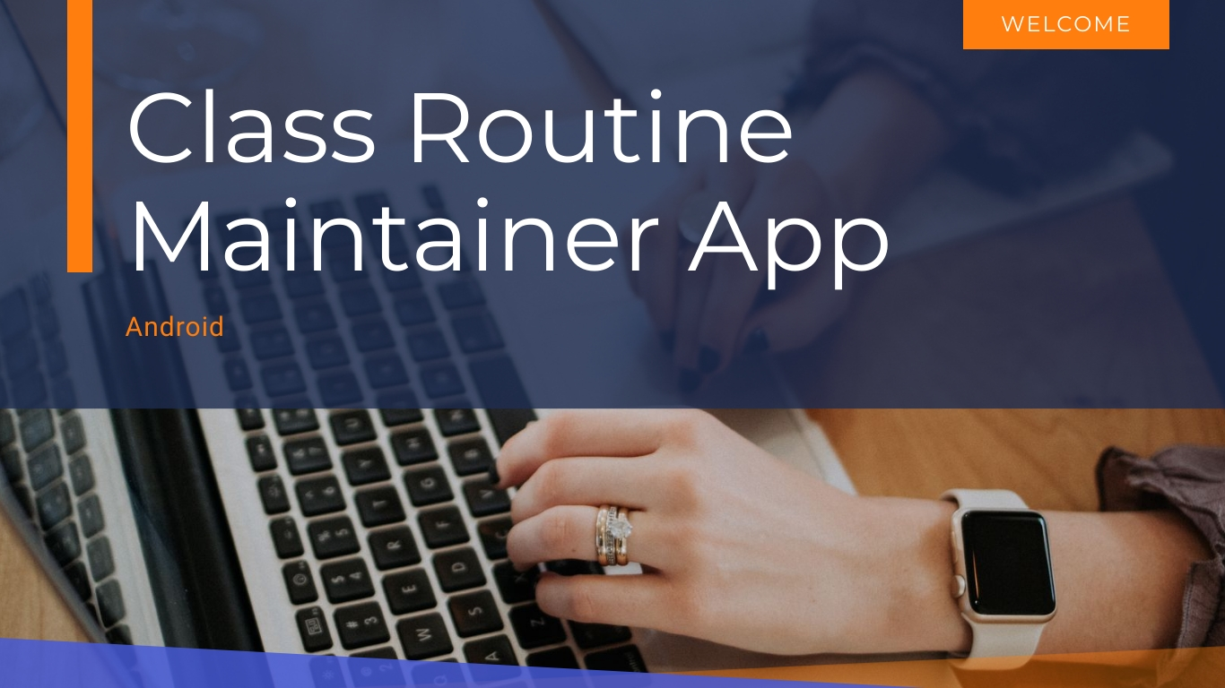

Slide 3

Introduction
Our app is a routine management app for students.
Our app is a combination of 3 applications, this saves a lot of time.
Our app is lite and very easy to use and can be modified as demand.
This makes student’s life easier by helping them managing daily class routine and works.
The features of our apps are already used by students but in a complex way. Our app makes those simpler.

Slide 4
Motivation
To learn the development basics of Android Studio.
To provide a useful app for daily use.
To learn the most popular programming language – Java.

Slide 5
Methods
Android Studio
Java
HTML
Fire Base Database

Slide 6


Data Flow Diagram/Functionalities
Home
Text Note
Text View
Database
Alarm

Slide 7
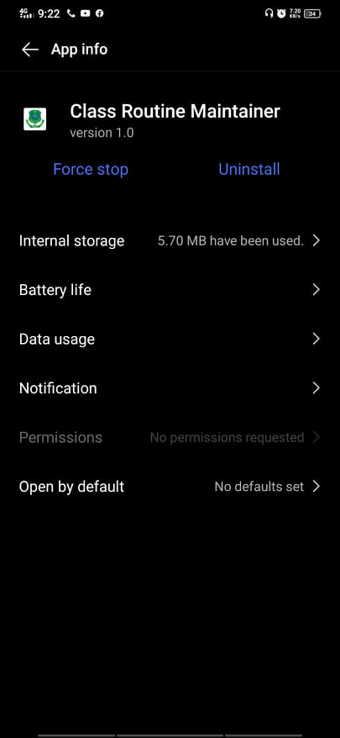
Result - App

Slide 8
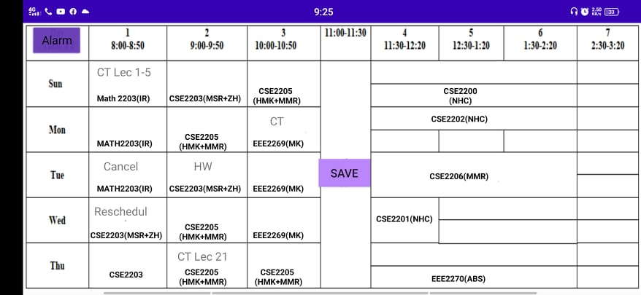
Result – UI

Slide 9
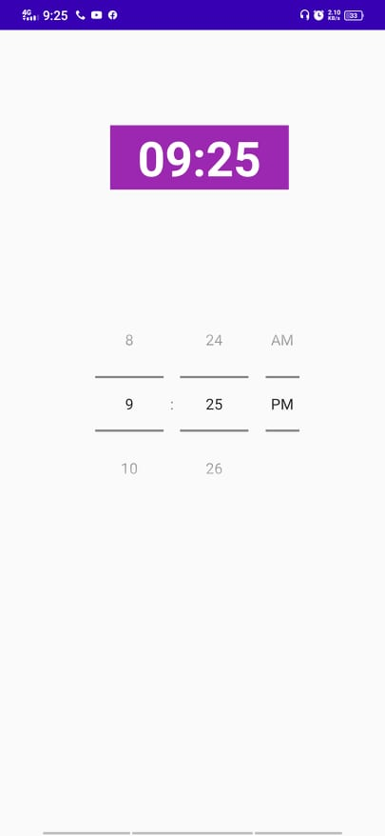
Result – Alarm System

Slide 10
Discussion
The main purpose behind making this app was to learn Android Studio as android is dominating the smartphone market.
We also learned about Debugging.
We used our problem solving skills to implement logics using Java.
We learned some basic HTML.
We learned Google’s official Database – Firebase.

Slide 11
Conclusion
It's no wonder that, the app development process is exhausting, and overwhelming also. There have been lots of steps and processes to follow, and many decision making mechanism are involved as well.
The amount of time we spent together trying to solve an error was quite frustrating and satisfying after solving at the same time.
This project really helped us to develop our team work as well as improved our development skills.
The most important part of this project was learning.

Slide 12
