Slide 1



Vishwakarma Application ID
VK26-AU-HCI-0032
GIG Assistance and Training Glasses
Stage 2 Design Specification · HCI 2.0: Designing Interaction Beyond Chat
Notes:
Application ID: VK26-AU-HCI-0032. Theme: HCI 2.0: Designing Interaction Beyond Chat. Title and technical scope come from the team Stage 1 proposal. Design Development Stage: this deck presents design targets and concept visuals, not measured GIG results.

Slide 2


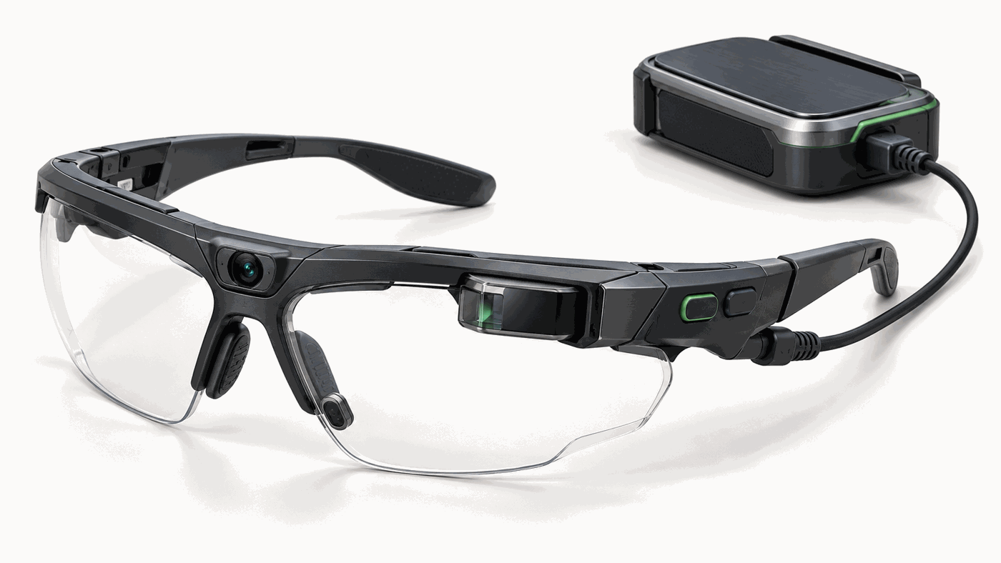
Project Overview: GIG Assistance and Training Glasses
Look
Confirm
Follow
Replay
GAZE PROPOSES A CANDIDATE ITEM
A PHYSICAL CONTROL DECIDES
APPROVED SHORT INSTRUCTION
LINKED EVENT WITH AN INSTRUCTOR
One responder-training record
Core idea: The item, its approved check and the moment it happened, connected in one responder-training record.
Interaction: Look at a relief-kit item. Inspect its highlight. Confirm it with a physical control. Follow the approved instruction. Replay the confirmed event with an instructor.
Theme: HCI 2.0: Designing Interaction Beyond Chat. Positioning: Spatial Computing and Intent-Driven Physical Interfaces, with tangible, haptic and multimodal interaction.
First use case: A supervised relief/response-kit preparation and handover exercise.
Value to test: Fewer wrong-item or omitted checks and faster, more precise debriefing, without added distraction or task time. Field use needs separate safety, privacy, environmental and operational validation.
AI Generated Illustrative product concept; no fabricated glasses are claimed.
Design Development Stage. No built glasses, field data, pilot results or partner access are claimed.
VK26-AU-HCI-0032 · HCI 2.0 · Design Development Stage.
VK26-AU-HCI-0032 · HCI 2.0 · 2 / 16
Notes:
Sources: team Stage 1 proposal (title, scope, theme). Image 01_gig_product_concept.png is an AI-generated illustration, not a CAD render or photograph. The four tiles restate the interaction loop; they are not measured results. VERIFY before submission: team name and member details are not in this deck.

Slide 3
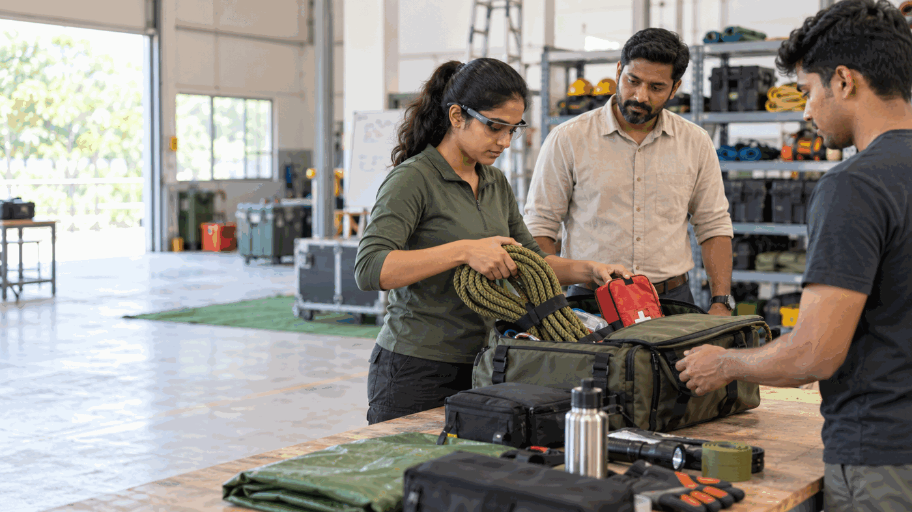
Problem Context: A Real Training Task With a Missing Thread
691
4 of 17
4 of 17
Not measured
NDRF MOCK EXERCISES, 2024 [S1]
WHO: UNFAMILIAR PROCEDURES [S3]
WHO: COORDINATION DIFFICULTY [S3]
GIG-SPECIFIC ERROR RATE
Target Beneficiary & Operational Pain
Target beneficiary: Disaster-response trainees and instructors who prepare, check and hand over equipment in supervised exercises. First task: one relief/response kit.
Operational pain: The wearer keeps both hands on equipment, identifies the intended item, consults a separate checklist, confirms its condition and must remember the context for later review.
Missing thread: A marked checklist does not show which physical item the trainee meant or what occurred at that moment. Raw video shows the moment but may take time to locate.
Status: This is the design hypothesis to test, not a measured failure rate.
AI Generated Illustrative supervised training scenario; not an NDRF photograph.
NDRF procedure [S2]: equipment must be functional before exercises; photos and video are treated as useful for later evaluation.
WHO context [S3]: a small international review of 17 simulation reports, mostly tabletop or public-health exercises outside India. Broader context only, not an NDRF statistic.
Evidence limit: The sources support the need for training and documentation. They give no GIG-specific error rate, and no NDRF affiliation or partner access is claimed.
VK26-AU-HCI-0032 · HCI 2.0 · 3 / 16
Notes:
S1: NDRF Raising Day 2025, 691 mock exercises in 2024. S2: NDRF Mock Exercise procedure. S3: WHO 2018 review of 17 simulation reports (4/17 unfamiliar with procedures, 4/17 coordination difficulty), mostly tabletop/public-health cases outside India, used only as broader context. Image 02_training_scenario.png is AI-generated, not an NDRF photograph. URLs are on the References slide.

Slide 4
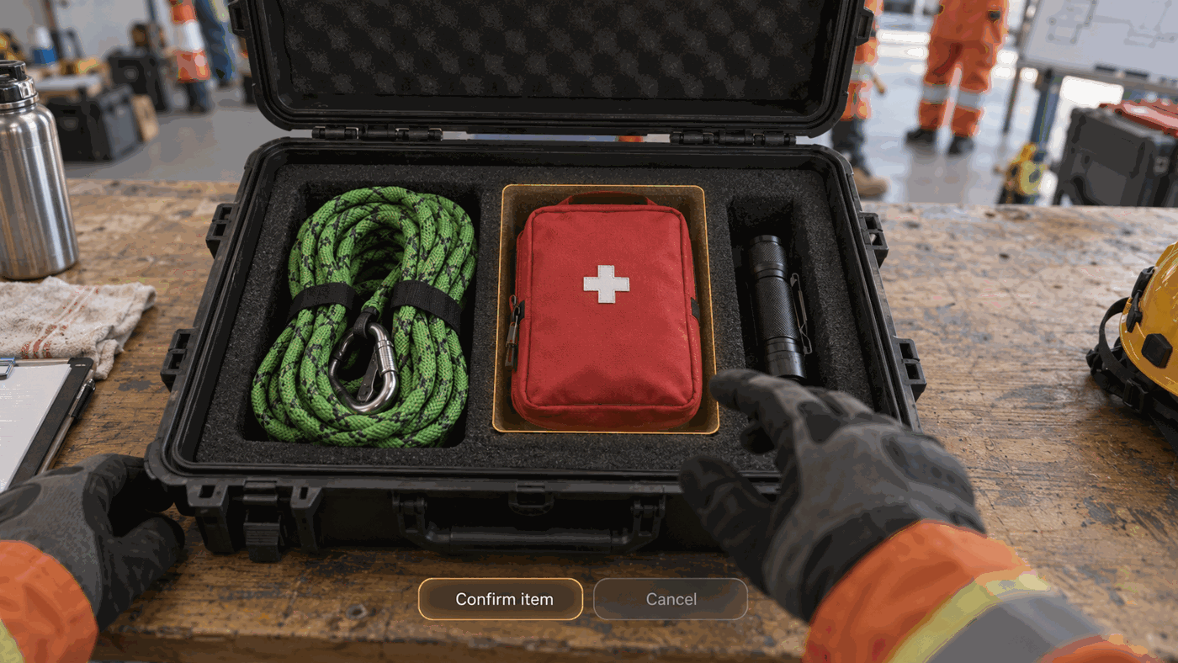
User Journey: Before and With GIG
Before: find, look away, check, mark, hand over, reconstruct
Find the item
Look away to paper or phone
Perform the check
Mark the list
Hand over
Reconstruct the moment from memory or search an unindexed recording
With GIG: the person decides at each green step
Look at the item
Inspect the candidate highlight
Press confirm
Read a short approved prompt
Explicitly mark the performed check
Hand over
Open the linked event during debrief
What changes
The item identity, prompt, human confirmation and evidence share one session record. Gaze proposes; the person decides.
Measures, not results
Wrong-item selections
Omitted checks
Task completion time
Interruptions
Time to retrieve a review moment
Concept of candidate-item highlight before confirmation.
VK26-AU-HCI-0032 · HCI 2.0 · 4 / 16
Notes:
Before and With GIG flows are the design hypothesis, not observed results. No time, error or cost figures are claimed; the five measures are what the pilot would record. Image 03_wearer_pov_concept.png is AI-generated.

Slide 5
Solution and System Architecture
System block diagram
Eye-facing tracker
Quality gate
Human confirmation
Event record: source timestamps, item ID, prompt version, confirmation, event media
Calibrate gaze into scene view
Candidate item, confidence, restrained highlight
Open the approved step
Outward scene camera
Low quality: no candidate shown
Cancel: nothing recorded
Recording or tracking gaps are shown in review
Core hardware
Core logic
Boundary
Head-worn: eye-facing tracker; outward scene camera; monocular near-eye display; tactile confirm and cancel controls; microphone and speaker for later expansion.
Body-worn: local pocket compute and protected battery.
Calibrate gaze into the scene view. Estimate the candidate item and confidence. Show a restrained highlight. Require physical confirmation. Open the approved step.
Record source timestamps, item ID, prompt version, confirmation and event media. Display any recording or tracking gaps during review.
Gaze alone never completes a check.
The system cannot certify equipment condition. The person inspecting the item remains responsible.
VK26-AU-HCI-0032 · HCI 2.0 · 5 / 16
Notes:
Architecture is a design, not a built system. The quality gate rejects low-quality gaze before any candidate is displayed. The human confirmation gate (physical confirm or cancel) must pass before an event record is written. No decorative AI graphic is used. Hardware models are not selected; see BOM slide.

Slide 6
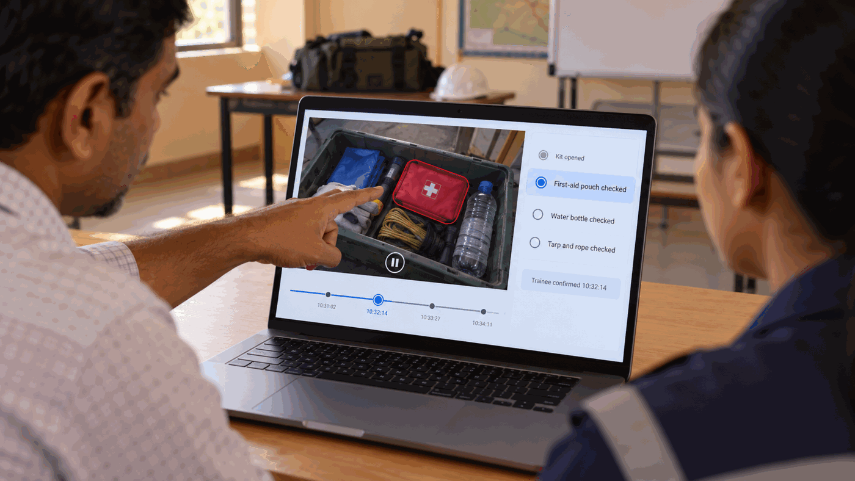
First Prototype Interaction: One Complete Loop
One loop, five steps
Prepare: Instructor approves one kit, item list and checklist. Trainee starts a consented indoor session.
Calibrate: System maps gaze to the scene camera and fails closed if quality is inadequate.
Look and confirm: Candidate item is highlighted; the trainee presses confirm or cancel.
Check: One short instruction appears. The trainee performs the physical inspection and explicitly records completion.
Review: The instructor selects the check and replays its linked clip with the trainee.
AI Generated Illustrative wearer view; highlight is a candidate, not a completed check.
Demo item
First-aid pouch within a relief kit. No live casualty, classified scene or unsupervised deployment in the first demonstration.
Review step: illustrative debrief concept.
VK26-AU-HCI-0032 · HCI 2.0 · 6 / 16
Notes:
Image 03_wearer_pov_concept.png is AI-generated. The highlight shown is a candidate only; no completed-check symbol appears. First demonstration: indoor, supervised, consented, single kit.

Slide 7
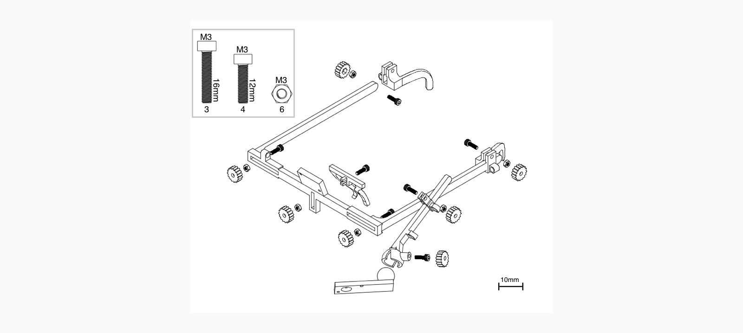
CAD Design & Mechanical Specs
Mechanical Build Path & Validation
Base frame: Use an open-hardware printable frame and adjustable eye-camera mount as the first fit reference. Check the exact camera, head fit and sightline before adapting.
GIG module: The original OpenSCAD temple draft has a cable opening and two M2.5 clearance holes. Its 44 × 20 × 14 mm body and channel are placeholders, not measured fit.
Integration: Add a separate scene camera, one accessible confirm control and a tether to pocket compute. Select a display after alignment, eye clearance and power checks.
CAD files: GIG_parametric_temple_module.scad + reference .3mf/STLs: github.com/labishbardiya/GIG-Assistance-and-Training
Next checks: Print a fit coupon; measure frame and components; assess retention, cable strain, heat, sightline, comfort and rapid removal. No FEA or stress result yet.
Exploded CAD view of a printable gaze frame; reference geometry, not a GIG assembly.
GIG add-on module: draft dimensions only
Parameter | Current CAD input | Status
Body | 44 × 20 × 14 mm | Replace with real footprints
Temple channel | 8.5 × 4.0 mm + fit clearance | Not measured on chosen frame
Features | Cable opening; two top holes | Generic clip-on module
Reference CAD and GIG module are design-stage files. No fabricated assembly, fit test or FEA is claimed.
VK26-AU-HCI-0032 · HCI 2.0 · 7 / 16
Notes:
VERIFY before submission: the OpenSCAD file cad/GIG_parametric_temple_module.scad was not available when this deck was built, so its description and parameters (44 x 20 x 14 mm body; 8.5 x 4.0 mm channel; cable opening; two top holes) come from the team brief and were not checked against the file. If you can render the file, replace the image with a genuine OpenSCAD screenshot and keep the caption honest. Material selection is not stated because no material has been chosen or tested.

Slide 8
Electronics & Indicative BOM
Indicative Bill of Materials: no prices yet
Subsystem | Initial selection criterion | Qty | Evidence status
Eye tracker | Live gaze, confidence and source timestamps; developer API; documented eye safety | 1 | Model and quote pending
Scene camera | Calibratable camera view, time-synchronised with gaze | 1 | May be integrated with tracker; confirm
Microdisplay | Short, readable prompts; safe mounting and optical documentation | 1 | Model and quote pending
Physical input | Tactile confirm and cancel | 2 | Fit and reach test pending
Compute / power | Local processor, protected battery, storage | 1 set | Power and thermal test pending
Structure | Frame, adjustable mounts, tether and strain relief | 1 set | CAD concept supplied; fit pending
Total: pending verified vendor quotations.
AI Generated Illustrative concept: headborne modules and pocket compute.
Optional wrist module
Pulse and motion signals are a separate experiment, not required for the first loop. No stress or competence label may be inferred from them.
Keep it only if it adds useful instructor feedback beyond video.
Procurement rule: a costed BOM needs real part numbers, Indian vendor quotations and lead times. No prices, quotes, lead times or totals are claimed.
VK26-AU-HCI-0032 · HCI 2.0 · 8 / 16
Notes:
Indicative BOM only: selection criteria and evidence status, no unit prices, vendors or totals. The template asks for part numbers, unit cost and lead time; these are intentionally absent until verified quotations exist. Image is AI-generated concept art.

Slide 9
Maker Journey & Authenticity
Work prepared for this stage
Evidence still to collect
Clear disclosure
Stage 1 problem definition
Revised training-first workflow
Architecture and verification plan
Four labeled concept illustrations
Original parametric temple-module source (design draft)
Public CAD repository with licensed frame reference
Actual frame and hardware selection
Native full assembly and wiring schematic
Vendor quotations
Real calibration and timing logs
Team fabrication photos with institutional IDs
Real printed parts and fit-test results
Instructor feedback and pilot results
The concept images are AI-generated.
The OpenSCAD file is a design draft.
No built glasses, team build photographs, FEA outputs or user-study results are represented as completed.
Pending team details: to be added by the team before submission. None is represented as complete.
Authenticity verification
Team members with institutional ID badges at work; joint lab review photo if a faculty mentor is attached.
Work-in-progress evidence
Genuine CAD feature-tree and wiring-schematic screenshots; calibration and timing logs.
Public CAD repository
https://github.com/labishbardiya/GIG-Assistance-and-Training
VK26-AU-HCI-0032 · HCI 2.0 · 9 / 16
Notes:
No lab photos, IDE screenshots, terminal logs, timestamps or faculty sign-off are shown, by design. VERIFY before submission: add member names, institutional IDs, faculty mentor and a repository link once they exist. The template asks for proof of personal fabrication; none exists yet and none is simulated.

Slide 10
Safety & Hazard Mitigation
Design FMEA (Failure Mode and Effects Analysis)
Failure Mode | Possible Harm | Control / Verification
Wrong item highlighted | Wrong instruction opened | Candidate display plus deliberate confirm; reject low-quality gaze; log false selections
Display distraction | Task interruption or reduced situational awareness | Brief prompts, blank-display button, indoor pilot and stop rule
Recording without consent | Privacy harm | Explicit session start, visible indicator, pause and delete, restricted access and retention limit
Missing or misaligned media | Misleading debrief | Source timestamps, gap flags, start/end sync markers and dropout tests
Uncomfortable mount or cable | Fatigue, snagging or unsafe removal | Fit and cable-routing tests; quick-release path; no certified PPE modification
Wrist overinterpretation | Unfair performance judgment | Optional, consented trends only; never infer stress, emotion or competence
Scope: training-only in controlled indoor exercises until safety, environment, security and PPE compatibility are verified. These are design controls, not tested results.
VK26-AU-HCI-0032 · HCI 2.0 · 10 / 16
Notes:
FMEA is a design-stage analysis; none of the controls has been tested. No standards compliance (ISO, IEC, IP rating) is claimed because none has been assessed.

Slide 11
Fabrication Roadmap
Four phases to a working loop and measured comparison
Phase 1
Specification and procurement
Phase 2
Interaction loop
Phase 3
Evidence loop
Phase 4
Supervised evaluation
Phases 1 and 2: Specify, then Build the Loop
Phases 3 and 4: Link Evidence, then Evaluate
Phase 1, specification and procurement: confirm the exact instructor-approved exercise and baseline. Select a compatible eye tracker, scene camera, display and frame. Collect supplier eye-safety documents and quotes. Measure frame geometry.
Phase 2, interaction loop: build gaze-to-scene calibration, candidate highlight, physical confirmation and approved checklist display. Add a head-centred fallback.
Phase 3, evidence loop: link selected item, prompt, controls and captured clip in one timestamped record. Add dropout flags, replay and deletion. Measure latency, drift, endurance and heat.
Phase 4, supervised evaluation: if access permits, run an exploratory 8 to 12-adult indoor pilot with equivalent kits and counterbalanced order. Report every failure.
Stage 3 deliverable: a working loop plus a measured comparison, not a claim of field readiness. No procurement, build or pilot has happened yet; calendar dates are set once supplier lead times are known.
VK26-AU-HCI-0032 · HCI 2.0 · 11 / 16
Notes:
The brief gives phases but no calendar dates, so none are shown. Add dates after vendor lead times are confirmed. Procurement, build and pilot are plans only; the pilot depends on access and is exploratory (8 to 12 adults).

Slide 12
Technical Challenges & Risks
Gaze drift
Small item ambiguity
Optical and mechanical integration
Head movement or frame slip changes the mapping between eye and scene.
Tested by: wrong-item rate and calibration failures by item position.
Adjacent objects may be difficult to distinguish with gaze alone.
Tested by: wrong-item rate by item position; head-centred fallback.
The display, eye sensor and camera may compete for frame space and comfort.
Tested by: readability, comfort, mount retention and rapid removal.
Timing and power
Training effect
Video, gaze and controls need trustworthy timestamps. Continuous capture consumes energy and generates heat.
Tested by: injected dropped frames and delayed signals; measured runtime and enclosure temperature.
Prompts may distract, or may cause trainees to follow the display without understanding the task.
Tested by: interruptions and total task time against a phone or paper baseline.
Evidence rule: these are known design risks, not problems already observed in GIG tests.
VK26-AU-HCI-0032 · HCI 2.0 · 12 / 16
Notes:
Each risk links to the go/no-go evidence on the next slide. No GIG test has been run, so no risk is reported as observed.

Slide 13
Mitigations & Go/No-Go Tests
Design response and the evidence that decides go or no-go
Risk | Design Response | Go/No-Go Evidence
Drift / ambiguous item | Recalibrate; confidence threshold; head-centred fallback | Wrong-item rate and calibration failures by item position
Fit / optics | Adjustable modules and measured component placement | Readability, comfort, mount retention and rapid removal
Timing gaps | Source timestamps, start/end markers, visible uncertainty | Inject dropped frames and delayed signals; verify record integrity
Power / heat | Pocket compute; configurable capture duration | Measured runtime and enclosure temperature
Cognitive burden | Short approved prompts; physical cancel; display blanking | Compare interruptions and total task time with phone/paper baseline
Optional wrist target: if integrated, verify wrist-to-video alignment within one second and report the actual error. Retain the module only if it adds useful instructor feedback beyond video.
VK26-AU-HCI-0032 · HCI 2.0 · 13 / 16
Notes:
Go/no-go evidence is what the team will measure in Stage 3; no result exists yet.

Slide 14
Differentiation, Prior Art & Pilot Decision
What already exists
Three fair comparisons
Decision rule
Open eye-tracking software and APIs [S5]
Gaze-directed contextual AI research [S6]
Video-based simulation debriefing [S7]
Printable research gaze frames [S8]
The existence of these tools is not evidence that GIG works.
GIG contribution to test
An approved equipment-check workflow that binds a deliberately confirmed physical item to the instruction shown, the person’s completion action and a first-person event for review.
Gaze plus confirmation versus head-centred selection.
GIG versus a phone or paper checklist on wrong-item choices, omissions, interruptions and task time.
Event-linked replay versus unindexed video on time to find and explain a marked moment.
Keep gaze if it improves selection or checklist completeness without a meaningful distraction or time penalty.
Keep wrist sensing only if it improves review.
If simple tools perform as well, simplify the product.
Prior-art caution: video debriefing is established (Laerdal SimCapture [S7]); GIG does not claim it as new. The open-source tools [S5, S8] do not make the GIG hardware open or compatible.
VK26-AU-HCI-0032 · HCI 2.0 · 14 / 16
Notes:
S5 Pupil Labs (check component licences before reuse). S6 GazeGPT, Konrad et al. 2024: research baseline for gaze selection, not a responder-training workflow. S7 Laerdal SimCapture: commercial debrief prior art. S8 Thurnherr et al. printable gaze frames, MIT licence, RealSense-specific, mechanical inspiration only.

Slide 15
References & Sources
[S1]
National Disaster Response Force, NDRF Raising Day 2025
691 mock exercises in 2024; 2025 “Year of Training.”
ndrf.gov.in/en/pressrelease/national-disaster-response-force-ndrf-raising-day-2025
[S5]
Pupil Labs, open-source eye tracking and developer API
Software availability does not make the hardware open or compatible with our frame. Check component licences before reuse.
github.com/pupil-labs/pupil and docs.pupil-labs.com/neon/open-source-libs/
[S2]
NDRF, Mock Exercise procedure
Equipment checks, debrief and the value of photographs and video.
ndrf.gov.in/sites/default/files/MOCK EXERCISE.pdf
[S6]
Konrad et al., GazeGPT (2024)
Gaze-directed contextual queries; a research baseline for selection, not a responder training workflow.
computationalimaging.org/publications/gazegpt-2024/
[S3]
WHO, 2018 review of 17 simulation exercise reports
4/17 unfamiliar with procedures; 4/17 coordination difficulty. Mostly tabletop or public-health cases outside India; context only.
who.int/news-room/articles-detail/after-action-reviews-and-simulations-exercises-within-the-monitoring-and-evaluation-framework-for-the-international-health-regulations-(2005)-main-trends-in-2018
[S7]
Laerdal SimCapture
Commercial recording and debriefing prior art; video debrief is not claimed as new.
laerdal.com/in/services-and-programs/educational-services/getting-started-with-simcapture/
[S4]
Vishwakarma Awards 2026-27 official site
Stage 2 design specification; prototype video belongs to Stage 3; judging criteria.
vishwakarma-awards.org
[S8]
MEYELens, 3D-printable wearable gaze-tracking hardware (CERN-OHL-P-2.0)
Reference frame, STL/3MF and exploded view; adaptation required for GIG scene camera, control and display.
github.com/raffaelemazziotti/MEYElens
Design targets and concept visuals are not measured GIG results. No NDRF affiliation or partner access is claimed.
VK26-AU-HCI-0032 · HCI 2.0 · 15 / 16
Notes:
All hyperlinks are live. S3 and S1 figures are quoted with their sample and context only. S4 (official site) was the source for stage requirements; it supports no claim about GIG performance.

Slide 16
Image Sources & Disclosure
images/01_gig_product_concept.png Used on: Project Overview, Electronics
Source: AI-generated illustrative product concept. Not a CAD render, photograph or built device.
images/02_training_scenario.png Used on: Problem Context
Source: AI-generated illustration of a supervised training scenario. Not an NDRF photograph.
images/03_wearer_pov_concept.png Used on: User Journey, First Prototype Interaction
Source: AI-generated illustrative wearer view. The highlight is a candidate, not a completed check.
images/04_instructor_debrief_concept.png Used on: First Prototype Interaction (review step)
Source: AI-generated illustrative debrief interface. Not functional software.
CAD files: original untested GIG temple .scad; third-party open-hardware frame .3mf/STLs and exploded reference drawing [S8].
The four concept images are AI-generated. The CAD view is a cited third-party reference, not a built or validated GIG assembly.
VK26-AU-HCI-0032 · HCI 2.0 · 16 / 16
Notes:
Generation prompts (from the team brief). 01: Photorealistic but clearly conceptual industrial-design render of humanitarian responder training glasses with scene camera, inward eye sensor, small monocular display, tactile temple controls and cable to pocket compute; no logos. 02: Supervised indoor disaster-response training exercise in India; trainee with subtle smart-glasses prototype prepares an open relief kit; instructor observes; no uniforms, agency logos, victims or UI overlay. 03: First-person view into a relief-kit case; only the first-aid pouch has a restrained amber candidate highlight; Confirm item and Cancel overlay; no completed-check symbol. 04: Instructor and trainee at a laptop; concept interface shows paused first-person kit video, one highlighted item, short checklist and four event markers; no biometric interpretation or agency marks.

