Slide 1
Introduction to Hortonworks Data Platform (HDP)
Data Science Foundations
Notes:
Hortonworks est une société de logiciels informatique basée à Santa Clara, en Californie. La société se concentre sur le développement et le soutien de Hadoop, un framework Java qui permet le traitement distribué de grands volumes de données par des grappes de serveurs.

Slide 2
Unit objectives
Describe the functions and features of HDP
List the IBM value-add components
Explain what IBM Watson Studio is
Give a brief description of the purpose of each of the value-add components

Slide 3
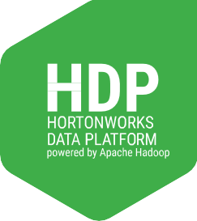
Hortonworks Data Platform (HDP)
HDP is platform for data-at-rest
Secure, enterprise-ready open source Apache Hadoop distribution based on a centralized architecture (YARN)
HDP is:
Open
Central
Interoperable
Enterprise ready
Notes:
Hortonworks Data Platform (HDP) is a powerful platform for managing Big Data at rest. HDP is Open Enterprise Hadoop, and it's a platform that is:
100% Open Source
Centrally architected with YARN at its core
Interoperable with existing technology and skills, AND
Enterprise-ready, with data services for operations, governance and security

Slide 4


Hortonworks Data Platform (HDP)
Governance
Integration
Tools
Security | Operations
Ranger | Ambari
Knox | Cloudbreak
Atlas | ZooKeeper
HDFS Encryption | Oozie
Data Lifecycle & Governance
Falcon
Atlas
Data workflow
Sqoop
Flume Kafka NFS
WebHDFS
Zeppelin
Ambari User Views
Data Access
 | Batch | Script | SQL | NoSQL | Stream | Search | In-Mem | Others
 | Map Reduce | Pig | Hive | HBase Accumulo Phoenix | Storm | Solr | Spark | HAWQ Partners Big SQL
 |  | Tez | Tez | Slider |  |  |  | S T
 | YARN: Data Operating System
Hadoop Distributed File System (HDFS)
Data Management
Notes:
Here is the high level view of the Hortonworks Data Platform. It is divided into several categories, listed in no particular order of importance.
Governance, Integration
Tools
Security
Operations
Data Access
Data Management
These next several slides will go in more detail of each of these groupings.

Slide 5
Appendix B

Slide 6
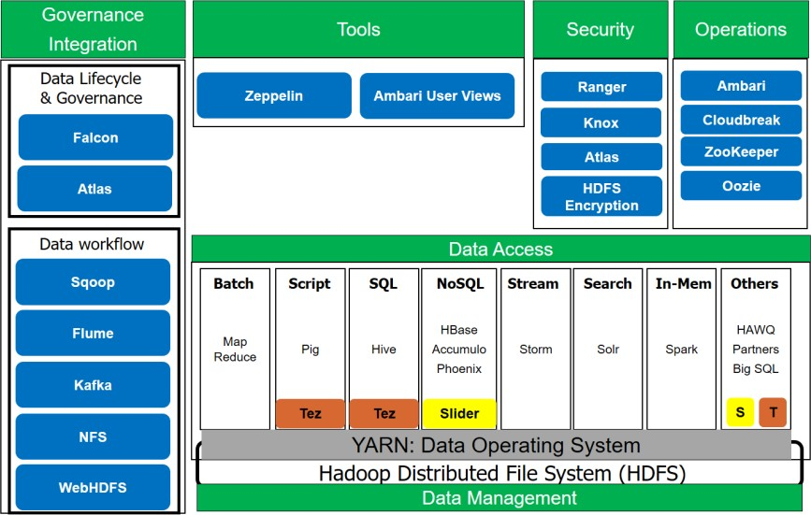
Data workflow

Slide 7

Sqoop
Tool to easily import information from structured databases (Db2, MySQL, Netezza, Oracle, etc.) and related Hadoop systems (such as Hive and HBase) into your Hadoop cluster
Can also use to extract data from Hadoop and export it to relational databases and enterprise data warehouses
Helps offload some tasks such as ETL from Enterprise Data Warehouse to Hadoop for lower cost and efficient execution
Notes:
Sqoop is a tool for moving data between structured databases or relational databases and related Hadoop system. This works both ways. You can take data in your RDBMS and move to your HDFS and move from your HDFS to some other form of RDBMS. You can use Sqoop to offload tasks such as ETL from data warehouses to Hadoop for lower cost and efficient execution for analytics.
Check out the Sqoop documentation for more info: http://sqoop.apache.org/

Slide 8

Flume
Apache Flume is a distributed, reliable, and available service for efficiently collecting, aggregating, and moving large amounts of streaming event data.
Flume helps you aggregate data from many sources, manipulate the data, and then add the data into your Hadoop environment.
Its functionality is now superseded by HDF (Hortonworks Data Flow) / Apache Nifi.
Notes:
To set the stage, Flume is now deprecated by HDP in favor of HDF, Hortonworks Data Flow. This course, will, however, cover what Flume does on a very high level, but will not get into HDF of any great detail until the end. Essentially, when you have large amounts of data, such as log files, that needs to be moved from one location to another, Flume is the tool. Now, with that said, in the common cases, when moving log data, you would consider looking into streaming technologies to move data in real-time (or near real-time) as the log files are generated from the data warehouse into the Hadoop datastore for processing. This is where Hortonworks Data Flow comes in.
For more information, refer to: https://hortonworks.com/products/data-platforms/hdf/

Slide 9
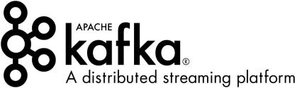
Kafka
Apache Kafka is a fast, scalable, durable, and fault-tolerant publish-subscribe messaging system.
Used for building real-time data pipelines and streaming apps
Often used in place of traditional message brokers like JMS and AMQP because of its higher throughput, reliability and replication.
Kafka works in combination with variety of Hadoop tools:
Apache Storm
Apache HBase
Apache Spark
Notes:
Kafka Apache Kafka is a messaging system used for real-time data pipelines. Kafka is used to build real-time streaming data pipelines that get data between systems or applications. Kafka works with a number variety of Hadoop tools for various applications. Such exmaples of uses cases are:
Website activity tracking: capturing user site activities for real-time tracking/monitoring
Metrics: monitoring data
Log aggregation: collecting logs from various sources to a central location for processing.
Stream processing: article recommendations based on user activity
Event sourcing: state changes in applications are logged as time-ordered sequence of records
Commit log: external commit log system that helps with replicating data between nodes in case of failed nodes
More information can be found here: https://kafka.apache.org/

Slide 10
Data access

Slide 11

Hive
Apache Hive is a data warehouse system built on top of Hadoop.
Hive facilitates easy data summarization, ad-hoc queries, and the analysis of very large datasets that are stored in Hadoop.
Hive provides SQL on Hadoop
Provides SQL interface, better known as HiveQL or HQL, which allows for easy querying of data in Hadoop
Includes HCatalog
Global metadata management layer that exposes Hive table metadata to other Hadoop applications.

Slide 12

Pig
Apache Pig is a platform for analyzing large data sets.
Pig was designed for scripting a long series of data operations (good for ETL)
Pig consists of a high-level language called Pig Latin, which was designed to simplify MapReduce programming.
Pig's infrastructure layer consists of a compiler that produces sequences of MapReduce programs from this Pig Latin code that you write.
The system is able to optimize your code, and "translate" it into MapReduce allowing you to focus on semantics rather than efficiency.

Slide 13

HBase
Apache HBase is a distributed, scalable, big data store.
Use Apache HBase when you need random, real-time read/write access to your Big Data.
The goals of the HBase project is to be able to handle very large tables of data running on clusters of commodity hardware.
HBase is modeled after Google's BigTable and provides BigTable-like capabilities on top of Hadoop and HDFS. HBase is a NoSQL datastore.

Slide 14

Accumulo
Apache Accumulo is a sorted, distributed key/value store that provides robust, scalable data storage and retrieval.
Based on Google’s BigTable and runs on YARN
Think of it as a "highly secure HBase"
Features:
Server-side programming
Designed to scale
Cell-based access control
Stable
Notes:
Accumulo
Accumulo is another key/value store, similar to HBase. You can think of Accumulo as a "highly secure HBase". There are various features that provides a robust, scalable, data storage and retrieval. It is also based on Google's BigTable, which again, is the same technology for HBase. HBase, however, is getting more features as aligns it more with what the community needs. It is up to you to evaluate your requirements and determine the best tool for your needs.
Accumulo documentation: https://accumulo.apache.org/

Slide 15

Phoenix
Apache Phoenix enables OLTP and operational analytics in Hadoop for low latency applications by combining the best of both worlds:
The power of standard SQL and JDBC APIs with full ACID transaction capabilities.
The flexibility of late-bound, schema-on-read capabilities from the NoSQL world by leveraging HBase as its backing store.
Essentially this is SQL for NoSQL
Fully integrated with other Hadoop products such as Spark, Hive, Pig, Flume, and MapReduce
Notes:
Phoenix enables online transactional process and operational analytics in Hadoop for low latency applications. Essentially, this is a SQL for NoSQL database. Recall that HBase is not designed for transactional processing. Phoenix combines the best of the NoSQL datastore and the need for transactional processing. This is fully integrated with other Hadoop produces such as Spark, Hive, Pig and MapReduce.
Phoenix documentation: https://phoenix.apache.org

Slide 16

Storm
Apache Storm is an open source distributed real-time computation system.
Fast
Scalable
Fault-tolerant
Used to process large volumes of high-velocity data
Useful when milliseconds of latency matter and Spark isn't fast enough
Has been benchmarked at over a million tuples processed per second per node
Notes:
Storm is designed for real-time computation that is fast, scalable, and fault-tolerant. When you have a use case to analyze streaming data, consider Storm as an option. Of course, there are numerous other streaming tools available such as Spark or even IBM Streams, a proprietary software with decades of research behind it for real-time analytics.

Slide 17

Solr
Apache Solr is a fast, open source enterprise search platform built on the Apache Lucene Java search library
Full-text indexing and search
REST-like HTTP/XML and JSON APIs make it easy to use with variety of programming languages
Highly reliable, scalable and fault tolerant, providing distributed indexing, replication and load-balanced querying, automated failover and recovery, centralized configuration and more
Notes:
Solr is built off of the Apache Lucene search library. It is designed for full text indexing and searching. Solr powers the search of many big sites around the internet. It is highly reliable, scalable and fault tolerant providing distributed indexing, replication and load- balanced querying, automated failover and recover, centralized configure and more!

Slide 18
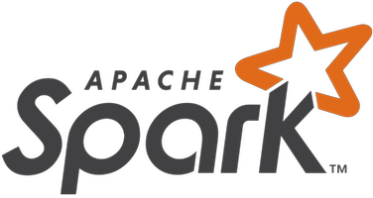
Spark
Apache Spark is a fast and general engine for large-scale data processing.
Spark has a variety of advantages including:
Speed
Run programs faster than MapReduce in memory
Easy to use
Write apps quickly with Java, Scala, Python, R
Generality
Can combine SQL, streaming, and complex analytics
Runs on variety of environments and can access diverse data sources
Hadoop, Mesos, standalone, cloud…
HDFS, Cassandra, HBase, S3…
Notes:
Spark is an in-memory processing engine where speed and scalability is the big advantage. There are a number of built-in libraries that sits on top of the Spark core, which takes advantage of all its capabilities. Spark ML, Spark's GraphX, Spark Streaming, Spark SQL and DataFrames. There are three main languages supported by Spark: Scala, Python, and R. In most cases, Spark can run programs faster than MapReduce can by utilizing its in-memory architecture.
Spark documentation: https://spark.apache.org/

Slide 19

Druid
Apache Druid is a high-performance, column-oriented, distributed data store.
Interactive sub-second queries
Unique architecture enables rapid multi-dimensional filtering, ad-hoc attribute groupings, and extremely fast aggregations
Real-time streams
Lock-free ingestion to allow for simultaneous ingestion and querying of high dimensional, high volume data sets
Explore events immediately after they occur
Horizontally scalable
Deploy anywhere
Notes:
Druid is a datastore designed for business intelligence (OLAP) queries. Druid provides real-time data ingestion, query, and fast aggregations. It integrates with Apache Hive to build OLAP cubes and run sub-seconds queries.

Slide 20
Data Lifecycle and Governance

Slide 21

Falcon
Framework for managing data life cycle in Hadoop clusters
Data governance engine
Defines, schedules, and monitors data management policies
Hadoop admins can centrally define their data pipelines
Falcon uses these definitions to auto-generate workflows in Oozie
Addresses enterprise challenges related to Hadoop data replication, business continuity, and lineage tracing by deploying a framework for data management and processing
Notes:
Falcon is used for managing the data life cycle in Hadoop clusters. One example use case would feed management services such as feed retention, replications across clusters for backups, archival of data, etc.
Falcon documentation: https://falcon.apache.org/

Slide 22

Atlas
Apache Atlas is a scalable and extensible set of core foundational governance services
Enables enterprises to effectively and efficiently meet their compliance requirements within Hadoop
Exchange metadata with other tools and processes within and outside of the Hadoop
Allows integration with the whole enterprise data ecosystem
Atlas Features:
Data Classification
Centralized Auditing
Centralized Lineage
Security & Policy Engine
Notes:
Atlas enables enterprises to meet their compliance requirements within Hadoop. It provides features for data classification, centralized auditing, centralized lineage, and security and policy engine. It integrates with the whole enterprise data ecosystem.
Atlas documentation: https://atlas.apache.org/

Slide 23
Security

Slide 24

Ranger
Centralized security framework to enable, monitor and manage comprehensive data security across the Hadoop platform
Manage fine-grained access control over Hadoop data access components like Apache Hive and Apache HBase
Using Ranger console can manage policies for access to files, folders, databases, tables, or column with ease
Policies can be set for individual users or groups
Policies enforced within Hadoop
Notes:
Ranger is used to control data security across the entire Hadoop platform. The Ranger console can manage policies for access to files, folders, databases, tables and columns. The policies can be set for individual users or groups.
Ranger documentation: https://ranger.apache.org/

Slide 25

Knox
REST API and Application Gateway for the Apache Hadoop Ecosystem
Provides perimeter security for Hadoop clusters
Single access point for all REST interactions with Apache Hadoop clusters
Integrates with prevalent SSO and identity management systems
Simplifies Hadoop security for users who access cluster data and execute jobs
Notes:
Knox is a gateway for the Hadoop ecosystem. It provides perimeter level security for Hadoop. You can think of Knox like the castle walls, where within walls is your Hadoop cluster. Knox integrates with SSO and identity management systems to simplify Hadoop security for users who access cluster data and execute jobs.
Knox documentation: https://knox.apache.org/

Slide 26
Operations

Slide 27

Ambari
For provisioning, managing, and monitoring Apache Hadoop clusters.
Provides intuitive, easy-to-use Hadoop management web UI backed by its RESTful APIs
Ambari REST APIs
Allows application developers and system integrators to easily integrate Hadoop provisioning, management, and monitoring capabilities to their own applications
Notes:
You will grow to know your way around Ambari, as this is the central place to manage your entire Hadoop cluster. Installation, provisioning, management and monitoring of your Hadoop cluster is done with Ambari. It also comes with some easy to use RESTful APIs which allows application developers to easily integrate Ambari with their own applications.

Slide 28
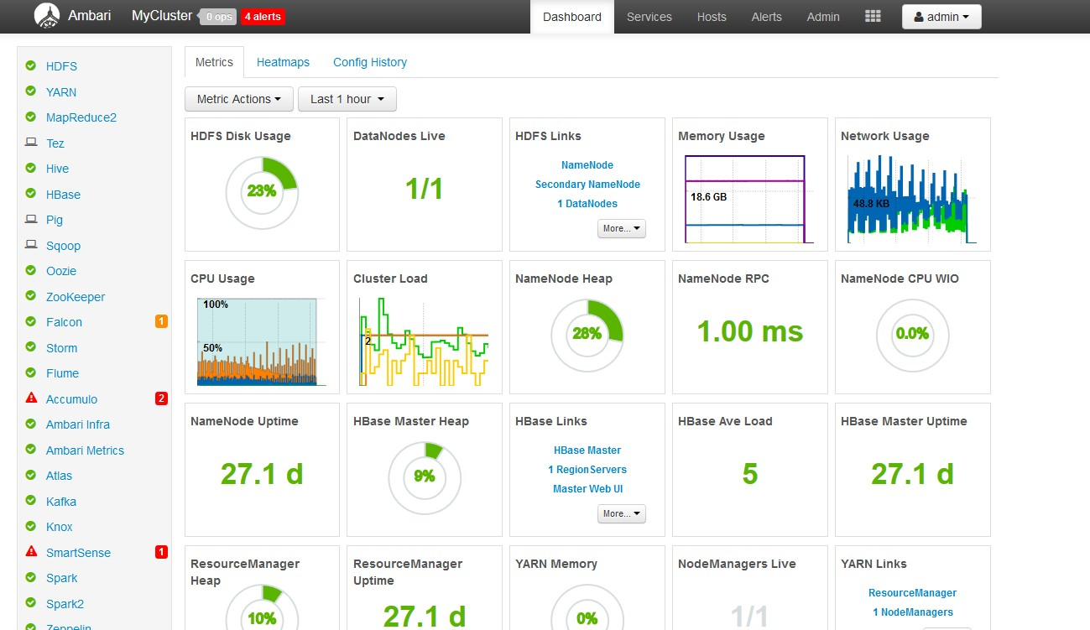
The Ambari web interface
Notes:
Here is a look at the Ambari web interface. Available services are shown on the left with the metrics of your cluster showing on the center of the page. Additional component and server configurations are available once you drill down on the respective pages.

Slide 29
Cloudbreak
A tool for provisioning and managing Apache Hadoop clusters in the cloud
Automates launching of elastic Hadoop clusters
Policy-based autoscaling on the major cloud infrastructure platforms, including:
Microsoft Azure
Amazon Web Services
Google Cloud Platform
OpenStack
Platforms that support Docker container
Notes:
Cloudbreak is a tool for managing clusters in the cloud. Cloudbreak is a Hortonworks' project, and is currently not a part of Apache. It automates the launch of clusters into various cloud infrastructure platforms.
Des regles de mise à l echelle automatique

Slide 30

ZooKeeper
Apache ZooKeeper is centralized service for maintaining configuration information, naming, providing distributed synchronization, and providing group services
All of these kinds of services are used in some form or another by distributed applications
Saves time so you don't have to develop your own
It is fast, reliable, simple and ordered
Distributed applications can use ZooKeeper to store and mediate updates to important configuration information
Notes:
ZooKeeper provides a centralized service for maintaining configuration information, naming, providing distributed synchronization and providing group services across your Hadoop cluster. Applications within the Hadoop cluster can use ZooKeeper to maintain configuration information.
ZooKeeper documentation: https://zookeeper.apache.org/

Slide 31

Oozie
Oozie is a Java based workflow scheduler system to manage Apache Hadoop jobs
Oozie Workflow jobs are Directed Acyclical Graphs (DAGs) of actions
Integrated with the Hadoop stack
YARN is its architectural center
Supports Hadoop jobs for MapReduce, Pig, Hive, and Sqoop
Notes:
Oozie is a workflow scheduler system to manage Hadoop jobs. Oozie is integrated with the rest of the Hadoop stack. Oozie workflow jobs are Directed Acyclical Graphs (DAGs) of actions. At the heart of this is YARN.
Oozie documentation: http://oozie.apache.org/

Slide 32
Tools

Slide 33

Zeppelin
Apache Zeppelin is a Web-based notebook that enables data-driven, interactive data analytics and collaborative documents
Documents can contain SparkSQL, SQL, Scala, Python, JDBC connection, and much more Easy for both end-users and data scientists to work with
Notebooks combine code samples, source data, descriptive markup, result sets, and rich visualizations in one place
Notes:
Zepplin is a web based notebook designed for data scientists to easily and quickly explore dataset through collaborations. Notebooks can contain Spark SQL, SQL, Scala, Python, JDBC, and more. Zeppelin allows for interaction and visualization of large datasets.
Zeppelin documentation: https://zeppelin.apache.org/

Slide 34
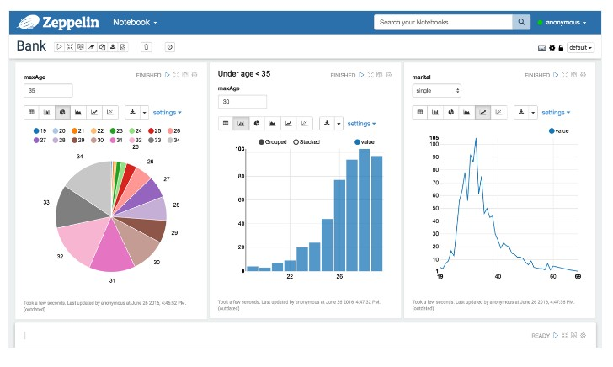
Zeppelin GUI

Slide 35
Ambari Views
Ambari web interface includes a built-in set of Views that are pre- deployed for you to use with your cluster
These GUI components increase ease-of-use
Includes views for Hive, Pig, Tez, Capacity Scheduler, File, HDFS
Ambari Views Framework allow developers to create new user interface components that plug into Ambari Web UI
Notes:
Ambari views provide a built-in set of views for Hive, Pig, Tez, Capacity Schedule, File, HDFS which allows developers to monitor and manage the cluster. It also allows developers to create new user interface components that plug in to the Ambari Web UI.

Slide 36
IBM value-add components
Big SQL
Big Replicate
BigQuality
BigIntegrate
Big Match
Notes:
These are some of the value-add components available from IBM. You will learn a bit about these components next.

Slide 37


Big SQL is SQL on Hadoop
Big SQL builds on Apache Hive foundation
Integrates with the Hive metastore
Instead of MapReduce, uses powerful native C/C++ MPP engine
View on your data residing in the Hadoop FileSystem
No proprietary storage format
Modern SQL:2011 capabilities
Same SQL can be used on your warehouse data with little or no modifications
Hive
Big SQL
Hive APIs
Sqoop
Pig
Hive APIs
Hive APIs
Hive Metastore
Hadoop Cluster
Notes:
Big SQL is a SQL processing engine for the Hadoop cluster. It provides a SQL on Hadoop interface and plugs in directly to the cluster. There is no proprietary format and no new SQL syntax to learn. The same SQL can be used on the warehouse data with little or no modification. It provides an ease-of-use language for SQL developers to be able to work with data on Hadoop.

Slide 38
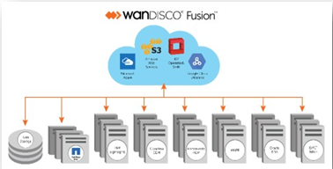
Big Replicate
Provides active-active data replication for Hadoop across supported environments, distributions, and hybrid deployments
Replicates data automatically with guaranteed consistency across Hadoop clusters running on any distribution, cloud object storage and local and NFS mounted file systems
Provides SDK to extend Big Replicate replication to virtually any data source
Patented distributed coordination engine enables:
Guaranteed data consistency across any number of sites at any distance
Minimized RTO/RPO
Totally non-invasive
No modification to source code
Easy to turn on/off
Notes:
For active-active data replication on Hadoop clusters, Big Replicate has no competition. It replicates data automatically with guaranteed consistency on Hadoop clusters on any distribution, cloud object storage and local and NDFS mounted file systems. Big Replicate provides SDK to extend it to any other data source. Patented distributed coordination engine enables guaranteed data consistency across any number of sites at any distance.

Slide 39
Information Server and Hadoop: BigQuality and BigIntegrate
IBM InfoSphere Information Server is a market-leading data integration platform which includes a family of products that enable you to understand, cleanse, monitor, transform, and deliver data, as well as to collaborate to bridge the gap between business and IT.
Information Server can now be used with Hadoop
You can profile, validate, cleanse, transform, and integrate your big data on Hadoop, an open source framework that can manage large volumes of structured and unstructured data.
This functionality is available with the following product offerings
IBM BigIntegrate: Provides data integration features of Information Server.
IBM BigQuality: Provides data quality features of Information Server.
Notes:
Information Server is a platform for data integration, data quality, and governance that is unified by a common metadata layer and scalable architecture. This means more reuse, better productivity, and the ability to leverage massively scalable architectures like MPP, GRID, and Hadoop clusters.
Provides data integration features == Fournit des fonctionnalités d'intégration de données

Slide 40
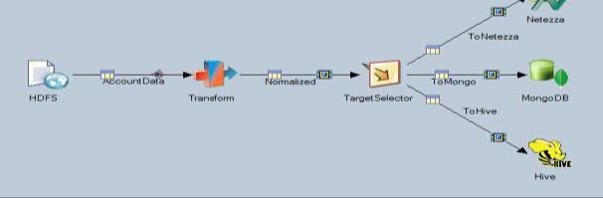
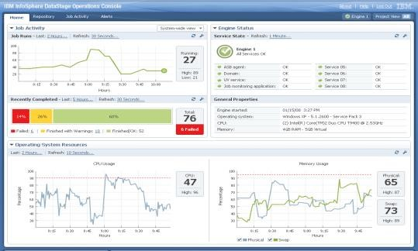
Information Server - BigIntegrate: Ingest, transform, process and deliver any data into & within Hadoop
Satisfy the most complex transformation requirements with the most scalable runtime available in batch or real-time
Connect
Connect to wide range of traditional enterprise data sources as well as Hadoop data sources
Native connectors with highest level of performance and scalability for key data sources
Design & Transform
Transform and aggregate any data volume
Benefit from hundreds of built-in transformation functions
Leverage metadata-driven productivity and enable collaboration
Manage & Monitor
Use a simple, web-based dashboard to manage your runtime environment

Slide 41
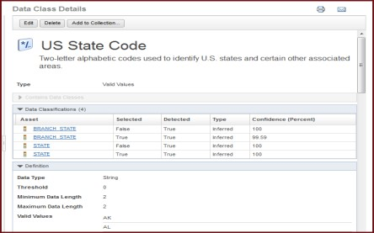
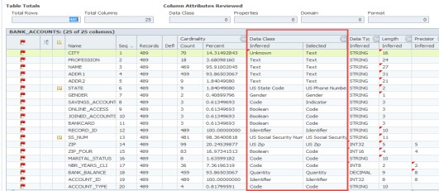
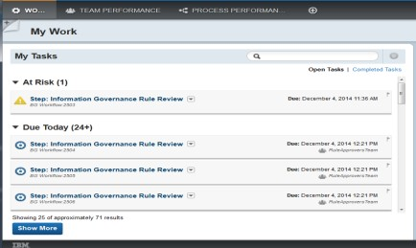
Information Server - BigQuality: Analyze, cleanse and monitor your big data
Most comprehensive data quality capabilities that run natively on Hadoop
Analyze
Discovers data of interest to the organization based on business defined data classes
Analyzes data structure, content and quality
Automates your data analysis process
Cleanse
Investigate, standardize, match and survive data at scale
and with the full power of common data integration
processes
Monitor
Assess and monitor the quality of your data in
any place and across systems
Align quality indicators to business policies
Engage data steward team when issues exceed thresholds of the business

Slide 42

IBM InfoSphere Big Match for Hadoop
PME
Hadoop
Algorithm
Big Match is a Probabilistic Matching Engine (PME) running
natively within Hadoop for Customer Data Matching
Notes:
Big Match provides proven probabilistic matching algorithms natively in Hadoop to accurately and economically link all customer data across structured and un-structured data sources at large scale. Big Match helps provide customer information that consuming applications can act on with confidence.
Big Match integrates directly with Apache Hadoop.

Slide 43






Watson Studio (formerly Data Science Experience (DSX))
Watson Studio is a collaborative platform for data scientists, built on open source components and IBM added value, available in the cloud or on premises.
https://datascience.ibm.com/
Learn
Create
Collaborate
Built-in learning to get started or go the distance with advanced tutorials
The best of open source and IBM value-add to create state-of-the-art data products
Community and social features that provide meaningful collaboration
Notes:
Watson Studio is a collaborative platform designed for data scientists, built on open source components and IBM value-add components available in the cloud or on- premise

Slide 44
Checkpoint
List the components of HDP which provides data access capabilities?
List the components that provides the capability to move data from relational database into Hadoop?
Managing Hadoop clusters can be accomplished using which component?
True or False? The following components are value-add from IBM: Big Replicate, Big SQL, BigIntegrate, BigQuality, Big Match
True or False? Data Science capabilities can be achieved using only HDP.

