Slide 1
Data Science and Data Science Notebooks

Slide 2
Unit objectives
Have a better understanding of methodology “scientific approach” methods used & skills practiced by Data Scientists
Recognize the iterative nature of a data science project
Outline the benefits of using Data Science Notebooks
Describe the mechanisms and tools used with Data Science Notebooks
Compare and contrast the major Notebooks used by Data Scientists

Slide 3
A lead-in to Data Analysis
The right data, the right questions,
… and the right methodology
At Google major decisions are based on only a tiny sampling of all their data. You don’t always need a ton of data to find important insights. You need the right data. …
Most important, to squeeze insights out of Big Data, you have to ask the right questions. Just as you can’t point a telescope at the night sky and have it discover Pluto for you, you can’t download a whole bunch of data and have it discover the secrets of human nature for you.
Stephens-Davidowitz, S. (2017). Everybody lies: Big data, new data, and what the internet can tell us who we really are. New York: Dey Street Books / William Morrow / Harper Collins. Pp 21-22.

Slide 4
What is methodology?
General strategy that guides processes and activities within a domain
Provides the analyst with a framework for how to proceed with the methods, processes, and heuristics used to obtain answers or results
Doesn’t depend on particular technologies or tools
Not a set of techniques or recipes
In the domain of data science, we are concerned with solving a problem or answering a question through analyzing data
Often, we construct a model of some sort to predict outcomes or discover underlying patterns > predictive & descriptive models
Goal of modeling is to gain insights from which we can formulate actions to influence future outcomes or behaviors
For our purpose, we need a data science methodology to guide us in achieving this goal
Notes:
Definition of methodology (pl.: methodologies) in the Merriam-Webster Dictionary:
a body of methods, rules, and postulates employed by a discipline; a particular procedure or set of procedures
the analysis of the principles or procedures of inquiry in a particular field
In the domain of data science, solving problems and answering questions through data analysis is standard practice. Often, data scientists construct a model to predict outcomes or discover underlying patterns, with the goal of gaining insights.

Slide 5
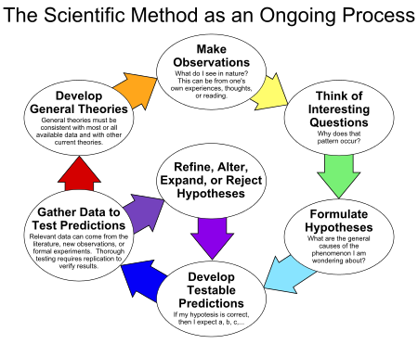
Data Science - using the Scientific Method
The scientific method is a body of techniques for:
investigating phenomena
acquiring new knowledge, or
correcting and integrating previous knowledge
To be termed scientific, a method of inquiry is commonly based on empirical or measurable evidence subject to specific principles of reasoning
−Wikipedia, Scientific Method

Slide 6
Applying methodology to Data Science
We need a data science methodology to provide us with a guiding strategy… regardless of particular technologies & approaches
Data science methodology presented in the diagram on the next slide
Bears similarities to recognized methodologies for data mining, notably CRISP-DM*.
Updated for new considerations in data science
Cross Industry Standard Process for Data Mining
In the next few slides, we will look at a number of different representations of the Data Science methodology process

Slide 7
Diagrams for Data Science Methodology
The goal of the next three slides is to show you some different representations of Data Science Methodology, aka Data Science Lifecycle
Note the steps and the iteration between the steps
We will then look at the specific skills needed for the Data Scientist
And, afterwards, compare the skills of the Data Scientist with those expected of the Business Analyst

Slide 8
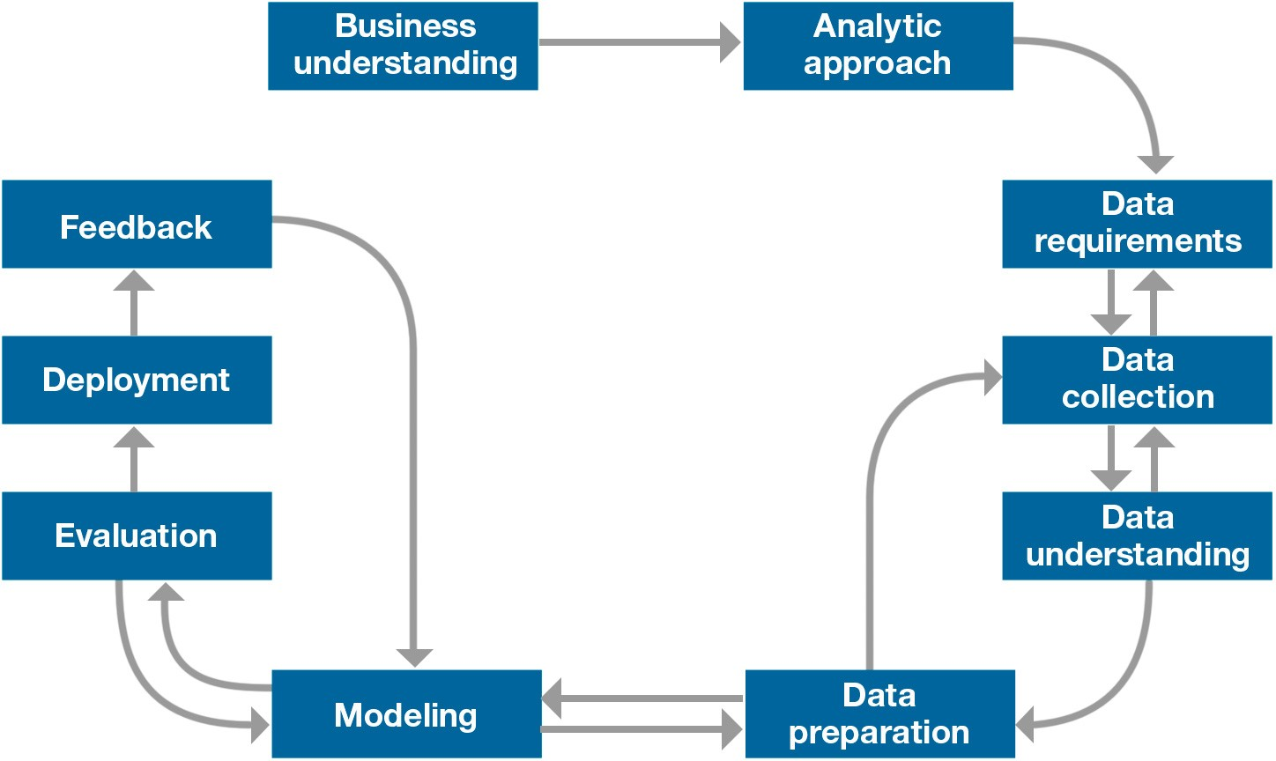
Data Science Methodology
Notes:
Here, we see that our data science methodology:
Begins with understanding the business problem (not with data).
Is highly iterative.
Does not “end.” As long as the business problem is relevant, we continue to refine the model (including data requirements and data preparation) based on feedback and then re-implement and refresh the model.
This is a general strategy for problem-solving:
It does not depend on particular technologies or tools.
It provides a “top-down” approach, but is conceptually consistent with “bottom- up” approach (i.e., we still need to understand data, prepare data, have an analytic approach, build a model, evaluate it, deploy it, and refine it).

Slide 9
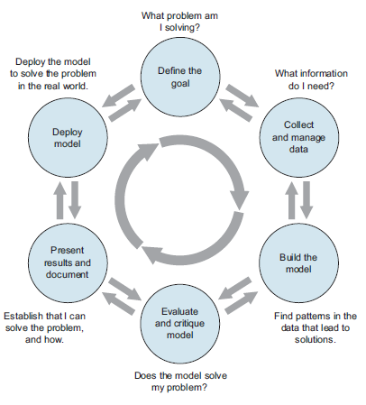
Data science project lifecycle
Another description of a data science project lifecycle:
“The lifecycle of a data science project: loops within loops”
Zumel, N., & Mount, J. Practical data science with R. Shelter Island, NY: Manning Publications, p. 7.

Slide 11
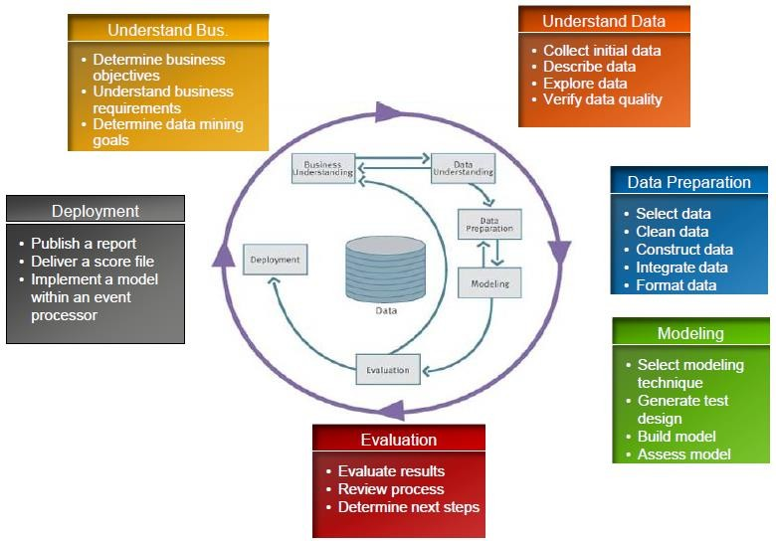
Analytics & the analytic life cycle

Slide 12
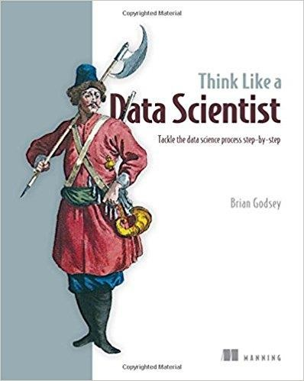
Systematic approach in Three Phases
Brian Godsey in Think Like a Data Scientist organizes a data science project into three phases:
The first phase is preparation-time and effort spent gathering information at the beginning of a project can spare big headaches later.
The second phase is building the product, from planning through execution, using what you learned during the preparation phase and all the tools that statistics and software can provide
The third and final phase is finishing- delivering the product, getting feedback, making revisions, supporting the product, and wrapping up the project

Slide 13
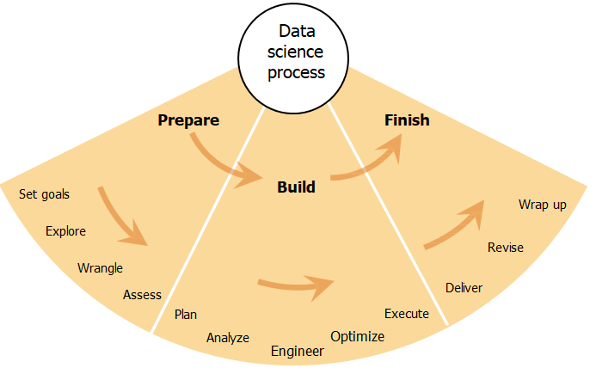
Godsey’s Three Phases in a diagram

Slide 14
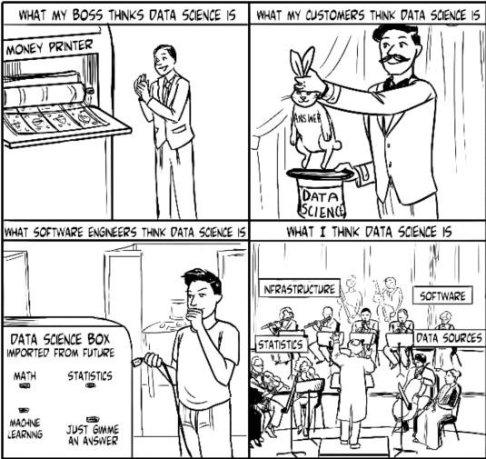
So then, what is Data Science?
Tools are only part of the picture -- Data Science is much more than the tools that are used
Data Science is a mode of thinking
And requires an orchestration of talents
Source:
Godsey, B. (2017). Think like a Data Scientist: Tackle the data science process step-by-step. Shelter Island, NY: Manning Publications, p. 4.

Slide 15
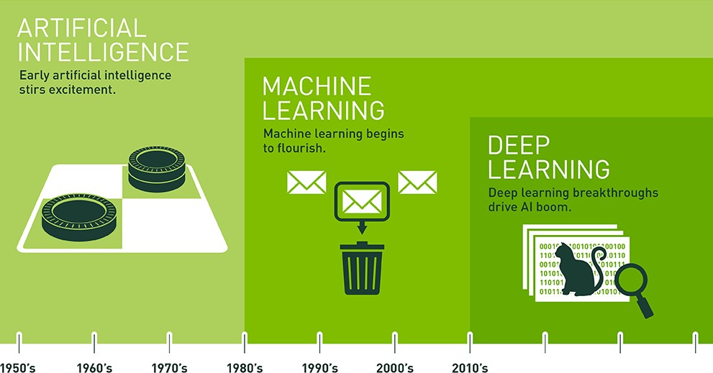
AI >> Machine Learning >> Deep Learning
Notes:
Since an early flush of optimism in the 1950s, smaller subsets of artificial intelligence - first machine learning, ten deep learning, a subset of machine learning - have created every larger disruptions.
Artificial intelligence is the future. Artificial intelligence is science fiction. Artificial intelligence is already part of our everyday lives. All those statements are true, it just depends on what flavor of AI you are referring to. The easiest way to think of their relationship is to visualize them as concentric circles with AI - the idea that came first - the largest, then machine learning - which blossomed later, and finally deep learning - which is driving today’s AI explosion - fitting inside both.
What’s the Difference Between Artificial Intelligence, Machine Learning, and Deep Learning?
https://opendatascience.com/blog/whats-difference-artificial-intelligence-machine- learning-deep-learning-ai/

Slide 16

The Work of the Data Scientist
Drew Conway’s Venn diagram
The Data Scientist’s Skill Set
Role of Business Analyst vs Data Scientist
Education
The Art of Data Science in 5 Steps

Slide 17
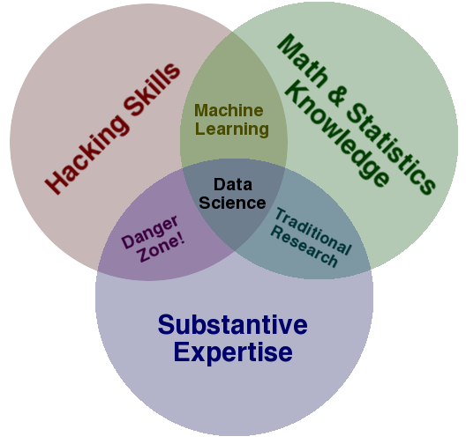
Drew Conway’s Venn diagram
Notes:
Source:
http://drewconway.com/zia/2013/3/26/the-data-science-venn-diagram
This diagram is the classic Drew Conway diagram that everyone talks about. It starts the discussion on the question of What is Data Science?
How to read the Data Science Venn Diagram:
http://drewconway.com/zia/2013/3/26/the-data-science-venn-diagram
http://www.dataists.com/2010/09/the-data-science-venn-diagram The “official” notes (by Conway himself):
The primary colors of data: hacking skills, math and stats knowledge, and
substantive expertise
Previously, we spent a lot of time talking about "where" a course on data science might exist at a university. The conversation was largely rhetorical, as everyone was well aware of the inherent interdisciplinary nature of these skills; but then, why have I highlighted these three? First, none is discipline specific, but more importantly, each of these skills are on their own very valuable, but when combined with only one other are at best simply not data science, or at worst downright dangerous.
For better or worse, data is a commodity traded electronically; therefore, in order to be in this market you need to speak hacker. This, however, does not require a background in computer science-in fact-many of the most impressive hackers I have met never took a single CS course. Being able to manipulate text files at the command-line, understanding vectorized operations, thinking algorithmically; these are the hacking skills that make for a successful data hacker.
Once you have acquired and cleaned the data, the next step is to actually extract insight from it. In order to do this, you need to apply appropriate math and statistics methods, which requires at least a baseline familiarity with these tools. This is not to say that a PhD in statistics in required to be a competent data scientist, but it does require knowing what an ordinary least squares regression (http://en.wikipedia.org/wiki/Ordinary_least_squares) is and how to interpret it.
In the third critical piece-substance-is where thoughts on data science diverge from most of what has already been written on the topic. Data plus math and statistics only gets you machine learning, which is great if that is what you are interested in, but not if you are doing data science. Science is about discovery and building knowledge, which requires some motivating questions about the world and hypotheses that can be brought to data and tested with statistical methods. On the flip-side, substantive expertise plus math and statistics knowledge is where most traditional researcher falls. Doctoral level researchers spend most of their time acquiring expertise in these areas, but very little time learning about technology. Part of this is the culture of academia, which does not reward researchers for understanding technology. That said, there are many young academics and graduate students that are eager to bucking that tradition.
Finally, a word on the hacking skills plus substantive expertise danger zone. This is where people can be placed who, "know enough to be dangerous," and is the most problematic area of the diagram. In this area people who are perfectly capable of extracting and structuring data, likely related to a field they know quite a bit about, and probably even know enough R to run a linear regression and report the coefficients; but they lack any understanding of what those coefficients mean. It is from this part of the diagram that the phrase "lies, damned lies, and statistics" emanates, because either through ignorance or malice this overlap of skills gives people the ability to create what appears to be a legitimate analysis without any understanding of how they got there or what they have created. Fortunately, it requires near willful ignorance to acquire hacking skills and substantive expertise without also learning some math and statistics along the way. As such, the danger zone is sparsely populated, however, it does not take many to produce a lot of damage
Hopefully this brief illustration has provided some clarity into what data science is and what it takes to get there. By considering these questions at a high level it prevents the discussion from degrading into minutia, such as specific tools or platforms, which I think hurts the conversation.

Slide 18
Drew Conway’s Venn diagram (adapted)
The center is marked "Unicorn“ - real Data Scientists can be as hard to find as unicorns.
A team of people with complimentary skills is the course of action for most data driven organizations.
Some individuals might posses Computer Science, Statistics, and Subject Matter Expertise. They are just very hard to find.
Notes:
There have been a number of attempts to get our collective brains around all the skill sets needed to effectively do Data Science.
Here are two...
http://drewconway.com/zia/2013/3/26/the-data-science-venn-diagram
http://upload.wikimedia.org/wikipedia/commons/4/44/DataScienceDisciplines.png
Below is a position on the subject.
The center is marked "Unicorn." This a reference to the discussions in the press and blogosphere indicating that Data Scientists are as hard to find as unicorns. Finally the mindset is changing that a team of people with complimentary skills is the course of action for most data driven organizations. Certainly some individuals might possess Computer Science, Statistics and Subject Matter Expertise. They are just very hard to find. Many Data Scientist job descriptions don't reflect this reality and so these positions go unfilled for six months or more.
This is an Adaptation of the original Data Science Venn Diagram which is licensed under Creative Commons Attribution-NonCommercial.
Source: http://www.anlytcs.com/2014/01/data-science-venn-diagram-v20.html

Slide 19
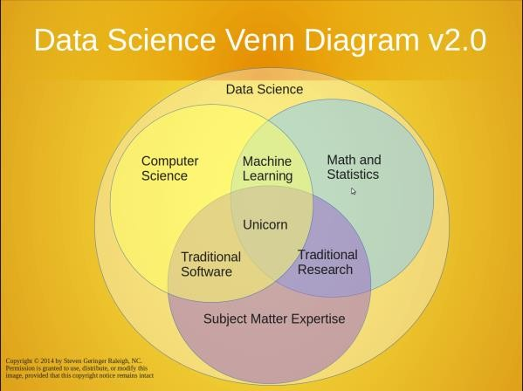

Slide 20
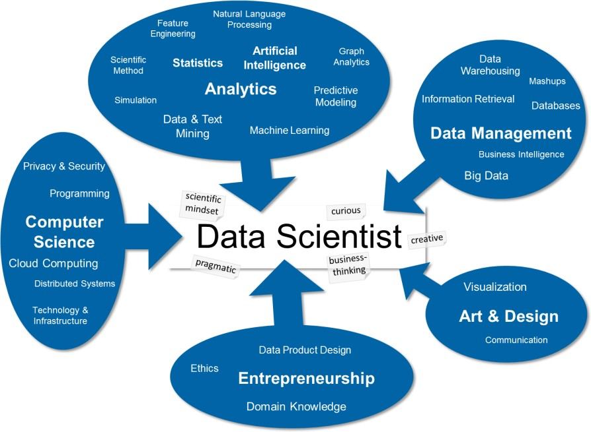
The data science skill set
Notes:
For us, it is a very useful (and used) tool to explain what data science is and what we can do:
First, it shows the different high-level skills a data scientist should master. This unveils the intrinsic interdisciplinarity of data science (I usually say that an actual data scientist should comprise approximately 80% of these skills, scattered over all 5 blue bubbles). These skills can be trained, usually by earning a degree in one of the top 3 bubbles (with a focus on quantitative analytics) and getting skills in the other bubbles by interdisciplinary work and/or advanced training.
Second, it shows character traits of a data scientist as grey labels attached to the center of the map. These attitudes are hard to train, but reveal the mindset of a data scientist.
Third, the history of the field shows up on the map: all the skills have been developed in disciplines of their own right (like, e.g., statistics or artificial intelligence). Data science now is a unique blend of these skills (from analytics, engineering and communication) aiming at a specific goal: generating (corporate and/or societal) value from (all kinds of) data.
More Information on this skill set map and how we implement it within the Datalab can also be found in a paper “Applied Data Science in Europe.”
This diagram and the accompanying text were posted by Thilo Stadelmann in a blog at https://blog.zhaw.ch/datascience/the-data-science-skill-set

Slide 21
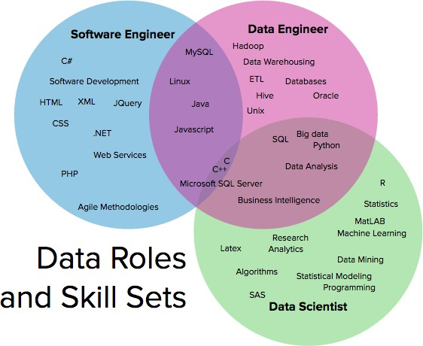
Data Roles & Skill Sets
Notes:
Data Roles & Skill Sets
Reference:
http://101.datascience.community/2016/11/28/data-scientists-data-engineers- software-engineers-the-difference-according-to-linkedin/
Software Engineer
A software engineer builds applications and systems. Developers will be involved through all stages of this process from design, to writing code, to testing and review. They are creating the products that create the data. Software engineering is the oldest of these three roles, and has established methodologies and tool sets.
Work includes:
Frontend and backend development
Web apps
Mobile apps
Operating system development
Software design
Data Engineer
A data engineer builds systems that consolidate, store, and retrieve data from the various applications and systems created by software engineers. Data engineering emerged as a niche skill set within software engineering. 40% of all data engineers were previously working as a software engineer (https://www.stitchdata.com/resources/
reports/the-state-of-data-engineering), making this the most common career path for data engineers by far.
Work includes:
Advanced data structures
Distributed computing
Concurrent programming
Knowledge of new & emerging tools: Hadoop, Spark, Kafka, Hive, etc.
Building ETL/data pipelines
Data Scientist
A data scientist builds analysis on top of data. This may come in the form of a one-off analysis for a team trying to better understand customer behavior, or a machine learning algorithm that is then implemented into the code base by software engineers and data engineers.
Work includes:
Data modeling
Machine learning
Algorithms
Business Intelligence dashboards
Evolving Data Teams
These roles are still evolving. The process of ETL is getting much easier overall as new tools (like Stitch - https://www.stitchdata.com/) enter the market, making it easy for software developers to set up and maintain data pipelines. Larger companies are pulling data engineers off the software engineering team entirely in lieu of forming a centralized data team where infrastructure and analysis sit together. In some scenarios data scientists are responsible for both data consolidation and analysis (http://multithreaded.stitchfix.com/blog/2016/03/16/engineers-shouldnt-write-etl/)
At this point, there is no single dominant path. But we expect this rapid evolution to continue, after all, data certainly isn’t getting any smaller.

Slide 22
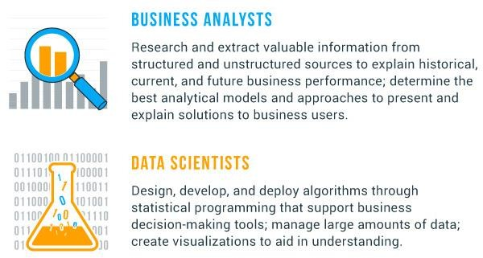
Business Analysts vs Data Scientists
Who are they?

Slide 23
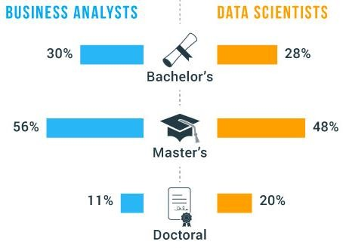
What type of education do Data Scientists have?
The majority of business analysts come from a variety of backgrounds including business and humanities, while data scientists tend to come from computer science, mathematics, and technology backgrounds
Sample Undergraduate Majors
BUSINESS ANALYST Business Administration Information Technology Finance Political science Anthropology Economics History Psychology | DATA SCIENTISTS Mathematics Computer Science Information Science Computer Software Engineering Technical Communications Computer Information Systems Statistics

Slide 24

The art of Data Science in 5 steps
Get passionate about Big Data
Embrace hands-on learning
Learn the language and communicate your insights
Learn from people in the
industry
Keep challenging yourself
“As you set out to learn this field and become a data scientist, you’ll find that entering an emerging field is both exciting and overwhelming. As you come across challenges and obstacles, and as the definition of data science seems to change depending on whom you’re reading or listening to, the whole endeavor can seem intimidating enough to want to quit. If you’re passionate about data and what you can do with it, though, you’ll have motivation to keep going.”
Notes:
From an article on LinkedIn pulse: https://www.linkedin.com/pulse/learn-art-data- science-five-steps-ronald-van-loon
“The field of data science is one of the youngest and most exciting fields in the technology sector. In no other industry or field can you combine statistics, data analysis, research, and marketing to do jobs that help businesses make the digital transformation and come to full digital maturity.

Slide 25
Important things to know about Data Science
Handy list of 50 quotes from some of the leading minds in the field
http://www.datasciencecentral.com/profiles/blogs/50-important-things-you-need-to-know-about-data-science-1
Do data science because you love data
Weaker motivations won’t sustain you in the long run.
Learn data science by doing it - and then by doing it some more
The word “possessed” rings true here. Longer versions of these quotes reveal a common denominator in these influencers’ schedules: they spent, and continue to spend, a lot of time practicing their craft.
Don’t forget the importance of theory amid all that practice
Don’t expect to learn data science overnight
Or even over several nights. It’s a lifelong learning curve, especially as the field evolves so quickly.
Communicate
Learn how to tell a meaningful, understandable story with the insights you draw from your data. This is critical in just about any application of data science.
Notes:
Note that these are action verbs: do, learn, understand the importance of theory,
have patience in learning, and communicate.

Slide 26

Now down to the practical steps in the process
We will look at the steps in more detail
And introduce the notion of a Data Science Notebook

Slide 27
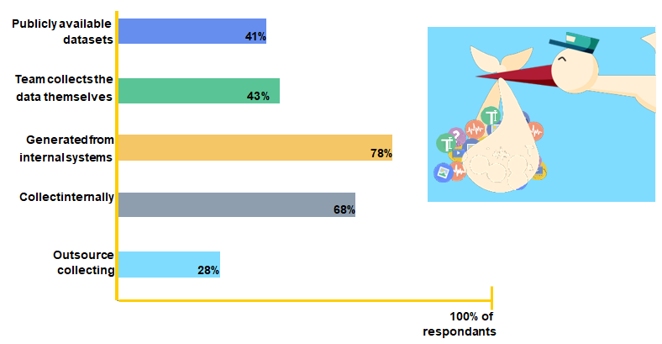
Mommy, where does data come from?
Notes:
While the majority of data scientists utilize data generated from internal systems (78%), over half of them get data from at least 3 different sources including manual internal collection, publicly available datasets, and outsourcing.
Finally, while 48% list collecting data as one of their 3 least favorite tasks, 43% of data scientists are doing just that - collecting data themselves.
While there’s no shortage of data, access to quality data is definitely an issue. Specifically when it comes to AI projects,
51% of respondents listed issues related to quality data ("getting good training data" or "improving the quality of your training dataset") as the biggest bottleneck to successfully completing projects.
Reference:
For this year’s survey, CrowdFlower surveyed 179 data scientists globally representing a balance of company ranging in size from <100 to 10,000+. A variety of industries were represented as well, with a slightly weighted emphasis on ‘technology’ - representing 40% of respondents. The survey was conducted in February and March of 2017.
https://visit.crowdflower.com/rs/416-ZBE- 142/images/CrowdFlower_DataScienceReport.pdf

Slide 28
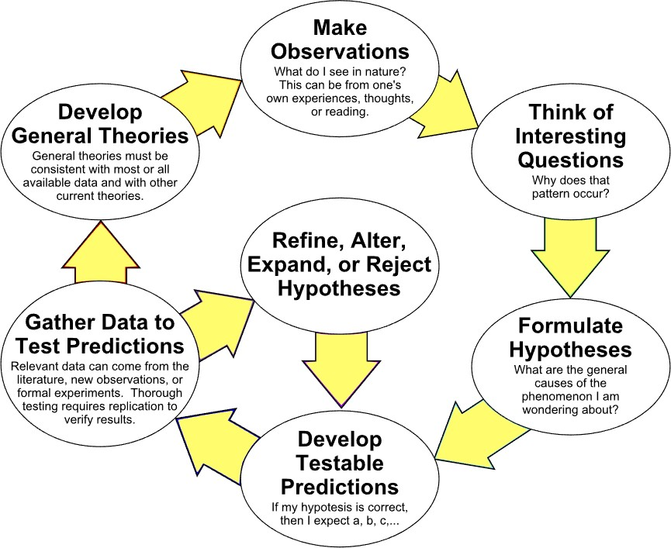
The scientific method - Generic
An ongoing & iterative process
Notes:
By ArchonMagnus (Own work) [CC BY-SA 4.0 (http://creativecommons.org/licenses/by- sa/4.0)], via Wikimedia Commons
Generally speaking, both traditional scientists and data scientists ask questions and/or define a problem, collect and leverage data to come up with answers or solutions, test the solution to see if the problem is solved, and iterate as needed to improve on, or finalize the solution.

Slide 29
Data Notebooks: Tools for data scientists
Interactive notebooks are experiencing a rise in popularity
Traditionally, notebooks have been used to document research and make results reproducible, simply by re-running the notebook on source data.
Notebooks are typically used by data scientists for quick exploration tasks. In that regard they offer a number of advantages over any local scripts or tools. When properly set up by the organization, a notebook offers direct connections to all necessary sources of data, without additional effort on the part of the user
The major notebooks currently used by Data Scientists are:
Jupyter - based on the IPython notebook - and named after 3 of the 60 or so language-kernels now available for it: Julia, Python, and R
Apache Zeppelin - distributed with ODPi - emphasized by Hortonworks
Jupyter notebook within the IBM’s Watson Studio (formerly DSX) platform.
- proprietary, with a free trial available
Knitr - affiliated with Foundation for Open Access Statistics (FOAS) - for R
Notes:
Data science is inherently an exploratory and creative process because there is usually neither a definitive answer to the problem at hand nor a well-defined approach to reaching one. Data scientists research problems, explore data, visualize patterns across data and use their experience and judgment to choose parameters and processes that may be relevant to the specific problem at hand. This makes sharing and collaboration a critical activity that enables teams of data scientists to build on each other’s knowledge and to produce the overall best results.
As data science has evolved over time with big data, new techniques and technologies have emerged. This change is reflected in the background and training of the data scientists across organizations.
References:
What is a Data Science Workbench and Why Do Data Scientists Need One? (August 17, 2017)
https://hortonworks.com/blog/data-science-workbench-data-scientists-need-one/
The Rise of Data Science Notebooks
https://www.datanami.com/2016/05/04/rise-data-science-notebooks/

Slide 30
The Data Science Pipeline - Summarization
The five key steps in Data Analysis:
Acquisition: Acquire data from a variety of sources, including RDBMS systems,
NoSQL and document store, webscraping, Data Lakes, HDFS, etc.
Exploration & Understanding: Understanding the data that you will use and how it was collected, often requiring significant exploration
Munging, Wrangling, & Manipulation: Single most time-consuming and
important step in the pipeline - data is rarely in the needed form for analysis
Analysis & Modeling: The fun part where the data scientist explores the statistical relationship between the variables in the data and uses a bag of machine learning tricks to cluster, categoralize, classify Predictive Models
Communicate & Operationalize: Give the data back in a compelling form and structure - one-off report, scalable web product, interactive data, …

Slide 31
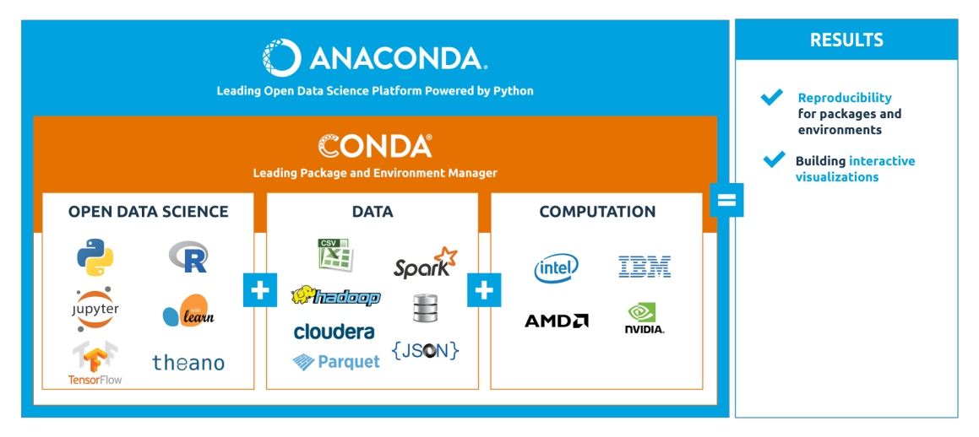
We will use the Anaconda distribution of Python

Slide 32
If your Python 3 is weak? …and new to Jupyter?
Rather than just reading about what happens when you type some Python, try out the commands for yourself
You should have Python 3 running as you read, try out every snippet of code, and observe what the language does to respond
Reading about a computer language won’t teach you the language. You can teach yourself the language by working through all the examples and lab exercises, and then using what you’ve learning on you own problems later.
Ask yourself: “What would happen if … ?”, “How can I accomplish that?” Just try things! And this process is not only more fun than passively accumulating facts - and it is fr more effective.
Make mistakes! - not necessarily deliberately - as each mistake provide the opportunity to learn something new.
Good practice: keep a log! That is what any scientist does, and as we are new data scientists, our log is Jupyter Notebook.

Slide 33
Getting started with Jupyter
Use Anaconda 5 to install Jupyter on your computer from Anaconda
Windows, MacOS, & Linux versions at https://www.anaconda.com/download/
Install Python 3.6 (or later) version 64-bit
The open source version of Anaconda is a high performance distribution of Python and R and includes over 100 of the most popular Python, R, and Scala packages for data science
Additionally, you'll have access to over 720 packages that can easily be installed with conda, the renowned package, dependency, and environment manager, that is included in Anaconda - from Continuum Analytics
Start using Jupyter
Quick start: https://jupyter-notebook-beginner-guide.readthedocs.io/en/latest/
Tutorials: http://bebi103.caltech.edu.s3-website-us-east- 1.amazonaws.com/2015/tutorials.html
Other tutorials: http://www.kdnuggets.com/2016/04/top-10-ipython-nb-tutorials.html
Plus many YouTube videos

Slide 34
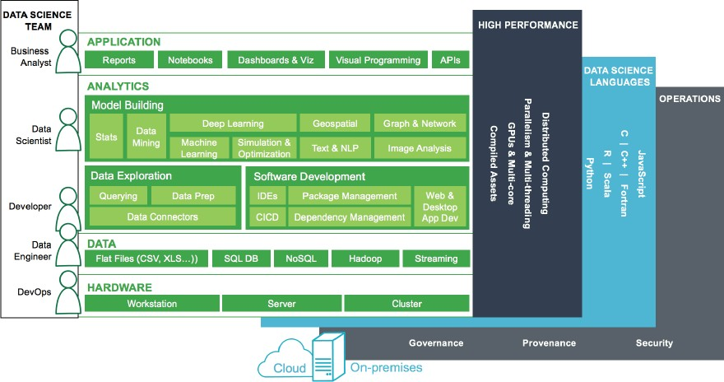
Data Science - according to Continuum Analytics
Notes:
https://know.anaconda.com/journey-to-ODS-whitepaper.html
Anaconda is software from Anaconda (formerly known as Continuum Analytics). This graphic is the final image in an 8 page whitepaper on Open Data Science (ODS), available at https://know.anaconda.com/journey-to-ODS-whitepaper.html
Anaconda is the leading modern open source analytics platform powered by Python. Anaconda enables modernization to Open Data Science as a platform that embraces the entire ODS ecosystem - Python, R, Java, Scala, Hadoop and more - across the entire modern analytics stack from desktop to server to clusters and cloud for enterprises. Anaconda makes it easy to:
Create, collaborate and deploy Data Science solutions
Leverage modern architectures and frameworks
Set up and manage open source

Slide 35
Python libraries for Data Analysis
Standard Python libraries useful for Data Analysis with Python are:
Pandas - for data munging and preparation
NumPy - abundance of useful features for operations on n-arrays and matrices in Python
SciPy - library of software for engineering and science
Matplotlib - tailored for the generation of simple and powerful visualizations
Statsmodels - data exploration by using methods of estimation of statistical models
scikit-learn - concise & consistent interface to the common ML algorithms
Seaborn - visualization of statistical models; based & highly dependent on Matplotlib
Bokeh - is aimed at interactive visualizations; independent of Matplotlib - main focus is interactivity, with presentation via modern browsers in the style of Data-Driven Documents
Plotly - web-based toolbox for building visualizations, exposing APIs to Python, etc.
Theano / TensorFlow / Keras
NLTK - Natural Language Toolkit - tasks of symbolic & statistical NL processing
Gensim / Scrapy

Slide 36
Pandas
Author: Wes McKinney
Book: Python for Data Analysis, 2nd ed. (O’Reilly: Sebastopol, October 2017)
10-minute tour of Pandas: https://vimeo.com/59324550
What problem does Pandas solve (from http://pandas.pydata.org):
Python has long been great for data munging and preparation, but less so for data analysis and modeling. pandas helps fill this gap, enabling you to carry out your entire data analysis workflow in Python without having to switch to a more domain specific language like R.
Combined with the excellent IPython toolkit and other libraries, the environment for doing data analysis in Python excels in performance, productivity, and the ability to collaborate.
pandas does not implement significant modeling functionality outside of linear and panel regression; for this, look to statsmodels and scikit-learn. More work is still needed to make Python a first class statistical modeling environment, but we are well on our way toward that goal.

Slide 37
The tools of statistics
The tools of statistics include:
Data collection: We will use data from a large national survey that was designed explicitly with the goal of generating statistically valid inferences about the U.S. population.
Descriptive statistics: We will generate statistics that summarize the data concisely, and evaluate different ways to visualize data.
Exploratory data analysis: We will look for patterns, differences, and other features that address the questions we are interested in. At the same time we will check for inconsistencies and identify limitations.
Estimation: We will use data from a sample to estimate characteristics of the general population.
Hypothesis testing: Where we see apparent effects, like a difference between two groups, we will evaluate whether the effect might have happened by chance.
By performing these steps with care to avoid pitfalls, we can reach conclusions that are more justifiable and more likely to be correct
Notes:
Pitfalls= pièges

Slide 38
Hardware & software for Data Science
Data Science algorithms are processing intensive
CPUs & multiple cores
GPUs (Graphics Processing Unit)
This is why you will hear discussion about GPUs from companies such as NVidia and AMD
Specialized algorithms, implemented with interfaces from Python and R, are state of the art
Google’s TensorFlow
Keras
Theano
…
Notes:
A few paragraphs on the hardware side from: Mueller, J. P., & Massaron, L. (2017).
Algorithms for dummies. Hoboken, NJ: Wiley.
General-purpose processors, CPUs, started out as a means to solve problems using algorithms. However, their general-purpose nature also means that a CPU can perform a great many other tasks, such as moving data around or interacting with external devices. A general-purpose processor does many things well, which means that it can perform the steps required to complete an algorithm, but not necessarily fast. In fact, owners of early general-purpose processors could add math coprocessors (special math-specific chips) to their systems to gain a speed advantage (see http://www.computerhope.com/jargon/m/mathcopr.htm for details).
Today, general-purpose processors have the math coprocessor embedded into them, so when you get an Intel i7 processor, you actually get multiple processors in a single package.
You may wonder why this section mentions Graphics Processing Units (GPUs). After all, GPUs are supposed to take data, manipulate it in a special way, and then display a pretty picture onscreen. Any computer hardware can serve more than one purpose. It turns out that GPUs are particularly adept at performing data transformations, which is a key task for solving algorithms in many cases. A GPU is a special-purpose processor, but one with capabilities that lend themselves to faster algorithm execution. It shouldn’t surprise you to discover that people who create algorithms spend a lot of time thinking outside the box, which means that they often see methods of solving issues in nontraditional approaches.
The point is that CPUs and GPUs form the most commonly used chips for performing algorithm-related tasks. The first performs general-purpose tasks quite well, and the second specializes in providing support for math-intensive tasks, especially those that involve data transformations. Using multiple cores makes parallel processing (performing more than one algorithmic step at a time) possible. Adding multiple chips increases the number of cores available. Having more cores adds speed, but a number of factors keeps the speed gain to a minimum. Using two i7 chips won’t produce double the speed of just one i7 chip.
A math coprocessor and a GPU are two examples of common special-purpose chips in that you don’t see them used to perform tasks such as booting the system. However, algorithms often require the use of uncommon special-purpose chips to solve problems.
… Spending a little time looking around can show you all sorts of interesting chips, such as the new artificial neurons that IBM is working on (see the story at http://www.computerworld.com/article/3103294/computer-processors/ibm-creates- artificial-neurons-from-phase-change-memory-for-cognitive-computing.html). Imagine
performing algorithmic processing using memory that simulates the human brain. It would create an interesting environment for performing tasks that might not otherwise be possible today.
Neural networks, a technology that is used to simulate human thought and make deep learning techniques possible for machine learning scenarios, are now benefitting from the use of specialized chips, such as the Tesla P100 from NVidia (see the story at https://www.technologyreview.com/s/601195/a-2-billion-chip-to-accelerate-artificial- intelligence/ for details). These kinds of chips not only perform algorithmic processing extremely fast, but learn as they perform the tasks, making them faster still with each iteration. Learning computers will eventually power robots that can move (after a fashion) on their own, akin to the robots seen in the movie I Robot (see one such robot described at http://www.cbsnews.com/news/this-creepy-robot-is-powered-by-a-neural- network/). There are also special chips that perform tasks such as visual recognition (see https://www.technologyreview.com/s/537211/a-better-way-to-build-brain-inspired- chips/ for details).

Slide 39
Notebooks & Workbenches for Data
Jupyter Notebook (formerly IPython)
Apache Zeppelin
BeakerX (Beaker Notebook)
IBM Watson Studio - a platform for data scientists
Databricks Unified Analytics Platform
Cloudera Data Science Workbench
MapR Data Science Refinery
Dataiku’s Data Science Studio
. . .

Slide 40
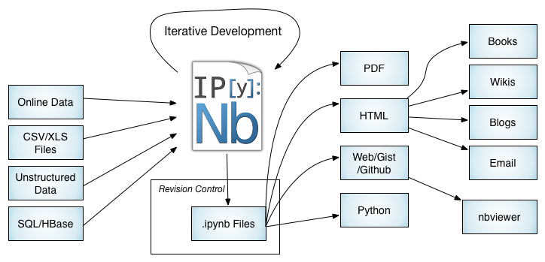
Jupyter Notebook (formerly IPython)

Slide 41
Apache Zeppelin - a short overview
Web-based notebook that enables data-driven, interactive data analytics and collaborative documents with SQL, Scala, and more - Supports over 20+ different interpreters - https://zeppelin.apache.org/
Pluggable visualization using the Helium framwork
Latest version (Apache Zeppelin 0.7) supports:
−Latest version of Apache Spark 2.1.0; Integrated Matplotlib with Python & Pyspark interpreter; Conda is available; can use Apache Beam, Scio, and Apache Pig as backend interpreters.
Usage:
Single User: Local Spark, 6 Built-in visualizations, display system, dynamic forms, multiple backends supported,
Multi-User: Has multi-user support w/ LDAP. Can be configured for a YARN cluster. Collaborative Mode is the default, but you can switch to a Personal Mode.
Interative demonstration: https://www.zepl.com/

Slide 42
IBM Watson Studio
IBM Watson Studio is an interactive, collaborative, cloud-based environment where data scientists can use multiple tools to activate their insights. Data scientists can work with a growing set of data science tools such as RStudio, Jupyter, Python, Scala, Spark, IBM Watson Machine Learning, and more
https://datascience.ibm.com/
https://developer.ibm.com/clouddataservices/docs/ibm-data-science- experience/
Watson Studio can be best described as a Platform

Slide 43
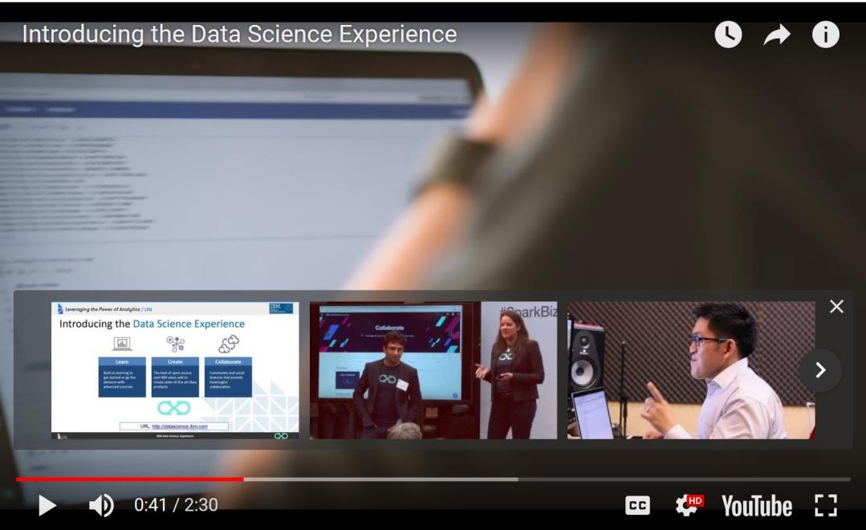
Demo: Introducing Watson Studio
Notes:
Play at full-screen the YouTube Video at: https://youtu.be/1HjzkLRdP5k
Watch this short video as an introduction to Watson Studio as part of the Watson Data Platform.
Other videos on the IBM Watson Studio are available at:
https://developer.ibm.com/clouddataservices/docs/ibm-data-science-experience/ Resources at this location include:
Get Started
Load and Analyze Public Data Sets
Manage Object Storage
Work with Data Connections
Collaborate on Projects
Publish Notebooks to GitHub
Notebooks
Use the Machine Learning Library
Build SQL Queries
Build a Custom Library for Apache Spark
Introduction to Decision Tree Learning
Introduction to Machine Learning: Predict Cancer Diagnosis
Introduction to Natural Language Processing (NLP)
Community Notebook: Precipitation Analysis
Community Notebook: NY Motor Vehicle Accidents Analysis
Community Notebook: Use Spark R to Load and Analyze Data
Integrate
Analyze Data Using RStudio
Load Db2 Warehouse on Cloud Data with Apache Spark
Use the SQL-Cloudant Connector in Scala Notebook
Use the SQL-Cloudant Connector in Python Notebook
Use GraphFrames
Sentiment Analysis of Twitter Hashtags Using Spark Streaming
Sentiment Analysis of Reddit AMAs
Reddit sentiment analysis in SparkR and CouchDB
R in Jupyter Notebooks

Slide 44
Working with Data Science in the Cloud
White Paper by Hortonworks, Power Data Science with Apache Spark in the Cloud: http://info.hortonworks.com/rs/549-QAL-086/images/hwx-spark-in-the- cloud.pdf
Key uses cases to illustrate the role that Apache Hadoop, Apache Spark and Apache Zeppelin technologies in the daily work of the data scientists
Why do data science with Apache Spark and Apache Zeppelin
How to best take advantage of solving data science problems with the cloud
Features:
Designed for AWS: Optimized for and integrated with AWS services such as EC2, S3, RDS
Focus on your data: Ease of use for developers and data scientists - Zeppelin notebook integrated with Spark & Hive
Interoperable HDP services: no rework or recoding from on premises to cloud
Enterprise ready: simple, flexible, efficient, secure
Visit: https://hortonworks.com/products/cloud/aws/

Slide 45
Checkpoint
What are the generic stages in using the scientific method?
What are the 5 major steps in the Data Analytics cycle? Which one typically take the most time?
What are the most important computer languages for Data Analytics?
Why are Graphical Processing Units (GPUs) important for Data Analytics?
How does Jupyter store its workbooks?

Slide 46
Unit summary
Have a better understanding of methodology “scientific approach” methods used & skills practiced by Data Scientists
Recognize the iterative nature of a data science project
Outline the benefits of using Data Science Notebooks
Describe the mechanisms and tools used with Data Science Notebooks
Compare and contrast the major Notebooks used by Data Scientists

