Slide 1
Data Science with Open Source Tools

Slide 2
Unit objectives
Getting started with Jupyter Notebook
Data and notebooks in Jupyter
How notebooks help data scientists
Essential packages: NumPy, SciPy, Pandas, scikit-learn, NLTK, BeautifulSoup, …
Data visualizations: matplotlib, …, PixieDust
Using Jupyter “Magic” commands

Slide 3


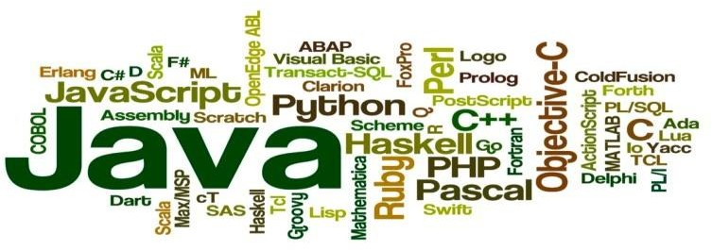
Supported languages
Jupyter: Python, R, Julia, and dozens of community maintained kernels.
Zeppelin: Various languages supports are included in the binary package: Spark, Python, JDBC, JDBC, etc. Third-party interpreters are available through an online registry.

Slide 4
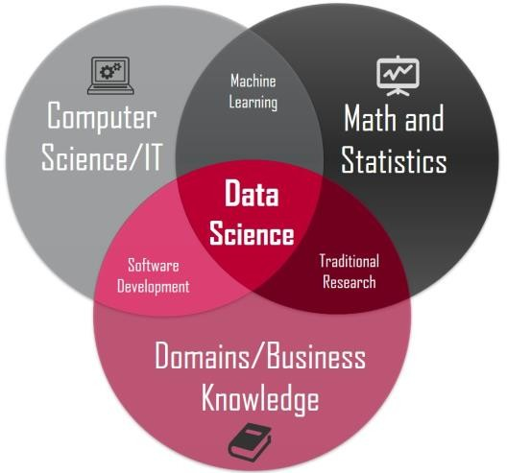
Data Science readiness
Jupyter: Widely used by data scientists for a variety of tasks including quick exploration, documentation of findings, reproducibility, teaching, and presentations
Zeppelin: Data scientists can collaborate with each other. Als business users can login and collaborate with data scientists directly on notebooks
Notes:
Excellent comparison of Jupyter and Zeppelin by the Open Data Platform Initiative (ODPi) at the Linux Foundation:
Data Science Notebook Guidelines http://go.linuxfoundation.org/datasciencenotebookguidelines
ODPi Webinar on How BI and Data Science Gets Results https://www.odpi.org/tag/data-science
Multi-user support:
Jupyter: Native Jupyter does not support multi-user. However, JupyterHub can be used to serve notebooks to users working in separate sessions.
Zeppelin: Multiple users can collaborate in real-time on a notebook. Multiple users can work with multiple languages in the same notebook.
Architecture:
Jupyter: The notebook server sends code to language kernels, renders in a browser, and stores code/output/Markdown in JSON files.
Zeppelin: Zeppelin server daemon manages multiple interpreters (backend integrations). Web application communicates to server using web socket for real-time communication.
BigData Ecosystem:
Jupyter: Can be connected to a variety of big data execution engines and frameworks: Spark, massively parallel processing (MPP) databases, Hadoop, etc.
Zeppelin: Tightly integrated with Apache Spark and other big data processing engines.
Security:
Jupyter: Code executed in the notebook is trusted, like any other Python program. Token-based authentication on by default. Root use disabled by default.
Zeppelin: User authentication (LDAP, AD integration) Notebook ACL. Interpreter ACL. SSL connection.
Support and Community:
Jupyter: Mature project with active community and good support. Jupyter project born in 2014 but has roots going back to iPython in 2001. Steering council of
~15 members from academia and commercial companies. Search https://stackoverflow.com/search?q=jupyter returns ~10,500 results
Zeppelin: Apache Zeppelin is one of the most active projects in Apache Software Foundation. Project born in 2013 and became a top level project of ASF in 2015

Slide 5

Jupyter works with 60+ language Kernels

Slide 6
Getting started with the Jupyter notebook
Project Jupyter was born out of the IPython project as the project evolved to become a notebook that could support multiple languages Hence the historical name as the IPython notebook
The name Jupyter is an indirect acronym of the three core languages it was designed for: JUlia, PYThon, and R - and is inspired by the planet Jupiter.
When working with Python in Jupyter, the IPython kernel is used, which gives us some handy access to IPython features from within our Jupyter notebooks
Jupyter, like IPython, can be hosted locally on your own notebook or on almost any server with ssh or http access
Projects & team work can be supported with JupyterHub and similar servers
You can write code in any of the supported languages, annotate the code with comments using markdown, and generate graphical output

Slide 7
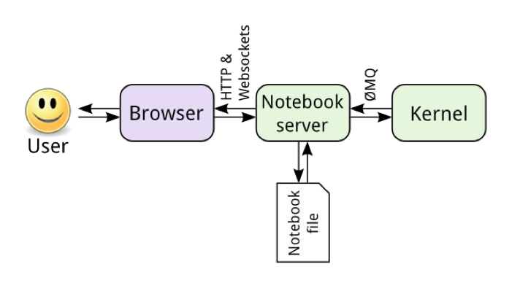
Architecture

Slide 8
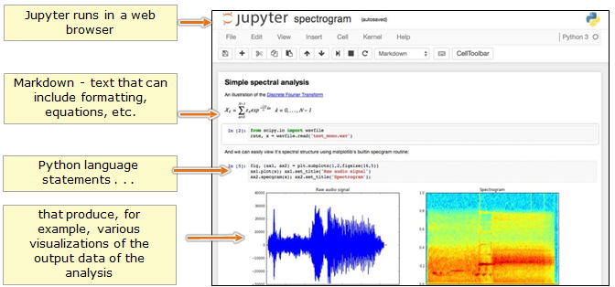
Example of Jupyter in action

Slide 9
How notebooks help a data scientist
Notebooks originated in packages such as Mathematica & Matlab
Traditionally, notebooks have been used to document research and make results reproducible, simply by rerunning the notebook on source data
Notebooks are typically used by data scientists for quick exploration tasks
When properly set up by the organization, a notebook offers direct connections to all necessary sources of data, without additional effort on the part of a future researcher
Setting up connections to the right data sources - whether traditional databases or NoSQL data stores, data lakes, and various object and blob stores, each requiring drivers, APIs, permissions, and credentials - is non- trivial, and hence documentation is essential
Notebooks can be shared and collaborated - and full documentation is typically built in through markdown language(s)
The end product of the research is available through output and visualization
Notes:
Data notebooks such as the Jupyter notebook take the place often of previous approached to presenting the end products of research that have been regularly presented through:
PowerPoint slides
Written reports
Notebooks also tend to be set up in a cluster environment, allowing the data scientist to take advantage of computational resources beyond what is available on her laptop, and operate on the full data set without having to downsample and download local copy.
Additional computational power also enables complex processing, even quick machine learning model training that would be intractable on a local machine.
References:
The Rise of Data Science Notebooks https://www.datanami.com/2016/05/04/rise-data-science-notebooks/
An example of what can be done with a shared notebook can be seen with a demo of Databricks notebook running Spark: https://www.youtube.com/watch?v=NR1MYg_7oSg

Slide 10
Why do we want to study & use Jupyter?
Jupyter is the prototypical Data Science Notebook
It is the basis for other Notebooks: e.g., IBM Watson Studio, Cloudera Data Science Workbench, etc.
Notebooks support Data Science using a scientific notebook approach
Jupyter is quite extensible, supports many programming languages, and is easily hosted on your computer or on almost any server - you only need to have ssh or http access
Supports Python 3 out of the box. Other languages are available by installing appropriate language kernels: e.g., Julia, R, Scala, Python 2, C++, Java, Kotlin, NodeJS, Haskel, etc.
And is, of course, Open Source and completely free
DS projects are often distributed in the form of .ipynb notebooks

Slide 11
Features of Data Science Notebooks
Supported languages for Data Science Notebooks
Jupyter, for instance, offers over 60 supported Kernels (Python, R, Julia, Scala, …)
Some notebooks are designed around a single language (e.g., R)
A Jupyter Notebook consists of a Sequence of Cells that are:
Code cells that hold code written in the current language of choice
Code is in one of the supported Computer Languages (our examples will use Python 3)
Code cells can include Magic statements (discussed soon)
Markdown cells for documenting the computational process in a literate way
Raw cells - used for output, including, optionally, graph visualization of output
Notes & documentation can be included, intermixed with language elements
Markdown language (.md suffix) - with some variations
Markdown can include LaTeX statements (for equations) and HTML5 statements
Notes:
A Jupyter notebook consists of a sequence of cells. A cell is a multiline text input field, and its contents can be executed by using Shift-Enter, or by clicking either the “Play” button the toolbar, or Cell | Run in the menu bar. The execution behavior of a cell is determined by the cell’s type. There are three types of cells: code cells, markdown cells, and raw cells. Every cell starts off being a code cell, but its type can be changed by using a drop-down on the toolbar (which will be “Code”, initially), or via Keyboard shortcuts.
For more information on the different things you can do in a notebook, see the following (running in an nbviewer): http://nbviewer.jupyter.org/github/jupyter/notebook/tree/master/docs/source/examples/N otebook/

Slide 12
Browser compatibility
Jupyter Notebook is officially supported by the latest stable versions of the following browsers:
Chrome
Safari
Firefox
This mainly due to the notebook’s usage of WebSockets and the flexible box model.
The following browsers are unsupported:
Safari < 5
Firefox < 6
Chrome < 13
Opera (any): CSS issues, but execution might work
Internet Explorer < 10
Internet Explorer ≥ 10 (same as Opera)
Using Safari with HTTPS and an untrusted certificate is known to not work (websockets will fail)

Slide 13
Jupyter keyboard-shortcuts
All actions in the notebook can be performed with the mouse, but keyboard shortcuts are also available for the most common ones. The essential shortcuts to remember are the following:
Shift-Enter € run cell - Execute the current cell, show output (if any), and jump to the next cell below. If Shift-Enter is invoked on the last cell, a new code cell will be created
Ctrl-Enter € run cell in-place - Execute the current cell as if it were in “terminal mode”, where any output is shown, but the cursor remains in the current cell. The cell’s entire contents are selected after execution, so you can just start typing and only the new input will be in the cell
Alt-Enter € run cell, insert below - Executes the current cell, shows the output, and inserts a new cell between the current cell and the cell below (if one exists)
Esc & Enter € Command mode & edit mode - In command mode, you navigate around the notebook using keyboard shortcuts. In edit mode, you can edit text in cells

Slide 14
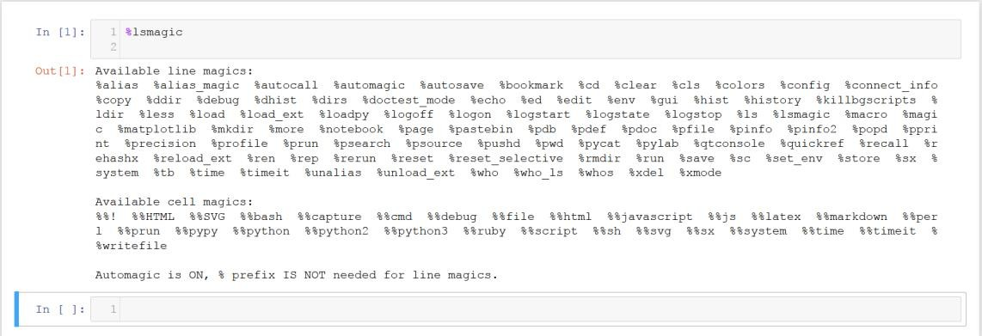
Jupyter magic commands / functions
Jupyter kernels support varying Magic commands that extend the core language with useful shortcuts - Magic commands start with %
%lsmagic (“list magic”) can be used to list all available Magic commands
Notes:
Working scientists and data crunchers familiar with reading and writing Python code will find this comprehensive desk reference ideal for tackling day-to-day issues: manipulating, transforming, and cleaning data; visualizing different types of data; and using data to build statistical or machine learning models. Quite simply, this is the must- have reference for scientific computing in Python.
With this handbook, you’ll learn how to use:
IPython and Jupyter: provide computational environments for data scientists using Python
NumPy: includes the ndarray for efficient storage and manipulation of dense data arrays in Python
Pandas: features the DataFrame for efficient storage and manipulation of labeled/columnar data in Python
Matplotlib: includes capabilities for a flexible range of data visualizations in Python
scikit-Learn: for efficient and clean Python implementations of the most important and established machine learning algorithms

Slide 15
Markdown
Markdown is a lightweight markup language with plain text formatting syntax. It is designed so that it can be converted to HTML and many other formats using a tool by the same name
There is no clearly defined Markdown standard, apart from the original writeup and implementation by John Gruber
From 2012, a group of people including Jeff Atwood launched what Atwood characterized as a standardization effort € CommonMark
Wikipedia has an excellent introduction: https://en.wikipedia.org/wiki/Markdown
There are some flavors of Markdown
Markdown Extra (https://en.wikipedia.org/wiki/Markdown#Markdown_Extra)
GitHub-Flavored Markdown Editor (https://jbt.github.io/markdown-editor/)
WordPress Markdown (https://en.support.wordpress.com/markdown-quick-reference/)

Slide 16
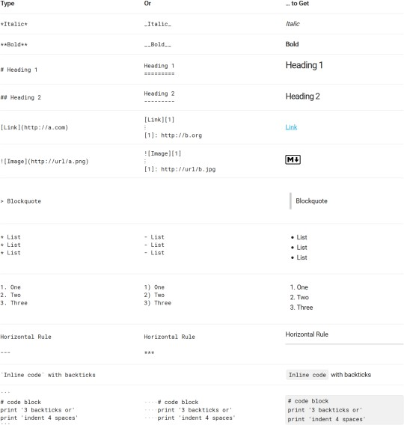
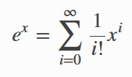
Example Markdown formatting
Basic (plain text) formatting shown on left from http://commonmark.org/help/
With MathJax, you can included mathematical expressions both inline e^{iπ}+1=0 and displayed
This is important to express the mathematical and statistical intent of the work in hand
To convert from Markdown to LaTeX, visit http://kesdev.com/you-got-latex-in- my-markdown/
Notes:
References:
Markdown for Jupyter notebooks Cheatsheet (from IBM Watson Data Platform) https://medium.com/ibm-data-science-experience/markdown-for-jupyter-notebooks- cheatsheet-386c05aeebed
http://commonmark.org/help/ http://jupyter-
notebook.readthedocs.io/en/stable/examples/Notebook/Working%20With%20Markdow n%20Cells.html
The examples with MathJax shown on the slide can be achieve in the following manner:
Inline expressions can be added by surrounding the latex code with $:
$e^{i\pi} + 1 = 0$
Expressions on their own line are surrounded by $$:
$$e^x=\sum_{i=0}^\infty \frac{1}{i!}x^i$$

Slide 17
Essential packages - for Python 3
NumPy
The most fundamental package, around which the scientific computation stack is built, is NumPy (stands for Numerical Python). It provides an abundance of useful features for operations on n-arrays and matrices in Python.
SciPy
SciPy is a library of software for engineering and science with modules for linear algebra, optimization, integration, and statistics. The main functionality of SciPy library is built upon NumPy, and its arrays thus make substantial use of NumPy.
Pandas
Pandas is a Python package designed to do work with “labeled” and “relational” data simple and intuitive. Pandas is a perfect tool for data wrangling. It designed for quick and easy data manipulation, aggregation, and visualization.

Slide 18
Essential packages - for Python 3 - continued
scikit-learn
Exposes a concise and consistent interface to the common machine learning algorithms, making it simple to bring ML into production systems. The library combines quality code and good documentation, ease of use and high performance and is a de-facto industry standard for machine learning with Python
NLTK
The Natural Language Toolkit is used for common tasks of symbolic and statistical NLP
Allows such as text tagging, classification, and tokenizing, name entities identification, building corpus tree that reveals inter and intra-sentence dependencies, stemming, and semantic reasoning.
All of the building blocks allow for building complex research systems for different tasks, for example, sentiment analytics, automatic summarization
And more …

Slide 19
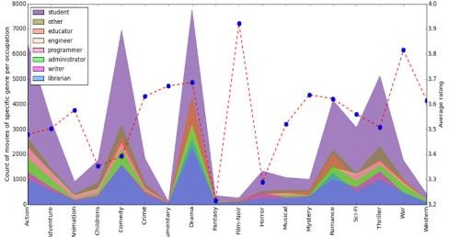
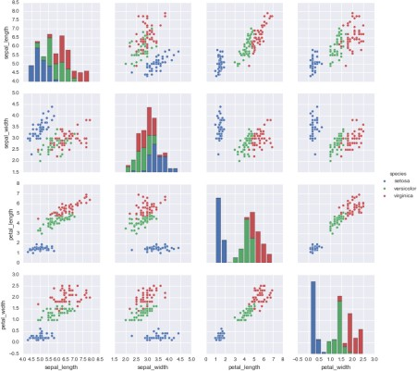
Essential packages - for Python 3 - visualization
Matplotlib
Top-notch piece of software which is making Python (with some help from NumPy, SciPy, and Pandas) a worthy and cognizant competitor to such scientific tools as MatLab or Mathematica
Line plots; Scatter plots; Bar charts and Histograms; Pie charts; Stem plots; Contour plots; Quiver plots; Spectrograms
Seaborn
Mostly focused on the visualization of statistical models; such visualizations include heat maps, those that summarize the data but still depict the overall distributions
Seaborn is based on Matplotlib and highly dependent on that package

Slide 20
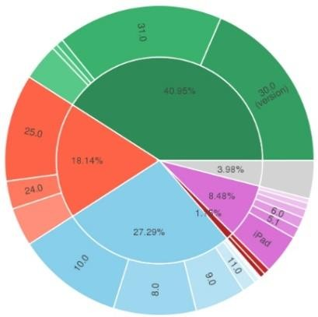
Essential packages - for Python 3 - visualization 2
Bokeh (pronounced as /ˈboʊkə/ BOH-kə)
Aimed at interactive visualizations
In contrast, this one is independent of Matplotlib
The main focus of Bokeh is interactivity and it makes its presentationvia modern browsers in the style of Data-Driven Documents (d3.js)
Plotly
Mostly focused on the visualization of statistical models; such visualizations include heat maps, those that summarize the data but still depict the overall distributions
Plotly provides online graphing, analytics, and statistics tools for individuals and collaboration, as well as scientific graphing libraries for Python, R, MATLAB, Perl, Julia, Arduino, and REST

Slide 21

Essential packages - for Python 3 - HTML
Data mining of websites with Python and BeautifulSoup - aka web scraping
BeautifulSoup v4
Python package for parsing HTML and XML documents
Creates a parse tree from webpages that can be used to extract data from HTML
Provides a scalable way to collect, organize, and analyze information from the Internet

Slide 22
Installing Jupyter
If Jupyter is not already installed, it is installed best using Anaconda 5 using:
Anaconda 5.0.1 for Linux 64-bit with Python 3.6 (Anaconda3-5.0.1-Linux- x86_64.sh) from https://www.anaconda.com/download/#linux
Anaconda Distribution Starter Guide http://know.anaconda.com/rs/387-XNW-688/images/2017- 08_Anaconda_Starter_Guide_CheatSheet_Web.pdf
Distributions of Jupyter are available from Anaconda.com for:
Windows 64-bit & 32-bit
MacOS 64-bit
Linux 64-bit (x86 & Power8) & 32-bit
In each case with Python 3.6 or Python 2.7 - and earlier
With BSD licensing and thus permission to use commercially and for redistribution
Free Community support or paid Enterprise support
Notes:
Project Jupyter: http://jupyter.org/ “Project Jupyter exists to develop open-source software, open-standards, and services for interactive computing across dozens of programming languages.”
Jupyter is best run as a web application.
You can also run the command line version QtConsole or use the Spyder IDE (Integrated Development Environment). When you install Anaconda 5, you get the local web-based browser version as well as QtConsolt and Spyder. The QtConsole can use any Jupyter kernel.
References:
The Qt Console for Jupyter - Jupyter Qt Console 4.3.1 documentation https://qtconsole.readthedocs.io/
Demonstration of the Jupyter QtConsole + Vim integration - YouTube https://www.youtube.com/watch?v=Fi_Xd6h4ncw
Integrating Vim and jupyter-qtconsole https://blogs.aalto.fi/marijn/tag/jupyter-qtconsole/

Slide 23
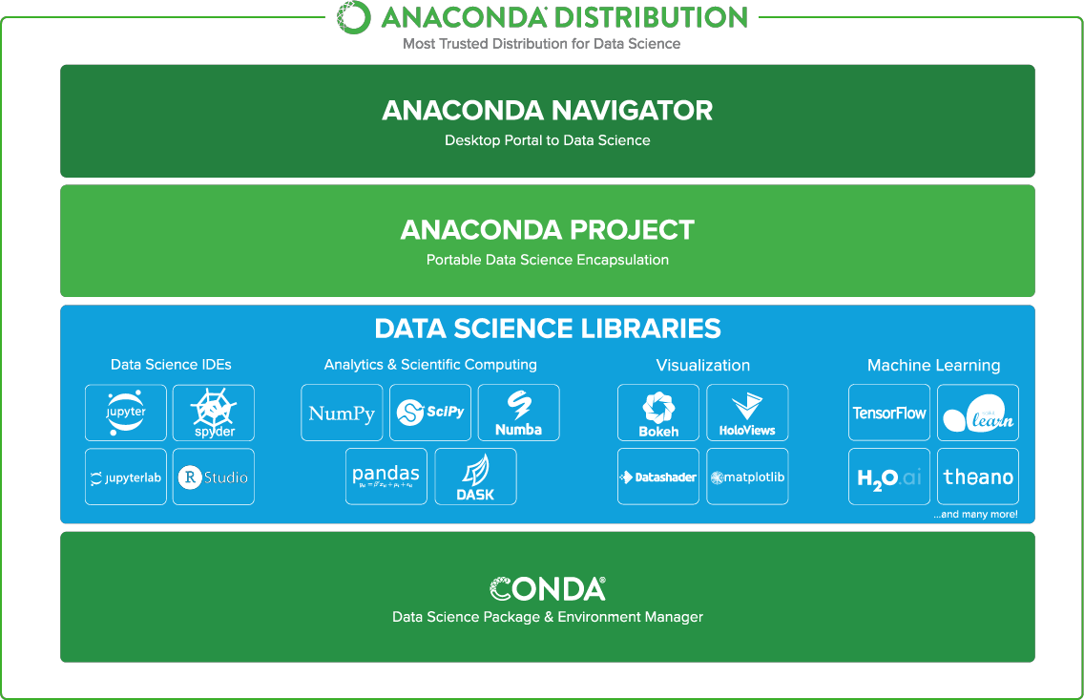
Architecture of Anaconda 5 with Jupyter Notebook
Notes:
Even though Python 2.7 distributions are available, you should note that Python 2.x will be no longer supported after 2020 (extended from 2015). All packages from Python 2.x are now available with Python 3.

Slide 24
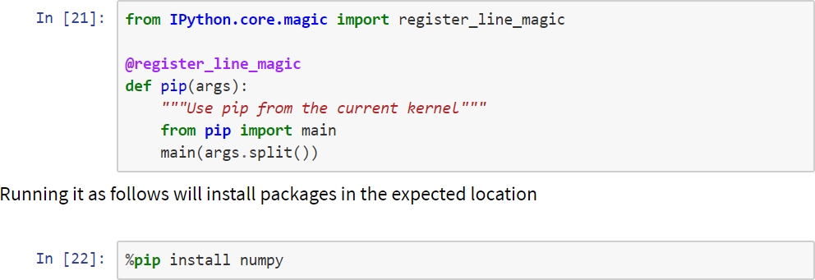
Jupyter magic for installing Python packages
How can I install a Python package so that it works with my Python notebook, using pip and/or conda ?
Fundamentally the problem is usually rooted in the fact that the Jupyter kernels are disconnected from Jupyter's shell; in other words, the installer points to a different Python version than is being used in the notebook
The solution requires you to define a %pip magic function (and/or a %conda magic function) that works in the current notebook kernel

Slide 25
Git / GitHub for version control and for distribution
Git is a version control system for tracking changes in computer files and coordinating work on those files among multiple people
Linus Torvalds wanted in 2005 a distributed system that he could use, but none of the available free systems met his needs, especially for performance
GitHub is a Web-based Git version control repository hosting service.
It is mostly used for computer code
It offers all of the distributed version control and source code management (SCM) functionality of Git as well as adding its own features
It provides access control and several collaboration features such as bug tracking, feature requests, task management, and wikis for every project
GitHub has become an effective public repository for a large number of Notebooks - introductory & advanced - on Data Science and other topics
Notes:
A Gallery of Interesting Jupyter Notebooks https://github.com/jupyter/jupyter/wiki/A-gallery-of-interesting-Jupyter-Notebooks
Entire books or other large collections of notebooks on a topic
Introductory Tutorials
Programming and Computer Science
Statistics, Machine Learning and Data Science
Mathematics, Physics, Chemistry, Biology
Earth Science and Geo-Spatial data
Linguistics and Text Mining
Signal Processing
Engineering Education
Scientific computing and data analysis with the SciPy Stack:
General topics in scientific computing
Social data
Psychology and Neuroscience
Machine Learning, Statistics and Probability
Physics, Chemistry and Biology
Economics and Finance
Earth science and geo-spatial data
Data visualization and plotting
Mathematics
Signal, Sound and Image Processing
Natural Language Processing
Pandas for data analysis
General Python Programming Notebooks in languages other than Python:
Julia
Haskell
Ruby
Perl
F#
C#
JavaScript
Miscellaneous topics about doing various things with the Notebook itself:
Reproducible academic publications
Other publications using Notebooks
Data-driven journalism

Slide 26
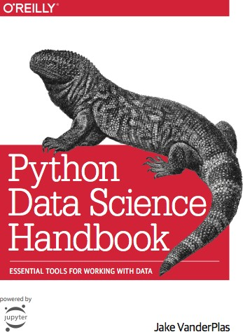
Python Data Science Handbook
The full text of the book Python Data Science Handbook is available for free on the website
https://jakevdp.github.io/PythonDataScienceHandbook/
- this content is available there as text pages and on GitHub as a set of Jupyter notebooks
Go to the author’s GitHub site at
https://github.com/jakevdp/PythonDataScienceHandbook and click on the green “clone or download”
to get the full set of Jupyter .ipynb files
(use download to get a zipfile with everything)
Once downloaded, any of the .ipynb files can then be uploaded locally into your Jupyter browser

Slide 27
Unit summary
Getting started with Jupyter Notebook
Data and notebooks in Jupyter
How notebooks help data scientists
Essential packages: NumPy, SciPy, Pandas, scikit-learn, NLTK, BeautifulSoup, …
Data visualizations: matplotlib, …, PixieDust
Using Jupyter “Magic” commands

