Slide 1
Using Big SQL to access data residing in the HDFS
Data Science Foundations

Slide 2
Unit objectives
Overview of Big SQL
Understand how Big SQL fits in the Hadoop architecture
Start and stop Big SQL using Ambari and command line
Connect to Big SQL using command line
Connect to Big SQL using IBM Data Server Manager

Slide 3
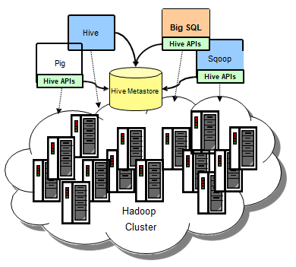
Big SQL is SQL on Hadoop
Big SQL builds on Apache Hive foundation
Integrates with the Hive metastore
Instead of MapReduce, uses powerful native C/C++ MPP engine
View on your data residing in the Hadoop FileSystem
No proprietary storage format
Modern SQL:2011 capabilities
Same SQL can be used on your warehouse data with little or no modifications
Notes:
Big SQL builds on an Apache Hive foundation. Hive consists of an execution engine, a storage model, and a metastore. This metastore tracks all the metadata about tables within Hadoop, and is used by multiple projects within the Hadoop ecosystem. Big SQL provides you with an alternate execution engine, which has many advantages when compared to Hive to accommodate a variety of workloads. Big SQL shines with high concurrency workloads, complex SQL, data virtualization, and more. Rather than using MapReduce (which Hive uses), Big SQL uses a powerful, native MPP engine, written in C/C++. Big SQL shares metadata with Hive using the same data on disk and same definition of tables within the metastore. A table in Hive can be seen in Big SQL and vice-versa.
Think of Big SQL as a logical view on top of your Hadoop data. The data resides in Hadoop and all you have to do is use Big SQL to access it. There is no need to change the format, or migrate the data out of Hadoop to do any work on the data. Big SQL supports modern SQL:2011 capabilities. So, when you migrate your data into Hadoop, the same SQL can be used on your warehouse data with little or no modification. That is one of the big benefits of Big SQL - no need to learn anything new, and can use your existing queries.
There are a number of tools available to work with data on Hadoop. Tools such as MapReduce, Pig, Hive, and many more. MapReduce, being one of the most common tools is highly scalable, but it is difficult to use. There are a lot of coding required for running batch jobs. There are other tools as well, but those all require a specific set of expertise. What Big SQL offers is a common and familiar query syntax that everybody understands.

Slide 4
SQL access for Hadoop: Why?
Data warehouse modernization is a leading Hadoop use case
Off-load "cold" warehouse data into query-ready Hadoop platform
Explore / transform / analyze / aggregate social media data, log records, etc. and upload summary data to warehouse
Limited availability of skills in MapReduce, Pig, etc.
SQL opens the data to a much wider audience
Familiar, widely known syntax
Common catalog for identifying data and structure
Notes:
Let's start with our motivation to build a new SQL engine for Hadoop...
Hadoop is very appealing to businesses needing to store large volumes of various types of data in a cost effective way. It's quite easy to store the data in a Hadoop cluster and scale out inexpensively. But it is very difficult to get value out of that information.
The expertise required to do traditional Hadoop programming is in short supply and is quite expensive. But the potential for Hadoop to extend the warehouse is so compelling that SQL access to Hadoop data has grown quite popular. Just think of it: you have a flexible platform like Hadoop, and you have an entire industry with SQL skills and extensive tools that are based on SQL. If Hadoop clusters can have that native SQL interface, this will rapidly speed up Hadoop's adoption, and make all sorts of analytics opportunities possible.

Slide 5
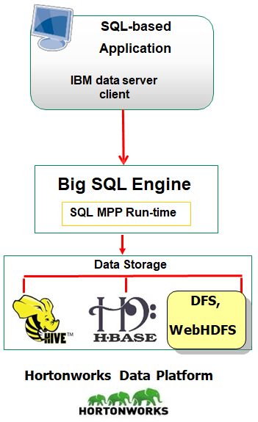
What does Big SQL provide?
Comprehensive, standard SQL
Optimization and performance
Support for variety of storage formats
Integration with RDBMSs
Notes:
Big SQL is a hybrid, high performance SQL engine for Hadoop, with support for a variety of data sources including HDFS, RDBMS, NoSQL databases, object stores and WebHDFS. Big SQL offers low latency queries, security, SQL compatibility, and federation capabilities, enabling organizations to derive value from enterprise data.

Slide 6
Big SQL provides comprehensive, standard SQL
SELECT: joins, unions, aggregates, subqueries . . .
UPDATE/DELETE (HBase-managed tables)
GRANT/REVOKE, INSERT … INTO
SQL procedural logic (SQL PL)
Stored procedures, user-defined functions
IBM data server JDBC and ODBC drivers
Notes:
Big SQL is designed to provide SQL developers with an easy on-ramp for querying data managed by Hadoop. Most of the SQL you use with your RDBMs can be easily used with Big SQL. In addition, a LOAD command enables administrators to populate Big SQL tables with data from various sources. Also, Big SQL's JDBC and ODBC drivers enable many existing tools to use Big SQL to query this distributed data.

Slide 7
Big SQL provides powerful optimization and performance
IBM MPP (massively parallel processing) engine (native C++) replaces Java MapReduce layer
Continuous running daemons (no start up latency)
Message passing allow data to flow between nodes without persisting intermediate results
In-memory operations with ability to spill to disk (useful for aggregations, sorts that exceed available RAM)
Cost-based query optimization with 140+ rewrite rules
Notes:
Big SQL is designed for performance. Big SQL's runtime execution engine is all native code (C/C++). It replaces MapReduce using a modern, massively parallel processing or MPP architecture. The compiler and runtime are written in native code, C/C++, so it is much faster. The SQL engine pushes down the processing to the same node the holds the data so all the processing happens locally at the data. There is also no startup latency - the daemons are continuously running. The operations occur in memory and if necessary, it can spill over to disk for processing. This allows for support of aggregations and sorts larger than available RAM.

Slide 8
Big SQL supports a variety of storage formats
Text (delimited), Sequence, RCFile, ORC, Avro, Parquet
Data persisted in:
DFS
Hive
Hbase,
WebHDFS URI* (Tech preview)
No IBM proprietary format required
Notes:
The Hadoop environment can read a large number of storage formats. This flexibility is partially because of the INPUTFORMAT and OUTPUTFORMAT classes that you can specify on the CREATE and ALTER table statements and because of the use of installed and customized SerDe classes. The file formats listed here are available either by using explicit SQL syntax, such as STORED AS PARQUETFILE, or by using installed interfaces, such as Avro. BigSQL generally supports anything that Hadoop handles, including compression types, file formats, and SerDes, among others.
For common table formats a native I/O engine is utilized. These table formats include SEQUENCEFILE, RCFILE, AVRO, PARQUET, and TEXTFILE. For all others, such as ORC, a java I/O engine is used, which maximizes compatibility with existing tables and allows for custom file formats and SerDe's.

Slide 9
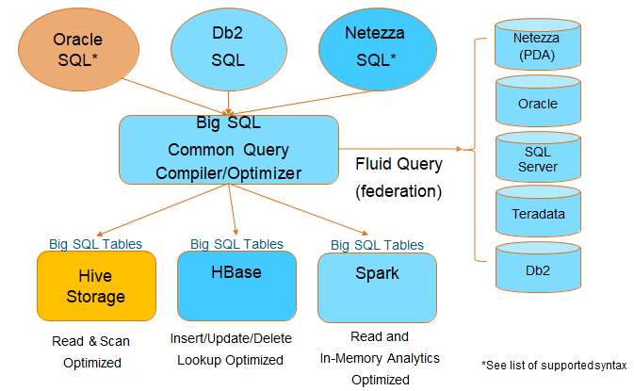
Big SQL integrates with RDBMS**
BIG SQL LOAD command can load data from remote DB or table
Query heterogeneous databases using federation feature
Notes:
Big SQL can communicate with heterogeneous databases, such as Oracle or Teradata, using the federation feature. Multi-vendor workloads are easier than ever.
Big SQL provides:
a unified view of all your tables, with federated query support to external databases
stored optimally as Hive, HBase, or read with Spark - optimized for the expected workload
secured under a single security model (including row/column security across all)
with the ability to join across all datasets using standard ANSI SQL across all types of tables
with Oracle, NZ, Db2 extensions if you prefer
using a single database connection and driver
This makes Big SQL a very unique SQL engine for Hadoop.

Slide 10
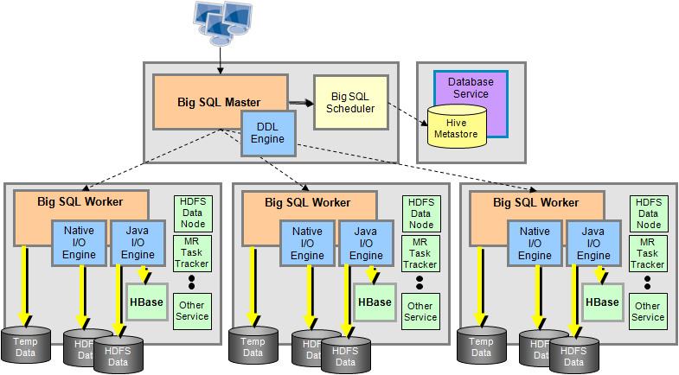
Big SQL architecture
Head (coordinator / management) node
Listens to the JDBC/ODBC connections
Compiles, optimizes, and coordinates execution of the query
Big SQL worker processes reside on compute nodes (some or all)
Worker nodes stream data between each other as needed
Workers can spill large data sets to local disk if needed
Notes:
The Big SQL architecture uses the latest relational database technology from IBM. The data remains on the HDFS cluster, with no relational database management system (RDBMS) structure or restrictions on the layout and organization of the data. The database infrastructure provides a logical view of the data (by allowing storage and management of metadata) and a view of the query compilation, plus the optimization and runtime environment for optimal SQL processing.
Applications connect on a specific node based on specific user configurations.
SQL statements are routed through this node, which is called the Big SQL management node, or the coordinating node. There can be one or many management nodes, but there is only one Big SQL management node. SQL statements are compiled and optimized to generate a parallel execution query plan.
Then, a runtime engine distributes the parallel plan to Big SQL worker nodes on the compute nodes and manipulates the consumption and return of the result set. The compute node is a node that can be a physical server or operating system. The worker nodes can contain the temporary tables, the runtime execution, the readers and writers, and the data nodes. The DataNode holds the data.
A worker node is not required on every HDFS data node. It can operate in a configuration where it is deployed on a subset of the Hadoop cluster.
When a worker node receives a query plan, it dispatches special processes that know how to read and write HDFS data natively. Big SQL uses native and Java open source-based readers (and writers) that are able to ingest different file formats.
The Big SQL engine pushes predicates down to these processes so that they can, in turn, apply projection and selection closer to the data. These processes also transform input data into an appropriate format for consumption inside Big SQL.
Big SQL uses the Hive Metastore (HCatalog) for table definitions, location, storage format and encoding of input files. This Big SQL catalog resides on the head node.
As long as the data is defined in the Hive Metastore and accessible in the Hadoop cluster, Big SQL can get to it. Big SQL stores some of the metadata from the Hive catalog locally for ease of access and to facilitate query execution.
Big SQL has a scheduler, which is a service that acts as a liaison between the SQL processes and Hadoop. It provides a number of important services such as interfacing with the Hive metastore and scheduling work by knowing where and how data is stored on Hadoop.
Big SQL workers can spill large data sets to local disk if needed which allows Big SQL to work with data sets larger than available memory.

Slide 11
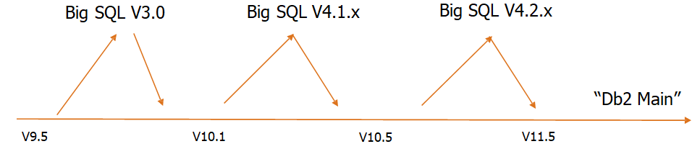
The relationship between Big SQL and Db2
Big SQL and Db2 have the same "DNA"
Bug fixes and enhancements (especially in Optimizer) in Db2 also benefit Big SQL.
Enhancements via Big SQL re-integrated into "Db2 Main" often
Features enabled for Big SQL for "almost free"
HADR for Head Node
Oracle PL/SQL support
Declared Global Temporary Tables
Time Travel Queries
Much more…
Notes:
Many Db2 technologies you already know exist in Big SQL, including
"Native Tables" with full transactional support on the Head Node
Row oriented, traditional Db2 tables
BLU Columnar, In-memory tables (on Head Node Only)
Materialized Query Tables
GET SNAPSHOT / snapshot table functions
RUNSTATS command (db2) € ANALYZE command (Big SQL)
Row and Column Security
Federation / Fluid Query
Views
SQL PL Stored Procedures & UDFs
Workload Manager
System Temporary Table Spaces to support sort overflows
User Temporary Table Spaces for Declared Global Temporary Tables

Slide 12
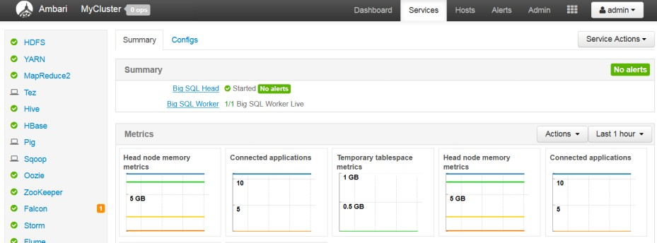
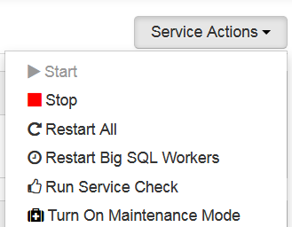
Starting and stopping Big SQL using Ambari
Notes:
You can start or stop Big SQL using either the Ambari interface or the command line. To start Big SQL using the Ambari web interface, navigate to Big SQL in the left hand services menu. Then click the Service Actions menu and select either Start or Stop.
You can also restart the Big SQL Workers, Run Service Check, or Turn On
Maintenance Mode from this menu.

Slide 13
Starting and stopping Big SQL from the command line
As bigsql user, run following command from the active/primary headnode
View the status of all Big SQL services:
$BIGSQL_HOME/bin/bigsql status
Stop Big SQL:
$BIGSQL_HOME/bin/bigsql stop
Start Big SQL:
$BIGSQL_HOME/bin/bigsql start

Slide 14
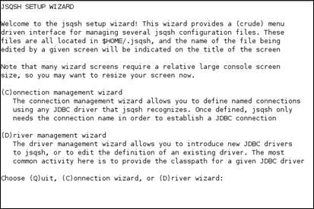
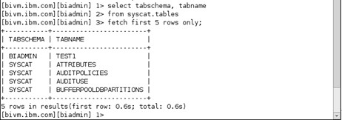
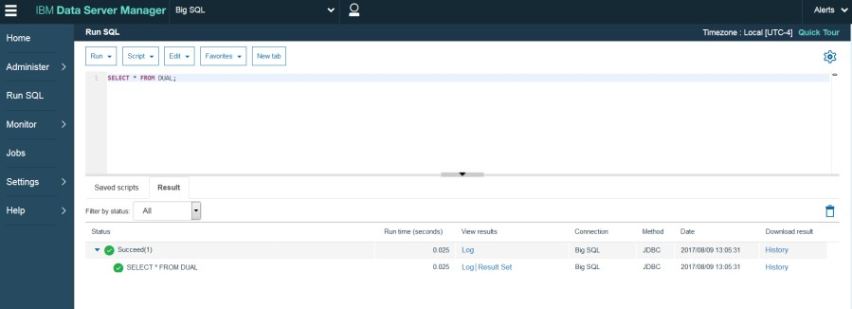
Accessing Big SQL
Java SQL Shell (JSqsh)
Web tooling using Data Server Manager (DSM)
Tools that support IBM JDBC/ODBC driver
Notes:
Big SQL includes a command-line interface called JSqsh. JSqsh (pronounced Jay- skwish), short for Java SQshell (pronounced s-q-shell), is an open source database query tool featuring much of the functionality provided by a good shell, such as variables, redirection, history, command line editing, and so on. As shown on this chart, it includes built-in help information and a wizard for establishing new database connections.
In addition, when Big SQL is installed, administrators can also install IBM Data Server Manager on the Big SQL Head Node. This Web-based tool includes a SQL editor that runs statements and returns results, as shown here. DSM also includes facilities for monitoring your Big SQL database. For more on DSM, visit http://www- 03.ibm.com/software/products/en/ibm-data-server-manager.
Tools that support IBM's JDBC / ODBC driver are also options that can be used to access Big SQL.

Slide 15

JSqsh (1 of 3)
Big SQL comes with a CLI pronounced as "jay-skwish" - Java SQL Shell
Open source command client
Query history and query recall
Multiple result set display styles
Multiple active sessions
Started under /usr/ibmpacks/common-utils/current/jsqsh/bin
Notes:
Big SQL has a CLI known as JSqsh.
JSqsh is an open source client that works with any JDBC driver, not just Big SQL. JSqsh has the capability to do query history and query recall. It displays results in various styles depending on the file type such as traditional, CSV, JSON, etc.). You can have also have multiple active sessions.
The CLI can be started with:
cd /usr/ibmpacks/common-utils/current/jsqsh/bin
./jsqsh

Slide 16
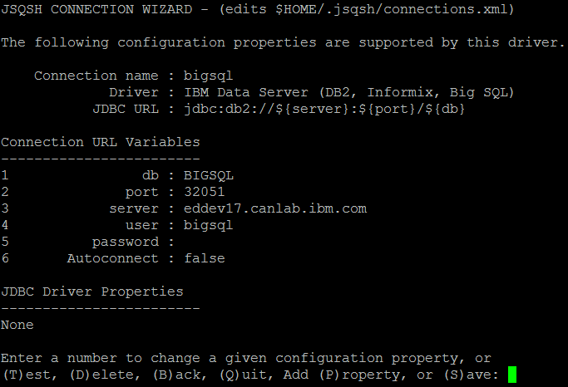
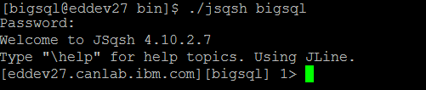
JSqsh (2 of 3)
Run the JSqsh connection wizard to supply connection information:
Connect to the bigsql database:
./jsqsh bigsql
Notes:
When you first use JSqsh, it is recommended that you set up the connection using the wizard to supply the information. Once that has been set up, you can connect to the default bigsql database.

Slide 17
JSqsh (3 of 3)
JSqsh's default command terminator is a semicolon Semicolon is also a valid SQL PL statement terminator!
JSqsh applies a basic heuristics to determine the actual statement end
CREATE FUNCTION COMM_AMOUNT(SALARY DEC(9,2))
RETURNS DEC(9,2)
LANGUAGE SQL BEGIN ATOMIC
DECLARE REMAINDER DEC(9,2) DEFAULT 0.0;
... END;
Change the terminator
Use the 'go' command
1> \set terminator='@';
1> quit@
1> CREATE FUNCTION COMM_AMOUNT(SALARY DEC(9,2))
... 20> END;
21> go
Notes:
If you have used JSqsh before, you will know that the default command terminator is a semicolon. With Big SQL, the semicolon is also a valid SQL PL statement terminator, so while JSqsh can take a best guess to determine the actual statement, it can sometimes get it wrong. When that happens, the statement will not run until you explicitly execute the "go" command. The semicolon in Big SQL is actually the go command underneath. Alternatively, you can change the default terminator from a semicolon to another terminator such as the @ symbol.

Slide 18
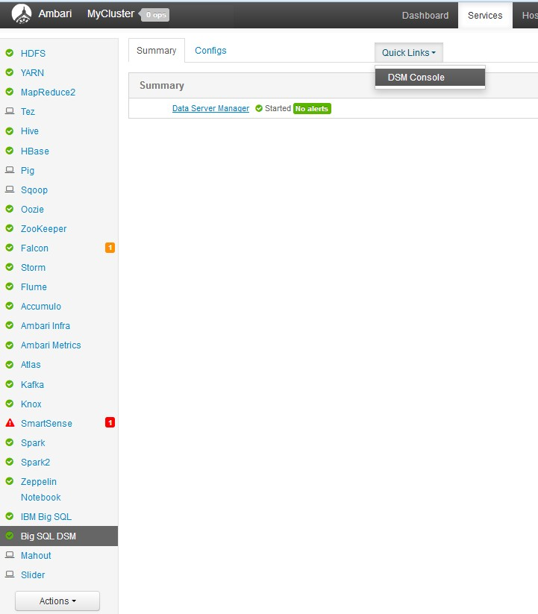
Web tooling using Data Server Manager (DSM)
Big SQL includes web tooling called IBM Data Server Manager.
You start the web tooling by clicking "Big SQL DSM" in the services menu within Ambari.
Then, click the Quick Links menu and select "DSM Console".
From there, you can work with Big SQL and perform tasks such as querying and monitoring Big SQL.
The Web tooling is launched via the Ambari console.
Notes:
Big SQL includes web tooling called IBM Data Server Manager. You start the web tooling by clicking "Big SQL DSM" in the services menu within Ambari. Then, click the Quick Links menu and select "DSM Console". From there, you can work with Big SQL and perform tasks such as querying and monitoring Big SQL.

Slide 19
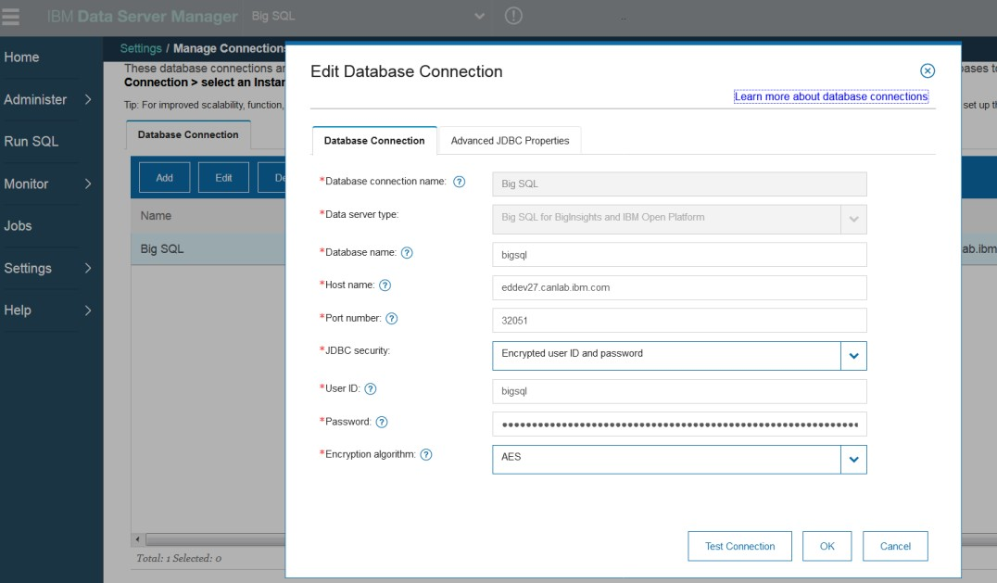
Connecting to Big SQL with Data Server Manager
Create a database connection to Big SQL within DSM
Notes:
Within Data Server Manager (DSM), you create a connection to your Big SQL database. Once this connection is setup, you can connect to your Big SQL instance and submit queries.

Slide 20
Checkpoint
What is one of the many reasons to use Big SQL?
List the two ways you can access and use Big SQL.
What command is used to start Big SQL from the command line?

Slide 21
Unit summary
Overview of Big SQL
Understand how Big SQL fits in the Hadoop architecture
Start and stop Big SQL using Ambari and command line
Connect to Big SQL using command line
Connect to Big SQL using IBM Data Server Manager

