Slide 1
Apache Ambari
Data Science Foundations

Slide 2
Unit objectives
Understand the purpose of Apache Ambari in the HDP stack
Understand the overall architecture of Ambari, and Ambari’s relation to
other services and components of a Hadoop cluster
List the functions of the main components of Ambari
Explain how to start and stop services from Ambari Web Console

Slide 3
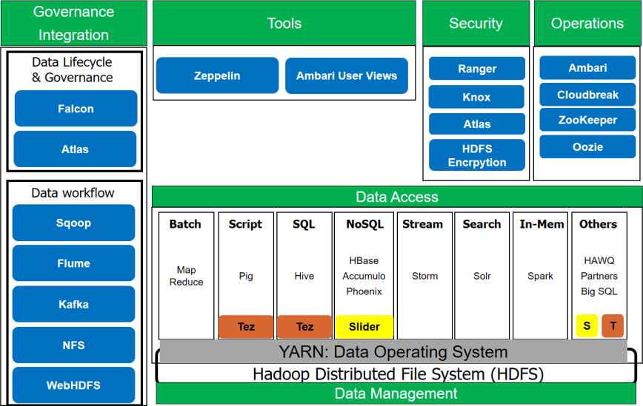
Operations

Slide 4

Apache Ambari
For provisioning, managing, and monitoring Apache Hadoop clusters.
Provides intuitive, easy-to-use Hadoop management web UI backed by its RESTful APIs
Ambari REST APIs
Allows application developers and system integrators to easily integrate Hadoop provisioning, management, and monitoring capabilities to their own applications
Notes:
The Apache Ambari project is aimed at making Hadoop management simpler by developing software for provisioning, managing, and monitoring Apache Hadoop clusters. Ambari provides an intuitive, easy-to-use Hadoop management web user interface (UI) backed by its RESTful APIs.

Slide 5
Functionality of Apache Ambari
Ambari enables System Administrators to:
Provision a Hadoop cluster
Ambari provides wizard for installing Hadoop services across any number of hosts
Ambari handles configuration of Hadoop services for the cluster
Manage a Hadoop cluster
Ambari provides central management for starting, stopping, and reconfiguring Hadoop services across the entire cluster
Monitor a Hadoop cluster
Ambari provides dashboard for monitoring health and status of the Hadoop cluster
Ambari leverages Ambari Metrics System ("AMS") for metrics collection
Ambari leverages Ambari Alert Framework for system alerting and will notify you when your attention is needed
− For example, a node goes down, remaining disk space is low, etc.
Ambari enables application developers and system integrators to:
Easily integrate Hadoop provisioning, management, and monitoring capabilities to their own applications with the Ambari REST APIs

Slide 6
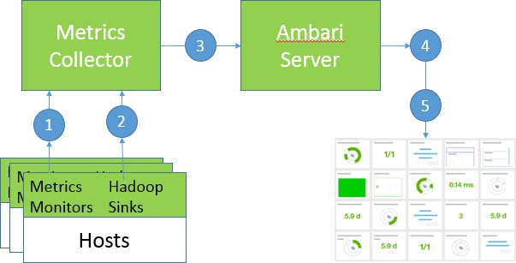
Ambari Metrics System ("AMS")
System for collecting, aggregating and serving Hadoop and system metrics in Ambari-managed clusters. The AMS works as follows:
Metrics Monitors run on each host and send system-level metrics to the AMS (which is a daemon).
Hadoop Sinks run on each host and send Hadoop-level metrics to the Collector.
The Metrics Collector stores and aggregates metrics. The Collector can store data either on the local filesystem ("embedded mode") or can use an external HDFS for storage ("distributed mode").
Ambari exposes a REST API, which makes metrics retrieval easy.
Ambari REST API feeds the Ambari Web UI.
Notes:
One of the one of the more fascinating pieces of Ambari is its Ambari Metrics System.
The Ambari Metrics System ("AMS") is a system for collecting, aggregating and serving Hadoop and system metrics in Ambari-managed clusters. The AMS works as follows (note that the numbered points correspond with the following diagram. Read through each step and find the corresponding number on the diagram).
The above diagram depicts the high level conceptual architecture of the new Ambari Metrics System. Note that in the diagram there is a GUI component, this is the Ambari User Interface, which is a web-based interface that allows users to easily interact with the system.

Slide 7
Ambari architecture
In addition to the agents seen in the prior slide, the Ambari Server also contains or interacts with the following components:
Postgres RDBMS (default) stores the cluster configurations
Authorization Provider integrates with an organization's authentication/authorization provider such as the LDAP service (By default, Ambari uses an internal database as the user store for authentication and authorization)
Ambari Alert Framework supports alerts and notifications
REST API integrates with the web-based front-end Ambari Web. This REST API can also be used by custom applications

Slide 8
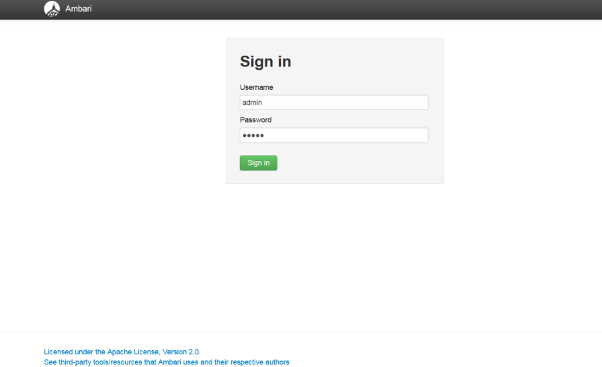
Sign in to the Ambari web interface
Via web browser:
URL is ip_address_of_Ambari_Server:8080 and sign in as: admin / admin (default)
Notes:
There are two Ambari interfaces to the outside world (through the firewall around the Hadoop cluster):
Ambari web Interface, which you will review and use
custom application API that allows programs to talk to Ambari

Slide 9
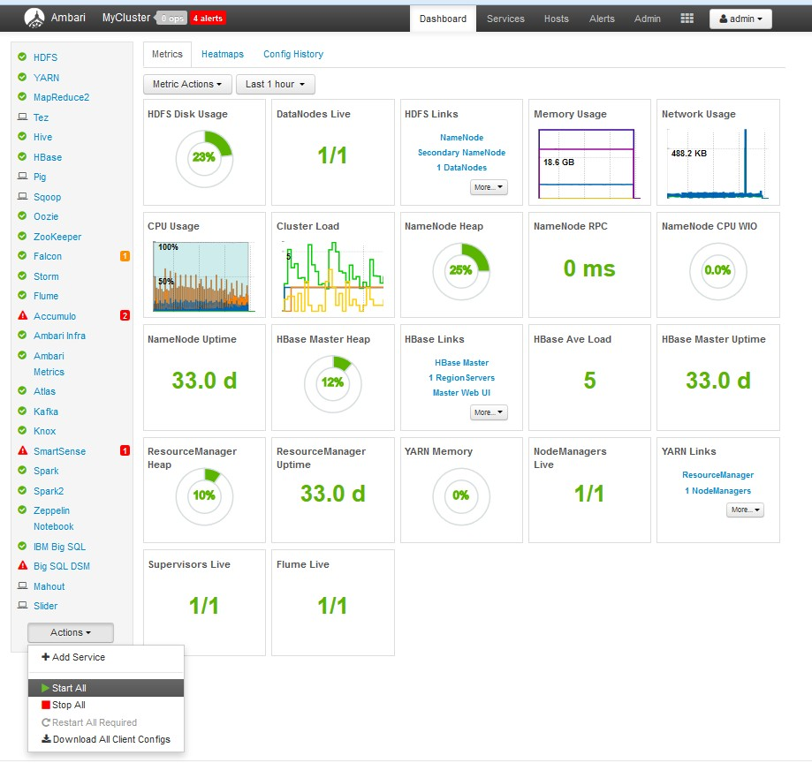

Navigating the Ambari web interface
Main tabs:
Dashboard
Services
Hosts
Admin
Repositories
Service Accounts
Security
Views
admin
About
Manage Ambari
Settings
Sign Out
Drop down to add a service, or start or stop all services
Notes:
Note that the "admin" tab is an icon that acts as a drop-down menu.

Slide 10
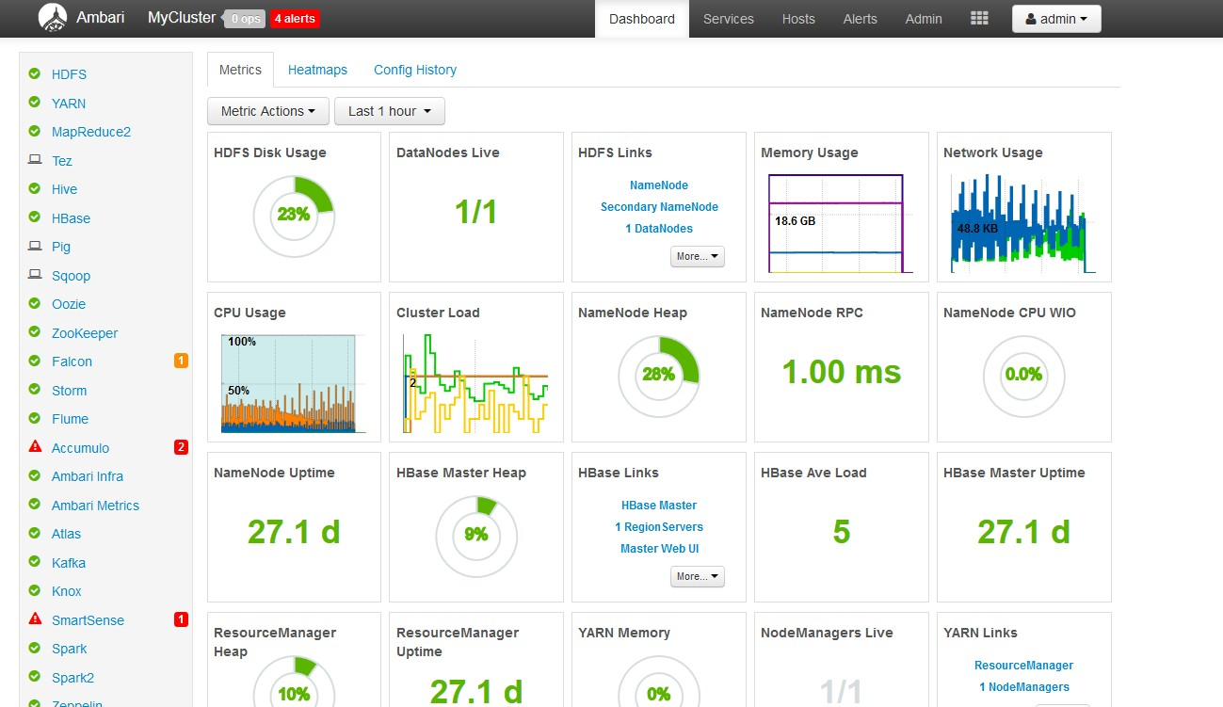
The Ambari web dashboard
Notes:
This slide shows a view of the Dashboard within the Ambari web interface.
Notice the various components on the standard dashboard configuration. The typical items here include:
HDFS Disk Usage: 23%
DataNodes Live: 1/1; this shows the lab environment. There is 1 data node in this example, and it is live and running.
This system shown here has been up 27 days ("27.1 d" for NameNode Uptime and for the ResourceManager Uptime).
Note in the example, which components are running: all, except Accumulo and SmartSense are running smoothly (notice the red triangles with exclamation points).

Slide 11
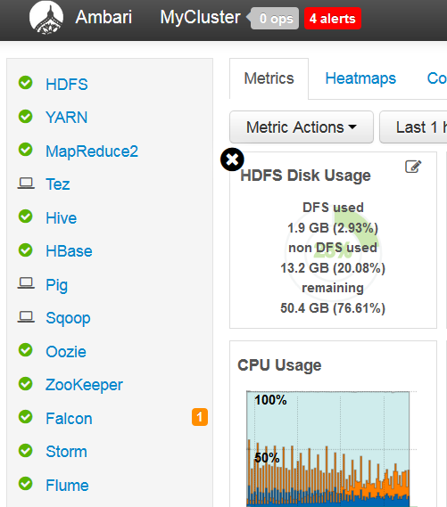
Metric details on the Ambari dashboard
Metric details on the Ambari dashboard
Use Services to monitor and manage selected services running in your Hadoop cluster
All services installed in your cluster are listed in the leftmost Services panel; the metrics are shown in the main body of the dashboard
Hover the cursor over the individual entry on the dashboard
Metric details are shown (see
example at right)
Notes:
By holding your mouse cursor over the "Card" you can get the detailed metrics of the component.
The CPU usage metric detail is on the next slide.

Slide 12
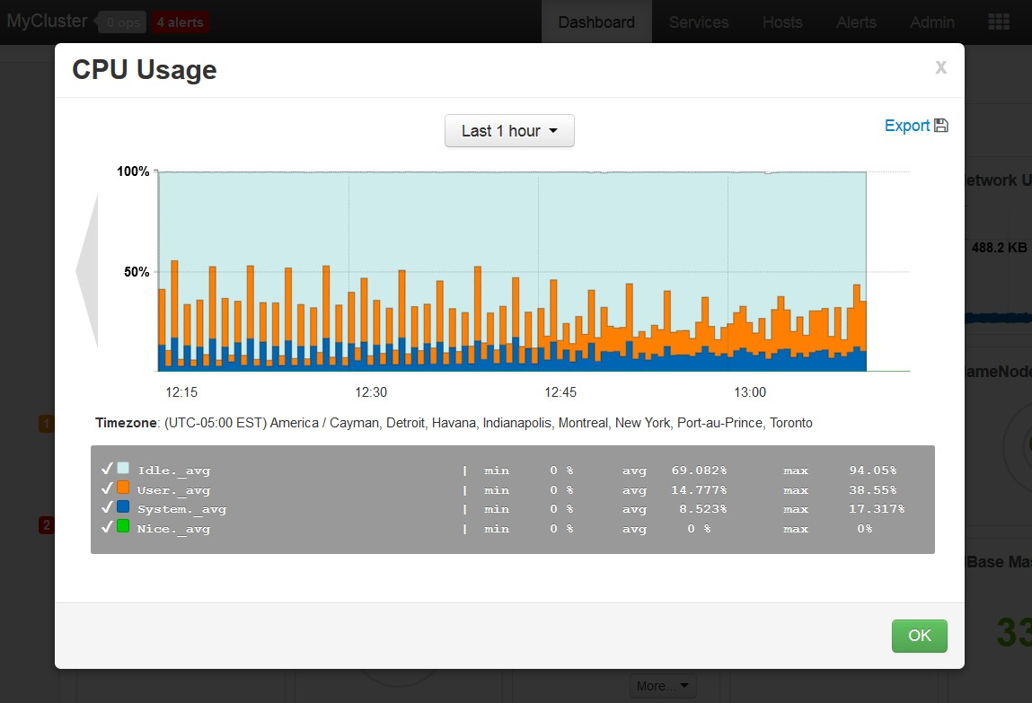
Metric details for time-based cluster components
Notes:
For other components, such as CPU usage, you may be not as interested in the instantaneous metric value as you are with current disk usage, but you may be interested in the metric over a recent time period.

Slide 13
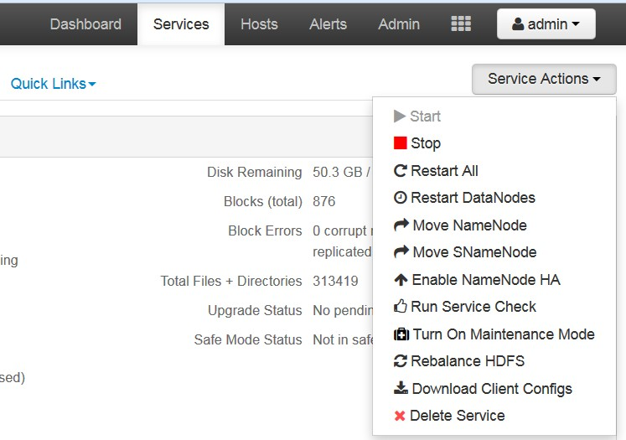
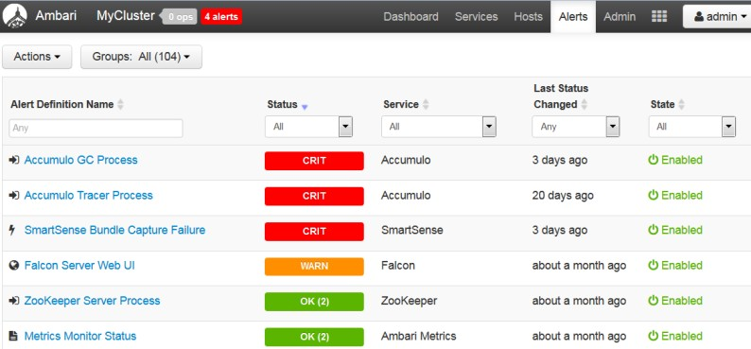
Service Actions/Alert and Health Checks
Service Actions
drop-down menu
Alerts and Health Checks
View results of health checks
Display lists each issue and its rating, sorted first by descending severity, then by descending time
Notes:
Ambari is intended to be the center for monitoring performance of the Hadoop cluster, as well as the center for generic and particular alert and health checks.
The Ambari Metrics System ("AMS") is a system for collecting, aggregating and serving Hadoop and system metrics in Ambari-managed clusters.

Slide 14
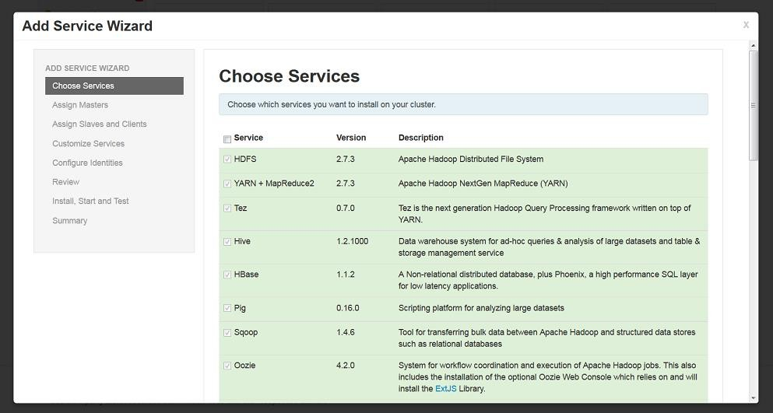
Add Service Wizard
Background is pale-green for installed services
Other services can be added by checking the service(s) and clicking Next to setup details
Notes:
The Add Service Wizard allows you to:
add a service to the cluster
add components to the service
create configuration
apply configuration to the cluster
create host components
install and start the service For further information, go to:
https://cwiki.apache.org/confluence/display/AMBARI/Adding+a+New+Service+to+an+E xisting+Cluster

Slide 15
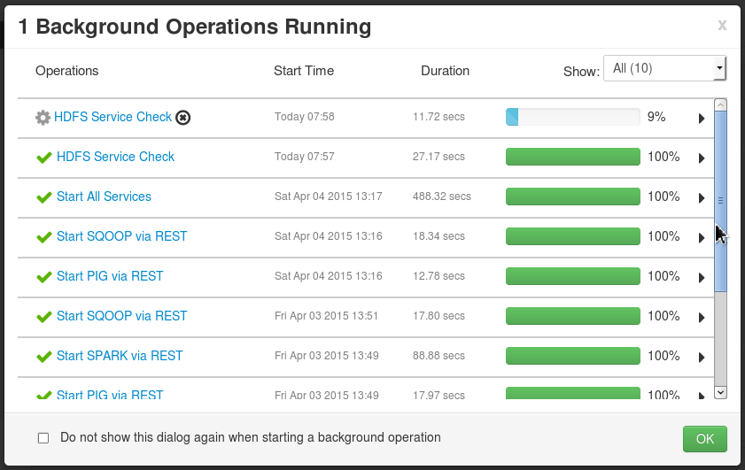
Background service check from the admin menu
Notes:
When you activate adding a service or starting a service, the action takes place in background mode so that you can continue to perform other operations while the requested change runs.
You can view current background operations (blue), completed successful operations (green), and terminated failed operations (red) in the Background Service Check window.

Slide 16
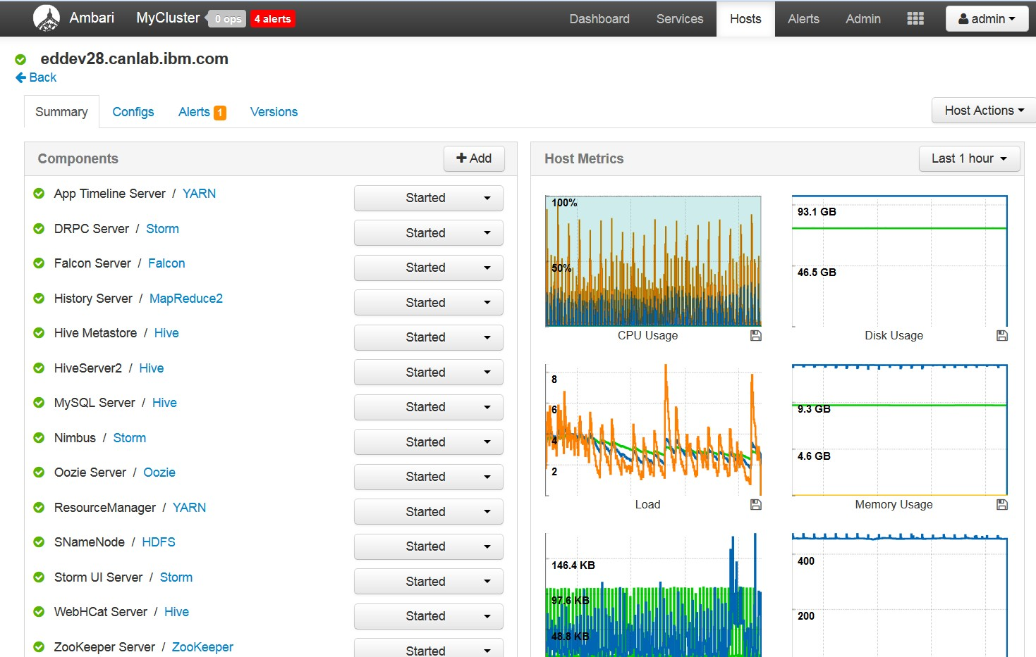
Host metrics: Example of a host

Slide 17
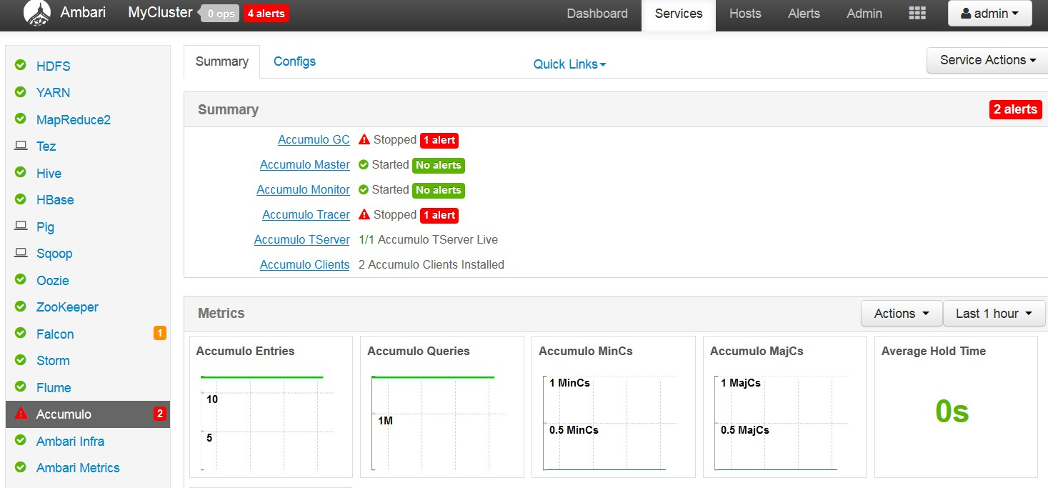

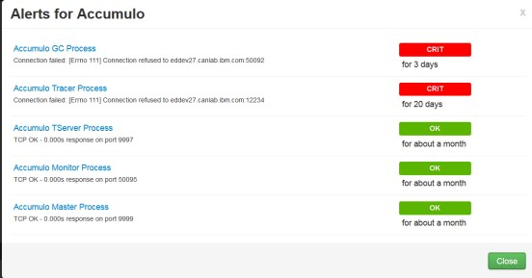
Non-functioning/failed services: Example of HBase
Notes:
A currently failed service is shown with a red-triangle on the left side of the display. This service happens to be Accumulo.

Slide 18
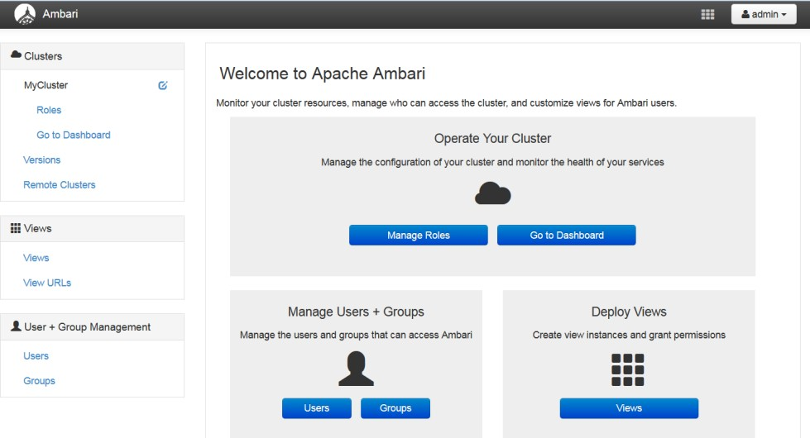
Managing Ambari
Click the admin drop-down
Select Manage Ambari for this display: 3 areas to manage

Slide 19
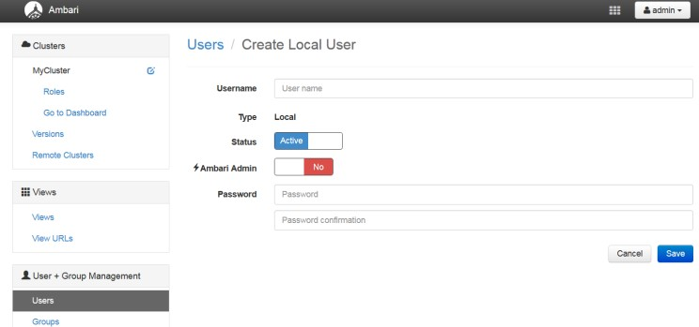
Creating users and groups
This screen is for creating Ambari web users and groups, and not HDFS users and groups
Default for Ambari Admin is No (for example, non-administrative user)
Two user roles: User and Admin. Users can view metrics, view service status and configuration, and browse job information. Admins can do all User tasks plus start and stop services, modify configurations, and run service checks.
Initial Ambari Administrator credential is admin/admin
HDFS users/groups are managed totally separately
Notes:
The individual services in Hadoop are each run under the ownership of a corresponding UNIX account. These accounts are known as service users, and these service users belong to a special UNIX group. In addition there is a special service user for running smoke tests on components during installation and on-demand using the Management Header in the Services View of the Ambari Web GUI. Any of these users and groups can be customized using the Misc tab of the Customize Services step.
If you choose to customize names, Ambari checks to see if these custom accounts already exist; if they do not exist, Ambari creates them. The default accounts are always created during installation whether or not custom accounts are specified. These default accounts are not used and can be removed after install is performed.

Slide 20
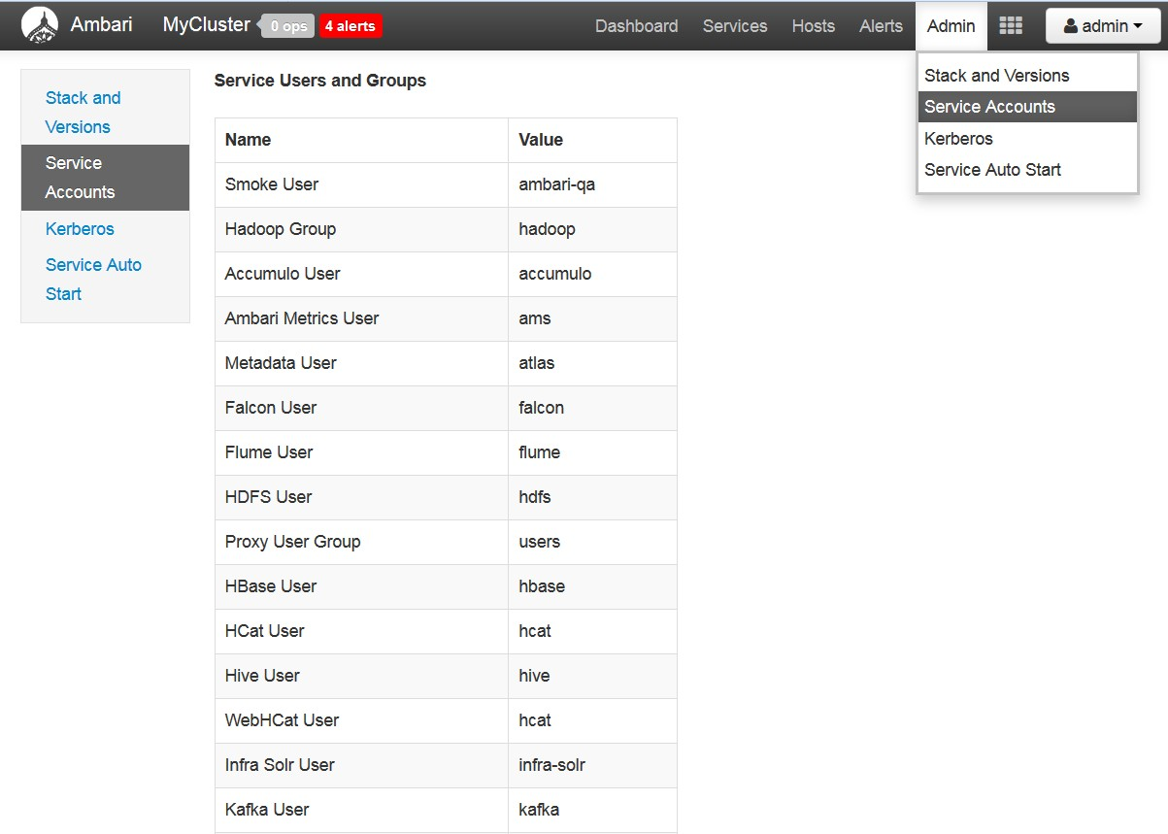


Standard Ambari Service users and groups

Slide 21
Managing hosts in a cluster
Ambari provides the following actions using the Hosts tab:
Working with Hosts
Determining Host Status
Filtering the Hosts List
Performing Host-Level Actions
Viewing Components on a Host
Decommissioning Masters and Slaves
Deleting a Host from a Cluster
Setting Maintenance Mode
Adding Hosts to a Cluster

Slide 22
Running Ambari from the command line
Ambari allows commands to be run at the command line
To read settings from Ambari (such as hosts in the cluster)
curl -i -uadmin:admin http://eddev27.canlab.ibm.com:8080/api/v1/hosts
To deploy services across a cluster using a script
To undeploy services which are not being used
(Note that generally services should be stopped manually before removing them. Sometimes stopping from Ambari might not stop some of the sub-components, so sub-components may also need to be stopped.)
curl -u admin:admin -H "X-Requested-By: ambari" -X DELETE
http://localhost:8080/api/v1/clusters/BI4_QSVservices/FLUME curl -u admin:admin -H "X-Requested-By: ambari" -X DELETE
http://localhost:8080/api/v1/clusters/BI4_QSVservices/SLIDER
curl -u admin:admin -H "X-Requested-By: ambari" -X DELETE http://localhost:8080/api/v1/clusters/BI4_QSVservices/SOLR
An Ambari shell (with prompt) is available
− https://cwiki.apache.org/confluence/display/AMBARI/Ambari+Shell

Slide 23
Ambari terminology
Service
Component
Host/Node
Node Component
Operation
Task
Stage
Action
Stage Plan
Manifest
Role
Notes:
The following definitions can be found at http://ambari.apache.org.
Service: Service refers to services in the Hadoop stack. HDFS, HBase, and Pig are examples of services. A service may have multiple components (for example, HDFS has NameNode, Secondary NameNode, DataNode, etc.). A service can just be a client library (for example, Pig does not have any daemon services, but just has a client library).
Component: A service consists of one or more components. For example, HDFS has 3 components: NameNode, DataNode and Secondary NameNode. Components may be optional. A component may span multiple nodes (for example, DataNode instances on multiple nodes).
Node/Host: Node refers to a machine in the cluster. Node and host are used interchangeably in this document.
Node-Component: Node-component refers to an instance of a component on a particular node. For example, a particular DataNode instance on a particular node is a node-component.
Operation: An operation refers to a set of changes or actions performed on a cluster to satisfy a user request or to achieve a desirable state change in the cluster. For example, starting of a service is an operation and running a smoke test is an operation. If a user requests to add a new service to the cluster and that includes running a smoke test as well, then the entire set of actions to meet the user request will constitute an operation. An operation can consist of multiple "actions" that are ordered (see below).
Task: Task is the unit of work that is sent to a node to execute. A task is the work that node has to carry out as part of an action. For example, an "action" can consist of installing a DataNode on Node n1 and installing a DataNode and a secondary NameNode on Node n2. In this case, the "task" for n1 will be to install a DataNode and the "tasks" for n2 will be to install both a DataNode and a secondary NameNode.
Stage: A stage refers to a set of tasks that are required to complete an operation and are independent of each other; all tasks in the same stage can be run across different nodes in parallel.
Action: An 'action' consists of a task or tasks on a machine or a group of machines. Each action is tracked by an action id and nodes report the status at least at the granularity of the action. An action can be considered a stage under execution. In this document a stage and an action have one-to-one correspondence unless specified otherwise. An action id will be a bijection of request-id, stage-id.
Stage Plan: An operation typically consists of multiple tasks on various machines and they usually have dependencies requiring them to run in a particular order. Some tasks are required to complete before others can be scheduled. Therefore, the tasks required for an operation can be divided in various stages where each stage must be completed before the next stage, but all the tasks in the same stage can be scheduled in parallel across different nodes.
Manifest: Manifest refers to the definition of a task which is sent to a node for execution. The manifest must completely define the task and must be serializable. Manifest can also be persisted on disk for recovery or record.
Role: A role maps to either a component (for example, NameNode, DataNode) or an action (for example, HDFS rebalancing, HBase smoke test, other admin commands, etc.)

Slide 24
Checkpoint
True or False? Ambari is backed by RESTful APIs for developers to easily integrate with their own applications.
Which Hadoop functionalities does Ambari provide?
Which page from the Ambari UI allows you to check the versions of the software installed on your cluster?
True or False? Creating users through the Ambari UI will also create the user on the HDFS.
True or False? You can use the CURL commands to issue commands to Ambari.

