Slide 1
Apache Spark
Data Science Foundations

Slide 2
Unit objectives
Understand the nature and purpose of Apache Spark in the Hadoop ecosystem
List and describe the architecture and components of the Spark unified stack
Describe the role of a Resilient Distributed Dataset (RDD)
Understand the principles of Spark programming
List and describe the Spark libraries
Launch and use Spark's Scala and Python shells

Slide 3
Big data and Spark
Faster results from analytics has become increasingly important
Apache Spark is a computing platform designed to be fast and general-purpose, and easy to use
Speed | In-memory computations Faster than MapReduce for complex applications on disk
Generality | Covers a wide range of workloads on one system Batch applications (e.g. MapReduce) Iterative algorithms Interactive queries and streaming
Ease of use | APIs for Scala, Python, Java, R Libraries for SQL, machine learning, streaming, and graph processing Runs on Hadoop clusters or as a standalone including the popular MapReduce model
Notes:
There is an explosion of data, and no matter where you look, data is everywhere. You get data from social media such as Twitter feeds, Facebook posts, SMS, and a variety of others. The need to be able to process those data as quickly as possible becomes more important than ever. How can you find out what your customers want and be able to offer it to them right away? You do not want to wait hours for a batch job to complete; you need to have it in minutes or less.
MapReduce has been useful, but the amount of time it takes for the jobs to run is no longer acceptable in many situations. The learning curve to writing a MapReduce job is also difficult as it takes specific programming knowledge and expertise. Also, MapReduce jobs only work for a specific set of use cases. You need something that works for a wider set of use cases.
Apache Spark was designed as a computing platform to be fast, general-purpose, and easy to use. It extends the MapReduce model and takes it to a whole other level.
The speed comes from the in-memory computations. Applications running in memory allows for a much faster processing and response. Spark is even faster than MapReduce for complex applications on disk.
This generality covers a wide range of workloads under one system. You can run batch application such as MapReduce type jobs or iterative algorithms that builds upon each other. You can also run interactive queries and process streaming data with your application. In a later slide, you'll see that there are a number of libraries which you can easily use to expand beyond the basic Spark capabilities.
The ease of use with Spark enables you to quickly pick it up using simple APIs for Scala, Python, Java, and R. As mentioned, there are additional libraries which you can use for SQL, machine learning, streaming, and graph processing. Spark runs on Hadoop clusters such as Hadoop YARN or Apache Mesos, or even as a standalone with its own scheduler.

Slide 4
Ease of use
To implement the classic wordcount in Java MapReduce, you need three classes: the main class that sets up the job, a Mapper, and a Reducer, each about 10 lines long
For the same wordcount program, written in Scala for Spark:
With Java, Spark can take advantage of Scala's versatility, flexibility, and its functional programming concepts
val conf = new SparkConf().setAppName("Spark wordcount")
val sc = new SparkContext(conf)
val file = sc.textFile("hdfs://...")
val counts = file.flatMap(line => line.split(" "))
.map(word => (word, 1)).countByKey() counts.saveAsTextFile("hdfs://...")
Notes:
Spark supports Scala, Python, Java, and R programming languages, all now in widespread use among data scientists. The slide shows programming in Scala. Python is widespread among data scientists and in the scientific community, bringing those users on par with Java and Scala developers.
An important aspect of Spark is the ways that it can combine the functionalities of many tools in available in the Hadoop ecosystem to provide a single unifying platform. In addition, the Spark execution model is general enough that a single framework can be used for:
batch processing operations (similar to that provided by MapReduce),
stream data processing,
machine learning,
SQL-like operations, and
graph operations.
The result is that many different ways of working with data are available on the on same platform, bridging the gap between the work of the classic big data programmer, data engineers and data scientists.
All the same, Spark has its own limitations. There are no universal tools. Thus Spark is not suitable for transaction processing and other ACID types of operations.

Slide 5
Who uses Spark and why?
Spark is related to MapReduce in a sense that it expands on Hadoop's capabilities.
Parallel distributed processing, fault tolerance on commodity hardware, scalability, in-memory computing, high level APIs, etc.
Data scientist
Analyze and model the data to obtain insight using ad-hoc analysis
Transforming the data into a useable format
Statistics, machine learning, SQL
Data engineers
Develop a data processing system or application
Inspect and tune their applications
Programming with the Spark's API
Everyone else
Ease of use
Wide variety of functionality
Mature and reliable
Notes:
You may be asking why you would want to use Spark and what you would use it for.
Spark is related to MapReduce in a sense that it expands on Hadoop's capabilities. Like MapReduce, Spark provides parallel distributed processing, fault tolerance on commodity hardware, scalability, etc. Spark adds to the concept with aggressively cached in-memory distributed computing, low latency, high level APIs and stack of high level tools described on the next slide. This saves time and money.
There are two groups that we can consider here who would want to use Spark: Data Scientists and Engineers - and they have overlapping skill sets.
Data scientists need to analyze and model the data to obtain insight. They need to transform the data into something they can use for data analysis. They will use Spark for its ad-hoc analysis to run interactive queries that will give them results immediately. Data scientists may have experience using SQL, statistics, machine learning and some programming, usually in Python, MatLab or R. Once the data scientists have obtained insights on the data and determined that there is a need develop a production data processing application, a web application, or some system to act upon the insight, the work is handed over to data engineers.
Data engineers use Spark's programming API to develop a system that implement business use cases. Spark parallelize these applications across the clusters while hiding the complexities of distributed systems programming and fault tolerance. Data engineers can employ Spark to monitor, inspect, and tune applications.
For everyone else, Spark is easy to use with a wide range of functionality. The product is mature and reliable.

Slide 6
Spark unified stack
Spark SQL
Spark
Streaming
real-time processing
MLlib
machine learning
GraphX
graph processing
Spark Core
Standalone Scheduler
YARN
Mesos
The Spark core is at the center of the Spark Unified Stack. The Spark core is a general- purpose system providing scheduling, distributing, and monitoring of the applications across a cluster.
The Spark core is designed to scale up from one to thousands of nodes. It can run over a variety of cluster managers including Hadoop YARN and Apache Mesos, or more simply, it can run standalone with its own built-in scheduler.
Spark Core contains basic Spark functionalities required for running jobs and needed by other components. The most important of these is the RDD concept, or resilient distributed dataset, the main element of Spark API. RDD is an abstraction of a distributed collection of items with operations and transformations applicable to the dataset. It is resilient because it is capable of rebuilding datasets in case of node failures.
Various add-in components can run on top of the core; these are designed to interoperate closely, letting the users combine them, just like they would any libraries in a software project. The benefit of the Spark Unified Stack is that all the higher layer components will inherit the improvements made at the lower layers. Example: Optimization to the Spark Core will speed up the SQL, the streaming, the machine learning and graph processing libraries as well.
Spark simplifies the picture by providing many of Hadoop ecosystem functions through several purpose-built components. These are Spark Core, Spark SQL, Spark Streaming, Spark MLib, and Spark GraphX:
Spark SQL is designed to work with the Spark via SQL and HiveQL (a Hive variant of SQL). Spark SQL allows developers to intermix SQL with Spark's programming language supported by Python, Scala, Java, and R.
GraphX is a graph processing library with APIs to manipulate graphs and performing graph-parallel computations. Graphs are data structures comprised of vertices and edges connecting them. GraphX provides functions for building graphs and implementations of the most important algorithms of the graph theory, like page rank, connected components, shortest paths, and others.
"If you compare the functionalities of Spark components with the tools in the Hadoop ecosystem, you can see that some of the tools are suddenly superfluous. For example, Apache Storm can be replaced by Spark Streaming, Apache Giraph can be replaced by Spark GraphX and Spark MLlib can be used instead of Apache Mahout. Apache Pig, and Apache Sqoop are not really needed anymore, as the same functionalities are covered by Spark Core and Spark SQL.
Spark Streaming provides processing of live streams of data. The Spark Streaming API closely matches that of the Sparks Core's API, making it easy for developers to move between applications that processes data stored in memory vs arriving in real-time. It also provides the same degree of fault tolerance, throughput, and scalability that the Spark Core provides.
MLlib is the machine learning library that provides multiple types of machine learning algorithms. These algorithms are designed to scale out across the cluster as well. Supported algorithms include logistic regression, naive Bayes classification, SVM, decision trees, random forests, linear regression, k-means clustering, and others.
Notes:
The Spark core is at the center of the Spark Unified Stack. The Spark core is a general- purpose system providing scheduling, distributing, and monitoring of the applications across a cluster.
The Spark core is designed to scale up from one to thousands of nodes. It can run over a variety of cluster managers including Hadoop YARN and Apache Mesos, or more simply, it can run standalone with its own built-in scheduler.
Spark Core contains basic Spark functionalities required for running jobs and needed by other components. The most important of these is the RDD concept, or resilient distributed dataset, the main element of Spark API. RDD is an abstraction of a distributed collection of items with operations and transformations applicable to the dataset. It is resilient because it is capable of rebuilding datasets in case of node failures.
Various add-in components can run on top of the core; these are designed to interoperate closely, letting the users combine them, just like they would any libraries in a software project. The benefit of the Spark Unified Stack is that all the higher layer components will inherit the improvements made at the lower layers. Example: Optimization to the Spark Core will speed up the SQL, the streaming, the machine learning and graph processing libraries as well.
Spark simplifies the picture by providing many of Hadoop ecosystem functions through several purpose-built components. These are Spark Core, Spark SQL, Spark Streaming, Spark MLib, and Spark GraphX:
Spark SQL is designed to work with the Spark via SQL and HiveQL (a Hive variant of SQL). Spark SQL allows developers to intermix SQL with Spark's programming language supported by Python, Scala, Java, and R.
Spark Streaming provides processing of live streams of data. The Spark Streaming API closely matches that of the Sparks Core's API, making it easy for developers to move between applications that processes data stored in memory vs arriving in real-time. It also provides the same degree of fault tolerance, throughput, and scalability that the Spark Core provides.
MLlib is the machine learning library that provides multiple types of machine learning algorithms. These algorithms are designed to scale out across the cluster as well. Supported algorithms include logistic regression, naive Bayes classification, SVM, decision trees, random forests, linear regression, k-means clustering, and others.
GraphX is a graph processing library with APIs to manipulate graphs and performing graph-parallel computations. Graphs are data structures comprised of vertices and edges connecting them. GraphX provides functions for building graphs and implementations of the most important algorithms of the graph theory, like page rank, connected components, shortest paths, and others.
"If you compare the functionalities of Spark components with the tools in the Hadoop ecosystem, you can see that some of the tools are suddenly superfluous. For example, Apache Storm can be replaced by Spark Streaming, Apache Giraph can be replaced by Spark GraphX and Spark MLlib can be used instead of Apache Mahout. Apache Pig, and Apache Sqoop are not really needed anymore, as the same functionalities are covered by Spark Core and Spark SQL. But even if you have legacy Pig workflows and need to run Pig, the Spork project enables you to run Pig on Spark." - Bonaći, M., & Zečević, P. (2015). Spark in action. Greenwich, CT: Manning Publications. ("Spork" is Apache Pig on Spark, see https://github.com/sigmoidanalytics/spork).

Slide 7
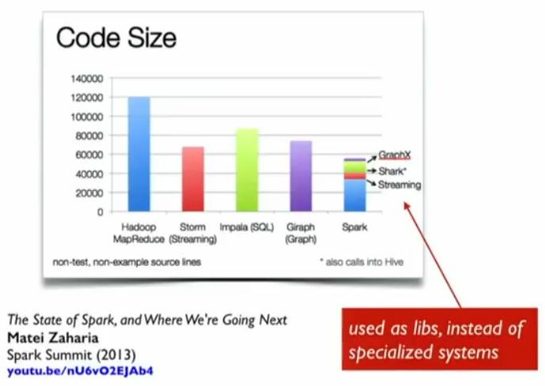
Brief history of Spark
Timeline
2002: MapReduce @ Google
2004: MapReduce paper
2006: Hadoop @ Yahoo
2008: Hadoop Summit
2010: Spark paper
2014: Apache Spark top-level
MapReduce started a general batch processing paradigm, but had its limitations:
difficulty programming in MapReduce
batch processing did not fit many use cases
MR spawned a lot of specialized systems (Storm, Impala, Giraph, etc.)
Notes:
MapReduce was developed over a decade ago as a fault tolerant framework that ran on commodity systems.
MapReduce started off as a general batch processing system, but there are two major limitations.
Difficulty in programming directly in MR.
Batch jobs do not fit many use cases.
This spawned specialized systems to handle the other needed use cases. When you try to combine these third party systems into your applications, there is a lot of overhead.
Spark comes out about a decade later with similar framework to run data processing on commodity systems also using a fault tolerant framework.
Taking a looking at the code size of some applications on the graph on this slide, you can see that Spark requires a considerable amount less. Even with Spark's libraries, it only adds a small amount of code due to how tightly everything is with little overhead. There is great value to be able to express a wide variety of use cases with few lines of code and the corresponding increase in programmer productivity.

Slide 8
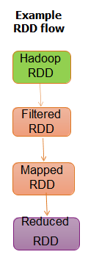
Resilient Distributed Datasets (RDDs)
Spark's primary abstraction is the RDD: which is a Distributed collection of elements, parallelized across the cluster
Two types of RDD operations:
Transformations
Creates a directed acyclic graph (DAG)
Lazy evaluations
No return value
(Transformations do not return a value. In fact, nothing is evaluated during the definition of transformation statements. Spark just creates the definition of a transformation that will be evaluated later at runtime. This is called this lazy evaluation. The transformation is stored as a directed acyclic graphs (DAG).)
Actions
Performs the transformations
The action that follows returns a value
(For example, you can do a count on a RDD, to get the number of elements within and that value is returned.)
RDD provides fault tolerance
Has in-memory caching (with overflow to disk)
Notes:
Looking at the core of Spark, Spark's primary core abstraction is called Resilient Distributed Dataset (RDD).
RDD essentially is just a distributed collection of elements that is parallelized across the cluster.
There are two types of RDD operations: transformations and actions.
Transformations do not return a value. In fact, nothing is evaluated during the definition of transformation statements. Spark just creates the definition of a transformation that will be evaluated later at runtime. This is called this lazy evaluation. The transformation is stored as a directed acyclic graphs (DAG).
Actions actually perform the evaluation. The action is transformations are performed along with the work that is called for to consume or produce RDDs. Actions return values. For example, you can do a count on a RDD, to get the number of elements within and that value is returned.
The fault tolerance aspect of RDDs allows Spark to reconstruct the transformations used to build the lineage to get back any lost data.
In the example RDD flow shown on the slide, the first step loads the dataset from Hadoop. Successive steps apply transformations on this data such as filter, map, or reduce. Nothing actually happens until an action is called. The DAG is just updated each time until an action is called. This provides fault tolerance; for example, if a node goes offline, all it needs to do when it comes back online is to re-evaluate the graph to where it left off.
In-memory caching is provided with Spark to enable the processing to happen in memory. If the RDD does not fit in memory, it will spill to disk.

Slide 9
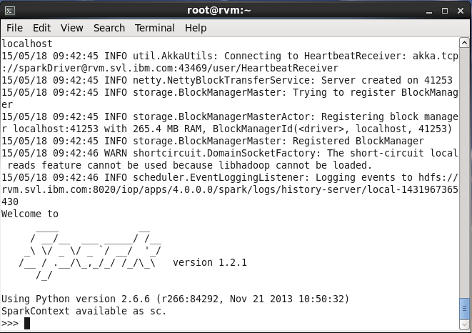
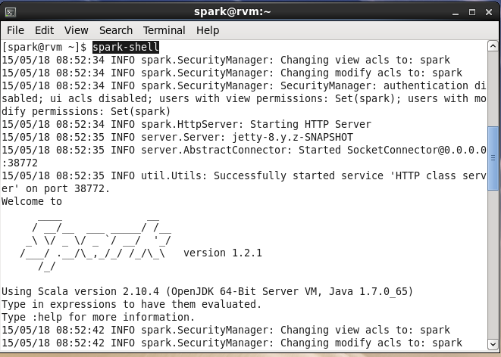
Spark jobs and shell
Spark jobs can be written in Scala, Python, or Java. APIs are available for all three: http://spark.apache.org/docs/1.6.3/
Spark shells are provided for Scala (spark-shell) and Python (pyspark)
Spark's native language is Scala, so it is natural to write Spark applications using Scala
Notes:
Spark jobs can be written in Scala, Python or Java. Spark shells are available for Scala (spark-shell) and Python (pyspark). This course will not teach how to program in each specific language, but will cover how to use them within the context of Spark. It is recommended that you have at least some programming background to understand how to code in any of these.
If you are setting up the Spark cluster yourself, you will have to make sure that you have a compatible version of it. This information can be found on Spark's website. In the lab environment, everything has been set up for you - all you do is launch up the shell and you are ready to go.
Spark itself is written in the Scala language, so it is natural to use Scala to write Spark applications. This course will cover code examples from by Scala, Python, and Java. Java 8 actually supports the functional programming style to include lambdas, which concisely captures the functionality that are executed by the Spark engine. This bridges the gap between Java and Scala for developing applications on Spark. Java 6 and 7 is supported, but would require more work and an additional library to get the same amount of functionality as you would using Scala or Python.

Slide 10
Brief overview of Scala
Everything is an Object:
Primitive types such as numbers or Boolean
Functions
Numbers are objects
1 + 2 * 3 / 4 € (1).+(((2).*(3))./(x)))
Where the +, *, / are valid identifiers in Scala
Functions are objects
Pass functions as arguments
Store them in variables
Return them from other functions
Function declaration
def functionName ([list of parameters]) : [return type]
Notes:
Everything in Scala is an object. The primitive types defined by Java such as int or boolean are objects in Scala. Functions are objects in Scala and play an important role in how applications are written for Spark.
Numbers are objects. As an example, in the expression that you see here: 1 + 2 * 3 / 4 actually means that the individual numbers invoke the various identifiers +,-,*,/ with the other numbers passed in as arguments using the dot notation.
Functions are objects. You can pass functions as arguments into another function. You can store them as variables. You can return them from other functions. The function declaration is the function name followed by the list of parameters and then the return type.
If you want to learn more about Scala, check out its website for tutorials and guide. Throughout this course, you will see examples in Scala that will have explanations on what it does. Remember, the focus of this unit is on the context of Spark, and is not intended to teach Scala, Python or Java.
References for learning Scala:
Horstmann, C. S. (2012). Scala for the impatient. Upper Saddle River, NJ: Addison-Wesley Professional
Odersky, M., Spoon, L., & Venners, B. (2011). Programming in Scala: A Comprehensive Step-by-Step Guide (2nd ed.). Walnut Creek, CA: Artima Press

Slide 11
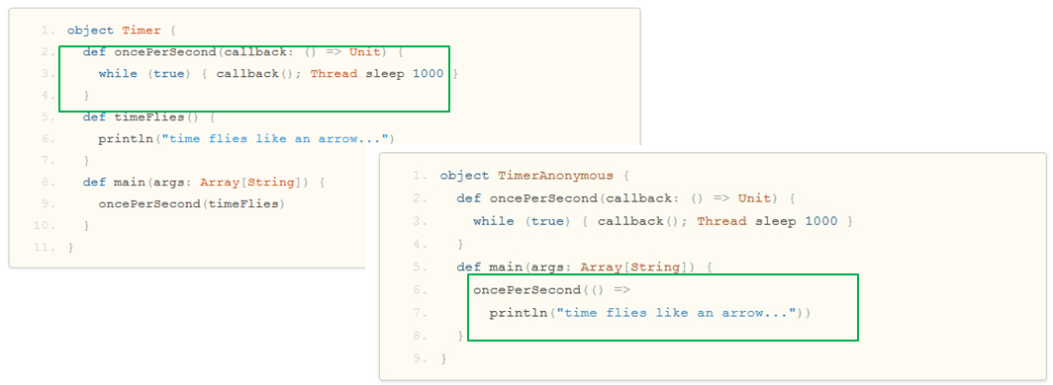
Scala: Anonymous functions, aka Lambda functions
Lambda, or => syntax: functions without a name created for one-time use to pass to another function
The left side of the right arrow => is where the argument are placed resides (no arguments in the example)
Right side of the arrow is the body of the function (here the println statement)
Notes:
Anonymous functions are very common in Spark applications. Essentially, if the function you need is only going to be required once, there is really no value in naming it. Just use it anonymously on the go and forget about it. For example, if you have a timeFlies function and in it, you just print a statement to the console. In another function, oncePerSecond, you need to call this timeFlies function. Without anonymous functions, you would code it like the top example by defining the timeFlies function. Using the anonymous function capability, you just provide the function with arguments, the right arrow, and the body of the function after the right arrow as in the bottom example.
Because this is the only place you will be using this function, you do not need to name the function.'
Python's syntax is relatively convenient and easy to work with, but aside from the basic structure of the language Python is also sprinkled with small syntax structures that make certain tasks especially convenient. The lambda keyword/function construct is one of these, where the creators call it "syntactical candy."
References:
http://docs.scala-lang.org/tutorials/scala-for-java-programmers.html

Slide 12
Computing wordcount using Lambda functions
The classic wordcount program can be written with anonymous (Lambda) functions
Three functions are needed:
Tokenize each line into words (with space as delimiter)
Map to produce the <word, 1> key/value pair from each word that is read
Reduce to aggregate the counts for each word individually (reduceByKey)
The results are written to HDFS
Lambda functions can be used with Scala, Python, and Java v8; this example is Scala
text_file = spark.textFile("hdfs://...")
counts = text_file.flatMap(lambda line: line.split(" ")) \
.map(lambda word: (word, 1)) \
.reduceByKey(lambda a, b: a + b)
counts.saveAsTextFile("hdfs://...")
Notes:
The Lambda or => syntax is a shorthand way to define functions inline in Python and Scala. With Spark you can define anonymous functions separately and then pass the name to Spark. For example, in Python:
def hadHDP(line):
return "HDP" in line; HDPLines = lines.filter(hasHDP)
…is functionally equivalent to:
grep HDP inputfile
A common example is a MapReduce wordcount. You first split up the file by words ("tokenize") and then map each word into a key value pair with the word as the key, and the value of 1. Then you reduce by the key, which adds up all the value of the same key, effectively, counting the number of occurrences of that key. Finally, the counts are written out to a file in HDFS.

Slide 13
Resilient Distributed Dataset (RDD)
Fault-tolerant collection of elements that can be operated on in parallel
RDDs are immutable
Three methods for creating RDD
Parallelizing an existing collection (This means that the data already resides within Spark and can now be operated on in parallel. As an example, if you have an array of data, you can create a RDD out of it by calling the parallelized method. This method returns a pointer to the RDD. So this new distributed dataset can now be operated upon in parallel throughout the cluster)
Referencing a dataset (This dataset can come from any storage source supported by Hadoop such as HDFS, Cassandra, HBase, Amazon S3, etc.)
Transformation from an existing RDD (if you have the array of data that you parallelized earlier, and you want to filter out the records available. A new RDD is created using the filter method)
Notes:
Major points of interest here:
Resilient Distributed Dataset (RDD) is Spark's primary abstraction.
An RDD is a fault tolerant collection of elements that can be parallelized. In other words, they can be made to be operated on in parallel. They are immutable.
These are the fundamental primary units of data in Spark.
When RDDs are created, a direct acyclic graph (DAG) is created. This type of operation is called transformations. Transformations makes updates to that graph, but nothing actually happens until some action is called. Actions are another type of operations. We'll talk more about this shortly. The notion here is that the graphs can be replayed on nodes that need to get back to the state it was before it went offline, thus providing fault tolerance. The elements of the RDD can be operated on in parallel across the cluster. Remember, transformations return a pointer to the RDD created and actions return values that comes from the action.
There are three methods for creating a RDD. You can parallelize an existing collection. This means that the data already resides within Spark and can now be operated on in parallel. As an example, if you have an array of data, you can create a RDD out of it by calling the parallelized method. This method returns a pointer to the RDD. So this new distributed dataset can now be operated upon in parallel throughout the cluster.
The second method to create a RDD, is to reference a dataset. This dataset can come from any storage source supported by Hadoop such as HDFS, Cassandra, HBase, Amazon S3, etc.
The third method to create a RDD is from transforming an existing RDD to create a new RDD. In other words, if you have the array of data that you parallelized earlier, and you want to filter out the records available. A new RDD is created using the filter method.
The final point on this slide: Spark supports text files, SequenceFiles, and any other Hadoop InputFormat.

Slide 14
Resilient Distributed Dataset (RDD)
Two types of RDD operations
Transformations
Actions
Dataset from any storage supported by Hadoop
HDFS, Cassandra, HBase, Amazon S3, etc.
Types of files supported:
Text files, SequenceFiles, Hadoop InputFormat, etc

Slide 15
Creating an RDD
Launch the Spark shell (requires PATH environment )
spark-shell
Create some data
val data = 1 to 10000
Parallelize that data (creating the RDD)
val distData = sc.parallelize(data)
Perform additional transformations or invoke an action on it.
distData.filter(…)
Alternatively, create an RDD from an external dataset
val readmeFile = sc.textFile("Readme.md")
Notes:
Here is a quick example of how to create an RDD from an existing collection of data. In the examples throughout the course, unless otherwise indicated, you will be using Scala to show how Spark works. In the lab exercises, you will get to work with Python and Java as well.
First, launch the Spark shell. This command is located under the /usr/bin directory.
Once the shell is up (with the prompt "scala>"), create some data with values from 1 to 10,000. Then, create an RDD from that data using the parallelize method from the SparkContext, shown as sc on the slide; this means that the data can now be operated on in parallel.
More will be covered on the SparkContext, the sc object that is invoking the parallelized function later, so for now, just know that when you initialize a shell, the SparkContext, sc, is initialized for you to use.
The parallelize method returns a pointer to the RDD. Remember, transformations operations such as parallelize, only returns a pointer to the RDD. It actually will not create that RDD until some action is invoked on it. With this new RDD, you can perform additional transformations or actions on it such as the filter transformation. This is important with large amounts of data (big data), because you do not want to duplicate the date until needed, and certainly not cache it in memory until needed.
Another way to create an RDD is from an external dataset. In the example here, you are creating a RDD from a text file using the textFile method of the SparkContext object. You will see more examples of how to create RDD throughout this course.

Slide 16
Spark's Scala and Python shells
Spark's shells provides simple ways to learn the APIs and provide a set of powerful tools to analyze data interactively
Scala shell:
Runs on the Java VM & provides a good way to use existing Java libraries
To launch the Scala shell: ./bin/spark-shell
The prompt is: scala>
To read in a text file: scala> val textFile = sc.textFile("README.md")
Python shell:
To launch the Python shell: ./bin/pyspark
The prompt is: >>>
To read in a text file: >>> textFile = sc.textFile("README.md")
Two additional variations: IPython & the IPythyon Notebook
To quit either shell, use: Ctrl-D (the EOF character)
Notes:
The Spark shell provides a simple way to learn Spark's API. It is also a powerful tool analyze data interactively. The Shell is available in either Scala, which runs on the Java VM, or Python. To start up Scala, execute the command spark-shell from within the Spark's bin directory. To create a RDD from a text file, invoke the textFile method with the sc object, which is the SparkContext.
To start up the shell for Python, you would execute the pyspark command from the same bin directory. Then, invoking the textFile command will also create a RDD for that text file.
In the lab exercise later, you will start up either of the shells and run a series of RDD transformations and actions to get a feel of how to work with Spark. Later you will get to dive deeper into RDDs.
IPython offers features such as tab completion. For further details: http://ipython.org IPython Notebook is a web-browser based version of IPython.

Slide 17
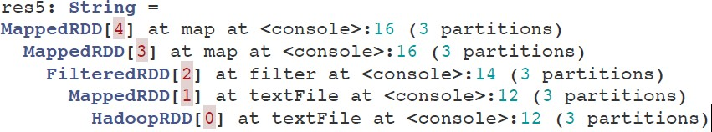
RDD basic operations
Loading a file
val lines = sc.textFile("hdfs://data.txt")
Applying transformation
val lineLengths = lines.map(s => s.length)
Invoking action
val totalLengths = lineLengths.reduce((a,b) => a + b)
View the DAG
lineLengths.toDebugString
Notes:
You have seen how to load a file from an external dataset. This time, however, you are loading a file from the hdfs. Loading the file creates a RDD, which is only a pointer to the file. The dataset is not loaded into memory yet. Nothing will happen until some action is called. The transformation basically updates the direct acyclic graph (DAG).
So the transformation here is saying map each line - ‘s’ - to the length of that line. Then, the action operation is reducing it to get the total length of all the lines. When the action is called, Spark goes through the DAG and applies all the transformation up until that point, followed by the action and then a value is returned back to the caller.
Directed Acyclic Graph (DAG)
On this slide, you will see how to view the DAG of any particular RDD. A DAG is essentially a graph of the business logic and does not get executed until an action is called - often called lazy evaluation.
To view the DAG of a RDD after a series of transformation, use the toDebugString method as you see here on the slide. It will display the series of transformation that Spark will go through once an action is called. You read it from the bottom up. In the sample DAG shown on the slide, you can see that it starts as a textFile and goes through a series of transformation such as map and filter, followed by more map operations. Remember, that it is this behavior that allows for fault tolerance. If a node goes offline and comes back on, all it has to do is just grab a copy of this from a neighboring node and rebuild the graph back to where it was before it went offline.

Slide 18
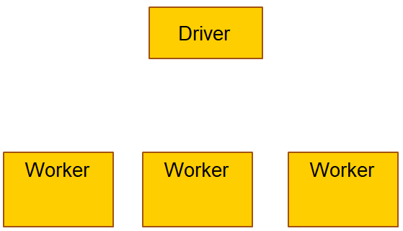
What happens when an action is executed? (1 of 8)
// Creating the RDD
val logFile = sc.textFile("hdfs://…")
// Transformations
val errors = logFile.filter(_.startsWith("ERROR"))
val messages = errors.map(_.split("\t")).map(r => r(1))
//Caching
messages.cache()
// Actions
messages.filter(_.contains("mysql")).count()
messages.filter(_.contains("php")).count()
Notes:
In the next several slides, you will see at a high level what happens when an action is executed.
Let's look at the code first. The goal here is to analyze some log files. The first line you load the log from the hadoop file system. The next two lines you filter out the messages within the log errors. Before you invoke some action on it, you tell it to cache the filtered dataset; it doesn't actually cache it yet as nothing has been done up until this point.
Then you do more filters to get specific error messages relating to mysql and php followed by the count action to find out how many errors were related to each of those filters.

Slide 19
What happens when an action is executed? (2 of 8)
// Creating the RDD
val logFile = sc.textFile("hdfs://…")
// Transformations
val errors = logFile.filter(_.startsWith("ERROR"))
val messages = errors.map(_.split("\t")).map(r => r(1))
//Caching
messages.cache()
// Actions
messages.filter(_.contains("mysql")).count()
messages.filter(_.contains("php")).count()
Driver
Worker
Worker
Worker
Block 1
Block 2
Block 3
The data is partitioned
into different blocks
Notes:
In reviewing the steps, the first thing that happens when you load in the text file is the data is partitioned into different blocks across the cluster.

Slide 20
What happens when an action is executed? (3 of 8)
// Creating the RDD
val logFile = sc.textFile("hdfs://…")
// Transformations
val errors = logFile.filter(_.startsWith("ERROR"))
val messages = errors.map(_.split("\t")).map(r => r(1))
//Cache
messages.cache()
// Actions
messages.filter(_.contains("mysql")).count()
messages.filter(_.contains("php")).count()
Driver
Worker
Worker
Worker
Block 1
Block 2
Block 3
Driver sends the code to be executed on each block
Notes:
Then the driver sends the code to be executed on each block. In the example, it would be the various transformations and actions that will be sent out to the workers. Actually, it is the executor on each workers that is going to be performing the work on each block. You will see a bit more on executors later.

Slide 21
What happens when an action is executed? (4 of 8)
// Creating the RDD
val logFile = sc.textFile("hdfs://…")
// Transformations
val errors = logFile.filter(_.startsWith("ERROR"))
val messages = errors.map(_.split("\t")).map(r => r(1))
//Caching
messages.cache()
// Actions
messages.filter(_.contains("mysql")).count()
messages.filter(_.contains("php")).count()
Driver
Worker
Worker
Worker
Block 1
Block 2
Block 3
Read HDFS block
Notes:
The executors read the HDFS blocks to prepare the data for the operations in parallel.

Slide 22
What happens when an action is executed? (5 of 8)
// Creating the RDD
val logFile = sc.textFile("hdfs://…")
// Transformations
val errors = logFile.filter(_.startsWith("ERROR"))
val messages = errors.map(_.split("\t")).map(r => r(1))
//Caching
messages.cache()
// Actions
messages.filter(_.contains("mysql")).count()
messages.filter(_.contains("php")).count()
Driver
Worker
Worker
Worker
Block 1
Block 2
Block 3
Cache
Cache
Cache
Process + cache data
Notes:
After a series of transformations, you want to cache the results up until that point into memory. A cache is created.

Slide 23
What happens when an action is executed? (6 of 8)
// Creating the RDD
val logFile = sc.textFile("hdfs://…")
// Transformations
val errors = logFile.filter(_.startsWith("ERROR"))
val messages = errors.map(_.split("\t")).map(r => r(1))
//Caching
messages.cache()
// Actions
messages.filter(_.contains("mysql")).count()
messages.filter(_.contains("php")).count()
Driver
Worker
Worker
Worker
Block 1
Block 2
Block 3
Cache
Cache
Cache
Send the data back to the
driver
Notes:
After the first action completes, the results are sent back to the driver. In this case, you are looking for messages that relate to mysql. This is then returned back to the driver.

Slide 24
What happens when an action is executed? (7 of 8)
// Creating the RDD
val logFile = sc.textFile("hdfs://…")
// Transformations
val errors = logFile.filter(_.startsWith("ERROR"))
val messages = errors.map(_.split("\t")).map(r => r(1))
//Caching
messages.cache()
// Actions
messages.filter(_.contains("mysql")).count()
messages.filter(_.contains("php")).count()
Driver
Worker
Worker
Worker
Block 1
Block 2
Block 3
Cache
Cache
Cache
Process from cache
Notes:
To process the second action, Spark will use the data on the cache; it does not need to go to the HDFS data again. It just reads it from the cache and processes the data from there.

Slide 25
What happens when an action is executed? (8 of 8)
// Creating the RDD
val logFile = sc.textFile("hdfs://…")
// Transformations
val errors = logFile.filter(_.startsWith("ERROR"))
val messages = errors.map(_.split("\t")).map(r => r(1))
//Caching
messages.cache()
// Actions
messages.filter(_.contains("mysql")).count()
messages.filter(_.contains("php")).count()
Driver
Worker
Worker
Worker
Block 1
Block 2
Block 3
Cache
Cache
Cache
Send the data back to the
driver
Notes:
Finally the results are sent back to the driver and you have completed a full cycle

Slide 26
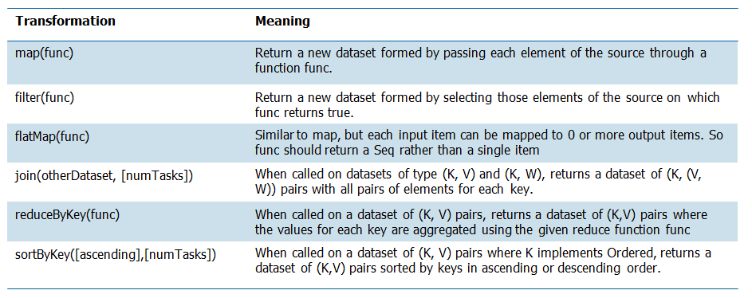
RDD operations: Transformations
These are some of the transformations available - the full set can be found on Spark's website.
Transformations are lazy evaluations
Returns a pointer to the transformed RDD
Notes:
These are some of the transformations available; the full set can be found on Spark's website. The Spark Programming Guide can be found at https://spark.apache.org/docs/latest/programming-guide.html and transformations can be found at https://spark.apache.org/docs/latest/programming- guide.html#transformations.
Remember that Transformations are essentially lazy evaluations. Nothing is executed until an action is called. Each transformation function basically updates the graph and when an action is called, the graph is executed. Transformation returns a pointer to the new RDD.
Some of the less obvious are:
The flatMap function is similar to map, but each input can be mapped to 0 or more output items. What this means is that the returned pointer of the func method, should return a sequence of objects, rather than a single item. It would mean that the flatMap would flatten a list of lists for the operations that follows. Basically this would be used for MapReduce operations where you might have a text file and each time a line is read in, you split that line up by spaces to get individual keywords. Each of those lines ultimately is flatten so that you can perform the map operation on it to map each keyword to the value of one.
The join function combines two sets of key value pairs and return a set of keys to a pair of values from the two initial set. For example, you have a K,V pair and a K,W pair. When you join them together, you will get a K, (V,W) set.
The reduceByKey function aggregates on each key by using the given reduce function. This is something you would use in a WordCount to sum up the values for each word to count its occurrences.

Slide 27
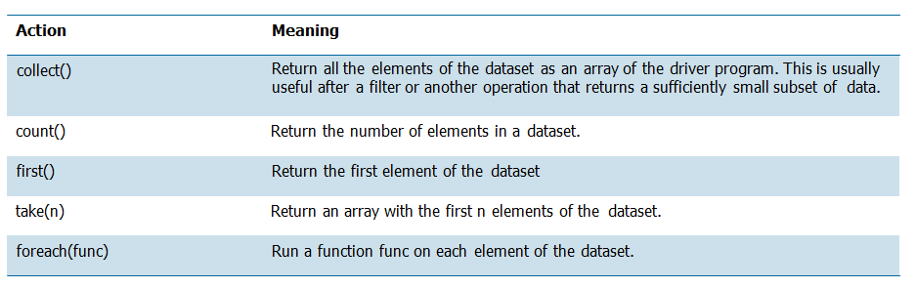
RDD operations: Actions
On the other hand, actions return values
Notes:
Action returns values. Again, you can find more information on Spark's website. The full set of functions are available at https://spark.apache.org/docs/latest/programming- guide.html#actions.
The slide shows a subset:
The collect function returns all the elements of the dataset as an array of the driver program. This is usually useful after a filter or another operation that returns a significantly small subset of data to make sure your filter function works correctly.
The count function returns the number of elements in a dataset and can also be used to check and test transformations.
The take(n) function returns an array with the first n elements. Note that this is currently not executed in parallel. The driver computes all the elements.
The foreach(func) function run a function func on each element of the dataset.

Slide 28
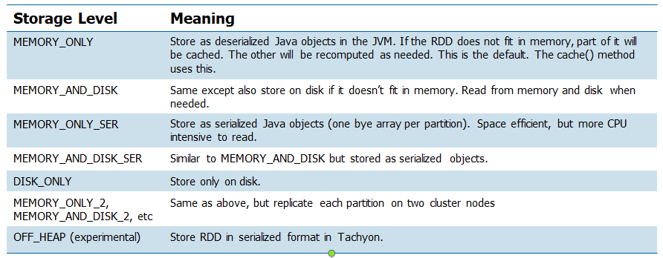
RDD persistence
Each node stores partitions of the cache that it computes in memory
Reuses them in other actions on that dataset (or derived datasets)
Future actions are much faster (often by more than 10x)
Two methods for RDD persistence: persist(), cache()
Notes:
Now to want to get a bit into RDD persistence. You have seen this used already; it is the cache function. The cache function is actually the default of the persist function; cache() is essentially just persist with MEMORY_ONLY storage.
One of the key capability of Spark is its speed through persisting or caching. Each node stores any partitions of the cache and computes it in memory. When a subsequent action is called on the same dataset, or a derived dataset, it uses it from memory instead of having to retrieve it again. Future actions in such cases are often 10 times faster. The first time a RDD is persisted, it is kept in memory on the node. Caching is fault tolerant because if it any of the partition is lost, it will automatically be recomputed using the transformations that originally created it.
There are two methods to invoke RDD persistence. persist() and cache(). The persist() method allows you to specify a different storage level of caching. For example, you can choose to persist the data set on disk, persist it in memory but as serialized objects to save space, etc. Again the cache() method is just the default way of using persistence by storing deserialized objects in memory.
The table shows the storage levels and what it means. Basically, you can choose to store in memory or memory and disk. If a partition does not fit in the specified cache location, then it will be recomputed on the fly. You can also decide to serialized the objects before storing this. This is space efficient, but will require the RDD to deserialized before it can be read, so it takes up more CPU workload. There's also the option to replicate each partition on two cluster nodes. Finally, there is an experimental storage level storing the serialized object in Tachyon. This level reduces garbage collection overhead and allows the executors to be smaller and to share a pool of memory. You can read more about this on Spark's website.

Slide 29
Best practices for which storage level to choose
The default storage level (MEMORY_ONLY) is the best
Otherwise MEMORY_ONLY_SER and a fast serialization library
Don't spill to disk unless the functions that computed your datasets are expensive, or they filter a large amount of the data - recomputing a partition may be as fast as reading it from disk.
Use the replicated storage levels if you want fast fault recovery (such as if using Spark to serve requests from a web application)
All the storage levels provide full fault tolerance by recomputing lost data, but the replicated ones let you continue running tasks on the RDD without waiting to recompute a lost partition
The experimental OFF_HEAP mode has several advantages:
Allows multiple executors to share the same pool of memory in Tachyon
Reduces garbage collection costs
Cached data is not lost if individual executors crash.
Notes:
la sérialisation (de l'anglais américain serialization) est le codage d'une information sous la forme d'une suite d'informations plus petites (dites atomiques, voir l'étymologie de atome) pour, par exemple, sa sauvegarde (persistance) ou son transport sur le réseau (proxy, RPC…). L'activité réciproque, visant à décoder cette suite pour créer une copie conforme de l'information d'origine, s'appelle la désérialisation (ou unmarshalling).
There are a lot of rules on this page; use them as a reference when you have to decide the type of storage level. There are tradeoffs between the different storage levels. You should analyze your current situation to decide which level works best. You can find this information on Spark's website: https://spark.apache.org/docs/latest/rdd-programming- guide.html#rdd-persistence
The primary rules are:
If the RDDs fit comfortably with the default storage level (MEMORY_ONLY), leave them that way - the most CPU-efficient option, allowing operations on the RDDs to run as fast as possible. Basically if your RDD fits within the default storage level, by all means, use that. It is the fastest option to fully take advantage of Spark's design.
Otherwise use MEMORY_ONLY_SER and a fast serialization library to make objects more space-efficient, but still reasonably fast to access.
Do not spill to disk unless the functions that compute your datasets are expensive or it requires a large amount of space.
If you want fast recovery, use the replicated storage levels. Note that all levels of storage are fully fault tolerant, but would still require the recomputing of the data. If you have a replicated copy, you can continue to work while Spark is recomputing a lost partition.
In environments with high amounts of memory or multiple applications, the experimental OFF_HEAP mode has several advantages. Use Tachyon if your environment has high amounts of memory or multiple applications. It allows you to share the same pool of memory and significantly reduces garbage collection costs. Also, the cached data is not lost if the individual executors crash.

Slide 30
Shared variables and key-value pairs
When a function is passed from the driver to a worker, normally a separate copy of the variables are used ("pass by value").
Two types of variables:
Broadcast variables
Read-only copy on each machine
Distribute broadcast variables using efficient broadcast algorithms
As an example, broadcast variables can be used to give every node a copy of a large dataset efficiently.
Accumulators
Variables added through an associative operation
Implement counters and sums
Only the driver can read the accumulators value
Numeric types accumulators. Extend for new types.
As an example, you can use accumulator variables to implement counters or sums, as in MapReduce.
Scala: key-value pairs val pair = ('a', 'b') pair._1 // will return 'a' pair._2 // will return 'b' | Python: key-value pairs pair = ('a', 'b') pair[0] # will return 'a' pair[1] # will return 'b' | Java: key-value pairs Tuple2 pair = new Tuple2('a', 'b'); pair._1 // will return 'a' pair._2 // will return 'b'
Notes:
On this page and the next, you will review Spark shared variables and the type of operations you can do on key-value pairs.
Spark provides two limited types of shared variables for common usage patterns: broadcast variables and accumulators. Normally, when a function is passed from the driver to a worker, a separate copy of the variables are used for each worker. Broadcast variables allow each machine to work with a read-only variable cached on each machine. Spark attempts to distribute broadcast variables using efficient algorithms. As an example, broadcast variables can be used to give every node a copy of a large dataset efficiently.
The other shared variables are accumulators. These are used for counters in sums that works well in parallel. These variables can only be added through an associated operation. Only the driver can read the accumulators value, not the tasks. The tasks can only add to it. Spark supports numeric types but programmers can add support for new types. As an example, you can use accumulator variables to implement counters or sums, as in MapReduce.
Last, but not least, key-value pairs are available in Scala, Python and Java. In Scala, you create a key-value pair RDD by typing val pair = ('a', 'b'). To access each element, invoke the ._ notation. This is not zero-index, so the ._1 will return the value in the first index and ._2 will return the value in the second index. Java is also very similar to Scala where it is not zero-index. You create the Tuple2 object in Java to create a key-value pair. In Python, it is a zero-index notation, so the value of the first index resides in index 0 and the second index is 1.

Slide 31
Programming with key-value pairs
There are special operations available on RDDs of key-value pairs
Grouping or aggregating elements by a key
Tuple2 objects created by writing (a, b)
Must import org.apache.spark.SparkContext._
PairRDDFunctions contains key-value pair operations
reduceByKey((a, b) => a + b)
Custom objects as key in key-value pair requires a custom equals() method with a matching hashCode() method.
Example:
val textFile = sc.textFile("…")
val readmeCount = textFile.flatMap(line =>
line.split(" ")).map(word => (word, 1)).reduceByKey(_ + _)
Notes:
There are special operations available to RDDs of key-value pairs. In an application, you must remember to import the SparkContext package to use PairRDDFunctions such as reduceByKey.
The most common ones are those that perform grouping or aggregating by a key. RDDs containing the Tuple2 object represents the key-value pairs. Tuple2 objects are simple created by writing (a, b) as long as you import the library to enable Spark's implicit conversion.
If you have custom objects as the key inside your key-value pair, remember that you will need to provide your own equals() method to do the comparison as well as a matching hashCode() method.
In the example, you have a textFile that is just a normal RDD. You then perform some transformations on it and it creates a PairRDD which allows it to invoke the reduceByKey method that is part of the PairRDDFunctions API.

Slide 32
Programming with Spark
You have reviewed accessing Spark with interactive shells:
spark-shell (for Scala)
pyspark (for Python)
Next you will review programming with Spark with:
Scala
Python
Java
Compatible versions of software are needed
Spark 1.6.3 uses Scala 2.10. To write applications in Scala, you will need to use a compatible Scala version (e.g. 2.10.X)
Spark 1.x works with Python 2.6 or higher (but not yet with Python 3)
Spark 1.x works with Java 6 and higher - and Java 8 supports lambda expressions
Notes:
Compatibility of Spark with various versions of the programming languages is important.
Note also that as new releases of the HDP are released, you should revisit the issue of compatibility of languages to work with the new versions of Spark. View all versions of Spark and compatible software at: http://spark.apache.org/documentation.html

Slide 33
SparkContext
The SparkContext is the main entry point for Spark functionality; it represents the connection to a Spark cluster
Use the SparkContext to create RDDs, accumulators, and broadcast variables on that cluster
With the Spark shell, the SparkContext, sc, is automatically initialized for you to use
But in a Spark program, you need to add code to import some classes and implicit conversions into your program:
import org.apache.spark.SparkContext
import org.apache.spark.SparkContext._ import org.apache.spark.SparkConf
Notes:
The SparkContext is the main entry point to everything Spark. It can be used to create RDDs and shared variables on the cluster. When you start up the Spark Shell, the SparkContext is automatically initialized for you with the variable sc. For a Spark application, you must first import some classes and implicit conversions and then create the SparkContext object.
The three import statements for Scala are shown on the slide.

Slide 34
Linking with Spark: Scala
Spark applications requires certain dependencies.
Needs a compatible Scala version to write applications.
For example, Spark 1.6.3 uses Scala 2.10.
To write a Spark application, you need to add a Maven dependency on Spark.
Spark is available through Maven Central at:
groupId = org.apache.spark artifactId = spark-core_2.10 version = 1.6.3
To access a HDFS cluster, you need to add a dependency on hadoop-client for your version of HDFS
groupId = org.apache.hadoop artifactId = hadoop-client version = <your-hdfs-version>
Notes:
Each Spark application you create requires certain dependencies. Over the next three slides you will review how to link to those dependencies depending on which programming language you decide to use.
To link with Spark using Scala, you must have a compatible version of Scala with the Spark you choose to use. For example, Spark 1.6.3 uses Scala 2.10, so make sure that you have Scala 2.10 if you wish to write applications for Spark 1.6.3.
To write a Spark application, you must add a Maven dependency on Spark. The information is shown on the slide here. If you wish to access a Hadoop cluster, you need to add a dependency to that as well.
In the lab environment, this will already be set up for you. The information on this page is important if you want to set up a Spark stand-alone environment or your own Spark cluster. Visit the site for more information on Spark versions and dependencies: https://mvnrepository.com/artifact/org.apache.spark/spark-core?repo=hortonworks- releases

Slide 35
Initializing Spark: Scala
Build a SparkConf object that contains information about your application
val conf = new SparkConf().setAppName(appName).setMaster(master)
The appName parameter ➔ Name for your application to show on the cluster UI
The master parameter ➔ is a Spark, Mesos, or YARN cluster URL (or a special "local" string to run in local mode)
In testing, you can pass "local" to run Spark.
local[16] will allocate 16 cores
In production mode, do not hardcode master in the program. Launch with spark-submit and provide it there.
Then, you need to create the SparkContext object.
Notes:
Once you have the dependencies established, the first thing is to do in your Spark application before you can initialize Spark is to build a SparkConf object. This object contains information about your application.
For example,
val conf = new SparkConf().setAppName(appName).setMaster(master)
You set the application name and tell it which is the master node. The master parameter can be a standalone Spark distribution, Mesos, or a YARN cluster URL. You can also decide to use the local keyword string to run it in local mode. In fact, you can run local[16] to specify the number of cores to allocate for that particular job or Spark shell as 16.
For production mode, you would not want to hardcode the master path in your program. Instead, launch it as an argument to the spark-submit command.
Once you have the SparkConf all set up, you pass it as a parameter to the SparkContext constructor to create it.

Slide 36
Linking with Spark: Python
Spark 1.x works with Python 2.6 or higher
Uses the standard CPython interpreter, so C libraries like NumPy can be used.
To run Spark applications in Python, use the bin/spark-submit script located in the Spark directory.
Load Spark's Java/Scala libraries
Allow you to submit applications to a cluster
If you want to access HDFS, you need to use a build of PySpark linking to your version of HDFS.
Import some Spark classes
from pyspark import SparkContext, SparkConf
Notes:
Spark 1.6.3 works with Python 2.6 or higher. It uses the standard CPython interpreter, so C libraries like NumPy can be used.
Check which version of Spark you have when you enter an environment that uses it.
To run Spark applications in Python, use the bin/spark-submit script located in the Spark's home directory. This script will load the Spark's Java/Scala libraries and allow you to submit applications to a cluster. If you want to use HDFS, you will have to link to it as well. In the lab environment, you will not need to do this as Spark is bundled with it. You also need to import some Spark classes, as shown.

Slide 37
Initializing Spark: Python
Build a SparkConf object that contains information about your application
conf = SparkConf().setAppName(appName).setMaster(master)
The appName parameter € Name for your application to show on the cluster UI
The master parameter € is a Spark, Mesos, or YARN cluster URL (or a special "local" string to run in local mode)
In production mode, do not hardcode master in the program. Launch with spark-submit and provide it there.
In testing, you can pass "local" to run Spark.
Then, you need to create the SparkContext object.
sc = SparkContext(conf=conf)
Notes:
Here's the information for Python. It is pretty much the same information as Scala. The syntax here is slightly different, otherwise, you are required to set up a SparkConf object to pass as a parameter to the SparkContext object. You are also recommended to pass the master parameter as an argument to the spark-submit operation.

Slide 38
Linking with Spark: Java
Spark 1.6.3 works with Java 7 and higher.
Java 8 supports lambda expressions
Add a dependency on Spark
Available through Maven Central at: groupId = org.apache.spark artifactId = spark-core_2.10 version = 1.6.3
If you want to access an HDFS cluster, you must add the dependency as well.
groupId = org.apache.hadoop
artifactId = hadoop-client
version = <your-hdfs-version>
Import some Spark classes
import org.apache.spark.api.java.JavaSparkContext
import org.apache.spark.api.java.JavaRDD import org.apache.spark.SparkConf
Notes:
Spark 1.6.3 works with Java 6 and higher. If you are using Java 8, Spark supports lambda expressions for concisely writing functions. Otherwise, you can use the org.apache.spark.api.java.function package with older Java versions.
As with Scala, you need to a dependency on Spark, which is available through Maven Central. If you wish to access an HDFS cluster, you must add the dependency there as well. Last, but not least, you need to import some Spark classes.

Slide 39
Initializing Spark: Java
Build a SparkConf object that contains information about your application
SparkConf conf = new SparkConf().setAppName(appName).setMaster(master)
The appName parameter € Name for your application to show on the cluster UI
The master parameter € is a Spark, Mesos, or YARN cluster URL (or a special "local" string to run in local mode)
In production mode, do not hardcode master in the program. Launch with spark-submit and provide it there.
In testing, you can pass "local" to run Spark.
Then, you will need to create the JavaSparkContext object.
JavaSparkContext sc = new JavaSparkContext(conf);
Notes:
Here is the same information for Java. Following the same idea, you need to create the SparkConf object and pass that to the SparkContext, which in this case, would be a JavaSparkContext. Remember, when you imported statements in the program, you imported the JavaSparkContext libraries.

Slide 40
Passing functions to Spark
Spark's API relies on heavily passing functions in the driver program to run on the cluster
Three methods
Anonymous function syntax (x: Int) => x + 1
Static methods in a global singleton object
object MyFunctions {
def func1 (s: String): String = {…}
}
myRdd.map(MyFunctions.func1)
Passing by reference, to avoid sending the entire object, consider copying the function to a local variable
val field = "Hello"
Avoid:
def doStuff(rdd: RDD[String]):RDD[String] = {rdd.map(x => field + x)}
Consider:
def doStuff(rdd: RDD[String]):RDD[String] = {
val field_ = this.field rdd.map(x => field_ + x) }
Notes:
Passing functions to Spark is important to understand as you begin to think about the business logic of your application.
The design of Spark's API relies heavily on passing functions in the driver program to run on the cluster. When a job is executed, the Spark driver needs to tell its worker how to process the data.
There are three methods that you can use to pass functions.
The first method to do this is using an anonymous function syntax. You saw briefly what an anonymous function is in the first lesson. This is useful for short pieces of code. For example, here we define the anonymous function that takes in a parameter x of type Int and add one to it. Essentially, anonymous functions are useful for one-time use of the function. In other words, you do not need to explicitly define the function to use it. You define as you go. Again, the left side of the => are the parameters or the argument. The right side of the => is the body of the function.
Another method to pass functions around Spark is to use static methods in a global singleton object. This means that you can create a global object, in the example, it is the object MyFunctions. Inside that object, you basically define the function func1. When the driver requires that function, it only needs to send out the object - the worker will be able to access it. In this case, when the driver sends out the instructions to the worker, it just has to send out the singleton object.
It is possible to pass reference to a method in a class instance, as opposed to a singleton object. This would require sending the object that contains the class along with the method. To avoid this consider copying it to a local variable within the function instead of accessing it externally.
Example, say you have a field with the string Hello. You want to avoid calling that directly inside a function as shown on the slide as x => field + x.
Instead, assign it to a local variable so that only the reference is passed along and not the entire object shown val field_ = this.field
For an example such as this, it may seem trivial, but imagine if the field object is not a simple text Hello, but is something much larger, say a large log file. In that case, passing by reference will have greater value by saving a lot of storage by not having to pass the entire file.

Slide 41
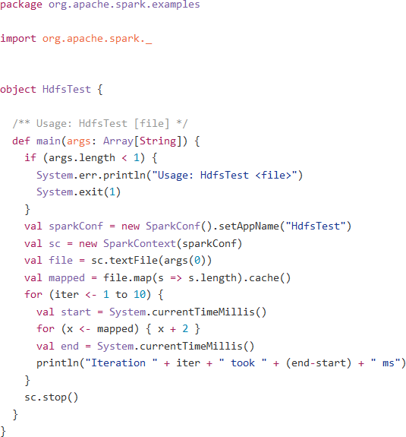
Programming the business logic
Spark's API available in Scala, Java, R, or Python.
Create the RDD from an external dataset or from an existing RDD.
Transformations and actions to process the data.
Use RDD persistence to improve performance
Use broadcast variables or accumulators for specific use cases
Notes:
At this point, you should know how to link dependencies with Spark and also know how to initialize the SparkContext. I also touched a little bit on passing functions with Spark to give you a better view of how you can program your business logic. This course will not focus too much on how to program business logics, but there are examples available for you to see how it is done. The purpose is to show you how you can create an application using a simple, but effective examples which demonstrates Spark's capabilities.
Once you have the beginning of your application ready by creating the SparkContext object, you can start to program in the business logic using Spark's API available in Scala, Java, or Python. You create the RDD from an external dataset or from an existing RDD. You use transformations and actions to compute the business logic. You can take advantage of RDD persistence, broadcast variables and/or accumulators to improve the performance of your jobs.
Here's a sample Scala application. You have your import statement. After the beginning of the object, you see that the SparkConf is created with the application name. Then a SparkContext is created. The several lines of code after is creating the RDD from a text file and then performing the Hdfs test on it to see how long the iteration through the file takes. Finally, at the end, you stop the SparkContext by calling the stop() function.
Again, just a simple example to show how you would create a Spark application. You will get to practice this in an exercise.

Slide 42
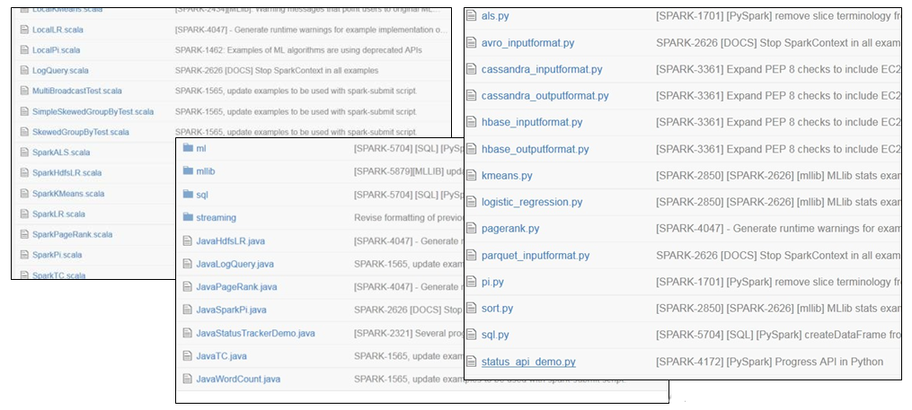
Running Spark examples
Spark samples available in the examples directory
Run the examples: ./bin/run-example SparkPi
where SparkPi is the name of the sample application
In Python:./bin/spark-submit examples/src/main/python/pi.py
Notes:
There are many example programs available that shows the various usage of Spark. Depending on your programming language preference, there are examples in three languages that work with Spark. You can view the source code of the examples on the Spark website, or on GitHub, or within the Spark distribution itself. The slide is a partial overview.
Unit 6 Apache Spark
For a full list of the examples available in GitHub:
Scala: https://github.com/apache/spark/tree/master/examples/src/main/scala/org/apache/spark/examples
Python: https://github.com/apache/spark/tree/master/examples/src/main/python
Java: https://github.com/apache/spark/tree/master/examples/src/main/java/org/apache/spark/examples
R:
https://github.com/apache/spark/tree/master/examples/src/main/r
Spark Streaming: https://github.com/apache/spark/tree/master/examples/src/main/scala/org/apache/spark/ examples/streaming
Java Streaming: https://github.com/apache/spark/tree/master/examples/src/main/java/org/apache/spark/ examples/streaming
The slide lists the steps to run some of these examples. To run Scala or Java examples, you would execute the run-example script under the Spark's bin directory. So for example, to run the SparkPi application, execute run-example SparkPi, where SparkPi would be the name of the application. Substitute that with a different application name to run that other applications.
To run the sample Python applications, use the spark-submit command and provide the path to the application.

Slide 43
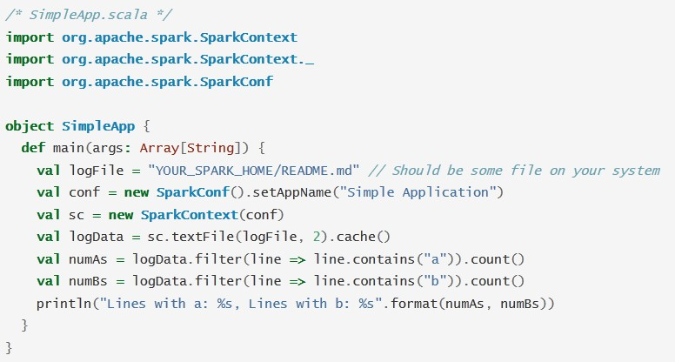
Create Spark standalone applications: Scala
Import statements
SparkConf and SparkContext
Transformations
+ Actions
Notes:
This is an example application using Scala. Similarly programs can be written in Python or Java.
The application shown here counts the number of lines with 'a' and the number of lines with 'b' - you need to replace the YOUR_SPARK_HOME with the directory where Spark is installed.
Unlike the Spark shell, you have to initialize the SparkContext in a program. First you must create a SparkConf to set up your application's name. Then you create the SparkContext by passing in the SparkConf object. Next, you create the RDD by loading in the textFile, and then caching the RDD. Since we will be apply a couple of transformation on it, caching will help speed up the process, especially if the logData RDD is large. Finally, you get the values of the RDD by executing the count action on it. End the program by printing it out onto the console.

Slide 44
Run standalone applications
Define the dependencies using any system build mechanism (Ant, SBT, Maven, Gradle)
Example:
Scala € simple.sbt
Java € pom.xml
Python € --py-files argument (not needed for SimpleApp.py)
Create the typical directory structure with the files
Create a JAR package containing the application's code.
Use spark-submit to run the program
Scala using SBT :
./simple.sbt
./src
./src/main
./src/main/scala
./src/main/scala/SimpleApp.scala
Java using Maven:
./pom.xml
./src
./src/main
./src/main/java
./src/main/java/SimpleApp.java
Notes:
At this point, you should know how to create a Spark application using any of the supported programming language. Now you get to explore how to run the application. You will need to first define the dependencies. Then you have to package the application together using system build tools such as Ant, sbt, or Maven. The examples here show how you would do it using various tools. You can use any tool for any of the programming languages. For Scala, the example is shown using sbt, so you would have a simple.sbt file. In Java, the example shows using Maven so you would have the pom.xml file. In Python, if you need to have dependencies that requires third party libraries, then you can use the -py-files argument to handle that.
Again, shown here are examples of what a typical directory structure would look like for the tool that you choose.
Finally, once you have the JAR packaged created, run the spark-submit to execute the application:
Scala: sbt
Java: mvn
Python: submit-spark

Slide 45
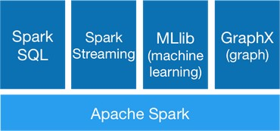
Spark libraries
Extension of the core Spark API.
Improvements made to the core are passed to these libraries.
Little overhead to use with the Spark core
spark.apache.org
Notes:
Spark comes with libraries that you can utilize for specific use cases. These libraries are an extension of the Spark Core API. Any improvements made to the core will automatically take effect with these libraries. One of the big benefits of Spark is that there is little overhead to use these libraries with Spark as they are tightly integrated.
The rest of this lesson will cover on a high level, each of these libraries and their capabilities. The main focus will be on Scala with specific callouts to Java or Python if there are major differences.
The four libraries are Spark SQL, Spark Streaming, MLlib, and GraphX. The remainder of this course will cover these libraries.

Slide 46
Spark SQL
Allows relational queries expressed in
SQL
HiveQL
Scala
SchemaRDD
Row objects
Schema
Created from:
Existing RDD
Parquet file
JSON dataset
HiveQL against Apache Hive
Supports Scala, Java, R, and Python
Notes:
Spark SQL allows you to write relational queries that are expressed in either SQL, HiveQL, or Scala to be executed using Spark. Spark SQL has a new RDD called the SchemaRDD. The SchemaRDD consists of rows objects and a schema that describes the type of data in each column in the row. You can think of this as a table in a traditional relational database.
You create a SchemaRDD from existing RDDs, a Parquet file, a JSON dataset, or using HiveQL to query against the data stored in Hive. Spark SQL is currently an alpha component, so some APIs may change in future releases.
Spark SQL supports Scala, Java, R, and Python.

Slide 47
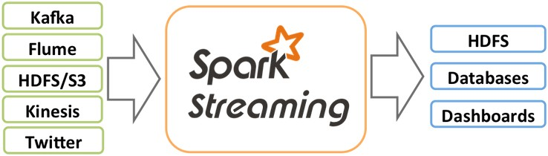
Spark streaming
Scalable, high-throughput, fault- tolerant stream processing of live data streams
Receives live input data and divides into small batches which are processed and returned as batches
DStream - sequence of RDD
Currently supports Scala, Java, and Python
Receives data from:
Kafka
Flume
HDFS / S3
Kinesis
Twitter
Pushes data out to:
HDFS
Databases
Dashboard
Notes:
Spark streaming gives you the capability to process live streaming data in small batches. Utilizing Spark's core, Spark Streaming is scalable, high-throughput and fault- tolerant. You write Stream programs with DStreams, which is a sequence of RDDs from a stream of data. There are various data sources that Spark Streaming receives from including, Kafka, Flume, HDFS, Kinesis, or Twitter. It pushes data out to HDFS, databases, or some sort of dashboard.
Spark Streaming supports Scala, Java and Python. Python was actually introduced with Spark 1.2. Python has all the transformations that Scala and Java have with DStreams, but it can only support text data types. Support for other sources such as Kafka and Flume will be available in future releases for Python.

Slide 48
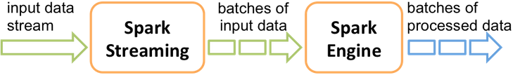
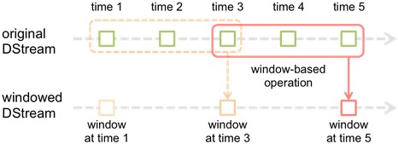
Spark Streaming: Internals
The input stream (DStream) goes into Spark Streaming
The data is broken up into batches that are fed into the Spark engine for processing
The final results are generated as a stream of batches
spark.apache.org
Sliding window operations
Windowed computations
Window length
Sliding interval
reduceByKeyAndWindow
spark.apache.org
Notes:
Here's a quick view of how Spark Streaming works. First the input stream comes in to Spark Streaming. That data stream is broken up into batches of data that are fed into the Spark engine for processing. Once the data has been processed, it is sent out in batches.
Spark Stream support sliding window operations. In a windowed computation, every time the window slides over a source of DStream, the source RDDs that falls within the window are combined and operated upon to produce the resulting RDD.
There are two parameters for a sliding window:
The window length is the duration of the window
The sliding interval is the interval in which the window operation is performed.
Both of these parameters must be in multiples of the batch interval of the source DStream.
In the second diagram, the window length is 3 and the sliding interval is 2. To put it into perspective, maybe you want to generate word counts over last 30 seconds of data, every 10 seconds. To do this, you would apply the reduceByKeyAndWindow operation on the pairs of DStream of (Word,1) pairs over the last 30 seconds of data.
Doing wordcount in this manner is provided as an example program NetworkWordCount, available on GitHub at https://github.com/apache/spark/blob/master/examples/src/main/scala/org/apache/spar k/examples/streaming/NetworkWordCount.scala

Slide 49
MLlib
MLlib for machine learning library - under active development
Provides, currently, the following common algorithm and utilities
Classification
Regression
Clustering
Collaborative filtering
Dimensionality reduction
Notes:
Here is a really short overview of the machine learning library. The MLlib library contains algorithms and utilities for classification, regression, clustering, collaborative filtering and dimensionality reduction. Essentially, you would use this for specific machine learning use cases that requires these algorithms.

Slide 50
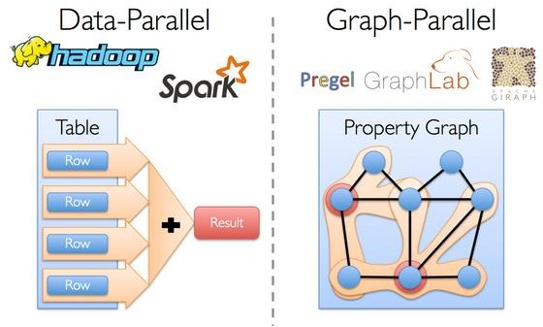
GraphX
GraphX for graph processing
Graphs and graph parallel computation
Social networks and language modeling
https://spark.apache.org/docs/latest/graphx-programming-guide.html#overview
Notes:
The GraphX is a library that sits on top of the Spark Core. It is basically a graph processing library which can used for social networks and language modeling. Graph data and the requirement for graph parallel systems is becoming more common, which is why the GraphX library was developed. Specific scenarios would not be efficient if it is processed using the data-parallel model. A need for the graph-parallel model is introduced with new graph-parallel systems like Giraph and GraphLab to efficiently execute graph algorithms much faster than general data-parallel systems.
There are new inherent challenges that comes with graph computations, such as constructing the graph, modifying its structure, or expressing computations that span several graphs. As such, it is often necessary to move between table and graph views depending on the objective of the application and the business requirements.
The goal of GraphX is to optimize the process by making it easier to view data both as a graph and as collections, such as RDD, without data movement or duplication.

Slide 51
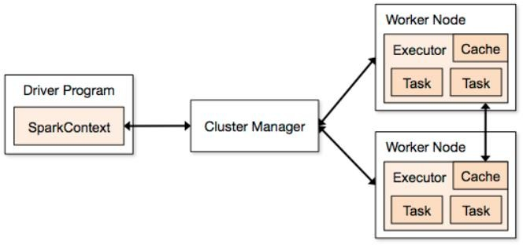
Spark cluster overview
Components
Driver
Cluster Master
Executors
Three supported Cluster Managers:
Standalone
Apache Mesos
Hadoop YARN
Notes:
There are three main components of a Spark cluster. You have the driver, where the SparkContext is located within the main program. To run on a cluster, you would need some sort of cluster manager. This could be either Spark's standalone cluster manager, or Mesos or YARN. Then you have your worker nodes where the executors reside. The executors are the processes that run computations and store the data for the application. The SparkContext sends the application, defined as JAR or Python files to each executor. Finally, it sends the tasks for each executor to run.
Several things to understand this architecture.
Each application gets its own executor processes. The executor stays up for the entire duration that the application is running. The benefit of this is that the applications are isolated from each other, on both the scheduling side, and running on different JVMs. However, this means that you cannot share data across applications. You would need to externalize the data if you wish to share data between different applications, instances of SparkContext.
Spark applications don't care about the underlying cluster manager. As long as it can acquire executors and communicate with each other, it can run on any cluster manager.
Because the driver program schedules tasks on the cluster, it should run close to the worker nodes on the same local network. If you like to send remote requests to the cluster, it is better to use a RPC and have it submit operations from nearby.
There are currently three supported cluster managers. Spark comes with a standalone manager that you can use to get up and running. You can use Apache Mesos, a general cluster manager that can run and service Hadoop jobs. Finally, you can also use Hadoop YARN, the resource manager in Hadoop
2. In the lab exercise, you will be using HDP with YARN to run your Spark applications.

Slide 52
Spark monitoring
Three ways to monitor Spark applications
Web UI
Port 4040 (lab exercise on port 8088)
Available for the duration of the application
Metrics
Based on the Coda Hale Metrics Library
Report to a variety of sinks (HTTP, JMX, and CSV)
/conf/metrics.properties
External instrumentations
Cluster-wide monitoring tool (Ganglia)
OS profiling tools (dstat, iostat, iotop)
JVM utilities (jstack, jmap, jstat, jconsole)
Notes:
There are three ways to monitor Spark applications. The first way is the Web UI. The default port is 4040. The port in the lab environment is 8088. The information on this UI is available for the duration of the application. If you want to see the information after the fact, set the spark.eventLog.enabled to true before starting the application. The information will then be persisted to storage as well.
The Web UI has the following information.
A list of scheduler stages and tasks.
A summary of RDD sizes and memory usage.
Environmental information and information about the running executors.
To view the history of an application after it has running, you can start up the history server. The history server can be configured on the amount of memory allocated for it, the various JVM options, the public address for the server, and a number of properties.
Metrics are a second way to monitor Spark applications. The metric system is based on the Coda Hale Metrics Library. You can customize it so that it reports to a variety of sinks such as CSV. You can configure the metrics system in the metrics.properties file under the conf directory.
In addition, you can also use external instrumentations to monitor Spark. Ganglia is used to view overall cluster utilization and resource bottlenecks. Various OS profiling tools and JVM utilities can also be used for monitoring Spark.

Slide 53
Checkpoint
List the benefits of using Spark.
List the languages supported by Spark.
What is the primary abstraction of Spark?
What would you need to do in a Spark application that you would not need to do in a Spark shell to start using Spark?

Slide 54
Unit summary
Understand the nature and purpose of Apache Spark in the Hadoop ecosystem
List and describe the architecture and components of the Spark unified stack
Describe the role of a Resilient Distributed Dataset (RDD)
Understand the principles of Spark programming
List and describe the Spark libraries
Launch and use Spark's Scala and Python shells
Notes:
Additional information and exercises are available in the Cognitive Class course Spark Fundamentals available at https://cognitiveclass.ai/learn/spark/. That course gets into further details on most of the topics covered here, especially Spark configuration, monitoring, and tuning.
Cognitive Class has been chosen by IBM as one of the issuers of badges as part of the IBM Open Badge program.
Cognitive Class leverages the services of Pearson VUE Acclaim to assist in the administration of the IBM Open Badge program. By enrolling into this course, you agree to Cognitive Class sharing your details with Pearson VUE Acclaim for the strict use of issuing your badge upon completion of the badge criteria. The course comes with a final quiz where the minimum passing mark for the course is 60%, where the final test is worth 100% of the course mark.

