Slide 1
Configuring Big SQL security

Slide 2
Unit objectives
Configure authentication for Big SQL
Manage security with Apache Ranger
Enable SSL encryption
Configure authorization of Big SQL objects
Configure impersonation in Big SQL

Slide 3
Authentication for Big SQL
Authentication modes
Uses the authentication mode of HDP: LDAP*, flat file, Kerberos
In addition to client authentication, which can also be done through LDAP, flat file, and Kerberos
LDAP: Lightweight Directory Access Protocol: the process of validating a username and password combination with a directory server
Kerberos for authentication
Central repository for user IDs (also known as principals)
Network authentication protocol
Secret-key cryptography
Free to use
Client/server prove their identity to each other
Notes:
Big SQL inherits the authentication modes of Hortonworks Data Platform to authenticate users. Big SQL can use LDAP, flat files, or Kerberos. This authentication is done in addition to the client authentication, which can also be through LDAP, flat file, and Kerberos. With Kerberos authentication, a central repository is created for all the user IDs. Kerberos is a network authentication protocol that works through a secret-key cryptography, where the client and server must identify themselves to one another. A free version of an implementation of this protocol is available from MIT. It's also available in many commercial products as well.

Slide 4
Setting up Kerberos for the Big SQL service
Enable Kerberos security through Ambari
Set the max_renewable_life parameter in the realms section
/var/kerberos/krb5kdc/kdc.conf
Configure Kerberos to work in the Big SQL service
Kerberize the entire Big SQL cluster
Install Big SQL on a Kerberized cluster
Kerberos troubleshooting commands
Start Kerberos
/sbin/service krb5kdc start /sbin/service kadmin start
Run kdadmin commands
kadmin.local
Get principal from KDC server using kadmin
getprinc bigsql/myserver.abc.com@MYCOMPANY.COM
Notes:
You can set up Kerberos for the Big SQL service. The first thing you will need to do is prepare the cluster and you can do that by following the instructions provided by Hortonworks. https://docs.hortonworks.com/HDPDocuments/Ambari- 2.5.1.0/bk_ambari-security/content/enabling_kerberos_security_in_ambari.html
Additional steps needed if you are sharing the KDC server with another cluster. Then you can enable the security through the Ambari UI. You can configure Kerberos on an existing Big SQL cluster or you can install Big SQL on a Kerberized cluster. Both have their specific sets of instructions you can follow. Here are some of the Kerberos troubleshooting commands.

Slide 5
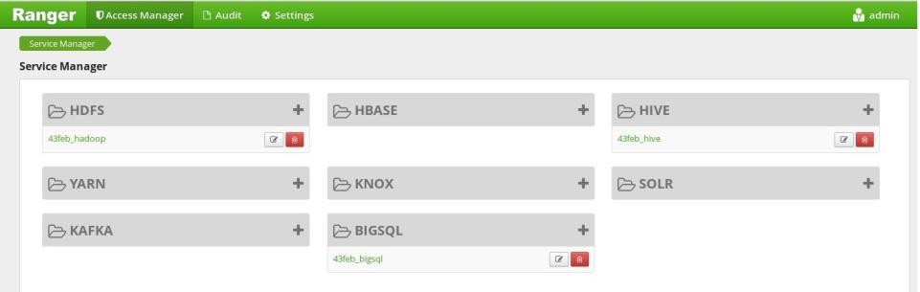
Ranger security for Big SQL
Framework to enable, monitor, manage comprehensive data security across the Hadoop platform
Support is available for Big SQL
Can be enabled to control access to Hadoop and HBase tables
Enable / Disable the Big SQL Ranger plugin
All access to Big SQL tables automatically audited by Ranger
Two limitations
Ranger security cannot be used in combination with Impersonation
View based access control is not available at the view level
Notes:
If you have used Apache Ranger before and would like to apply its security framework to Big SQL, it is now available in this release of Big SQL. Ranger is a framework to enable, monitor, and manage comprehensive data security across the Hadoop platform, including Big SQL. With Ranger, you can control access to your Hadoop and HBase tables. You need to separately install Ranger in addition to HDP and Big SQL.
Once Ranger is installed, you enable the Big SQL Ranger plugin to set up Ranger as the authorizer for Big SQL tables. You will need to restart Big SQL after you enable the plugin for it to take effect. If you decide to disable the Big SQL Ranger plugin, you will be removing the Big SQL service from Ranger, including all the policies that have been set up. Ranger also provides auditing to all the tables that it manages.
There are two limitations with Ranger. If you are using Ranger, you cannot use Big SQL impersonation, which is another form of authorization that is covered in a later unit.
Ranger also cannot control view based access at the view level. You would need separate authorizations at the underlying table level.

Slide 6
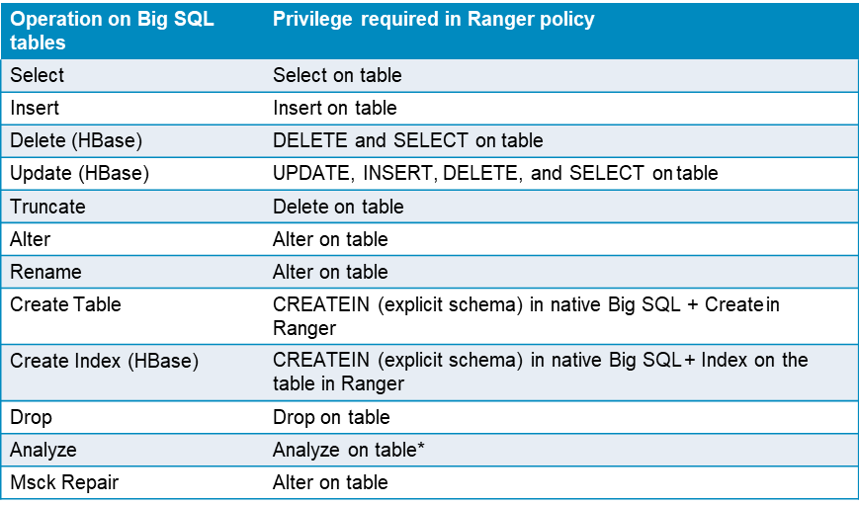
Privileges and operations controlled by Ranger
Notes:
When you enable the Big SQL Ranger plugin, these are the operations that Ranger controls. One comment on this slide here is on the Analyze operation. In addition to the Analyze operation, the user will also need whatever operation it needs in native Big SQL to run the Analyze operation.

Slide 7
Enable SSL encryption
Big SQL supports SSL encryption
Configure the SSL support in the Db2 instance (Big SQL engine)
Modify the configuration file to add SSL port
Restart Big SQL
Notes:
Big SQL supports SSL encryption. You can set it up by configuring the SSL support in the Db2 instance through the following link:
https://www.ibm.com/support/knowledgecenter/SSEPGG_10.5.0/com.ibm.db2.luw.adm in.sec.doc/doc/t0025241.html
Then you need to modify the configuration file to add the SSL port and restart Big SQL for the changes to take effect.

Slide 8
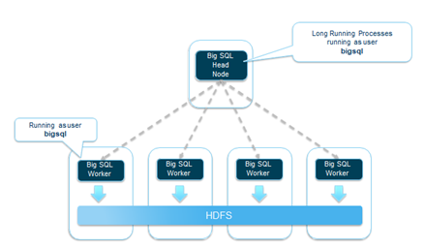
Basic process architecture
To understand the Big SQL security model, here is a high level architecture overview.
Big SQL is classified as a long running service in Hadoop.
This means that the service is running whether or not users are connected to Big SQL.
This operating model is what provides Big SQL the ability to support low latency and high concurrency workloads.
The Big SQL head node has a set of processes running and waiting to perform work.
These operating system processes are running as a service ID called bigsql, by default.
Similarly, on the data nodes, Big SQL worker processes are running and waiting to perform work.
These processes are also running as the bigsql service ID.
The Big SQL workers perform the reads and writes as the bigsql user to HDFS when queries are submitted.
Notes:
To understand the Big SQL security model, here is a high level architecture overview. Big SQL is classified as a long running service in Hadoop. This means that the service is running whether or not users are connected to Big SQL. This operating model is what provides Big SQL the ability to support low latency and high concurrency workloads.
The Big SQL head node has a set of processes running and waiting to perform work. These operating system processes are running as a service ID called bigsql, by default.
Similarly, on the data nodes, Big SQL worker processes are running and waiting to perform work. These processes are also running as the bigsql service ID.
The Big SQL workers perform the reads and writes as the bigsql user to HDFS when queries are submitted.

Slide 9
Authorization of Big SQL objects
Level 1 – Controlling access with authorization in the distributed file system
Level 2 – Authorization with the GRANT command
Level 3 – Authorization at the row and column level
Level 4 – Controlling access by using VIEWS or STORED PROCEDURES
Notes:
There are four different levels to manage authorizations with Big SQL objects. The permissions are managed within the Big SQL catalog tables.

Slide 10
Level 1 - Controlling access with authorization in the distributed file system
The data directories and files for the tables are owned by the bigsql service ID in HDFS
Creating a schema
A directory is created inside /apps/hive/warehouse on the DFS
The <schema> directory is created with the permissions that are inherited from the /warehouse directory
Directory permissions
Set the directory permissions to the DFS first
Set permission 770 to give full access by the owner and the group, but no public access
hdfs dfs –chmod 770 /hive/warehouse
Set permission 700 to give full access to the bigsql user, but no access for anyone else
hdfs dfs –chmod 700 /hive/warehouse
Notes:
Level 1 is controlled at the distributed file system layer, where, as the default bigsql user, you own all the files and tables that are created through Big SQL. For example, when you create a schema, a <schema> directory is created under
/apps/hive/warehouse on the DFS. The permissions of the <schema> folder are
inherited from the /apps/hive/warehouse folder. So, before you create any schemas, you should set the directory permissions to the DFS first. This way, when you create the schemas, it will automatically inherit what you set. The slide lists two examples, one to set the permissions as 770 to give full access to the owner and the group, but no public access. The second example gives full access to just the bigsql user, but no access for anyone else.

Slide 11
Level 2 - Authorization with the GRANT command
GRANT or REVOKE to give or remove certain privileges to users
If you created the table, you have the authority
The DBA can grant authority other others
For example, as the bigsql user, you can run
GRANT INSERT, SELECT, DELETE ON myschema.SALES to USER user1
Notes:
Level 2 is supported through the use of GRANT and REVOKE commands. As the bigsql user, you can give or remove privileges using GRANT and REVOKE. An example is shown with the bigsql user GRANTing INSERT, SELECT, and DELETE to user1.

Slide 12
Level 3 - Authorization at the row and column level
Additional layer of security based on row and column access (RCAC)
Controls access to the table at the row level, column level, or both
Row based access control
Only show rows that satisfy a certain criteria
User will not know that other rows exists
Column based access control
Applies a mask to the values of a column based on the user
Only certain users will see the actual values of the masked columns
− Other users will see a default/pre-defined value
Notes:
Level 3 is controlled at the table level, within the rows and columns. Row based access control limits the rows returned, based on a certain criteria. If a particular user does not fit within the criteria, they will not know about the other rows. Column based access control applies a mask on columns where, if the user is part of the role, they will see the column's actual value. If not, they will only see a pre-set value as the masked value.

Slide 13
Level 3 - Why RCAC?
Managing privileges on users is tedious and error-prone
New users have to decide what kind of access they need
Departing users need to clean up their access rights
Users should only see data that matters to them (or rather, not see data that they should not)
Sensitive data in columns
Notes:
Before you get into the details of how to implement row and column access control, take a look at some of the reasons why you would want to do use RCAC. First of all, managing privileges on users is tedious and error prone. Imagine that you have to grant six different privileges across five tables for two users. That's a total of 12 GRANT statements that you need to manage for just two users across five tables. Now, the problem magnifies if you had to manage it for hundreds of users across dozens of tables. New users would have to decide what kind of access they need. Departing users need to clean up their access rights.
Another problem is that users should only see the data that matters to them, or rather, not be able to see the data they should not see. Say there are three departments or branches and if you belong to a particular branch, you should only see the data pertaining to that branch and not the other two.
The third problem is sensitive data in columns. A good, and common, example is the salary information. Most users should not have access to salary information, so this must be hidden from other users.

Slide 14
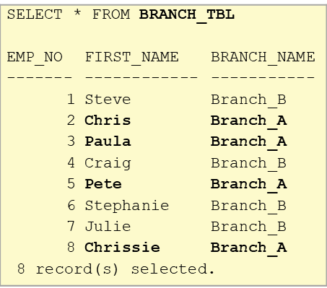
Level 3 - Row based access control (1 of 5)
Sample data to show row based access control
What would you need to do to limit the rows to either Branch_A or Branch_B?
Notes:
Here is some sample data to show row based access control. SELECT * from the BRANCH_TBL table. Eight rows are returned. Four of those rows belong to the Branch_A and the other four belongs to Branch_B. What would you need to do to limit the rows to either Branch_A or Branch_B?

Slide 15
Level 3 - Row based access control (2 of 5)
CREATE and GRANT access and roles
CREATE a BRANCH_A_ROLE
GRANT that role to a USER newton
GRANT SELECT to newton
CREATE ROLE BRANCH_A_ROLE
GRANT ROLE BRANCH_A_ROLE TO USER newton
GRANT SELECT ON BRANCH_TBL TO USER newton
ROLE BRANCH_A_ROLE
Say that you have a user, newton and newton only needs to see results from Branch_A.
CREATE the ROLE BRANCH_A_ROLE. Then, GRANT this role to the USER newton. Finally, instead of granting the SELECT privilege to the user, you grant it to the role.
Now imagine that if you had multiple privileges that you had to set, you would only need to set them once for the role and then as new users need them, you just assign the new users to that role. This greatly simplifies the case where if you had hundreds of users, you only need to assign the role to them (as opposed to each individual privilege). The reverse is also true where if a user needs to have the access revoked, they just need to be removed from the role (as opposed to revoking each privilege).
Notes:
Say that you have a user, newton and newton only needs to see results from
Branch_A.
CREATE the ROLE BRANCH_A_ROLE. Then, GRANT this role to the USER newton. Finally, instead of granting the SELECT privilege to the user, you grant it to the role.
Now imagine that if you had multiple privileges that you had to set, you would only need to set them once for the role and then as new users need them, you just assign the new users to that role. This greatly simplifies the case where if you had hundreds of users, you only need to assign the role to them (as opposed to each individual privilege). The reverse is also true where if a user needs to have the access revoked, they just need to be removed from the role (as opposed to revoking each privilege).

Slide 16
Level 3 - Row based access control (3 of 5)
Create permissions
CREATE PERMISSION BRANCH_A_ACCESS on the table
User is equal to the BRANCH_A_ROLE
The branch is equal to BRANCH_A
CREATE PERMISSION BRANCH_A_ACCESS ON BRANCH_TBL
FOR ROWS WHERE(VERIFY_ROLE_FOR_USER(SESSION_USER,'BRANCH_A_ROLE') = 1
AND
BRANCH_TBL.BRANCH_NAME = 'Branch_A') ENFORCED FOR ALL ACCESS
ENABLE
Notes:
Create the permission for BRANCH_A_ACCESS on the BRANCH_TBL where if the user is in the BRANCH_A_ROLE, then return the only the rows pertaining to Branch_A.

Slide 17
Level 3 - Row based access control (4 of 5)
Enable access control
Activate the access control on the table
ALTER TABLE BRANCH_TBL ACTIVATE ROW ACCESS CONTROL

Slide 18
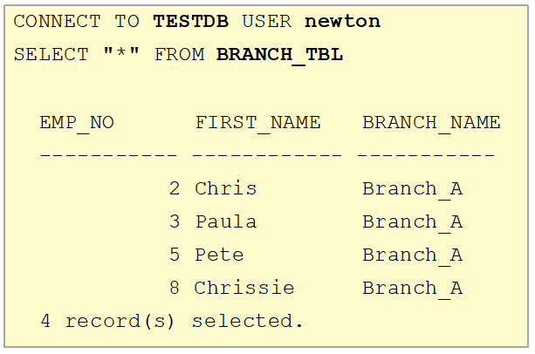
Level 3 - Row based access control (5 of 5)
Select as Branch_A user
Only the 4 records from Branch_A are returned
Notes:
Perform another SELECT on the table as a USER of the BRANCH_A _ROLE, which is newton in the example. Note that only the Branch_A rows are returned because of the row access control. Now, if the user newton needs to have the access revoked, a simple revoke from the BRANCH_A_ROLE will remove the user's privilege to select from Branch_A.
This solves the first two problems that we identified where managing users is tedious and error prone and users should only see the data that applies to them. The final problem where column data is sensitive is addressed by column access control.

Slide 19
Level 3 - Column based access control (1 of 5)
Data from the salary table
Three columns
EMP_NO
FIRST_NAME
SALARY
SELECT "*" FROM SAL_TBL
EMP_NO FIRST_NAME SALARY
------- ------------ -----------
1 Steve 250000
2 Chris 200000
3 Paula 1000000
Notes:
Here is a table of salary information to demonstrate column based access control. There are three columns in this table: employee number, first name, and the salary. You are going to hide (mask) the salary column from employees, but keep it visible to managers.

Slide 20
Level 3 - Column based access control (2 of 5)
Create and grant access and roles
Create a manager and an employee role and grant it to two different users.
CREATE ROLE MANAGER
CREATE ROLE EMPLOYEE
GRANT SELECT ON SAL_TBL TO ROLE MANAGER
GRANT SELECT ON SAL_TBL TO ROLE EMPLOYEE
GRANT ROLE MANAGER TO USER socrates
GRANT ROLE EMPLOYEE TO USER newton
Notes:
First, create two roles: MANAGER and EMPLOYEE. Then, GRANT the SELECT privilege to the two different roles: MANAGER and EMPLOYEE. Finally, GRANT the MANAGER role to socrates and the EMPLOYEE role to newton. So socrates is the MANAGER and newton is the EMPLOYEE.

Slide 21
Level 3 - Column based access control (3 of 5)
Create permissions
Create a mask on the salary column
If the user belongs to the manager role
Show the salary column
Else
Show 0.00
CREATE MASK SALARY_MASK ON SAL_TBL FOR
COLUMN SALARY RETURN
CASE WHEN VERIFY_ROLE_FOR_USER(SESSION_USER,'MANAGER') = 1 THEN SALARY
ELSE 0.00
END ENABLE
Notes:
Create the SALARY_MASK on the SAL_TBL on the SALARY column. If the user is in the MANAGER role, then show the SALARY column, otherwise show the value 0.00.

Slide 22
Level 3 - Column based access control (4 of 5)
Enable access control
Created by a user with SECADM authority
ALTER TABLE SAL_TBL ACTIVATE COLUMN ACCESS CONTROL
Notes:
Activate the column access control on the SAL_TBL table.

Slide 23
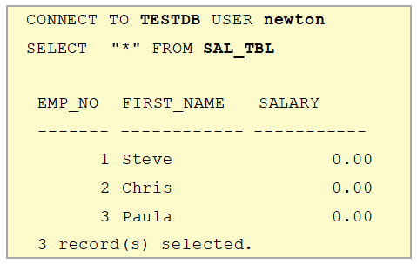

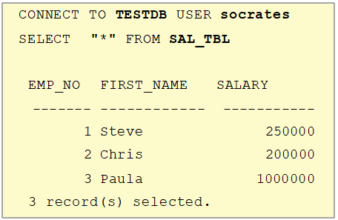

Level 3 - Column based access control (5 of 5)
Notes:
In the top example of the slide, you are selecting from the table as newton. In the bottom example, you are selecting as socrates. Remember that socrates is in the MANAGER role, so therefore, the salary column is returned. newton is not in the MANAGER role, so the salary column is masked with the value provided when you set up the column masking.

Slide 24
Level 4 - Controlling access by using VIEWS or STORED PROCEDURES
Standard type of database authorization control
Create a VIEW or a STORED PROCEDURE to limit access
Notes:
Level 4 is simply using VIEWS and STORED PROCEDURES to limit the access. By granting certain users only the ability to query a VIEW or STORED PROCEDURE, you can control the access to the data.

Slide 25
Impersonation in Big SQL
Ability to allow a service user to securely access data in Hadoop on behalf of another user
Example: If impersonation is enabled, the default bigsql user can impersonate the connected user to perform actions on Hadoop tables
By default, bigsql performs the read/write operations on HDFS, Hive, and HBase that is required for the Big SQL service
Impersonation is not needed if the bigsql user is the sole owner
You might need impersonation if the data that you want to analyze is produced outside of the Big SQL service
Loading data from a different data source
Sharing data between multiple services in the cluster
Thorough review of the entire life cycle of your data is needed before you decide on whether to use impersonation
Notes:
Impersonation in Big SQL allows the service user to securely access Hadoop data on behalf of another. For example, by default, the service id is bigsql. If the service user needs to access a set of data belonging to user1, impersonation would allow bigsql to access and perform actions on the data belonging to user1.
You might need impersonation when the data you want to analyze was created outside of the Big SQL service (for example, another Hadoop job). You might also want to use impersonation for cases where you may need to share the data among multiple services (for example, using Hadoop for ETL, Spark for basic analytics and transformations, and Big SQL for advanced analytics.).
A thorough review of your entire life cycle of the data is needed before you decide on whether or not to use impersonation. The change to go back from impersonation is not trivial.

Slide 26
Why would you want to use impersonation?
Only applies to certain uses cases
Data produced by one service to be consumed by another
Multiple services needing to use the same data
ETL to move the data into HDFS
Spark for some cleansing and basic analysis
Big SQL for advanced analytics
Difficult to set up authorizations for each individual service
When you do not need enhanced security controls provided by Big SQL
RCAC
Label-based security
View-based security
Notes:
Here are a few more reasons why you would want to use impersonation. These only apply to certain use cases, so be sure to evaluate your data before making the decision.
If your data was produced by another service, particularly outside of Big SQL, you may want to use impersonation.
If your data needs to be shared across multiple services, you may want to use impersonation to simplify access control.
If it is difficult to set up authorizations for each individual service separately, you may want to use impersonation.
More importantly, when you do not need the enhanced security controls provided by Big SQL such as the RCAC, label based security or view-based security. Impersonation does not work with these.

Slide 27
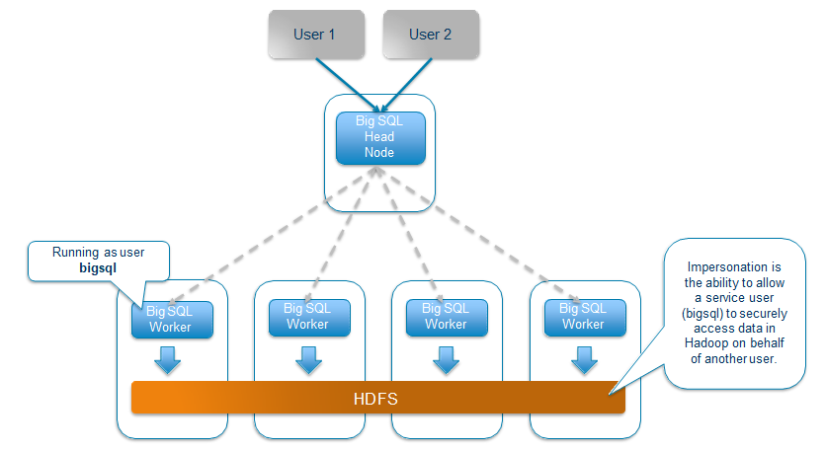
Basic architecture with impersonation
Notes:
To understand the default security model of Big SQL, this slide illustrates what happens when different users, say User 1 and User 2 submit queries to Big SQL. The queries are compiled and optimized in the Big SQL head node and instructions are passed to the workers. But the workers, remember, are running as the bigsql service ID. So the files in HDFS are read by the bigsql service ID on behalf of the end user.

Slide 28
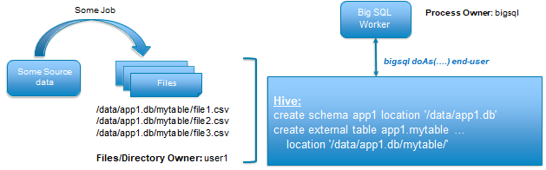
Populate Hive/Big SQL tables via HDFS directly
Files for app1.mytable on HDFS are owned by user1
E.g. files are the output of a Hadoop job executed by user1
Any user can query app1.mytable provided HDFS level permissions to /data/app1.db/mytable
End users or other application ID’s external to Big SQL directly manage who can access their datasets
LOAD HADOOP utility still works the same way
BUT any directories and files created will be owned by the end user in HDFS
Notes:
Here it shows that user1 owns the /data/app1.db/mytable/ directory. The directory contains files from a Hadoop job. To use Big SQL on this data, the bigsql service ID impersonates user1 and create the schema along with the table, overlaying the data in Hadoop. Now, user1 can run SQL on the data residing in HDFS. The HDFS level permission of the /data/app1.db/mytable directory is set where any user can query that table. The LOAD HADOOP utility works the same way, but any new directory and files create will be owned by the user1 in HDFS.

Slide 29
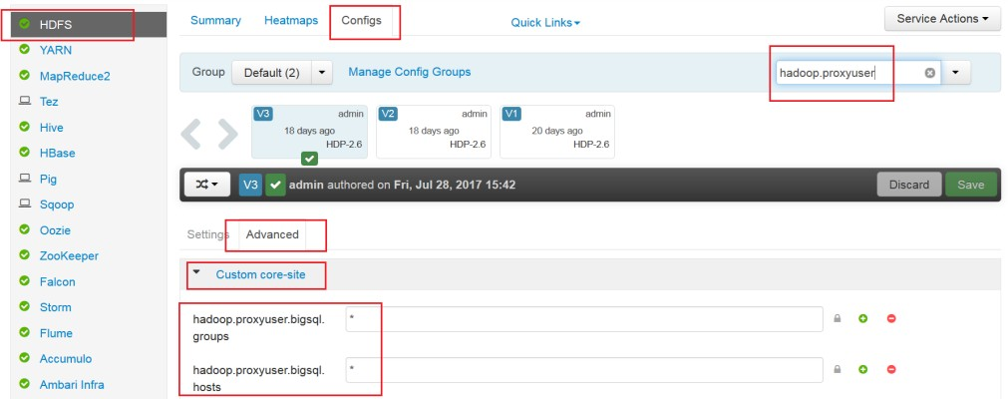
Enabling impersonation for Big SQL (1 of 3)
Verify that the HDFS configuration properties have been configured
hadoop.proxyuser.<bigsql>.groups is set to *
hadoop.proxyuser.<bigsql>.hosts is set to the fully qualified hostname of the Big SQL head node
Notes:
The first thing you must do before you can enable impersonation in Big SQL is to verify that the correct HDFS configuration properties have been configured. This should be set up by default during installation, but it is good practice to verify this. You can do this through the Ambari UI by going to HDFS € Configs € Advanced € Custom core- site. A quicker way to do this is by typing in the property name in the Filter field and these properties will show up. If it does not exist, you need to create them. This is to ensure that the bigsql user is listed in the HDFS configuration property and allows the bigsql user to impersonate other users.

Slide 30
Enabling impersonation for Big SQL (2 of 3)
The impersonated user must have the appropriate authority to create a table in the specified schema
Modify the properties in $BIGSQL_HOME/conf/bigsql-conf.xml
bigsql.alltables.io.doAs = true (default is false)
bigsql.impersonation.create.table.grant.public = true (default is false)
Notes:
The impersonated user, such as user1, must have the appropriate authority in the HDFS to create a table in the specified schema. To enable impersonation, you must modify the bigsql-conf.xml file. In particular, you must set the bisql.alltables.io.doAs to true. This enables the impersonation for all Hadoop table operations. You also need to set bigsql.impersonation.create.table.grant.public to true to ensure any new Hadoop table is granted ALTER, INDEX, INSERT, UPDATE, and DELETE to public.

Slide 31
Enabling impersonation for Big SQL (3 of 3)
Check authorization settings in Hive
Authorization = None
Run as end user instead of Hive user = True
Make sure to grant the bigsql user admin privileges in Hive
Set the /apps/hive/warehouse folder to 777, writable by all users
Disable inherit permissions in Hive
Set hive.warehouse.subdir.inherit.perms to false
Ignores permissions of /app/hive/warehouse
Instead, rely on default UMASK
Notes:
In Ambari € Hive € Configs, ensure that the Authorization is set to None and the Run as end user instead of Hive user is set to True. These are the default settings. You can search for the hive.server2.enable.doAs property using the Filter if you do not see it on the Configs page.
Then, make sure to grant the bigsql user admin privileges in Hive so that the user can administer the table in Hive without impersonation in Big SQL.
Set the /apps/hive/warehouse folder to 777, so that it is writable by all users.
Finally, you want to disable inherit permissions in Hive so that new directories created under /apps/hive/warehouse does not inherit the permissions, but instead you want to rely on the default UMASK.

Slide 32
Set folder permissions
When users create new Hive schemas, /apps/hive/warehouse needs to be writable by all users
CREATE SCHEMA henry € /apps/hive/warehouse/henry.db
To allow users to create their own schemas, we need:
This is why we set hive.warehouse.subdir.inherit.perms=False
Command:
hdfs dfs -chmod 777 /apps/hive/warehouse
Path | ownership : group name | Permissions
/apps/hive/warehouse | hive:hadoop | rwxrwxrwx = 777
Notes:
You want to set the warehouse directory to 777, so that all users can write to the directory. For example, when you create a schema, a directory is created under the warehouse folder. To allow users to create their own schema, you need to set the inherit permissions properties to false along with setting the permissions to 777 on the warehouse directory.

Slide 33
What is UMASK?
When users create Hive schemas and tables, new directories are created
CREATE SCHEMA henry € /apps/hive/warehouse/henry.db
CREATE TABLE henry.test (…) € /apps/hive/warehouse/henry.db/test/
UMASK determines their permissions setting for new directories/files
What do you want it to be?
Start with*:
777 = rwxrwxrwx
Subtract UMASK (022)
777
-022
755 = rwxr-xr-x
*Note: For files, start with 666 = -rw-rw-rw
Notes:
So what is UMASK?
UMASK determines the permissions settings for new directories/files that are created. The default UMASK setting is 022, so when you start with 777, you subtract the UMASK value to get 755. This translate to the owner having full READ, WRITE, and EXECUTE permissions on the newly created schema. The group has READ and EXECUTE. All others have READ and EXECUTE.

Slide 34
Examples
Example 1: If user schema directories should have rwxr-xr-x (755), set UMASK=022 (default)
Example 2: If user schema directories should have rwxrwx--- (770), set UMASK=007
ownership : group name | Permissions | Path
user1:user1 | rwxr-xr-x | /apps/hive/warehouse/user1
bigsql:hadoop | rwxr-xr-x | /apps/hive/warehouse/user2
ownership : group name | Permissions | Path
user1:user1 | rwxrwx--- | /apps/hive/warehouse/user1
bigsql:hadoop | rwxrwx--- | /apps/hive/warehouse/user2
Notes:
By adjusting the UMASK value to get want you need, you can control the permissions of the folders.

Slide 35
Impersonation usage notes and restrictions
The /user/<username> directory must exist with READ, WRITE, and EXECUTE for the user
DROPped tables remain in the HDFS trash folder
In case there were errors in the DROP operation, you can recover
.Trash folder under the home directory of the connected user
<username> must exist on each node of the cluster
Impersonation behavior applies to Hadoop tables only
Any storage handlers or SERDEs used in a CREATE HADOOP TABLE statement sees the impersonation behavior
Impersonation is not used for HBase tables
If you are using encryption, you must still provide the encryption key to the bigsql user
Notes:
Before you start to use impersonation, you must ensure that the /user/<username> directory on HDFS exists with READ, WRITE, and EXECUTE for the user. Otherwise, the queries will return an error. Tables that are dropped from the database goes into the
.Trash folder under the /user/<username>/ directory. This is because when you run a
DROP table statement, Big SQL does the drop operation in Hive as the connect user. Sometimes Hive allows the DROP to proceed even though there might be errors. As a result, the data is retained even if the table is dropped from Big SQL and Hive.
The <username> must exist on each node of the cluster. Impersonation only applies to Hadoop tables.
Any storage handlers and SERDEs used in a CREATE HADOOP TABLE statement also sees the impersonation behavior.
Impersonation is not used for tables that are created by the HBASE TABLE statement. For HBase tables, the bigsql user creates a logical Big SQL table over the HBase table in Hive in the <schema>.db directory. You must have the appropriate permissions set up in HDFS for the warehouse folder.
If you use encryption, you must provide the encryption key to the bigsql user.

Slide 36
Checkpoint
True or False? Authentication with Big SQL only occurs at the Big SQL layer or the client's application layer.
True or False? You can only Kerberize a Big SQL server before it is installed.
True or False? Ranger and impersonation works well together.
True or False? RCAC can hide rows and columns.
True or False? UMASK is used to determine permissions on directories and files.

Slide 37
Unit summary
Configure authentication for Big SQL
Manage security with Apache Ranger
Enable SSL encryption
Configure authorization of Big SQL objects
Configure impersonation in Big SQL

