Slide 1
Storing and querying data
Data Science Foundations

Slide 2
Unit objectives
List the characteristics of representative data file formats, including flat/text files, CSV, XML, JSON, and YAML
List the characteristics of the four types of NoSQL datastores
Describe the storage used by HBase in some detail
Describe and compare the open source programming languages, Pig and Hive
List the characteristics of programming languages typically used by Data Scientists: R and Python

Slide 3
Introduction to data
"Data are values of qualitative or quantitative variables, belonging to a set of items" - Wikipedia
Common data representation formats used for big data include:
Row- or record-based encodings:
Flat files / text files
CSV and delimited files
Avro / SequenceFile
JSON
Other formats: XML, YAML
Column-based storage formats:
RC / ORC file
Parquet
NoSQL datastores
Compression of data
Notes:
Storing petabytes of data in Hadoop is relatively easy, but it is more important to choose an efficient storage format for faster querying.
Row-based encodings (Text, Avro, JSON) with a general purpose compression library (gzip, LZO, CMX, Snappy) are common mainly for interoperability reasons, but column- based storage formats (Parquet, ORC) provide not only faster query execution by minimizing IO but also great compression.
Compression is important to big data file storage:
Reduces file sizes and thus speeds up transfer to/from disk
Generally faster to transfer a small file and then decompress than to transfer a larger file

Slide 4
Gathering and cleaning/munging/wrangling data
"In our experience, the tasks of exploratory data mining and data cleaning constitute 80% of the effort that determines 80% of the value of the ultimate data."
Dasu, T., & Johnson, T. (2003) Exploratory data mining and data cleaning
Sources of error in data: Data quality/veracity issues
Data entry errors (such as call center records manually entered)
Measurement errors (such as bad/inappropriate sampling)
Distillation errors (such as smoothing due to noise)
Data integration errors (such as multiple databases)
Data manipulation
Filtering or subsetting
Transforming: add new variables or modify existing variables
Aggregating: collapse multiple values into a single value
Sorting: change the order of values
Notes:
Often the data that is gathered (raw data) needs to be seriously processed and even converted/transformed either before or in the process of loading into HDFS.
There is no settled terminology for the set of activities between acquiring and modeling data. You will see the phrase data preparation to describe these activities. Data preparation seeks to turn newly acquired raw data into clean data that can be analyzed and modeled in a meaningful way. This phase of the data science workflow, and subsets of it, have been variously labeled munging, wrangling, reduction, and cleansing. You can use the various terms indifferently, though some of them are often classified as jargon.
Data munging or data wrangling is loosely the process of manually converting or mapping data from one raw form into another format that allows for more convenient consumption of the data with the help of semi-automated tools. This may include further munging, data visualization, data aggregation, training a statistical model, as well as many other potential uses.
Data munging as a process typically follows a set of general steps which begin with extracting the data in a raw form from the data source, munging the raw data using algorithms (like sorting) or parsing the data into predefined data structures, and finally depositing the resulting content into a data sink for storage and future use.[1] Given the rapid growth of the internet such techniques will become increasingly important in the organization of the growing amounts of data available.
In the world of data warehousing, ETL (extract-transform-load) is referred to; here the process is often ELT - load first, transform later.
Dasu and Johnson's book (2003) is available online at https://goo.gl/nIoSvj (this url shortener will open at the quotation).
Data wrangling also the subject of a New York Times article: http://www.nytimes.com/2014/08/18/technology/for-big-data-scientists-hurdle-to- insights-is-janitor-work.html (For Big-Data Scientists, "Janitor Work" Is Key Hurdle to Insights).

Slide 5
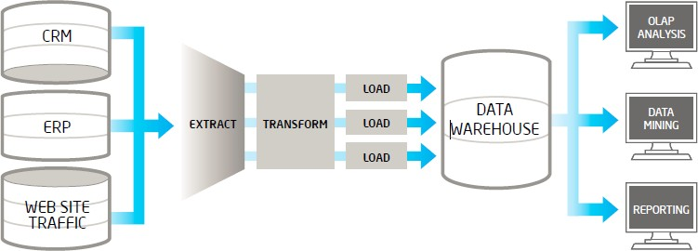
Flat files/text files
The traditional ETL (extract-transform-load) process extracts data from multiple sources, then cleanses, formats, and loads it into a data warehouse for analysis
Flat files or text files may need to be parsed into fields/attributes
Fields may be positional at fixed offset from the beginning of the record
Or, text analytics may be required to extract meaning

Slide 6
CSV and various forms of delimited files
Familiar to everyone as input/output to spreadsheet applications:
Rows correspond to individual records
Columns of plain text are separated by comma or some other delimiter (tab, |, etc.)
May have a header record with names of columns
Problems:
Quotes may be used in order to deal with strings of text
Escape characters may be present (typically backslash = \)
Windows and Linux/UNIX use different end-of-line characters
Python has a standard library that includes a CSV package
Though attractive, the capabilities of CSV-style formats are limited:
Assumes each record has a fix number of attributes
Not easy to represent sets, lists, or maps, or more complex data structures
Notes:
An example of CSV-formatted data with a header row:
id,title,description,price 1,shoes,red shoes,$70.00
2,hat,a black hat,$20.00 3,sweater,a wool sweater,$50.00

Slide 7

Avro/SequenceFile
Avro data files are a compact, efficient binary format that provides interoperability with applications written in other programming languages
Avro also supports versioning, so that when, for example, columns are added or removed from a table, previously imported data files can be processed along with new ones
SequenceFiles are a binary format that store individual records in custom record-specific data types
This format supports exact storage of all data in binary representations, and is appropriate for storing binary data (for example, VARBINARY columns), or data that will be principally manipulated by custom MapReduce programs
Reading from SequenceFiles is higher-performance than reading from text files, as records do not need to be parsed).
Notes:
Doug Cutting (one of the original developers of Hadoop) answered the question, “What are the advantages of Avro's object container file format over the SequenceFile container format?” http://www.quora.com/What-are-the-advantages-of-Avros-object- container-file-format-over-the-SequenceFile-container-format
Two primary reasons:
Language Independence. The SequenceFile container and each Writable implementation stored in it are only implemented in Java. There is no format specification independent of the Java implementation. Avro data files have a language-independent specification and are currently implemented in C, Java, Ruby, Python, and PHP. A Python-based application can directly read and write Avro data files.
Avro's language-independence is not yet a huge advantage in MapReduce programming, since MapReduce programs for complex data structures are generally written in Java. But, once you implement Avro tethers for other languages (http://s.apache.org/ZOw, Hadoop Pipes for Avro), then it will be possible to write efficient mappers and reducers in C, C++, Python, and Ruby that operate on complex data structures.
Language independence can be an advantage today however if you'd like to create or access data outside of MapReduce programs from non-Java applications. Moreover, as the Hortonworks Data Platform expands, Hortonworks would like to be able to include more non-Java applications and to easily interchange data with these applications, so establishing a standard, language- independent data format for this platform is a priority.
Versioning. If a Writable class changes, if fields are added or removed, the type of a field is changed or the class is renamed, then data is usually unreadable. A Writable implementation can explicitly manage versioning, writing a version number with each instance and handling older versions at read-time. This is rare, but even then, it does not permit forward-compatibility (old code reading a newer version) nor branched versions. Avro automatically handles field addition and removal, forward and backward compatibility, branched versioning, and renaming, all largely without any awareness by an application.
The versioning advantages are available today for Avro MapReduce applications.

Slide 8
JSON format: JavaScript Object Notation
JSON is a plain-text object serialization format that can represent quite complex data in a way that can be transferred between a user and a program or one program to another program
Often called the language of Web 2.0
Two basic structures:
Records consisting of maps (aka key/value pairs), in curly braces:
{name: "John", age: 25}
Lists (aka arrays), in square brackets: [ . . . ]
Records and arrays can be nested in each other multiple times
Support libraries are available in R, Python, and other languages
Standard JSON format does not offer any formal schema mechanism although there are attempts at developing a formal schema
APIs that return JSON data: Cnet, Flikr, Google Geocoder, Twitter, Yahoo Answers, Yelp, etc.
Notes:
JSON (JavaScript Object Notation) is an open standard format that uses human- readable text to transmit data objects consisting of attribute-value pairs. It is used primarily to transmit data between a server and web application, as an alternative to XML. Although originally derived from the JavaScript scripting language, JSON is a language-independent data format. Code for parsing and generating JSON data is readily available in many programming languages.
The primary reference site (www.json.org) describes JSON as built on two structures:
A collection of name/value pairs. In various languages, this is realized as an object, record, struct, dictionary, hash table, keyed list, or associative array.
An ordered list of values. In most languages, this is realized as an array, vector, list, or sequence.
These are universal data structures with great flexibility in practice. Virtually all modern programming languages support them in one form or another. It makes sense that a data format that is interchangeable between programming languages is also based on these structures.

Slide 9
XML (eXtensible Markup Language)
XML is an incredibly rich and flexible data representation format
Uses markup to provide context for fields in plain text
Provides an excellent mechanism for serializing objects and data
Widely used as an electronic data interchange (EDI) format within industry sectors
XML has a formal schema language, written in XML, and data written within the constraints of a schema are guaranteed to be valid for later processing
Webpages are written in HTML, a variant on XML
Web scraping/web harvesting/web data extraction can be used to extract information from websites
Web crawling and scraping can be done with languages such as Python, R, and others
Many of the configuration files used in the Hadoop ecosystem are in XML format
Notes:
Example of XML formatted data:
<Items>
<listing id=1 title="shoes" price="$70.00">
<description>red shoes</description>
</listing>
<listing id=2 title="hat" price="$20.00">
<description>black hat</description>
</listing>
<listing id=3 title="sweater" price="$50.00">
<description>a wool sweater</description>
</listing>
</Items>

Slide 10
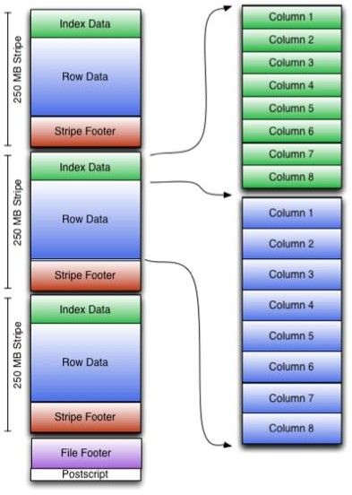
RC/ORC file formats
RC (Record Columnar File) file format was developed to support Hive ORC (Optimized Row Columnar) format now challenges the RC format by providing an optimized / more efficient approach
Specific encoders for different column data types
Light-weight indexing that enables skipping of complete blocks of rows
Provides basic statistics such as min, max, sum, and count, on columns
Larger default blocksize (256MB)
Notes:
ORC goes beyond RCFile and uses specific encoders for different column data types to improve compression further, e.g. variable length compression on integers. ORC introduces a lightweight indexing that enables skipping of complete blocks of rows that do not match a query. It comes with basic statistics, min, max, sum, and count, on columns. Lastly, a larger block size of 256 MB by default optimizes for large sequential reads on HDFS for more throughput and fewer files to reduce load on the NameNode.
Reference: http://www.semantikoz.com/blog/orc-intelligent-big-data-file-format-hadoop- hive

Slide 11
Parquet
"Apache Parquet is a columnar storage format available to any project in the Hadoop ecosystem, regardless of the choice of data processing framework, data model or programming language“ http://parquet.apache.org
Compressed, efficient columnar storage, developed by Cloudera and Twitter
Efficiently encodes nested structures and sparsely populated data based on the Google BigTable / BigQuery / Dremel definition/repetition levels
Allows compression schemes to be specified on a per-column level
Future-proofed to allow adding more encodings to be added as they are invented and implemented
Provides some of the best results in various benchmark, performance tests
Notes:
Résolue pour permettre l'ajout de codages supplémentaires au fur et à mesure de leur invention et de leur mise en œuvre
This is the official announcement from Cloudera and Twitter about Parquet, an efficient general-purpose columnar file format for Apache Hadoop (from http://blog.cloudera.com/blog/2013/03/introducing-parquet-columnar-storage-for- apache-hadoop):
Parquet is designed to bring efficient columnar storage to Hadoop. Compared to, and learning from, the initial work done toward this goal in Trevni, Parquet includes the following enhancements:
Efficiently encode nested structures and sparsely populated data based on the Google Dremel definition/repetition levels
Provide extensible support for per-column encodings (such as delta, run length, etc.)
Provide extensibility of storing multiple types of data in column data (such as indexes, bloom filters, statistics)
Offer better write performance by storing metadata at the end of the file
A new columnar storage format was introduced for Hadoop called Parquet, which started as a joint project between Twitter and Cloudera engineers.
Parquet was created to make the advantages of compressed, efficient columnar data representation available to any project in the Hadoop ecosystem, regardless of the choice of data processing framework, data model, or programming language.
Parquet is built from the ground up with complex nested data structures in mind. This seems to be a very efficient method of encoding data in non-trivial object schemas.
Parquet is built to support very efficient compression and encoding schemes. Parquet allows compression schemes to be specified on a per-column level, and is future-proofed to allow adding more encodings as they are invented and implemented. The concepts of encoding and compression are separated, allowing Parquet consumers to implement operators that work directly on encoded data without paying decompression and decoding penalty when possible.
Parquet is built to be used by anyone. The Hadoop ecosystem is rich with data processing frameworks. An efficient, well-implemented columnar storage substrate should be useful to all frameworks without the cost of extensive and difficult to set up dependencies.
The initial code defines the file format, provides Java building blocks for processing columnar data, and implements Hadoop Input/Output Formats, Pig Storers/Loaders, and an example of a complex integration, Input/Output formats that can convert Parquet-stored data directly to and from Thrift objects.
Related references:
Google Big Table: https://cloud.google.com/files/BigQueryTechnicalWP.pdf
Dremel: http://research.google.com/pubs/pub36632.html

Slide 12
NoSQL
NoSQL, aka "Not only SQL," aka "Non-relational" was specifically introduced to handle the rise in data types, data access, and data availability needs brought on the dot.com boom
It is generally agreed that there are four types of NoSQL datastores:
Key-value stores
Graph stores
Column stores
Document stores
Why consider NoSQL?
Flexibility
Scalability - they scale horizontally rather than vertically
Availability
Lower operational costs
Specialized capabilities
Notes:
Examples of each of the four types of NoSQL datastores:
Key-value stores: MemcacheD, REDIS, and Riak
Graph stores: Neo4j and Sesame
Column stores: HBase and Cassandra
Document stores: MongoDB, CouchDB, Cloudant, and MarkLogic
NoSQL datastores will not be replacing the traditional RDMSs, neither transactional relational databases nor data warehouses. Nor will Hadoop be replacing them either

Slide 13
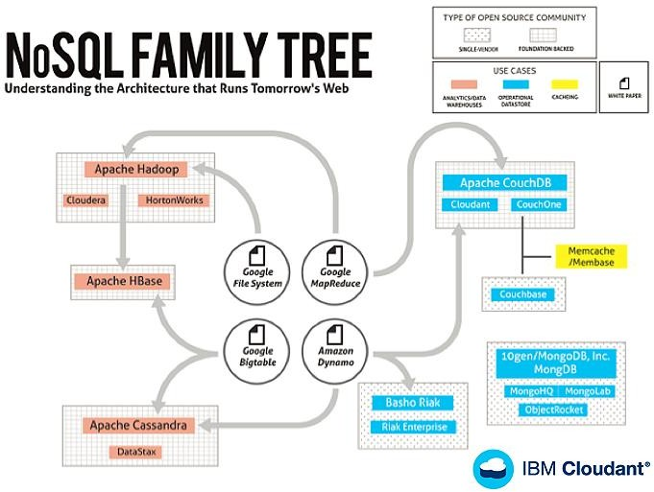
Origins of the NoSQL products

Slide 14
What is HBase?
An industry leading implementation of Google's BigTable Design
What's a BigTable?
−"A BigTable is a sparse, distributed, persistent multidimensional sorted map" http://research.google.com/archive/bigtable-osdi06.pdf
An open source Apache Top Level Project
Embraced and supported by IBM
HBase powers some of the leading sites on the Web (such as Facebook, Yahoo, etc.)
http://wiki.apache.org/hadoop/Hbase/PoweredBy)
A NoSQL data store
Notes:
In 2004 Google began development of a distributed storage system for structured data called BigTable. Google engineers designed a system for storing big data that can scale to petabytes leveraging commodity servers. Projects at Google like Google Earth, web indexing and Google Finance required a new cost effective, robust and scalable system that the traditional RDBMS was incapable of supporting. In November of 2006 Google released a whitepaper describing BigTable (see the URL). Roughly one year later, Powerset created HBase which is a BigTable implementation compliant with the Google specification. In 2008 HBase was released as an open source top-level Apache project (http://hbase.apache.org) and HBase is now the Hadoop database.
HBase powers some of the leading sites on the World Wide Web refer to: http://wiki.apache.org/hadoop/Hbase/PoweredBy

Slide 15
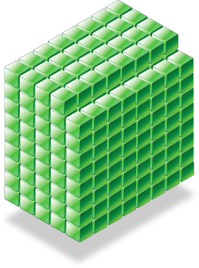












Why NoSQL?
Zettabytes
Cost effective technology is needed to handle new volumes of data
Increased data volumes lead to RDBMS Sharding
Flexible Data Models are Needed to Support BigData Applications
Petabytes
Sharding
A
B
ABC
C
Id | Fn | Ln | Addr
1 | Fred | Jones | Liberty, NY
2 | John | Smith | ??????
Notes:
So why consider NoSQL Technology? This slide presents three key reasons:
Massive data sets exhaust the capacity and scale of existing RDBMSs. Buying additional licenses and adding more CPU, RAM and DISK is very expensive and not linear in cost. Many companies and organizations also want to leverage more cost effective commodity systems and open source technologies. NoSQL technology deployed on commodity high volume servers can solve these problems.
Distributing the RDBMS is operationally challenging and often technically impossible. The architecture breaks down when sharding is implemented on a large scale. Denormalization of the data model, joins, referential integrity and rebalancing are common issues.
Un-structured data (such as social media data: Twitter, Facebook, email, etc.) and semi-structured data (such as application logs, security logs) do not fit the traditional model of schema-on-ingest. Typically the schema is developed after ingest and analysis. Un-structured and semi-structured data generate a variable number of fields and variable data content, and are therefore problematic for the data architect when designing the database. There may be many NULL fields (sparse data), and or the number and type of fields may be variable.
So why consider NoSQL Technology? This slide presents three key reasons:
Massive data sets exhaust the capacity and scale of existing RDBMSs. Buying additional licenses and adding more CPU, RAM and DISK is very expensive and not linear in cost. Many companies and organizations also want to leverage more cost effective commodity systems and open source technologies. NoSQL technology deployed on commodity high volume servers can solve these problems.
Distributing the RDBMS is operationally challenging and often technically impossible. The architecture breaks down when sharding is implemented on a large scale. Denormalization of the data model, joins, referential integrity and rebalancing are common issues.
Un-structured data (such as social media data: Twitter, Facebook, email, etc.) and semi-structured data (such as application logs, security logs) do not fit the traditional model of schema-on-ingest. Typically the schema is developed after ingest and analysis. Un-structured and semi-structured data generate a variable number of fields and variable data content, and are therefore problematic for the data architect when designing the database. There may be many NULL fields (sparse data), and or the number and type of fields may be variable.
Additional consideration points:
In this new age of big data, most or all of these challenges are typical and as a result the NoSQL market is growing rapidly. Traditional RDBMS technologies and high end server platforms often exceed budgets. Organizations want to leverage commodity high volume servers. Elastic scale out is needed to handle new volumes of data (sensors, log files, social media data, etc.) and increased retention requirements.
Sharding is not cost effective in the age of big data. Sharding creates architectural issues (such as Joins/Denormalization, Referential Integrity and Challenges with Rebalancing).
New applications require a flexible schema. Records can be sparse (e.g. social media data is variable). Schema cannot always be designed up front.
And, briefly:
Increased complexity of SQL
Sharding introduces complexity
Single point of failure
Failover servers more complex
Backups more complex
Operational complexity added

Slide 16
Why HBase in particular?
Highly Scalable
Automatic partitioning (sharding)
Scale linearly and automatically with new nodes
Low Latency
Support random read/write, small range scan
Highly Available
Strong Consistency
Very good for "sparse data" (no fixed columns)
Notes:
So why are so many businesses and government organizations choosing HBase over other NoSQL technologies?
For starters, HBase is considered "…the Hadoop Database" (see hbase.apache.org) and is bundled with supported Apache Hadoop distributions like Hortonworks Data Platform. If you need high performance random read/write access to your big data you are probably going to leverage HBase on your Hadoop cluster. HBase users can easily leverage the Map/Reduce model and other powerful features included with Apache Hadoop.
HDP's strategy for Apache Hadoop is to embrace and extend the technology with powerful advanced analytics, development tooling, performance and availability enhancements, security and manageability. As a key component of Hadoop, HBase is part of this strategy with strong support and a solid roadmap going forward.
When the requirements fit, HBase can replace certain costly RDBMSs.
HBase handles sharding seamlessly and automatically and benefits from the non- disruptive horizontal scaling feature of Hadoop. When more capacity and or performance is needed, users add DataNodes to the Hadoop cluster. This provides immediate growth to HBase data stores since HBase leverages the HDFS. Users can easily scale from TBs to PBs as their capacity needs grow.
HBase supports a flexible and dynamic data model. The Schema does not need to be defined up front which makes HBase a natural fit for many big data applications and some traditional applications as well.
The Apache Hadoop file system, HDFS, does not naturally support applications requiring random read/write capability. HDFS was designed for large sequential batch operations (e.g. write once with many large sequential reads during analysis). HBase does support high performance random r/w applications and for this reason alone it is often leveraged in Hadoop applications.

Slide 17
HBase and ACID Properties
Atomicity
All reading and writing of data in one region is done by the assigned Region Server
All clients have to talk to the assigned Region Server to get to the data
Provides row level atomicity
Consistency and Isolation
All rows returned via any access API will consist of a complete row that existed at some point in the table's history
A scan is not a consistent view of a table. Scans do not exhibit snapshot isolation. Any row returned by the scan will be a consistent view (for example, that version of the complete row existed at some point in time)
Durability
All visible data is also durable data. That is to say, a read will never return data that has not been made durable on disk
Notes:
ACID Properties: un ensemble de propriétés qui garantissent qu'une transaction informatique est exécutée de façon fiable.
A frequently asked question whenever discussing HBase technology is: "How does HBase adhere to the ACID Properties?"
The HBase community provided a very good page discussing this, which is summarized on this slide: http://hbase.apache.org/acid-semantics.html
When strict ACID properties are required:
HBase provides strict row level atomicity.
As far as Apache HBase is concerned - "There is no further guarantee or transactional feature that spans multiple rows or across tables."**
See also Indexed-Transactional HBase project - https://github.com/hbase- trx/hbase-transactional-tableindexed
Note: HBase and other NoSQL distributed data stores are subject to the CAP Theorem which states that distributed NoSQL data stores can only achieve 2 out of the 3 properties: consistency, availability and partition tolerance.

Slide 18
Atomicité
assure qu'une transaction se fait au complet ou pas du tout : si une partie d'une transaction ne peut être faite, il faut effacer toute trace de la transaction et remettre les données dans l'état où elles étaient avant la transaction. L'atomicité doit être respectée dans toutes situations, comme une panne d'électricité, une défaillance de l'ordinateur, ou une panne d'un disque magnétique.
Cohérence
assure que chaque transaction amènera le système d'un état valide à un autre état valide. Tout changement à la base de données doit être valide selon toutes les règles définies, incluant mais non limitées aux contraintes d'intégrité, aux rollbacks en cascade, aux déclencheurs de base de données, et à toutes combinaisons d'événements.
Isolation
Toute transaction doit s'exécuter comme si elle était la seule sur le système. Aucune dépendance possible entre les transactions. La propriété d'isolation assure que l'exécution simultanée de transactions produit le même état que celui qui serait obtenu par l'exécution en série des transactions. Chaque transaction doit s'exécuter en isolation totale : si T1 et T2 s'exécutent simultanément, alors chacune doit demeurer indépendante de l'autre.
Durabilité
assure que lorsqu'une transaction a été confirmée, elle demeure enregistrée même à la suite d'une panne d'électricité, d'une panne de l'ordinateur ou d'un autre problème. Par exemple, dans une base de données relationnelle, lorsqu'un groupe d'énoncés SQL a été exécuté, les résultats doivent être enregistrés de façon permanente, même dans le cas d'une panne immédiatement après l'exécution des énoncés.

Slide 19
HBase data model
Data is stored in HBase table(s)
Tables are made of rows and columns
All columns in HBase belong to a particular column family
Table schema only defines column families
Can have large, variable number of columns per row
(row key, column key, timestamp) ➔ value
A {row, column, version} tuple exactly specifies a cell
Each cell value has a version
Timestamp
Row stored in order by row keys
Row keys are byte arrays; lexicographically sorted
"... a sparse, distributed, persistent, multi-dimensional sorted map. The map is indexed by a row key, column key, and a timestamp; each value in the map is an uninterrupted array of bytes"
- Google BigTable paper

Slide 20
Think "Map": This is not a spreadsheet model
Most literature describes HBase as a Column-Oriented data store which it is, but this can lead to confusion
"In computer science, an associative array, map, or dictionary is an abstract data type composed of a collection of (key,value) pairs, such that each possible key appears at most once in the collection."
Technically HBase is a multidimensional sorted map
 | Column A | Column B | Column C
Row A
Row B
Row C
Note: Column Families contain Columns with time stamped versions. Columns only exist when inserted (i.e. sparse)
Row A
Row B
Row C
Column A
Integer
Column B
Value
Column B
Long Timestamp1
Long Timestamp2
Column C
Huge URL
Family 1
Family 2

Slide 21
HBase Data Model: Logical view
Table
Contains column-families
Column family
Logical and physical grouping of columns
Column
Exists only when inserted
Can have multiple versions
Each row can have different set of columns
Each column identified by it’s key
Row key
Implicit primary key
Used for storing ordered rows
Efficient queries using row key
HBTABLE
Row key | Value
11111 | cf_data: {‘cq_name’: ‘name1’, ‘cq_val’: 1111} cf_info: {‘cq_desc’: ‘desc11111’}
22222 | cf_data: {‘cq_name’: ‘name2’, ‘cq_val’: 2013 @ ts = 2013, ‘cq_val’: 2012 @ ts = 2012 }
HFile
HFile
11111 cf_data cq_name name1 @ ts1
11111 cf_data cq_val 1111 @ ts1
22222 cf_data cq_name name2 @ ts1
22222 cf_data cq_val 2013 @ ts1
22222 cf_data cq_val 2012 @ ts2
11111 cf_info cq_desc desc11111 @ ts1
Notes:
This slide covers the logical representation of an HBase table. A table is made of column families which are the logical and physical grouping of columns.
Each column value is identified by a key. The row key is the implicit primary key. It is used to sort rows.
The table shown on the slide (HBTABLE) has two column families: cf_data, cf_info. cf_data has two columns with qualifiers cq_name and cq_val. A column in HBase is referred using family:qualifier. cf_info column family has only one column: cq_desc.
The green boxes show how column families also provide physical separation. The columns in cf_data family are stored separately from columns in cf_info family. This is another important thing to keep in mind when designing the layout of HBase table. If you have data that is not often queried, it is better to assign that to a separate column family.

Slide 22
Column family
Basic storage unit. Columns in the same family should have similar properties and similar size characteristics
Configurable by column family
Multiple time-stamped versions
Such as 3rd dimension to Tables
Compression
(none, gzip, LZO, SNAPPY)
Version retention policies
Time To Live (TTL)
A column is named using the following syntax: family:qualifier
"Column keys are grouped into sets called column families, which form the basic unit of access control" - Google BigTable paper

Slide 23
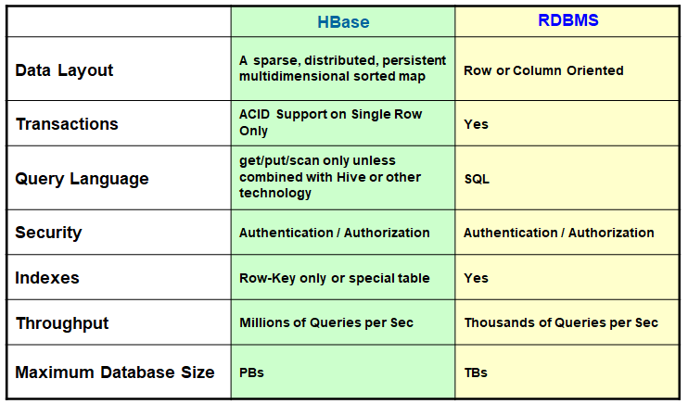
HBase vs. traditional RDBMS

Slide 24
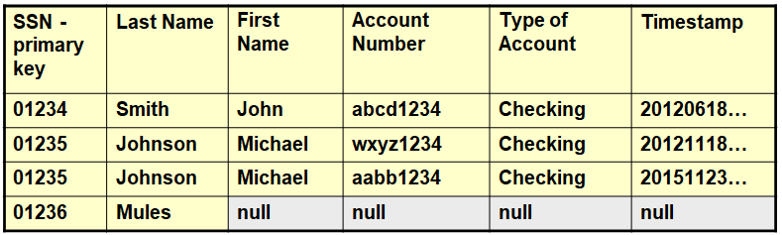
Example of a classic RDBMS table

Slide 25
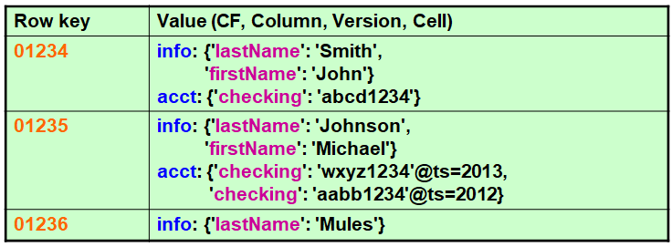
Example of HBase logical view ("records")
Good for sparse data since non-exist columns are just ignored There are no nulls
Notes:
The example table could be implemented logically as follows in HBase.
Note the time stamp data pointed to by the Row key 01235. This makes HBase multidimensional.

Slide 26
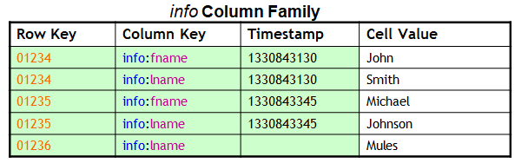
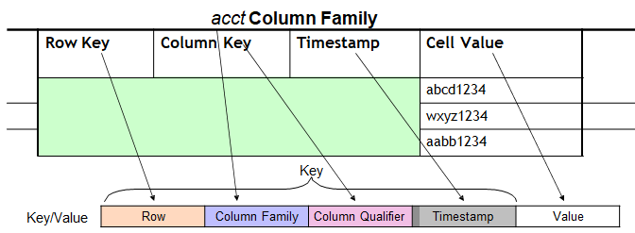
Example of the physical view ("cell")
Notes:
While the physical cell layout in HBase would look something like this, there are more details to the physical layout of course which will be described further in this presentation (such as how data is actually stored in Apache Hadoop HDFS).

Slide 27
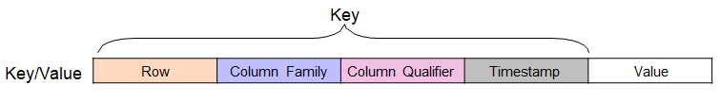
More on the HBase data model
There is no Schema for an HBase Table in the RDBMS sense
Except that you have to declare the Column Families
−Since it determines the physical on-disk organization
Thus every row can have a different set of Columns
HBase is described as a key-value store
Each key-value pair is versioned
Can be a timestamp or an integer
Update a column is just to add a new version
All data are byte arrays, including table name, Column Family names, and Column names (also called Column Qualifiers)
Notes:
A detailed schema in the RDBMS sense does not need to be defined up front in HBase. You only need to define Column Families, since they impact physical on-disk storage
This slide also illustrates why HBase is called a Key/Value pair data store.
Varying the granularity of the key impacts retrieval performance and cardinality when querying HBase for a Value.
Data types are converted to and from the raw byte array format that HBase supports natively.

Slide 28
Indexes in HBase
All table accesses are via table row key, effectively, its primary key.
Rows are stored in byte-lexographical order
Within a row, columns are stored in sorted order, with the result that it is fast, cheap, and easy to scan adjacent rows and columns
Partial key lookups also possible
HBase does not support indexes natively
Instead, a Table can be created that serves the same purpose
HBase supports "bloom filters"
Used to decide quickly if a particular row / column combination exists in the store file and reduce IO and access time
Secondary Indexes are not supported
Notes:
This slide explains how data in HBase is sorted and can be searched and indexed. The sorting within Tables makes adjacent queries and scans more efficient.
HBase does not support indexes natively but Tables can be created to serve the same purpose.
Bloom filters can be used to reduce IOs and look up time. More information on Bloom filters can be found at: http://en.wikipedia.org/wiki/Bloom_filter
More information on Bloom Filter usage in HBase can be found in: George, L. (2011).
HBase: The definitive guide. Savastopol, CA: O'Reilly Media, p. 372.

Slide 29
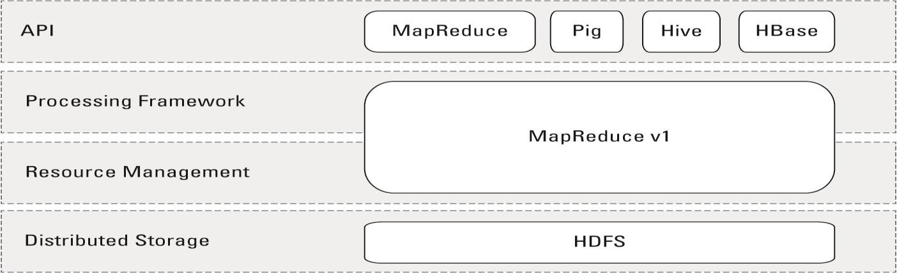
Hadoop v1 processing environment
Multi-layered framework

Slide 30
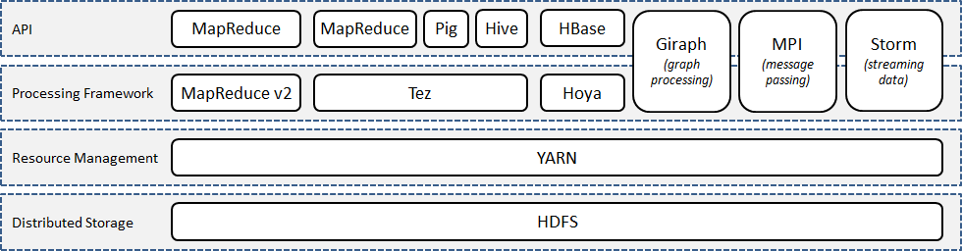
Hadoop v2 processing environment
Four levels in an Hadoop cluster - from the bottom up
Distributed storage
Resource management
Processing framework
APIs (application programming interfaces)

Slide 31
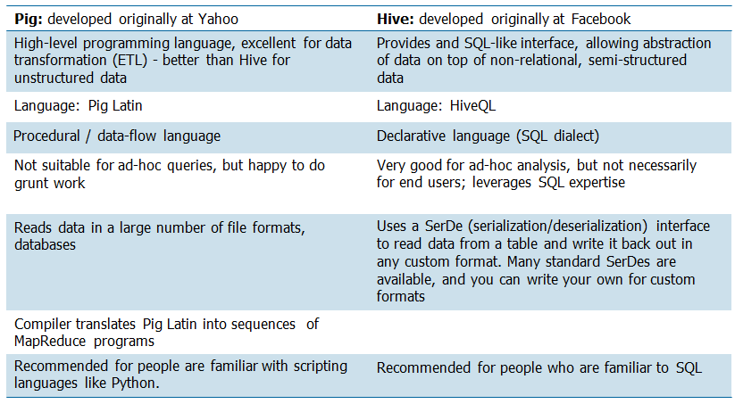
Open source programming languages: Pig and Hive

Slide 32
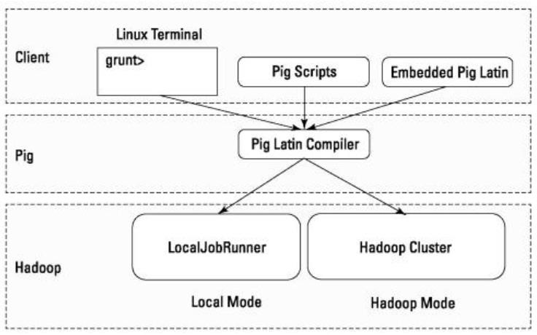

Pig
Pig runs in two modes:
Local mode: on a single machine without requirement for HDFS
MapReduce/Hadoop mode: execution on an HDFS cluster, with the Pig script converted to a MapReduce job
When Pig run runs in an interactive shell, the prompt is grunt>
Pig scripts have, by convention, a suffix of .pig
Pig is written in the language Pig Latin

Slide 33
Pig vs. SQL
In contrast to SQL, Pig:
uses lazy evaluation
uses ETL techniques
is able to store data at any point during a pipeline
declares execution plans
supports pipeline splits
DBMSs are generally substantially faster than the MapReduce system once the data is loaded, but loading the data takes considerably longer in database systems
RDBMSs offer out-of-the-box support for column-storage, working with compressed data, indexes for efficient random data access, and transaction-level fault tolerance
Pig Latin is procedural language with a pipeline paradigm
SQL is a declarative language
Notes:
In SQL users can specify that data from two tables must be joined, but not what join implementation to use. But, with some RDBMS systems, extensions ("query hints") are available outside the official SQL query language to allow the implementation of queries and the type of joins to be performed on a single statement basis.
Pig Latin allows users to specify an implementation or aspects of an implementation to be used in executing a script in several ways.
Pig Latin programming is similar to specifying a query execution plan

Slide 34
Characteristics of the Pig language
Most Pig scripts start with the LOAD statement to read data from HDFS (or from the local file system when running in local mode)
In the example on the next slide, you will load data from a .CSV file
The USING statement maps the file's data to the Pig data model
Aggregations are commonly used to summarize dataset
Variations include: GROUP, ALL, GROUP ALL
FOREACH … GENERATE statements can be used to transform column data
Notes:
At its core, Pig Latin is a data flow language, where you define a data stream and a series of transformations that are applied to the data is it flows through the application.
This is in contrast to a control flow language (such as C or Java), where you write a series of instructions. In control flow languages, you use constructs such as loops and conditional logic (if and case statements) There are no loops and no if-statements in Pig Latin.

Slide 35
Example of a Pig script
input_lines = LOAD '/tmp/my-data' AS (line: chararray);
-- Extract words from each line and put them into a Pig bag,
-- and then flatten the bag to get one word for each row
words = FOREACH input_lines GENERATE FLATTEN(TOKENIZE(LINE)) AS word;
-- Filter out any words that are just white spaces
filtered_words = FILTER words BY word MATCHES '\\w+';
-- Create a group for each word
word_groups = GROUP filtered_words BY word;
-- Count the entries in each group
word_count = FOREACH word_groups GENERATE COUNT(filtered_words) AS count, group AS word;
-- Order the records by count and write out the results ordered_word_count = ORDER word_count BY count DESC;
STORE ordered_word_count INTO '/tmp/sorted-word-count';
Notes:
The actual program is 7 lines of code.
Lines that start with double-dash are comments, in this case explaining the line(s) that follow.

Slide 36
What is Hive?
A system for managing and querying structured data built on top of Hadoop
MapReduce for execution
HDFS for storage
Metadata on raw files
Key Building Principles:
SQL is a familiar data warehousing language
Extensibility - Types, Functions, Formats, Scripts
Scalability and Performance
Notes:
The Apache Hive data warehouse software facilitates querying and managing large datasets residing in distributed storage. Built on top of Apache Hadoop, it provides:
tools to enable easy data extract/transform/load (ETL)
a mechanism to impose structure on a variety of data formats
access to files stored either directly in Apache HDFS or in other data storage systems such as Apache HBase
query execution via MapReduce
Hive defines a simple SQL-like query language, called QL, which enables users familiar with SQL to query the data. At the same time, this language also allows programmers who are familiar with the MapReduce framework to be able to plug in their custom mappers and reducers to perform more sophisticated analysis that may not be supported by the built-in capabilities of the language. QL can also be extended with custom scalar functions (UDF's), aggregations (UDAF's), and table functions (UDTF's).
Hive does not mandate read or written data be in the "Hive format" - there is no such thing. Hive works equally well on Thrift, control delimited, or your specialized data formats. Please see File Formats and Hive SerDe in the Developer Guide for details.
Hive is not designed for OLTP workloads and does not offer real-time queries or row- level updates. It is best used for batch jobs over large sets of append-only data (like web logs). What Hive values most are scalability (scale out with more machines added dynamically to the Hadoop cluster), extensibility (with MapReduce framework and UDF/UDAF/UDTF), fault-tolerance, and loose-coupling with its input formats.
Components of Hive include HCatalog and WebHCat:
HCatalog is a component of Hive. It is a table and storage management layer for Hadoop that enables users with different data processing tools - including Pig and MapReduce - to more easily read and write data on the grid.
WebHCat provides a service that you can use to run Hadoop MapReduce (or YARN), Pig, Hive jobs or perform Hive metadata operations using an HTTP (REST style) interface.

Slide 37
SQL for Hadoop
Data warehouse augmentation is a very common use case for Hadoop
While highly scalable, MapReduce is notoriously difficult to use
Java API is tedious and requires programming expertise
Unfamiliar languages (such as Pig) also requiring expertise
Many different file formats, storage mechanisms, configuration options, etc.
SQL support opens the data to a much wider audience
Familiar, widely known syntax
Common catalog for identifying data and structure
Clear separation of defining the what (you want) vs. the how (to get it)

Slide 38
Java vs. Hive: The wordcount algorithm
package org.myorg;
import java.io.IOException;
import java.util.*;
import org.apache.hadoop.fs.Path;
import org.apache.hadoop.conf.*;
import org.apache.hadoop.io.*;
import org.apache.hadoop.mapreduce.*;
import org.apache.hadoop.mapreduce.lib.input.FileInputFormat;
import org.apache.hadoop.mapreduce.lib.input.TextInputFormat;
import org.apache.hadoop.mapreduce.lib.output.FileOutputFormat;
import org.apache.hadoop.mapreduce.lib.output.TextOutputFormat;
public class WordCount {
public static class Map extends Mapper<LongWritable, Text, Text, IntWritable> {
private final static IntWritable one = new IntWritable(1);
private Text word = new Text();
public void map(LongWritable key, Text value, Context context) throws IOException, InterruptedException {
String line = value.toString();
StringTokenizer tokenizer = new StringTokenizer(line);
while (tokenizer.hasMoreTokens()) {
word.set(tokenizer.nextToken());
context.write(word, one);
}
}
}
public static class Reduce extends Reducer<Text, IntWritable, Text, IntWritable> {
public void reduce(Text key, Iterable<IntWritable> values, Context context)
throws IOException, InterruptedException {
int sum = 0;
for (IntWritable val : values) {
sum += val.get();
}
context.write(key, new IntWritable(sum));
}
}
public static void main(String[] args) throws Exception {
Configuration conf = new Configuration();
Job job = new Job(conf, "wordcount");
job.setOutputKeyClass(Text.class);
job.setOutputValueClass(IntWritable.class);
job.setMapperClass(Map.class);
job.setReducerClass(Reduce.class);
job.setInputFormatClass(TextInputFormat.class);
job.setOutputFormatClass(TextOutputFormat.class);
FileInputFormat.addInputPath(job, new Path(args[0]));
FileOutputFormat.setOutputPath(job, new Path(args[1]));
job.waitForCompletion(true);
}
}

Slide 39
Hive and wordcount
Wordcount in Java is 70+ lines of Java code
Below you have the equivalent program in HiveQL, just 8 lines of code and does not require compilation, nor the creation of a JAR file (Java ARchive) to run
CREATE TABLE docs (line STRING);
LOAD DATA INPATH 'docs' OVERWRITE INTO TABLE docs;
CREATE TABLE word_counts AS
SELECT word, count(1) AS count FROM
(SELECT explode(split(line, '\s')) AS word FROM docs)
GROUP BY word ORDER BY word;

Slide 40
Hive components
Hive Application
Applications
Web Browser
Thrift Client
JDBC
ODBC
Client Interfaces (remote)
Hive Web Interface
Hive Server
CLI
hive>
Query Execution
Metastore
Hive Metastore Driver
JobConf Config
Metadata
Notes:
These are the major components that you might deal with when working with Hive.

Slide 41
Starting Hive: The Hive shell
The Hive shell is located in $HIVE_HOME/bin/hive
From the shell you can:
perform queries, DML, and DDL
view and manipulate table metadata
retrieve query explain plans (execution strategy)
$ $HIVE_HOME/bin/hive
2013-01-14 23:36:52.153 GMT : Connection obtained for host: master-
Logging initialized using configuration in file:/opt/ibm/biginsight
Hive history file=/var/ibm/biginsights/hive/query/biadmin/hive_job
hive> show tables;
mytab1
mytab2
mytab3
OK
Time taken: 2.987 seconds
hive> quit;
Notes:
This Hive shell runs in a command line interface.

Slide 42
Data types and models
Supports a number of scalar and structured data types
tinyint, smallint, int, bigint, float, double
boolean
string, binary
timestamp
array: for example array<int>
struct: for example struct<f1:int,f2:array<string>>
map: for example map<int,string>
union: for example uniontype<int,string,double>
Partitioning
can partition on one or more columns
value partitioning only, range partitioning is not yet supported
Bucketing*
sub-partitioning/grouping of data by hash within partitions
useful for sampling and improves some join operations
Notes:
There are times when it is not obvious in which partition data should reside, although the partitioning key can be identified. Rather than group similar data, there are times when it is desirable to distribute data such that it does not correspond to a business or a logical view of the data, as it does in range partitioning. With hash partitioning, a row is placed into a partition based on the result of passing the partitioning key into a hashing algorithm.
Using this approach, data is randomly distributed across the partitions rather than grouped.

Slide 43
Data model partitions
Value partition based on partition columns
Nested sub-directories in HDFS for each combination of partition column values
Example
Partition columns : ds and ctry
HDFS subdirectory for ds = 20090801, ctry = US
…/hive/warehouse/pview/ds=20090801/ctry=US
HDFS subdirectory for ds = 20090801, ctry = CA
…/hive/warehouse/pview/ds=20090801/ctry=CA
Notes:
Here, partitioning is on columns:
ds (datestamp)
ctry (country)

Slide 44
Data model external table
Point to existing data directories in HDFS
Can create tables and partitions; partition columns just become annotations to external directories
Example : create external table with partition
Example : add a partition to external table
CREATE EXTERNAL TABLE pview (userid int, pageid int, ds string, ctry string)
PARTITIONED ON (ds string, ctry string) STORED AS textfile
LOCATION '/path/to/existing/table'
ALTER TABLE pview
ADD PARTITION (ds='20090801', ctry='US')
LOCATION '/path/to/existing/partition'

Slide 45
Physical layout
Hive warehouse directory structure
.../hive/warehouse/
db1.db/
tab1/
tab1.dat
part_tab1/
state=NJ/
part_tab1.dat
state=CA/
part_tab1.dat
Data files are just regular HDFS files
Internal format can vary table-to-table (delimited, sequence, etc.)
Supports “external” tables
Database (schemas) are contained in ".db" subdirectoriesschemabdirectories
Table "tab1"“tab1”
Table partitioned by "state" column. One subdirectory per unique value. Query predicates eliminate partitions (directories) that need to be read

Slide 46
Creating a table
file: users.dat
Creating a delimited table
hive> create table users
(
id int,
office_id int,
name string,
children array<string>
)
row format delimited
fields terminated by '|'
collection items terminated by ':'
stored as textfile;
Inspecting tables:
hive> show tables;
OK
users
Time taken: 2.542 seconds
hive> describe users;
OK
id int
office_id int
name string
children array<string>
Time taken: 0.129 seconds
1|1|Bob Smith|Mary
2|1|Frank Barney|James:Liz:Karen
3|2|Ellen Lacy|Randy:Martin
4|3|Jake Gray|
5|4|Sally Fields|John:Fred:Sue:Hank:Robert
Notes:
Two levels of separator are used here:
Column or attribute separator: |
Collection item separator: :

Slide 47
Hive and HBase
Hive comes with an HBase storage handler
Allows MapReduce queries and loading of HBase tables
Uses predicate pushdown to optimize query
scans only necessary regions based upon table key
applies predicates as HBase row filters (if possible)
Usually Hive must be provided additional jars and configuration in order to work with HBase
$ hive \
--auxpath \
$HIVE_SRC/build/dist/lib/hive-hbase-handler-0.9.0.jar,\
$HIVE_SRC/build/dist/lib/hbase-0.92.0.jar,\
$HIVE_SRC/build/dist/lib/zookeeper-3.3.4.jar,\
$HIVE_SRC/build/dist/lib/guava-r09.jar \
-hiveconf hbase.master=hbase.yoyodyne.com:60000

Slide 48
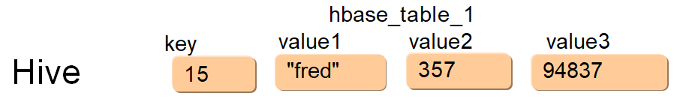
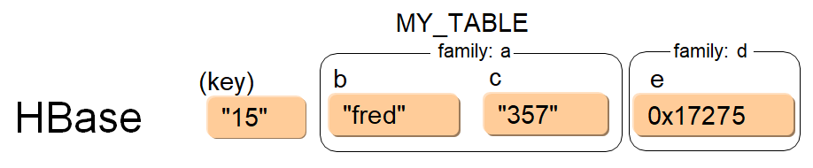
HBase table mapping
CREATE TABLE hbase_table_1 (
key int, value1 string, value2 int, value3 int)
WITH SERDEPROPERTIES ("hbase.columns.mapping"= ":key,a:b,a:c,d:e") TBLPROPERTIES("hbase.table.name" = "MY_TABLE");

Slide 49
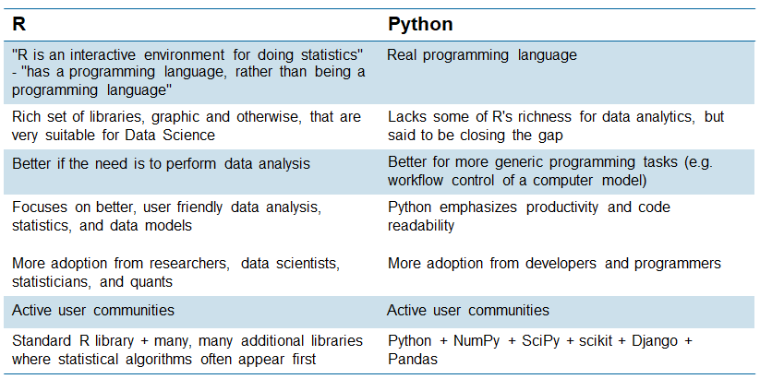
Languages used by data scientists: R and Python
Comparison of programming languages typically used by Data Scientists: R and Python
Notes:
The conclusion is that both are excellent, but they have their individual strengths. Over time, you probably need both.
One approach, if you know Python already, is to use that as your first tool. When you find Python lacking, learn enough R to do what you want, and then either:
write scripts in R and run them from Python using the subprocess module, or
install the RPy module
Use Python for what Python is good at and fill in the gaps with one of the above. Use R for plotting things, and Python for the heavy lifting.
Sometimes though, the tool you already know or that is easy to learn, is far more likely to win, than the powerful-but-complex tool that is currently out of your reach.
In the 2013 KDNuggets poll of top languages for data analytics, data mining, and data science, R was the most-used software for the third year running (60.9%), with Python in second place (38.8%). More tellingly, R's usage grew almost four times faster than Python's in 2013 versus 2012 (8.4 percentage points for R, compared to 2.7 percentage points for Python).

Slide 50
Quick overview of R
R is a free interpreted language
Best suited for statistical analysis and modeling
Data exploration and manipulation
Descriptive statistics
Predictive analytics and machine learning
Visualization
▪ +++
Can produce "publication quality graphics"
Emerging as a competitor to proprietary platforms
Widely used in Universities and companies
Not as easy to use or performant as SAS or SPSS
Algorithms tend to first be available in R
Made available by companies and universities as packages
−rpart(classification), tree(random forest trees), etc.
Notes:
More details on R can be found widely in the web. It is similar to Matlab and SAS/SPSS.
Pluses and minuses:
+ Very sophisticated algorithms,
+ Very good graphics
Not very good data transformation and file type support
Not very fast
Mostly in memory so limited data sizes

Slide 51
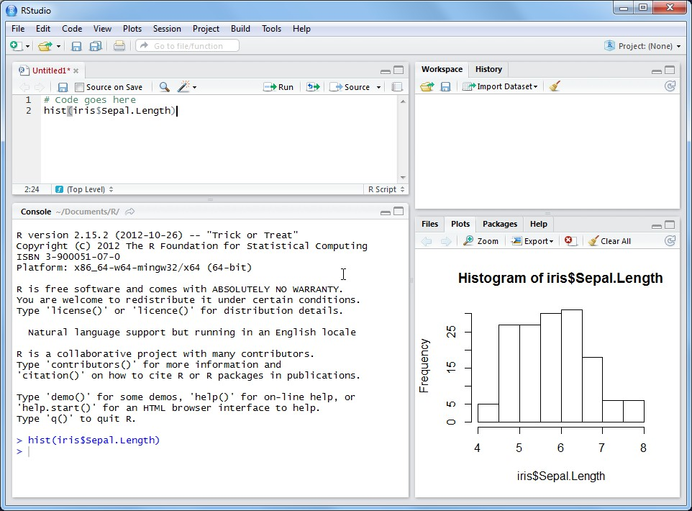
R clients
RStudio (shown) is a simple, popular IDE, but there are others too…
Run
Write code here
File
See results here
Or write code here
Console
Notes:
There are different R clients out there. This is R Studio (a free download, available for Windows, Linux, and Mac); this the most common one.

Slide 52
Simple example
R supports atomic data types, lists, vectors, matrices and data frames
Data Frames are analogous to database tables
Can be created or read from CSV files
Large set of statistical functions
Additional functions can be loaded as packages
# Vectors
> kidsNames <- c("Henry", "Peter", "Allison")
> kidsAges <- c(7, 11, 17)
# data.frame
> kids <- data.frame(ages = kidsAges, names = kidsNames)
> print(kids) ages names
7 Henry
11 Peter
17 Allison
> mean(kids$ages) [1] 11.66667
Notes:
This is a very simple interactive R program that works on basic data. The program creates two vectors then merges them together into one Data frame as two columns. Then shows how to display the table and how to compute a basic average.
This type of interactive use of R can be done in the free, downloadable RStudio, which runs on Linux, Windows, and Mac.

Slide 53
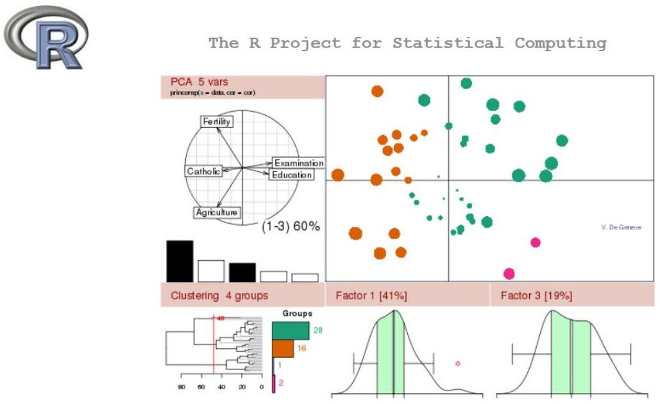
R is noted for its ability to produce graphical output

Slide 54
Quick overview of Python
Python is dynamic
No need to declare variables: just assign variables (with "=") and use them
No explicit Boolean type
Classes, with most of the tools you expect in an object-oriented language
Python does not use braces: begin-end, {}
Indentation is used to denote blocks: everything at the same level of indentation is considered in the same block
Data structures
Python has a variety : strings, lists, tuples, dictionaries (hash tables)
Python data structures are either mutable (changeable) or not, but strings are not mutable
And, of course, …
Control constructs: if, for (more like foreach), and while control statements
Module, namespaces, …

Slide 55
Python wordcount program
Open the file passed as the parameter to the program (argv[0]) and read as encoded in UTF-8
Split the text of the line using space, comma, semi-colon, single quote
Split() can be called with no argument - in this case, split() uses spaces as the delimiter, with multiple spaces treated as a single space
Accumulate the count for each word (+=)
import sys
file=open(sys.argv[0],"r+", encoding="utf-8-sig")
wordcount={}
for word in file.read().split(" ,;'"):
if word not in wordcount:
wordcount[word] = 1
else:
wordcount[word] += 1
for key in wordcount.keys():
print ("%s %s " %(key , wordcount[key])) file.close();

Slide 56
Checkpoint
List the common data types of big data.
True or False. NoSQL database is designed for those that do not want to use SQL.
Which database is a columnar storage database?
Which database provides a SQL for Hadoop interface?

Slide 57
Unit summary
List the characteristics of representative data file formats, including flat/text files, CSV, XML, JSON, and YAML
List the characteristics of the four types of NoSQL datastores
Describe the storage used by HBase in some detail
Describe and compare the open source programming languages, Pig and Hive
List the characteristics of programming languages typically used by Data Scientists: R and Python

