Slide 1
ZooKeeper, Slider, and Knox
Data Science Foundations

Slide 2
Unit objectives
Understand the challenges posed by distributed applications and how
ZooKeeper is designed to handle them
Explain the role of ZooKeeper within the Apache Hadoop infrastructure and the realm of Big Data management
Explore generic use cases and some real-world scenarios for ZooKeeper
Define the ZooKeeper services that are used to manage distributed systems
Explore and use the ZooKeeper CLI to interact with ZooKeeper
services
Understand how Apache Slider works in conjunction with YARN to deploy distributed applications and to monitor them
Explain how Apache Knox provides peripheral security services to an Hadoop cluster

Slide 3
Topic: ZooKeeper

Slide 4
Distributed systems
Multiple software components on multiple computers, but run as a single system
Computers can be physically close (local network), or geographically distant (WAN)
The goal of distributed computing is to make such a network work as a single computer
Distributed systems offer many benefits over centralized systems
Scalability: System can easily be expanded by adding more machines as needed
Redundancy: Several machines can provide the same services, so if one is unavailable: work does not stop, smaller machines can be used, redundancy not prohibitively expensive
Notes:
A distributed computer system consists of multiple software components that are on multiple computers, but run as a single system. The computers that are in a distributed system can be physically close together and connected by a local network, or they can be geographically distant and connected by a wide area network. The goal of distributed computing is to make such a network work as a single computer.
Distributed systems offer many benefits over centralized systems. One benefit is that of Scalability. Systems can easily be expanded by adding more machines as needed.
Another major benefit of distributed systems is Redundancy. Several machines can
provide the same services, so if one is unavailable, work does not stop. Additionally, because many smaller machines can be used, this redundancy does not need to be prohibitively expensive.

Slide 5

What is ZooKeeper?
Distributed applications require coordination
Develop your own service (a lot of work)
Or, use robust pre-existing coordination services (ZooKeeper)
Distributed open-source centralized coordination service for:
Maintaining configuration information: Sharing config info across all "nodes"
Naming: Find a machine in a cluster of 1,000s of servers, Naming Service
Providing distributed synchronization: Locks, Barriers, Queues, etc.
Providing group services: Leader election and more
The ZooKeeper service is distributed, reliable, fast, and simple
Notes:
Distributed applications require coordination. Coordination services are notoriously hard to get right. They are especially prone to errors such as race conditions and deadlock.
The motivation behind ZooKeeper is to relieve distributed applications the responsibility of implementing coordination services from scratch.
You could develop your own coordination service, however that can take a lot of work and is not a trivial task. The alternative is using a robust coordination service that is already available for use. ZooKeeper is just that - a distributed centralized coordination service that is open-source and ready for use.
ZooKeeper is a distributed, open-source coordination service for distributed applications. It exposes a simple set of primitives that distributed applications can build upon to implement higher level services for synchronization, configuration maintenance, and groups and naming. It is designed to be easy to program to, and uses a data model styled after the familiar directory tree structure of file systems. It runs in Java and has bindings for both Java and C.
ZooKeeper is simple. ZooKeeper allows distributed processes to coordinate with each other through a shared hierarchical namespace which is organized similarly to a standard file system. The name space consists of data registers, called ZNodes, in ZooKeeper parlance, and these are similar to files and directories. Unlike a typical file system, which is designed for storage, ZooKeeper data is kept in-memory, which means ZooKeeper can achieve high throughput and low latency numbers.
The ZooKeeper implementation puts a premium on high performance, highly available, strictly ordered access. The performance aspects of ZooKeeper means it can be used in large, distributed systems. The reliability aspects keep it from being a single point of failure. The strict ordering means that sophisticated synchronization primitives can be implemented at the client. The ZooKeeper service can be used to help you tackle many of the common challenges distributed applications face.
ZooKeeper can be used to maintain configuration information. For example you can store configuration data in ZooKeeper and share that data across all nodes in your distributed setup.
ZooKeeper can be used for naming. An example is using it as a naming service, allowing one node to find a specific machine in a cluster of thousands of servers.
ZooKeeper can be used to solve the problem of distributed synchronization, providing the building blocks for Locks, Barriers, and Queues.
ZooKeeper can also be used for group services such as leader election and more.
ZooKeeper provides the building blocks for all of these scenarios and is distributed, reliable and fast, while still being relatively simple to work with!
Reference: http://zookeeper.apache.org/doc/current/index.html

Slide 6
ZooKeeper
ZooKeeper provides support for writing distributed applications in the Hadoop ecosystem
ZooKeeper addresses the issue of partial failure
Partial failure is intrinsic to distributed systems
ZK provides a set of tools to build distributed applications that can safely handle partial failures
ZooKeeper has the following characteristics:
simple
expressive
highly available
facilitates loosely coupled interactions
is a library
Apache ZooKeeper is an open source server that enables highly reliable distributed coordination
Notes:
ZooKeeper is a centralized service for maintaining configuration information, naming, providing distributed synchronization, and providing group services. All of these kinds of services are used in some form or another by distributed applications. Each time they are implemented there is a lot of work that goes into fixing the bugs and race conditions that are inevitable. Because of the difficulty of implementing these kinds of services, applications initially usually skimp on them, which make them brittle in the presence of change and difficult to manage. Even when done correctly, different implementations of these services lead to management complexity when the applications are deployed.
Information on ZooKeeper can be found at:
Primary website: http://zookeeper.apache.org
Wiki: https://cwiki.apache.org/confluence/display/ZOOKEEPER/Index
Documentation: http://zookeeper.apache.org/doc/current/index.html
FAQ: https://cwiki.apache.org/confluence/display/ZOOKEEPER/FAQ
Chapter 21 (pp. 601-40) in: White, T. (2015). Hadoop: The definitive guide (4th ed.). Sabastopol, CA: O'Reilly Media.
The standard documentation includes the following sections:
ZooKeeper Overview
Developers
Administrators & Operators
Contributors to ZooKeeper
Miscellaneous FAQ

Slide 7
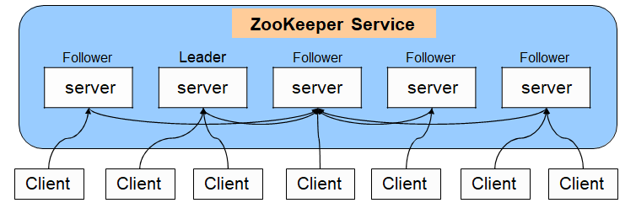
ZooKeeper service: Replicated mode
ZooKeeper runs on cluster of machines, Ensemble, providing high availability and consistency
Requires majority of servers; 7 node ensemble can lose 3 nodes
Writes go through leader; requires majority consensus Servers that make up the ZooKeeper service know about each other
Maintain an in-memory image of state
Clients connect to only one server, but If they loose the connection, can connect to another server automatically
Notes:
In a distributed ZooKeeper implementation, there are multiple servers. This is known as ZooKeeper's Replicated Mode. One server is elected as the leader and all additional servers are followers. If the ZooKeeper leader fails, then a new leader is elected.
All ZooKeeper servers must know about each other. Each server maintains an in- memory image of the overall state as well as transaction logs and snapshots in persistent storage. Clients connect to just a single server, however, when a client is started, it can provide a list of servers. In that way, if the connection to server for that client fails, the client connects to the next server in its list. Since each server maintains the same information, the client is able to continue to function without interruption.
A ZooKeeper client can perform a read operation from any server in the ensemble, however a write operation must go through the ZooKeeper leader and requires a majority consensus to succeed.
Who does what? Reads are satisfied by followers, writes are committed by the leader.
The processing sequence is:
ZooKeeper Service is replicated over a set of machines
All machines store a copy of the data (in memory)
A leader is elected on service startup
Clients only connect to a single ZooKeeper server & maintains a TCP connection.
Client can read from any ZooKeeper server, writes go through the leader & and this needs a majority consensus.
The image in the slide above is based on: https://cwiki.apache.org/confluence/display/ZOOKEEPER/ProjectDescription

Slide 8
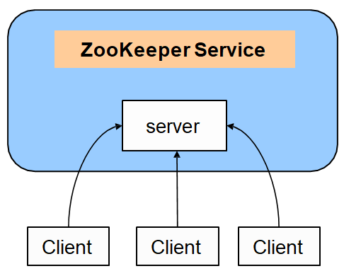
ZooKeeper service: Standalone mode
Single ZooKeeper server
Good for testing/learning
Lacks benefits of Replicated Mode; no guarantee of high-availability or resilience
Notes:
ZooKeeper can also be run in Standalone mode. In this mode only a single ZooKeeper server exists. All clients connect to the ZooKeeper service via this one server. You lose the benefits of replicated mode when using standalone mode. Trading high-availability and resilience for a simpler environment can be useful for testing and learning purposes.

Slide 9
Consistency guarantees
Sequential consistency
Client updates are applied in order they are received/sent
Atomicity
Updates succeed or fail; partial updates are not allowed
Single system image
Client sees same view of ZooKeeper service regardless of server
Reliability
If update succeeds then it persists
Timeliness
Client view of system is guaranteed up-to-date within a time bound
Generally within tens of seconds
If client does not see system changes within time bound, then service-outage
Notes:
ZooKeeper provides five consistency guarantees:
Sequential Consistency: updates from a client to the ZooKeeper service are applied in the order they are sent.
Atomicity: updates in ZooKeeper either succeed or fail. Partial updates are not allowed.
Single System Image: a client will see the same view of the ZooKeeper service regardless of the server in the ensemble that it is connected to.
Reliability: if an update succeeds in ZooKeeper then it will persist and not be rolled back. The update will only be overwritten when another client performs a new update.
Timeliness: a client's view of the system is guarantee to be up-to-date within a certain time bound, generally within tens of seconds. If a client does not see system changes within that time bound, then the client assumes a service outage and will connect to a different server in the ensemble.

Slide 10
What ZooKeeper does not guarantee
Simultaneously consistent cross-client views
Different clients will not always have identical views of ZooKeeper data at every instance in time.
ZooKeeper provides the sync() method
−Forces a ZooKeeper ensemble server to catch up with leader
Notes:
In the previous slide we looked at the consistency guarantees that ZooKeeper makes. It is important to understand that ZooKeeper does not make a Simultaneously Consistent Cross-Client View guarantee. This means that ZooKeeper does not guarantee that different clients will have identical views of ZooKeeper data at every instance in time.
Network delays and other factors may make it possible for one client to perform an update before another client is notified of the change. The way you can handle this is using the sync() method that ZooKeeper provides. The sync method forces a ZooKeeper ensemble server to catch up with the leader.

Slide 11
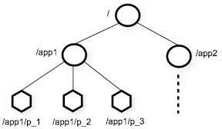
ZooKeeper structure: Data model
Distributed processes coordinate through shared hierarchical namespaces
These are organized very similarly to standard UNIX and Linux file systems
A namespace consists of data registers
Called ZNodes
Similar to files and directories
ZNode holds data, children, or both
ZNode types
Persistent: lasts until deleted
Ephemeral: lasts for the duration of the session, cannot have children
Sequence: provides unique numbering
Notes:
The distributed processes using ZooKeeper coordinate with each other through shared hierarchical namespaces. These namespaces are organized similarly to file systems in UNIX or Linux.
Each namespace has a root node and can have one or more child nodes. Since the term node has so many different connotations, ZooKeeper refers to each of these nodes as ZNodes.
As previously stated, data can be stored in a ZNode.
When data is written to or read from a ZNode, all of the data is either written or read. Also, there is an access controlled list (also known as an ACL) that is associated with each ZNode. This allows control over who can create, read, update, and delete a ZNode.

Slide 12
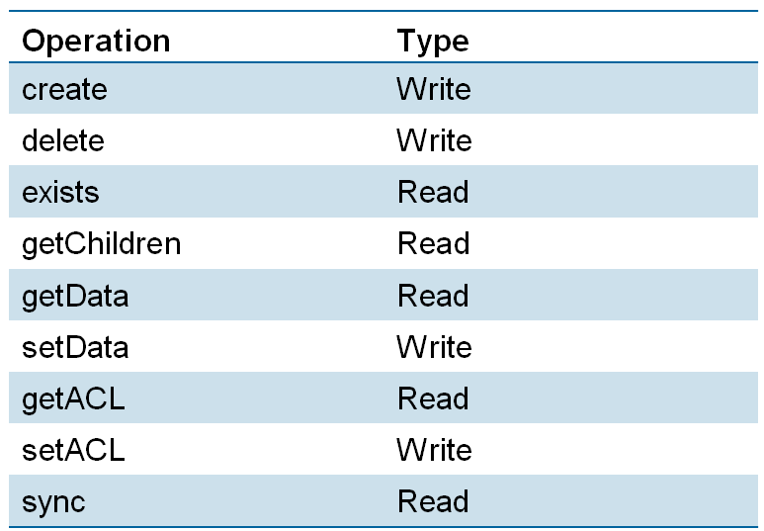
ZNode operations
ZNodes are the main entity that a programmer or administrator uses
Access is also available through a ZooKeeper Shell

Slide 13
ZNode watches
Clients can set watches on ZNodes:
NodeChildrenChanged
NodeCreated
NodeDataChanged
NodeDeleted
Changes to a ZNode trigger the watch and ZooKeeper sends the client a notification.
Watches are one-time triggers.
Watches are always ordered.
Client sees watched event before new ZNode data.
Client should handle cases of latency between getting the event and sending a new request to get a watch
Notes:
Les modifications apportées à un ZNode déclenchent la surveillance et ZooKeeper envoie une notification au client.

Slide 14
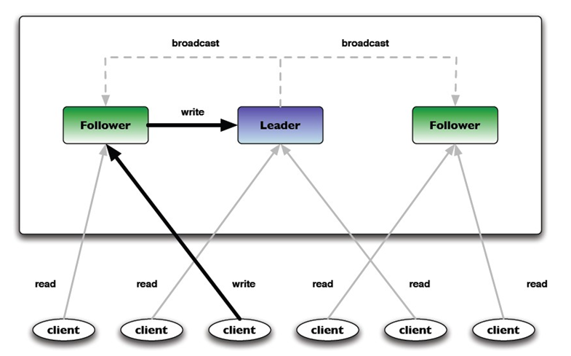
ZNode reads and writes
Read requests are processed locally at the ZooKeeper server to which the client is currently connected
Write requests are forwarded to the leader and go through majority consensus before a response is generated

Slide 15
ZooKeeper generic use cases
Configuration Management
Cluster member nodes bootstrapping configuration from a centralized source in unattended way
Easier, simpler deployment/provisioning
Distributed Cluster Management
Node join/leave
Node statuses in real time
Naming service such as DNS
Distributed synchronization: locks, barriers, queues
Leader election in a distributed system
Centralized and highly reliable (simple) data registry

Slide 16
ZooKeeper's role in the Hadoop infrastructure
HBase
Uses ZooKeeper for master election, server lease management, bootstrapping, and coordination between servers
Hadoop and MapReduce
Uses ZooKeeper to aid in high availability of Resource Manager
Flume
Uses ZooKeeper for configuration purposes in recent releases
Notes:
As new versions of Hadoop are released, ZooKeeper is being used more and more in the Hadoop infrastructure. Some of the uses are:
HBase uses ZooKeeper for master election, server lease management, bootstrapping, and coordination between servers.
Later versions of Hadoop are using ZooKeeper to provide high availability for YARN's Resource Manager.
Apache Flume has been using ZooKeeper for configuration purposes in recent releases.

Slide 17
Real world use cases for ZooKeeper
Rackspace
"The Email and Apps team uses ZooKeeper to coordinate sharding and responsibility changes in a distributed e-mail client that pulls and indexes data for search. ZooKeeper also provides distributed locking for connections to prevent a cluster from overwhelming servers."
Twitter
Service Discovery
Vast.com
"Used internally as a part of sharding services, distributed synchronization of data/index updates, configuration management and failover support"
Yahoo
"ZooKeeper is used for a myriad of services inside Yahoo! for doing leader election, configuration management, sharding, locking, group membership etc."
Zynga
"Used for a variety of services including configuration management, leader election, sharding and more ..."
Notes:
A variety of companies are using ZooKeeper with their distributed applications. Twitter, Yahoo and many others are using ZooKeeper for different purposes such as configuration management, sharding, locking and more.
Sources: Apache ZooKeeper wiki and blog.twitter.com

Slide 18
Topic: Slider

Slide 19
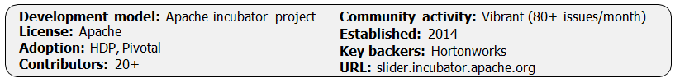
Slider
Apache Slider is a YARN application to deploy existing distributed applications on YARN, monitor them and make them larger or smaller as desired, even while the application is running.
Some of the features are:
Allows users to create on-demand applications in a YARN cluster
Allows different users/applications to run different versions of the application.
Allows users to configure different application instances differently
Stop/restart application instances as needed
Expand/shrink application instances as needed
The Slider tool is a Java command line application.
Notes:
Apache Slider is a YARN application to deploy existing distributed applications on YARN, monitor them and make them larger or smaller as desired, even while the application is running.
Applications can be stopped then started; the distribution of the deployed application across the YARN cluster is persisted -enabling a best-effort placement close to the previous locations. Applications which remember the previous placement of data (such as HBase) can exhibit fast start-up times from this feature.
YARN itself monitors the health of "YARN containers" hosting parts of the deployed application -it notifies the Slider manager application of container failure. Slider then asks YARN for a new container, into which Slider deploys a replacement for the failed component. As a result, Slider can keep the size of managed applications consistent with the specified configuration, even in the face of failures of servers in the cluster, as well as parts of the application itself.
Apache Slider (incubating) is an effort undergoing incubation at The Apache Software Foundation (ASF), sponsored by the name of Apache TLP sponsor. Incubation is required of all newly accepted projects until a further review indicates that the infrastructure, communications, and decision making process have stabilized in a manner consistent with other successful ASF projects. While incubation status is not necessarily a reflection of the completeness or stability of the code, it does indicate that the project has yet to be fully endorsed by the ASF.

Slide 20
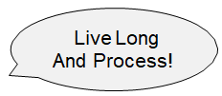
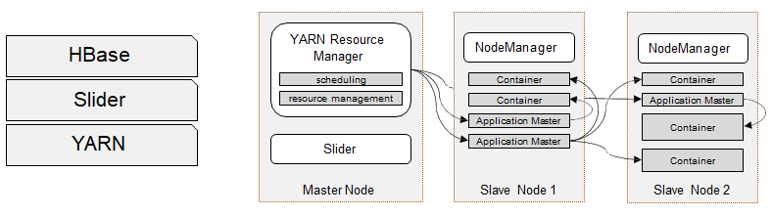
Apache Slider: Enable long running services on YARN
YARN resource management and scheduling works well for batch workloads, but not for interactive or real-time data processing services
Apache Slider extends YARN to support long-running distributed services on an Hadoop cluster
Dynamic expansion or contraction of services
Dedicated monitoring
Supports restart after process failure
Live Long and Process (LLAP) is the next-generation execution engine with a better performance and response time

Slide 21
Role of Slider in the Hadoop ecosystem (1 of 2)
Applications can be stopped then started
The distribution of the deployed application across the YARN cluster is persisted
This enables best-effort placement close to the previous locations
Applications which remember the previous placement of data (such as HBase) can exhibit fast start-up times from this feature.
YARN itself monitors the health of "YARN containers" hosting parts of the deployed application
YARN notifies the Slider manager application of container failure
Slider then asks YARN for a new container, into which Slider deploys a replacement for the failed component, keeping the size of managed applications consistent with the specified configuration
The tool persists the information as JSON documents in HDFS.
Notes:
Applications can be stopped then started; the distribution of the deployed application across the YARN cluster is persisted -enabling a best-effort placement close to the previous locations. Applications which remember the previous placement of data (such as HBase) can exhibit fast start-up times from this feature.
YARN itself monitors the health of "YARN containers" hosting parts of the deployed application -it notifies the Slider manager application of container failure. Slider then asks YARN for a new container, into which Slider deploys a replacement for the failed component. As a result, Slider can keep the size of managed applications consistent with the specified configuration, even in the face of failures of servers in the cluster, as well as parts of the application itself.

Slide 22
Role of Slider in the Hadoop ecosystem (2 of 2)
Once the cluster has been started:
The cluster can be made to grow or shrink using Slider commands
The cluster can also be stopped and later restarted
Slider implements all its functionality through YARN APIs and the existing application shell scripts
The goal of the application was to have minimal code changes and impact on existing applications
Notes:
Some of the features of Slider are:
Allows users to create on-demand applications in a YARN cluster
Allow different users/applications to run different versions of the application.
Allow users to configure different application instances differently
Stop / Restart application instances as needed
Expand / shrink application instances as needed The Slider tool is a Java command-line application.
Once the cluster has been started, the cluster can be made to grow or shrink using the Slider commands. The cluster can also be stopped and later restarted.
Slider implements all its functionality through YARN APIs and the existing application shell scripts. The goal of the application was to have minimal code changes and as of this writing, it has required few changes

Slide 23
Appendix C: Knox

Slide 24
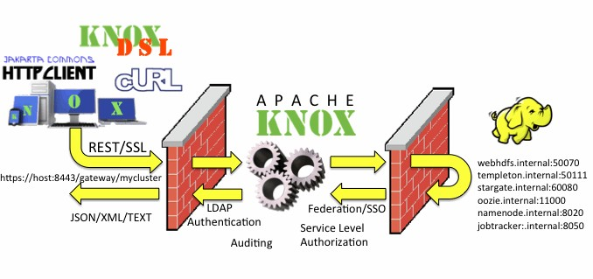
Knox
The Apache Knox Gateway is an extensible reverse proxy framework for securely exposing REST APIs and HTTP based services at a perimeter
Different types of REST access supported: HTTP(S) client, cURL, Knox Shell (DSL), SSL, …
Notes:
The Apache Knox Gateway is a REST API Gateway for interacting with Hadoop clusters. The Knox Gateway provides a single access point for all REST interactions with Hadoop clusters. In this capacity, the Knox Gateway is able to provide valuable functionality to aid in the control, integration, monitoring and automation of critical administrative and analytical needs of the enterprise.
Authentication (LDAP and Active Directory Authentication Provider)
Federation/SSO (HTTP Header Based Identity Federation)
Authorization (Service Level Authorization)
Auditing
While there are a number of benefits for unsecured Hadoop clusters, the Knox Gateway also complements the Kerberos secured cluster quite nicely. Coupled with proper network isolation of a Kerberos secured Hadoop cluster, the Knox Gateway provides the enterprise with a solution that:
Integrates well with enterprise identity management solutions
Protects the details of the Hadoop cluster deployment (hosts and ports are hidden from end-users)
Simplifies the number of services that clients need to interact with Reference: https://knox.apache.org (including the diagram above).
Knox runs in a firewall DMZ between the external clients and the Apache Hadoop components.
Additional information:
cURL is a computer software project providing a library and command line tool for transferring data using various protocols. The cURL project produces two products, libcurl and cURL. The name is a recursive acronym that stands for Curl URL Request Library.
The Knox Wiki (https://cwiki.apache.org/confluence/display/KNOX/Examples) provides examples of the use of the Knox Shell DSL including an example that submits the familiar WordCount Java MapReduce job to the Hadoop cluster via the gateway using the Knox Shell DSL. However, in this case, the job is submitted via an Oozie workflow, showing several different ways of doing this.

Slide 25
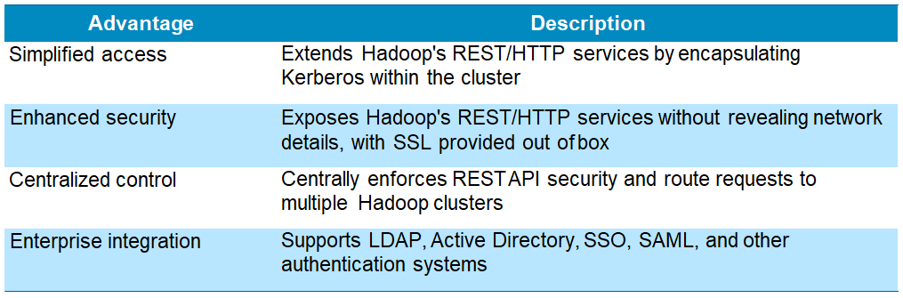
Knox security
Knox provides perimeter security for Hadoop clusters with the following advantages:
Any fully secure Hadoop cluster needs Kerberos, but Kerberos requires a client-side library and complex client side configuration
By encapsulating Kerberos, Knox eliminates the need for client software and client configuration thereby simplifying the access model
Kerberos est un protocole d'authentification réseau qui repose sur un mécanisme de clés secrètes (chiffrement symétrique) et l'utilisation de tickets, et non de mots de passe en clair, évitant ainsi le risque d'interception frauduleuse des mots de passe des utilisateurs.
Notes:
REST (Representational State Transfer) is an architectural style for networked hypermedia applications. It is primarily used to build Web services that are lightweight, maintainable, and scalable. A service based on REST is called a RESTful service.
REST is not dependent on any protocol, but almost every RESTful service uses HTTP
as its underlying protocol.
The client and service talk to each other via messages. Clients send a request to the server, and the server replies with a response. Apart from the actual data, these messages also contain some metadata about the message.
Reference: http://www.drdobbs.com/web-development/restful-web-services-a- tutorial/240169069

Slide 26
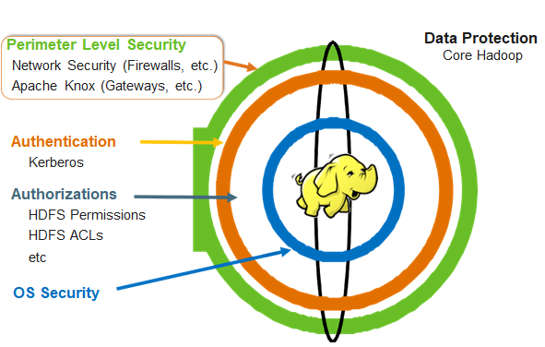
Apache Knox is just one ring of an overall security system
Notes:
Apache Knox provides perimeter security.
Other levels of security, including Access Control Lists (ACLs) and file level protections are needed at other levels within the Hadoop cluster.

Slide 27
Checkpoint
Which Apache project provides coordination of resources?
What is ZooKeeper's role in the Hadoop infrastructure?
True or False? Slider provides an intuitive UI which allows you to dynamically allocate YARN resources.
True or False? Knox can provide all the security you need within your Hadoop infrastructure.

Slide 28
Unit summary
Understand the challenges posed by distributed applications and how ZooKeeper is designed to handle them
Explain the role of ZooKeeper within the Apache Hadoop infrastructure and the realm of Big Data management
Explore generic use cases and some real-world scenarios for ZooKeeper
Define the ZooKeeper services that are used to manage distributed systems
Explore and use the ZooKeeper CLI to interact with ZooKeeper services
Understand how Apache Slider works in conjunction with YARN to deploy distributed applications and to monitor them
Explain how Apache Knox provides peripheral security services to an Hadoop cluster

