Slide 1
Loading data with Sqoop
Data Science Foundations

Slide 2
Unit objectives
List some of the load scenarios that are applicable to Hadoop
Understand how to load data at rest
Understand how to load data in motion
Understand how to load data from common sources such as a data warehouse, relational database, web server, or database logs
Explain what Sqoop is and how it works
Describe how Sqoop can be used to import data from relational systems into Hadoop and export data from Hadoop into relational systems
Brief introduction to what Flume is and how it works

Slide 3
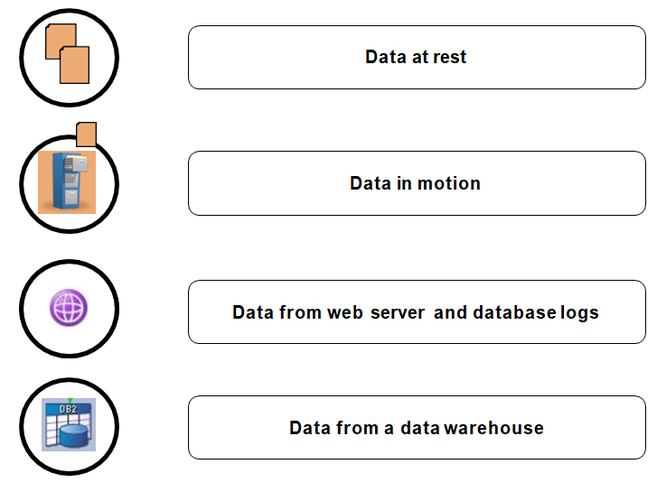
Load scenarios
Notes:
Several load scenarios are discussed in this unit:
Data at rest
Data in motion
Data from web server and database logs
Data from a data warehouse

Slide 4
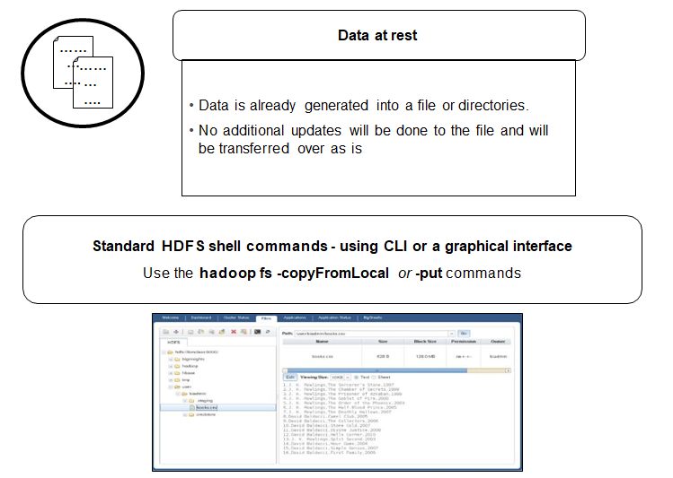
Data at rest
Notes:
Data at rest is already in a file in some directory. No additional updates are planned on this data and it can be transferred as is. This can be accomplished using standard HDFS shell commands, put, cp or copyFromLocal, or using the HDP web console.

Slide 5
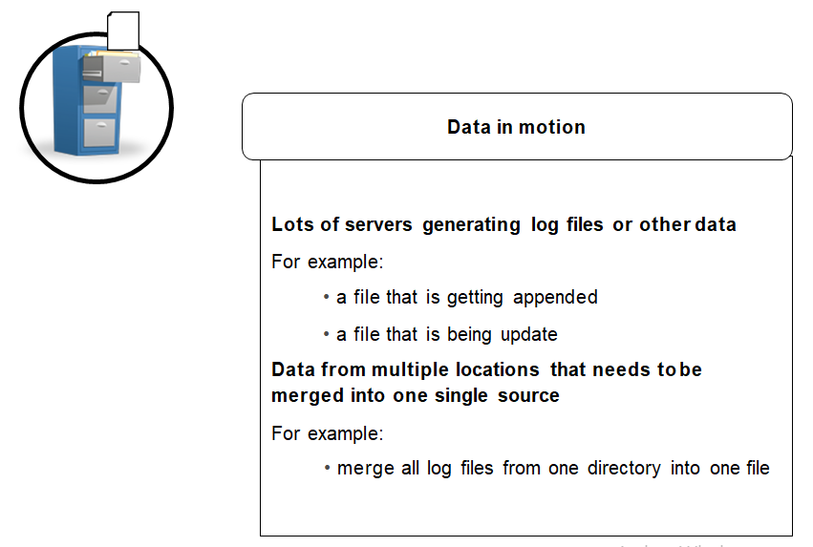
Data in motion
Notes:
What about when data is in motion?
First of all, what is meant by data in motion? This is data that is continually updated. New data might be added regularly to these data sources, data might be appended to a file, or logs might be getting merged into one log. You need to have the capability of merging the files before copying them into Hadoop.
Examples of data in motion include:
Data from a web server such as WebSphere Application Server or Apache Server
Data in server logs, or application logs, for example site browsing histories

Slide 6
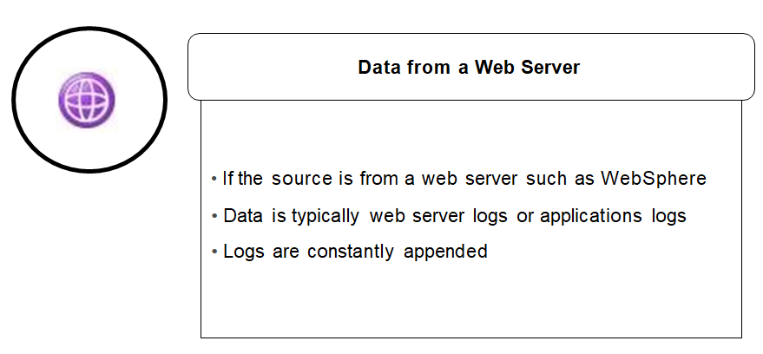
Data from a web server
Notes:
Flume is a great tool for collecting data from a web server. Another option would be to use Java Management Extension (JMX) commands.

Slide 7
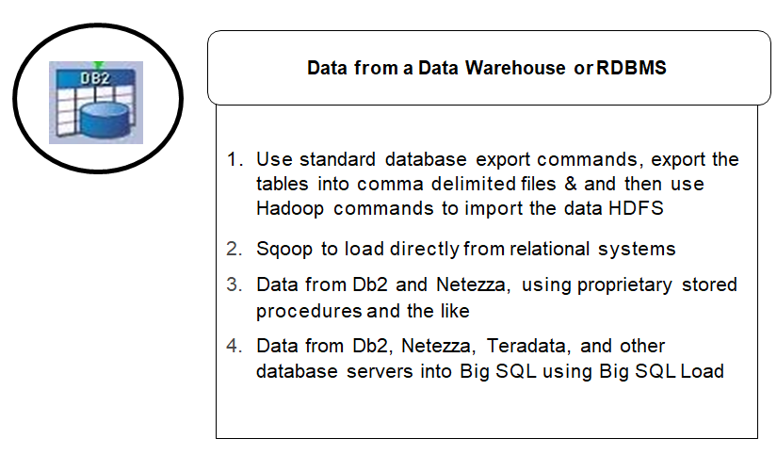
Solution if data is from a data warehouse or RDBMS
Notes:
When moving data from a data warehouse, (or any RDBMS), you export the data into an operating system file in CSV or other format and then use Hadoop commands to import the data.
If you are working with IBM Integrated Analytics System (IIAS) system or Db2, you may find proprietary stored procedures that allow reading/writing between database tables and HDFS - depending on the particular version of HDP.

Slide 8
Sqoop
Transfers data between Hadoop and relational databases
Uses JDBC
Must copy the JDBC driver JAR files for any relational databases to $SQOOP_HOME/lib
Uses the database to describe the schema of the data
Uses MapReduce to import and export the data
Import process creates a Java class
− Can encapsulate one row of the imported table
The source code of the class is provided to you
Can help you to quickly develop MapReduce applications that use HDFS-stored records
The options import and export work in relation to HDFS (and the opposite of the relation to the database itself)
Notes:
After completing this topic, you should be able to:
Explain the use of Sqoop to:
Import data from relational database tables into HDFS
Export data from HDFS into relational database tables
Describe the basic Sqoop commands:
Import statement
Export statement
The sqoop binary is /usr/bin/sqoop
If accumulo is needed and installed, $ACCUMULO_HOME should be set

Slide 9
Sqoop connection
Database connection requirements are the same for import and export
Specify as command line options:
JDBC connection string
Username
Password
Table
Target directory
Number of Mappers
Or, put the options into a file for execution
sqoop import|export \
--connect jdbc:db2://your.db2.com:50000/yourDB \
--username db2user --password yourpassword \
...
Notes:
The example shows using a Db2 database connection. Sqoop works with all databases that have a JDBC connection.
In the exercise later, you will export data from a MySQL database

Slide 10
Sqoop import
Imports data from relational tables into HDFS
Each row in the table becomes a separate record in HDFS
Data can be stored
Text files
Binary files
Into HBase
Into Hive
Imported data
Can be all rows of a table
Can limit the rows and columns
Can specify your own query to access relational data
Target directory (--target-dir)
Specifies the directory in HDFS in which to place the data
− If omitted, the name of the directory is the name of the table

Slide 11
Sqoop import examples
Import all rows from a table
Addition parameters, as needed:
sqoop import --connect jdbc:db2://your.db2.com:50000/yourDB \
--username db2user --password db2password --table db2table \
--target-dir sqoopdata
--split-by tbl_primarykey
--columns "empno,empname,salary"
--where "salary > 40000"
--query 'SELECT e.empno, e.empname, d.deptname FROM employee e JOIN department d on (e.deptnum = d.deptnum)'
--as-textfile
--as-avrodatafile
--as-sequencefile

Slide 12
Sqoop export
Exports a set of files from HDFS to a relational database system
Table must already exist
Records are parsed based upon user's specifications
Default mode is insert
Inserts rows into the table
Update mode
Generates update statements
Replaces existing rows in the table
Does not generate an insert
Missing rows are not inserted
Not detected as an error
Call mode
Makes a stored procedure call for each record
--export-dir
Specifies the directory in HDFS from which to read the data

Slide 13
Sqoop export examples
Basic export from files in a directory to a table
sqoop export --connect jdbc:db2://your.db2.com:50000/yourDB \
--username db2user --password db2password --table employee \
--export-dir /employeedata/processed
Example calling a stored procedure
sqoop export --connect jdbc:db2://your.db2.com:50000/yourDB \
--username db2user --password db2password --call empproc \
--export-dir /employeedata/processed
Example updating a table
sqoop export --connect jdbc:db2://your.db2.com:50000/yourDB \
--username db2user --password db2password --table employee \
--update_key empno --export-dir /employeedata/processed

Slide 14
Additional export information
Parsing data
Default is comma separated fields with newline separated records
Can provide input arguments that override the default
If the records to be exports loaded into HDFS using the import command
The original generated Java class can be used to read the data
Transactions
Sqoop uses multi-row insert syntax
Inserts up to 100 rows per statement
Commits work every 100 inserts
Commit every 10,000 rows
Each export map task operates as a separate transaction

Slide 15
Flume
Distributed, reliable service for efficient collection, aggregation, and transfer of large amounts of streaming data into Hadoop
Supports dynamic reconfiguration without the need to restart
Each Flume agent runs independently of others with no single point of failure
Data ingest coordinated by YARN
Stream sources include application logs, sensor and machine data, geo-location data and social media
Notes:
Flume has agents, installed at a source, which only know how to read data and pass it on to a sink. A source can be a file, a stream or it might be another Flume agent.
Likewise the sink might be, among other things, HDFS or another Flume agent. The
final agent in the chain is the collector.

Slide 16
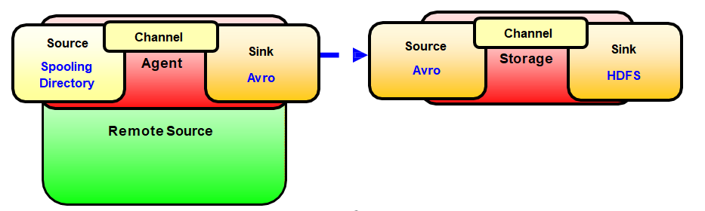
How Flume works
It is built on the concept of flows
Flows might have different batching or reliability setup
Flows are comprised of nodes chained together
Each node receives data as "source", stores it in a channel, and sends it via a "sink“
Flume is now deprecated in favor of Hortonworks Data Flow (HDF)
Notes:
Any number of Flume agents can be chained together. You start by installing a Flume agent where the data originates. This is the agent tier.
Every logical node has both a source and a sink. You define the sink to continually watch the tail of some file.
After capturing data, the logical node at the agent tier sends the data to a logical node at the collector tier. This logical node also has a source and a sink defined. The source is reading from the logical node at the agent tier.
At the collector tier, you will want to do data consolidation. Decorators are defined to accomplish that. You can do some additional data processing by writing your own decorator using a Java-based plug-in API.

Slide 17
Checkpoint
True or False? Sqoop is used to transfer data between Hadoop and relational databases.
List four different load scenarios.
True or False? For Sqoop to connect to a relational database, the JDBC JAR files for that database must be located in $SQOOP_HOME/bin.
If you omit the Target directory (--target-dir) command line option in a Sqoop import statement, what is used as the default directory name?
True or False? Each Flume node receives data as “source”, stores it in a “channel”, and sends it via a “sink”.

Slide 18
Unit summary
List some of the load scenarios that are applicable to Hadoop
Understand how to load data at rest
Understand how to load data in motion
Understand how to load data from common sources such as a data warehouse, relational database, web server, or database logs
Explain what Sqoop is and how it works
Describe how Sqoop can be used to import data from relational systems into Hadoop and export data from Hadoop into relational systems
Brief introduction to what Flume is and how it works

