Slide 1
Security and Governance
Data Science Foundations

Slide 2
Unit objectives
Explain the need for data governance and the role of data security in this governance
List the Five Pillars of security and how they are implemented with HDP
Discuss the history of security with Hadoop
Identify the need for and the methods used to secure Personal & Sensitive Information
Describe the function of the Hortonworks DataPlane Service (DPS)

Slide 3
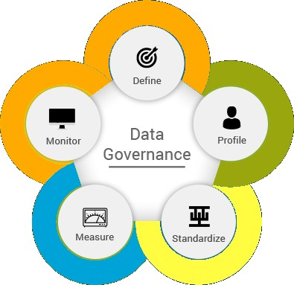
The need for data governance
Data governance ➔ Data reliability
Accurate analysis & reporting
Confident decision making
Reduce unwanted financial outlays
Functionality requirement:
Discover & Understand (embody the “data guru”)
Define the Metadata
Handle Security
Provide Privacy
Maintain Data integrity
Measure & Monitor

Slide 4
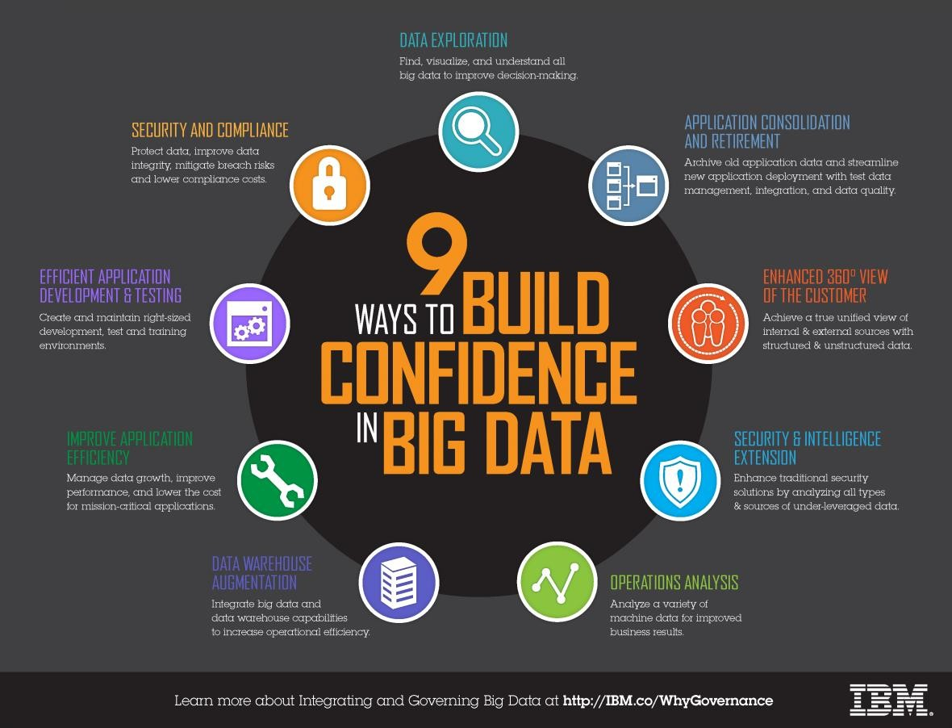
9 ways to build confidence in big data

Slide 5
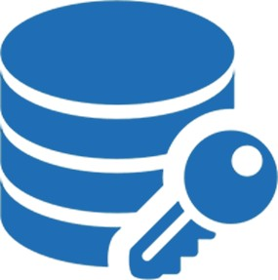

What Hadoop security requires
Strong authentication
Makes malicious impersonation impossible
Strong authorization
Control over who can access data that is stored
Local
Cloud
Hybrid
Control over who can view / control jobs and processes
Isolation between running tasks
Ongoing development priority & commitment
… using Open Source technologies
Notes:
We will be following the open source approach available with Hortonworks HDP product and related.
Hortonworks offers a 3-day training program:
HDP Operations: Apache Hadoop Security Training https://hortonworks.com/services/training/class/hdp-administrator-security/
“This course is designed for experienced administrators who will be implementing
secure Hadoop clusters using authentication, authorization, auditing, and data protection strategies and tools.”
The Cloudera CDH distribution has its training on security matters as well. This is described in:
Cloudera Training: Secure Your Cloudera Cluster https://www.slideshare.net/cloudera/cloudera-training-secure-your-cloudera-cluster
Sometimes security of computer systems is described in terms of 3As:
Authentication
Authorization
Accountability
Security must be applied to network connectivity, running processes, and the data itself. When dealing with data, we are concerned primarily with:
Integrity
Confidentiality & privacy
Rules & regulations concerning who has valid access to what - based on both the role performed and the individual exercising that role

Slide 6
How is security provided?
HDP ensures comprehensive enforcement of security requirements across the entire Hadoop stack.
Kerberos is the key to strong authentication
Ranger provides a single simple interface for security policy definition and maintenance
Encryption options available for data at-rest and in-motion

Slide 7
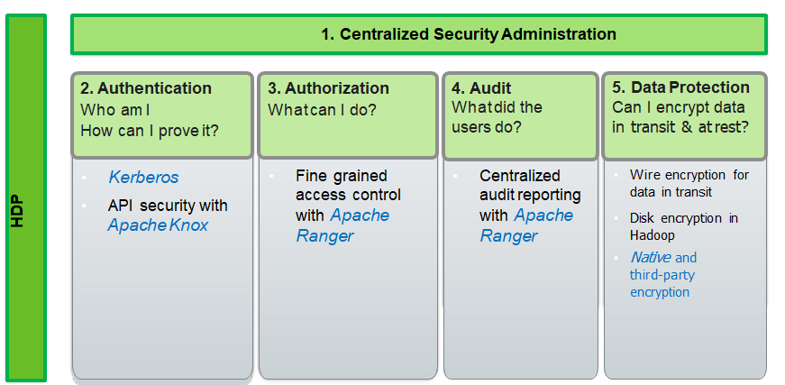
Enterprise security services with HDP
Five Pillars of Security
Notes:
Security is essential for organizations that store and process sensitive data in the Hadoop ecosystem. Many organizations must adhere to strict corporate security policies.
The challenges with Hadoop Security in general:
Hadoop is a distributed framework used for data storage and large-scale processing on clusters using commodity servers. Adding security to Hadoop is challenging because not all of the interactions follow the classic client-server pattern.
In Hadoop, the file system is partitioned and distributed, requiring authorization checks at multiple points.
A submitted job is executed at a later time on nodes different than the node on which the client authenticated and submitted the job.
Secondary services such as a workflow system (Oozie, etc.) access Hadoop on behalf of users.
A Hadoop cluster can scale to thousands of servers and tens of thousands of concurrent tasks.
Hadoop / YARN / etc. are evolving technologies - and each component is subject to versionality and cross-component integration

Slide 8
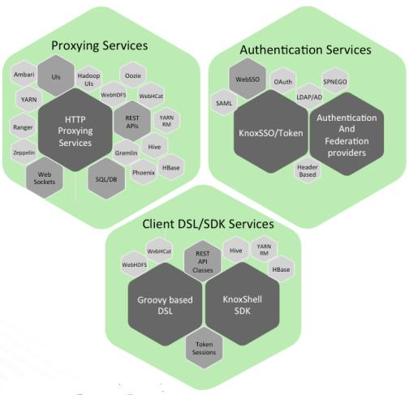
Authentication: Kerberos & Knox
Ambari provides automation and management of Kerberos into the Hadoop cluster
Kerberos can be combined with Active Directory to provide a combined Kerberos/AD approach
Apache Knox is used for API & Perimeter Security
Removes the need for end users to interact with Kerberos
Enables integration with different authentication standards
Provides a single location to manage security for REST APIs & HTTP based services
Notes:
Kerberos was originally developed for MIT’s Project Athena in the 1980 and is the most widely deployed system for authentication. It is shipped with all major computer operating systems. MIT developers & maintains implementations for:
Linux/UNIX
Mac OS X
Windows
Apache Knox 1.0.0 (released 7-Feb-2018) delivers three groups of user facing services:
Proxying services
Authentication Services
Client DSL/SDK services
The user guide is: https://knox.apache.org/books/knox-1-0-0/user-guide.html Java 1.8 (i.e., Java version 8) is required for the Knox Gateway runtime.
Knox 1.0.0 supports the soon to be released Hadoop 3.x, but can be used with Hadoop 2.x.
Knox 1.0.0 upgrades Knox 0.14.0 (released 14-Dec-2017), but is largely the same release with a handful of bug releases and a repackaging of the member classes. V1.0.0 is a milestone release because of the naming convention change.

Slide 9
Authorization & Auditing: Apache Ranger
Authorization - with fine-grain access control:
HDFS - Folder, File
Hive - Database, Table, Column
HBase - Table, Column Family, Column
Storm, Knox, and more
Audit - Extensive user access auditing in HDFS, Hive, and HBase
IP Address
Resource type/ resource
Timestamp
Access granted or denied
Flexibility in defining policies + the control of access into systems
Notes:
Apache Ranger delivers a comprehensive approach to security for a Hadoop cluster. It provides a centralized platform to define, administer and manage security policies consistently across Hadoop components.
Apache Ranger provides a Centralized Security Framework to manage fine-grained access control that uses an Ambari interface to provide an Administration Console that can:
Deliver a “single pane of glass” for the security administrator
Centralize administration of security policy
Policies for Accessing a Resource (File, Directories, Database, Table Column) for Users/Groups
Enforce Authorization Policies within Hadoop
Enable Audit Tracking and Policy Analytics
Ensure consistent coverage across the entire Hadoop stack
Ranger has plugins for:
HDFS
Hive
Knox
Storm
HBase
The Ranger Key Management Service (Ranger KMS) provides a scalable cryptographic key management service for HDFS “data at rest” encryption. Ranger KMS is based on the Hadoop KMS originally developed by the Apache community and extends the native Hadoop KMS functionality by allowing system administrators to store keys in a secure database.
Reference: https://hortonworks.com/apache/ranger/

Slide 10
History of Hadoop security
In the beginning…
Insufficient authentication/authorization of both users & services
Framework did not perform mutual authentication
Malicious user could impersonate services
Minimal authorization allowed anyone to read / write data
Arbitrary java code could be executed by user/service account
File permissions was easily circumvented
Only disk encryption
And now…
5 Pillars of Security: Administration, Authentication, Authorization, Audit, and Data Protection
Notes:
Hadoop is essentially at its heart was designed for storing and processing large amounts of data efficiently and as it turns out, cheaply (monetarily) when compared to other platforms. The focus early on in the project was around the actual technology to make this happen. Much of the code covered the logic on how to deal with the complexities inherent in distributed systems, such as handling of failures and coordination.
Because of this focus, the early Hadoop project established a security stance that the entire cluster of machines and all of the users accessing it are part of a trusted network. What that mean effectively means was that Hadoop did not initially have strong security measures in place to enforce, well, much of anything.
As the Hadoop ecosystem evolved, it became apparent that at a minimum there should be a mechanism for users to strongly authenticate to prove their identities. The primary mechanism chosen for Hadoop was Kerberos, a well-established protocol that today is common in enterprise systems such as Microsoft Active Directory. After strong authentication came strong authorization. Strong authorization defined what an individual user could do after they had been authenticated.
Initially, authorization was implemented on a per-component basis, meaning that administrators needed to define authorization controls in multiple places. This lead to the need for centralized administration of security - handled now by Apache Ranger
Another evolving need is the protection of data through encryption and other confidentiality mechanisms. In the trusted network, it was assumed that data was inherently protected from unauthorized users because only authorized users were on the network. Since then, Hadoop has added encryption for data transmitted between nodes, as well as data stored on disk.
Thus, now, we have the Five Pillars of Security:
Administration
Authentication
Authorization
Audit
Data Protection
Hadoop 3.0.0 (GA as of early 2018, https://hadoop.apache.org/docs/r3.0.0/), as Hadoop 2, is intimately concerned with security:
Hadoop in Secure Mode https://hadoop.apache.org/docs/current/hadoop-project-dist/hadoop- common/SecureMode.html

Slide 11
Implications of security
Data is now an essential new driver of competitive advantage
Hadoop plays critical role in modern data architecture by
Providing low-cost
Scale-out data storage
Value-add processing
Any internal or external breach of this enterprise-wide data can be catastrophic
Privacy violations
Regulatory infractions
Damage to corporate image
Damage to long-term shareholder value and consumer confidence
Notes:
In every industry, data is now an essential new driver of competitive advantage. Hadoop plays a critical role in the modern data architecture by providing low-cost, scale-out data storage, and value-add processing.
The Hadoop cluster with its HDFS file system, and the broader role of a Data Lake, are used to hold the “crown jewels” of the business organization, namely vital operational data that is used to drive the business and make it unique amongst its peers. Some of this data, in addition, is highly sensitive.
Any internal or external breach of this enterprise-wide data can be catastrophic, from privacy violations, to regulatory infractions, to damage to corporate image, and long- term shareholder value. To prevent damage to the company’s business, customers, finances and reputation, management and IT leaders must ensure that this data - whether Hadoop HDFS, Data Lake, or hybrid storage, including cloud storage - meets the same high standards of security as any legacy data environment.

Slide 12
Personal & Sensitive Information
Personally identifiable information (PII), or sensitive personal information (SPI), as used in information security and privacy laws, is information that can be used on its own, or with other information, to identify, contact, or locate a single person, or to identify an individual in context - Wikipedia
Privacy Laws: Most countries
Including the new GPDR regulations in the EU
Regulatory Laws & Standards by industry: Examples from USA
Sarbanes-Oxley Act (SOX) of 2002
Health Insurance Portability and Accountability Act of 1996 (HIPAA)
Payment Card Industry Data Security Standard (PCI DSS), versions in 2004-16
…
Notes:
This topic is well covered in Wikipedia:
https://en.wikipedia.org/wiki/Personally_identifiable_information
Other references:
https://en.wikipedia.org/wiki/Sarbanes%E2%80%93Oxley_Act https://en.wikipedia.org/wiki/Health_Insurance_Portability_and_Accountability_Act https://en.wikipedia.org/wiki/Payment_Card_Industry_Data_Security_Standard
Other relevant standards include:
The Health Information Technology for Economic and Clinical Health Act (HITECH), part of the American Recovery and Reinvestment Act of 2009
International Organization Standardization (ISO)
Control Objectives for Information and Related Technology (COBIT), a good- practice framework created by international professional association ISACA for information technology (IT) management and IT governance
And, naturally, every company has its own Corporate Security Policies

Slide 13
Hortonworks DataPlane Service (DPS)
DPS was made available with HDP 2.6.3, released November 2017
DPS is remarketed by IBM in conjunction with Hortonworks HDF
Use it to access and manage all the data stored across all of the storage environments used by the organization in support of the Hadoop Ecosystem
On-Prem Cluster data (HDFS, …)
Cloud stored data (AWS, IBM Cloud, …)
Point-of-Origin data
Hybrids of On-Prem / Cloud / …
Thus, support for any form of Data Lake
With consistent Security and Governance
Through a series of Next-Gen Services
Notes:
The first release of the Hortonworks DataPlane Service (DPS) with HDP 2.6.3 includes Data Lifecycle Manager Service (DLM) as General availability (GA) and Data Steward Service (DSS) in technical preview (TP) mode.
These are the first of a series of Next-Gen Services.
The DPS Platform is the architectural foundation that helps register multiple data lakes and manages data services across these data lakes from a single unified pane of glass

Slide 14
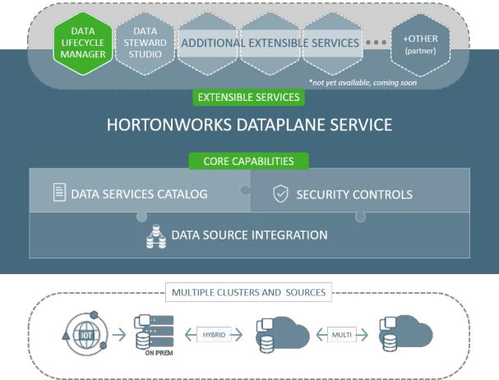
Hortonworks DataPlane Service (DPS)
DPS is a game changer for this platform and associated services will help enterprises gain visibility over all of their data across all of their environments while making it easy to maintain consistent security and governance
DPS was made available with HDP 2.6.3, released November 2017
Notes:
Use these resources to learn more about DPS:
Web Site: https://hortonworks.com/products/data-management/dataplane- service/
Blogs:
https://hortonworks.com/blog/disasters-can-instant-takes-village-build- hybrid-cloud-based-recovery-solution/
https://hortonworks.com/blog/category-emerges-introducing-hortonworks- dataplane-service/
Press Release: https://hortonworks.com/press-releases/hortonworks-dataplane- service/
Product Docs: https://docs.hortonworks.com/HDPDocuments/DPS1/DPS- 1.0.0/index.html
A one-hour, on-demand webinar, Global Data Management In A Multi-Cloud Hybrid World, is available at: https://hortonworks.com/webinar/global-data- management-multi-cloud-hybrid-world/

Slide 15
Manage, secure, and govern data across all assets
DataPlane Service (DPS) is a service that reimagines the Modern Data Architecture and solves next-gen data problems
Reliably access and understand all your data assets
Apply consistent security and governance policies
Manage data across on-prem, cloud, and hybrid environments
Extend platform and easily add next-gen services
New next-gen services include:
Data Lifecycle Manager: Control & manage the lifecycle of data across multiple tiers
Data Steward Studio: Curate, govern, and understand data assets to access deep insight and apply consistent policies across multiple tiers

Slide 16
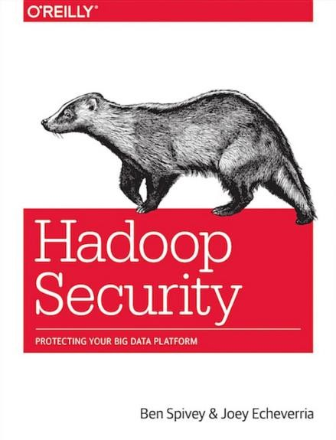
Further reading
Spivey, B., & Echeverria, J. (2015). Hadoop security: Protecting your big data platform. Sebastopol, CA: O’Reilly

Slide 17
Checkpoint
What is the new driver of competitive advantage?
What role does Hadoop play in modern data architecture?
What are some types of sensitive data?
Name compliance adherences that exists today?
What does HDP use for authentication, authorization and audit?
What are the Five Pillars of Security?
Through what HDP component are Kerberos, Knox, and Ranger managed?
Which security component is used to provide peripheral security?
Name some types of sensitive data.
What are some of the compliance adherences required of organizations some of which are industry specific?
What governance issue does Hortonworks DataPlane Service (DPS) address?

Slide 18
Unit summary
Explain the need for data governance and the role of data security in this governance
List the Five Pillars of security and how they are implemented with HDP
Discuss the history of security with Hadoop
Identify the need for and the methods used to secure Personal & Sensitive Information
Describe the function of the Hortonworks DataPlane Service (DPS)

