Slide 1
Stream Computing
Data Science Foundations

Slide 2
Unit objectives
Define streaming data
Describe IBM as a pioneer in streaming data - with System S €IBM Streams
Explain streaming data - concepts & terminology
Compare and contrast batch data vs streaming data
List and explain streaming components & Streaming Data Engines (SDEs)

Slide 3
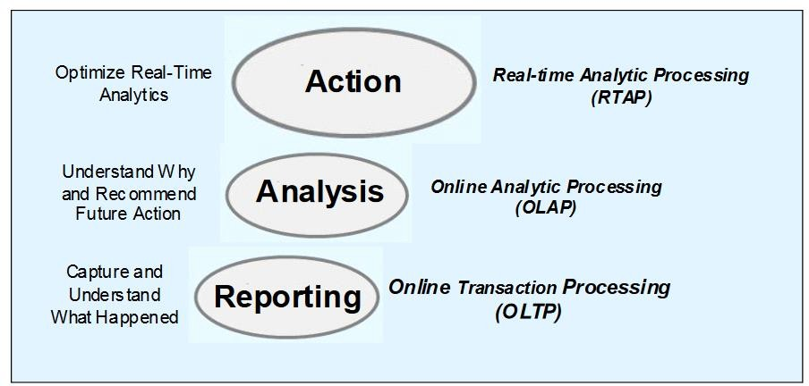
Generations of analytics processing
From Relational Databases (OLTP) € Data Warehouses (OLAP) € Real-time Analytic Processing (RTAP) on Streaming Data
Notes:
Hierarchical databases were invented in the 1960s and still serve as the foundation for online transaction processing (OLTP) systems for all forms of business and government that drive trillions of transactions today. Consider a bank as an example. It is likely that even today in many banks that information is entered into an OLTP system, possibly by employees or by a web application that captures and stores that data in hierarchical databases. This information then appears in daily reports and graphical dashboards to demonstrate the current state of the business and to enable and support appropriate actions. Analytical processing here is limited to capturing and understanding what happened.
Relational databases brought with them the concept of data warehousing, which extended the use of databases from OLTP to online analytic processing (OLAP). By using our example of the bank, the transactions that are captured by the OLTP system were stored over time and made available to the various business analysts in the organization. With OLAP, the analysts can now use the stored data to determine trends in loan defaults, overdrawn accounts, income growth, and so on. By combining and enriching the data with the results of their analysis, they could do even more complex analysis to forecast future economic trends or make recommendations on new investment areas. Additionally, they can mine the data and look for patterns to help them be more proactive in predicting potential future problems in areas such as foreclosures. The business can then analyze the recommendations to decide whether they must take action. The core value of OLAP is focused on understanding why things happened to make more informed recommendations.
A key component of OLTP and OLAP is that the data is stored. Now, some new applications require faster analytics than is possible when you have to wait until the data is retrieved from storage. To meet the needs of these new dynamic applications, you must take advantage of the increase in the availability of data before storage, otherwise known as streaming data. This need is driving the next evolution in analytic processing called real-time analytic processing (RTAP). RTAP focuses on taking the proven analytics that are established in OLAP to the next level. Data in motion and unstructured data might be able to provide actual data where OLAP had to settle for assumptions and hunches. The speed of RTAP allows for the potential of action in place of making recommendations.
So, what type of analysis makes sense to do in real time? Key types of RTAP include, but are not limited to, the following analyses:
Alerting
Feedback
Detecting failures
[These uses are discussed in more detail on pp. 26-27.]

Slide 4
What is streaming data?
Applications that require on-the-fly processing, filtering, and analysis of streaming data
Sensors: environmental, industrial, surveillance video, GPS, …
“Data exhaust”: network/system/webserver log files
High-rate transaction data: financial transactions, call detail records
Criteria: two or more of the following
Messages are processed in isolation or in limited data windows
Sources include non-traditional data (spatial, imagery, text, …)
Sources vary in connection methods, data rates, and processing requirements, that present integration challenges
Data rates / volumes require the resources of multiple processing nodes
Analysis and response are needed with sub-millisecond latency
Data rates and volumes are too great for store-and-mine approaches
Notes:
Reading:
What is Streaming Data?
(excellent article written from the perspective of Amazon’s AWS, but with general
applicability) https://aws.amazon.com/streaming-data/
Benefits of Streaming Data
Streaming Data Examples
Comparison between Batch Process and Stream Processing
Challenged in Working with Streaming Data

Slide 5
IBM is a pioneer in streaming analytics
Book:
Roy, J. (2016). Streaming analytics with IBM Streams: Analyze more, act faster, and get continuous insights. Indianapolis, IN: Wiley.
Available as a free PDF download from IBM at: https://www-01.ibm.com/common/ssi/cgi-bin/ssialias?
htmlfid=IMM14184USEN&attachment=IMM14184USEN.PDF
IBM researchers spent a decade transforming the vision of stream computing into a product - a new programming language, IBM Streams Processing Language (SPL), was even built just for streaming systems

Slide 6
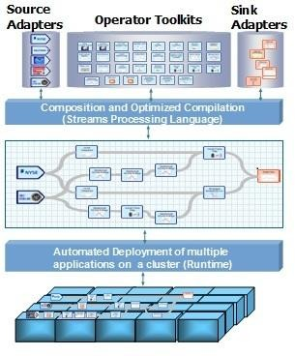
IBM System S
System S provides a programming model and an execution platform for user- developed applications that ingest, filter, analyze, and correlate potentially massive volumes of continuous data streams
Source Adapters = an operator that connects to a specific type of input (e.g., Stock Exchange, Weather, file system, …)
Sink Adapters = an operator that connects to a specific type of output external to the streams processing system (RDBMS, , …)
Operator = software processing unit
Stream = flow of tuples from one operator to the next operator (they do not traverse operators)
Notes:
References:
Stream Computing Platforms, Applications, and Analytics (Tab 4: System S) https://researcher.watson.ibm.com/researcher/view_group_subpage.php?id=253 4&t=4
System S: While at IBM, Dr. Ted Codd invented the relational database. In the defining IBM Research project, it was referred to as System R, which stood for Relational. The relational database is the foundation for data warehousing that launched the highly successful Client/Server and On-Demand informational eras. One of the cornerstones of that success was the capability of OLAP products that are still used in critical business processes today.
When the IBM Research division again set its sights on developing something to address the next evolution of analysis (RTAP) for the Smarter Planet evolution, they set their sights on developing a platform with the same level of world-changing success, and decided to call their effort System S, which stood for Streams. Like System R, System S was founded on the promise of a revolutionary change to the analytic paradigm. The research of the Exploratory Stream Processing Systems team at T.J. Watson Research Center, which was set on advanced topics in highly scalable stream- processing applications for the System S project, is the heart and soul of Streams.

Slide 7
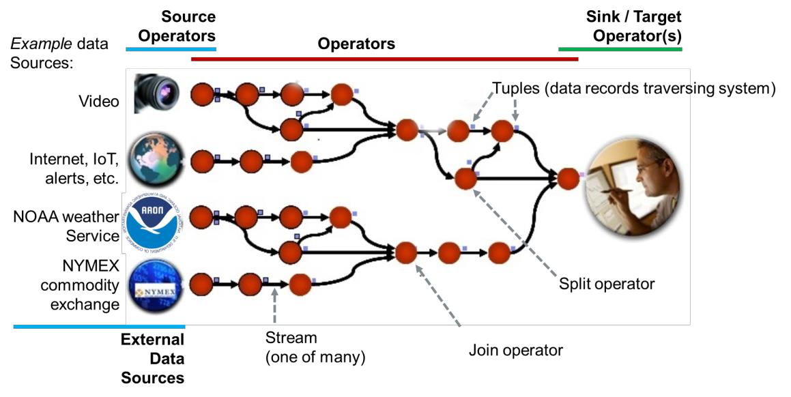
Streaming data - concepts & terminology (1)

Slide 8
Streaming data - concepts & terminology (2)
Directed Acyclic Graph (DAG) - a directed acyclic graph (DAG) is a directed graph that contains no cycles
Hardware Node - one computer in a cluster of computers that can work as a single processing unit
Operator (or Software Node ) - a software process that handles one unit of the processing that needs to be performed on the data
Tuple - an ordered set of elements (equivalent to the concept of a record)
Source - an operator where tuples are ingested
Target (or Sink) - an operator where tuples are consumed (and usually made available outside the streams processing environment)

Slide 9
Streaming data - concepts & terminology (3)
Types of Operators:
Source - Reads the input data in the form of streams.
Sink - Writes the data of the output streams to external storage or systems.
Functor - An operator that filters, transforms, and performs functions on the data of the input stream.
Sort - Sorts streams data on defined keys.
Split- Splits the input streams data into multiple output streams.
Join - Joins the input streams data on defined keys.
Aggregate - Aggregates streams data on defined keys.
Barrier - Combines and coordinates streams data.
Delay - Delays a stream data flow.
Punctor - Identifies groups of data that should be processed together.
Notes:
The terminology used here is that of IBM Streams, but similar terminology applies to other Streams Processing Engines (SPE).
References:
Glossary of terms for IBM Streams (formerly known as IBM InfoSphere Streams) https://www.ibm.com/support/knowledgecenter/en/SSCRJU_4.2.1/com.ibm.strea ms.glossary.doc/doc/glossary_streams.html
Examples of other terminology:
Apache Storm: http://storm.apache.org/releases/current/Concepts.html
A spout is a source of streams in a topology. Generally spouts will read tuples from an external source and emit them into the topology.
All processing in topologies is done in bolts. Bolts can do anything from filtering, functions, aggregations, joins, talking to databases, and more

Slide 10
Streaming data - concepts & terminology (4)
Topologies
Generally defined in terms of a Directed Acyclic Graph (DAG)
Reliability
Different Stream Processing Engines (SPE) provide reliability differently:
Some take full responsibility for guaranteeing that no tuple is lost (but that can slow the engine down)
Some require that the developer program for reliability using, for example, redundant processing streams in parallel
Operators / Software Nodes / Workers
To handle volume and velocity of data, most SPEs divide the work among multiple software operators (= typically JVM tasks) that work in parallel
The software operators are often spread over multiple Hardware Nodes in a cluster
Notes:
Reliability, using the example of Apache Storm (http://storm.apache.org/releases/current/Concepts.html):
Storm guarantees that every spout tuple will be fully processed by the topology. It does this by tracking the tree of tuples triggered by every spout tuple and determining when that tree of tuples has been successfully completed. Every topology has a "message timeout" associated with it. If Storm fails to detect that a spout tuple has been completed within that timeout, then it fails the tuple and replays it later.
To take advantage of Storm's reliability capabilities, you must tell Storm when new edges in a tuple tree are being created and tell Storm whenever you've finished processing an individual tuple. These are done using the OutputCollector object that bolts use to emit tuples. Anchoring is done in the emit method, and you declare that you're finished with a tuple using the ack method.

Slide 11
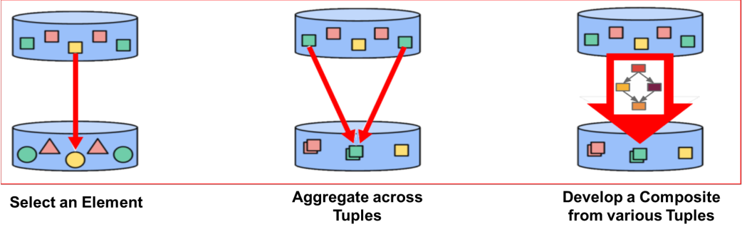
Batch processing - classic approach
With batch processing, the data is stationary (“at rest”) in a database or an application store
Operations are performed over all the data that is stored
Notes:
We are familiar with these operations in classic batch SQL. In the case of batch processing, all that data is present at the time the SQL statement is processed.
But, with streaming data, the data is constantly flowing and thus other techniques need to be performed. With streaming data, operations will be performed on windows of data.

Slide 12
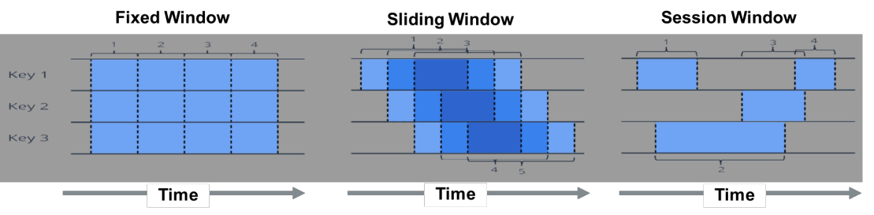
Stream processing - the real-time data approach
Moving from a multi‐threaded program to one that takes advantage of multiple nodes is a major rewrite of the application We are now dealing with multiple processes as well as the communication between them - aka message queues move data = multiple streams
Instead of all data, only windows of data are visible for processing
Notes:
Sometimes a stream processing job needs to do something in regular time intervals, regardless of how many incoming messages the job is processing. For example, say you want to report the number of page views per minute. To do this, you increment a counter every time you see a page view event. Once per minute, you send the current counter value to an output stream and reset the counter to zero. This is a fixed time window and is useful for reporting, for instance, sales that occurred during a clock- hour.
Other methods of windowing of streaming data use a sliding window or a session window (both illustrated above).
Microsoft Azure offers tumbling, hopping, and sliding windows to perform temporal operations on streaming data. See Microsoft’s article: Introduction to Stream Analytics Window functions, https://docs.microsoft.com/en-us/azure/stream- analytics/stream-analytics-window-functions

Slide 13
Streaming components & Streaming Data Engines
Open Source:
Hortonworks HDF / NiFi
Apache Storm
Apache Flink
Apache Kafka
Apache Samza
Apache Beam (an SDK)
Apache Spark Streaming
Proprietary:
IBM Streams (full SDE)
Amazon Kinesis
Microsoft Azure Stream Analytics
Notes:
To work with streaming analytics is important to understand what are the various available components are and how they relate. The topic itself is quite complex and deserving of a full workshop in itself - thus, here, we can only provide an introduction.
A full data pipeline (i.e., Streaming Application) involves:
Accessing data at its source (“source operator” components) - Kafka can be used here
Processing data (serializing data, merging & joining individual streams, referencing static data from in-memory stores and databases, transforming data, performing aggregation and analytics, … ) - Storm is a component that is sometimes used here
Delivering data to long-term persistence and to on-the-fly visualization
(“sink operators”)
IBM Streams can handle all these operations with using standard and custom-build operators and is thus a full Streaming Data Engine (SDE), but open source components can be used to build somewhat equivalent systems.
We are only going to look at HDF / NiFi and IBM Streams (data pipeline) in detail - and separately; they are bolded in the list above.

Slide 14
Hortonworks HDF / NiFi
Hortonworks DataFlow (HDF) provides an only end-to-end platform that collects, curates, analyzes, and acts on data in real-time, on- premises or in the cloud
With version 3.x, HDF has an available a drag-and-drop visual interface
HDF is an integrated solution that uses Apache Nifi/MiNifi, Apache Kafka, Apache Storm, Superset, and Druid components where appropriate
The HDF streaming real-time data analytics platform includes Data Flow Management Systems, Stream Processing, and Enterprise Services
The newest additions to HDF include a Schema Repository

Slide 15
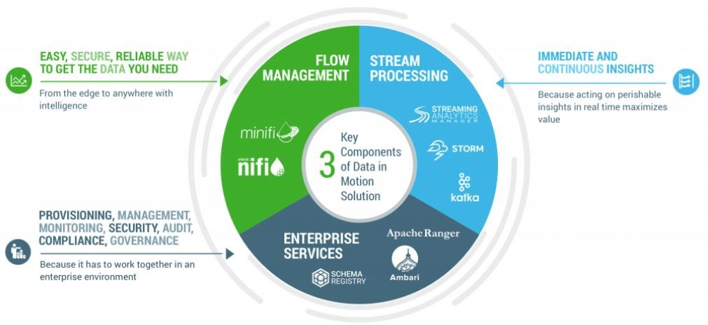
What is Hortonworks DataFlow (HDF)?
HDF is a collection of products for data movement, streaming analytics, and the management and governance of streaming data
Notes:
Hortonworks DataFlow (HDF) is a collection of products for data movement, streaming analytics, and the management and governance of streaming data:
Flow management: NiFi/MiNiFi
Stream processing: Storm, Kafka, Streaming Analytics Manager
Enterprise services: Schema Registry, Apache Ranger, Ambari
The Streams Processing element is the only component that competes with IBM Streams.
There is a more complete competitive presentation on Storm available but we’ll cover
the basics in here.

Slide 16
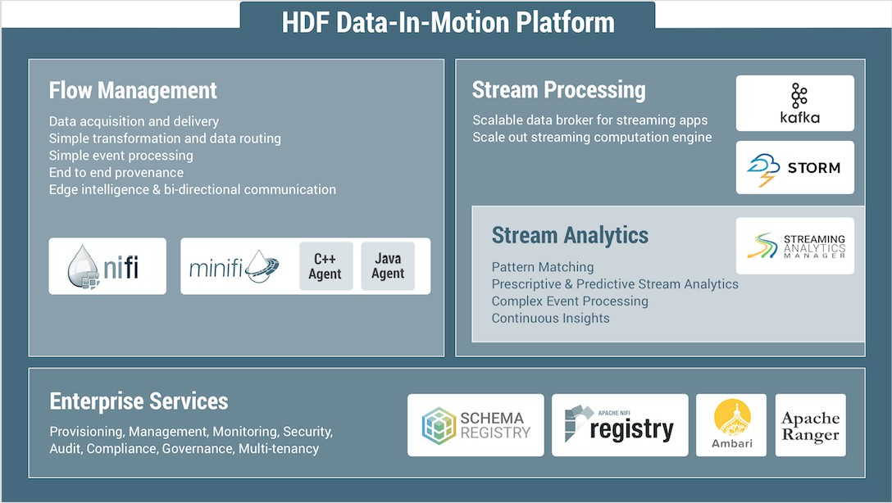
Components of the HDF Platform
Notes:
Reference for this graphic: https://hortonworks.com/products/data-platforms/hdf/
Hortonworks provides a 7-part Data-in-Motion webinar series (available on demand) at:
https://hortonworks.com/blog/harness-power-data-motion/

Slide 17
NiFi & MiNiFi
NiFi is a disk-based, microbatch ETL tool that can duplicate the same processing on multiple hosts for scalability
Web-based user interface
Highly configurable / Loss tolerant vs guaranteed delivery / Low latency vs high throughput
Tracks dataflow from beginning to end
MiNiFi-a subproject of Apache NiFi-is a complementary data collection approach that supplements the core tenets of NiFi in dataflow management, focusing on the collection of data at the source of its creation
Small size and low resource consumption
Central management of agents
Generation of data provenance (full chain of custody of information)
Integration with NiFi for follow-on dataflow management
Notes:
References:
https://nifi.apache.org
https://nifi.apache.org/minifi/ NiFi background:
Originated at the National Security Agency (NSA) - more than eight years of development as a closed-source product
Apache incubator November 2014 as part of NSA technology transfer program
Apache top-level project in July 2015
Java based, running on a JVM
Wikipedia (“Apache NiFi):
Apache NiFi (short for NiagaraFiles) is a software project from the Apache Software Foundation designed to automate the flow of data between software systems. It is based on the "NiagaraFiles" software previously developed by the NSA and open-sourced as a part of its technology transfer program in 2014
The software design is based on the flow-based programming model and offers features which prominently include the ability to operate within clusters, security using TLS encryption, extensibility (users can write their own software to extend its abilities) and improved usability features like a portal which can be used to view and modify behavior visually.
NiFi is written in Java and runs within a Java virtual machine running on the server that hosts it. The main components of Nifi are
Web Server - the HTTP-based component used to visually control the software and monitor the
Flow Controller - serves as the brains of NiFi's behavior and controls the running of Nifi extensions, scheduling the allocation of resources for this to happen.
Extensions - various plugins that allow Nifi to interact with different kinds of systems
FlowFile repository - used by NiFi to maintain and track status of the currently active FlowFile, including the information that NiFi is helping move between systems
Cluster manager - an instance of NiFi that provides the sole management point for the cluster; the same data flow runs on all the nodes of the cluster
Content repository - where data in transit is maintained
Provenance repository - metadata detailing to the provenance of the data flowing through the Software development and commercial support is offered by Hortonworks. The software is fully open source. This software is also sold and supported by IBM.
MiNiFi is a subproject of NiFi designed to solve the difficulties of managing and transmitting data feeds to and from the source of origin, often the first/last mile of digital signal, enabling edge intelligence to adjust flow behavior/bi-directional communication.
Reference:
https://hortonworks.com/blog/edge-intelligence-iot-apache-minifi/
Free eBook (PDF, 52 pp., authored by Hortonworks & Attunity): http://discover.attunity.com/apache-nifi-for-dummies-en-report-go-c-lp8558.html

Slide 18
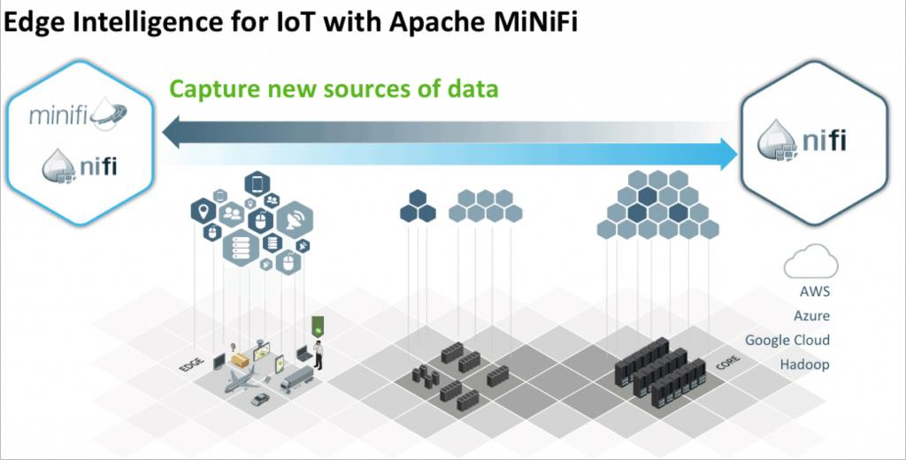
Edge Intelligence for IoT with Apache MiNiFi
Since the first mile of data collection (the far edge), is very distributed and likely involves a very large number of end devices (ie. IoT), MiNiFi carries over all the main capabilities of NiFi
Notes:
Reference: https://hortonworks.com/blog/edge-intelligence-iot-apache-minifi/
MiNiFi is ideal for situations where there are a large number of distributed, connected devices. For example first mile data collection from routers, security cameras, cable modems, ATMs, security appliances, point of sale systems, weather detection systems, fleets of trucks/trains/planes/ships, thermostats, utility or power meters are all good uses cases for MiNiFi due the distributed nature of their physical locations. MiNIFi then enables multiple applications. For example, by deploying MiNiFi on point of sale terminals, retailers can gather data from 100’s or 1000’s or more terminals.
This edge collection role was played often in the past by Flume, but Flume is has been marked as deprecated. See: https://docs.hortonworks.com/HDPDocuments/HDP2/HDP-2.6.3/bk_release- notes/content/deprecated_items.html

Slide 19
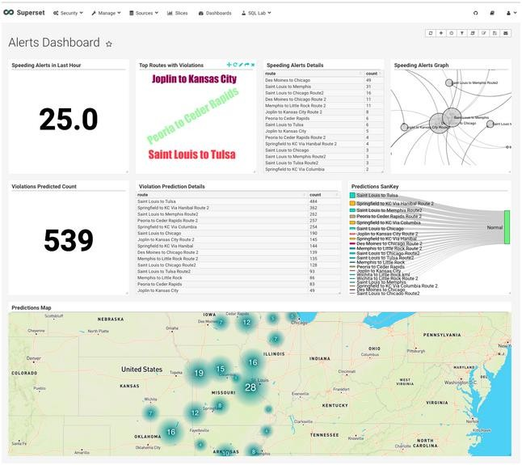
HDP dashboard - example
Hortonworks provides a full tutorial - Trucking IoT on HDF - that covers the core concepts of Storm and the role it plays in an environment where real-time, low-latency and distributed data processing are important
Continuous IoT data (Kafka)
Real-time stream processing
(Storm)
Visualization (Web application)
https://hortonworks.com/hadoop- tutorial/trucking-iot-hdf/
Notes:
This tutorial discuss a real-world use-case and provides an understanding of the role Storm plays within in HDF.
https://hortonworks.com/hadoop-tutorial/trucking-iot-hdf/
The use case is a trucking company that dispatches trucks across the country. The trucks are outfitted with sensors that collect data (IoT, Internet of Things). The data includes:
The name of the driver
The route the truck is using and intends to use
The speed of the truck
Event recently occurred (speeding, the truck weaving out of its lane, following too closely, etc)
Data like this is generated often - perhaps several times per second - and is
streamed back to the company’s servers.
Components of the tutorial are:
Demonstration
A dive into the Storm internals and how to build a topology from scratch
A discussion of how to package the Storm code and deploy onto a cluster

Slide 20
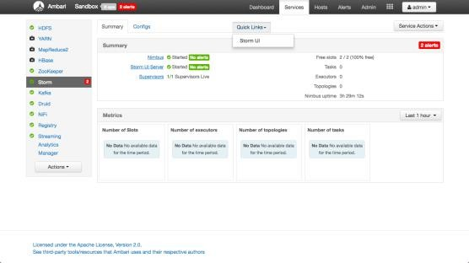
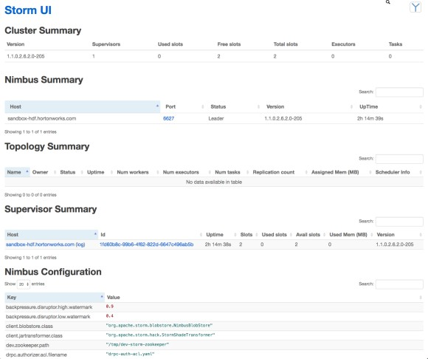
Controlling HDF components from Ambari
Example: Storm
Notes:
The Ambari interface provides:
Open source management platform
Ongoing cluster management and maintenance (cluster size irrelevant) via Web UI and REST API (cluster operations automation)
Visualization of cluster health and extended cluster capability by wrapping custom services under management
Centralized security setup

Slide 21
IBM Streams
IBM Streams is an advanced computing platform that allows user- developed applications to quickly ingest, analyze, and correlate information as it arrives from thousands of real-time sources
The solution can handle very high data throughput rates, up to millions of events or messages per second
IBM Streams provides:
Development support - Rich Eclipse-based, visual IDE lets solution architects visually build applications or use familiar programming languages like Java, Scala or Python
Rich data connections - Connect with virtually any data source whether structured, unstructured or streaming, and integrate with Hadoop, Spark and other data infrastructures
Analysis and visualization - Integrate with business solutions. Built-in domain analytics like machine learning, natural language, spatial-temporal, text, acoustic, and more, to create adaptive streams applications
Notes:
Streams is based on nearly two decades of effort by the IBM Research team to extend computing technology to handle advanced analysis of high volumes of data quickly.
How important is their research? Consider how it would help crime investigation to analyze the output of any video cameras in the area that surrounds the scene of a
crime to identify specific faces of any persons of interest in the crowd and relay that information to the unit that is responding. Similarly, what a competitive edge it could provide by analyzing 6 million stock market messages per second and execute trades with an average trade latency of only 25 microseconds (far faster than a hummingbird flaps its wings). Think about how much time, money, and resources could be saved by analyzing test results from chip-manufacturing wafer testers in real time to determine whether there are defective chips before they leave the line.
System S: While at IBM, Dr. Ted Codd invented the relational database. In the defining IBM Research project, it was referred to as System R, which stood for Relational. The relational database is the foundation for data warehousing that launched the highly successful Client/Server and On-Demand informational eras. One of the cornerstones of that success was the capability of OLAP products that are still used in critical business processes today.
When the IBM Research division again set its sights on developing something to address the next evolution of analysis (RTAP) for the Smarter Planet evolution, they set their sights on developing a platform with the same level of world- changing success, and decided to call their effort System S, which stood for Streams. Like System R, System S was founded on the promise of a revolutionary change to the analytic paradigm. The research of the Exploratory Stream Processing Systems team at T.J. Watson Research Center, which was set on advanced topics in highly scalable stream-processing applications for the System S project, is the heart and soul of Streams.
Critical intelligence, informed actions, and operational efficiencies that are all available in real time is the promise of Streams.

Slide 22
Comparison of IBM Streams vs NiFi
IBM Streams
Stream Data Engine (SDE)
Complete cluster support
C++ engine - performance & scalability
Mature & proven product (v4.2)
Memory-based
Streaming analytics
Many analytics operators
Enterprise data source / sink support
Web-based, command-line based, and
REST- based monitoring tooling
Drag-and-drop development environment + Streams Processing Language (SPL)
NiFi
Microbatch engine
Master-slave, duplicate processing
Java engine
Evolving product
Disk-based
Extract-Tranform-Load (ETL) oriented
No analytics Processors
Limited data source / sink support
Web-based monitoring tooling
Web-based development environment
Needs Storm or Spark to provide the analytics
Notes:
NiFi itself is not a streaming analytics engine. HDF uses Storm for the analytic processing.
Apache Storm is a distributed stream processing computation framework written predominantly in the Clojure programming language. Originally created by Nathan Marz and team at BackType, the project was open sourced after being acquired by Twitter.
Why use Storm? http://storm.apache.org/
Apache Storm is a free and open source distributed realtime computation system. Storm makes it easy to reliably process unbounded streams of data, doing for realtime processing what Hadoop did for batch processing. Storm is simple, can be used with any programming language, and is a lot of fun to use!
Storm has many use cases: realtime analytics, online machine learning, continuous computation, distributed RPC, ETL, and more. Storm is fast: a benchmark clocked it at over a million tuples processed per second per node. It is scalable, fault-tolerant
Storm integrates with the queueing and database technologies you already use. A Storm topology consumes streams of data and processes those streams in arbitrarily complex ways, repartitioning the streams between each stage of the computation however needed.
The reference provides a tutorial.
Apache Storm with v1.0 works with Apache Trident. Trident is a high-level abstraction for doing realtime computing on top of Storm. Trident provides microbatching.
Trudent allows you to seamlessly intermix high throughput (millions of messages per second), stateful stream processing with low latency distributed querying. If you're familiar with high level batch processing tools like Pig or Cascading, the concepts of Trident will be very familiar – Trident has joins, aggregations, grouping, functions, and filters. In addition to these, Trident adds primitives for doing stateful, incremental processing on top of any database or persistence store. Trident has consistent, exactly-once semantics, so it is easy to reason about Trident topologies.

Slide 23
Advantages of IBM Streams & Streams Studio
Streams Studio provides the ability to create stream processing topologies without programming through a comprehensive set of capabilities:
Pre-built Sources (input): Kafka, Event Hubs, HDFS
Pre-built Processing (operators): Aggregate, Branch, Join, PMML, Projection Bolt, Rule
Pre-built Sink (output): Cassandra, Druid, Hive, HBase, HDFS, JDBC, Kafka
Notification (email), Open TSDB, Solr
Pre-built visualization: 30+ business visualizations - and these can be organized into a dashboard
Extensible: Ability to add user-defined functions (UDF) and aggregates (UDA) through jar files
Notes:
Being able to create stream processing topologies without programming is a worthwhile goal. This is something that is possible already with IBM Streams using Streams Studio.
IBM Streams is a complete, off-the-shelf Streaming Data Engine (SDE) that is ready to run immediately after installation. In addition, you have all the tools to develop custom source and sink
PMML stands for "Predictive Model Markup Language." It is the de-facto standard to represent predictive solutions. A PMML file may contain a myriad of data transformations (pre- and post-processing) as well as one or more predictive models.
IBM Streams comes with the ability to cross-integrate with IBM SPSS Statistics to provide PMML capability and work with R, the open source statistical package that supports PMML.
What is PMML?
https://www.ibm.com/developerworks/library/ba-ind-PMML1/

Slide 24
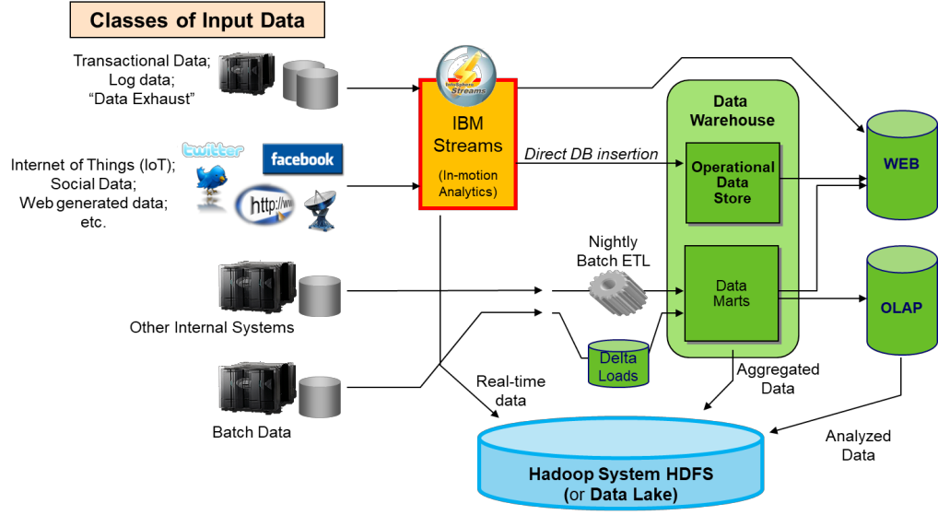
Where does IBM Streams fit in the processing cycle?
Notes:
What if you wanted to add in fraud detection to your processing cycle before authorizing the transaction and committing it to the database? Fraud detection has to happen in real-time in order for it to truly be of a benefit. So instead of taking our data and running it directly into the authorization / OLTP process, we process it as it streaming data using IBM Streams. The results of this process can be directed to our transactional system or data warehouse or to a Data Lake or Hadoop system storage (e.g., HDFS).

Slide 25
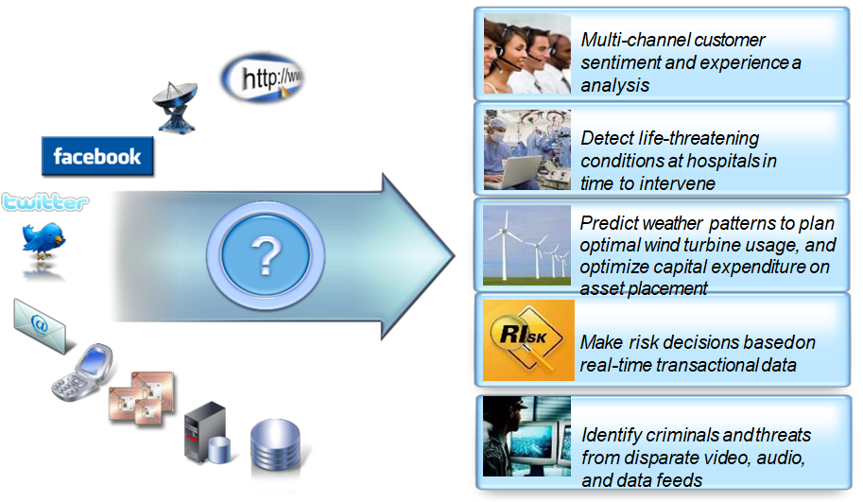
Real-time processing to find new insights
Notes:
The graphic represents some of the situations in which IBM Streams have been applied to perform real-time analytics on streaming data.
Today organizations are only tapping in to a small fraction of the data that is available to them. The challenge is figuring out how to analyze ALL of the data, and find insights in these new and unconventional data types. Imagine if you could analyze the 7 terabytes of tweets being created each day to figure out what people are saying about your products, and figure out who the key influencers are within your target demographics.
Can you imagine being able to mine this data to identify new market opportunities?
What if hospitals could take the thousands of sensor readings collected every hour per patients in ICUs to identify subtle indications that the patient is becoming unwell, days earlier that is allowed by traditional techniques? Imagine if a green energy company could use petabytes of weather data along with massive volumes of operational data to optimize asset location and utilization, making these environmentally friendly energy sources more cost competitive with traditional sources.
What if you could make risk decisions, such as whether or not someone qualifies for a mortgage, in minutes, by analyzing many sources of data, including real-time transactional data, while the client is still on the phone or in the office? Or if law enforcement agencies could analyze audio and video feeds in real-time without human intervention to identify suspicious activity?
As new sources of data continue to grow in volume, variety and velocity, so too does the potential of this data to revolutionize the decision-making processes in every industry.

Slide 26
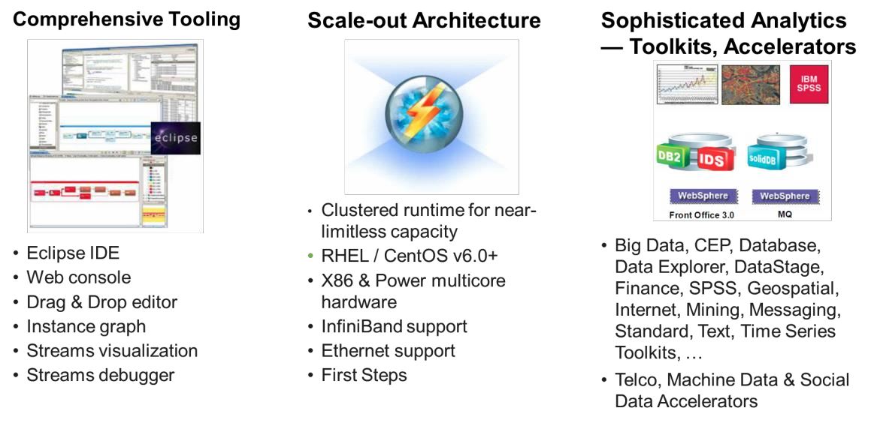
Components of IBM Streams

Slide 27
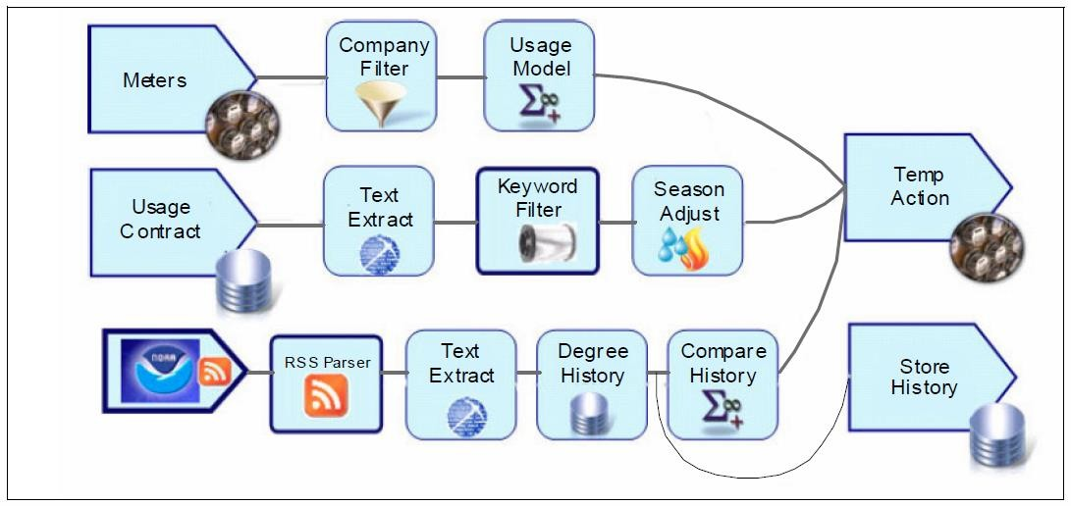
Application graph of an IBM Streams application
Notes:
Applications can be developed in the IBM Streams Studio by using IBM Streams Processing Language (SPL), a declarative language that is customized for stream computing. Applications with the latest release are, however, generally developed using a drag-and-drop graphical approach.
After the applications are developed, they are deployed to Streams Runtime environment. By using Streams Live Graph, you can monitor the performance of the runtime cluster from the perspective of individual machines and the communications between them.
Virtually any device, sensor, or application system can be defined by using the language. But, there are predefined source and output adapters that can further simplify application development. As examples, IBM delivers the following adapters, among many others:
TCP/IP, UDP/IP, and files
IBM WebSphere Front Office, which delivers stock feeds from major exchanges worldwide
IBM solidDB® includes an in-memory, persistent database that uses the Solid Accelerator API
Relational databases, which are supported by using industry standard ODBC Applications, such as the one shown above, almost always feature multiple steps.
For example, some utilities began paying customers who sign up for a particular usage plan to have their air conditioning units turned off for a short time, allowing the temperature to be changed. An application to implement this plan collects data from meters and might apply a filter to monitor only for those customers who selected this service. Then, a usage model must be applied that was selected for that company. Up- to-date usage contracts then need to be applied by retrieving them, extracting text, filtering on key words, and possibly applying a seasonal adjustment. Current weather information can be collected and parsed from the US National Oceanic & Atmospheric Administration (NOAA), which has weather stations across the United States. After the correct location is parsed for, text can be extracted and temperature history can be read from a database and compared to historical information.
Optionally, the latest temperature history could be stored in a warehouse for future use.
Finally, the three streams (meter information, usage contract, and current weather comparison to historical weather) can be used to take actions.
This example is taken from the free IBM RedBook (PDF): Ebbers, M., Abdel-Gayed, A., Budhi, V. B., Dolot, F., Kamat, V., Picone, R., & Trevelin, J. (2013). Addressing Data Volume, Velocity, and Variety with IBM InfoSphere Streams V3.0. Raleigh, NC: IBM International Technical Support Organization (ITSO), p. 31.
This RedBook is available from: http://www.redbooks.ibm.com/redbooks/pdfs/sg248108.pdf

Slide 28
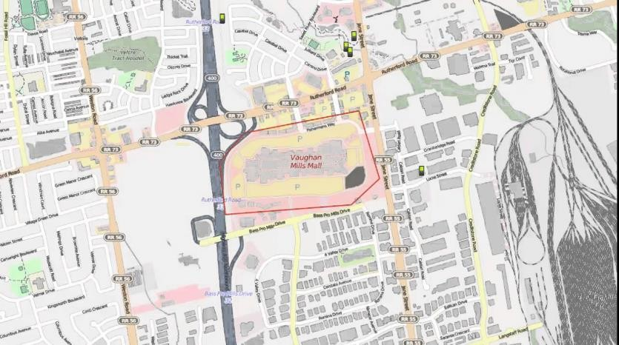
Demo: “Learn IBM Streams in 5 minutes” (5:53)
Play at full-screen, the YouTube Video: https://www.ibm.com/ms- en/marketplace/stream-computing
Notes:
Example exploration: How to capture data streams and analyze them faster with IBM Streams.
YouTube URL: https://www.youtube.com/watch?v=HLHGRy7Hif4

Slide 29
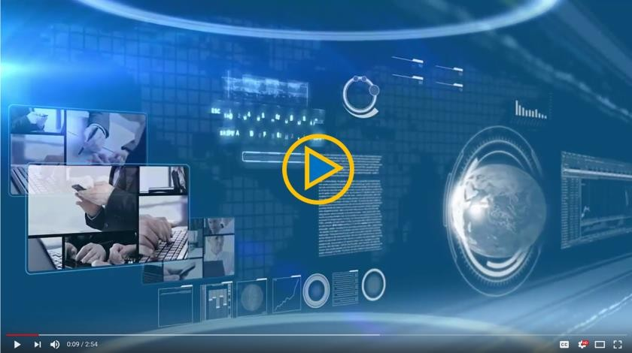
Demo: “IBM Streams Designer Overview” (2:54)
Play at full-screen, the YouTube Video:
https://youtu.be/i6nBhFoXZqo
Notes:
This video provides an overview of IBM Streams Designer, part of IBM Watson Data Platform.
Find more videos in the IBM Streams Designer Learning Center at:
http://ibm.biz/streams-designer-learning.

Slide 30
Checkpoint
What are the typical sources of streaming data?
Name some of the components of Hortonworks DataFlow (HDF)
What are the primary differences between NiFI and MiNiFi?
What main features does IBM Streams provide as a Streaming Data Platform?

Slide 31
Unit summary
Define streaming data
Describe IBM as a pioneer in streaming data - with System S €IBM Streams
Explain streaming data - concepts & terminology
Compare and contrast batch data vs streaming data
List and explain streaming components & Streaming Data Engines (SDEs)

