Slide 1
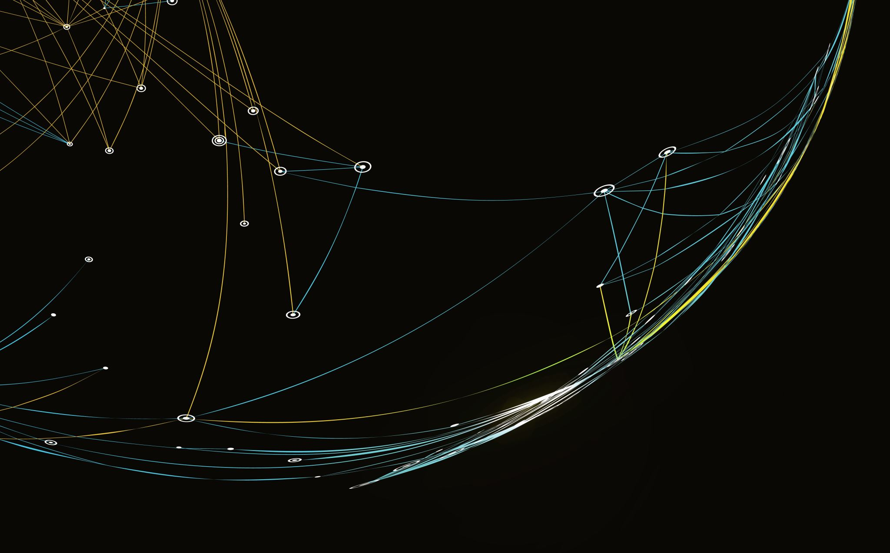
ID-Assignment 1
Vivian Lee Ching_S10247725

Slide 2

Project Idea 1: Real band
Maroon 5

Slide 3
Wireframe

Slide 4
Code
1 md file
README.md
6 HTML files
index.html
about.html
albums.html
ticket.html
newsletter.html
submitted.html
Photos (folder)
6 CSS files
index.css
about.css
albums.css
ticket.css
newsletter.css
normalise.css
4 JS files
about.js
Members.js
abums.js
albumslist.js

Slide 5
Code
http://127.0.0.1:5501/index.html

Slide 6
Code (chrome)

