Slide 1
Cyber Covid Awareness
FLOWCHART

Slide 2
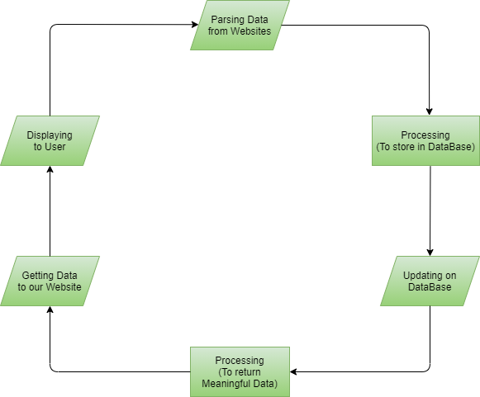

Slide 3
Members
Muhammad Umer Farooq
Muhammad Usman Naeem
Zain-Ul-Abdin

