Slide 1
Cyber Covid Awareness
PRESENTATION

Slide 2
Details
Muhammad Umer Farooq
Muhammad Usman Naeem
Zain-Ul-Abdin
- 19681
- 19679
- 19683
Presentation Link : https://youtu.be/MkT_2JtrIr0
Website Link : http://ezytech.tech/covid19-parser

Slide 3
Purpose
Provide awareness among public
Give daily updated stats
Provide an Email-Newsletter
Show information effectively using Graphs
Allowing user to see if they are in a hot zone or not
Providing an intelligent Chat Bot
Showing information during a user selective timeframe
Percentage of infections, recoveries, and deaths.
Provide a one-in-all interactive platform

Slide 4
Requirements
Functional
Users shall be able to see today’s stats
The data should update at 9:00 every day automatically
The user shall be able to see the overall stat
Users shall be able to chat with bot
User shall be able to select range date to see stats
User shall be able to see graphic to visualize clearly
The data should not be able to other sites and should be secured

Slide 5
The UI should be responsive to all screens
For the Chat, users should have to do firebase google login
User shall be able to view average cases during a timeframe
user shall be able to get notifications at 9:01
user shall be able to see if he is in hot zone or not (city based)
User shall be able to mark himself as COVID-19 patient if not recognized by the medical team
User shall be able to check nearby quarantine centers
Users shall be able to see the percentage of recovering patients and dying patients of a particular country.

Slide 6
Non-Functional
The backend of system should be in Python
For the database SQLite should be used
For the frontend VueJS should be used
Users should be able to complain for data correction.
The cronjob to run the program automatically should be done from script.
It is a high quality software hosted on servers
It will be free and open for common public to use

Slide 7
Planning
Background Details:
The coronavirus aka COVID-19, is igniting fear worldwide because of a number of reasons. As COVID-19 is a new virus, there is no available vaccine for this. Alongside developing a vaccine for COVID-19, researchers are also trying to predict its behavior. We need a system that develops awareness among the public and they should be able to ask questions.

Slide 8
Planning
Objectives:
We need to get/parse/scrape data from the trusted source
Setup an offline database to store all data
To build a dashboard to visualize the data
Build a chatbot for the public to be able to ask general questions
Automate this entire process

Slide 9
Planning
Milestones:
Dec 18, 2020
Get requirements, identify purpose, and write planning document.
Dec 28, 2020
Analysis and implementation.
Jan 01, 2021
Testing and deployment.

Slide 10
Analysis
In the development of this system, the agile method was adopted and used for the system. The purpose of adopting the agile methodology is because requirements are flexible and can be changed upon customer needs.
The system will be delivered on time under the budget constraints
The regular meeting with client/customer enables the project to complete what he/she wants
Advantages

Slide 11
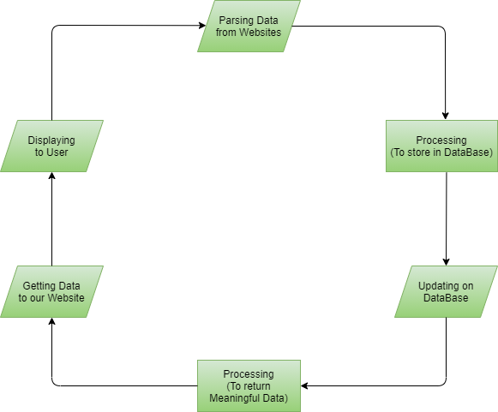
Flow Chart
Loop is run automatically once in a day.

Slide 12
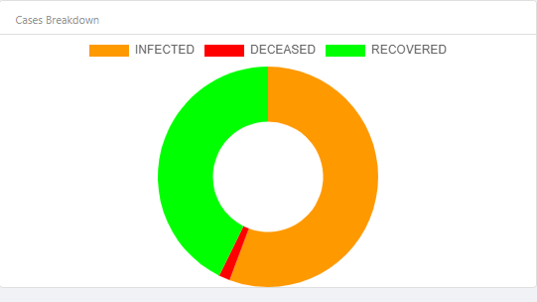
Design
Percentage of Total Cases

Slide 13
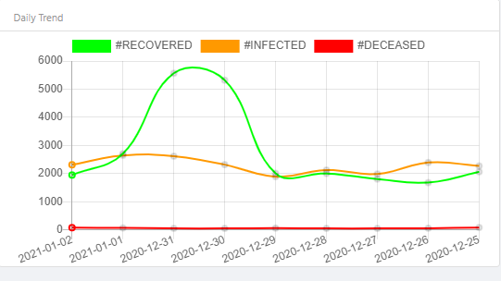
Easy to Understand Data Representation

Slide 14
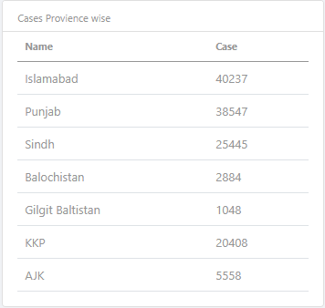
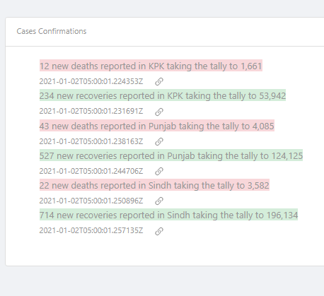
Displaying Realtime Numbers

Slide 15
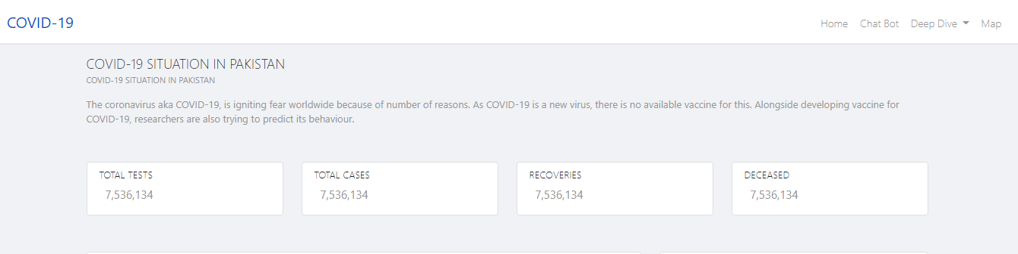
Displaying Realtime Numbers

Slide 16
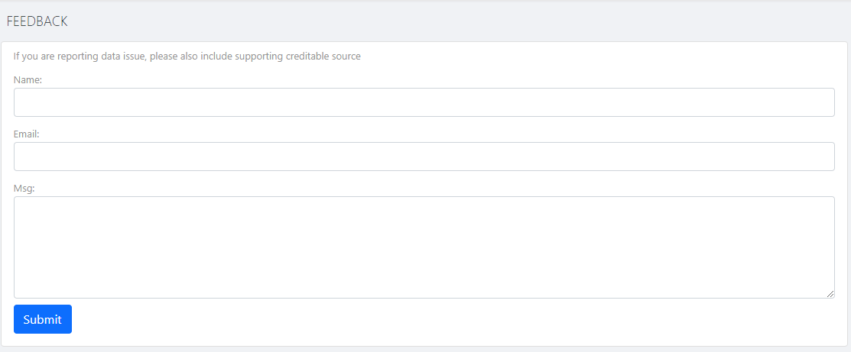
Getting User Feedback

Slide 17
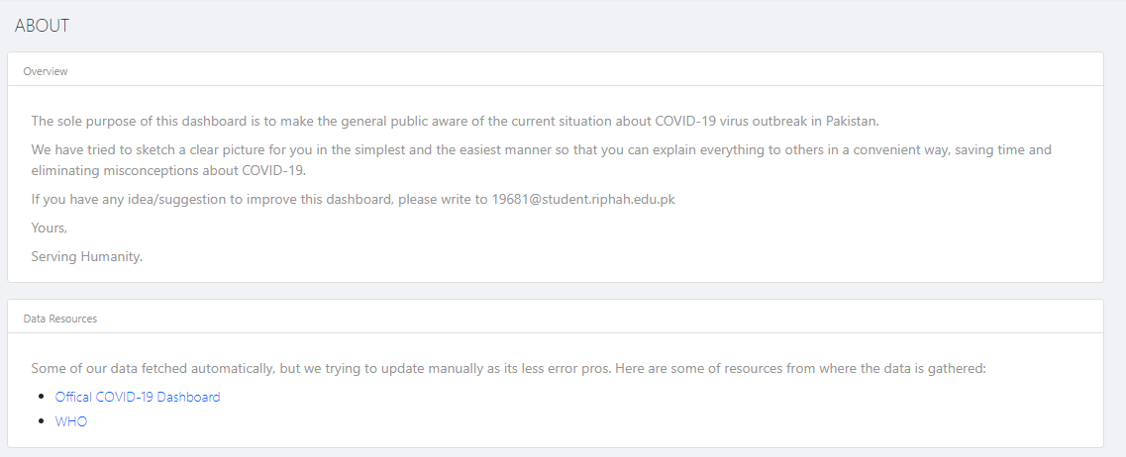
Detailed About Page

Slide 18
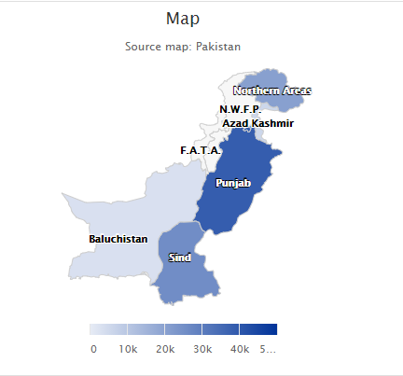
Hot Zone Identification

Slide 19
Implementation
The system can be implemented as a standalone system
The system can be implemented online or on a locally hosted server
The system can be part of a cloud network

Slide 20
Coding
Programming Language | Python, TypeScript
Database | SQLite, CSV
UI | Bootstrap, Tailwind CSS, Material Design
Supported Browsers | All
Visualization | Chart JS
Data source | http://covid.gov.pk/

Slide 21
Testing
The backend is tested using Python unit testing framework called PyUnit
Frontend tested using unit testing framework called Jest
Integration testing can be seen on the dashboard
Note: As there is no user input, No input precautions are taken.

Slide 22
Maintenance
The maintenance of system will start after deployment of product to the client.

Slide 23
THANK YOU

