Slide 1

Lua
an embeddable,
high-performance
scripting language
and its applications
Hisham Muhammad
hisham@inf.puc-rio.br
PUC-Rio, Rio de Janeiro, Brazil

Slide 2


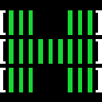
Introductions
Hisham Muhammad
PUC-Rio
  University in Rio de Janeiro, Brazil
LabLua research laboratory
  founded by Roberto Ierusalimschy,
  Lua's chief architect
lead developer of LuaRocks
  Lua's package manager
other open source projects:
  GoboLinux, htop process monitor

Slide 3
What we will cover today
The Lua programming language
  what's cool about it
  how to make good uses of it
Real-world case study
  an M2M gateway and energy analytics system
  making a production system highly adaptable
Other high-profile uses of Lua
  from Adobe and Angry Birds
  to World of Warcraft and Wikipedia

Slide 4

Lua?
...is what we tend to call a
"scripting language"
  dynamically-typed, bytecode-compiled,
  garbage-collected
  like Perl, Python, PHP, Ruby, JavaScript...
What sets Lua apart?
  Extremely portable: pure ANSI C
  Very small: embeddable, about 180 kiB
  Great for both embedded systems and for
  embedding into applications

Slide 5
Lua is fully featured
All you expect from the core of
a modern language
  First-class functions (proper closures
  with lexical scoping)
  Coroutines for concurrency management
  (also called "fibers" elsewhere)
  Meta-programming mechanisms
    object-oriented
    functional programming
    procedural, "quick scripts"

Slide 6


To get licensing out of the way
MIT License
You are free to use it anywhere
Free software projects
  OSI certified license
Proprietary commercial projects
  No royalties

Slide 7
What Lua looks like
function process(filename, fn, ...)
local f = io.open(filename)
local rets = {}
for line in f:lines() do
rets[#rets+1] = { fn(line, …) }
end
f:close()
return rets
end
matches = process("file.txt", string.find, "foo")
for i, match in ipairs(matches) do
print(i, table.concat(match), ", ")
end

Slide 8
What Lua looks like
function process(filename, fn, ...)
local f = io.open(filename)
local rets = {}
for line in f:lines() do
rets[#rets+1] = { fn(line, …) }
end
f:close()
return rets
end
matches = process("file.txt", string.find, "foo")
for i, match in ipairs(matches) do
print(i, table.concat(match), ", ")
end
objects

Slide 9
What Lua looks like
function process(filename, fn, ...)
local f = io.open(filename)
local rets = {}
for line in f:lines() do
rets[#rets+1] = { fn(line, …) }
end
f:close()
return rets
end
matches = process("file.txt", string.find, "foo")
for i, match in ipairs(matches) do
print(i, table.concat(match), ", ")
end
first-class functions

Slide 10
What Lua looks like
function process(filename, fn, ...)
local f = io.open(filename)
local rets = {}
for line in f:lines() do
rets[#rets+1] = { fn(line, …) }
end
f:close()
return rets
end
matches = process("file.txt", string.find, "foo")
for i, match in ipairs(matches) do
print(i, table.concat(match), ", ")
end
iterators

Slide 11
What Lua looks like
function process(filename, fn, ...)
local f = io.open(filename)
local rets = {}
for line in f:lines() do
rets[#rets+1] = { fn(line, …) }
end
f:close()
return rets
end
matches = process("file.txt", string.find, "foo")
for i, match in ipairs(matches) do
print(i, table.concat(match), ", ")
end
tables, tables everywhere!

Slide 12
So, what's the trick?
How can it be so small? Python takes 72 MiB!

Slide 13
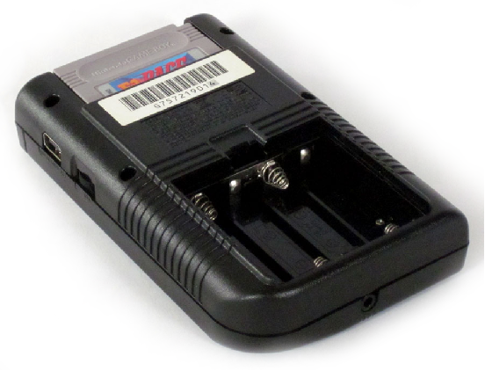
So, what's the trick?
How can it be so small? Python takes 72 MiB!
The answer:
"Batteries not included!"
The core gives you
only the core: standard
types and ANSI C
facilities (such as files)
Zero bloat
  you "pay" for what you need

Slide 14
For anything else: modules
Everything else is provided through external libraries
What do I mean by everything?
Lua

Slide 15
For anything else: modules
Everything else is provided through external libraries
What do I mean by everything? Everything:
GUI
SQL
XML
Sockets
JSON
Lua

Slide 16
But you don't have to implement it
All these libraries are already available
It's easy to load them to your Lua environment
LuaRocks, the package management
system for Lua
  like RubyGems, CPAN, npm, etc.
Need sockets?
  luarocks install luasocket
(this is a shameless plug:
I maintain LuaRocks :-) )

Slide 17
The size of your needs
You only "pay" in memory and space for what you need
Good for security audits
Sockets
Lua

Slide 18
The size of your needs
You only "pay" in memory and space for what you need
Good for security audits
Good for embedding in applications:
Lua
Your application

Slide 19
The size of your needs
You only "pay" in memory and space for what you need
Good for security audits
Good for embedding in applications:
Sockets
Lua
Your application

Slide 20
A case study: M2M gateway application
Let's have a more concrete idea
through a real-world example
A project I worked on for a Brazilian company

Slide 21
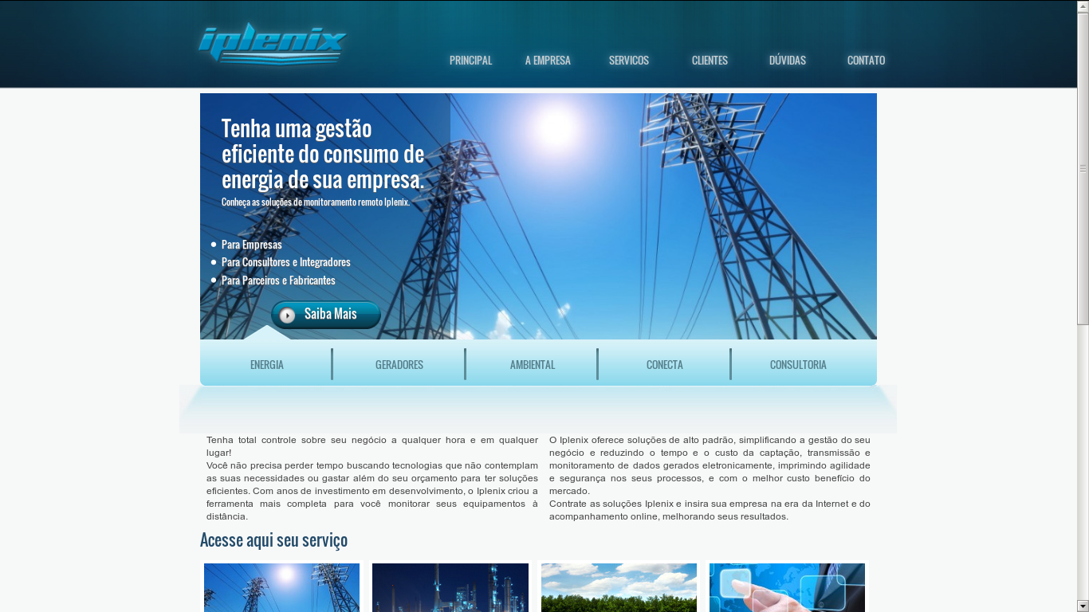

Slide 22
The context
Telemetry for energy equipment
  Power generators, consumption meters
  Data collection and statistics
Analytics on energy bills
Machine-to-machine (M2M) communication:
  Get custom hardware (legacy ports, etc.) in the net
  Aggregate their data

Slide 23
The Iplenix architecture
Clients (web)
Frontend Servers
web interface
Devices
Gateway
Servers
device
connection
mgmt
Backend
Servers
data management,
aggregation, analytics
NoSQL
database
...

Slide 24
The Iplenix architecture
Clients (web)
Frontend Servers
web interface
Devices
Gateway
(C)
device
connection
mgmt
Backend
Servers
data management,
aggregation, analytics
NoSQL
database
...
maximum performance
low footprint

Slide 25
The Iplenix architecture
Clients (web)
Frontend Servers
web interface
Devices
Gateway
(C)
device
connection
mgmt
Backend
(Java)
data management,
aggregation, analytics
NoSQL
database
...
business logic
integration with NoSQL db
maximum performance
low footprint

Slide 26
The Iplenix architecture
Clients (web)
Frontend (PHP)
web interface
Devices
batteries for the
web included
Gateway
(C)
device
connection
mgmt
Backend
(Java)
data management,
aggregation, analytics
NoSQL
database
...
business logic
integration with NoSQL db
maximum performance
low footprint

Slide 27
Where did Lua fit in?
Two challenges:
  Many incompatible devices connecting
    Gateway needs to be quickly adaptable
  Ever-changing energy tariffs and legislation
    Backend needs to be quickly adaptable

Slide 28
The Gateway Server
Many incompatible devices connecting
  Generators, energy accounting devices
  Each speaks its own protocol (or incompatible / poorly-implemented variations of protocols!)
  Almost one protocol for each customer
  Written in C: recompile, rebuild, redeploy, restart
Gateway
(C)
device
connection
mgmt
Protocols,
protocols,
protocols...

Slide 29
Lua in the Gateway
Strip away the protocols
Gateway
(C)
device
connection
mgmt

Slide 30
Lua in the Gateway
Strip away the protocols
High-level API with the main features of the gateway
Gateway API
Gateway
(C)
device
connection
mgmt

Slide 31
Lua in the Gateway
Strip away the protocols
High-level API with the main features of the gateway
Bindings to connect the Lua VM to this API
Lua
Lua bindings
Gateway API
Gateway
(C)
device
connection
mgmt

Slide 32
Lua in the Gateway
Strip away the protocols
High-level API with the main features of the gateway
Bindings to connect the Lua VM to this API
Protocols in Lua
P
P
...
P
P
P
Lua
Lua bindings
Gateway API
Gateway
(C)
device
connection
mgmt

Slide 33
What Lua bindings look like
int send_data(lua_State* L) {
size_t size, sent;
const char* data = luaL_checklstring(L, 1, &size);
lua_getfield(L, LUA_REGISTRYINDEX, "gw");
Gateway* gw = lua_touserdata(L, -1);
sent = Gateway_sendData(gw, data, size);
lua_pop(L, lua_gettop(L));
lua_pushinteger(L, sent);
return 1;
}

Slide 34
What Lua bindings look like
int send_data(lua_State* L) {
size_t size, sent;
const char* data = luaL_checklstring(L, 1, &size);
lua_getfield(L, LUA_REGISTRYINDEX, "gw");
Gateway* gw = lua_touserdata(L, -1);
sent = Gateway_sendData(gw, data, size);
lua_pop(L, lua_gettop(L));
lua_pushinteger(L, sent);
return 1;
}
handle to a Lua instance (yes, there can be many)

Slide 35
What Lua bindings look like
int send_data(lua_State* L) {
size_t size, sent;
const char* data = luaL_checklstring(L, 1, &size);
lua_getfield(L, LUA_REGISTRYINDEX, "gw");
Gateway* gw = lua_touserdata(L, -1);
sent = Gateway_sendData(gw, data, size);
lua_pop(L, lua_gettop(L));
lua_pushinteger(L, sent);
return 1;
}
read arguments from Lua into C

Slide 36
What Lua bindings look like
we can store pointers to C context data
inside our Lua context
int send_data(lua_State* L) {
size_t size, sent;
const char* data = luaL_checklstring(L, 1, &size);
lua_getfield(L, LUA_REGISTRYINDEX, "gw");
Gateway* gw = lua_touserdata(L, -1);
sent = Gateway_sendData(gw, data, size);
lua_pop(L, lua_gettop(L));
lua_pushinteger(L, sent);
return 1;
}

Slide 37
What Lua bindings look like
int send_data(lua_State* L) {
size_t size, sent;
const char* data = luaL_checklstring(L, 1, &size);
lua_getfield(L, LUA_REGISTRYINDEX, "gw");
Gateway* gw = lua_touserdata(L, -1);
sent = Gateway_sendData(gw, data, size);
lua_pop(L, lua_gettop(L));
lua_pushinteger(L, sent);
return 1;
}
we call our Gateway API function

Slide 38
What Lua bindings look like
int send_data(lua_State* L) {
size_t size, sent;
const char* data = luaL_checklstring(L, 1, &size);
lua_getfield(L, LUA_REGISTRYINDEX, "gw");
Gateway* gw = lua_touserdata(L, -1);
sent = Gateway_sendData(gw, data, size);
lua_pop(L, lua_gettop(L));
lua_pushinteger(L, sent);
return 1;
}
we clean the stack and
push our return value back to Lua
(yes, there can be many)

Slide 39
What Lua bindings look like
int send_data(lua_State* L) {
size_t size, sent;
const char* data = luaL_checklstring(L, 1, &size);
lua_getfield(L, LUA_REGISTRYINDEX, "gw");
Gateway* gw = lua_touserdata(L, -1);
sent = Gateway_sendData(gw, data, size);
lua_pop(L, lua_gettop(L));
lua_pushinteger(L, sent);
return 1;
}
...and yes, there are many bindings generators to automate this
boring stuff! Huge libraries like Qt are bound using generators.

Slide 40
Advantages
Writing protocols in Lua is simpler
We could load/unload them on the fly without restarting
  We did have support for loading C protocols as dynamic libraries, but with Lua code is bound per thread, not per process
The C core stabilized to a point were we basically never touched it anymore
P
P
...
P
P
P
Lua
Lua bindings
Gateway API
Gateway
(C)
device
connection
mgmt

Slide 41
Second challenge: the frontend server
Ever-changing business logic
  Brazil is a large country (5th largest in both pop. and area)
  with a privatized energy system
  Each of the 26 states has one or more electricity companies
  Billing plans and rates change, laws change
  Also, data from devices also had to be processed in different ways
AES Sul • AMAZONAS • Ampla • Bandeirante • BOA VISTA • Caiuá • CEA • CEAL • CEB • CEEE • CELESC • CELG • CELPA •
CELPE • CELTINS • CEMAR • CEMAT • CEMIG • CEPISA • CERON • CERR • CFLM • CFLO • Chesp • CJE • CLFSC • CNEE • COCEL •
Coelba • COELCE • COOPERALIANÇA • COPEL • COSERN • CPEE • CPFL Paulista • CPFL Piratininga • CSPE • DEMEI • DMED • EBO • EDEVP •
EEB • EFLUL • ELEKTRO • ELETROACRE • ELETROCAR • AES Eletropaulo • ELFJC • ELFSM • EMG • ENERSUL • ENF • EPB • Escelsa • ESE •
FORCEL • HIDROPAN • IGUAÇU • Light • MUXFELDT • RGE • SULGIPE • UHENPAL

Slide 42
The frontend server
Responsible for several tasks
  Receiving data from gateway servers
  Responding requests from frontend servers
  Taking data in and out of the NoSQL database
  The big part that kept changing, though, was the business logic
Backend
(Java)
Business logic

Slide 43
Lua in the backend
Strip away the business logic
Backend
(Java)

Slide 44
Lua in the backend
Strip away the business logic
Plug in the LuaJava bridge
LuaJava
Backend
(Java)

Slide 45
Lua in the backend
Strip away the business logic
Plug in the LuaJava bridge
LuaJava uses the Java Reflection API which discovers classes automatically: no bindings needed!
LuaJava
Backend
(Java)

Slide 46
Lua in the backend
Strip away the business logic
Plug in the LuaJava bridge
LuaJava uses the Java Reflection API which discovers classes automatically: no bindings needed!
Lua
LuaJava
Backend
(Java)

Slide 47
Lua in the backend
Strip away the business logic
Plug in the LuaJava bridge
LuaJava uses the Java Reflection API which discovers classes automatically: no bindings needed!
Write business logic in Lua
Logic
Logic
Logic
Logic
Logic
Lua
LuaJava
Backend
(Java)

Slide 48
Advantages
Simpler to write business code logic
On-the-fly updates
We wrote some specialized, high-level Java classes with simplified interfaces to be used from Lua
We also wrote some custom Lua code to hide some Java-isms:
for obj in each(vec) ... end
  A 5-line function which implements a Lua iterator that accepts any Java objects that implements Iterable.

Slide 49
The Iplenix architecture, improved
Devices
P
P
...
Logic
Logic
P
P
P
Logic
Logic
Logic
Lua
Lua bindings
Lua
Gateway API
LuaJava
Gateway
(C)
NoSQL
database
...
Backend
(Java)
Frontend (PHP)
web interface
Clients
(web)

Slide 50
Results
A very flexible solution
We tried to use, for each job, the best tool for the job
The message is: don't be afraid to integrate languages
  Give programmers the most adequate tools
  and they will be more productive
When I joined Iplenix, I was the only one who knew Lua
When I left, at least five others in the team were familiar with it
  Also using it for other tasks

Slide 51
Some high-profile uses of Lua
That was just one real-world example
Lua is used in many industrial-strength applications,
both commercial and open source
Adobe Photoshop Lightroom
Apache web server
VLC media player
Corona SDK for iOS/Android
Cisco Adaptive Security Appliance
Many others we'll never know
about

Slide 52

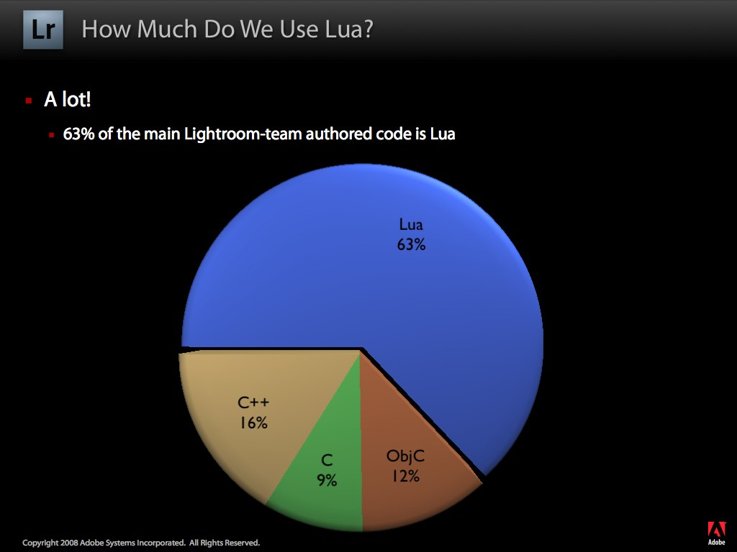
http://troygaul.com/LrExposedC4.html

Slide 53


Lua in games
Typical split between "heavy lifting/backend" (engine)
and " business game logic"
World of Warcraft, a massively
multiplayer online RPG
  UI is customizable in Lua
  tweaked by power users
Angry Birds, casual game for mobile
  Levels written in Lua
  data files stored in Lua
  (save games, high scores)

Slide 54
...plus many others
Allods Online - American Girl - Angry Birds - Aquaria - Baldur's Gate - The Battle for Wesnoth - Bet On Soldier: Blood Sport - Blitzkrieg - Brave: The Search for Spirit Dancer - Brütal Legend - Bubble Ball - Buzz! - BZFlag - Civilization V - Company of Heroes - Cortex Command - Crackdown - Crowns of Power - Crysis - DarkSpace - Dead Hungry Diner - Demigod - Digital Combat Simulator - Diner Dash - Driver: San Francisco - Dungeon Crawl Stone Soup - Dungeons - Empire: Total War - Enigma - Escape from Monkey Island - Etherlords - Eufloria - Evil Islands: Curse of the Lost Soul - EXperience112 - Fable II - The Fairly OddParents: Shadow Showdown - Far Cry - FlatOut - FlatOut 2 - Foldit - Fortress Forever - Freeciv - Freeciv Greatturn - Freelancer - Garry's Mod - Grim Fandango - The Guild 2 - Tom Clancy's H.A.W.X - Headhunter Redemption - Hearts of Iron III - Hedgewars - Heroes of Might and Magic V - Homeworld 2 - Hyperspace Delivery Boy! - Impossible Creatures - The Incredibles: When Danger Calls - King's Bounty: The Legend - L.A. Noire - Legend of Grimrock - Lego Universe - Linley's Dungeon Crawl - Lock On: Modern Air Combat - Mafia II - Magic: The Gathering – Duels of the Planeswalkers - MDK2 - Mercenaries: Playground of Destruction - Metaplace - Monopoly Tycoon - Multi Theft Auto - MUSHclient - Napoleon: Total War - Natural Selection 2 - Operation Flashpoint: Dragon Rising - Orbiter - Painkiller - PlayStation Home - Project Zomboid - Psychonauts - Puzzle Quest: Challenge of the Warlords - Rail Simulator - RailWorks - Rappelz - Regnum Online - Requiem: Memento Mori - Richard Burns Rally - Rift - RigidChips - Roblox - Rolando 2: Quest for the Golden Orchid - Room for PlayStation Portable - ROSE Online - Runes of Magic - Ryzom - S.T.A.L.K.E.R.: Shadow of Chernobyl - Saints Row 2 - Serious Sam 3: BFE - Shank - Shank 2 - Silent Storm - SimCity 4 - The Sims 2: Nightlife - Singles: Flirt Up Your Life - Skyland SSR - Sonic Unleashed - SpellForce: The Order of Dawn - SplitApple - Spring - Star Wars: Battlefront - Star Wars: Battlefront II - Star Wars: Empire at War - Star Wars: Empire at War: Forces of Corruption - Star Wolves - StepMania - Stolen - Stratagus - Strike Suit Zero - Supreme Commander - Supreme Commander: Forged Alliance - T-80 Darts - Tales of Pirates - Tap Tap Revenge - There - Toribash - Trouble in Terrorist Town - ÜberSoldier - UFO: Afterlight - UltraStar - Universe at War: Earth Assault - Vegas Tycoon - Vendetta Online - Warhammer 40,000: Dawn of War - Warhammer 40,000: Dawn of War II - Widelands - The Witcher - World of Warcraft - X-Moto - You Are Empty

Slide 55
One recent adoption of Lua...

Slide 56

One recent adoption of Lua...

Slide 57

Lua in Wikipedia
Lua has been recently chosen as the scripting language for Wikipedia
It will gradually replace the existing custom template language
Templates create infoboxes, summaries, [citation needed] links, etc.
Some Wikipedia pages take up to 30 seconds to render due to the old template
language! (and you thought your internet was slow)

Slide 58
Lua in Wikipedia
These scripts are written by the users,
right from their browsers,
and run in the server
Major demonstration of Lua's safety
running untrusted, unverified code
This is possible because Lua can be
100% sandboxed
  Also features resource limits for memory and running time

Slide 59
Lua in Wikipedia
WikiMedia Foundation developers wrote Lua libraries to extend Lua for their needs
  Unicode handling libraries
  PHP integration (MediaWiki is written in PHP)
Benchmarks:
  PHP-to-Lua: 2μs
  Lua-to-PHP: 0.5μs
  As fast as PHP-to-PHP

Slide 60
Why not other languages?
Why not JavaScript with V8?
  Not safe for embedding: no mem alloc hook
Why not JavaScript with Rhino?
  Slow startup, no CPU limit control
Why not PHP itself?
  Very big language, impossible to sandbox
The Lua source code was entirely audited by the WikiMedia Security Team

Slide 61

In conclusion...
...
Lua is a mature and proven language
  This year it celebrates its 20th anniversary!
From Angry Birds to Wikipedia,
Lua is everywhere
  You might not knowing, but you may have
  been using it already!
There are all kinds of resources available
to learn Lua
  Books, IDEs, Eclipse plugin, very active and
  friendly list, Reference Manual (in Russian too!)

Slide 62
Thank you!
Questions?
Contact:
Lua: http://lua.org/
List: http://www.lua.org/lua-l.html
LuaRocks: http://luarocks.org/
List: http://www.luarocks.org/en/Mailing_list
me (Hisham): http://hisham.hm/
Email: h@hisham.hm

Slide 63

About these slides...
Feel free to share this presentation
and to use parts of it in your own material
Licensed under the Creative Commons CC BY 2.0:
  https://creativecommons.org/licenses/by/2.0/

