Slide 1
Audiovisual Analytics of social linked data
Renato Fabbri (ICMC/USP)
Marilia M. Pisani (CCNH/UFABC)
Maria Cristina Ferreira de Oliveira (ICMC/USP)

Slide 2
Linked data
Data integration from different sources,
Semantic representation and manipulation of data,
Automated inferences,
Conceptual considerations of both domain and context knowledge.
1
Notes:
1

Slide 3
Social data
LOSD (Linked Open Social Data)
Anthropological Physics
Big data
1
Notes:
1

Slide 4
AAVO
(Audio)visual Analytics Vocabulary and Ontology
Described in ENMC2017/arXiv
Incipient: core and extended
Integration of OWL and SKOS, potential relations
1
Notes:
1

Slide 5
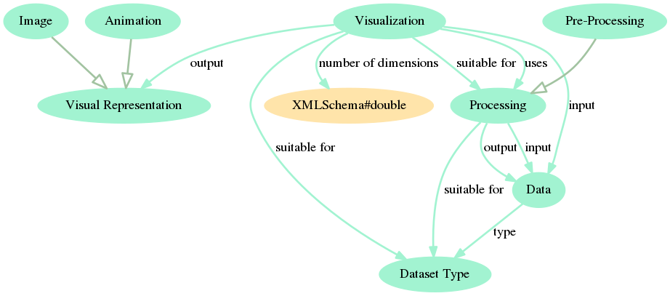
AAVO Core diagram
1
Notes:
1

Slide 6
AAVO – further considerations
These concepts should be in Core:
Hypothesis,
Analysis,
Task/Purpose/Application.
Other AAVO layers for data types, colors, charts
1
Notes:
1

Slide 7
Audiovisual Analytics system
Periodic changes in the audiovisual presentation of the system
Simultaneous use of visual and auditory channels
Aesthetic experience
Sessions, state and annotations
Persistence
Sharing
Written interface
Linked data; emphasis in text and network data; tests and logs
1
Notes:
1

Slide 8
Perceptual framework
Weber-Fechner law: exponential, log
Steven’s law: power law, log-log
Virtual/imaginary space for Fourier transforms
Human Processor Model (eye movement, memory, capacity of perceptual channels)
1
Notes:
1

Slide 9
ToDo
Integrate the envisioned concepts into AAVO Core
Develop the Audiovisual Analytics system
Deepen the perceptual framework
Formalize more conceptualizations
Thank you!
1
Notes:
1

