Slide 1
FARMER COMPANION

Slide 2



TEAM MEMBER’S
- Avishisht Gupta
B.TECH 2ND YEAR
- Prateek Bisht
B.TECH 2ND YEAR
- Aditya Singh
B.TECH 2ND YEAR

Slide 3
TABLE OF CONTENTS
1
2
3
INTRODUCTION
PROBLEM
SOLUTION/FEATURES

Slide 4
INTRODUCTION
1

Slide 5
INTRODUCTION
In order to revolutionize farmer sector, we provide solution to problems faced by farmer, solutions to problems which are never talked about, and hence improving the quality of crops and hence improving the farming sector.

Slide 6
PROBLEM
2

Slide 7
PROBLEM
Due to lack of knowledge about Crops health , many crops get affected by the diseases
Due to Improper communication Landlord and small Farmer get in a dispute and
Buying Tools at low price
Weather Reports desired undesired

Slide 8
FEATURES
2

Slide 9
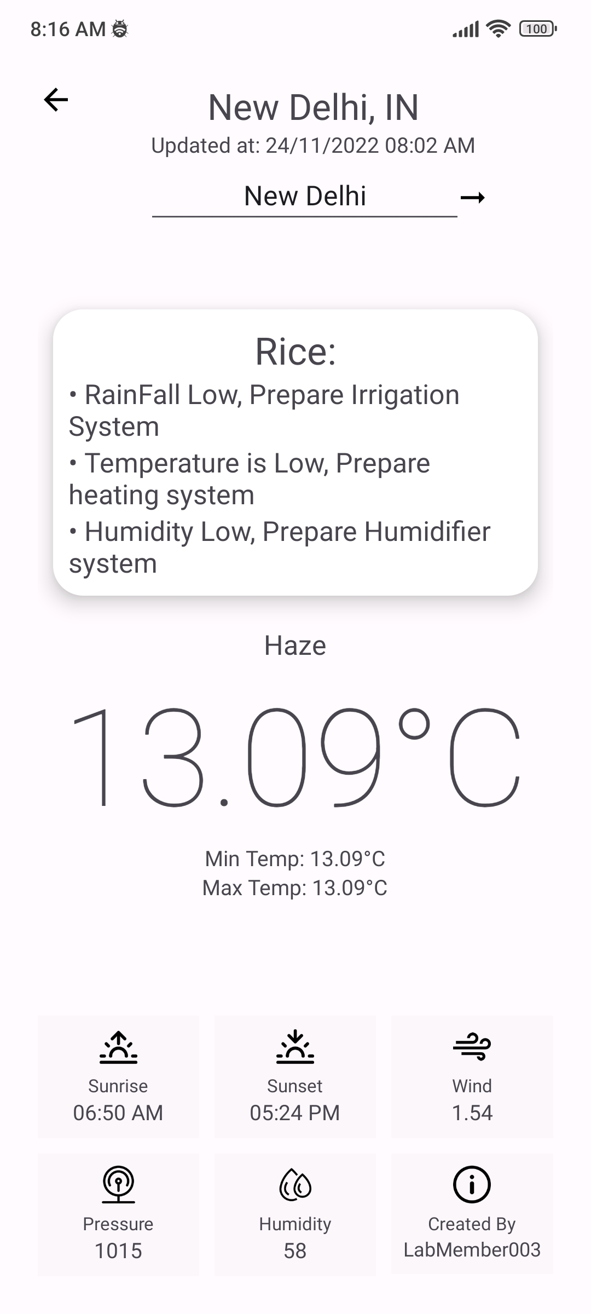
FEATURES
1. We will make a an app where farmer can input their currently growing crop and according to current weather, humidity, temperature etc. and app will notify the farmer the best care for their app.

Slide 10
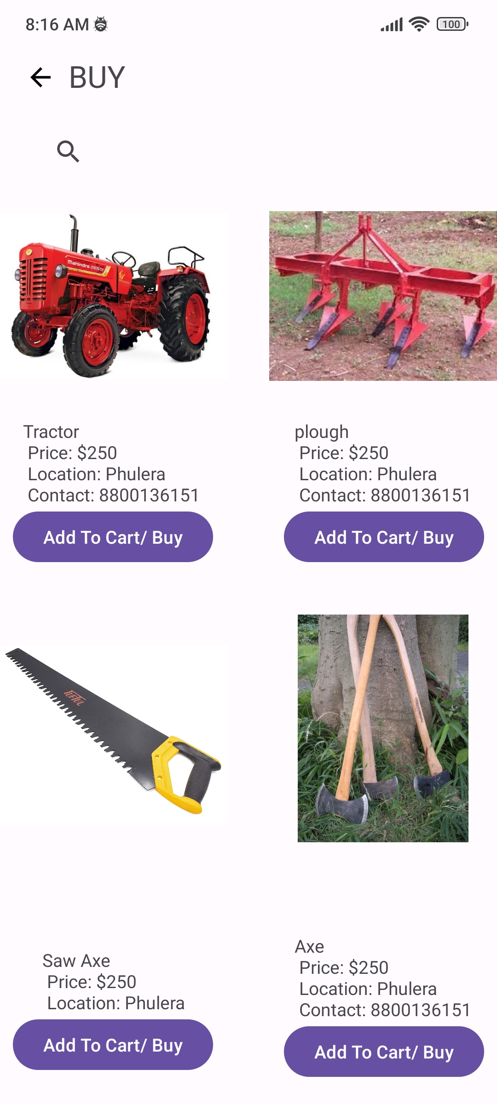
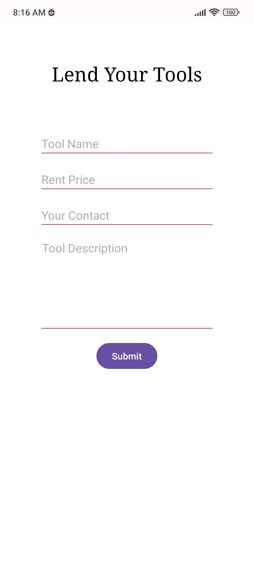
2. we will make a platform where big farmers can lend there machinery and small farmer who can rent them. Our App will display a list showing prices of all tools along with lenders information along with that For tools and equipment's we will connect farmers to nearby Local shops for purchase and deliver companies to deliver the tool at the home.

Slide 11
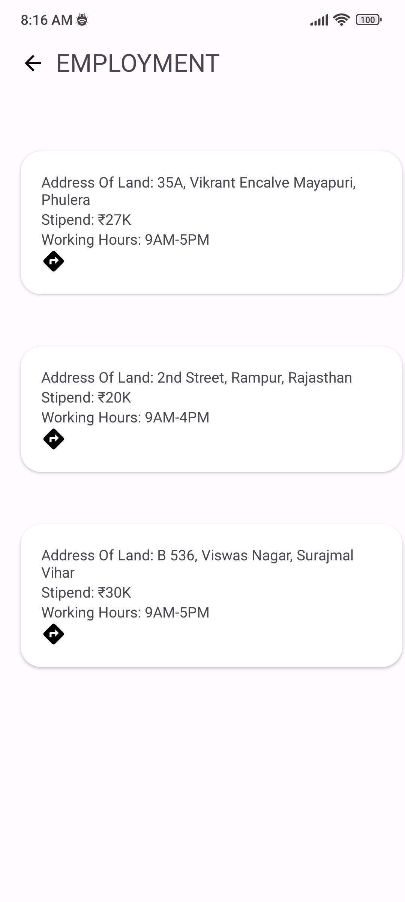
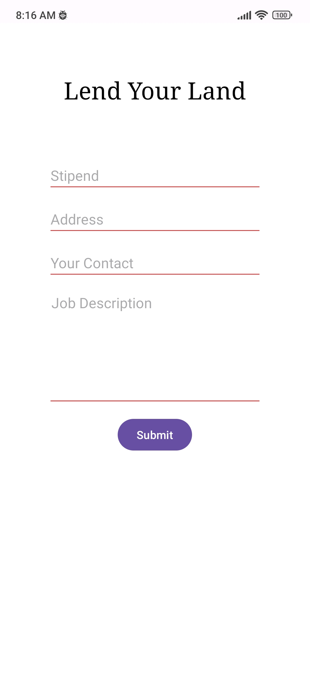
3. we had make a platform where big farmers can lend there machinery and small farmer who can rent them. Our App will display a list showing prices of all tools along with lenders information along with that For tools and equipment's we will connect farmers to nearby Local shops for purchase and deliver companies to deliver the tool at the home.

Slide 12
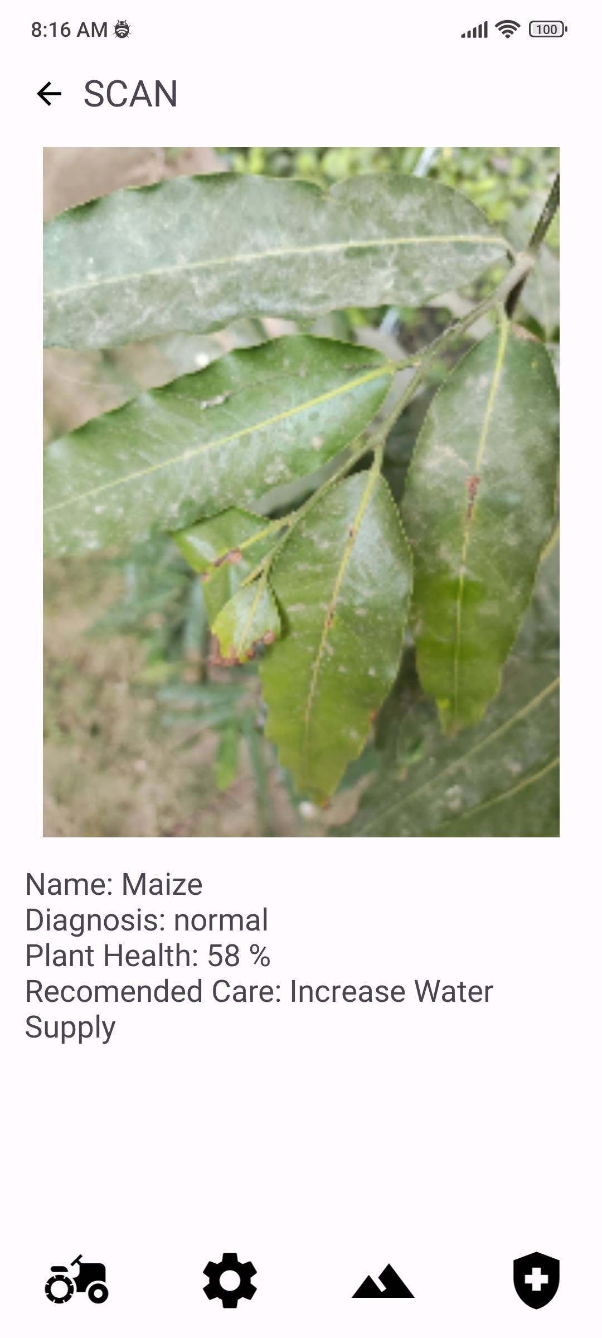
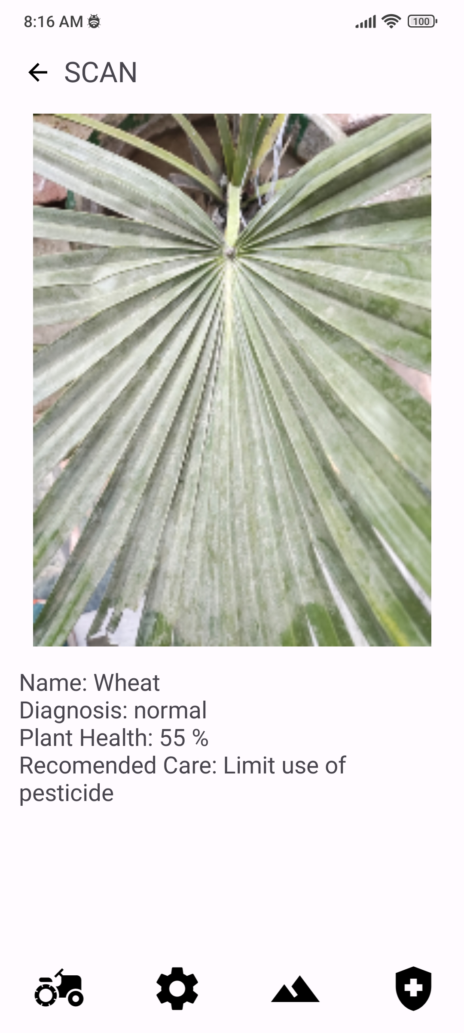
4. We have added photo scan feature where you can predict the growth and quality of the crops.

Slide 13
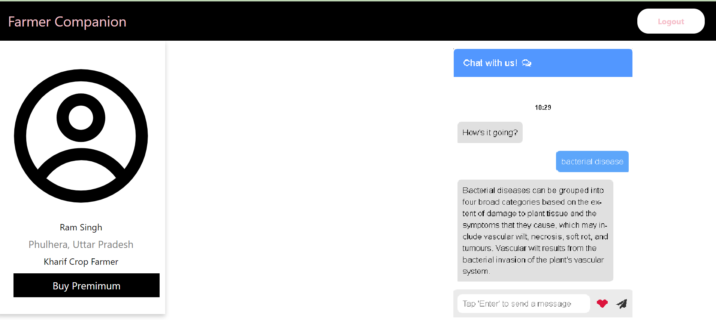
5.We will also add the features where we can chat with an AI bot in order to predict and prevent crops diseases, we will deploy an ML model which would predict and diagnose diseases and give possible care to them.

Slide 14
Farmers can easily make their profile where they can add their skills and we will also make a profile for landlords so that they can tell the farmers about type of work on their field to be done with exact prices.

Slide 15
THANKS!
Github (Application) :- https://github.com/labmember003/farmer_companion_bpit
Github (web Application) :-
https://github.com/Adi-ty/Farmer-Companion-web
Please, keep this slide for attribution.

