Slide 1
CS1632, Lecture 11: Test-Driven Development
Bill Laboon

Slide 2
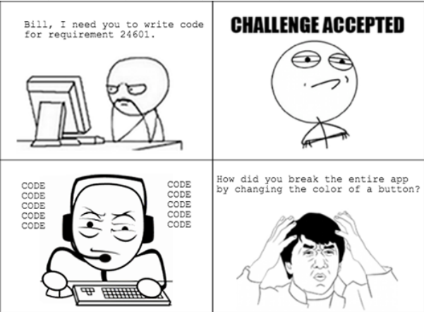
THE DARK AGES
Bill Laboon

Slide 3
Nowadays…
We know how important tests are to prevent issues like that
Code quality is everyone’s responsibility, including developers’
Developers write tests (usually unit tests)

Slide 4
But…
What to test?
How deep to go into testing?
How many edge cases?
How to prioritize testing and development?
What order should I write tests?
How do I structure code to be testable?

Slide 5
There is no one right answer
Many studies done
Different domains, different developers, different languages, etc…
“No silver bullet”

Slide 6
Test-Driven Development
A strategy for developing highly tested, quality software
Not the be-all and end-all of strategies
Google “TDD is dead” for a great argument against it
Welcome to the still-forming world of software development!

Slide 7
So What is TDD?
A software development methodology that comprises:
Writing tests BEFORE writing code
Writing ONLY code that is tested
Writing ONLY tests that test the code
A very short turnaround cycle
Refactoring early and often

Slide 8
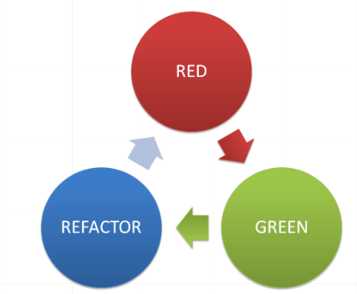
The Red-Green-Refactor Loop

Slide 9
The Red-Green-Refactor Loop
Red – Write a test for new functionality
This should immediately fail!
Green
Write only enough code to make the test pass
Refactor
Review code and make it better

Slide 10
Detailed Run-Through of RGR Loop
Write a test for new functionality
Run test suite - only the new test should fail
Write only enough code to make test pass
Run test suite
If any tests fail, go to step 3
Refactor code
Run test suite
If any tests fail, go to step 6
If any more functionality, go to step 1; otherwise done

Slide 11
TDD = A Kind of Test-First Development
Basic idea is to think about expected behavior FIRST, before code
You don’t want to “corrupt” your mind with implementation details
Figure out what the program should do (requirements!)
Side note: there are other kinds of test-first development, such as ATDD (Acceptance Test Driven Development) and BDD (Behavior Driven Development)

Slide 12
Step 1 – Write a test
This test should be a small unit of functionality, say one input value and output value for a method.
For pure TDD, you should not write multiple tests or tests which are very complex.

Slide 13
Step 2 – Run Test Suite
Run all the tests - only the one you've just added should fail.
If it doesn't fail, you've already written the code for it! This might be a redundant test.
If other tests fail, something weird happened. Completed tests should always be passing at this point.

Slide 14
Step 3 – Write the Code
Write just enough code to have the test pass.
Avoid the temptation to over-engineer your solution or add more functionality than the test covers!

Slide 15
Step 4 – Re-run the Test Suite
All the tests should pass this time, assuming you actually added the functionality.
Otherwise:
If only your new test fails:
You have not written your code (or possibly test) correctly.
If other tests fail:
You have created a regression failure; that is, you’ve broken other functionality on the system!
Note that these are not mutually exclusive!

Slide 16
Step 5 – Check Test Results
If any tests fail, fix them – either tests or code!
Never move on before having an ENTIRELY GREEN (i.e. passing) test suite!

Slide 17
Step 6 - Refactor
Your first attempt at writing code will probably not be perfect
Poor algorithm choice?
Bad variable names?
Poor performance?
Badly documented?
Magic numbers?
Not easily comprehensible?
General bad design?

Slide 18
Step 6 - Refactor
Remember – you already have a working version before you refactor
We know it works because it provides the correct expected behavior according to the unit test suite
When it comes to code, being right is more important than being good-looking

Slide 19
Step 7 – Re-run Test Suite Again
Make sure that your refactoring did not cause any problems
It should have the same functionality (according to the unit test suite), just better code
That is, all unit tests should still pass

Slide 20
Step 8 – Check test results
If any tests fail, something broke.
Go and fix it before moving on!
We are always aiming to have all-green tests

Slide 21
Step 9 - Done
Congratulations! You now have working code and can prove it with a test.
If there is more functionality to add, go back to step 1 and write a new test.
If not, SHIP IT.

Slide 22
YAGNI
"You Ain't Gonna Need It“
Don't add functionality you don't need right now. Chances are you won't need it and you're just going to waste time writing code for it.
Code to the test!

Slide 23
KISS
“Keep It Simple, Smarty-pants”
Don't try to write overly complex, clever, over-engineered code. Make it easy to understand and modify.
“Premature optimization is the root of all evil” –Donald Knuth
Prefer: i++; over i += (NUM_A / (c.getNum() - d.getNum));

Slide 24
Fake It ‘til You Make It
Obviously applies to mocks/stubs
But you can apply to smaller levels of functionality
Test:
assertEquals(sqrt(4), 2);
Code:
public void sqrt(int n) {
return 2;
}

Slide 25
Avoid Slow-Running Tests
Note that each iteration requires at least three test suite runs. If your tests take a long time to run, TDD is impractical.

Slide 26
Principles, Not Laws
Nobody will throw you in jail if you write two tests during an iteration
Sometimes tests are hard to make fast
Etc.
But they’re code smells if you are using TDD.

Slide 27
Benefits of TDD
Automatically create tests!
Research shows that more tests are correlated with fewer defects
Makes writing tests easy because it’s done often
Anything you do often, you learn how to do better
Tests are relevant
They are testing the exact functionality you are implementing
Developer is focused on end result, not code
Code is a way to get the functionality the user wants

Slide 28
Benefits of TDD
Ensures that you take small steps
You know where defects lie; help localize errors
Research shows more senior engineers take smaller steps
Code is extensible
You are already constantly extending the codebase
Large test suite automatically created for you!
Helps avoid regression errors
High code coverage
Confidence in the codebase

Slide 29
Drawbacks of TDD
Focus on unit tests may mean other aspects of testing get short shrift
Remember that unit tests focus on small units of code, not integration
Extra up-front time
May be saved in large projects due to fewer defects / test coverage
May not appropriate for prototyping
You may not always know expected behavior
Hard to do large architectural changes
Some things just aren’t possible to do in small steps

Slide 30
Drawbacks of TDD
Complex or mission/life-critical systems will require a more robust testing strategy
Tests become part of the overhead of the project
Especially if they are brittle/fragile, or poorly written!
Could fall into trap of overtesting
More time-consuming test suite runs, which hurts productivity
Can be difficult to implement TDD on existing projects developed in a different paradigm
TDD assumes easy-to-write, fast-to-execute tests

Slide 31
Fizzbuzzin’ With TDD
Print out the numbers from 1 to 100, each on a separate line. If a number is evenly divisible by 3, print "Fizz" instead. If a number is evenly divisible by 5, print "Buzz" instead. If a number is evenly divisible by 3 and 5, print "FizzBuzz" instead. Otherwise, just print the number.
1
2
Fizz
4
Buzz
Fizz
...

Slide 32
Start Out Nice and Easy
@Test public void testNumber() { assertEquals(_fb.value(1), "1"); } // Code public String value(int n) { return "1"; }

Slide 33


Slide 34
Let’s Add Another Test
@Test public void testNumber2() { assertEquals(_fb.value(2), "2"); }
// Code public String value(int n) { return "1"; }

Slide 35
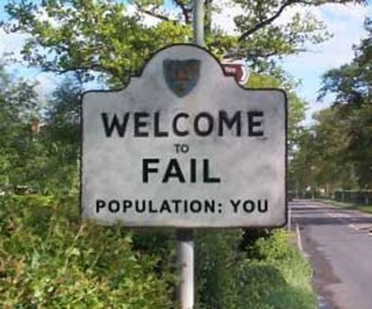

Slide 36
Let’s Make A Little Change
public String value(int n) { if (n == 1) { return "1"; } else { return "2"; } }

Slide 37
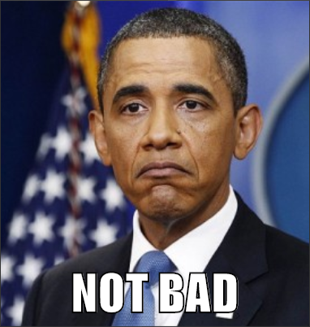
But could be better!

Slide 38
Let’s Refactor – now much nicer, and tests still pass!
public String value(int n) { return String.valueOf(n); }

Slide 39
Add Another Test – it fails
@Test public void testNumber3() { assertEquals(_fb.value(3), "Fizz"); }

Slide 40
We Need to Add Fizzy Code!
private boolean fizzy(int n) { return (n % 3 == 0); } public String value(int n) { if (fizzy(n)) { return "Fizz"; } else { return String.valueOf(n); } }

Slide 41


Slide 42
Let’s Add A Test For Buzziness - It should fail.
@Test public void testNumber5() { assertEquals(_fb.value(5), "Buzz"); }

Slide 43
Add and Integrate buzzy(n) Method
private boolean buzzy(int n) { return (n % 5 == 0); } public String value(int n) { if (fizzy(n)) { return "Fizz"; } else if (buzzy(n)) { return "Buzz"; } else { return String.valueOf(n); } }

Slide 44


Slide 45
The Final Equivalence Class
@Test public void testNumber15() { assertEquals(_fb.value(15), "FizzBuzz"); }

Slide 46
Modify The value() Method
public String value(int n) { if (fizzy(n) && buzzy(n)) { return "FizzBuzz"; } else if (fizzy(n)) { return "Fizz"; } else if (buzzy(n)) { return "Buzz"; } else { return String.valueOf(n); } }

Slide 47


Slide 48
Result?
We now have a working, tested implementation of FizzBuzz
We have automated test coverage for all equivalence classes
We had a path forward at all points

Slide 49

TDD makes you feel…

