Slide 1
CS1632, Lecture 13: Behavior-Driven Development
Bill Laboon

Slide 2
TDD is great and all, but…
The focus is still on code qua code. Remember, as developers and testers of software, we want to meet the needs of the end user, not the needs of the developer.

Slide 3
TDD is great and all, but..
TDD is supposed to move you away from the implementation details and have you focus on expected behavior, but the whole concept of very specific requirements and writing code to match them still keeps you in a “code-focused” mindset.

Slide 4
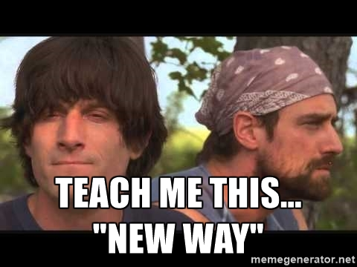
2006: Dan North shows a new way..

Slide 5
Behavior-Driven Development
In an article in Better Software magazine, Dan North explained an evolution of TDD that he called BDD, or "Behavior-Driven Development.“
-> An “evolution” of TDD which focuses on the general expected behavior of the application as opposed to focusing on blindly meeting the exact specifications of a system based on requirements

Slide 6
BDD != TDD
TDD is focused on writing good code
BDD is focused on building a good product
Good code should come out of that, though!

Slide 7
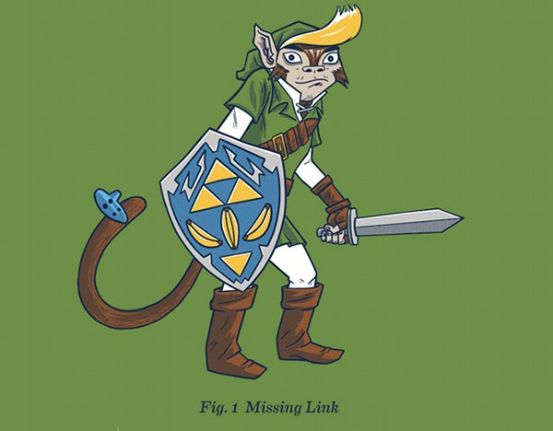
Let’s look at the “missing link” between TDD and BDD… ATDD

Slide 8
TDD -> ATDD
You can think of TDD as UTDD, “unit test-driven development”
ATDD is “acceptance test-driven development”
Write automated acceptance tests (“systems-level tests”), then fill in with TDD. Once full acceptance test works, move on to new acceptance test
Still follow red-green-refactor, but two layers:
Acceptance tests
Unit tests

Slide 9
ATDD –> BDD
Let’s work similarly to ATDD, but write everything in a way users, developers, and testers can all understand
Develop an “Esperanto”
Focus on describing the system – and tests! – in a way that users can undersand

Slide 10


Slide 11
Limitations of Jargon
If you and your users/customers/project managers are all speaking different languages, communication becomes more difficult.
If I told you a sorting algorithm was O(n!), you’d probably not want to use it.
A non-technical person would probably not understand that sentence.

Slide 12
Requirements
Do requirements really say what users want…
… or do they say what developers should do?

Slide 13
No user will ever use this language to describe what they want
“The system shall enable the LOWTEMP warning light when two out of three internal thermometers agree that the ambient temperature is below -10 degrees Celsius ( 14 degrees F, 263 degrees Kelvin), as indicated by the INTHERM1, INTHERM2, and INTHERM3 registers.”

Slide 14
User Stories
What if... we could use our Esperanto to describe this in a language that both sides could understand?
We could easily go back to customers and see that we're on the right track, before or during development.

Slide 15
The Connextra Template (a/k/a the “role/function/reason” template)
As a <role>
I want <function>
So that <reason / benefit>

Slide 16
Examples
As a systems administrator I want to create users So that users in my domain can log in
As a user I want to see my bank account balance So that I know how much money I have

Slide 17
Taking Advantage of Common Humanity
User stories allow flexibility and understanding

Slide 18
Role-Playing
You are part of the massive, global team tasked with creating the future of cat rental services,
Rent-A-Cat

Slide 19
Role-Playing
Users who want to rent cats for companionship
Users who want to rent cats for mousing
Users who want to rent cats for homework help
Cat trainers
Administrators
Marketing personnel

Slide 20
Testing User Stories
Our “requirements” for a program are now a bit less specific than traditional requirements
You will need to learn to deal with ambiguity!
Secret solution: communication, communication, communication

Slide 21
Scenarios are particular instantiations or situations of a user story
As a user I want to log in So that I can access my banking account
Scenario 1: I log in with correct username and password
Scenario 2: I log in with correct username, but incorrect password
Scenario 3: I log in with incorrect username

Slide 22
We can use the “Given / When / Then” template for scenarios
Example: Given a correct username And an incorrect password When I try to log in with those credentials Then I should receive an error page with "incorrect password entered" on it

Slide 23
Seem Familiar?
Given (preconditions)
When (execution steps)
Then (postconditions)

Slide 24
Re-writing in a way everyone can understand
Given one cat with name "Fluffernins“ When a user is logged in And searches for "Fluffernins“ The cat named "Fluffernins" should appear on the search results Preconditions: System is running. Cat named “Fluffernins” is in database. User is logged in. Execution steps: Go to home page. In “Search” box, type “Fluffernins” and then click the “search” button. Postconditions: New page appears. Of the cats listed, one should be “Fluffernins”.

Slide 25
Note Our Tests Are Less Specific!
The blessing and curse of BDD
Requires more of a tester, leaves room for ambiguity
Pays off with increased user collaboration and understanding
Depending on domain/field, may not be a good choice
Great for user-facing functionality
Worse for back-end or safety-critical development

Slide 26
Role-Playing
Develop three scenarios for one of the user stories you developed earlier

