Slide 1
CS1632, Lecture 14: Systems Testing the web with selenium
Bill Laboon

Slide 2
Background
So far, all of our testing has been with specific, often text-based, input and output
Turns out not everybody uses a text-based interface
GUIs, web pages, mobile applications, etc.

Slide 3
Testing Techniques are Similar
We can actually use many of the same tools and techniques to test more complicated interfaces. Now that you understand the basics of automated testing, it's possible to take what you've learned and apply it to a more complex interface.
But this remains:
EXPECTED BEHAVIOR vs OBSERVED BEHAVIOR

Slide 4
Testing the Web
Just an example – similar ideas for testing other graphical or non-textual / mathematical interfaces
Keep in mind that we are going to expect certain things to occur or be seen, and then observe whether or not they occur or are seen.

Slide 5
Web = text
Specially formatted and displayed text, but text!
If your computer can process it, it’s just 1s and 0s, which can be represented as text

Slide 6
Theoretically, we could test web pages like so…
// Any downsides to this? @Test public void testWeb() { String expectedHtml = “<head></head><body><strong>Hello, world!</strong></body>"; String pageText = getPage("http://example.com"); assertEquals(expectedHtml, pageText); }

Slide 7
Downsides
Change the page, change the entire test
Fragile tests!
What about JavaScript?
Just check that the right JS is on page?
Unreadable
Simplistic and low-level
Kind of like programming in assembly
No semantic understanding (e.g. of links, textboxes)

Slide 8
Web Testing Frameworks
Think of these as a higher-lever level programming language for testing web pages.
Sure, you could program everything in assembly, but this is rarely ideal.
Another way to think of it – just extra libraries so you don’t have to program everything yourself.

Slide 9
What is Selenium?
An open-source web testing framework.
Battle-hardened.
Works with Windows, OS X, Linux, other OSes.
Works with Java, Ruby, Python, other languages.
Works with most modern web browsers.
Has its own IDE.
Can also be used for quick scripting.

Slide 10
Why the name Selenium?
One of their competitors was "Mercury.“
Mercury poisoning is cured by Selenium pills.

Slide 11
Selenium is a whole ecosystem
Selenium is a very complex, complete framework. We're really just going to be seeing the tip of the iceberg in this class.
It has other uses aside from testing, as well:
Web macros
Scraping
Load testing or parallel testing with Selenium Grid

Slide 12
Getting Started with Selenium
Download Firefox (getting Selenium IDE working in Chrome is possible, but more prone to bugs)
Go to http://docs.seleniumhq.org/
Download and install Selenium4.
Click on the "Se" icon in the upper right-hand corner, or go to Tools -> Selenium IDE

Slide 13
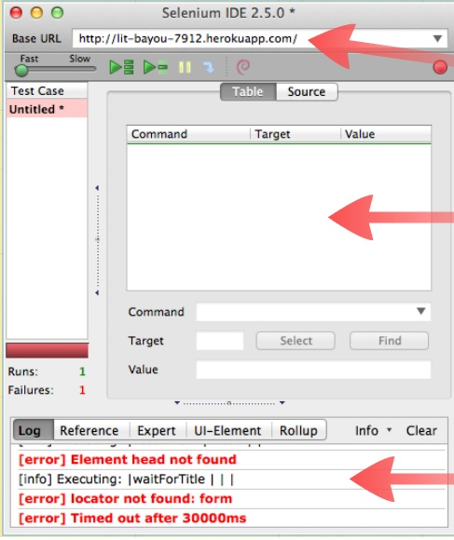
Starting URL Commands Logging output

Slide 14
Simple Scripting
File... New Test Case
Record an operation (red circle)
Stop recording
Run test suite (green triangle)

Slide 15
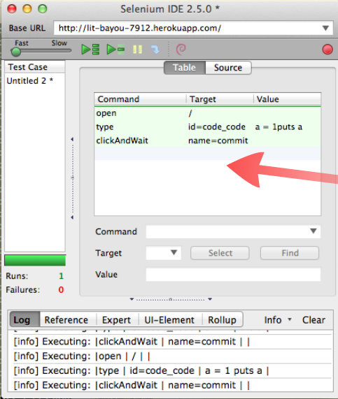
Our code

Slide 16
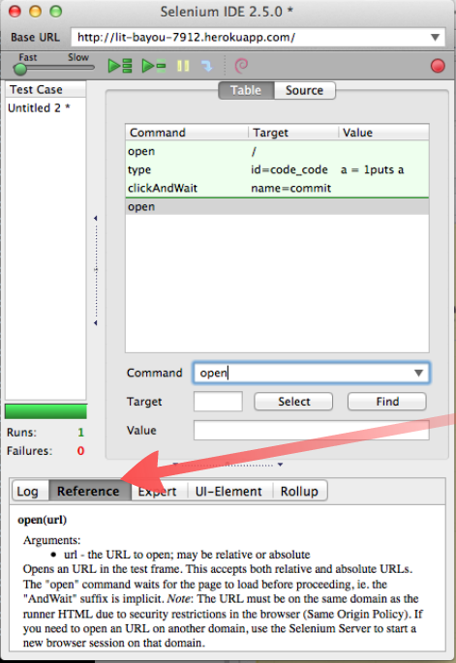
open <URL> - Opens either an absolute or relative URL Note that you can check what an operation does by clicking on the "Reference" tab at the bottom

Slide 17
Also note…
…you can move steps around by just clicking and dragging
… you can add comments by selecting “Add new comment”
… the textbox is not a traditional textbox
… commands may or may not have arguments

Slide 18
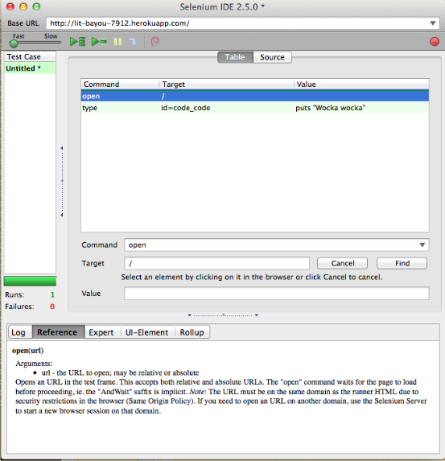
The type command will type in a given target (e.g. textbox)

Slide 19
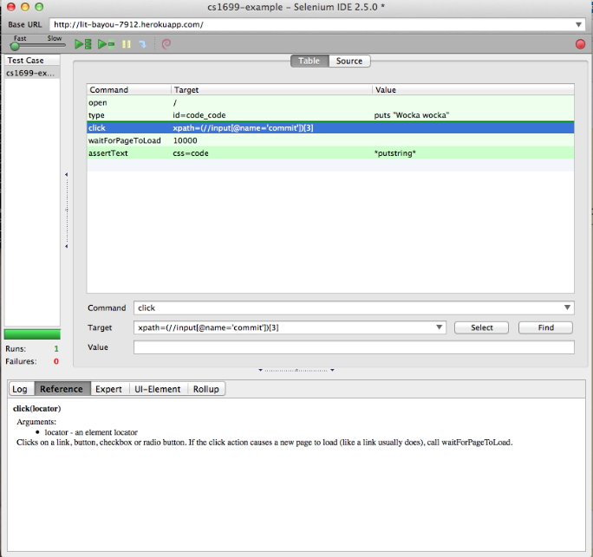
Click <target> will click on an element on the web page

Slide 20
Avoiding Intermittent Failures
waitForPageToLoad - Waits for another page to load, with an optional timeout.
If you don't wait, Selenium goes as fast as it can, and may do a check before the page is ready.
This means that your assertions may fail simply because the page hasn’t finished loading!
Intermittent (a/k/a non-deterministic or ND failures) are a common symptom of poorly written web tests.

Slide 21
…andWait
clickAndWait -> a combination of "click" and "waitForPageToLoad“
There are other "...andWait" variants since waiting for a page to load is very common.

Slide 22
Hello, assertions, my old friend… I’ve come to assert you again..
We are going to use assertions to specify expected behavior
Same concept as traditional Junit assertions, just at a different level of abstraction

Slide 23
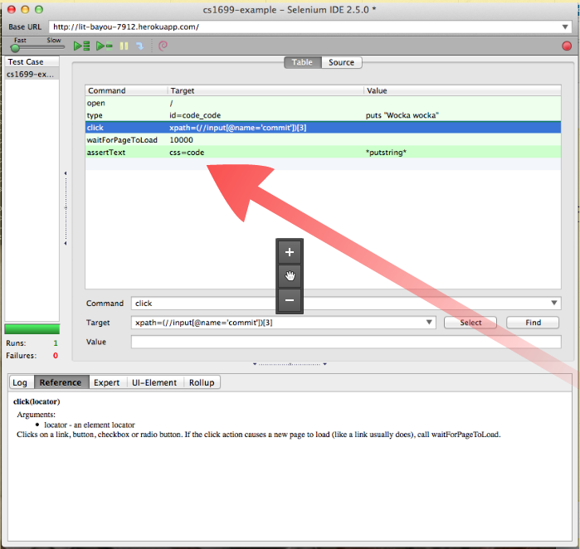
assertion

Slide 24
Select can be helpful to find a way to specify a target
Lots of ways to specify an element on a webpage
Select can help you find one that works

Slide 25
Lots of fun assertions…
assertText / assertTextPresent - Assert that text exists (on an element (former) or entire page (latter)). Note that this is a regex!
assertCookie - Assert that a cookie exists.
assertElementPresent - Assert that an element exists somewhere on the page.
assertAlert - Assert that an alert took place.
assertEditable - Assert that an element is editable.
assertEval - Evaluate some JavaScript and assert the result.

