Slide 1
CS1632, Lecture 16: Pairwise and Combinatorial Testing
Bill Laboon

Slide 2
Let’s Test A Word Processor
Specifically, its ten possible font effects
Italic
Bold
Underline
Strikethrough
Superscript
Shadow
Embossed
3-D
Outline
Inverse

Slide 3
These can be combined
Plain text
^{Superscript}
Bold
Italic and strikethrough
Bold and underlined
Bold italic strikethrough shadowed superscript

Slide 4
How many tests would you need to test all the possible font combinations?

Slide 5
2¹⁰
1,024 tests!

Slide 6
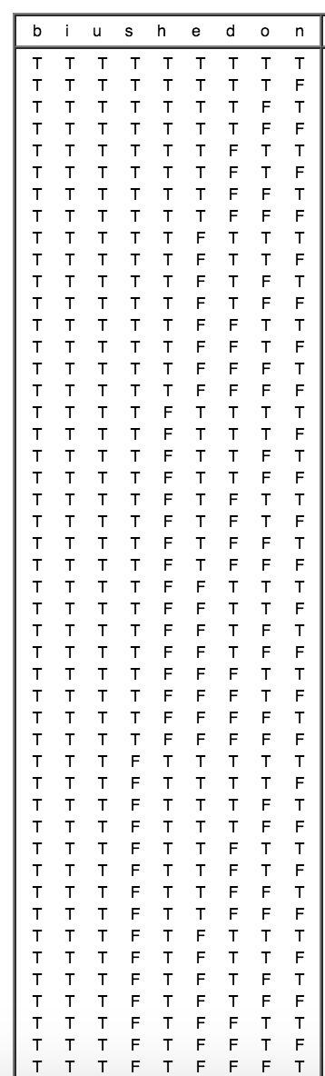
That’s quite a few tests…

Slide 7
But it’s necessary! What if…
… a problem only occurs with 3-D shadowed bold italic superscript text?
That’s going to be hard to find.

Slide 8
Turns Out Other People Have Thought About This!
The National Institute of Standards and Technology did a study on the topic.
See: "Practical Combinatorial Testing", http://nvlpubs.nist.gov/nistpubs/Legacy/SP/nistspecialpublication800-142.pdf

Slide 9
Turns Out That’s Unlikely!
Think of each font effect as a Boolean variable (e.g. bold vs not bold, italic vs non-italic)
Most (50 - 90%, depending on the project) defects come from combinations of one or two interactions (variables).
In other words, most defects would be found if you just tested, e.g., "bold 3-D" (two interactions) text or just "bold text" (one interactions).

Slide 10
Similar Distribution Found In Many Domains
Web browser
Avionics software
Telecommunications software
Flight Traffic Control
Network security software

Slide 11
The Interaction Rule
"Most failures are triggered by one or two parameters, and progressively fewer by three, four, or more parameters, and the maximum interaction degree is small." -Eric Kuhn, NIST

Slide 12
The Interaction Rule
The maximum number of interactions found to cause a defect was SIX.
This was after an analysis of dozens of software projects.

Slide 13
So…
So we can find a large percentage of defects with minimal work by making sure we test all possible pairs of values.

Slide 14
Pairwise Testing
This is called “pairwise”, or “all-pairs” testing.
We are testing all possible pairs of interactions, e.g.:
Not-Bold / Not-Italic
Bold / Not-Italic
Not-Bold / Italic
Bold / Italic

Slide 15
Remember our exhaustive 10-font-effect testing plan?
It was 1,024 (2 ^ 10) tests.
How many tests would it require to test all pairs of interactions?
That is, all possible combinations of:
bold/italic,
subscript/bold
underline/strikethrough
3-D / italic
Every possible pairing of two variables

Slide 16
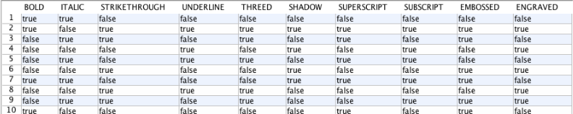
Answer: 10

Slide 17

Reduce Number of Tests By Two Orders Of Magnitude

Slide 18

Is This Always Good Enough?

Slide 19
Of course not
But we can “dial up” the number of possible interactions to check for any t
For example, check every three-way combination (t = 3):
Bold / Italic / Underline
Italic / Underline / Superscript
Shadow / Italic / Bold
Or four-way (t = 4)
Bold / Italic / Underline / Superscript
Embossed / 3-D / Outline / Strikethrough
Shadow / Bold / Inverse / Outline
Up to whatever the number of interactions is ( would be the same as exhaustive testing)

Slide 20
Combinatorial Testing
This generalized version of pairwise testing is known as “combinatorial testing”
Note that pairwise testing is technically just a specific kind of combinatorial testing where t = 2

Slide 21
Combinatorial Testing Example
The maximum number of interactions causing a defect found in the NIST studies was six. So let's test all six-way combinations of our font effects.
Recall that:
# tests required for full pairwise testing was 10
# tests required for exhaustive testing was 1,024
How many to test all six-way interactions?

Slide 22
Actually a difficult question to answer off the top of your head
Determining the exact number necessary is an NP-Hard problem.
But there are some good algorithms out there that approximate it (e.g. IPOG).
See “IPOG: A General Strategy for T-Way Software Testing” http://csrc.nist.gov/acts/ecbs-cr-final.pdf

Slide 23
… and the answer is…
The best answer my software could come up with is 178.
Approximately an order of magnitude less than exhaustive testing!
But in any piece of software tested by NIST, would have found the same number of defects

Slide 24
Interesting!
10 tests catch 90% of defects
178 tests catch ~99.9999999% of defects
1024 tests catch ~100% of defects IF THEY ARE DONE RIGHT!

Slide 25
Sidenot: The Pareto Principle
"80% of effects come from 20% of causes.“
Examples:
80% of your sales come from 20% of your customers.
80% of your code execution time is in 20% of your code.
Specific Testing Examples
80% of your defects will be found with 20% of your tests
80% of your defects will be found in 20% of the code

Slide 26
Recap
10 tests catch 90% of defects
178 tests catch ~99.9999999% of defects
1024 tests catch ~100% of defects IF THEY ARE DONE RIGHT!

Slide 27
It Gets Harder the Closer You Get
You can see how much more expensive it becomes to test depending on how arbitrarily close to "100% free of defects" you want to be.
It is NOT a linear relationship.
It is asymptotic.

Slide 28
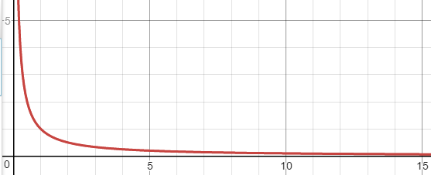
Example: f(x) = 1 / x

Slide 29
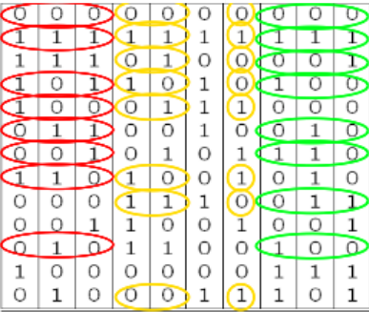
Covering Arrays

Slide 30
Steps To Make Your Own Covering Array
Make a truth table with all variables
Each line in truth table indicates a test
Running all these tests would be an exhaustive test
Make a list of all t-way interactions for desired t
Example: Bold, Italic, Underline. t = 2
Bold / Italic
Bold /Underline
Italic/Underline

Slide 31
Generating Covering Arrays
Look for tests which make a complete truth table for each t-way interaction
Mark these tests as “Tests To Be Executed”
Continue adding t-way interactions tests
Prefer using tests which are already scheduled to be executed
When all t-way interaction “mini truth tables” have been completed, put together all tests to be executed

Slide 32
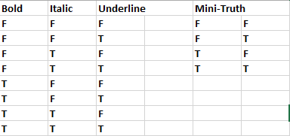
Covering Array Example

Slide 33
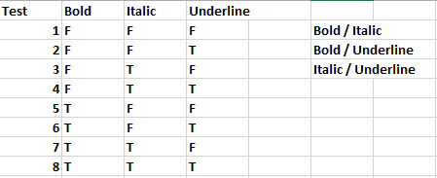
Covering Array Example

Slide 34
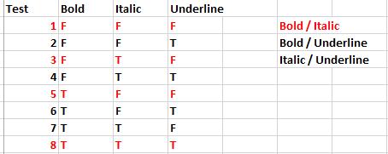
Covering Array Example – Bold / Italic

Slide 35
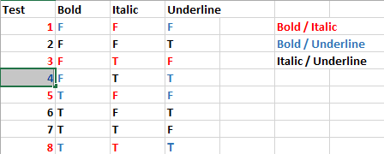
Covering Array Example – Bold / Underline

Slide 36
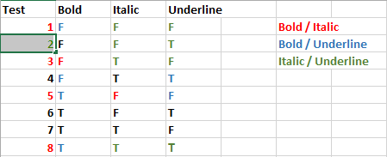
Covering Array Example – Italic / Underline

Slide 37
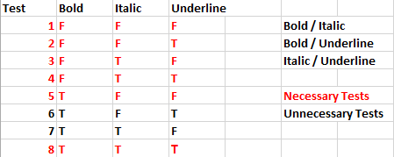
Run a Subset of Tests

Slide 38
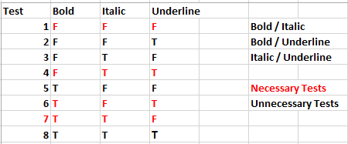
Can Minimize Further Using “Intuition” Or Better Algorithms

Slide 39
OK, this works for small numbers of variables, but what about big ones?
Imagine a 34-variable system
Exhaustive testing: 17 billion tests
All 3-way interactions: 33 tests
All 4-way interactions: 85 tests
Actually gets BETTER the higher the number of variables
Not just a little better – many orders of magnitude better

Slide 40


Slide 41
Remember at the beginning of the term when I talked about the impossibility of testing every combination of inputs?
This is a possible amelioration.

Slide 42

Won’t It Take a Long Time To Make Covering Arrays For Large Number of Variables?

Slide 43
YES
These are not artisanal, hand-crafted arrays, carved by the European masters high in their Swiss valleys
Let’s use a program to do it
Example: NIST ACTS

