Slide 1
CS1632, Lecture 17: property-based testing
Bill Laboon

Slide 2
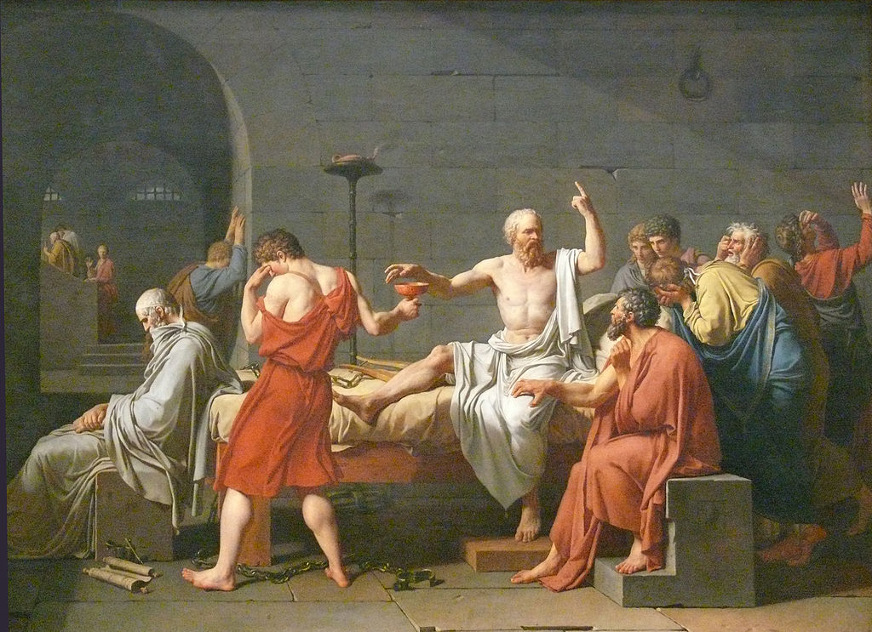
What is testing?
By Jacques-Louis David - http://www.metmuseum.org/collection/the-collection-online/search/436105, Public Domain, https://commons.wikimedia.org/w/index.php?curid=28552

Slide 3
Checking expected behavior against observed behavior

Slide 4
OK, so let’s assume a standard sort function
public int[] billSort(int[] arrToSort) { ... }

Slide 5
Possible test cases
null
[]
[1]
[-1]
[1, 2, 3, 4, 5]
[5, 4, 3, 2, 1]
[-9, 7, 2, 0, -14]
[1, 1, 1, 1, 1, 1]
[1, 2, 3, 4 … 99999, 100000, 100001]

Slide 6
Lots of tests to write!
What if you forget one?
What if the test only works with the certain values you pass in?
Lots of time will be spent writing boilerplate unit tests.

Slide 7
What other expected behavior could we check besides the correct value being returned?

Slide 8
properties
Let’s spell out:
the properties of what could be passed in
the expected properties of the return value given that input
Then let the computer come up with test cases for us!

Slide 9
Expected properties vs observed properties
Note that properties is a subset of “behavior”!
Before, our expected properties were all “specific values”
but this is not necessary to meet our definition of “testing”

Slide 10
Example
What properties would we expect of the output of a sorted array compared to the array passed in as an argument?

Slide 11
properties
Output array same size as passed-in array
Values in output array always increasing or staying the same
Value in output array never decreasing
Every element in input array is in output array
No element not in input array is in output array
Idempotent - running it again should not change output array
Pure - running it twice on same input array should always result in same output array

Slide 12
Let the computer do the work
Now that we have the properties of expected input values, and the properties of expected output values, we can let the computer do the grunt work of developing specific tests. This is called property-based testing.

Slide 13
[0] -> [0]
[1, 3, 2] -> [1, 2, 3]
[-1, 19, 17, -22] -> [-22, -1, 17, 19]

Slide 14
A new kind of testing
Presented at ICFP in the paper, “QuickCheck: A Lightweight Tool for Random Testing of Haskell Programs”
http://www.cs.tufts.edu/~nr/cs257/archive/john-hughes/quick.pdf
More popular in functional programming world (for various reasons) but becoming more mainstream

Slide 15
Not just used in functional programming!
Java: junit-quickcheck
Ruby: rantly
Scala: scalacheck
Python: pytest-quickcheck
Node.js: node-quickcheck
Clojure: simple-check
C++: QuickCheck++
.NET: FsCheck
Erlang: Erlang/QuickCheck
The only one I couldn't find is a version for PHP.

Slide 16
LESS useful for…
Writing to a file
Communicating over a network
Displaying text or graphics
Impure functions in general

Slide 17
More useful for..
Mathematical functions
Pure functions
Well-specified problems
Anything where a variety of inputs map to specific kinds of output

Slide 18
Two steps
Specify the properties of the allowed input
Specify the properties of the output that should always hold
These properties are called invariants.

Slide 19
Then sit back with a beverage of your choice
Based on our specifications, QuickCheck then makes and runs our test suite for us!

Slide 20
COMPUTER – DOING HARD WORK!
[17, 19, 1] -> [1, 17, 19] OK [-9, -100] -> [-100, -9] OK [8, 2, 987, 287, 201] -> [2, 8, 201, 287, 987] OK [101, 20, 32, -4] -> [-4, 20, 32, 101] OK [115] -> [115] OK [2, -9, -9, 1, 2] -> [-9, -9, 1, 2, 2] OK [8, 3, 0, 4] -> [0, 3, 4, 8] OK [17, 1009, -2, 413] -> [-2, 17, 413, 1009] OK [12, 12, 1, 17, -100] -> [-100, 1, 12, 12, 17] OK [] -> [] OK ...

Slide 21

YOU – lying on beach taking foot selfies!

Slide 22
This is what it sounds like when Invariants fail
[17, 19, 1] -> [1, 17, 19] OK [-9, -100] -> [-100, -9] OK [8, 2, 987, 287, 201] -> [2, 8, 201, 287, 987] OK [101, 20, 32, -4] -> [-4, 20, 32, 101] OK [115] -> [115] OK [2, -9, -9, 1, 2] -> [-9, -9, 1, 2, 2] OK [8, 3, 0, 4] -> [0, 3, 4, 8] OK [17, 1009, -2, 413] -> [-2, 17, 413, 1009] OK [12, 12, 1, 17, -100] -> [-100, 1, 12, 12, 17] OK [9, 0, -6, -5, 14] -> [0, -6, -5, 9, 14] FAIL [] -> [] OK

Slide 23
shrinking
[9, 0, -6, -5, 14] -> [0, -6, -5, 9, 14] FAIL [9, 0, -6] -> [0, -6, 9] FAIL [-6, -5, 14] -> [-6, -5, 14] OK [9, 0] -> [0, 9] OK [0, -6] -> [0, -6] FAIL [0] -> [0] OK [-6] -> [-6] OK Shrunk Failure: [0, -6] -> [0, -6]

Slide 24
shrinking
Finds the smallest possible failure
Helps track down actual issue
A “toy” failure is a great thing to add to a defect report

Slide 25
Think about the levels of abstraction we've jumped up since the beginning of the semester
Write and execute tests (manual testing)
Write tests, let computer execute
Write what KINDS of tests we want, let computer write tests and execute
With shrinking, will even try to track down the problem!

