Slide 1
CS1632, lecture 18: performance testing 1
Bill Laboon

Slide 2
Before we talk performance testing…
LET’S ASK: WHAT DO WE MEAN BY PERFORMANCE?

Slide 3
“I shall not today attempt further to define the kinds of material I understand to be embraced within that shorthand description, and perhaps I could never succeed in intelligibly doing so. But I know it when I see it.” -Potter Stewart, US Supreme Court Justice Concurrence in Jacobellis v. Ohio

Slide 4
But…
We can talk about what kinds of performance we're interested in, and set specific goals for the system under test.
A video game console will have very different performance requirements than a weather forecasting supercomputer.

Slide 5
Performance indicators
Quantitative measures of the performance of a system under test
Examples:
How long does it take to respond to a button press?
How many users can access the system at one time?
How long can the system go without a failure?
How much CPU does a standard query on the database takeup?
How big is the program in megabytes?
How fast the program calculate some function?

Slide 6
Kinds of performance indicators
Service-Oriented
Efficiency-Oriented

Slide 7
Service-oriented
Service-oriented indicators measure how well a system is providing a service to the users. They are measured from a specific user's point of view.

Slide 8
Efficiency-oriented
Efficiency-oriented indicators measure how well the system makes use of the computational resources available to it. This is looking at the performance from a more developmental perspective.

Slide 9
Categories of service-oriented indicators
Availability - How available is the system to the user? What percentage of the time can they access it?
Response Time - How quickly does the system respond to user input?

Slide 10
Categories of Efficiency-oriented indicators
Throughput - How many events can occur and be processed in a given amount of time?
Utilization - What percentage or absolute amount of computing resources are used to perform a task?

Slide 11
Testing performance
In order to test performance, you should have performance targets - quantitative values that the performance indicators should reach.
Performance targets may be assigned to a subset of the most important performance indicators, called key performance indicators (KPIs).

Slide 12
Performance thresholds
Performance thresholds are the absolute minimum performance level a system can reach and be considered production-ready.
These may be used in addition to performance targets as a “bare minimum” to reach, although not the desired target.

Slide 13
example
You are developing a web application which is expecting a relatively constant 20 hits per second.
A key performance indicator (KPI) might be response time, with a performance threshold of three seconds mean time to respond and a performance target of one second.
Ideally, your stakeholders would like sub-second response time, but they would be satisfied as long as the response time is below three seconds.

Slide 14
Testing Service-oriented performance indicators – response time
Response time
Easy to do!
Do something
Click “start” on stopwatch
Wait for response
Click “stop” on stopwatch
Write down number on stopwatch!

Slide 15
Any problems with this approach?

Slide 16
Impossible to measure sub-second response times
Human error
Probably the most boring thing a person can do
Time-consuming
Impossible to measure "hidden" responses
Inability to get large data sets

Slide 17
Performance testing, more than most other testing, relies heavily on coding / automation / statistics.

Slide 18
Statistics? Why?
You shouldn’t really trust a single result in performance testing, especially for response times. You should always be trying multiple times and discussing a mean value, maximum value, minimum values, etc.
There are so many variables in a single test run (other processes taking up CPU, pipelining issues, memory swaps, VM startup times, etc.) that a single test run is almost worthless.

Slide 19
HUMAN ERROR
Minor issues with human error can cause massive changes in performance results.

Slide 20
She blinded me with science
Performance testing is more like a science than other kinds of testing.
You want to run multiple experiments and eliminate all the other variables OTHER THAN THE CODE UNDER TEST.
Don't run version 1 on a ChromeBook and version 2 on a Cray supercomputer and talk about the massive speed improvement.

Slide 21
Kinds of events to test for response time
Time for calculation to take place
Time for character to appear on screen
Time for image to appear
Time to download
Time for server response
Time for page to load
Time for code to execute

Slide 22
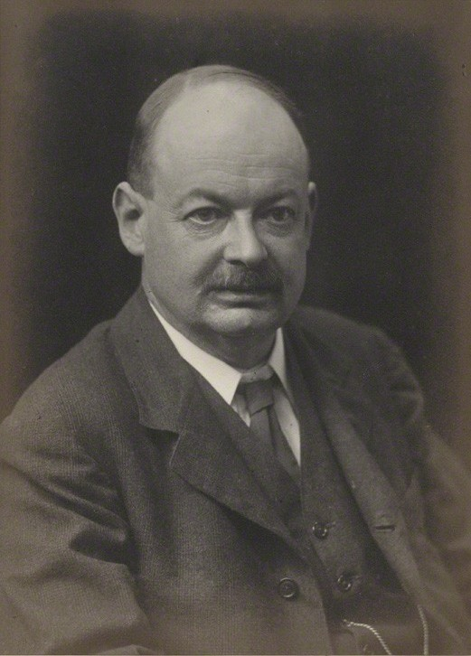
What is time?
By Walter Stoneman - http://www.npg.org.uk/collections/search/portraitLarge/mw124669/John-Mctaggart-Ellis-McTaggart, Public Domain, https://commons.wikimedia.org/w/index.php?curid=22142173

Slide 23
Assuming that time exists…
user time: Amount of time user code executes
system time: Amount of time kernel code executes
total time : user time + system time
real time: “Actual” amount of time taken (wall clock time)

Slide 24
example
time command in Unix
time java Foo
time curl http://www.example.com
time ls –l
Windows PowerShell has something similar
Measure-Command { java Foo –wait }

Slide 25
Users almost always care about real (“wall clock”) time.
You usually use total, user, and system time to help developers, not as KPIs in and of themselves.

Slide 26
Rough outline for response time performance targets
< 0.1 S : Response time required to feel that system is instantaneous
< 1 S : Response time required for flow of thought not to be interrupted
< 10 S : Response time required for user to stay focused on the application (and not go re-load Reddit)
-taken from Usability Engineering by Jakob Nielsen, 1993
Things haven't changed much since then!

Slide 27
Measuring availability performance indicators
Availability - often referred to as uptime - how often can a user access the system when they expect to be able to do so?
Often referred to as a SLA (service-level agreement).
“I am a web host. I guarantee you that you and your users will be able to access your server 99% of the time in a given month.”

Slide 28
nines
Uptime is often expressed in an abbreviated form as 9’s (e.g. 3 nines, 5 nines etc)
Refers to how many 9’s start out the percentage of time available
1 nine: 90% available (36.5 days of downtime per year)
2 nines: 99% available (3.65 days of downtime per year)
3 nines: 99.9% available (8.76 hours of downtime per year)
4 nines: 99.99% available (52.56 minutes of downtime per year)
5 nines: 99.999% available (5.26 minutes of downtime per year)
6 nines: 99.9999% available (31.5 seconds of downtime per year)
9 nines: 99.9999999% available (31.5 ms of downtime per year)

Slide 29
How to test?
Often difficult – most managers won’t let you run a few “test years” before deploying it for real
Modeling the system and estimating uptime is the best (feasible) approach

Slide 30
Determine values for model with load testing
Load testing - how many concurrent users and/or work can the system handle?
Kinds of load testing:
Baseline Test - A bare minimum amount of use, to provide a baseline
Soak / Stability Test - Leave it running for an extended period of time, usually at low levels of usage
Stress Test – High levels of activity

Slide 31
reality
For true availability numbers, also need to determine:
Likelihood of hardware failure
Likelihood of program-ending bugs
Planned maintenance
etc.

Slide 32
Sic transit Gloria mundi
Even with all this work, things go wrong
Many major service providers, such as Microsoft Azure and Amazon Web Services, “breach” their SLAs in a given month (e.g. their servers are guaranteed to be available 99.9% of the time, but are down for two days due to a power surge, meaning they were only available 93.6% of that month)
Usually, money is refunded automatically

Slide 33
Developing the service-oriented test plan
Think from a user’s perspective!
How fast do I expect this to be?
What things matter to me, speedwise?
How often do I expect this to be available?
Are large variances in response time allowed?

Slide 34
Determine kpis, targets, and thresholds
Example:
Average page load time – Target: less than two seconds, Threshold: less than five seconds
Max page load time – Target: less than five seconds, Threshold: less than ten seconds
Availability of system: Target: greater than 99.9%, threshold: greater than 99%

Slide 35
Think about contingency plans!
What if performance requirements aren't met?
What if they can't be?
What if they can be, but at a high cost in time/resources?
etc.

