Slide 1
CS1632, LECTURE 20: Security Testing
Bill Laboon

Slide 2
Writing Secure Software Is Difficult; So Is Testing It!
Heartbleed: ~ 66% of servers connected to the Internet vulnerable; allowed for basically untraceable eavesdropping on data in memory
Shellshock: A defect in bash (default shell for OS X and most Linux distributions) which allowed arbitrary code execution. Discovered in 2014; vulnerability was introduced in 1989.
June 2016: Sixteen vulnerabilities found in Windows 7 font display subsystem!

Slide 3
Why Is It Difficult?
Adversaries are actively seeking to defeat security
Information about security vulnerabilities modifies behavior of adversaries
You need to protect all doors; they only need to find one they can open
Even minor vulnerabilities can have truly catastrophic consequences

Slide 4
Pittsburgh – A Great City To Learn About Security!
Actually!
Many security researchers here at Pitt and CMU
LERSAIS in the iSchool – Laboratory for Education & Research on Security-Assured Information System
CyLab at CMU
Professors Lee, Farnan, Garrison here in the CS department
Software Engineering Institute
CERT
Many security engineering positions (esp. at banks)

Slide 5
History
Security was not a big deal in the early computing world
Usually required physical access to a system to do anything
Few people had necessary skills even if they did (“security through obscurity”)

Slide 6
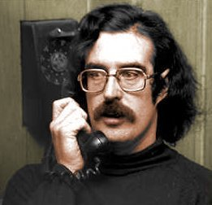

But there were networked systems in the 60s and 70s…

Slide 7
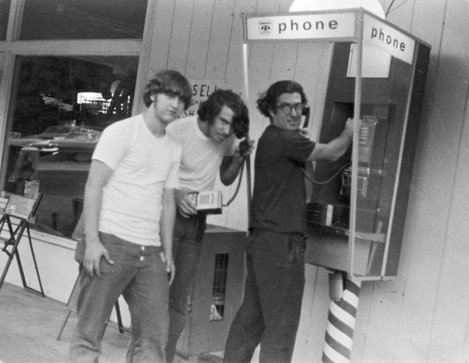
Phone Phreaking

Slide 8

The 80s: Security Goes Mainstream

Slide 9
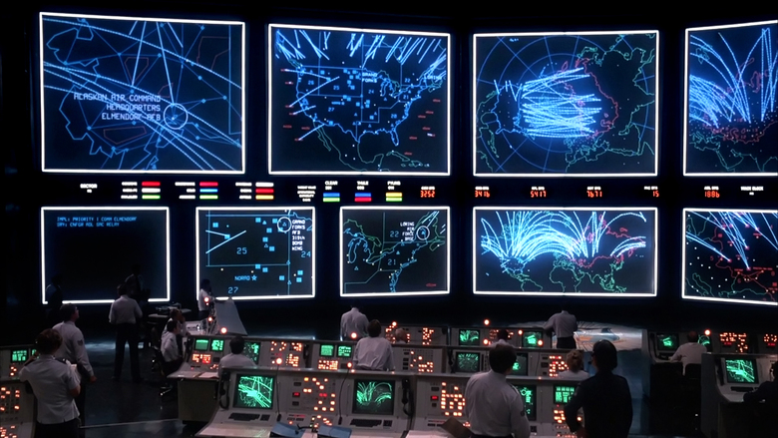
People Were Concerned This Would Happen

Slide 10
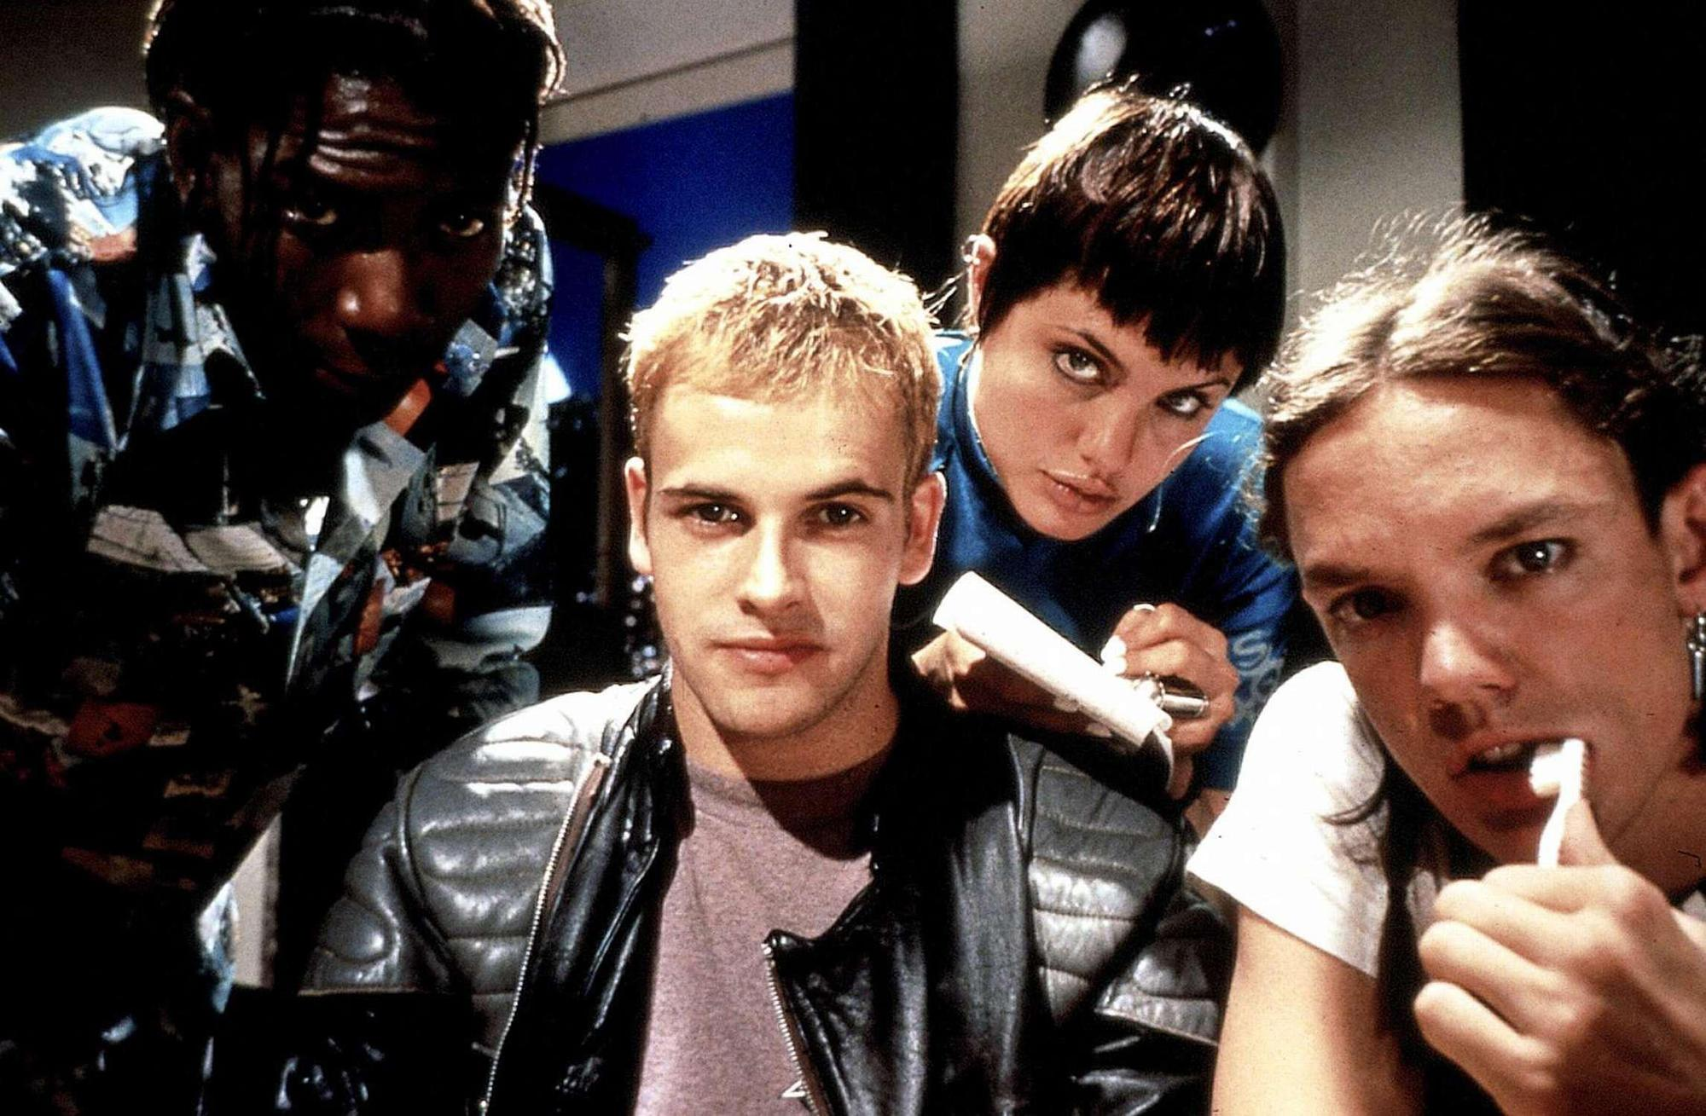
Breaking Into Computers Went Mainstream

Slide 11

1988 – The Year It All Changed

Slide 12
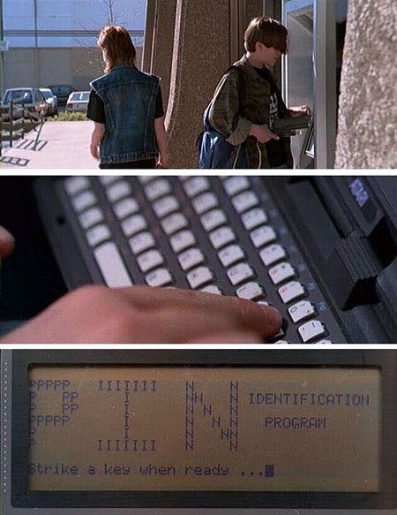
Sadly, skills used less and less often for curiosity… exploiting vulnerabilities is Big Business

Slide 13
The InfoSec (CIA) Triad
A secure system needs to provide three qualities:
Confidentiality
Integrity
Availability

Slide 14
Confidentiality
No unauthorized users may read data.

Slide 15
Integrity
No unauthorized users may write data.

Slide 16
Availability
System is available for authorized parties to read from and write to.

Slide 17
Terminology: Kinds of Security Attacks
Interruption (attack on availability, e.g. pulling plug from network switch, DDoS)
Interception (attack on confidentiality; e.g. eavesdropping, keylogger)
Modification (attack on integrity; modifying or deleting data)
Fabrication (attack on integrity; making up or inserting data)

Slide 18
Terminology: Passive vs Active Attacks
Passive: Do not modify system in any way
Eavesdropping
Monitoring
Traffic Analysis
Active: Modify the system in some way
Log in as a different user
Fill up database with garbage data
Modify bank account information

Slide 19
Terminology: Vulnerability vs Exploit
Vulnerability: identified weakness of a system
Exploit: (aka "sploit") Technique or mechanism used to compromise a system using a vulnerability

Slide 20
Terminology: Kinds of Malicious Code
Malware – General term for malicious code (includes all kinds below)
Bacteria - program that consumes system resources (e.g. fork bomb)
Logic bomb - code within a program which executes an unauthorized function
Trapdoor - secret undocumented access to a system or app
Trojan horse – program that pretends to be another program
Virus - replicates itself WITH human intervention
Worm - replicates itself WITHOUT human intervention
Zombie – A computer or program being run by an unauthorized controller
Bot network – collection of zombies controlled by master
Spyware – surreptitiously monitors your actions
Adware – Shows you more ads
DOS (Denial of service) attacks (e.g. via LOIC)

Slide 21
Protections
Firewalls
Operating System Permissions
CDNs
Well-written code
Proper security measures
Cryptography
User training

Slide 22
Common Attacks
Injection Attacks
Broken Authentication
Cross-Site Scripting (XSS)
Insecure Object References
Security Misconfiguration
Insecure Storage
Buffer overruns
Social Engineering

Slide 23

Injection Attacks

Slide 24
Broken Authentication
One user pretends to be another
How?
Guess or crack passwords
“Password reset”
Unencrypted session IDs
Apple iCloud leak was suspected of being this
Sarah Palin email hack was definitely this
All he needed to know, he learned from Wikipedia
Answered security questions, reset password

Slide 25
Cross-Site Scripting
Get a third party to execute code on their system
Similar to an injection attack, but with an intermediary
<html>I love Nickelback! They're so dreamy!<script>eval("evil code!!!!")</script></html>

Slide 26
Insecure Object References
Someone can access something by knowing where it is, despite not having proper security credentials
http://bank.com/?account=9844
http://bank.com/?account=9845

Slide 27
Security Misconfiguration
You have proper security, it’s just not set up correctly!
Default passwords
IPS, packet filtering, etc. not running
Insecure machine on secure network

Slide 28
Insecure Storage
Secure data is stored in an unsafe way
Example: credit card numbers being stored in a /tmp or logging directory as part of logging all transactions

Slide 29
Buffer Overrun
Trying to read or write more data than a buffer supposedly has access to – reading or writing past the end of a buffer
This is what heartbleed was – see heartbleed.c in sample_code directory

Slide 30
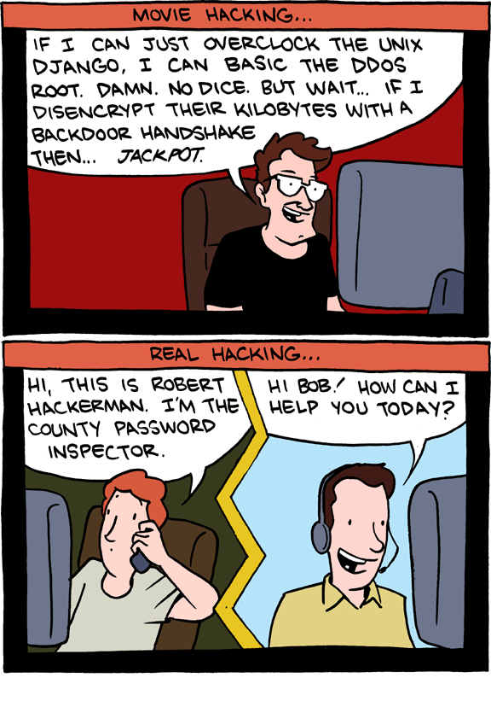
Social Engineering

