Slide 1
CS1632, Lecture 23: static analysis, part 1
Bill Laboon

Slide 2
Static vs Dynamic Analysis
Static analysis – Code is not executed by the test
Dynamic analysis – Code is executed by the test.
Almost everything that we have done so far!

Slide 3
Kinds of Static Analysis
Code coverage
Code review / walk-through
Code metrics
Formal verification
Compilers (technically!)
Bug finders
Linters

Slide 4
Code Coverage
How much of the codebase is covered by a particular test suite.
This can have different meanings!

Slide 5
Code Coverage
Consider the following code and tests and (pseudocode) unit tests

Slide 6
class Duck { public String quack(int x) { if (x > 0) { return "Quack!"; } else { return “Negative Quack!”; } } public String quock() { return "Quock!"; } }
assertEquals(quack(1), “Quack!”); assertEquals(quack(-4), “Negative Quack!”);

Slide 7
Method Coverage
What percentage of all methods have been called?
In previous example, 50%

Slide 8
Code Coverage
Consider the following code and tests and (pseudocode) unit tests

Slide 9
public static int noogie(int x) { if (x < 10) { return 1; } else { if ((int) Math.sqrt(x) % 2 == 0) { return (x / 0); } else { return 3; } } }
assertEquals(noogie(5), 1); assertEquals(noogie(81), 3); assertEquals(noogie(9), 3);

Slide 10
Statement Coverage
That’s 100% method coverage, but we are missing some statements!
Statement coverage = percentage of statements that have been tested
This is usually what’s referred to as “code coverage” (although technically it’s a kind of code coverage)

Slide 11
Other Kinds of Code Coverage
Branch coverage
Condition coverage
Decision coverage
Parameter value coverage
JJ-path Coverage
Path Coverage
Entry/Exit Coverage
State coverage

Slide 12
What’s the benefit?
Code coverage metrics lets you easily see where more tests would be useful and where tests are missing.
It does NOT tell you whether your tests are valid, or whether that line will always work, only that it will be executed by a test!
Consider the following…

Slide 13
public int chirp(int x, int y) { double z = Math.sqrt(x); return (int) z / y; }
// 100% code coverage! WOO-HOO!
assertEquals(chirp(1, 1), 1);

Slide 14
Note
Low code coverage is bad, but high code coverage does not always mean good.
Even 100% of code coverage cannot catch 100% of bugs!

Slide 15
Things Code Coverage Can’t Catch
Different variable values
Performance issues
Race conditions
Permutations of a statement
Combinatoric issues
More!

Slide 16
Code Metrics
Allow you to check :
Cyclomatic complexity!
Class fan-out!
Number of lines per class!
Number of interfaces!
Depth of inheritance tree!
NORM (Number of overridden methods)
Weighted methods per class!
Afferent and Efferent Coupling!

Slide 17
Code Metrics
Honestly, I have never found these very useful.
Some people/companies swear by them, though.
You can set “triggers” for these in checkstyle.

Slide 18
Formal Verification
Mathematically prove the behavior of a program from first principles
Allows for (in principle) defect-free code
Often done by reducing to a non-Turing-complete language to avoid the Halting Problem

Slide 19
Wait, did you say defect-free code?!?!
Sure did. Go back and see.

Slide 20
So why aren’t we using formal verification all the time?

Slide 21
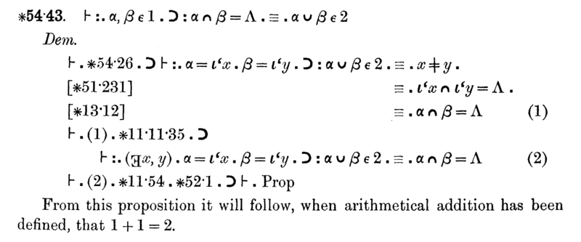
Page 379 of the Principia Mathematica

Slide 22
Formal Verification Is Slow and Inflexible
Used by:
Some embedded programs
Some cryptography libraries
At least one kernel, seL4
Places where accuracy is absolutely paramount

Slide 23

Compilers! Compilers! Compilers!

Slide 24
A compiler can tell you…
If your syntax is right
If you have uncaught exceptions
If you have dead code
The javac compiler isn’t even the best one out there, but it can give you lots of information
See the rustc and elm compilers for some really good static analysis
Or FP Complete’s “Haskell Complete” IDE

