Slide 1
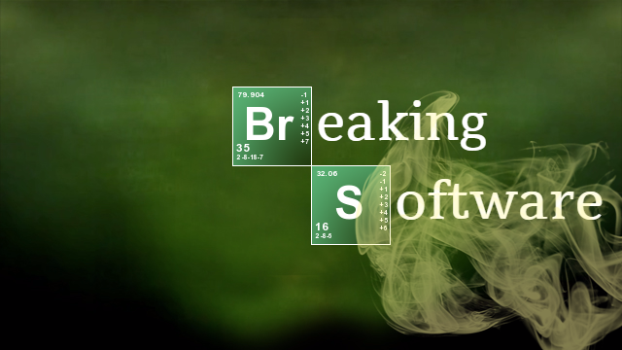
CS1632, Lecture 5

Slide 2
Software tends not to break much on the happy path.
It breaks when there's unexpected input.
Malicious users.
Systems going down.
When you're off in the wilderness.

Slide 3
Logic Errors: The logic of the program is incorrect
if (student.isTaking(cs1632)) {
student.setHappy(false);
} else {
student.setHappy(true);
}

Slide 4
OFF-by-one error: a subset of logic errors where values are specified incorrectly by one unit
if (student.getNumCredits() > 120) {
student.setCanGraduate(true);
} else {
student.setCanGraduate(false);
}

Slide 5
Rounding/floating point errors: rounding or floating point display give incorrect results.
double oneVal = 1.0 / 857.0; double total = oneVal * 857.0; System.out.println("Should be 1.0, actually = " + total); boolean areEqual = (total == 1.0); System.out.println("Are equal? " + areEqual);

Slide 6
Integration errors: Errors at boundaries between systems/subsystems.
int startDistanceInKilometers = 14; spacecraft.setDistance(startDistanceInKilometers); ... public class Spacecraft public void setDistance(int distanceInMiles) { ... }
}

Slide 7
Errors of assumption: The developer or system makes an assumption which turns out to be incorrect, or at odds with other assumptions.
OutputFile.write(TAB_DELIMITED); ... InputFile.read(COMMA_DELIMITED);

Slide 8
MISSING DATA ERRORS: An error occurs because needed data is missing and the system cannot operate properly without it.
public static void main(String[] args) {
System.out.println(args[3]);
}

Slide 9
BAD DATA ERRORS: System cannot handle improperly formatted or invalid data.
Enter two numbers to divide: 7 0 Exception in thread "main“ java.lang.ArithmeticException: / by zero

Slide 10
DISPLAY ERRORS: The data is correct but not displayed properly.
double pi = Math.PI;
System.out.printf("Pi is equal to...%.1f!", pi);

Slide 11
Null pointer error: The program dereferences a null pointer.
String oneILove = null; oneILove = oneILove.toUpperCase(); System.out.printf("This one goes out to the one I love," + oneILove);

Slide 12
I/O Errors: The system encounters an unexpected state of disk, network, or other I/O and cannot handle it.
try {
// read in file
} catch (FileNotFoundException e) {
// AAAGH WHAT DO I DO
System.exit(1);
}

Slide 13
Configuration error: The system could work correctly, but it was not configured to work correctly.
'javac' is not recognized as an internal or external command, operable program or batch file.

Slide 14
The list goes on…
Accessibility errors
Domain-specific errors
Version mismatch errors
Distributed system errors
Logging Errors
Interface Errors
Errors where the slide writer writes down an error that was already covered like say, Off-By-One Error
Logging Errors
Regulatory or Legal Errors

