Slide 1
CS1632, Lecture 7: Smoke and Exploratory Testing
Bill Laboon

Slide 2
Exploratory Testing
We have developed a very formal manner of testing
Develop requirements
Write test plan
Create and check traceability matrix
Execute tests

Slide 3
Exploratory Testing
But we have assumed that we know the EXACT expected behavior, EXACTLY how to cause it, and it is necessary to DEFINE all of these behaviors
Works fine in some circumstances!
But not others!
If I asked you to “test a poker program”, what would you do?

Slide 4
Sometimes, we don’t know exactly what the expected behavior is! Why not?
Subjective
Domain-specific
Uncertain of exact reproduction steps
Uncertain of interface
Unfamiliarity with general interaction
Implicit requirements

Slide 5
Exploratory Testing
Definition: testing without a specific test plan, in which the goals are to both learn more about the system and inform the development of system by finding defects and possible enhancements

Slide 6
Sometimes called “ad hoc” testing
Personally, I don’t like this term
It implies carelessness
Less rigid != more careless
Faith in the testers is required
To not go down blind alleys
To use their best judgment

Slide 7
How To Do It
Use your best judgment
If in doubt about next step, see Step 1.

Slide 8
Faith in Testers
Exploratory testing has faith that you instinctively "know" that there's a defect, or at least that you know something doesn't seem quite right.

Slide 9
Tips:
Try to accomplish important tasks
Think of edge cases on the fly
Try doing different things together
If I were the programmer, what wouldn't I have thought of?
Write down defects IMMEDIATELY
You can keep track of your steps and write them down later as formal tests.

Slide 10
Benefits of Exploratory Testing
Fast
Flexible
Relies on testers’ knowledge, and helps improve it
Very easy to update!

Slide 11
Drawbacks to Exploratory Testing
Unregulated
Possibly unrepeatable
Hard to say how much coverage there is
Difficult to automate

Slide 12

Smoke Testing

Slide 13
Smoke Testing (plumbing)
Send smoke down the pipes to find leaks BEFORE sending water or other fluids
Why?
If there is a leak, much easier to clean up / find smoke
Won’t waste effort
Won’t cause further damage (high pressure water going through a hole means a bigger hole will be formed)

Slide 14
Smoke Testing (software)
Do some minimal testing to ensure that the system is, in fact, testable or ready to be released
Why?
No need to test system that can’t perform minimal acceptable functionality
Setting up test harnesses / installing software may be non-trivial
Avoid wasting testers’ time

Slide 15
Smoke Testing can be:
Scripted: A few small but important test cases are run before the software is ready to be tested. These can be automated or manual.
Unscripted: An experienced tester does exploratory testing for a small amount of time to ensure that it meets minimum standards.

Slide 16
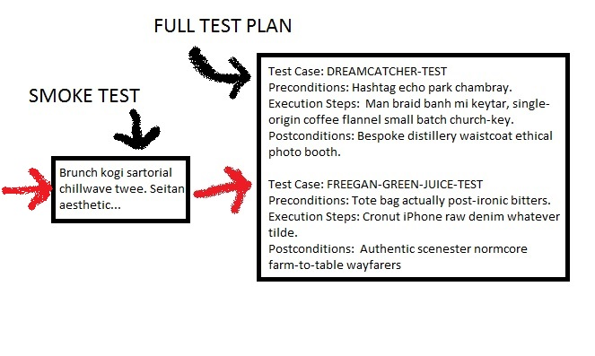
Smoke Testing is a GATEWAY

Slide 17
Media Check
A really, really basic smoke test
Can the CD be read?
Do files exist on server?
Etc.

Slide 18
A Note on “Sanity Testing”
Note: Some texts use the term “sanity testing” for “smoke testing”. I avoid this because:
It could be offensive
I think the parallel with smoke testing in plumbing is much more apt
However, you may come across the term so I wanted to cover it

