Slide 1
Replication and Reproducibility in Social Sciences and Statistics: Context, Concerns, and Concrete Measures
Lars Vilhuber
Cornell University
Partial funding acknowledged under NSF-#1131848 (NCRN) and a grant from the Alfred P. Sloan Foundation. The opinions expressed in this talk are solely the authors, and do not represent the views of the U.S. Census Bureau, the American Economic Association, or any of the funding agencies.

Slide 2
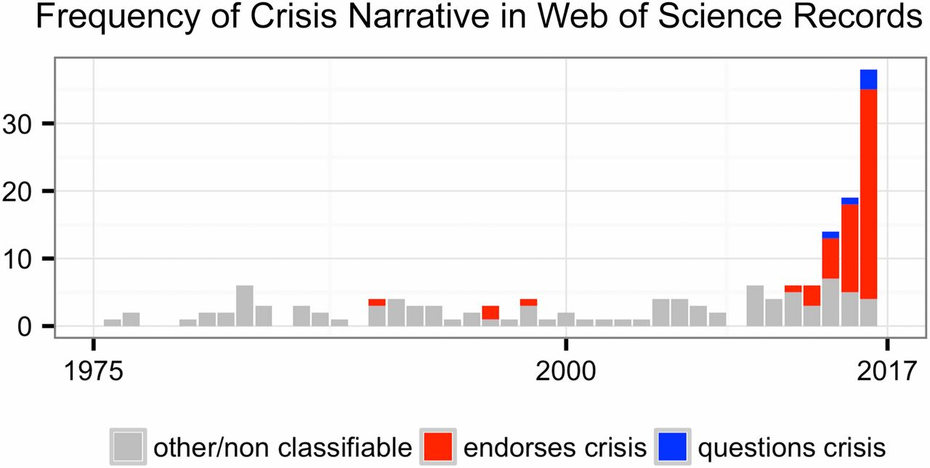
This reproducibility crisis thing….
https://doi.org/10.1073/pnas.1708272114
Notes:
Number of Web of Science records that in the title, abstract, or keywords contain one of the following phrases: “reproducibility crisis,” “scientific crisis,” “science in crisis,” “crisis in science,” “replication crisis,” “replicability crisis.” Records were classified by the author according to whether, based on title and abstracts, they implicitly or explicitly endorsed the crisis narrative described in the text (red), or alternatively questioned the existence of such a crisis (blue), or discussed “scientific crises” of other kinds or could not be classified due to insufficient information (gray).

Slide 3
The “crisis” in the 60s and 70s Sterling, 1959; Cohen, 1962; Lykken, 1968; Tukey, 1969; Greenwald, 1975; Meehl, 1978; Rosenthal, 1979
Low power
Flexibility in analysis
Selective reporting
Ignoring nulls
Lack of replication
Misuse of statistics
Source: Nosek Sackler talk 2017
Notes:
Source: Nosek, NAS.Sackler.2017.03.10
Examples from:
Button et al – Neuroscience
Ioannidis – why most results are false (Medicine)
GWAS
Biology
Two possibilities are that the percentage of positive results is inflated because negative results are much less likely to be published, and that we are pursuing our analysis freedoms to produce positive results that are not really there. These would lead to an inflation of false-positive results in the published literature.
Some evidence from bio-medical research suggests that this is occurring. Two different industrial laboratories attempted to replicate 40 or 50 basic science studies that showed positive evidence for markers for new cancer treatments or other issues in medicine. They did not select at random. Instead, they picked studies considered landmark findings. The success rates for replication were about 25% in one study and about 10% in the other. Further, some of the findings they could not replicate had spurred large literatures of hundreds of articles following up on the finding and its implications, but never having tested whether the evidence for the original finding was solid. This is a massive waste of resources.
Across the sciences, evidence like this has spurred lots of discussion and proposed actions to improve research efficiency and avoid the massive waste of resources linked to erroneous results getting in and staying in the literature, and about the culture of scientific practices that is rewarding publishing, perhaps at the expense of knowledge building. There have been a variety of suggestions for what to do. For example, the Nature article on the right suggests that publishing standards should be increased for basic science research.
[It is not in my interest to replicate – myself or others – to evaluate validity and improve precision in effect estimates (redundant). Replication is worth next to zero (Makel data on published replications; motivated to not call it replication; novelty is supreme – zero “error checking”; not in my interest to check my work, and not in your interest to check my work (let’s just each do our own thing and get rewarded for that)
Irreproducible results will get in and stay in the literature (examples from bio-med). Prinz and Begley articles (make sure to summarize accurately)
The Nature article by folks in bio-medicine is great. The solution they offer is a popular one in commentators from the other sciences -- raise publishing standards.

Slide 4
Efficiency of scholary discourse?
Early publications (20th century) contained tables of data, and the math was simple (maybe)
Data became electronic, was no longer included or cited
Math was transcribed to code, and was no longer included

Slide 5
Efficiency of scholary discourse!
Modern publications thus need the same transparency and completeness as in the old days
to facilitate replicability

Slide 6
Progress

Slide 7
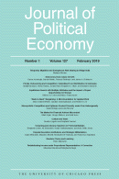
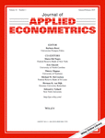


Progress
Replication archives and Data (Code) Availability policies

Slide 8
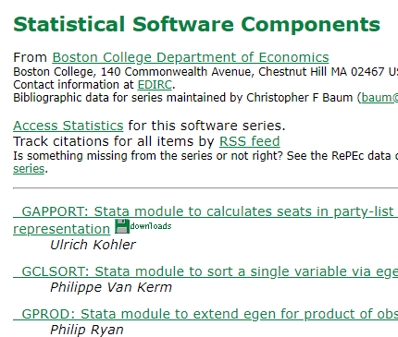

Progress
Replication archives and Data (Code) Availability policies
Shared open source software

Slide 9

Progress
Replication archives and Data (Code) Availability policies
Shared open source software
Better public-use and shared data
FSRDC
CASD
IAB

Slide 10


Progress
Replication archives and Data (Code) Availability policies
Shared open source software
Better public-use and shared data
Better ways of accessing preprints/ grey literature

Slide 11

Progress
Replication archives and Data (Code) Availability policies
Shared open source software
Better public-use and shared data
Better ways of accessing preprints/ grey literature
Pre-registration of trials, experiments, and analyses
It’s registered
Osf.io

Slide 12
More recently…

Slide 13
Second round (2012-)
Greater enforcement of data (and code) availability
2015, AJ Political Science
2016, Data Editor for ASA Software Section
2016, Statistical review added Science
2017: AEA appoints Data Editor, with mandate to do similar activities

Slide 14
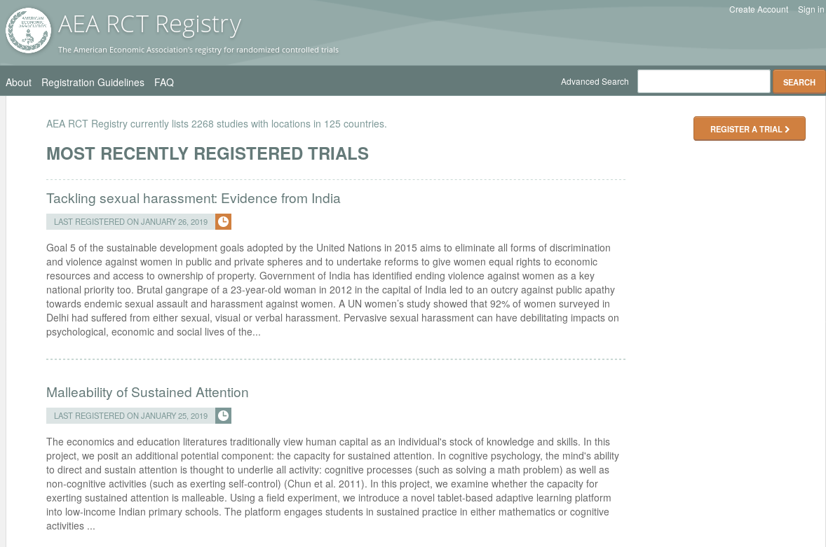
Pre-registration
“That information is especially helpful in research that emphasizes null hypothesis significance testing.
A thorough preregistration promotes transparency and openness and protects researchers from suspicions of p-hacking.”
https://www.psychologicalscience.org/publications/psychological_science/preregistration

Slide 15

Registered Reports
https://cos.io/rr
Chambers (2014)
Nosek & Lakens (2014)
Close cousin: Results-blind review

Slide 16


Preprints in other sciences
bioRxiv (2013)
PsyArXiv (2016)

Slide 17
Paluck (2018) https://osf.io/kvbnh/

Slide 18
Issues

Slide 19
Replication continuum
Same data | Same code | Same methods | Same context
08
08
08
Reproducibility
Replicability
Generalizability
Narrow Replication (Pesaran 2003)
Pure Replication (Hamermesh 2007)
Verification (Clemens 2015)
Wide Replication (Pesaran 2003)
Statistical Replication (Hamermesh 2007)
Reproduction/Reanalysis (Clemens 2015)
Wider Replication (Pesaran 2003)
Scientific Replication (Hamermesh 2007)
Reanalysis/Robustness (Clemens 2015)

Slide 20
Results?

Slide 21
Some key statistics
Study | Year | N | Success | Type | Type-R | Type-Data | Percent | Field
Dewald Thursby Anderson | 1986 | 54 | 2 | Complete | Reproducibility | Avail | 4% | Economics
Dewald Thursby Anderson | 1986 | 54 | 7 | Partial | Reproducibility | Avail | 13% | Economics
McCullough McGeary Harrison | 2006 | 186 | 14 | Complete | Reproducibility | All | 8% | Economics
McCullough McGeary Harrison | 2006 | 62 | 14 | Complete | Reproducibility | Avail | 23% | Economics
Nosek et al | 2015 | 100 | 36 | Complete | Replication |  | 36% | Psychology
Camerer et al | 2016 | 18 | 11 | Complete | Replication |  | 61% | Experimental Econ
Chang Li | 2017 | 67 | 22 | Complete | Reproducibility | Avail | 33% | Macroeconomics
Kingi et al | 2018 | 274 | 69 | Complete | Reproducibility | All | 25% | Economics
Kingi et al | 2018 | 162 | 69 | Complete | Reproducibility | Avail | 43% | Economics
Kingi et al | 2018 | 162 | 137 | Partial | Reproducibility | Avail | 85% | Economics
Kingi et al numbers are preliminary. Do not cite or quote.

Slide 22
Not enough articles are reproducible

Slide 23
Current Data Availability Policies are Broken
If the Data is not open-access, no systematic information is collected (“exemption”)

Slide 24
Not enough data is “accessible”

Slide 25
Current efforts at the AEA

Slide 26
Current efforts at the AEA
Provide more transparency
To assist replication efforts
By better linking to paper-related resources (data, code, registration, etc.)
Pre-emptively improve code archives
By conducting reproducibility checks
By working with groups that conduct reproducibility checks
Better archives
Greater transparency of the code and data archives

Slide 27
AEA “Data Availability Policy” (2018)
It is the policy of the American Economic Association to publish papers only if the data used in the analysis are clearly and precisely documented and are readily available to any researcher for purposes of replication.
Authors of accepted papers that contain empirical work, simulations, or experimental work must provide, prior to publication, the data, programs, and other details of the computations sufficient to permit replication. These will be posted on the AEA website. The Editor should be notified at the time of submission if the data used in a paper are proprietary or if, for some other reason, the requirements above cannot be met.

Slide 28
AEA “Data Availability Policy” (2019)
It is the policy of the American Economic Association to publish papers only if the data used in the analysis are clearly and precisely documented and are readily available to any researcher for purposes of replication.
Authors of accepted papers that contain empirical work, simulations, or experimental work must provide, prior to publication, the data, programs, and other details of the computations sufficient to permit replication. These will be posted on the AEA website. The Editor should be notified at the time of submission if the data used in a paper are proprietary or if, for some other reason, the requirements above cannot be met.

Slide 29
Improve reproducibility

Slide 30
It is not the access that is “broken”

Slide 31
Illustration
If you used files at the National Archives, would we ask you to “deposit” them?

Slide 32
It is the description of access that is “broken”

Slide 33
Encourage Best Practices
Deposit and archive early
If you collect data, archive it (possibly privately)
If you finish the manuscript, deposit the analysis files (possibly privately)

Slide 34
Encourage Best Practices
Follow robust coding
Ensure that code reliably produces results (possibly automated)
Before you finish the manuscript, run all analysis code again (if not too onerous)

Slide 35
Evolving Journal and Data Infrastructure
More self-deposit repositories in the social sciences
Dataverse
Figshare
openICPSR
Zenodo
Qualitative Data Repository (QDR)
Others…

Slide 36
Evolving Journal and Data Infrastructure
Use them!

Slide 37
Evolving Journal and Data Infrastructure
Describe them!
(cite them!)

Slide 38
Evolving Journal and Data Infrastructure
Treat all archives symmetrically!

Slide 39
Evolving Journal and Data Infrastructure
More self-deposit repositories in the social sciences
Dataverse
Figshare
openICPSR
Zenodo
Qualitative Data Repository (QDR)
Others…
CASD
IAB
Norway
US Federal Statistical RDC
….

Slide 40
Challenges?

Slide 41
Verifying Data and Code Deposits
Why do journals like affiliated repositories (or website deposits)?
They can ensure longevity/ persistence
They can ensure access
They can ensure availability

Slide 42
Verifying Data and Code Deposits
Not every data repository is created equal
Github, Dropbox, etc. are not data or code repositories
Is the institutional repository at the University of Southern Venezuela a reliable repository?
Is the institutional repository at Cornell University a reliable repository?
Is the institutional repository at Harvard University (Dataverse!) a reliable repository?
Are the National Archives a reliable repository?

Slide 43
Verifying Data and Code Deposits
Not every data repository is created equal
The Second Bank of Third City credit card data is not a data/code repository
Is the School Board of Third City a reliable repository?
Is the JPMC Institute a reliable repository?
Is the US Census Bureau a reliable repository?
Are any restriced-access repositories reliable archives?

Slide 44
Within Economics (AEA, Restud)
Ensure reproducibility of computational code
Challenge: Restricted-access data

Slide 45
Future efforts
AEA, Social Sciences, elsewhere

Slide 46
Better support for researchers
Training in methods (with various centers, institutions, etc.)
For current researchers
For integration into curriculums
Tools to streamline the process
A few technical things (not described here)
Coordinate among journals (no duplicate effort)
Awareness
Consider badges/ certification
Address issues with confidential data

Slide 47
Confidential data
Highlight where confidential data already require replicability
IAB
Remote processing servers (Canada, NCHS, Australia, etc.)
Work with Research Data Centers to facilitate transparency and reproducibility
Training (secure programming guidelines)
Standardize archives within RDCs + transparency

Slide 48
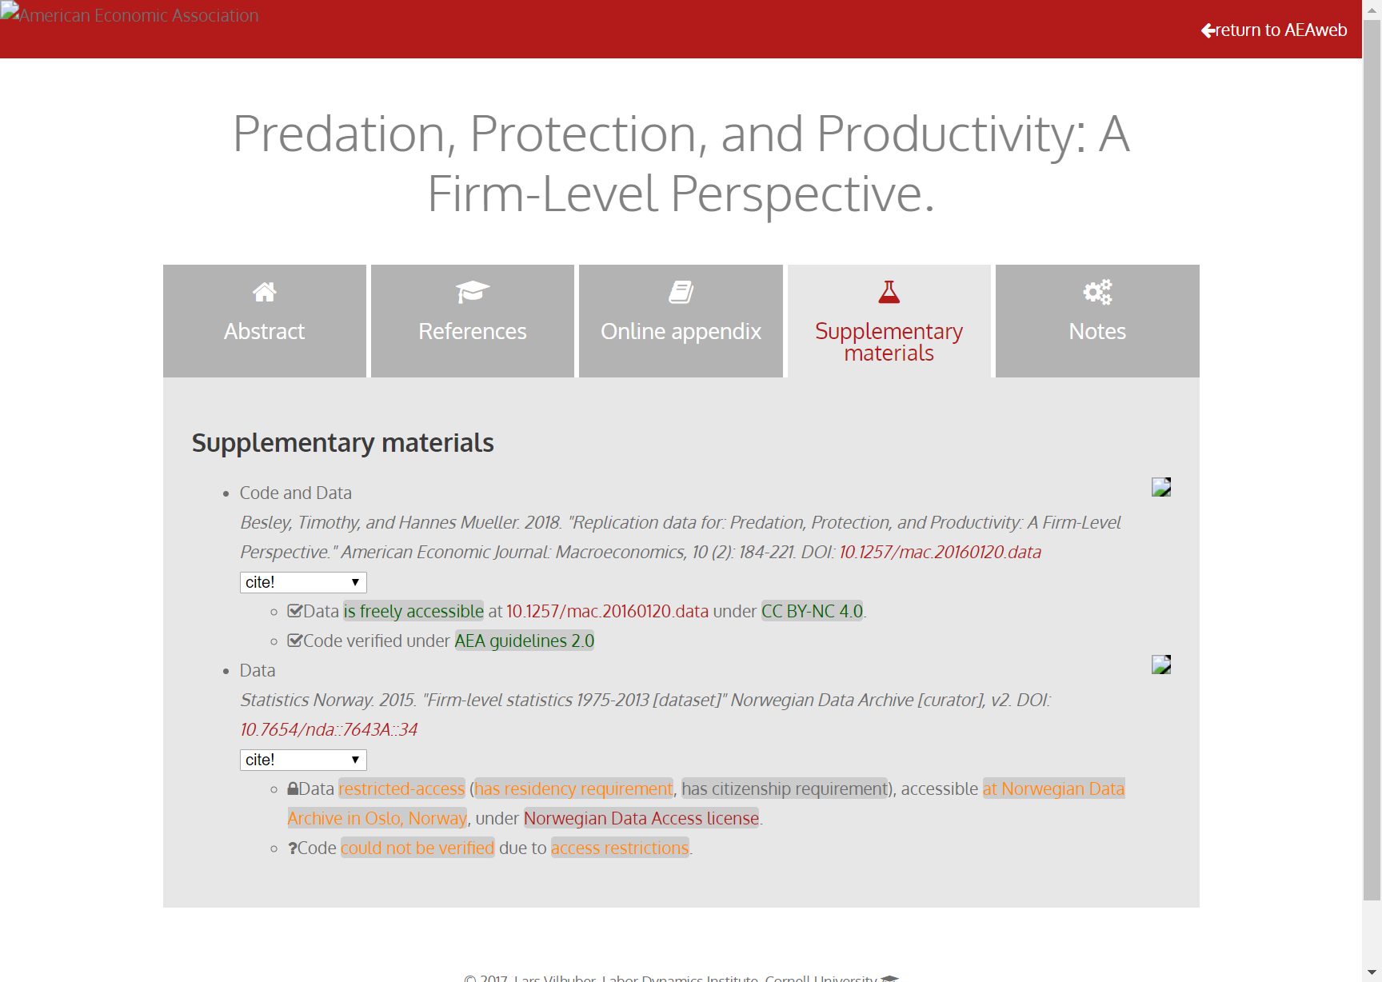
Richer metadata, more transparency

Slide 49
And you?

Slide 50
Researchers: New skills to learn/teach
How to incorporate reproducible practices into your workflow
When to pre-register, and when not to
Document early, and often (better READMEs!)
How, where, and when to archive data and code
How to license your contributions!

Slide 51
Summary
Greater transparency
Equal treatment of public-use and confidential data
Better computational reproducibility
For public data as well as confidential data
Greater reliance on shared resources
Encourage best practices

Slide 52
Merci!

