Slide 1
Before we start
Please fill out the following survey:
https://lars.vilhuber.com/s/mtl

Slide 2
Replication and Reproducibility in Social Sciences and Statistics: Context, Concerns, and Concrete Measures
Lars Vilhuber
Cornell University
Partial funding acknowledged under NSF-#1131848 (NCRN) and a grant from the Alfred P. Sloan Foundation. The opinions expressed in this talk are solely the authors, and do not represent the views of the U.S. Census Bureau, the American Economic Association, or any of the funding agencies.

Slide 3
Overview
Background
Economics and other social sciences
What are we doing in Economics? (at the AEA, in general)
What are we going to do in Economics?
What will you be doing going forward?

Slide 4
History

Slide 5
Replicability in Economics
Ragnar Frisch, editor of the first issue of Econometrica (1933), noted
“the original data will, as a rule, be published, unless their volume is excessive… to stimulate criticism, control, and further studies.”
Publication of data, however, was discontinued early in the journal’s history.
Frisch (1933)
Notes:
Replication is not new…

Slide 6
Introducing: The Reproducibility “Crisis”

Slide 7
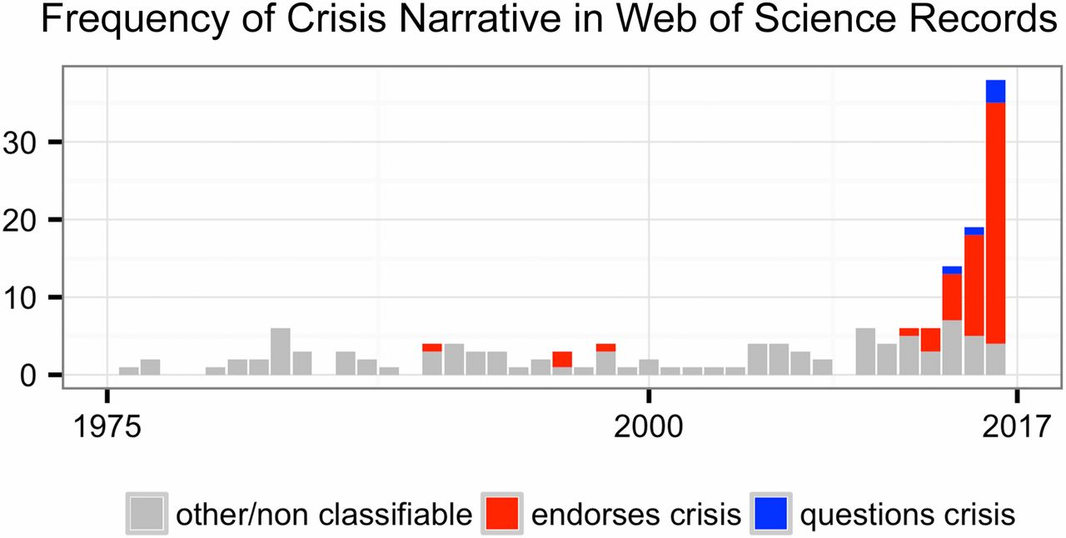
Fanelli (2018), Is science really facing a reproducibility crisis, and do we need it to?
https://doi.org/10.1073/pnas.1708272114
Notes:
Number of Web of Science records that in the title, abstract, or keywords contain one of the following phrases: “reproducibility crisis,” “scientific crisis,” “science in crisis,” “crisis in science,” “replication crisis,” “replicability crisis.” Records were classified by the author according to whether, based on title and abstracts, they implicitly or explicitly endorsed the crisis narrative described in the text (red), or alternatively questioned the existence of such a crisis (blue), or discussed “scientific crises” of other kinds or could not be classified due to insufficient information (gray).

Slide 8
The “crisis” in the 60s and 70s Sterling, 1959; Cohen, 1962; Lykken, 1968; Tukey, 1969; Greenwald, 1975; Meehl, 1978; Rosenthal, 1979
Low power
Flexibility in analysis
Selective reporting
Ignoring nulls
Lack of replication
Misuse of statistics
Source: Nosek Sackler talk 2017
Notes:
Source: Nosek, NAS.Sackler.2017.03.10
Examples from:
Button et al – Neuroscience
Ioannidis – why most results are false (Medicine)
GWAS
Biology
Two possibilities are that the percentage of positive results is inflated because negative results are much less likely to be published, and that we are pursuing our analysis freedoms to produce positive results that are not really there. These would lead to an inflation of false-positive results in the published literature.
Some evidence from bio-medical research suggests that this is occurring. Two different industrial laboratories attempted to replicate 40 or 50 basic science studies that showed positive evidence for markers for new cancer treatments or other issues in medicine. They did not select at random. Instead, they picked studies considered landmark findings. The success rates for replication were about 25% in one study and about 10% in the other. Further, some of the findings they could not replicate had spurred large literatures of hundreds of articles following up on the finding and its implications, but never having tested whether the evidence for the original finding was solid. This is a massive waste of resources.
Across the sciences, evidence like this has spurred lots of discussion and proposed actions to improve research efficiency and avoid the massive waste of resources linked to erroneous results getting in and staying in the literature, and about the culture of scientific practices that is rewarding publishing, perhaps at the expense of knowledge building. There have been a variety of suggestions for what to do. For example, the Nature article on the right suggests that publishing standards should be increased for basic science research.
[It is not in my interest to replicate – myself or others – to evaluate validity and improve precision in effect estimates (redundant). Replication is worth next to zero (Makel data on published replications; motivated to not call it replication; novelty is supreme – zero “error checking”; not in my interest to check my work, and not in your interest to check my work (let’s just each do our own thing and get rewarded for that)
Irreproducible results will get in and stay in the literature (examples from bio-med). Prinz and Begley articles (make sure to summarize accurately)
The Nature article by folks in bio-medicine is great. The solution they offer is a popular one in commentators from the other sciences -- raise publishing standards.

Slide 9
The crisis in the 1980s in Economics
Dewald, Thursby, Anderson (AER, 1986)
Leamer’s (1983) ‘Let’s take the con out of econometrics’

Slide 10
The crisis in the 1990s
Anderson and Dewald (1994) [Economics]
King (1995) “Replication, replication” [Political Science]
McCloskey and Ziliak, 1996: Do economists consider power calculations?
McCullough and Vinod (1999): call for replication archives

Slide 11
The crisis in the 2000s
McCullough & Vinod (2003) [Econometrics]
Ziliak and McCloskey (2004)
Anderson et al (2005, 2008), Vinod (2005)
Ioannides (2005)
McCullough et al (2006) Lessons learned JMCB, McCullough (2007)
Hamermesh (2007)
Koenker and Zeileis (2009)

Slide 12
The crisis in the 2010s
Ioannides (2016)
Ioannidis, Stanley, Doucouliagos (2017): bias, low power
Miguel et al (2014)
Chang & Li (2015)
Zimmermann (2015): Calls for a replication journal
Many others…

Slide 13
But there has also been improvement

Slide 14

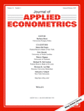
The crisis in the 1980s … lead to changes
1976- JPE Section on Confirmation and Contradictions
1988 Replication archive at the Journal of Applied Econometrics

Slide 15
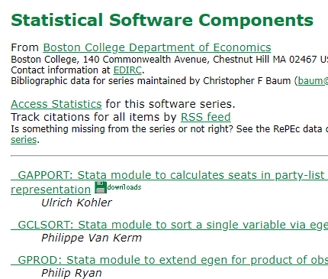

The crisis in the 1990s… lead to changes
Lead directly to
Data availability policies in Economics (1996: JMCB)
Replication section (Journal of Applied Econometrics, 2003)
More robust code archives (Goffe and Parks (1997), Eddelbüttel (1997): CodEC -> SSC)

Slide 16




The crisis in the 1990s… lead to changes
Coincidental:
Better public-use data (IPUMS: Sobek and Ruggles, 1999)
Better open-source software (R Core Team, 2000)
New methods of exchanging manuscripts (working papers/ preprints) (early 90s, but publications: Ginsparg, 1997, Halpern 1998: arXiv; Krichel, 1997, others: RePEc/WoPEc)

Slide 17


The crisis in the 2000s… lead to changes
Lead directly to
Data availability policies in Economics (2005: AER)
Subsequently to many other top journals
Social Science Registry (2011) for pre-registration

Slide 18
So is it a “crisis”?
crisis [kri´sis] (pl. cri´ses) (L.) 1. the turning point of a disease for better or worse; especially a sudden change, usually for the better, in the course of an acute disease. 2. a sudden paroxysmal intensification of symptoms in the course of a disease.

Slide 19
Scholarly Communications are Meant to Communicate
In the 17th century, scholars communicated by letter exchange
Collections of letters + editing became the first journals
Peer review was incorporated
But the review of a manuscript by an editor and two peers cannot possibly be equivalent to a full vetting
Rather, the back and forth in the pages of academic journals IS the discourse
In this view (also Hamermesh, 2007) bad publications (including those that do not privately replicate) die out, good publications withstand those tests

Slide 20
Maybe it’s only a tantrum…

Slide 21
Efficiency

Slide 22
Efficiency of scholary discourse?
If publishing is part of a discourse (and not the final truth), then it must be made efficient
When publication was exchange of ideas, the exchange of papers (1600s!) included everything necessary
Notes:
This needs pictures of AEA 2011 papers

Slide 23
Efficiency of scholary discourse?
Early publications (20th century) contained tables of data, and the math was simple (maybe)
Data became electronic, was no longer included or cited
Math was transcribed to code, and was no longer included

Slide 24
Citing data sources
“Many authors cited only general sources such as Survey of Current Business, Federal Reserve Bulletin, or International Financial Statistics, but did not identify the specific issues, tables, and pages from which the data had been extracted.”
(Dewald Thursby Anderson 1986, p. 591)

Slide 25
Efficiency of scholary discourse!
Modern publications thus need the same transparency and completeness as in the old days
to facilitate replicability

Slide 26
Definition

Slide 27
What IS reprodubility?

Slide 28
Replication continuum (Bollen et al. 2015)

Slide 29
Replication continuum
08
Reproducibility
Narrow Replication (Pesaran 2003)
Pure Replication (Hamermesh 2007)
Verification (Clemens 2015)

Slide 30
Replication continuum
Same data | Same code | Same methods | Same context
08
Reproducibility
Narrow Replication (Pesaran 2003)
Pure Replication (Hamermesh 2007)
Verification (Clemens 2015)

Slide 31
Replication continuum
08
08
Reproducibility
Replicability
Narrow Replication (Pesaran 2003)
Pure Replication (Hamermesh 2007)
Verification (Clemens 2015)
Wide Replication (Pesaran 2003)
Statistical Replication (Hamermesh 2007)
Reproduction/Reanalysis (Clemens 2015)

Slide 32
Replication continuum
Same data | Different code | Same methods | Same context
 | or software
08
08
Reproducibility
Replicability
Narrow Replication (Pesaran 2003)
Pure Replication (Hamermesh 2007)
Verification (Clemens 2015)
Wide Replication (Pesaran 2003)
Statistical Replication (Hamermesh 2007)
Reproduction/Reanalysis (Clemens 2015)

Slide 33
Replication continuum
New data | Same code | Same methods | Same context
collection
08
08
Reproducibility
Replicability
Narrow Replication (Pesaran 2003)
Pure Replication (Hamermesh 2007)
Verification (Clemens 2015)
Wide Replication (Pesaran 2003)
Statistical Replication (Hamermesh 2007)
Reproduction/Reanalysis (Clemens 2015)

Slide 34
Replication continuum
08
08
08
Reproducibility
Replicability
Generalizability
Narrow Replication (Pesaran 2003)
Pure Replication (Hamermesh 2007)
Verification (Clemens 2015)
Wide Replication (Pesaran 2003)
Statistical Replication (Hamermesh 2007)
Reproduction/Reanalysis (Clemens 2015)
Wider Replication (Pesaran 2003)
Scientific Replication (Hamermesh 2007)
Reanalysis/Robustness (Clemens 2015)

Slide 35
Replication continuum
Different data | Different code | Different | Different
 | or software | methods | context or
 |  |  | country
08
08
08
Reproducibility
Replicability
Generalizability
Narrow Replication (Pesaran 2003)
Pure Replication (Hamermesh 2007)
Verification (Clemens 2015)
Wide Replication (Pesaran 2003)
Statistical Replication (Hamermesh 2007)
Reproduction/Reanalysis (Clemens 2015)
Wider Replication (Pesaran 2003)
Scientific Replication (Hamermesh 2007)
Reanalysis/Robustness (Clemens 2015)

Slide 36
What is a “Data Availability Policy”?

Slide 37
AEA “Data Availability Policy” (2018)
It is the policy of the American Economic Association to publish papers only if the data used in the analysis are clearly and precisely documented and are readily available to any researcher for purposes of replication.
Authors of accepted papers that contain empirical work, simulations, or experimental work must provide, prior to publication, the data, programs, and other details of the computations sufficient to permit replication. These will be posted on the AEA website. The Editor should be notified at the time of submission if the data used in a paper are proprietary or if, for some other reason, the requirements above cannot be met.

Slide 38
Different

Slide 39
Today is different

Slide 40
What is different?
Technical infrastructure supporting openness
More and easier archives with self-service options (Figshare, Zenodo, OpenICPSR)
Github & Co.
Making science more easily reproducible
Institutions
Center for Open Science / Open Science Framework (OSF)
BITSS, J-PAL, etc.
Registries
New methods to do replications at scale
Collaborative efforts
Use of Mechanical Turk, Odesk, and other mechanisms

Slide 41
Nosek: “Why ineffective?”
“Strategy”
Study the issue Knowing what to change
Education & training Knowing how to change
Inculcate the values Wanting to change
Additions
Infrastructure Technology to enable change
Reward system Incentives to embrace change
Notes:
From Nosek NAS.Sackler.2017.03.10
Knowing what to do (knowledge), knowing how to do it (training), believing it should be done (values) are not sufficient. Training may be necessary, values may not even be necessary but they help.

Slide 42
Fanelli (2018): Opportunities
“These [information and communication] technologies promise to make research
more accurate, powerful,
open, democratic,
transparent, and
self-correcting
than ever before. At the same time, this technological revolution creates new expectations and new challenges that metaresearchers are striving to address.”

Slide 43
What does progress look like?

Slide 44
First round (2005-2012)
Adding data availability requirements
AEA, 2005
Other journals (econ, others) follow
Code availability as well
Experiments in post-publication discussion
AEA: Comments on articles

Slide 45
Broad adherence to AEA policy
Journals (Publisher) | Type of policy | Archive | Confidential data
AER and Journals (self) | AEA | Journal website | Exemption
QJE (OUP) | AEA | Dataverse | Exemption
ReStud (OUP) | Generic + assistance | Journal website | Exemption
ReStat (MIT) | Own | Dataverse | “… way to apply for data…”
J Applied Econometrics | Own | Own (Queens, 1988-) | Exemption
Econometrica | Own | Journal website | Exemption with “…reasonable effort…”
JOLE (Chicago) | AEA | Journal website | Exemption
JPE (Chicago) | AEA | Journal website | Exemption
JMCB | Own (barebones) | Journal website | --

Slide 46
Second round (2012-)
Broad replication projects in Psychology
Open Science Collaboration (2015, others)
Replication projects in Behavioral Economics
Camerer et al (2016)

Slide 47
Second round (2012-)
New data (and code) availability policies
2012, AJ Political Science
2016, QJE (last top journal)

Slide 48
Second round (2012-)
Greater enforcement of data (and code) availability
2015, AJ Political Science
2016, Data Editor for ASA Software Section
2016, Statistical review added Science
2017: AEA appoints Data Editor, with mandate to do similar activities

Slide 49
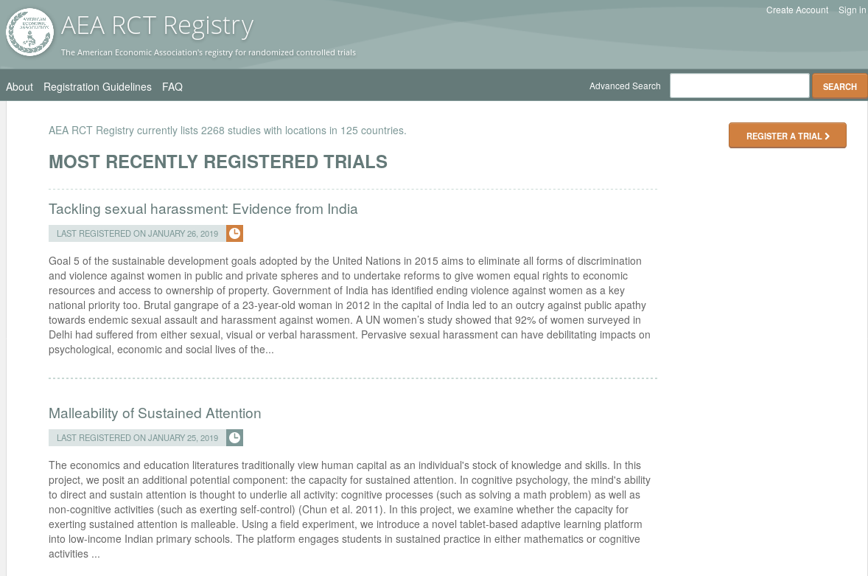
Preregistration
AEA RCT Registry (2011)

Slide 50
Pre-registration
The American Economic Association operates a registry for Randomized Controlled Trials (RCTs).
Registration of RCTs is required for all applicable submissions.
If the research in your paper involves an RCT, please register …
following information: PI name, project title, study location, project status, keyword(s), abstract, trial start and end dates, intervention start and end dates, proposed outcome(s), experimental design, whether the treatment is clustered, planned number of clusters, planned number of observations, and IRB information.

Slide 51
When to pre-register
Ideally before the start of the study
Alternatively, prior to seeing the data
Also (currently) accepted prior to submission

Slide 52
Why pre-register
“That information is especially helpful in research that emphasizes null hypothesis significance testing.
A thorough preregistration promotes transparency and openness and protects researchers from suspicions of p-hacking.”
https://www.psychologicalscience.org/publications/psychological_science/preregistration

Slide 53

Second round (2012-)
Registered Reports
https://cos.io/rr
Chambers (2014)
Nosek & Lakens (2014)
Close cousin: Results-blind review

Slide 54


Second round (2012-)
Preprints in other sciences
bioRxiv (2013)
PsyArXiv (2016)

Slide 55
Economics and other social sciences
A brief retrospective

Slide 56
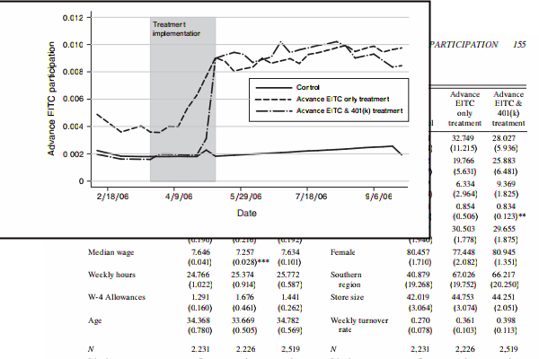
Analysis in Economics

Slide 57
Economics: Positive attitudes?
Often liberal sharing of data and code (via email, networks)
Sharing of articles prior to publication (RePEc/WoPEc since 1990s, working papers since 1970s)

Slide 58
Paluck (2018) https://osf.io/kvbnh/

Slide 59
Paluck (2018) https://osf.io/kvbnh/

Slide 60
Wide use of public-use data
Macrodata:
“We use data downloaded from the Bureau of Economic Analysis…”
Microdata:
“… this paper uses data from the Current Population Survey…”

Slide 61
Issues

Slide 62
And yet, there are issues

Slide 63
Wide use of public-use data
Macrodata:
“We use data downloaded from the Bureau of Economic Analysis…”
Microdata:
“… this paper uses data from the Current Population Survey…”

Slide 64
Making USEFUL archives
From analysis of code from 1996 to 2003 (MMH2006):
“Other authors seem to think that the entire world shares the exact same hard drive layout, with ‘‘C:\MYDATA\MYPROJECT\” sprinkled liberally throughout their code. Of course, a would-be replicator has to find and change all these.”
“The author might not realize all the data/subroutine files that his code utilizes, and forget to include said data/subroutine in his replication files.”

Slide 65
Making RELIABLE archives
Many datasets
Are imperfectly described
Are badly documented
Have no (permanent) location defined
All of the above

Slide 66
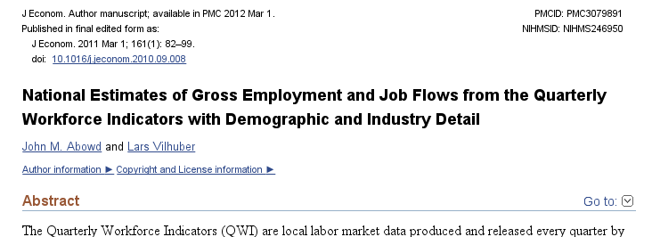
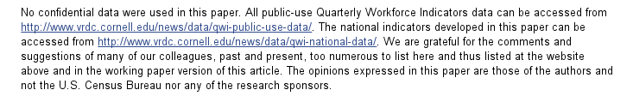
An example

Slide 67
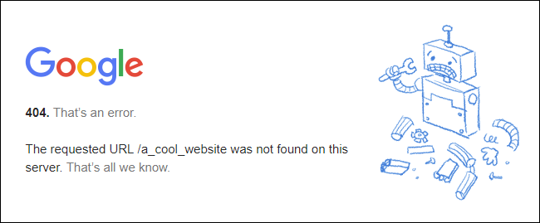
Risk

Slide 68

An example: not cited…

Slide 69
Data not attached to article
J of Econometrics Data Policy at the time could not accommodate 50MB file
Data was not attached to paper.
Today’s J of Econometrics policy suggests using third-party repositories
We will get to that later

Slide 70
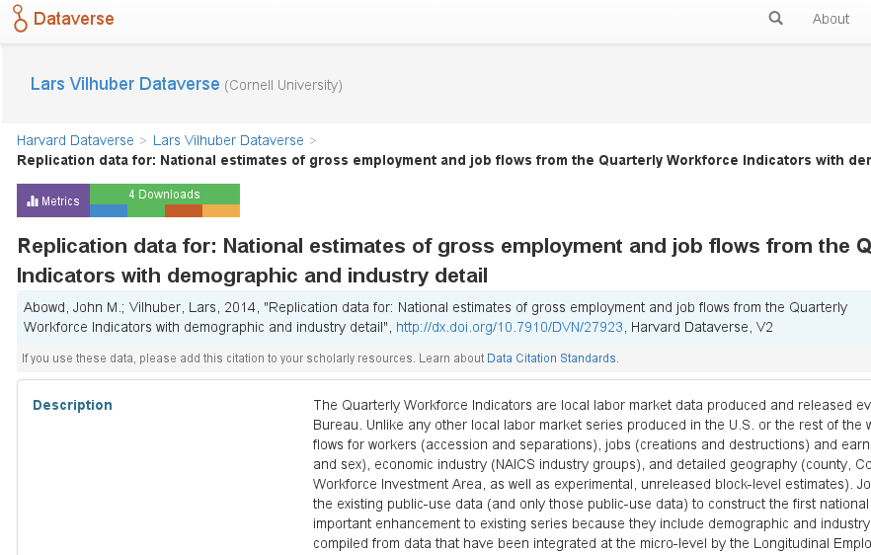
We went back, archived it

Slide 71
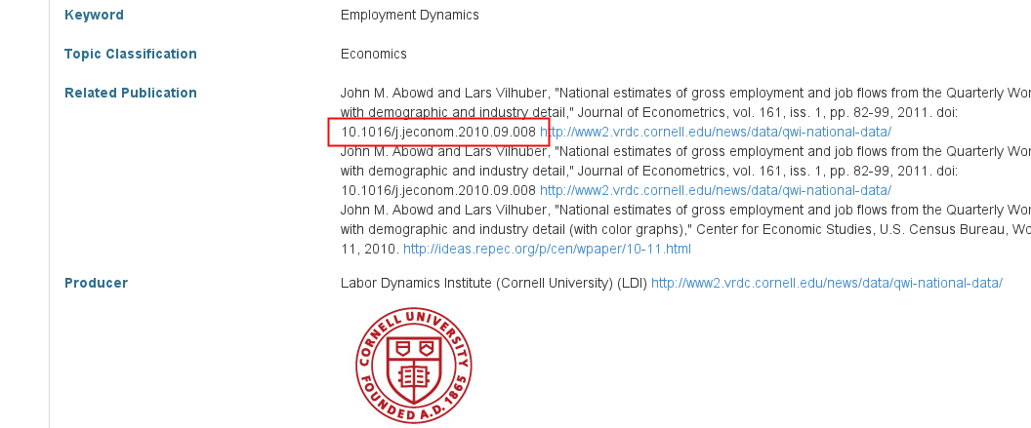
We went back, archived it, linked it back

Slide 72
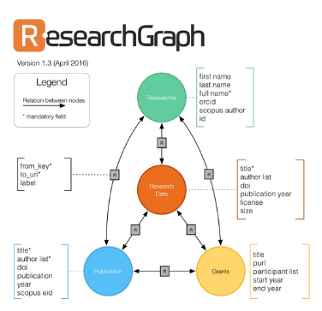


But journal and data infrastructure are incomplete
While Dataverse allows to manually link back…
… the article itself reveals none of that
True for most journals, and most data archives
ICPSR (manual linking to articles)
RePEc (no linkage possible)
Infrastructure starting to emerge
If article cites data (DOI!)
If archive and/or journal leverages infrastructure

Slide 73
Using personal websites
Don’t even think about using personal websites!

Slide 75

source

Slide 76
Yielding to the temptation of “administrative”data
State-level data
“Our analysis draws on administrative records from the Detroit Work First program linked with unemployment insurance (UI) wage records for the State of Michigan”
Autor/Houseman doi:10.1257/app.2.3.96
School-district data
“confidential student-level panel dataset provided by the School Board of Alachua County in Florida”
Carrel and Hoekstra doi:10.1257/app.2.1.211

Slide 77
… yielding…
Proprietary data
“This field experiment was made possible by the collaboration of a large-scale, nationwide firm in the retail sector. ”
Damon doi:10.1257/app.2.2.147

Slide 78
Death Knell for Public-use Data?
Sounded by young scholars pursuing research programs that mandate inherently identifiable data:
Geospatial relations,
Exact genome data,
Networks of all sorts,
Linked administrative records
These researchers acquire authorized, generally unfettered, restricted access to the confidential, identifiable data and perform their analyses in secure environments.
But: generally don’t leave behind the scientific trail that has made public-use files so important.

Slide 79


Slide 80
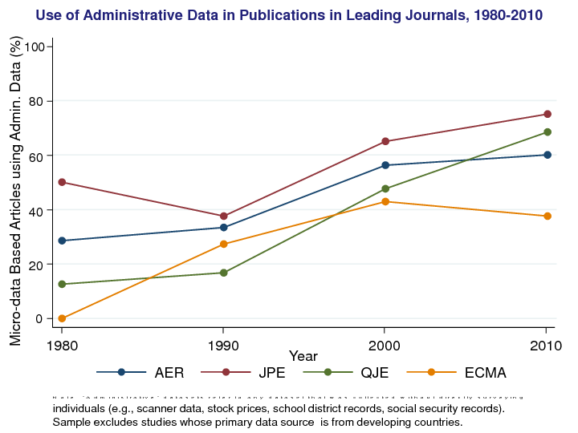

Slide 81
Progress in Economics

Slide 82
Increasing transparency in economics journals
Econometrica
“ the original raw data will, as a rule, be published, unless their volume is excessive”
1933

Slide 83
Increasing transparency in economics journals
Journal of Political Economy
“ Confirmations and Contradictions” Section
1976-1999

Slide 84
Increasing transparency in economics journals
Journal of Money, Credit & Banking
Data and Code requested upon submission
1982

Slide 85
Increasing transparency in economics journals
American Economic Association
Data and code availability policies
2005

Slide 86
Increasing transparency in economics journals
Promoting Transparency in Social Sciences Miguel et al (Science) 10.1126/science.1245317
2014
Greater transparency
Registration and pre-analysis plans
Open data and materials

Slide 87
Increasing transparency in economics journals
Quarterly Journal of Economics
Data and code availability policies

Slide 88
Explicit replication remains rare

Slide 89
How common is replication in economics?
0.1% of 126,505 “top 50” published articles 1974-2014 are replications – Mueller-Langer et al. (2018)
6.2% of 1,138 “top 10” development articles 2000-2015 were subjects of replications - Sukhtankar (2017)

Slide 90
Replications and Reproducibility Checks Remain Rare
No significant replication journal
ReplicationWiki identifies 44 “Comments” in the AER as “replications” of some sort, out of ~200*13 = 2600 articles (2004-2016) = 1.7%

Slide 91
Explicit replication remains rare
Or are they?

Slide 92
“Dark Web” of Replications
Personal communication: lots of micro, labor, macro Ph.D. classes have students run (successful) replications
Hamermesh (2007): papers that do not replicate do not get cited (… over time)
Projects (…) to provide replications (in the broad sense) by “swapping country”
(Do the results of Paper A – run on data from country B – work in country C)

Slide 93
Explicit Replications and Reproduction Attempts
Vary in how they assess the exercise
Replication or Reproducibility
Denominator: Data available, or all articles? Prevalence of restricted-access data!
Numerator: Partial or full reproduction/ replication? Who makes the assessment? How?
Quantity/ domain

Slide 94
Some key statistics

Slide 95
Some key statistics

Slide 96
Method

Slide 97

Cornell Replication Lab
2014 - 2018

Slide 98
Cornell Replication Lab
2014 - 2018
Economics
Comp Sci.
OpRe

Slide 99
Cornell Replication Lab
2014 - 2018
Economics
Comp Sci.
OpRe
Reproduction
VCS
Cloud Computing

Slide 100

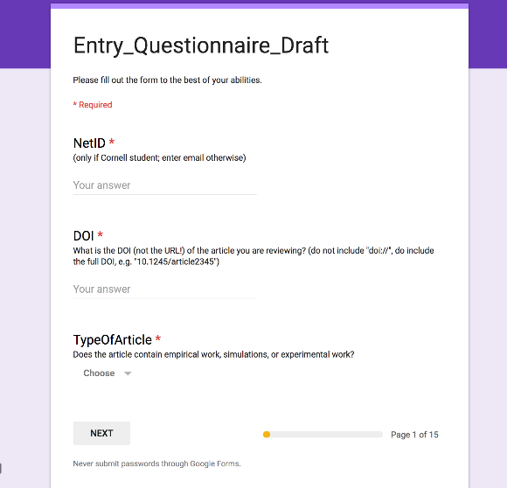
Method
Assessment Form

Slide 101

Method
Assessment Form
Reproduction Exercise

Slide 102

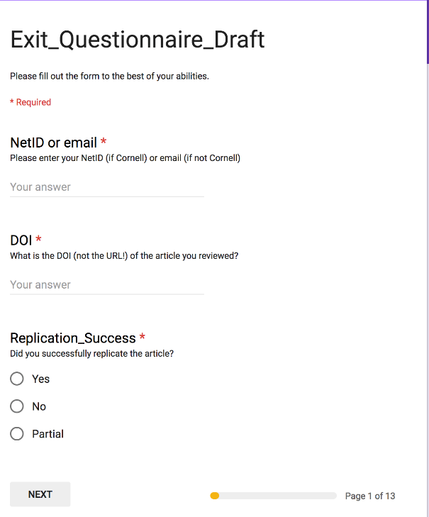
Method
Assessment Form
Reproduction Exercise
Exit Questionnaire

Slide 103
Replication continuum
Our Focus
08
Reproducibility
Replicability
Generalizability
Narrow Replication (Pesaran 2003)
Pure Replication (Hamermesh 2007)
Verification (Clemens 2015)
Wide Replication (Pesaran 2003)
Statistical Replication (Hamermesh 2007)
Reproduction/Reanalysis (Clemens 2015)
Wider Replication (Pesaran 2003)
Scientific Replication (Hamermesh 2007)
Reanalysis/Robustness (Clemens 2015)

Slide 104
Replication continuum
Same data | Same code | Same methods | Same context
08
08
08
Reproducibility
Replicability
Generalizability
Narrow Replication (Pesaran 2003)
Pure Replication (Hamermesh 2007)
Verification (Clemens 2015)
Wide Replication (Pesaran 2003)
Statistical Replication (Hamermesh 2007)
Reproduction/Reanalysis (Clemens 2015)
Wider Replication (Pesaran 2003)
Scientific Replication (Hamermesh 2007)
Reanalysis/Robustness (Clemens 2015)

Slide 105
Results?

Slide 106
Some key statistics
Study | Year | N | Success | Type | Type-R | Type-Data | Percent | Field
Dewald Thursby Anderson | 1986 | 54 | 2 | Complete | Reproducibility | Avail | 4% | Economics
Dewald Thursby Anderson | 1986 | 54 | 7 | Partial | Reproducibility | Avail | 13% | Economics
McCullough McGeary Harrison | 2006 | 186 | 14 | Complete | Reproducibility | All | 8% | Economics
McCullough McGeary Harrison | 2006 | 62 | 14 | Complete | Reproducibility | Avail | 23% | Economics
Nosek et al | 2015 | 100 | 36 | Complete | Replication |  | 36% | Psychology
Camerer et al | 2016 | 18 | 11 | Complete | Replication |  | 61% | Experimental Econ
Chang Li | 2017 | 67 | 22 | Complete | Reproducibility | Avail | 33% | Macroeconomics
Kingi et al | 2018 | 274 | 69 | Complete | Reproducibility | All | 25% | Economics
Kingi et al | 2018 | 162 | 69 | Complete | Reproducibility | Avail | 43% | Economics
Kingi et al | 2018 | 162 | 137 | Partial | Reproducibility | Avail | 85% | Economics
Kingi et al numbers are preliminary. Do not cite or quote.

Slide 107
Current efforts at the AEA

Slide 108
Current efforts at the AEA
Provide more transparency
To assist replication efforts
By better linking to paper-related resources (data, code, registration, etc.)
Pre-emptively improve code archives
By conducting reproducibility checks
By working with groups that conduct reproducibility checks
Better archives
Greater transparency of the code and data archives

Slide 109
AEA “Data Availability Policy” (2018)
It is the policy of the American Economic Association to publish papers only if the data used in the analysis are clearly and precisely documented and are readily available to any researcher for purposes of replication.
Authors of accepted papers that contain empirical work, simulations, or experimental work must provide, prior to publication, the data, programs, and other details of the computations sufficient to permit replication. These will be posted on the AEA website. The Editor should be notified at the time of submission if the data used in a paper are proprietary or if, for some other reason, the requirements above cannot be met.

Slide 110
AEA “Data Availability Policy” (2019)
It is the policy of the American Economic Association to publish papers only if the data used in the analysis are clearly and precisely documented and are readily available to any researcher for purposes of replication.
Authors of accepted papers that contain empirical work, simulations, or experimental work must provide, prior to publication, the data, programs, and other details of the computations sufficient to permit replication. These will be posted on the AEA website. The Editor should be notified at the time of submission if the data used in a paper are proprietary or if, for some other reason, the requirements above cannot be met.

Slide 111
Results?

Slide 112
Results?

Slide 113
From Post- to Pre-Publication Verification
Cornell Replication Lab has been verifying published articles
Now switching to manuscripts in the submission workflow
For now pilot
Authors have submitted prior to announcement of new data policy

Slide 114
Email during pilot phase
Dear [AUTHOR]: I am writing about your paper [MC ID]. I am ready to give you a "conditional accept" on the paper. The condition is simply to work with the AEA's data co-editor, Lars Vilhuber (copied on this email), to prepare the data and code for publication. The data is an important contribution of the paper. He is copied on this email. Thank you for submitting your work. I am looking forward to seeing the paper in print.

Slide 115
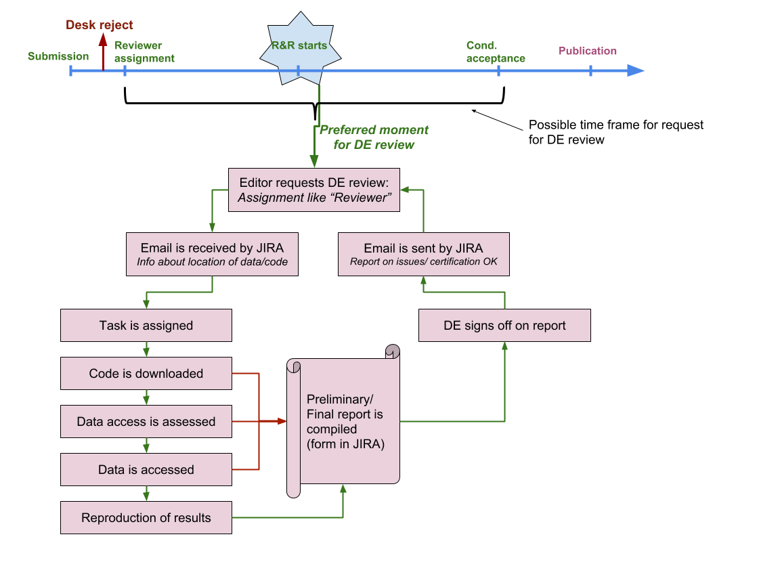

Slide 116
New AEA Data and Code Availability Policy
Dear [AUTHOR]: I am writing about your paper [MC ID]. I am ready to give you a "conditional accept" on the paper. The condition is simply to work with the AEA's data co-editor, Lars Vilhuber (copied on this email), to prepare the data and code for publication. The data is an important contribution of the paper. Thank you for submitting your work. I am looking forward to seeing the paper in print.

Slide 117
New AEA Data and Code Availability Policy
Dear [AUTHOR]: I am writing about your paper [MC ID]. I have received two referee reports, which you will find attached. We would like you to revise and resubmit your paper. […] As you revise the paper, please also work with the AEA's data co-editor, Lars Vilhuber (copied on this email), to document and verify the reproducibility of the data and code. The data is an important contribution of the paper. Thank you for submitting your work. I am looking forward to seeing the revised paper.

Slide 118
Goal: earlier provision of data and code
“Arguably, the replication files should be submitted when the paper is initially submitted so that they will be available for inspection by the referees, if the referees so desire.”
(McCullough et al, 2006)

Slide 119
More and easier data deposit
More integration into Journal Workflows
AJPS + Dataverse
QJE, Restat (both Harvard…) + Dataverse
Data deposit occurring during submission

Slide 120
At the AEA…
We will create a journal-specific repository for AEA journals
Open for deposit 2019 Q1
We will migrate all historical supplements to the archive
Explode the ZIP files: greater transparency

Slide 121
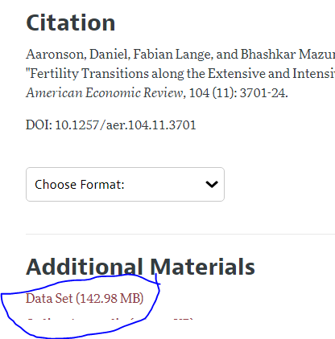
Moving from this:

Slide 122
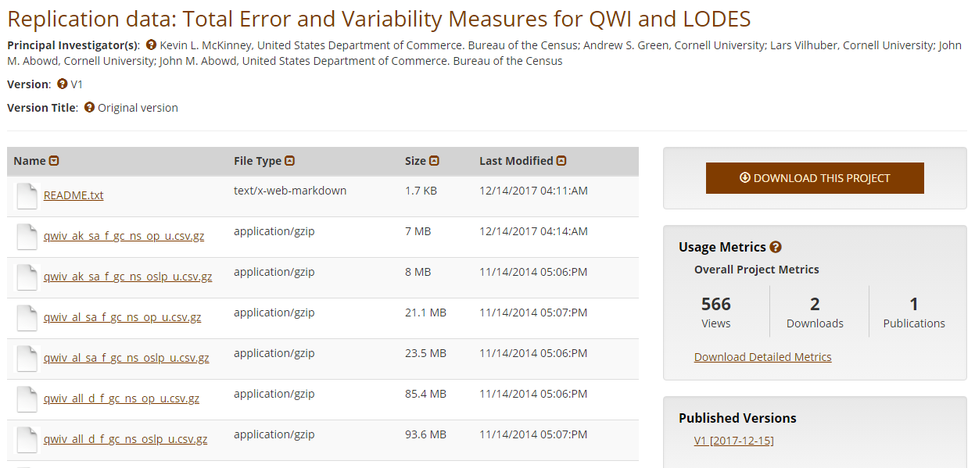
… to this

Slide 123
... complete history…
All 2672 archives (as of June 2018)
All 171 GB (only?)
Browsable interface
Searchable interface

Slide 124
And then we’ll kill it

Slide 125
Let me explain…

Slide 126
Remember this figure?

Slide 127
Assessing accessibility
Chetty’s assessment was entirely manual
Download the article
Read what kind of data is used
And yet does not provide information such as
Who can access?
How long can you access?
Characteristics of the data
… and not for want of trying, but because that information is not required and not provided

Slide 128
From earlier examples
Costly access but good intentions:
“researchers could submit programs that [...] research assistants would run. Alternatively, researchers wishing to work directly with the data could come and work on the Institute's premises.” Autor/Houseman doi:10.1257/app.2.3.96
Uncertain access
“Data [...] is proprietary and owned by the Alachua County, Florida School District. The corresponding author [...] holds the deidentified dataset [...] and will provide copies to authors who receive written permission from the Alachua County Public Schools.”

Slide 129
Current Data Availability Policies are Broken
If the Data is not open-access, no systematic information is collected (“exemption”)

Slide 130
Current Data Availability Policies are Broken
If the Data is not open-access, even if the Data Owner has already deposited it

Slide 131
Current Data Availability Policies are Broken
If the Data is open-access, you are asked to deposit the data in the “journal repository” even if the Data Owner has already deposited it

Slide 132
Current Data Availability Policies are Broken
If the Data is open-access, you are asked to deposit the data in the “journal repository” even if you have followed best practices and have already deposited it

Slide 133
Illustration
If you used the ACS, should you deposit it again?

Slide 134
Illustration
If you used the LEHD, has the Census Bureau not already archived it?

Slide 135
Illustration
If you used the LEHD, CRDCN files, Danish data can others not access it?

Slide 136
Illustration
If you used files at the National Archives, would we ask you to “deposit” them?

Slide 137
Best practices
Deposit and archive early
If you collect data, archive it (possibly privately)
If you finish the manuscript, deposit the analysis files (possibly privately)

Slide 138
Best practices
Follow robust coding
Ensure that code reliably produces results (possibly automated)
Before you finish the manuscript, run all analysis code again (if not too onerous)

Slide 139
Evolving Journal and Data Infrastructure
More self-deposit repositories in the social sciences
Dataverse
Figshare
openICPSR
Zenodo
Qualitative Data Repository (QDR)
Others…

Slide 140
Evolving Journal and Data Infrastructure
Use them!

Slide 141
Challenges?

Slide 142
Verifying Data and Code Deposits
Why do journals like affiliated repositories (or website deposits)?
They can ensure longevity/ persistence
They can ensure access
They can ensure availability

Slide 143
Verifying Data and Code Deposits
Not every data repository is created equal
Github, Dropbox, etc. are not data or code repositories
Is the institutional repository at the University of Southern Venezuela a reliable repository?
Is the institutional repository at Cornell University a reliable repository?
Is the institutional repository at Harvard University (Dataverse!) a reliable repository?
Are the National Archives a reliable repository?

Slide 144
Verifying Data and Code Deposits
Not every data repository is created equal
The Second Bank of Third City credit card data is not a data/code repository
Is the School Board of Third City a reliable repository?
Is the JPMC Institute a reliable repository?
Is the US Census Bureau a reliable repository?
Are any restriced-access repositories a reliable repository?

Slide 145
The goal at the AEA
Ensure reproducibility of computational code
Encourage best practices
Not require double-work
If you have deposited your work (in a reliable location), leave it there
If you have had your code verified (by a reliable third party), we will accept that

Slide 146
Future efforts
AEA, Social Sciences, elsewhere

Slide 147
Better support for researchers
Training in methods (with various centers, institutions, etc.)
For current researchers
For integration into curriculums
Tools to streamline the process
A few technical things (not described here)
Coordinate among journals (no duplicate effort)
Awareness
Consider badges/ certification
Address issues with confidential data

Slide 148
Confidential data
Highlight where confidential data already require replicability
IAB
Remote processing servers (Canada, NCHS, Australia, etc.)
Work with Research Data Centers to facilitate transparency and reproducibility
Training (secure programming guidelines)
Standardize archives within RDCs + transparency

Slide 149
Pre-registration

Slide 150
Preregistration

Slide 151
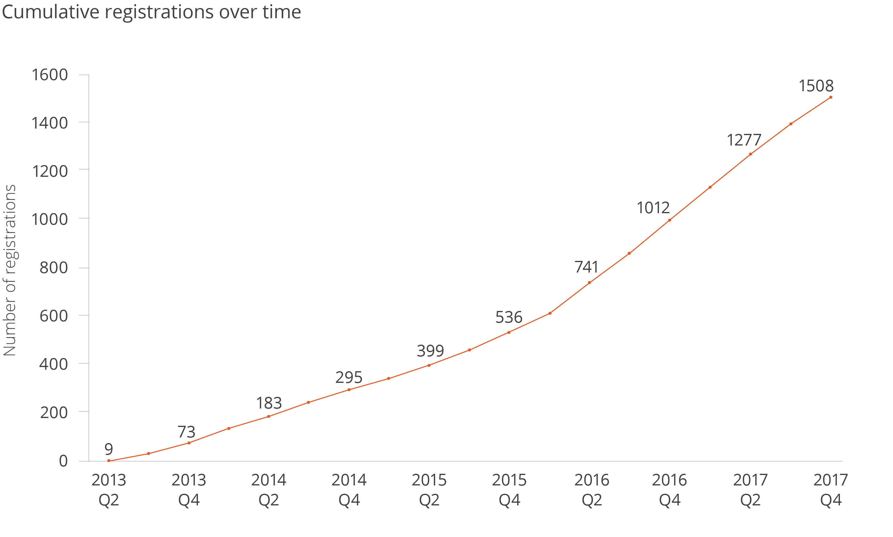
Registrations at the AEA Registry

Slide 152
Plans at the AEA
Integrate registrations more robustly
Cite through DOI
Link more robustly (not just citation!)
Highlight through badges?

Slide 153

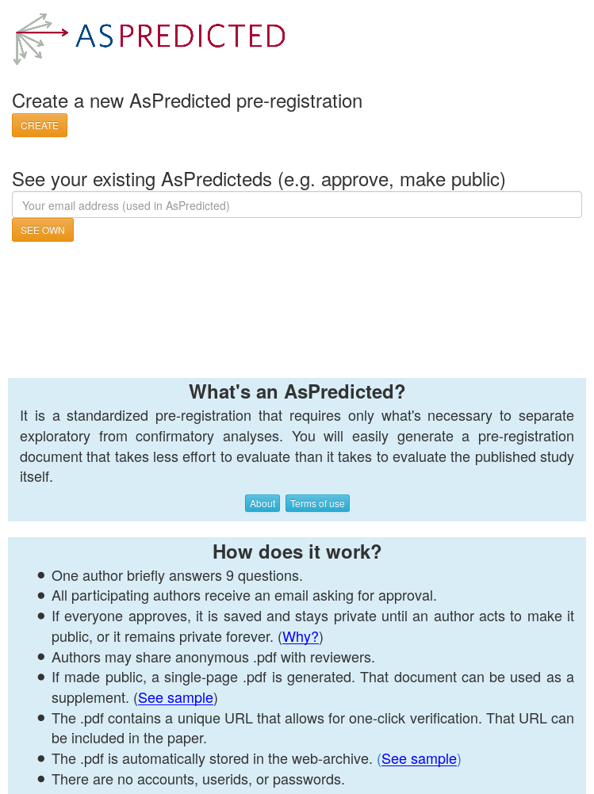
Plans at the AEA
Not just the AEA Registry
OSF registrations
Int’l Initiative for Impact Evaluation (3ie)’s RIDIE registry
Evidence in Governance And Politics (EGAP)’s registry
As-Predicted

Slide 154
Ensuring scalable reproducibility

Slide 155
Scalability and sustainability

Slide 156
Scalability of Verification
500+ articles per year at AEA (not all have code or data)
Financing:
$100 submission fee minus $100 per referee report (x2)
Undergraduate student (~$15/h) spends 10-20 hours on most verifications (would be far less if automated) = $200 extra
Most journals are run at a loss (but maybe Elsevier has the funds…)

Slide 157
Scalability of Verification
Third party verification services already exist!
For research institutes and groupings (J-PAL, NBER, etc.)
At universities (Cornell, etc.)
Because authors already do it
Even at restricted-access centers
Explicitly: France
Implicitly: German IAB data, other restricted-access data (remote processing at NCHS, Statistics Canada)
Interest in other institutions (including Census Bureau)

Slide 158
Scalability of Verification
Third party verification
How to fund
similar to open-access submission fees?
Requirement by funders?
How to certify third-party certifiers?
How reliable is their service? What do they check?
Who certifies? (Association of Data Editors?)
These are open questions
They need to be solved for persistence of the effort

Slide 159
Linking objects (data, programs), articles and researchers
Reminder: currently a very manual process
Only really works if the article cites the data
Infrastructure starting to emerge
If article cites data (DOI!)
If archive and/or journal leverages infrastructure

Slide 160
AEA: improve transparency of all data deposits
Developed a schema to collect relevant information
Relies as much as possible on lookups of existing data
Collects only as much information as necessary
Replaces existing documentation efforts
Can be done early in research workflow

Slide 161
AEA: improve transparency of all data deposits
Developed a schema to collect relevant information
Uniformly applied to public-use and restricted-access data
Can be added at low-cost to existing journal websites
Can be data-mined

Slide 162
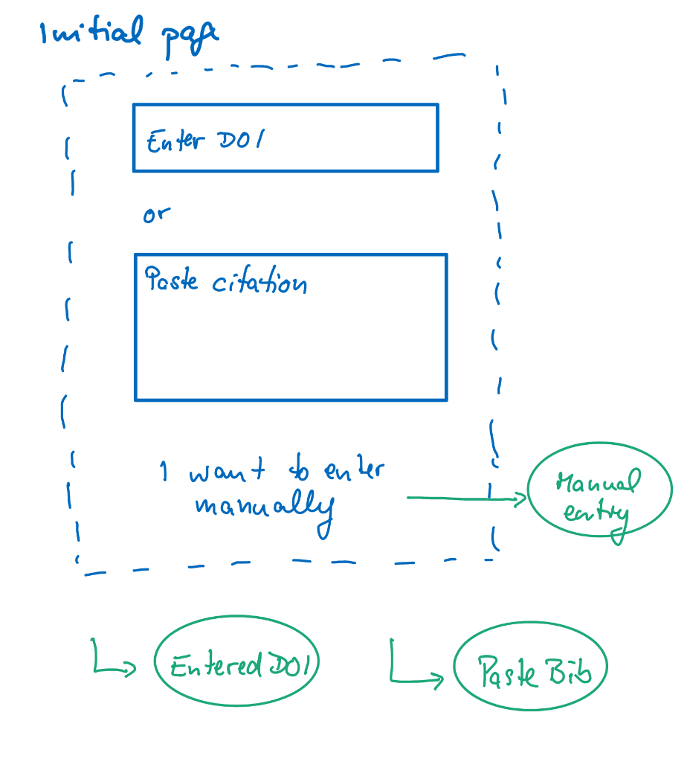
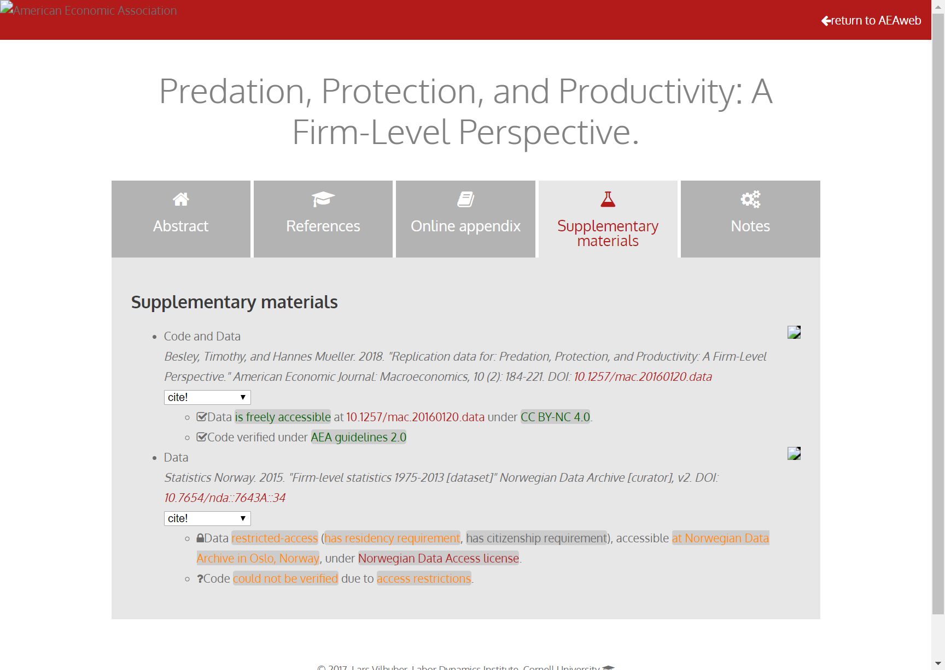
Richer metadata, more transparency

Slide 163
Richer metadata, more transparency

Slide 164
New problem: Licensing of code and data
Do you know what license your journal supplements are under?

Slide 165
Really brief licensing primer
Software licenses:
Copyright
protecting yourself from being held liable
US: copyright is automatic
if you don’t choose a license for your software, no one else can use it!
Journals: Usually acquire copyright
Most likely, you also assigned the copyright to the supplement to the journal!
Source: http://kbroman.org/steps2rr/pages/licenses.html

Slide 166
Did you know?
The AEA acquired the copyright to the supplements when you assigned the article copyright
The AEA did not grant a default license
Thus, all replication and reproduction attempts are infringing on the AEA’s copyright!
We’re fixing that…

Slide 167
Best practices in licensing
Data: Creative Commons Attribution (CC-BY) and variants
Non-commercial (NC)
Share-alike (SA)
Code: various Open Source licenses
GPL: GNU Public License (restrictive)
MIT or (modified) BSD license (less restrictive)

Slide 168
Other initiatives

Slide 169



Center for Open Science Badges
https://cos.io/our-services/open-science-badges/; 53 adopting journals (18 as of 2017)
Kidwell et al., 2016
Notes:
Badges
Open Data
Open Materials
Preregistration
Psychological Science (Jan 2014)

Slide 170
40%
30%
% Articles reporting data available in repository
20%
10%
0%

Slide 171
Signals? Badges? Transparency!
Positives:
Give credit for previously invisible activities
Can be assessed quickly
Negatives:
Need to be known in order to be effective
May bias outcomes!
Require effort for verification?

Slide 172
Example: COS disclosures
Open Data: Authors complete two disclosure items for each Open Data badge application:
Provide the URL, DOI, or other permanent path for accessing the data in a public, open access repository.
How do I know it is open access? Verify!
How do I know the data is permanent? Verify?
What do I do when access is possible, but not open access?

Slide 173
Example: COS disclosures
Open Data: Authors complete two disclosure items for each Open Data badge application:
Is there sufficient information for an independent researcher to reproduce the reported results? If no, explain.
All researchers claim the information is sufficient -> our results

Slide 174
Example: COS disclosures
Open Materials: Authors complete two disclosure items for each Open Materials badge application:
Provide the URL, DOI, or other permanent path for accessing the materials in a public, open access repository.
Is there sufficient information for an independent researcher to reproduce the reported methodology? If no, explain.
Similar concerns as before

Slide 175
Registered Reports

Slide 176
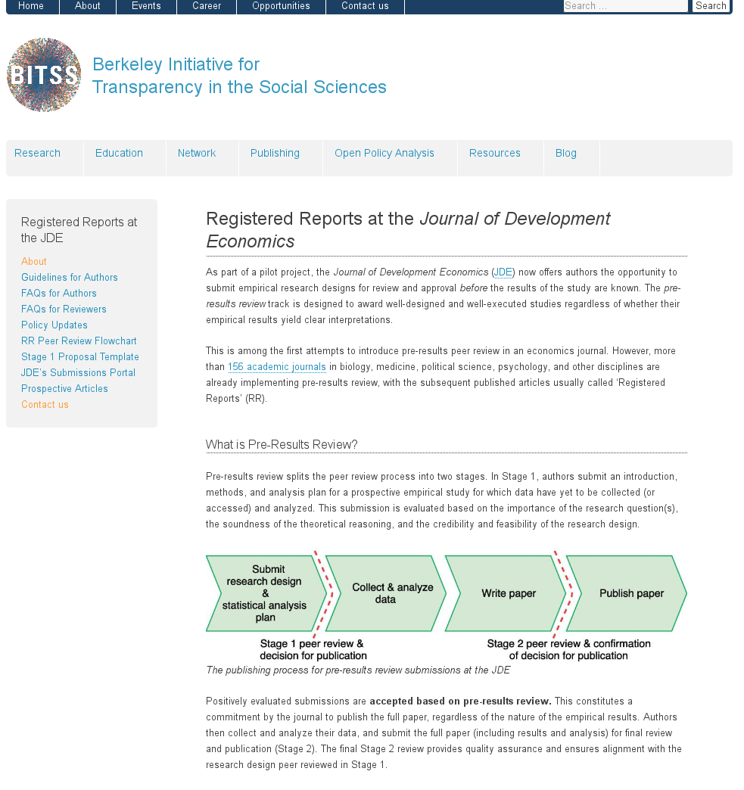
Registered Reports

Slide 177
Registered Reports

Slide 178
Your turn!

Slide 179
What will you be doing going forward?
Who has shared code and data?
Who has done so when not required?
Pre-registration

Slide 180
Sharing of code and data is coming
Are you ready?

Slide 181
It is good practice
Hamermesh (2007) already said:
“the payoff is in the influence of one’s ideas: having other scholars base their work on those ideas, having students learn from them, and […] having public policy influenced by them […] our ideas are unlikely to be taken seriously if our empirical research is not credible”

Slide 182
Students and Faculty: New skills to learn
How to incorporate reproducible practices into your workflow
How to structure your code and your data with an eye on reproducibility
How and when to deposit your code and data
How to license your contributions!
When to pre-register, and when not to
Document early, and often

Slide 183
An example: These presentations
Archive: 10.5281/zenodo.2573123
Live: https://github.com/labordynamicsinstitute/replicability-presentation2019

Slide 184
Another (simple) example
Archive: https://doi.org/10.5281/zenodo.400356
Live: https://github.com/larsvilhuber/jobcreationblog
Note: If you tried this now, it would fail…. because the Census Bureau doesn’t maintain complete archives of its data products…

Slide 185
Faculty: New skills to teach
How to incorporate reproducible practices into your workflow
How to structure your code and your data with an eye on reproducibility
How to license your contributions!
When to pre-register, and when not to
Document early, and often

Slide 186
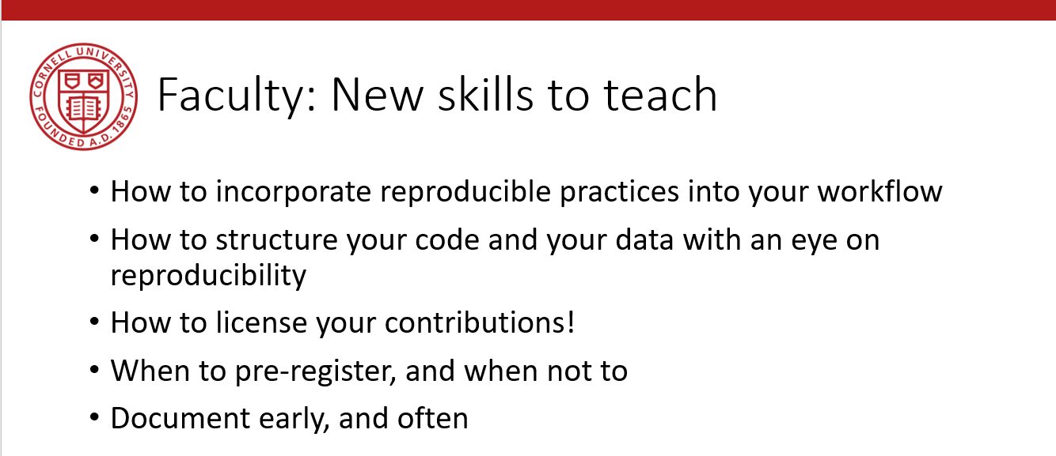
Faculty: New skills to teach
Need to be taught at undergraduate level
Need to be taught at the graduate level

Slide 187
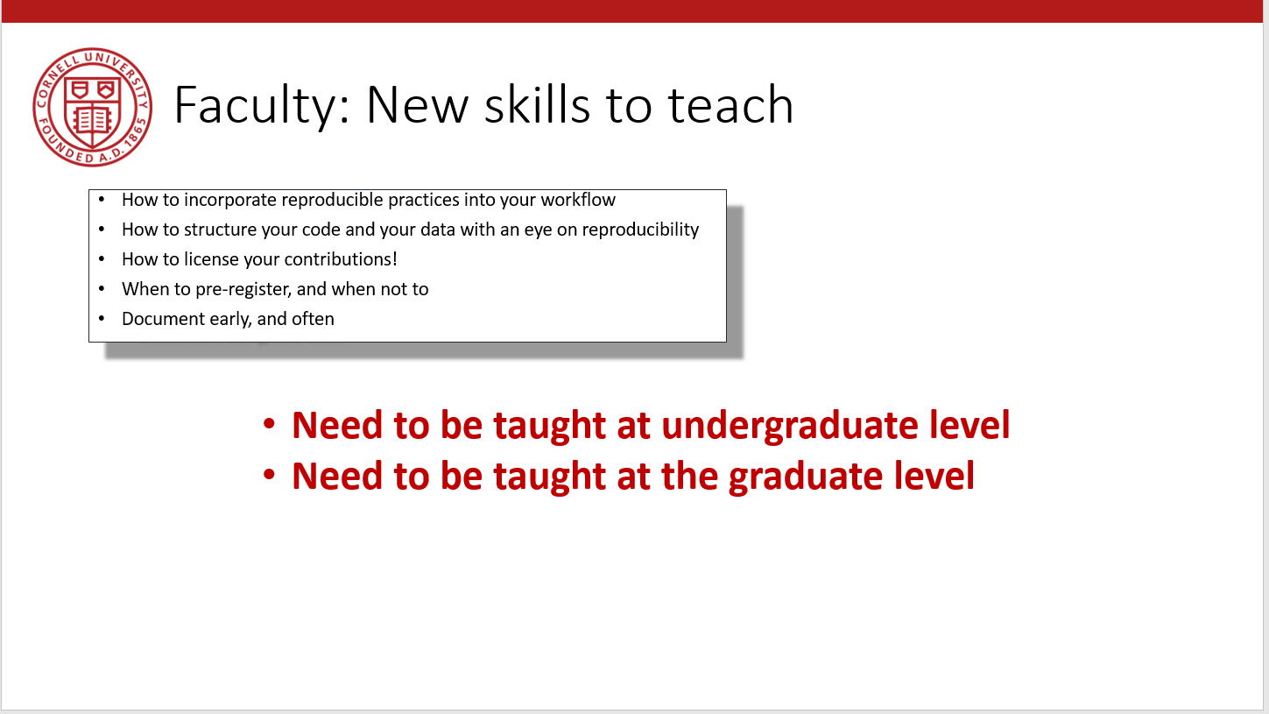
University: New support infrastructure
New courses?
New curricula?
New/expanded support services on campus:
Pre-submission verification
Institutional repositories (expanded or outsourced)
Professional data curation

Slide 189
Details of new data and code availability policy

Slide 190
Policy A.2 | Policy B
Data Availability Policy | Data and Code Availability Policy
It is the policy of the American Economic Association to publish papers only if | It is the policy of the American Economic Association to publish papers only if
the data used in the analysis are clearly and precisely documented | the data and code used in the analysis are clearly and precisely documented;
and are readily available to any researcher for purposes of replication. | access to the data and code is clearly and precisely documented, and is non-exclusive to the authors.
Authors of accepted papers that contain empirical work, simulations, or experimental work must provide, | Authors of accepted papers that contain empirical work, simulations, or experimental work must provide,
prior to publication, | prior to acceptance,
the data, programs, and other details of the computations sufficient to permit replication. | information about the data, programs, and other details of the computations sufficient to permit replication, as well as information about access to data and programs.
These will be posted on the AEA Data and Code Repository at TBD. | Data and programs should be archived in community-recognized or general repositories, including the AEA Data and Code Repository at TBD.
 | Authors will provide access to editors and reviewers, if requested, to both data and programs prior to acceptance.
The Editor should be notified at the time of submission if the data used in a paper are proprietary or if, for some other reason, the requirements above cannot be met. | The Editor should be notified at the time of submission if access to the data used in a paper is restricted or limited, or if, for some other reason, the requirements above cannot be met.
The AEA Data Editor will assess compliance with this policy. | The AEA Data Editor will assess compliance with this policy,
 | and will verify the accuracy of the information prior to acceptance by the Editor.
 | A statement describing compliance with this policy will be posted alongside the article.

Slide 191
Policy A.2 | Policy B
Data Availability Policy | Data and Code Availability Policy
It is the policy of the American Economic Association to publish papers only if | It is the policy of the American Economic Association to publish papers only if
the data used in the analysis are clearly and precisely documented | the data and code used in the analysis are clearly and precisely documented;
and are readily available to any researcher for purposes of replication. | access to the data and code is clearly and precisely documented, and is non-exclusive to the authors.
Authors of accepted papers that contain empirical work, simulations, or experimental work must provide, | Authors of accepted papers that contain empirical work, simulations, or experimental work must provide,
prior to publication, | prior to acceptance,
the data, programs, and other details of the computations sufficient to permit replication. | information about the data, programs, and other details of the computations sufficient to permit replication, as well as information about access to data and programs.
These will be posted on the AEA Data and Code Repository at TBD. | Data and programs should be archived in community-recognized or general repositories, including the AEA Data and Code Repository at TBD.
 | Authors will provide access to editors and reviewers, if requested, to both data and programs prior to acceptance.
The Editor should be notified at the time of submission if the data used in a paper are proprietary or if, for some other reason, the requirements above cannot be met. | The Editor should be notified at the time of submission if access to the data used in a paper is restricted or limited, or if, for some other reason, the requirements above cannot be met.
The AEA Data Editor will assess compliance with this policy. | The AEA Data Editor will assess compliance with this policy,
 | and will verify the accuracy of the information prior to acceptance by the Editor.
 | A statement describing compliance with this policy will be posted alongside the article.

Slide 192
Policy A.2 | Policy B
Data Availability Policy | Data and Code Availability Policy
It is the policy of the American Economic Association to publish papers only if | It is the policy of the American Economic Association to publish papers only if
the data used in the analysis are clearly and precisely documented | the data and code used in the analysis are clearly and precisely documented;
and are readily available to any researcher for purposes of replication. | access to the data and code is clearly and precisely documented, and is non-exclusive to the authors.
Authors of accepted papers that contain empirical work, simulations, or experimental work must provide, | Authors of accepted papers that contain empirical work, simulations, or experimental work must provide,
prior to publication, | prior to acceptance,
the data, programs, and other details of the computations sufficient to permit replication. | information about the data, programs, and other details of the computations sufficient to permit replication, as well as information about access to data and programs.
These will be posted on the AEA Data and Code Repository at TBD. | Data and programs should be archived in community-recognized or general repositories, including the AEA Data and Code Repository at TBD.
 | Authors will provide access to editors and reviewers, if requested, to both data and programs prior to acceptance.
The Editor should be notified at the time of submission if the data used in a paper are proprietary or if, for some other reason, the requirements above cannot be met. | The Editor should be notified at the time of submission if access to the data used in a paper is restricted or limited, or if, for some other reason, the requirements above cannot be met.
The AEA Data Editor will assess compliance with this policy. | The AEA Data Editor will assess compliance with this policy,
 | and will verify the accuracy of the information prior to acceptance by the Editor.
 | A statement describing compliance with this policy will be posted alongside the article.

Slide 193
DOI and metadata

Slide 194
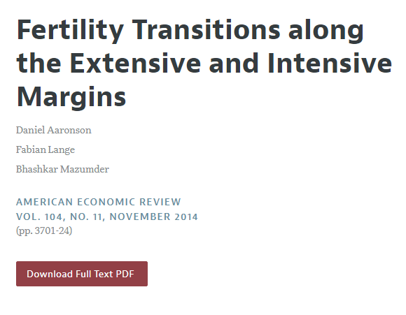
Digital Object Identifier (DOI)

Slide 195
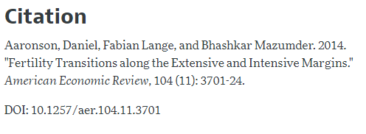
Digital Object Identifier (DOI)

Slide 196
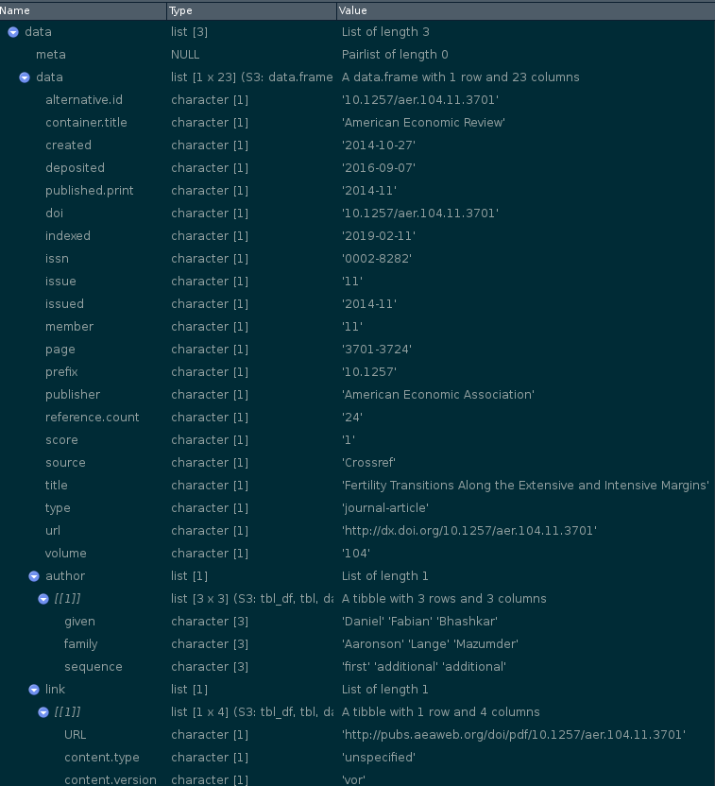
Digital Object Identifier (DOI)

Slide 197
Digital Object Identifier (DOI)
Registries handle DOI (e.g. 10.1257/aer.104.11.3701)
Key information: the link (https://www.aeaweb.org/articles?id=10.1257/aer.104.11.3701 )
Additional information:
Required Elements
Article: titles, publication_date (year), doi_data
Recommended Elements
Article: contributors, ORCIDs, publication_date (day, month), pages (first_page, last_page), citation_list
also strongly recommended: funding, license,

