Slide 1
Replication and Reproducibility in Social Sciences and Statistics: Context, Concerns, and Concrete Measures
Lars Vilhuber
Cornell University
Partial funding acknowledged under NSF-#1131848 (NCRN) and a grant from the Alfred P. Sloan Foundation. The opinions expressed in this talk are solely the authors, and do not represent the views of the U.S. Census Bureau, the American Economic Association, or any of the funding agencies.

Slide 2
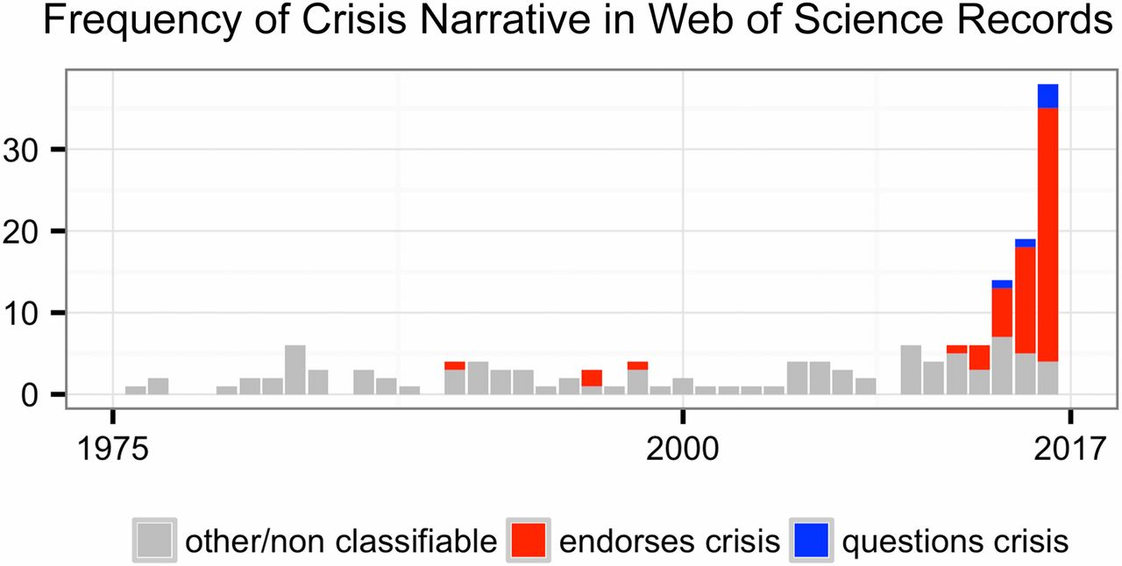
This reproducibility crisis thing….
https://doi.org/10.1073/pnas.1708272114
Notes:
Number of Web of Science records that in the title, abstract, or keywords contain one of the following phrases: “reproducibility crisis,” “scientific crisis,” “science in crisis,” “crisis in science,” “replication crisis,” “replicability crisis.” Records were classified by the author according to whether, based on title and abstracts, they implicitly or explicitly endorsed the crisis narrative described in the text (red), or alternatively questioned the existence of such a crisis (blue), or discussed “scientific crises” of other kinds or could not be classified due to insufficient information (gray).

Slide 3
The “crisis” in the 60s and 70s Sterling, 1959; Cohen, 1962; Lykken, 1968; Tukey, 1969; Greenwald, 1975; Meehl, 1978; Rosenthal, 1979
Low power
Flexibility in analysis
Selective reporting
Ignoring nulls
Lack of replication
Misuse of statistics
Source: Nosek Sackler talk 2017
Notes:
Source: Nosek, NAS.Sackler.2017.03.10
Examples from:
Button et al – Neuroscience
Ioannidis – why most results are false (Medicine)
GWAS
Biology
Two possibilities are that the percentage of positive results is inflated because negative results are much less likely to be published, and that we are pursuing our analysis freedoms to produce positive results that are not really there. These would lead to an inflation of false-positive results in the published literature.
Some evidence from bio-medical research suggests that this is occurring. Two different industrial laboratories attempted to replicate 40 or 50 basic science studies that showed positive evidence for markers for new cancer treatments or other issues in medicine. They did not select at random. Instead, they picked studies considered landmark findings. The success rates for replication were about 25% in one study and about 10% in the other. Further, some of the findings they could not replicate had spurred large literatures of hundreds of articles following up on the finding and its implications, but never having tested whether the evidence for the original finding was solid. This is a massive waste of resources.
Across the sciences, evidence like this has spurred lots of discussion and proposed actions to improve research efficiency and avoid the massive waste of resources linked to erroneous results getting in and staying in the literature, and about the culture of scientific practices that is rewarding publishing, perhaps at the expense of knowledge building. There have been a variety of suggestions for what to do. For example, the Nature article on the right suggests that publishing standards should be increased for basic science research.
[It is not in my interest to replicate – myself or others – to evaluate validity and improve precision in effect estimates (redundant). Replication is worth next to zero (Makel data on published replications; motivated to not call it replication; novelty is supreme – zero “error checking”; not in my interest to check my work, and not in your interest to check my work (let’s just each do our own thing and get rewarded for that)
Irreproducible results will get in and stay in the literature (examples from bio-med). Prinz and Begley articles (make sure to summarize accurately)
The Nature article by folks in bio-medicine is great. The solution they offer is a popular one in commentators from the other sciences -- raise publishing standards.

Slide 4
Efficiency of scholary discourse?
Early publications (20th century) contained tables of data, and the math was simple (maybe)
Data became electronic, was no longer included or cited
Math was transcribed to code, and was no longer included

Slide 5
Efficiency of scholary discourse!
Modern publications thus need the same transparency and completeness as in the old days
to facilitate replicability

Slide 6
Progress

Slide 7

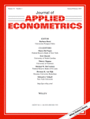


Progress
Replication archives and Data (Code) Availability policies

Slide 8
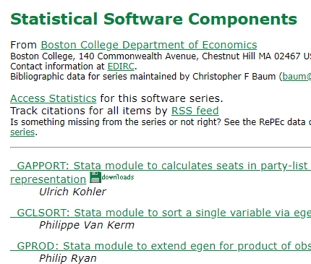

Progress
Replication archives and Data (Code) Availability policies
Shared open source software

Slide 9

Progress
Replication archives and Data (Code) Availability policies
Shared open source software
Better public-use and shared data
FSRDC
CASD
IAB

Slide 10


Progress
Replication archives and Data (Code) Availability policies
Shared open source software
Better public-use and shared data
Better ways of accessing preprints/ grey literature

Slide 11

Progress
Replication archives and Data (Code) Availability policies
Shared open source software
Better public-use and shared data
Better ways of accessing preprints/ grey literature
Pre-registration of trials, experiments, and analyses
It’s registered
Osf.io

Slide 12
Definition

Slide 13
Replication continuum
Same data | Same code | Same methods | Same context
08
Reproducibility
Narrow Replication (Pesaran 2003)
Pure Replication (Hamermesh 2007)
Verification (Clemens 2015)

Slide 14
Replication continuum
Same data | Different code | Same methods | Same context
 | or software
08
08
Reproducibility
Replicability
Narrow Replication (Pesaran 2003)
Pure Replication (Hamermesh 2007)
Verification (Clemens 2015)
Wide Replication (Pesaran 2003)
Statistical Replication (Hamermesh 2007)
Reproduction/Reanalysis (Clemens 2015)

Slide 15
Replication continuum
New data | Same code | Same methods | Same context
collection
08
08
Reproducibility
Replicability
Narrow Replication (Pesaran 2003)
Pure Replication (Hamermesh 2007)
Verification (Clemens 2015)
Wide Replication (Pesaran 2003)
Statistical Replication (Hamermesh 2007)
Reproduction/Reanalysis (Clemens 2015)

Slide 16
Replication continuum
Different data | Different code | Different | Different
 | or software | methods | context or
 |  |  | country
08
08
08
Reproducibility
Replicability
Generalizability
Narrow Replication (Pesaran 2003)
Pure Replication (Hamermesh 2007)
Verification (Clemens 2015)
Wide Replication (Pesaran 2003)
Statistical Replication (Hamermesh 2007)
Reproduction/Reanalysis (Clemens 2015)
Wider Replication (Pesaran 2003)
Scientific Replication (Hamermesh 2007)
Reanalysis/Robustness (Clemens 2015)

Slide 17
More recently…

Slide 18
Second round (2012-)
Greater enforcement of data (and code) availability
2015, AJ Political Science
2016, Data Editor for ASA Software Section
2016, Statistical review added Science
2017: AEA appoints Data Editor, with mandate to do similar activities

Slide 19
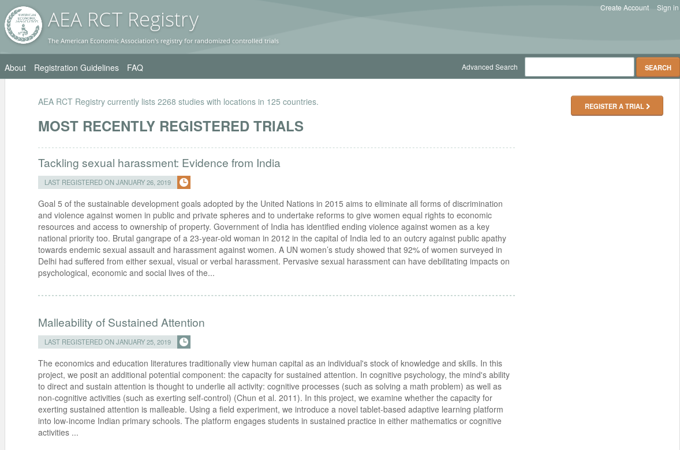
Preregistration
AEA RCT Registry (2011)

Slide 20
Pre-registration
The American Economic Association operates a registry for Randomized Controlled Trials (RCTs).
Registration of RCTs is required for all applicable submissions.
If the research in your paper involves an RCT, please register …
following information: PI name, project title, study location, project status, keyword(s), abstract, trial start and end dates, intervention start and end dates, proposed outcome(s), experimental design, whether the treatment is clustered, planned number of clusters, planned number of observations, and IRB information.

Slide 21
Pre-registration
“That information is especially helpful in research that emphasizes null hypothesis significance testing.
A thorough preregistration promotes transparency and openness and protects researchers from suspicions of p-hacking.”
https://www.psychologicalscience.org/publications/psychological_science/preregistration

Slide 22

Registered Reports
https://cos.io/rr
Chambers (2014)
Nosek & Lakens (2014)
Close cousin: Results-blind review

Slide 23


Preprints in other sciences
bioRxiv (2013)
PsyArXiv (2016)

Slide 24
Paluck (2018) https://osf.io/kvbnh/

Slide 25
Replicability of articles

Slide 26
Issues

Slide 27
Replication continuum
Same data | Same code | Same methods | Same context
08
08
08
Reproducibility
Replicability
Generalizability
Narrow Replication (Pesaran 2003)
Pure Replication (Hamermesh 2007)
Verification (Clemens 2015)
Wide Replication (Pesaran 2003)
Statistical Replication (Hamermesh 2007)
Reproduction/Reanalysis (Clemens 2015)
Wider Replication (Pesaran 2003)
Scientific Replication (Hamermesh 2007)
Reanalysis/Robustness (Clemens 2015)

Slide 28
Results?

Slide 29
Some key statistics
Study | Year | N | Success | Type | Type-R | Type-Data | Percent | Field
Dewald Thursby Anderson | 1986 | 54 | 2 | Complete | Reproducibility | Avail | 4% | Economics
Dewald Thursby Anderson | 1986 | 54 | 7 | Partial | Reproducibility | Avail | 13% | Economics
McCullough McGeary Harrison | 2006 | 186 | 14 | Complete | Reproducibility | All | 8% | Economics
McCullough McGeary Harrison | 2006 | 62 | 14 | Complete | Reproducibility | Avail | 23% | Economics
Nosek et al | 2015 | 100 | 36 | Complete | Replication |  | 36% | Psychology
Camerer et al | 2016 | 18 | 11 | Complete | Replication |  | 61% | Experimental Econ
Chang Li | 2017 | 67 | 22 | Complete | Reproducibility | Avail | 33% | Macroeconomics
Kingi et al | 2018 | 274 | 69 | Complete | Reproducibility | All | 25% | Economics
Kingi et al | 2018 | 162 | 69 | Complete | Reproducibility | Avail | 43% | Economics
Kingi et al | 2018 | 162 | 137 | Partial | Reproducibility | Avail | 85% | Economics
Kingi et al numbers are preliminary. Do not cite or quote.

Slide 30
Not enough articles are reproducible

Slide 31
Current Data Availability Policies are Broken
If the Data is not open-access, no systematic information is collected (“exemption”)

Slide 32
Not enough data is “accessible”

Slide 33
Current efforts at the AEA

Slide 34
Current efforts at the AEA
Provide more transparency
To assist replication efforts
By better linking to paper-related resources (data, code, registration, etc.)
Pre-emptively improve code archives
By conducting reproducibility checks
By working with groups that conduct reproducibility checks
Better archives
Greater transparency of the code and data archives

Slide 35
AEA “Data Availability Policy” (2018)
It is the policy of the American Economic Association to publish papers only if the data used in the analysis are clearly and precisely documented and are readily available to any researcher for purposes of replication.
Authors of accepted papers that contain empirical work, simulations, or experimental work must provide, prior to publication, the data, programs, and other details of the computations sufficient to permit replication. These will be posted on the AEA website. The Editor should be notified at the time of submission if the data used in a paper are proprietary or if, for some other reason, the requirements above cannot be met.

Slide 36
AEA “Data Availability Policy” (2019)
It is the policy of the American Economic Association to publish papers only if the data used in the analysis are clearly and precisely documented and are readily available to any researcher for purposes of replication.
Authors of accepted papers that contain empirical work, simulations, or experimental work must provide, prior to publication, the data, programs, and other details of the computations sufficient to permit replication. These will be posted on the AEA website. The Editor should be notified at the time of submission if the data used in a paper are proprietary or if, for some other reason, the requirements above cannot be met.

Slide 37
Improve reproducibility

Slide 38
It is not the access that is “broken”

Slide 39
Illustration
If you used files at the National Archives, would we ask you to “deposit” them?

Slide 40
It is the description of access that is “broken”

Slide 41
Encourage Best Practices
Deposit and archive early
If you collect data, archive it (possibly privately)
If you finish the manuscript, deposit the analysis files (possibly privately)

Slide 42
Encourage Best Practices
Follow robust coding
Ensure that code reliably produces results (possibly automated)
Before you finish the manuscript, run all analysis code again (if not too onerous)

Slide 43
Evolving Journal and Data Infrastructure
More self-deposit repositories in the social sciences
Dataverse
Figshare
openICPSR
Zenodo
Qualitative Data Repository (QDR)
Others…

Slide 44
Evolving Journal and Data Infrastructure
Use them!

Slide 45
Evolving Journal and Data Infrastructure
Describe them!
(cite them!)

Slide 46
Evolving Journal and Data Infrastructure
Treat all archives symmetrically!

Slide 47
Evolving Journal and Data Infrastructure
More self-deposit repositories in the social sciences
Dataverse
Figshare
openICPSR
Zenodo
Qualitative Data Repository (QDR)
Others…
CASD
IAB
Norway
US Federal Statistical RDC
….

Slide 48
Challenges?

Slide 49
Verifying Data and Code Deposits
Why do journals like affiliated repositories (or website deposits)?
They can ensure longevity/ persistence
They can ensure access
They can ensure availability

Slide 50
Verifying Data and Code Deposits
Not every data repository is created equal
Github, Dropbox, etc. are not data or code repositories
Is the institutional repository at the University of Southern Venezuela a reliable repository?
Is the institutional repository at Cornell University a reliable repository?
Is the institutional repository at Harvard University (Dataverse!) a reliable repository?
Are the National Archives a reliable repository?

Slide 51
Verifying Data and Code Deposits
Not every data repository is created equal
The Second Bank of Third City credit card data is not a data/code repository
Is the School Board of Third City a reliable repository?
Is the JPMC Institute a reliable repository?
Is the US Census Bureau a reliable repository?
Are any restriced-access repositories reliable archives?

Slide 52
Within Economics (AEA, Restud)
Ensure reproducibility of computational code
Challenge: Restricted-access data

Slide 53
Future efforts
AEA, Social Sciences, elsewhere

Slide 54
Better support for researchers
Training in methods (with various centers, institutions, etc.)
For current researchers
For integration into curriculums
Tools to streamline the process
A few technical things (not described here)
Coordinate among journals (no duplicate effort)
Awareness
Consider badges/ certification
Address issues with confidential data

Slide 55
Confidential data
Highlight where confidential data already require replicability
IAB
Remote processing servers (Canada, NCHS, Australia, etc.)
Work with Research Data Centers to facilitate transparency and reproducibility
Training (secure programming guidelines)
Standardize archives within RDCs + transparency

Slide 56
Pre-registration

Slide 57
Preregistration

Slide 58
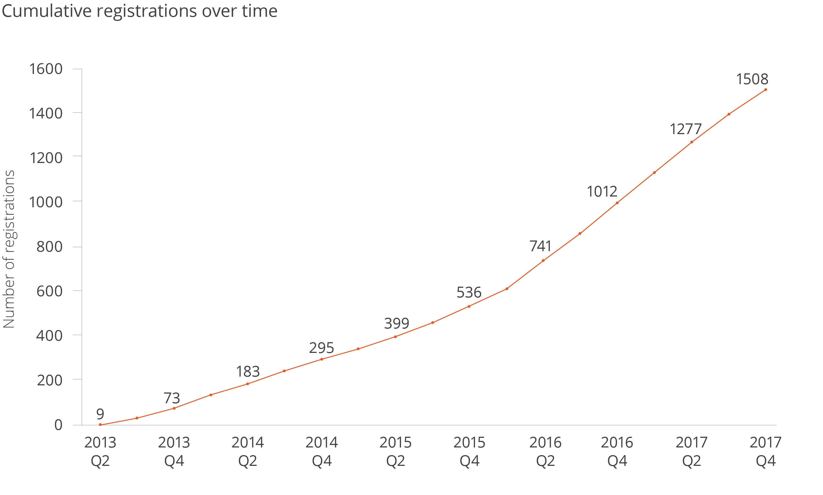
Registrations at the AEA Registry

Slide 59
Plans at the AEA
Integrate registrations more robustly
Cite through DOI
Link more robustly (not just citation!)
Highlight through badges?

Slide 60

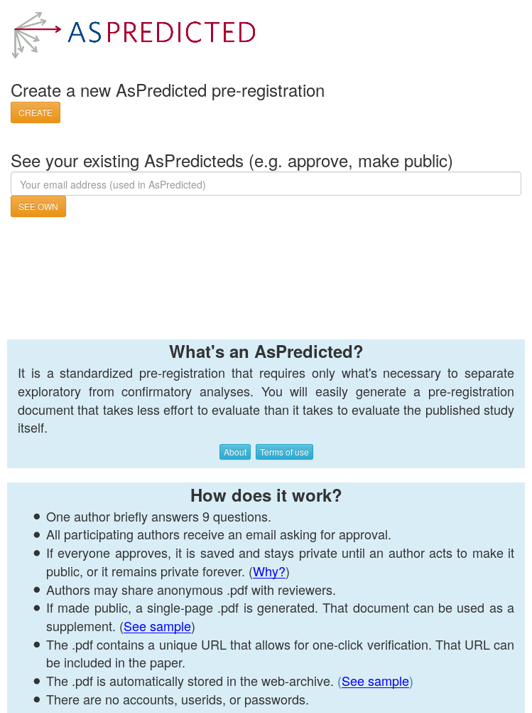
Plans at the AEA
Not just the AEA Registry
OSF registrations
Int’l Initiative for Impact Evaluation (3ie)’s RIDIE registry
Evidence in Governance And Politics (EGAP)’s registry
As-Predicted

Slide 61
Ensuring scalable reproducibility

Slide 62
Scalability and sustainability

Slide 63
Scalability of Verification
500+ articles per year at AEA (not all have code or data)
Financing:
$100 submission fee minus $100 per referee report (x2)
Undergraduate student (~$15/h) spends 10-20 hours on most verifications (would be far less if automated) = $200 extra
Most journals are run at a loss (but maybe Elsevier has the funds…)

Slide 64
Scalability of Verification
Third party verification services already exist!
For research institutes and groupings (J-PAL, NBER, etc.)
At universities (Cornell, etc.)
Because authors already do it
Even at restricted-access centers
Explicitly: France
Implicitly: German IAB data, other restricted-access data (remote processing at NCHS, Statistics Canada)
Interest in other institutions (including Census Bureau)

Slide 65
Scalability of Verification
Third party verification
How to fund
similar to open-access submission fees?
Requirement by funders?
How to certify third-party certifiers?
How reliable is their service? What do they check?
Who certifies? (Association of Data Editors?)
These are open questions
They need to be solved for persistence of the effort

Slide 66


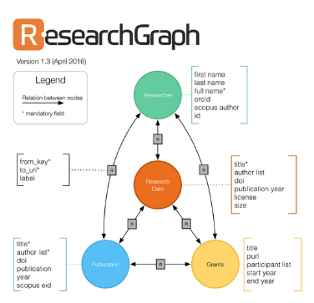
Linking objects (data, programs), articles and researchers
Reminder: currently a very manual process
Only really works if the article cites the data
Infrastructure starting to emerge
If article cites data (DOI!)
If archive and/or journal leverages infrastructure

Slide 67
AEA: improve transparency of all data deposits
Developed a schema to collect relevant information
Relies as much as possible on lookups of existing data
Collects only as much information as necessary
Replaces existing documentation efforts
Can be done early in research workflow

Slide 68
AEA: improve transparency of all data deposits
Developed a schema to collect relevant information
Uniformly applied to public-use and restricted-access data
Can be added at low-cost to existing journal websites
Can be data-mined

Slide 69
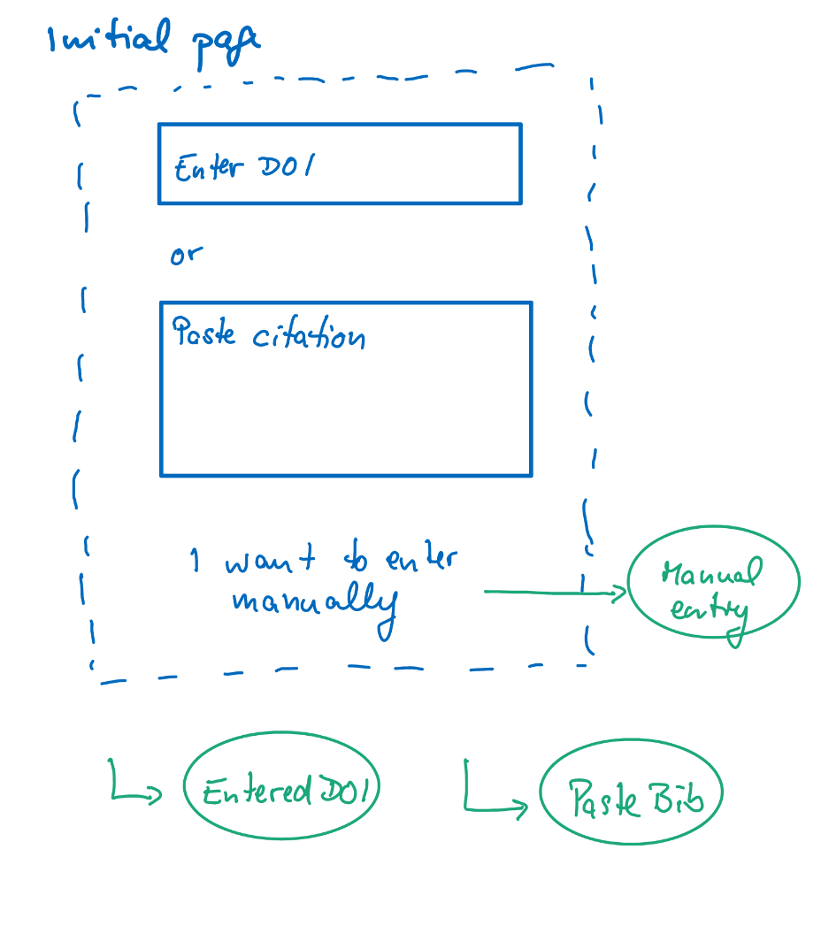
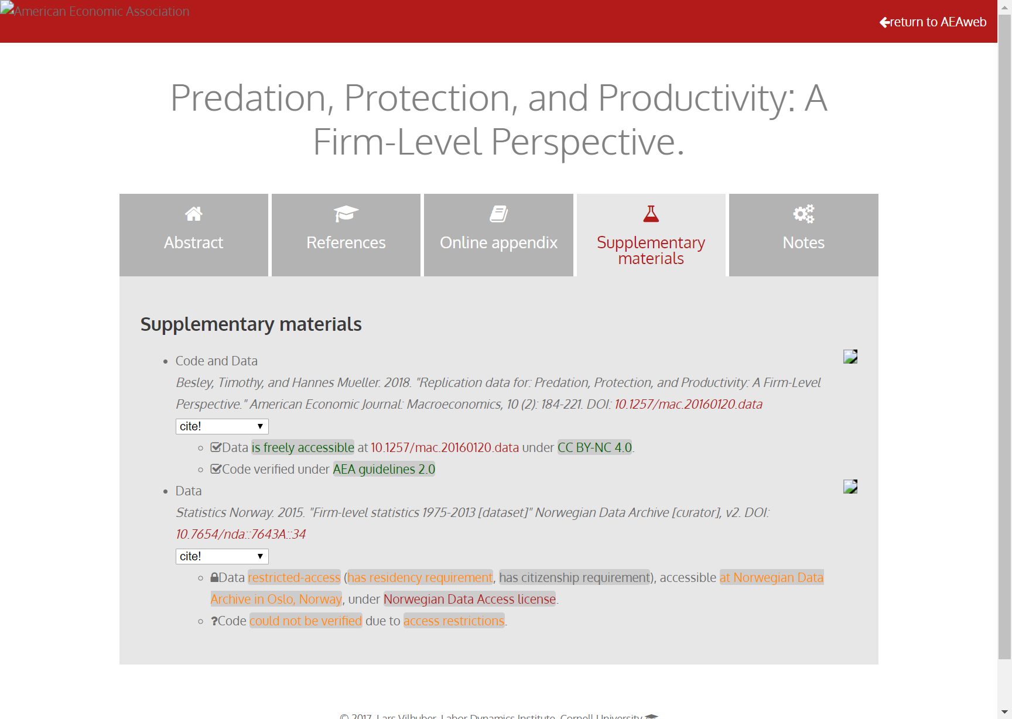
Richer metadata, more transparency

Slide 70
Richer metadata, more transparency

Slide 71
New problem: Licensing of code and data
Do you know what license your journal supplements are under?

Slide 72
Really brief licensing primer
Software licenses:
Copyright
protecting yourself from being held liable
US: copyright is automatic
if you don’t choose a license for your software, no one else can use it!
Journals: Usually acquire copyright
Most likely, you also assigned the copyright to the supplement to the journal!
Source: http://kbroman.org/steps2rr/pages/licenses.html

Slide 73
Did you know?
The AEA acquired the copyright to the supplements when you assigned the article copyright
The AEA did not grant a default license
Thus, all replication and reproduction attempts are infringing on the AEA’s copyright!
We’re fixing that…

Slide 74
Best practices in licensing
Data: Creative Commons Attribution (CC-BY) and variants
Non-commercial (NC)
Share-alike (SA)
Code: various Open Source licenses
GPL: GNU Public License (restrictive)
MIT or (modified) BSD license (less restrictive)

Slide 75
Other initiatives

Slide 76



Center for Open Science Badges
https://cos.io/our-services/open-science-badges/; 53 adopting journals (18 as of 2017)
Kidwell et al., 2016
Notes:
Badges
Open Data
Open Materials
Preregistration
Psychological Science (Jan 2014)

Slide 77
40%
30%
% Articles reporting data available in repository
20%
10%
0%

Slide 78
Signals? Badges? Transparency!
Positives:
Give credit for previously invisible activities
Can be assessed quickly
Negatives:
Need to be known in order to be effective
May bias outcomes!
Require effort for verification?

Slide 79
Example: COS disclosures
Open Data: Authors complete two disclosure items for each Open Data badge application:
Provide the URL, DOI, or other permanent path for accessing the data in a public, open access repository.
How do I know it is open access? Verify!
How do I know the data is permanent? Verify?
What do I do when access is possible, but not open access?

Slide 80
Example: COS disclosures
Open Data: Authors complete two disclosure items for each Open Data badge application:
Is there sufficient information for an independent researcher to reproduce the reported results? If no, explain.
All researchers claim the information is sufficient -> our results

Slide 81
Example: COS disclosures
Open Materials: Authors complete two disclosure items for each Open Materials badge application:
Provide the URL, DOI, or other permanent path for accessing the materials in a public, open access repository.
Is there sufficient information for an independent researcher to reproduce the reported methodology? If no, explain.
Similar concerns as before

Slide 82
Registered Reports

Slide 83
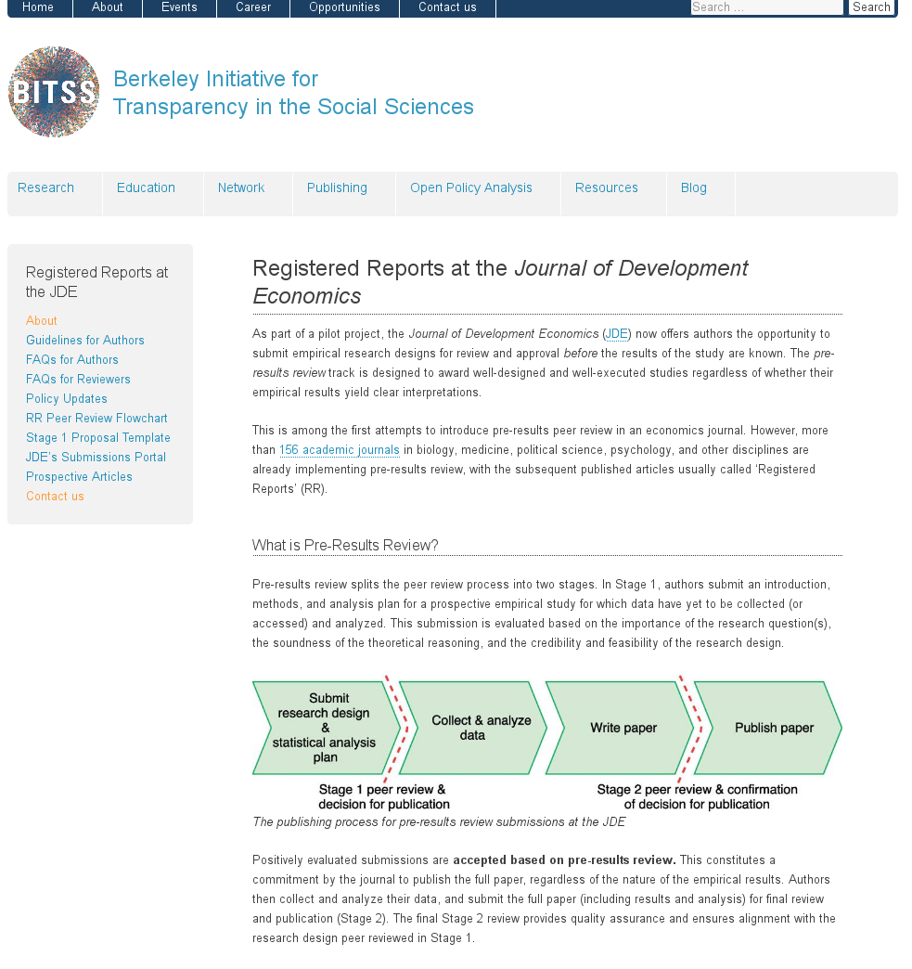
Registered Reports

Slide 84
Registered Reports

Slide 85
Your turn!

Slide 86
What will you be doing going forward?
Who has shared code and data?
Who has done so when not required?
Pre-registration

Slide 87
Sharing of code and data is coming
Are you ready?

Slide 88
It is good practice
Hamermesh (2007) already said:
“the payoff is in the influence of one’s ideas: having other scholars base their work on those ideas, having students learn from them, and […] having public policy influenced by them […] our ideas are unlikely to be taken seriously if our empirical research is not credible”

Slide 89
Students and Faculty: New skills to learn
How to incorporate reproducible practices into your workflow
How to structure your code and your data with an eye on reproducibility
How and when to deposit your code and data
How to license your contributions!
When to pre-register, and when not to
Document early, and often

Slide 90
An example: These presentations
Archive: 10.5281/zenodo.2573123
Live: https://github.com/labordynamicsinstitute/replicability-presentation2019

Slide 91
Another (simple) example
Archive: https://doi.org/10.5281/zenodo.400356
Live: https://github.com/larsvilhuber/jobcreationblog
Note: If you tried this now, it would fail…. because the Census Bureau doesn’t maintain complete archives of its data products…

Slide 92
And you?

Slide 93
Researchers: New skills to learn/teach
How to incorporate reproducible practices into your workflow
When to pre-register, and when not to
Document early, and often (better READMEs!)
How, where, and when to archive data and code
How to license your contributions!

Slide 94
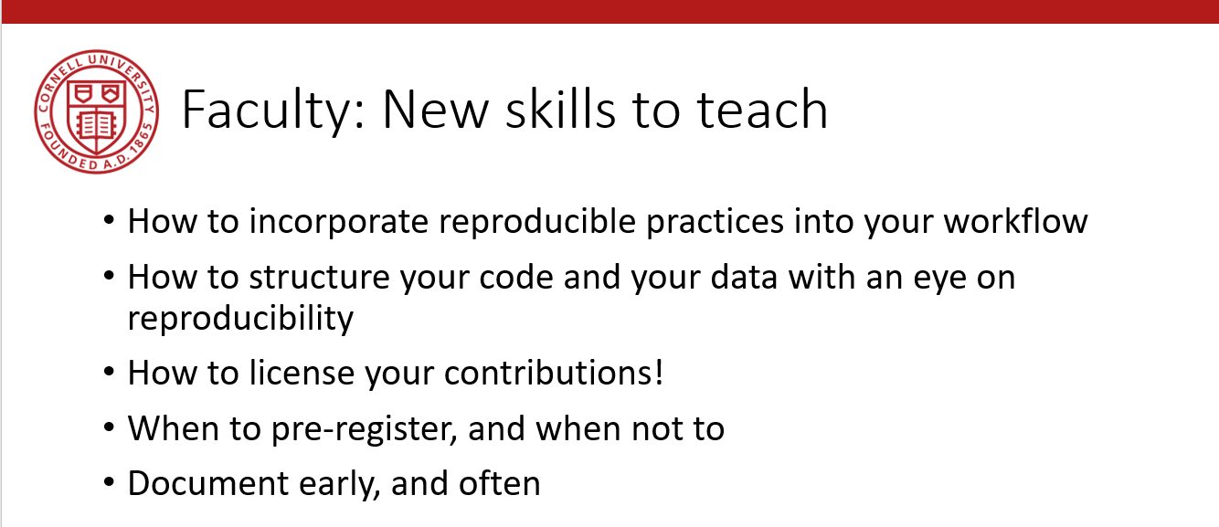
Faculty: New skills to teach
Need to be taught at undergraduate level
Need to be taught at the graduate level

Slide 95
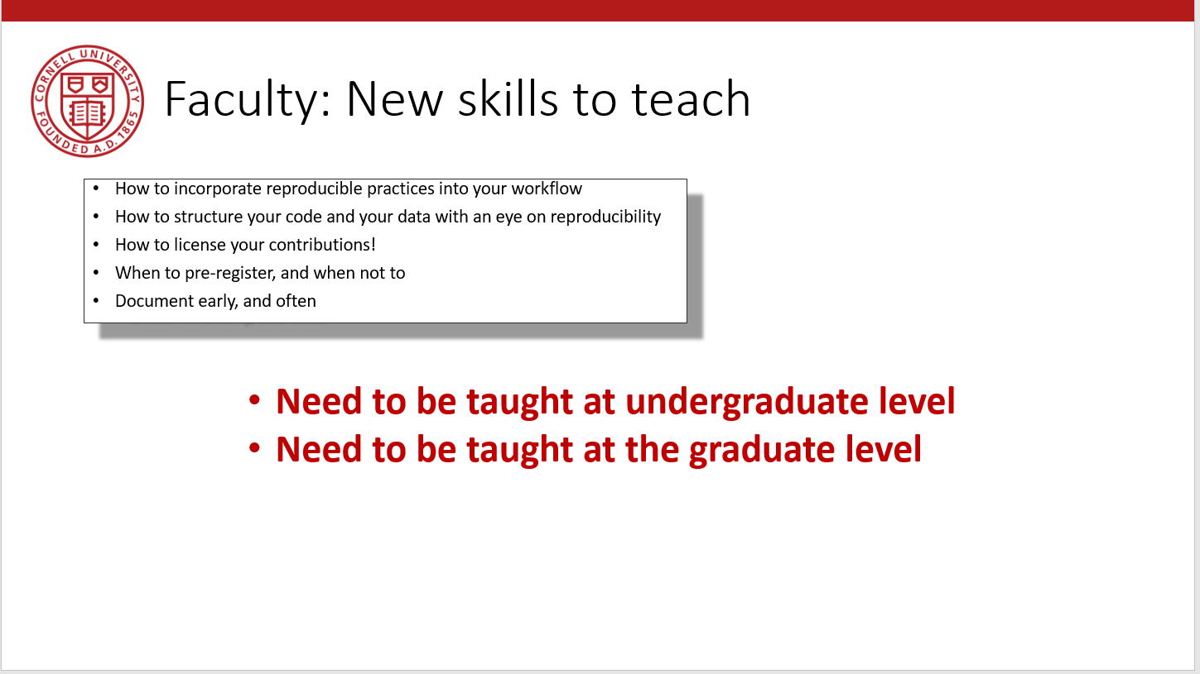
University: New support infrastructure
New courses?
New curricula?
New/expanded support services on campus:
Pre-submission verification
Institutional repositories (expanded or outsourced)
Professional data curation

Slide 96
Summary
Greater transparency
Equal treatment of public-use and confidential data
Better computational reproducibility
For public data as well as confidential data
Greater reliance on shared resources
Encourage best practices

Slide 97
Merci!

Slide 98
Details of new data and code availability policy

Slide 99
Policy A.2 | Policy B
Data Availability Policy | Data and Code Availability Policy
It is the policy of the American Economic Association to publish papers only if | It is the policy of the American Economic Association to publish papers only if
the data used in the analysis are clearly and precisely documented | the data and code used in the analysis are clearly and precisely documented;
and are readily available to any researcher for purposes of replication. | access to the data and code is clearly and precisely documented, and is non-exclusive to the authors.
Authors of accepted papers that contain empirical work, simulations, or experimental work must provide, | Authors of accepted papers that contain empirical work, simulations, or experimental work must provide,
prior to publication, | prior to acceptance,
the data, programs, and other details of the computations sufficient to permit replication. | information about the data, programs, and other details of the computations sufficient to permit replication, as well as information about access to data and programs.
These will be posted on the AEA Data and Code Repository at TBD. | Data and programs should be archived in community-recognized or general repositories, including the AEA Data and Code Repository at TBD.
 | Authors will provide access to editors and reviewers, if requested, to both data and programs prior to acceptance.
The Editor should be notified at the time of submission if the data used in a paper are proprietary or if, for some other reason, the requirements above cannot be met. | The Editor should be notified at the time of submission if access to the data used in a paper is restricted or limited, or if, for some other reason, the requirements above cannot be met.
The AEA Data Editor will assess compliance with this policy. | The AEA Data Editor will assess compliance with this policy,
 | and will verify the accuracy of the information prior to acceptance by the Editor.
 | A statement describing compliance with this policy will be posted alongside the article.

Slide 100
Policy A.2 | Policy B
Data Availability Policy | Data and Code Availability Policy
It is the policy of the American Economic Association to publish papers only if | It is the policy of the American Economic Association to publish papers only if
the data used in the analysis are clearly and precisely documented | the data and code used in the analysis are clearly and precisely documented;
and are readily available to any researcher for purposes of replication. | access to the data and code is clearly and precisely documented, and is non-exclusive to the authors.
Authors of accepted papers that contain empirical work, simulations, or experimental work must provide, | Authors of accepted papers that contain empirical work, simulations, or experimental work must provide,
prior to publication, | prior to acceptance,
the data, programs, and other details of the computations sufficient to permit replication. | information about the data, programs, and other details of the computations sufficient to permit replication, as well as information about access to data and programs.
These will be posted on the AEA Data and Code Repository at TBD. | Data and programs should be archived in community-recognized or general repositories, including the AEA Data and Code Repository at TBD.
 | Authors will provide access to editors and reviewers, if requested, to both data and programs prior to acceptance.
The Editor should be notified at the time of submission if the data used in a paper are proprietary or if, for some other reason, the requirements above cannot be met. | The Editor should be notified at the time of submission if access to the data used in a paper is restricted or limited, or if, for some other reason, the requirements above cannot be met.
The AEA Data Editor will assess compliance with this policy. | The AEA Data Editor will assess compliance with this policy,
 | and will verify the accuracy of the information prior to acceptance by the Editor.
 | A statement describing compliance with this policy will be posted alongside the article.

Slide 101
Policy A.2 | Policy B
Data Availability Policy | Data and Code Availability Policy
It is the policy of the American Economic Association to publish papers only if | It is the policy of the American Economic Association to publish papers only if
the data used in the analysis are clearly and precisely documented | the data and code used in the analysis are clearly and precisely documented;
and are readily available to any researcher for purposes of replication. | access to the data and code is clearly and precisely documented, and is non-exclusive to the authors.
Authors of accepted papers that contain empirical work, simulations, or experimental work must provide, | Authors of accepted papers that contain empirical work, simulations, or experimental work must provide,
prior to publication, | prior to acceptance,
the data, programs, and other details of the computations sufficient to permit replication. | information about the data, programs, and other details of the computations sufficient to permit replication, as well as information about access to data and programs.
These will be posted on the AEA Data and Code Repository at TBD. | Data and programs should be archived in community-recognized or general repositories, including the AEA Data and Code Repository at TBD.
 | Authors will provide access to editors and reviewers, if requested, to both data and programs prior to acceptance.
The Editor should be notified at the time of submission if the data used in a paper are proprietary or if, for some other reason, the requirements above cannot be met. | The Editor should be notified at the time of submission if access to the data used in a paper is restricted or limited, or if, for some other reason, the requirements above cannot be met.
The AEA Data Editor will assess compliance with this policy. | The AEA Data Editor will assess compliance with this policy,
 | and will verify the accuracy of the information prior to acceptance by the Editor.
 | A statement describing compliance with this policy will be posted alongside the article.

Slide 102
What is a “Data Availability Policy”?

Slide 103
AEA “Data Availability Policy” (2018)
It is the policy of the American Economic Association to publish papers only if the data used in the analysis are clearly and precisely documented and are readily available to any researcher for purposes of replication.
Authors of accepted papers that contain empirical work, simulations, or experimental work must provide, prior to publication, the data, programs, and other details of the computations sufficient to permit replication. These will be posted on the AEA website. The Editor should be notified at the time of submission if the data used in a paper are proprietary or if, for some other reason, the requirements above cannot be met.

Slide 104
DOI and metadata

Slide 105
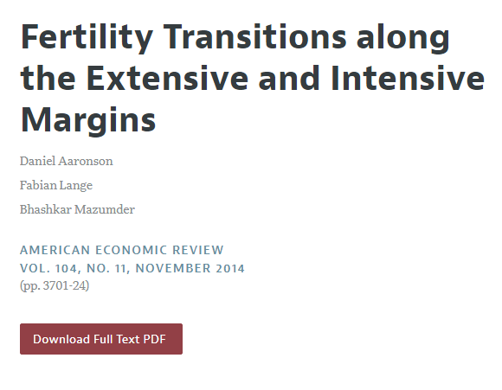
Digital Object Identifier (DOI)

Slide 106
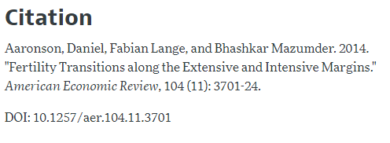
Digital Object Identifier (DOI)

Slide 107
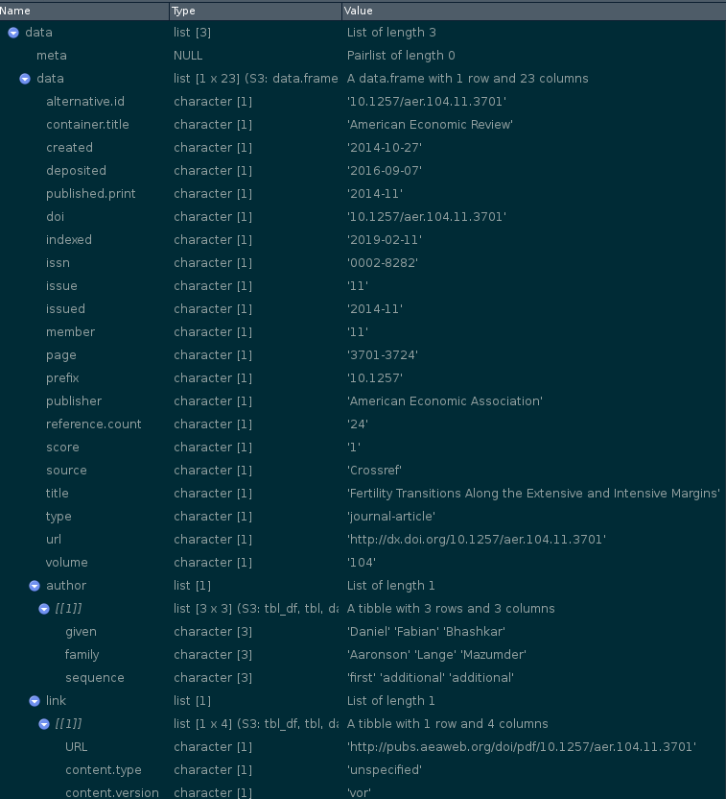
Digital Object Identifier (DOI)

Slide 108
Digital Object Identifier (DOI)
Registries handle DOI (e.g. 10.1257/aer.104.11.3701)
Key information: the link (https://www.aeaweb.org/articles?id=10.1257/aer.104.11.3701 )
Additional information:
Required Elements
Article: titles, publication_date (year), doi_data
Recommended Elements
Article: contributors, ORCIDs, publication_date (day, month), pages (first_page, last_page), citation_list
also strongly recommended: funding, license,

