Slide 1

https://forms.gle/zrY8dB8puTtud2Rt7 lars.vilhuber.com/s (and choose WEAI 2019)

Slide 2
Replication and Reproducibility in Social Sciences and Statistics: Context, Concerns, and Concrete Measures
Lars Vilhuber
Cornell University
Partial funding acknowledged under NSF-#1131848 (NCRN) and a grant from the Alfred P. Sloan Foundation. The opinions expressed in this talk are solely the authors, and do not represent the views of the U.S. Census Bureau, the American Economic Association, or any of the funding agencies.
Notes:
I am going to
Very briefly describe the background we are coming from
Make note of the various elements of progress (and the broader picture) of open science
Describe some of the ongoing challenges
Provide a glimpse of what is going to happen in economics, and maybe more broadly in the social sciences.

Slide 3
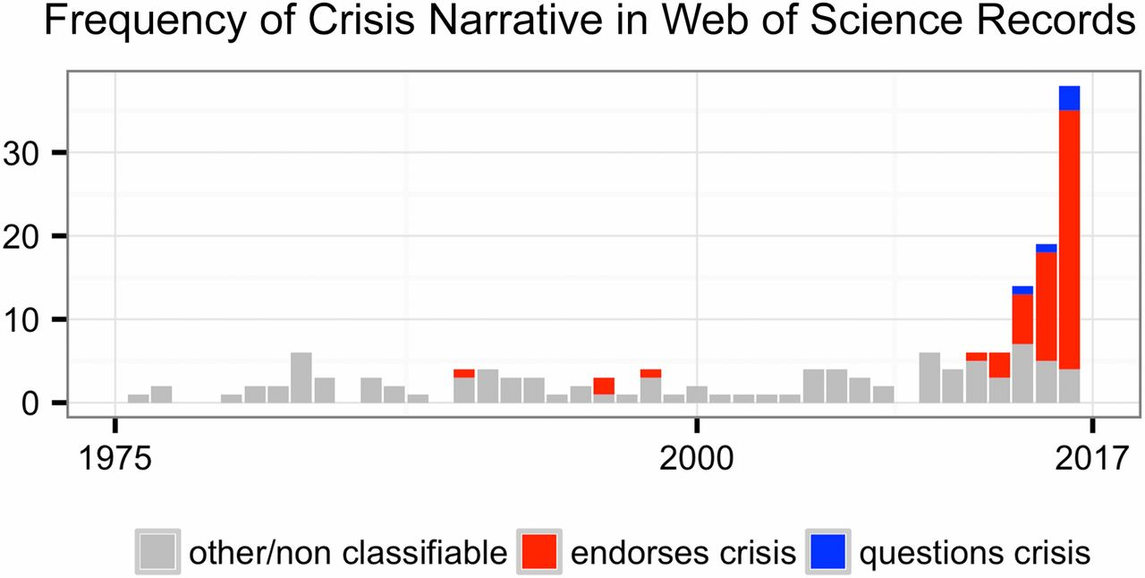
This reproducibility crisis thing….
https://doi.org/10.1073/pnas.1708272114
Notes:
Number of Web of Science records that in the title, abstract, or keywords contain one of the following phrases: “reproducibility crisis,” “scientific crisis,” “science in crisis,” “crisis in science,” “replication crisis,” “replicability crisis.” Records were classified by the author according to whether, based on title and abstracts, they implicitly or explicitly endorsed the crisis narrative described in the text (red), or alternatively questioned the existence of such a crisis (blue), or discussed “scientific crises” of other kinds or could not be classified due to insufficient information (gray).

Slide 4
The “crisis” in the 60s and 70s Sterling, 1959; Cohen, 1962; Lykken, 1968; Tukey, 1969; Greenwald, 1975; Meehl, 1978; Rosenthal, 1979
Low power
Flexibility in analysis
Selective reporting
Ignoring nulls
Lack of replication
Misuse of statistics
Source: Nosek Sackler talk 2017
Notes:
Source: Nosek, NAS.Sackler.2017.03.10
Examples from:
Button et al – Neuroscience
Ioannidis – why most results are false (Medicine)
GWAS
Biology
Two possibilities are that the percentage of positive results is inflated because negative results are much less likely to be published, and that we are pursuing our analysis freedoms to produce positive results that are not really there. These would lead to an inflation of false-positive results in the published literature.
Some evidence from bio-medical research suggests that this is occurring. Two different industrial laboratories attempted to replicate 40 or 50 basic science studies that showed positive evidence for markers for new cancer treatments or other issues in medicine. They did not select at random. Instead, they picked studies considered landmark findings. The success rates for replication were about 25% in one study and about 10% in the other. Further, some of the findings they could not replicate had spurred large literatures of hundreds of articles following up on the finding and its implications, but never having tested whether the evidence for the original finding was solid. This is a massive waste of resources.
Across the sciences, evidence like this has spurred lots of discussion and proposed actions to improve research efficiency and avoid the massive waste of resources linked to erroneous results getting in and staying in the literature, and about the culture of scientific practices that is rewarding publishing, perhaps at the expense of knowledge building. There have been a variety of suggestions for what to do. For example, the Nature article on the right suggests that publishing standards should be increased for basic science research.
[It is not in my interest to replicate – myself or others – to evaluate validity and improve precision in effect estimates (redundant). Replication is worth next to zero (Makel data on published replications; motivated to not call it replication; novelty is supreme – zero “error checking”; not in my interest to check my work, and not in your interest to check my work (let’s just each do our own thing and get rewarded for that)
Irreproducible results will get in and stay in the literature (examples from bio-med). Prinz and Begley articles (make sure to summarize accurately)
The Nature article by folks in bio-medicine is great. The solution they offer is a popular one in commentators from the other sciences -- raise publishing standards.

Slide 5
Efficiency of scholary discourse?
Early publications (20th century) contained tables of data, and the math was simple (maybe)
Data became electronic, was no longer included or cited
Math was transcribed to code, and was no longer included

Slide 6
Efficiency of scholary discourse!
Modern publications thus need the same transparency and completeness as in the old days
to facilitate replicability

Slide 7
Replication?

Slide 8
Replication continuum
08
Reproducibility
Narrow Replication (Pesaran 2003)
Pure Replication (Hamermesh 2007)
Verification (Clemens 2015)

Slide 9
Replication continuum
Same data | Same code | Same methods | Same context
08
Reproducibility
Narrow Replication (Pesaran 2003)
Pure Replication (Hamermesh 2007)
Verification (Clemens 2015)

Slide 10
Replication continuum
08
08
Reproducibility
Replicability
Narrow Replication (Pesaran 2003)
Pure Replication (Hamermesh 2007)
Verification (Clemens 2015)
Wide Replication (Pesaran 2003)
Statistical Replication (Hamermesh 2007)
Reproduction/Reanalysis (Clemens 2015)

Slide 11
Replication continuum
Same data | Different code | Same methods | Same context
 | or software
08
08
Reproducibility
Replicability
Narrow Replication (Pesaran 2003)
Pure Replication (Hamermesh 2007)
Verification (Clemens 2015)
Wide Replication (Pesaran 2003)
Statistical Replication (Hamermesh 2007)
Reproduction/Reanalysis (Clemens 2015)

Slide 12
Replication continuum
New data | Same code | Same methods | Same context
collection
08
08
Reproducibility
Replicability
Narrow Replication (Pesaran 2003)
Pure Replication (Hamermesh 2007)
Verification (Clemens 2015)
Wide Replication (Pesaran 2003)
Statistical Replication (Hamermesh 2007)
Reproduction/Reanalysis (Clemens 2015)

Slide 13
Replication continuum
08
08
08
Reproducibility
Replicability
Generalizability
Narrow Replication (Pesaran 2003)
Pure Replication (Hamermesh 2007)
Verification (Clemens 2015)
Wide Replication (Pesaran 2003)
Statistical Replication (Hamermesh 2007)
Reproduction/Reanalysis (Clemens 2015)
Wider Replication (Pesaran 2003)
Scientific Replication (Hamermesh 2007)
Reanalysis/Robustness (Clemens 2015)

Slide 14
Replication continuum
Different data | Different code | Different | Different
 | or software | methods | context or
 |  |  | country
08
08
08
Reproducibility
Replicability
Generalizability
Narrow Replication (Pesaran 2003)
Pure Replication (Hamermesh 2007)
Verification (Clemens 2015)
Wide Replication (Pesaran 2003)
Statistical Replication (Hamermesh 2007)
Reproduction/Reanalysis (Clemens 2015)
Wider Replication (Pesaran 2003)
Scientific Replication (Hamermesh 2007)
Reanalysis/Robustness (Clemens 2015)

Slide 15
Progress

Slide 16
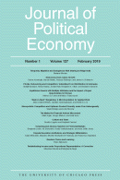
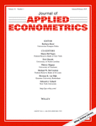


Progress
Replication archives and Data (Code) Availability policies

Slide 17
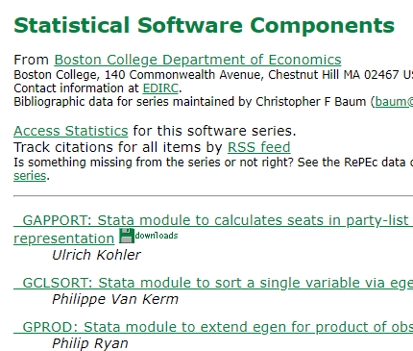

Progress
Replication archives and Data (Code) Availability policies
Shared open source software

Slide 18

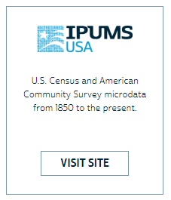




Progress
Replication archives and Data (Code) Availability policies
Shared open source software
Better public-use and shared data

Slide 19


Progress
Replication archives and Data (Code) Availability policies
Shared open source software
Better public-use and shared data
Better ways of accessing preprints/ grey literature

Slide 20



Progress
Replication archives and Data (Code) Availability policies
Shared open source software
Better public-use and shared data
Better ways of accessing preprints/ grey literature
Pre-registration of trials, experiments, and analyses

Slide 21
More recently…

Slide 22
Second round (2012-)
Greater enforcement of data (and code) availability
2015, AJ Political Science
2016, Data Editor for ASA Software Section
2016, Statistical review added Science
2017: AEA appoints Data Editor, with mandate to do similar activities (also EJ, Restud)

Slide 23
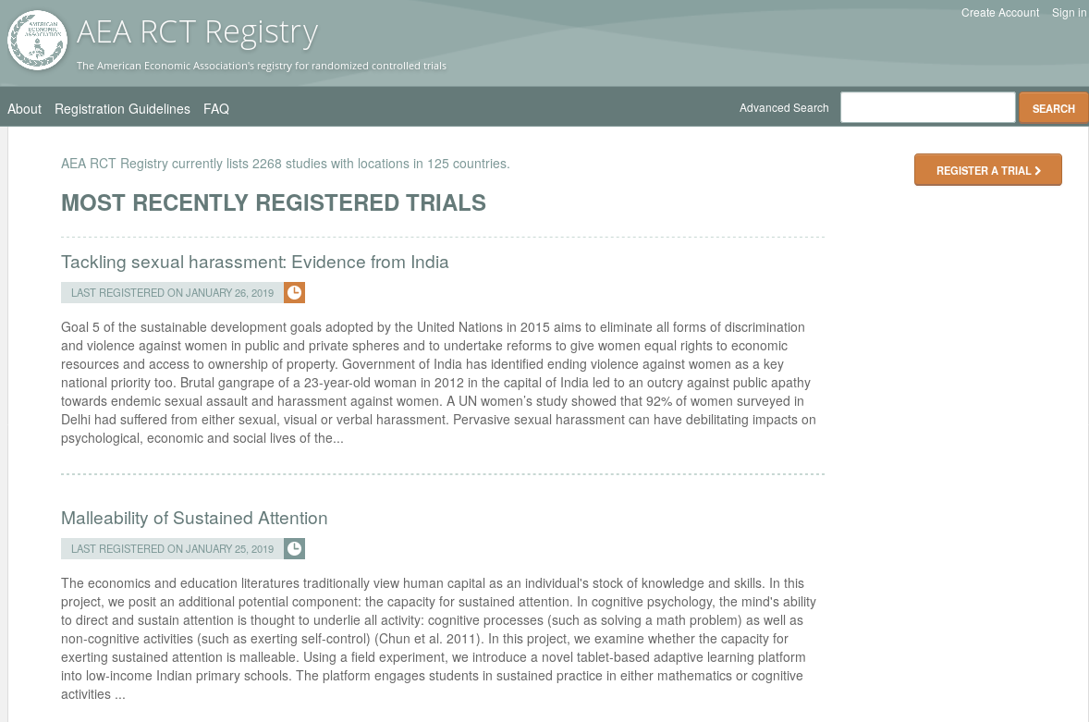
Pre-registration
“That information is especially helpful in research that emphasizes null hypothesis significance testing.
A thorough preregistration promotes transparency and openness and protects researchers from suspicions of p-hacking.”
https://www.psychologicalscience.org/publications/psychological_science/preregistration

Slide 24

Registered Reports
https://cos.io/rr
Chambers (2014)
Nosek & Lakens (2014)
Close cousin: Results-blind review

Slide 25


Preprints in other sciences
bioRxiv (2013)
PsyArXiv (2016)

Slide 26
Paluck (2018) https://osf.io/kvbnh/

Slide 27
Issues

Slide 28
Economics makes wide use of public-use data
Macrodata:
“We use data downloaded from the Bureau of Economic Analysis…”
Microdata:
“… this paper uses data from the Current Population Survey…”

Slide 29
This should be easy!

Slide 30
Problems Making RELIABLE archives
Many datasets
Are imperfectly described
Very few data citations
Are badly documented
Have no (permanent) location defined
Even for data from high-profile organizations!
All of the above

Slide 31
Making USEFUL archives
From analysis of code from 1996 to 2003 (MMH2006):
“Other authors seem to think that the entire world shares the exact same hard drive layout, with ‘‘C:\MYDATA\MYPROJECT\” sprinkled liberally throughout their code. Of course, a would-be replicator has to find and change all these.”
“The author might not realize all the data/subroutine files that his code utilizes, and forget to include said data/subroutine in his replication files.”

Slide 32
Still true today…

Slide 33
Let’s try and do better…

Slide 34
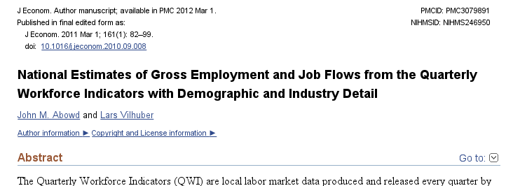
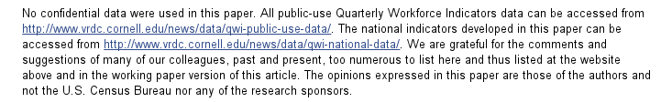
An example

Slide 35
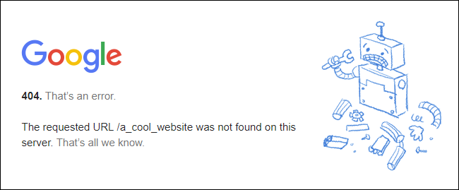
Risk

Slide 36

An example: not cited…

Slide 37
Data not attached to article
J of Econometrics Data Policy at the time could not accommodate 50MB file
Data was not attached to paper.
Today’s J of Econometrics policy suggests using third-party repositories
We will get to that later

Slide 38
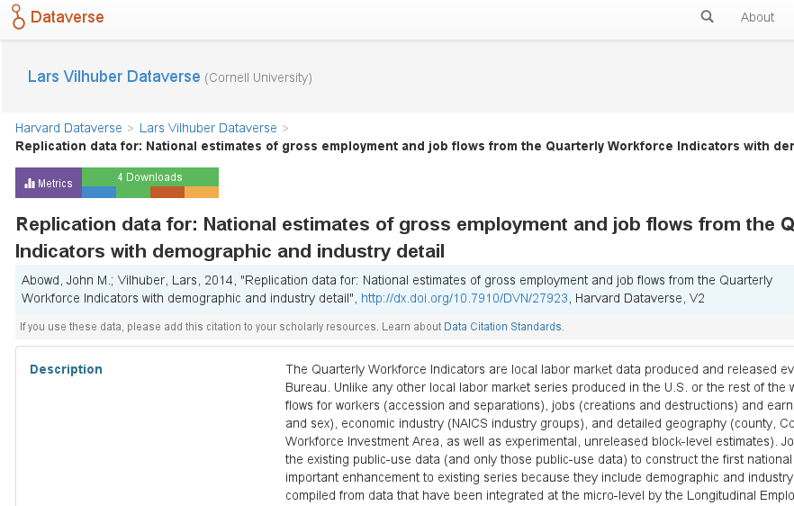
We went back, archived it

Slide 39
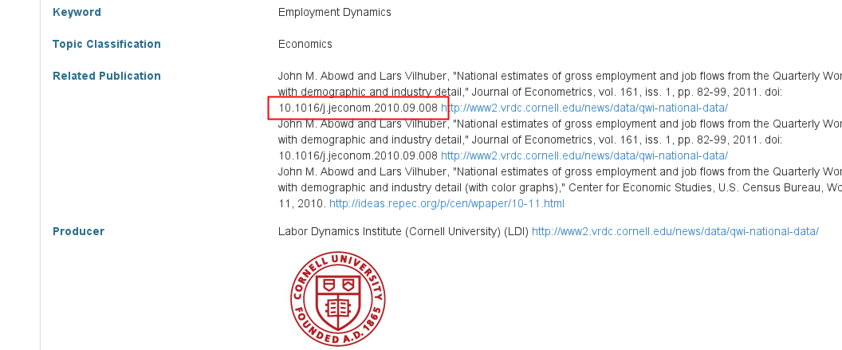
We went back, archived it, linked it back

Slide 40
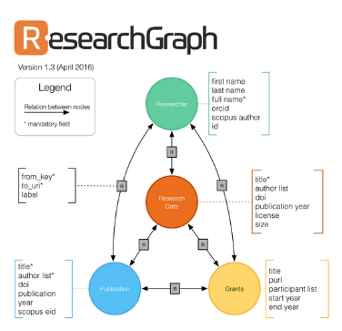


But journal and data infrastructure are incomplete
While Dataverse allows to manually link back…
… the article itself (journal website) reveals none of that
True for most journals, and most data archives
ICPSR (manual linking to articles)
RePEc (no linkage possible)
Infrastructure starting to emerge
If article cites data (DOI!)
If archive and/or journal leverages infrastructure

Slide 41
Still true today…

Slide 42
Issues

Slide 43
Not enough articles are reproducible

Slide 44
Replication continuum
Same data | Same code | Same methods | Same context
08
08
08
Reproducibility
Replicability
Generalizability
Narrow Replication (Pesaran 2003)
Pure Replication (Hamermesh 2007)
Verification (Clemens 2015)
Wide Replication (Pesaran 2003)
Statistical Replication (Hamermesh 2007)
Reproduction/Reanalysis (Clemens 2015)
Wider Replication (Pesaran 2003)
Scientific Replication (Hamermesh 2007)
Reanalysis/Robustness (Clemens 2015)

Slide 45
Results?

Slide 46
Some key statistics
Study | Year | N | Success | Type | Type-R | Type-Data | Percent | Field
Dewald Thursby Anderson | 1986 | 54 | 2 | Complete | Reproducibility | Avail | 4% | Economics
Dewald Thursby Anderson | 1986 | 54 | 7 | Partial | Reproducibility | Avail | 13% | Economics
McCullough McGeary Harrison | 2006 | 186 | 14 | Complete | Reproducibility | All | 8% | Economics
McCullough McGeary Harrison | 2006 | 62 | 14 | Complete | Reproducibility | Avail | 23% | Economics
Nosek et al | 2015 | 100 | 36 | Complete | Replication |  | 36% | Psychology
Camerer et al | 2016 | 18 | 11 | Complete | Replication |  | 61% | Experimental Econ
Chang Li | 2017 | 67 | 22 | Complete | Reproducibility | Avail | 33% | Macroeconomics
Kingi et al | 2018 | 274 | 69 | Complete | Reproducibility | All | 25% | Economics
Kingi et al | 2018 | 162 | 69 | Complete | Reproducibility | Avail | 43% | Economics
Kingi et al | 2018 | 162 | 137 | Partial | Reproducibility | Avail | 85% | Economics
Kingi et al numbers are preliminary. Do not cite or quote.

Slide 47

In a nutshell
40% use restricted-access data
25% use public-use data and are mostly or completely reproducible
25% use public-use data and are only partially reproducible
10% fail to yield useful results
It’s only ½ full!
Hey, it’s not empty!

Slide 48
Issues

Slide 49
Not enough data is “accessible”

Slide 50
Current Data Availability Policies are Broken
If the Data is not open-access, no systematic information is collected (“exemption”)

Slide 51
It is not the access that is “broken”

Slide 52
Illustration
If you used files at the National Archives, would we ask you to “deposit” them?

Slide 53
It is the description of access that is “broken”

Slide 54
Current Data Availability Policies are Broken
If the Data is open-access, no systematic information is collected (not cited, lack of information)

Slide 55
What to do about it?

Slide 56
Evolving Journal and Data Infrastructure

Slide 57
Why do journals like “supplemental ZIP files” and affiliated repositories?
They can ensure longevity/ persistence
They can ensure access
They can ensure availability

Slide 58
What are the characteristics of prominent data archives?
They DO ensure longevity/ persistence
They DO ensure access
They DO ensure availability

Slide 59
Evolving Journal and Data Infrastructure
More self-deposit repositories in the social sciences
Dataverse
Figshare
openICPSR
Zenodo
Qualitative Data Repository (QDR)
Others…

Slide 60
In a nutshell
40% use restricted-access data
25% use public-use data and are mostly or completely reproducible
25% use public-use data and are only partially reproducible
10% fail to yield useful results
It’s only ½ full!
Hey, it’s not empty!

Slide 61
Evolving Journal and Data Infrastructure
More self-deposit repositories in the social sciences
Dataverse
Figshare
openICPSR
Zenodo
Qualitative Data Repository (QDR)
Others…
CASD
IAB
Norway
US Federal Statistical RDC
….

Slide 62
Evolving Journal and Data Infrastructure
Goal: Use any repository!
(subject to conditions)

Slide 63
But: Encourage Best Practices
Deposit and archive early
If you collect data, archive it immediately (possibly privately)
If you finish the manuscript, archive the analysis files (possibly privately)

Slide 64
Evolving Journal and Data Infrastructure
Treat all archives symmetrically!

Slide 65
Verifying Data and Code Deposits
Not every data repository is created equal
Github, Dropbox, etc. are not data or code repositories
Is the institutional repository at the University of Southern Venezuela a reliable repository?
Is the institutional repository at Cornell University a reliable repository?
Is the institutional repository at Harvard University (Dataverse!) a reliable repository?
Are the National Archives a reliable repository?

Slide 66
Verifying Data and Code Deposits
Not every restricted-access repository is created equal
The Second Bank of Third City credit card data is not a data/code repository
Is the School Board of Third City a reliable repository?
Is the JPMC Institute a reliable repository?
Is the US Census Bureau a reliable repository?
Are any restriced-access repositories reliable archives?

Slide 67
Evolving Journal and Data Infrastructure
So: Describe them!
(cite them!)

Slide 68
Data (and Code) Availability Statements
A statement about where data supporting the results reported in a published article can be found
including unique identifiers linking to publicly archived datasets analyzed or generated during the study.
DASs can increase transparency by providing a reason why data cannot be made (immediately) available
need for registration, ethical or legal restrictions, or because of an embargo period

Slide 69
“Unscripted Segway”
Does that mean I cannot use data from Firm ABC?
Does that mean I have to give my data away?

Slide 70
Current efforts at the AEA

Slide 71
Current efforts at the AEA
Provide more transparency
To assist replication efforts
By better linking to paper-related resources
Public-use data
Restricted-access data
Code
Pre-Registration when available

Slide 72
Current efforts at the AEA
Pre-emptively improve code archives
By conducting reproducibility checks when we can
By working with groups that conduct reproducibility checks when we cannot

Slide 73
Current efforts at the AEA
Better archives
Greater transparency of the code and data archives
Better provenance tracking
Leave code where it is when appropriate
Leave data where it is almost always
Display that information

Slide 74
AEA “Data Availability Policy” (2018)
It is the policy of the American Economic Association to publish papers only if the data used in the analysis are clearly and precisely documented and are readily available to any researcher for purposes of replication.
Authors of accepted papers that contain empirical work, simulations, or experimental work must provide, prior to publication, the data, programs, and other details of the computations sufficient to permit replication. These will be posted on the AEA website. The Editor should be notified at the time of submission if the data used in a paper are proprietary or if, for some other reason, the requirements above cannot be met.

Slide 75
AEA “Data Availability Policy” (2018)
It is the policy of the American Economic Association to publish papers only if the data used in the analysis are clearly and precisely documented and are readily available to any researcher for purposes of replication.
Authors of accepted papers that contain empirical work, simulations, or experimental work must provide, prior to publication, the data, programs, and other details of the computations sufficient to permit replication. These will be posted on the AEA website. The Editor should be notified at the time of submission if the data used in a paper are proprietary or if, for some other reason, the requirements above cannot be met.

Slide 76
AEA “Data Availability Policy” (2019)
It is the policy of the American Economic Association to publish papers only if the data used in the analysis are clearly and precisely documented and are readily available to any researcher for purposes of replication.
Authors of accepted papers that contain empirical work, simulations, or experimental work must provide, prior to publication, the data, programs, and other details of the computations sufficient to permit replication. These will be posted on the AEA website. The Editor should be notified at the time of submission if the data used in a paper are proprietary or if, for some other reason, the requirements above cannot be met.
We will assess, by reviewing README and data appendices.

Slide 77
AEA “Data Availability Policy” (2019)
It is the policy of the American Economic Association to publish papers only if the data used in the analysis are clearly and precisely documented and are readily available to any researcher for purposes of replication.
Authors of accepted papers that contain empirical work, simulations, or experimental work must provide, prior to acceptance, evidence that the data, programs, and other details of the computations sufficient to permit replication. These will be posted on the AEA website. The Editor should be notified at the time of submission if the data used in a paper are proprietary or if, for some other reason, the requirements above cannot be met.
We will assess early,
but more flexible.

Slide 78
AEA “Data Availability Policy” (2019)
It is the policy of the American Economic Association to publish papers only if the data used in the analysis are clearly and precisely documented and are readily available to any researcher for purposes of replication.
Authors of accepted papers that contain empirical work, simulations, or experimental work must provide, prior to acceptance, evidence that the data, programs, and other details of the computations sufficient to permit replication. These will be posted on the AEA website. The Editor should be notified at the time of submission if the data used in a paper are proprietary or if, for some other reason, the requirements above cannot be met.
“Sufficient” = “it actually works”.

Slide 79
AEA “Data Availability Policy” (2019)
It is the policy of the American Economic Association to publish papers only if the data used in the analysis are clearly and precisely documented and are readily available to any researcher for purposes of replication.
Authors of accepted papers that contain empirical work, simulations, or experimental work must provide, prior to acceptance, evidence that the data, programs, and other details of the computations sufficient to permit replication. These should be available on the AEA Data and Code Repository. The Editor should be notified at the time of submission if the data used in a paper are proprietary or if, for some other reason, the requirements above cannot be met.
Better repository

Slide 80
AEA “Data Availability Policy” (2019)
It is the policy of the American Economic Association to publish papers only if the data used in the analysis are clearly and precisely documented and are readily available to any researcher for purposes of replication.
Authors of accepted papers that contain empirical work, simulations, or experimental work must provide, prior to acceptance, evidence that the data, programs, and other details of the computations sufficient to permit replication. These should be available on the AEA Data and Code Repository or another repository. The Editor should be notified at the time of submission if the data used in a paper are proprietary or if, for some other reason, the requirements above cannot be met.
… or other repository

Slide 81
Action: Encourage Best Practices
Follow robust coding
Ensure that code reliably produces results (possibly automated)
Before you finish the manuscript, run all analysis code again (if not too onerous)

Slide 82
Action: Pre-Publication Verification
Cornell Replication Lab has been verifying published articles
Now switching to manuscripts in the submission workflow
For now pilot
Authors have submitted prior to announcement of new data policy

Slide 83
Goal: Improve reproducibility

Slide 84
Action: Verifying Data and Code Deposits
Check README
Legible? Intelligible? Complete?
Check Code
Where is Table 1? Figure 1? Could this work?
Check Access Rights
Can the author provides us with data?
Does the data access as described work?

Slide 85
Challenges?

Slide 86
Reproducibility is harder than it should be
Often done piecemeal
At different times
By different people
Software versions
Stata 9? 15? 42?
rdrobust 2014? 2016? 2018 bug fix?
Compilers and exotic software

Slide 87
Impossible?

Slide 88
Lots of good examples
Open source software has practices that ensure reproducibility, but also describe it
Many papers do an admirable job, and teach the replicator how to proceed
Tools:
Make files and modern replacement
Docker
Rmd files
Maybe Jupyter notebooks (they have some issues)

Slide 89
Lots of good examples (restricted-access data)
IAB FDZ enforces reproducibility through its access procedures
So does the CDER/Statistics Canada
Some European agencies have excellent data documentation
So does (sometimes) Statistics Canada
Access procedures are often quite formal but impartial
US, Canada, France, Germany, etc.

Slide 90
Lots of bad examples too….

Slide 91
Goal: Confidential data
Work with Research Data Centers to facilitate transparency and reproducibility
Training (secure programming guidelines)
Standardize archives within RDCs + transparency
Develop guidelines and internal processes for preservation, reproducibility
Work with researchers to interact with data providers
Work with private sector data providers to clarify procedures, improve openness

Slide 92
Future efforts
AEA, Social Sciences, elsewhere

Slide 93
Better support for researchers
Training in methods (with various centers, institutions, etc.)
For current researchers
For integration into curriculums
Tools to streamline the process
A few technical things (not described here)
Coordinate among journals (no duplicate effort)
Awareness
Consider badges/ certification
Address issues with confidential data

Slide 94
Moving away from “supplemental data”
Data as a primary object
Title
Permanent location
Citable!
Better data repositories
Move away from ZIP files attached to web pages
Greater clarity about locations

Slide 95
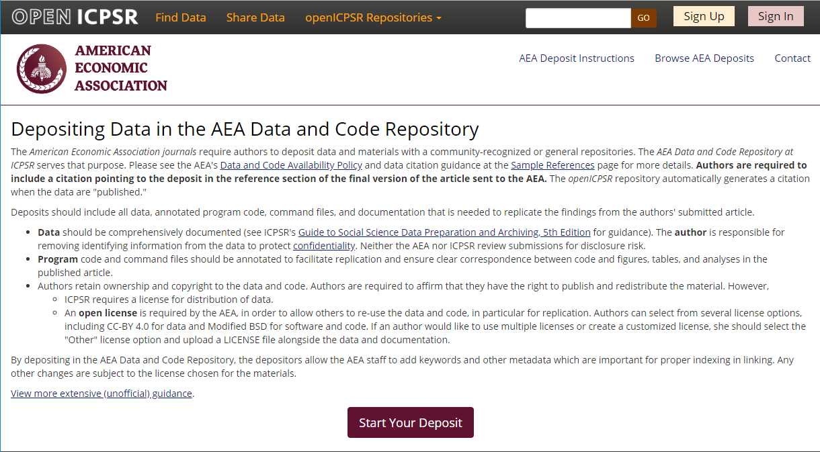
Full-featured repository

Slide 96
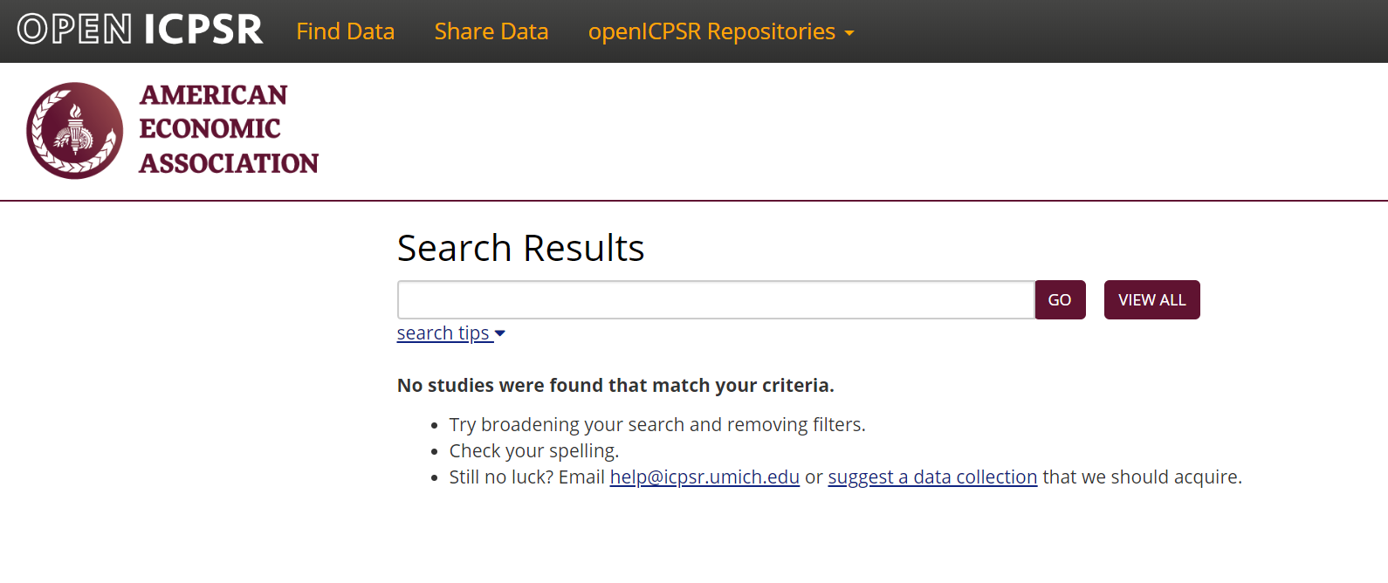
Full-featured repository

Slide 97
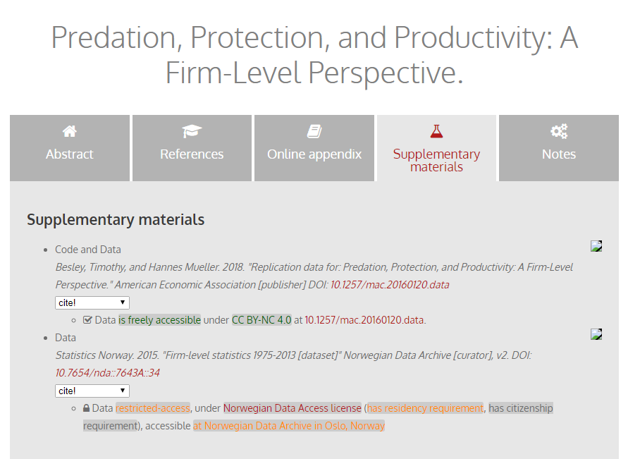
Richer metadata, more transparency

Slide 98
Collaboration

Slide 99
Goal: Transportability
Any standards, tools, methods: must be transportable across journals (no custom solutions)

Slide 100
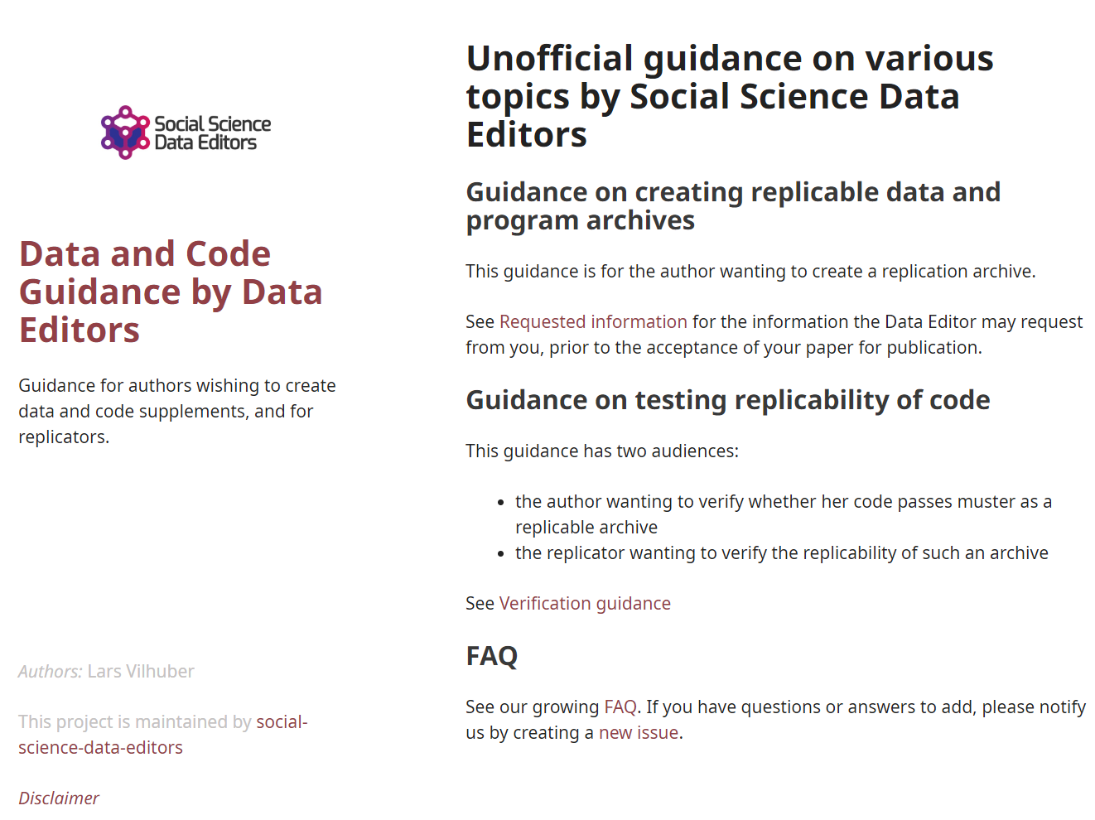
Social science “guild”
https:// social-science -data-editors. github.io/ guidance/

Slide 101
Challenges?

Slide 102
You…

Slide 103
Me…

Slide 104
Change ingrained habits…

Slide 105
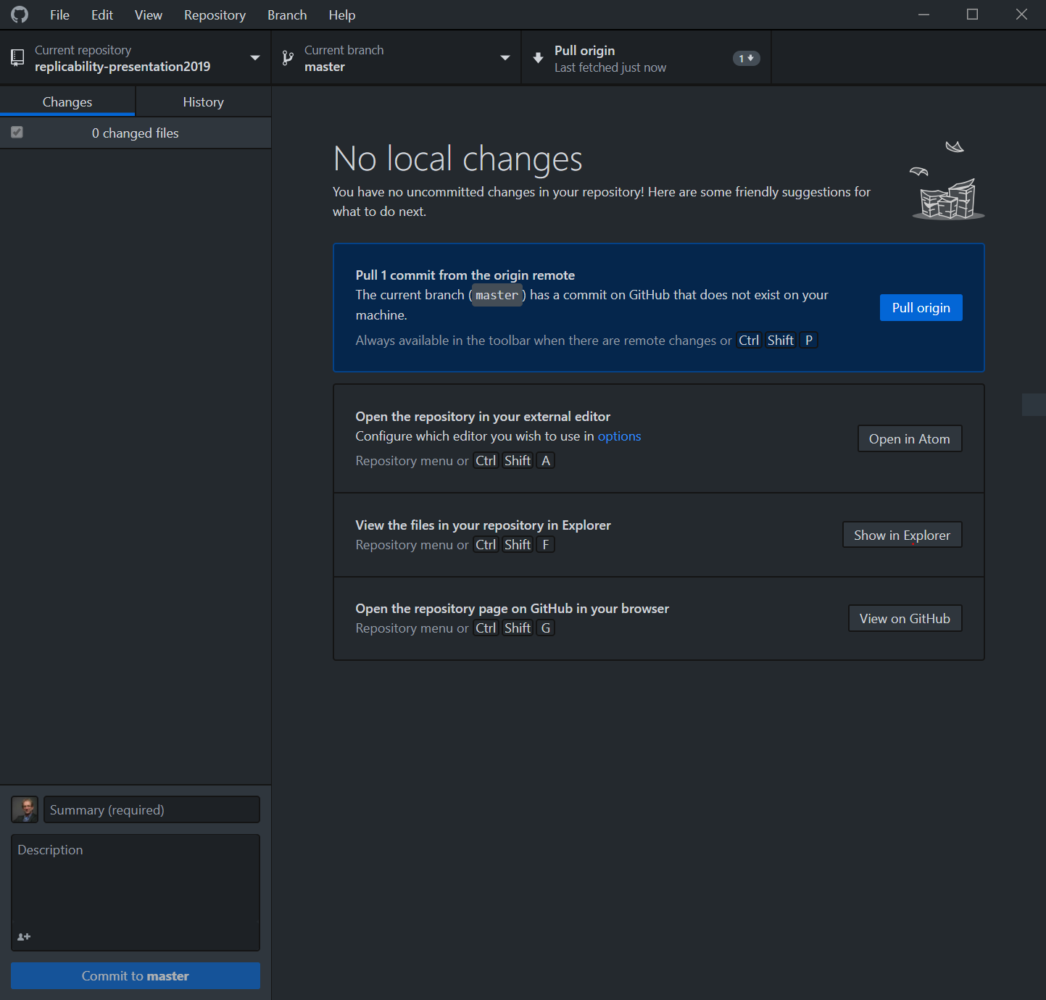

Slide 106
New skills to learn…

Slide 107
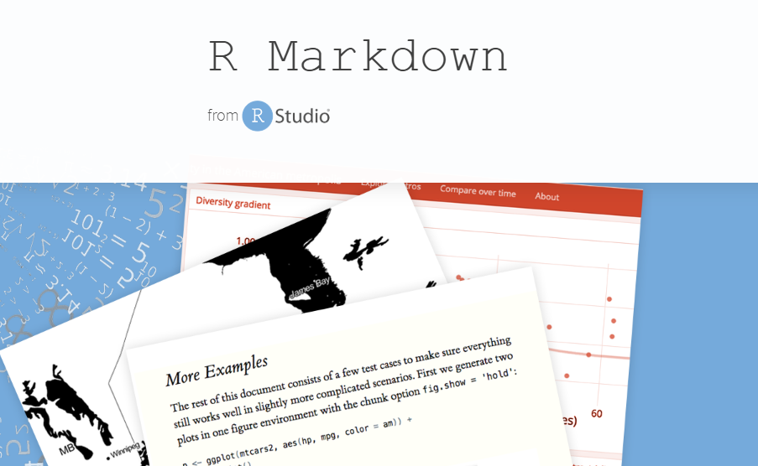
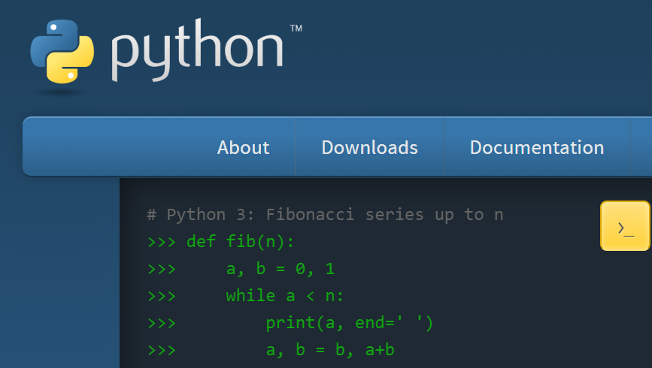

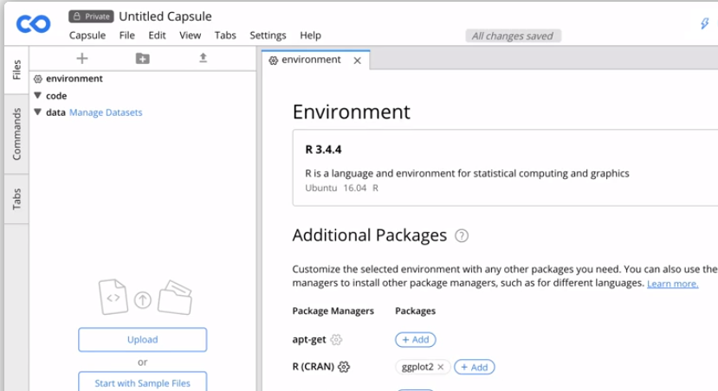

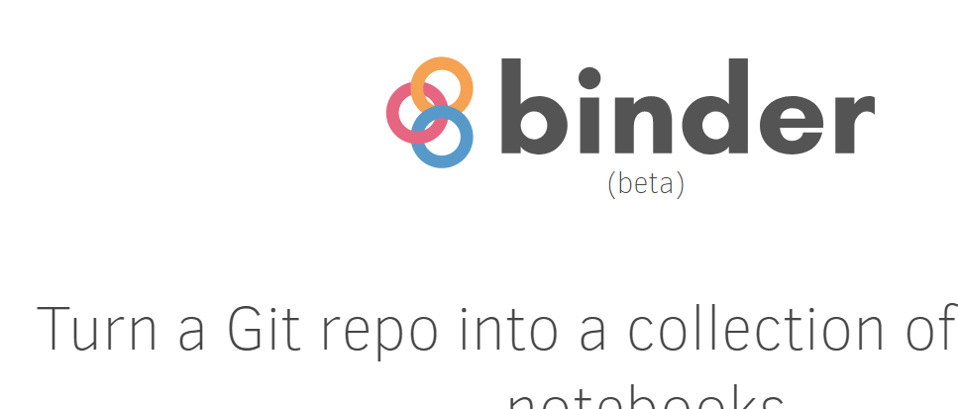

Slide 108
New methods to use …

Slide 109

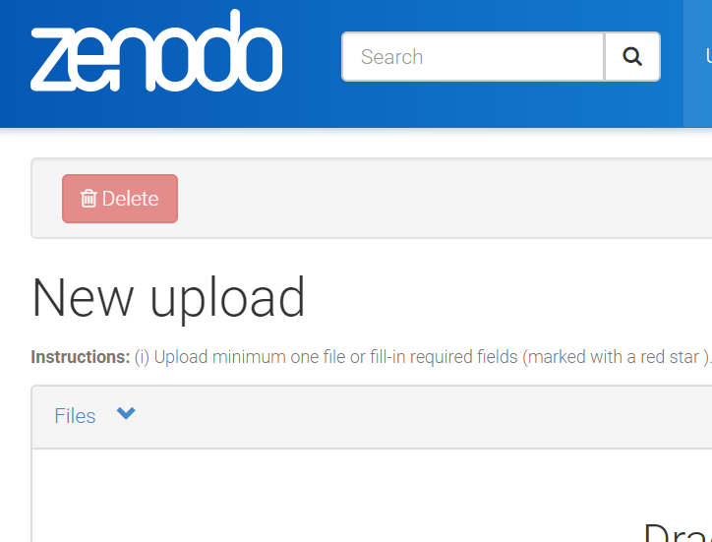
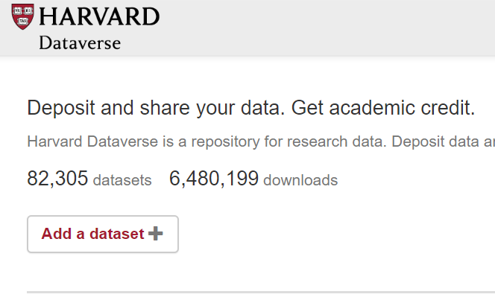
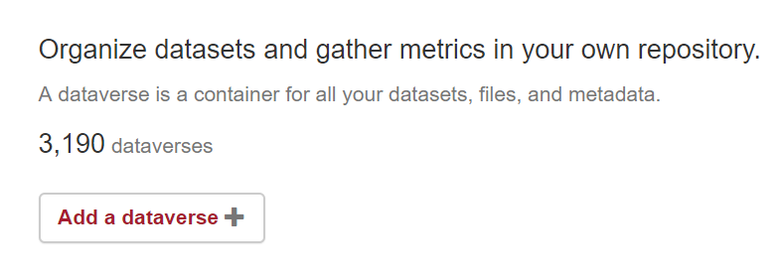
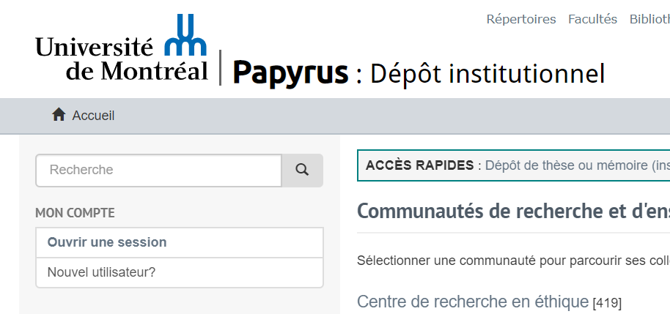
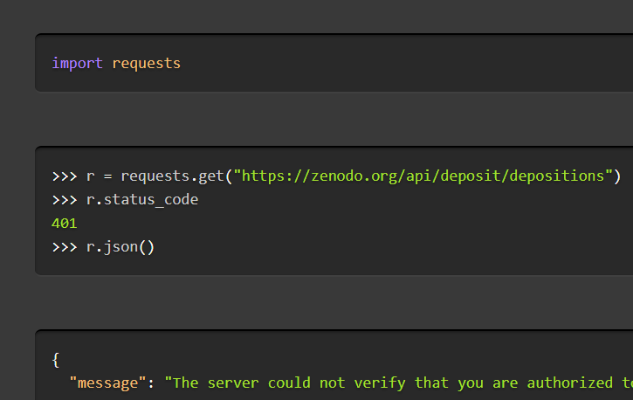

Slide 110
We!
Ingrained habits
New skills to learn
New methods to use

Slide 111
Push for better support…

Slide 112
Researchers: New skills to learn/teach
How to incorporate reproducible practices into your workflow
When to pre-register, and when not to
Document early, and often (better READMEs!)
How, where, and when to archive data and code
How to license your contributions!

Slide 113
Glimpses

Slide 114
Some random notes
Analogy between grant or RDC proposal and pre-registration
Incentives of stats agencies: transparency = credibility
Challenges with ad-hoc access (individuals accessing ministry data, CD in the back pocket/file drawer, unnamable private company)
From pre-acceptance verification to pre-submission verification (university or institute services) and the role of contract programming

Slide 115
Summary

Slide 116
Goals
Greater transparency
Equal treatment of public-use and confidential data
Better computational reproducibility
For public data as well as confidential data
Greater reliance on shared resources
Encourage best practices

Slide 117
Challenges for Restricted-Access Data
Verifiability
How can others obtain access?
Documentation
How can others learn about the data?
Persistence
How are data and programs preserved?

Slide 118
Thank you!
DOI: 10.5281/zenodo.2573123

