Slide 1
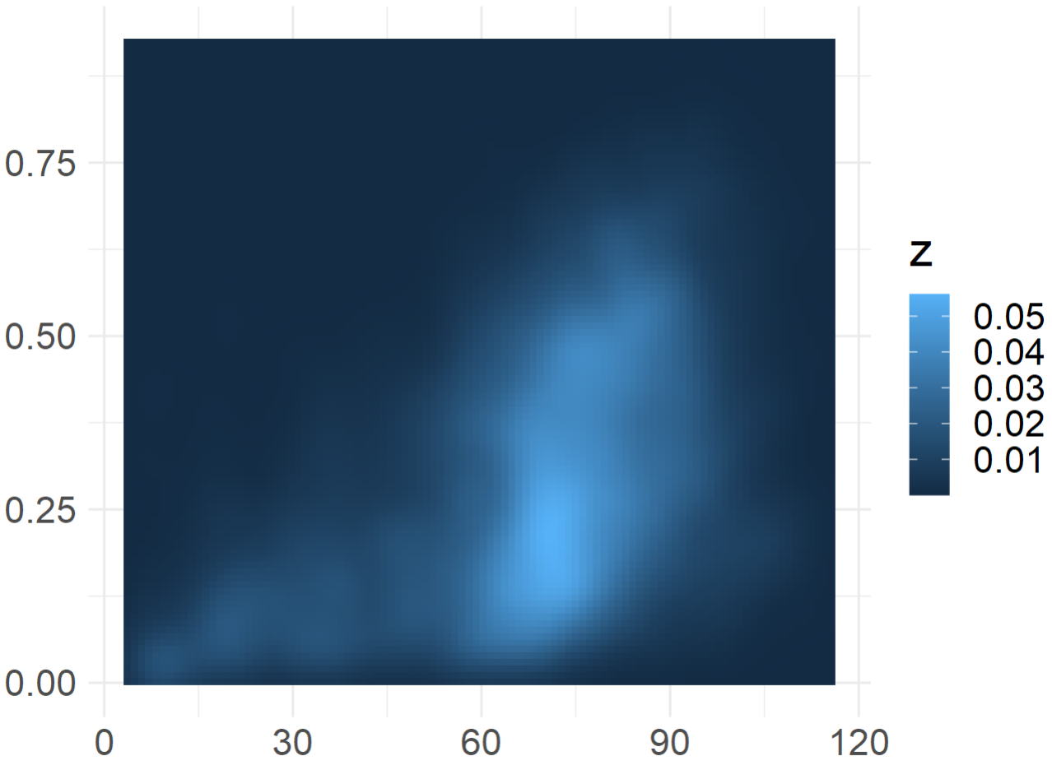
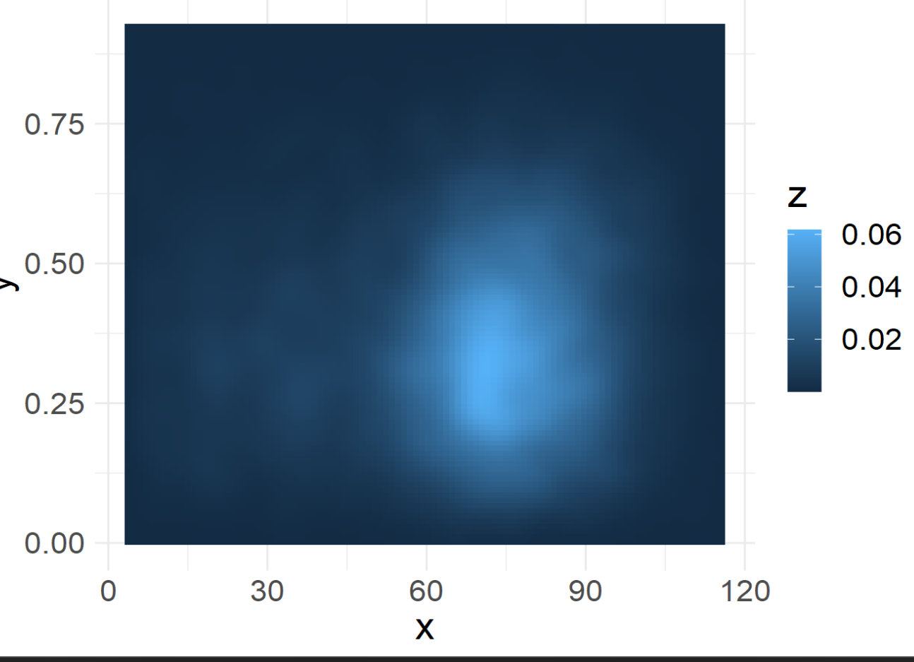
Real profiles
Randomized
Pathway distance
Global distance
Diverse cell types similar profiles
Global distance
Z=prob density of cell type pairs.

Slide 2
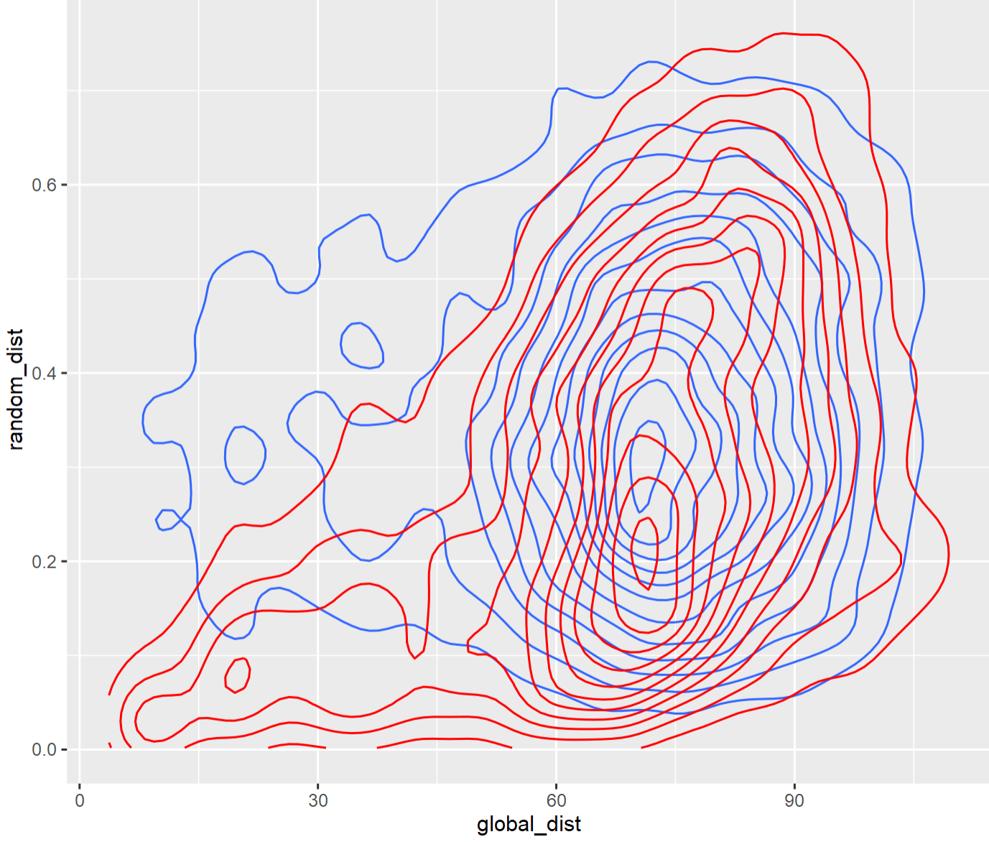
We are interested in the difference between the distributions.
Overlapping distributions
look a bit messy.
random
Pathway distance
real
Global distance

Slide 3
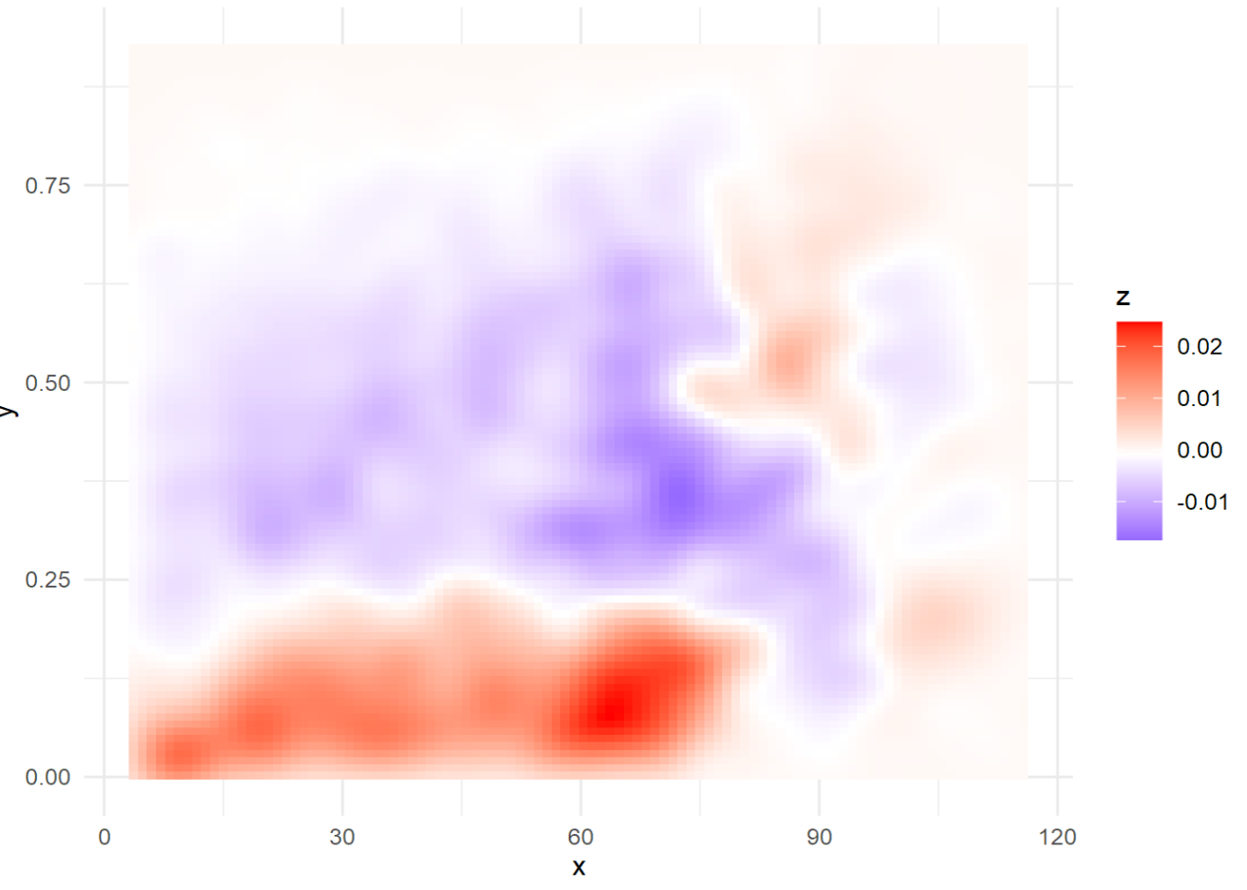
The difference between densities shows the enrichment in real profiles
More profiles in real
Pathway distance
More profiles in random
We see enrichment of
similar profiles
in both disperse and close cell types
Global distance

