Slide 1
Data Representation & Databases
Victor Roth Cardoso
04.12.2019

Slide 2
Data Representation & Databases
References
Overview to databases
Relational database systems
Understanding a database – Introduction to SQL
Other types of databases – InfluxDB and Neo4j
Exercises

Slide 3
References
1st Chapter of Fundamentals of Database Systems - Ramez Elmasri & Shamkant B. Navathe.
Comparison and evolution of databases: https://www.prisma.io/blog/comparison-of-database-models-1iz9u29nwn37
Easy to follow SQL course: https://swcarpentry.github.io/sql-novice-survey/
Chinook database (we are using today!): https://github.com/lerocha/chinook-database
Some information about the Chinook database: https://www.sqlitetutorial.net/sqlite-sample-database/

Slide 4
References
Graph database – Neo4j Sandbox: https://neo4j.com/sandbox-v2/
Graph database – Neo4j GraphGists: https://neo4j.com/graphgists/
Time-series database – InfluxDB Sample data: https://docs.influxdata.com/influxdb/v1.7/query_language/data_download/
Time-series database companion – Grafana Sandbox: https://play.grafana.org
Other SQL articles:
SQL Queries Don’t Start With Select: https://jvns.ca/blog/2019/10/03/sql-queries-don-t-start-with-select/
Why You Should Use SQL CTEs: http://www.helenanderson.co.nz/sql-ctes/
10 SQL Tricks That You Didn’t Think Were Possible: https://blog.jooq.org/2016/04/25/10-sql-tricks-that-you-didnt-think-were-possible/

Slide 5
Overview to databases
In our daily routine we interact with many databases
Bank storing data on accounts, balances and transactions
Libraries and the information on the media, rentals
Sports clubs with their different memberships
There are many systems that need to keep track of information…

Slide 6
Overview to databases
In our daily routine we interact with many databases
Bank storing data on accounts, balances and transactions
Libraries and the information on the media, rentals
Sports clubs with their different memberships
There are many systems that need to keep track of information…
… and even more lately, given the new possibilities of both infrastructure and analysis

Slide 7
Overview to databases
In our daily routine we interact with many databases
Bank storing data on accounts, balances and transactions
Libraries and the information on the media, rentals
Sports clubs with their different memberships
There are many systems that need to keep track of information…
… and even more lately, given the new possibilities of both infrastructure and analysis
Organizations store data in scales never seen before, and data has become an essential part of many businesses

Slide 8
Overview to databases
“A database is a collection of related data” and data are “facts that can be recorded and that have implicit meaning” – Fundamentals of Database Systems - Elmasri, R. & Navathe, S.
Databases have an universe of discourse, some structure and a purpose to it

Slide 9
Evolution of databases
Paper and pencil systems, folders and files organized into cabinets
Pros: good for small scale
Cons: hard to maintain with big scale
Spreadsheets
Pros: good for small scale
Cons: difficult to share access with others
Relational database systems
Pros: good for big scale
Cons: require Structured Query Language (SQL) knowledge
NoSQL: other than tabular
Pros: provide more options to database structure
Cons: require more specialized knowledge

Slide 10
In summary
Companies need databases. Databases store data. Data are facts. Facts should show some structure
There are many database systems, different advantages and disadvantages

Slide 11
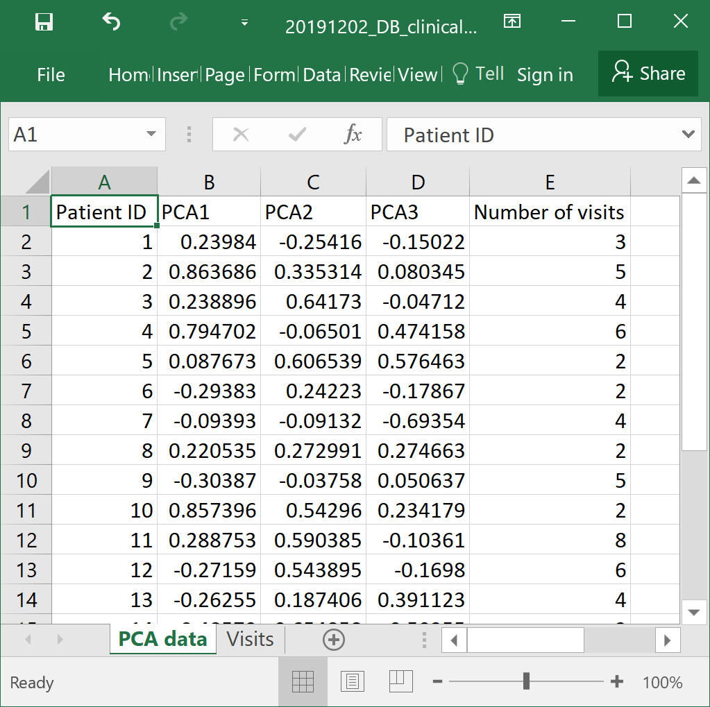
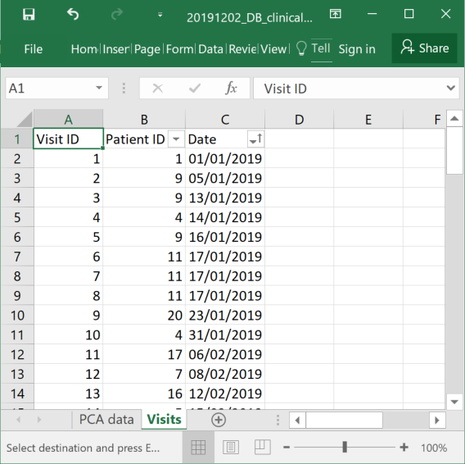
Relational database systems
Term invented in 1970 by Edgar F. Codd
It stands for a system that contains multiple tables, and data points that are related one-another.
For the time being, think of it as an excel file

Slide 12
Relation database systems
There are many relational database variants
PostgreSQL
MySQL
MariaDB
Microsoft SQL
SQLite
Some commands function in all of them
If not there are workarounds

Slide 13
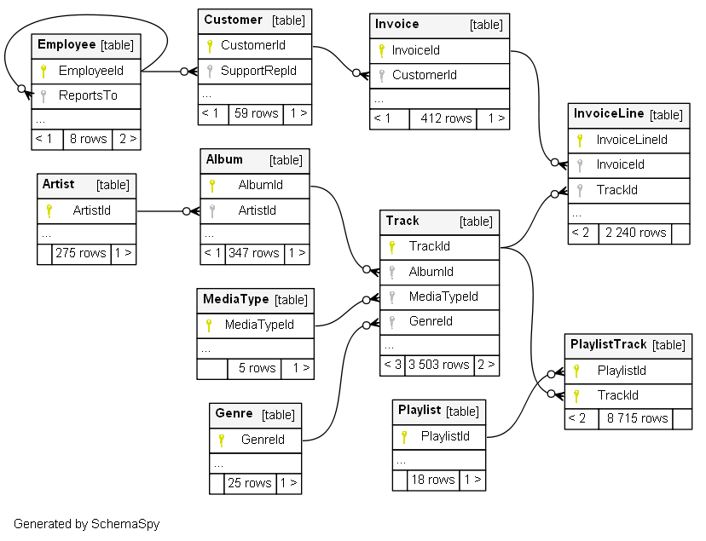
Understanding a database – Chinook database
Source: http://schemaspy.org/sample/relationships.html
Notes:
“The Chinook data model represents a digital media store, including tables for artists, albums, media tracks, invoices and customers”

Slide 14
Understanding a database – opening the database
Download DBeaver and the Chinook database.
Click around DBeaver, open different parts and see what happens.
Your goal: Explore the different tables, check the columns available, identify unique keys, foreign keys, indexes and references. Double-click some tables.
Identify some information:
Table Album: Data Type for column Title.
Table Track: Related tables.

Slide 15
Understanding a database – some initial queries
SELECT EmployeeId, LastName, FirstName, Title, ReportsTo, BirthDate, HireDate, Address, City, State, Country, PostalCode, Phone, Fax, Email FROM Employee
Right click on table Employee: Read data in SQL console
Wildcards
SELECT * FROM Employee

Slide 16
Understanding a database – where
SELECT EmployeeId, LastName, FirstName, Title, ReportsTo, BirthDate FROM Employee
It is possible to select some of the columns
Filter the results
Filtering text
SELECT EmployeeId, LastName, FirstName, Title, ReportsTo, BirthDate FROM Employee WHERE Title = 'IT Staff'
SELECT EmployeeId, LastName, FirstName, Title, ReportsTo, BirthDate FROM Employee WHERE Title LIKE '%Sales%'

Slide 17
Understanding a database – more conditions
SELECT EmployeeId, LastName, FirstName, Title, ReportsTo, BirthDate, HireDate, Address, City, State, Country, PostalCode, Phone, Fax, Email FROM Employee WHERE HireDate > '2002-10-10'
Filter using a date
Missing values
SELECT EmployeeId, LastName, FirstName, Title, ReportsTo, BirthDate, HireDate, Address, City, State, Country, PostalCode, Phone, Fax, Email FROM Employee WHERE ReportsTo IS NULL

Slide 18
Understanding a database – more conditions
SELECT EmployeeId, LastName, FirstName, Title, ReportsTo, BirthDate, HireDate, Address, City, State, Country, PostalCode, Phone, Fax, Email FROM Employee WHERE ReportsTo IS NOT NULL
Only existing values

Slide 19
Understanding a database – multiple conditions
SELECT EmployeeId, LastName, FirstName, Title, ReportsTo, BirthDate, HireDate, Address, City, State, Country, PostalCode, Phone, Fax, Email FROM Employee WHERE HireDate > '2002-10-10' AND Title LIKE 'IT%'
AND conditions
OR conditions
SELECT EmployeeId, LastName, FirstName, Title, ReportsTo, BirthDate, HireDate, Address, City, State, Country, PostalCode, Phone, Fax, Email FROM Employee WHERE HireDate > '2002-10-10' OR Title LIKE 'IT%'

Slide 20
Understanding a database – aggregate and other functions
SELECT MIN(BirthDate), MAX(BirthDate) FROM Employee
There are some build-in functions
Length of text columns
SELECT City FROM Customer WHERE LENGTH(City) > 10

Slide 21
Understanding a database – aggregate and other functions
Other functions:
AVG, COUNT, MAX, MIN, SUM
It is also possible to add the DISTINCT operator inside the aggregate function
SELECT COUNT(CustomerId) FROM Invoice;
SELECT COUNT(DISTINCT CustomerId) FROM Invoice;
More in: https://www.sqlite.org/lang_corefunc.html

Slide 22
Understanding a database – others
SELECT MIN(BirthDate) AS min_birth_date, MAX(BirthDate) AS max_birth_date FROM Employee
You can give alias to returned columns
Collect unique values
SELECT DISTINCT City FROM Customer WHERE LENGTH(City) > 10

Slide 23
Understanding a database
A query starts in the FROM term
After it is filtered with the WHERE conditions
Some columns are returned in the SELECT part
SELECT EmployeeId, LastName, FirstName, Title, ReportsTo, BirthDate, HireDate, Address, City, State, Country, PostalCode, Phone, Fax, Email FROM Employee WHERE HireDate > '2002-10-10'

Slide 24
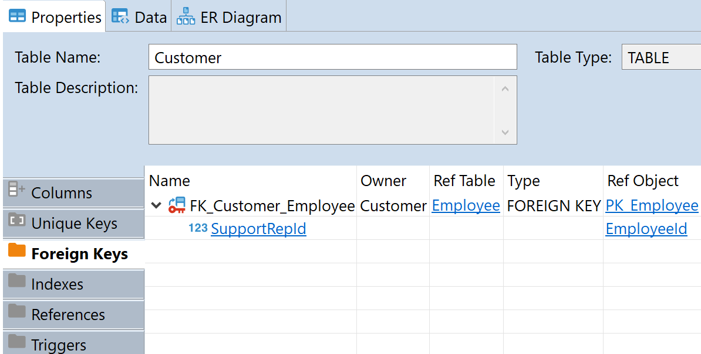
Understanding a database – relationships
Tables normally contain specific information about a thing
Querying information across tables provides more information
An example, table Customer: for a each customer there is an associated employee number

Slide 25
Understanding a database – relationships
There are different types of relations
1-1 relations:
One employee has only one supervisor (if it is not the big boss!)
One track has only a genre in this database
1-Many relations:
One employee supports multiple customers
SELECT TrackId, GenreId FROM Track
SELECT CustomerId, SupportRepId FROM Customer

Slide 26
Understanding a database – relationships
N-M relations:
Multiple from one side to multiple in the other side
The relationships come from the foreign keys and references
SELECT PlaylistId, TrackId FROM PlaylistTrack WHERE TrackId = 100
SELECT PlaylistId, TrackId FROM PlaylistTrack WHERE PlaylistId = 1

Slide 27
Understanding a database – relationships
There are many ways to get the tables together
Table
Table
Left side
Intersection
Right side

Slide 28
Understanding a database – relationships
LEFT JOIN: get all from the left, extras from the right side
All the records on the LEFT side, extras from the RIGHT side if there
SELECT staff.FirstName, staff.Title, staff.ReportsTo, supervisor.EmployeeId, supervisor.FirstName, supervisor.Title FROM Employee staff LEFT JOIN Employee supervisor ON staff.ReportsTo = supervisor.EmployeeId

Slide 29
Understanding a database – relationships
RIGHT JOIN: get all from the RIGHT, extras from the LEFT side
All the records on the RIGHT side, extras from the LEFT side if available
SELECT staff.FirstName, staff.Title, staff.ReportsTo, supervisor.EmployeeId, supervisor.FirstName, supervisor.Title FROM Employee staff RIGHT JOIN Employee supervisor ON staff.ReportsTo = supervisor.EmployeeId
Notes:
SQLite does not support it

Slide 30
Understanding a database – relationships
INNER JOIN: prioritize the left side, with added information from the right side
Complete query on both left and right side
SELECT staff.FirstName, staff.Title, staff.ReportsTo, supervisor.EmployeeId, supervisor.FirstName, supervisor.Title FROM Employee staff INNER JOIN Employee supervisor ON staff.ReportsTo = supervisor.EmployeeId

Slide 31
Understanding a database – relationships
FULL JOIN: information from both sides
SELECT TrackId, Name, AlbumId, MediaTypeId, GenreId, g.Name FROM Track FULL OUTER JOIN Genre g ON Track.GenreId = g.GenreId
SELECT * FROM Track AS a LEFT JOIN Genre AS b ON a.GenreId = b.GenreId UNION SELECT * FROM Genre AS a LEFT JOIN Track AS b ON a.GenreId = b.GenreId WHERE a.GenreId IS NULL
Notes:
SQLite does not support it

Slide 32
Understanding a database – relationships
It is possible to add conditions to these queries
Query the employees – supervisors relation which the supervisor has General title
Query the employees – supervisors relation which staff is in Sales
SELECT staff.FirstName, staff.Title, staff.ReportsTo, supervisor.EmployeeId, supervisor.FirstName, supervisor.Title FROM Employee staff INNER JOIN Employee supervisor ON staff.ReportsTo = supervisor.EmployeeId WHERE supervisor.Title LIKE 'General%'
SELECT staff.FirstName, staff.Title, staff.ReportsTo, supervisor.EmployeeId, supervisor.FirstName, supervisor.Title FROM Employee staff INNER JOIN Employee supervisor ON staff.ReportsTo = supervisor.EmployeeId WHERE staff.Title LIKE 'Sales%'

Slide 33
Understanding a database – groupings
SELECT CustomerId, FirstName FROM Customer
Get some information from the table
Count the number of customers from the United Kingdom
What if you need for other countries?
It goes very repetitive to all the countries in the list
SELECT COUNT(*) FROM Customer WHERE Country = ‘United Kingdom’
SELECT COUNT(*) FROM Customer WHERE Country = ‘USA’
SELECT DISTINCT Country FROM Customer

Slide 34
Understanding a database – groupings
SELECT Country, COUNT(*) FROM Customer GROUP BY Country
GROUP BY operator
For each Country, use the aggregate function count
It is possible to add conditionals in the query
SELECT Country, COUNT(*) FROM Customer WHERE Company IS NOT NULL GROUP BY Country

Slide 35
Understanding a database – complex queries
When a query becomes too long and complex it is good to break it into chunks: Common Table Expression (CTE)
WITH operator
WITH customers_USA AS ( SELECT * FROM Customer WHERE Country = 'USA' AND Company IS NOT NULL ), customers_purchases AS ( SELECT CustomerId, SUM(Total) AS T FROM Invoice GROUP BY CustomerId ) SELECT EmployeeId, e.FirstName, c.CustomerId, c.FirstName, cp.T FROM Employee e INNER JOIN customers_USA c ON c.SupportRepId = e.EmployeeId LEFT JOIN customers_purchases cp ON cp.CustomerId = c.CustomerId

Slide 36
Understanding a database
Some queries might return too much data
DBeaver returns the data in blocks by default
It might be needed to limit in other interfaces/programs
SELECT PlaylistId, TrackId FROM PlaylistTrack LIMIT 100

Slide 37
Understanding a database
The database tries to optimize the queries for the fastest/optimal execution
Some commands not shown are:
CREATE TABLE
CREATE INDEX
ALTER TABLE
DROP TABLE
SELECT INTO

Slide 38
Other types of databases
Many different types:
Relational databases
Graph databases
Object storage
Document store
Time-series database
Optimized to different scenarios

Slide 39
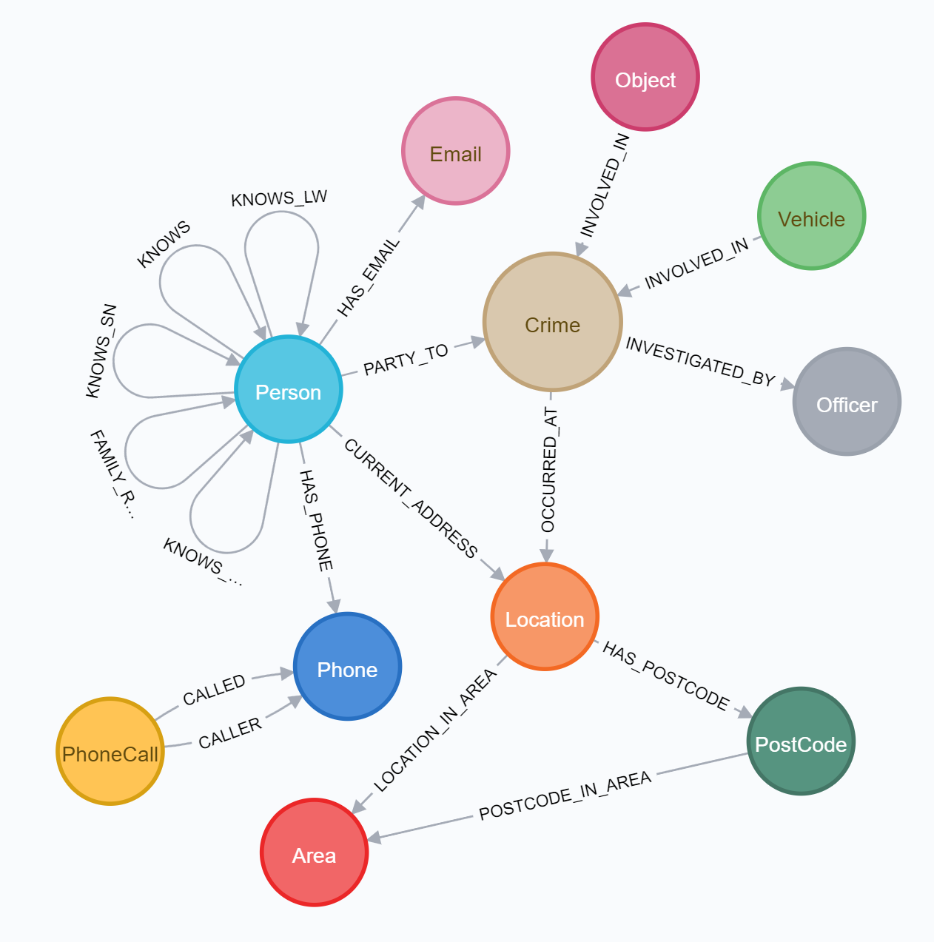
Other types of databases – Graph Database Neo4j
Part of the database features an embedded browser for visualisation
In the Neo4j sandbox are some datasets
In an example, this is a dataset on public
information about crimes in the UK
The dataset focuses on relationships
between different elements

Slide 40
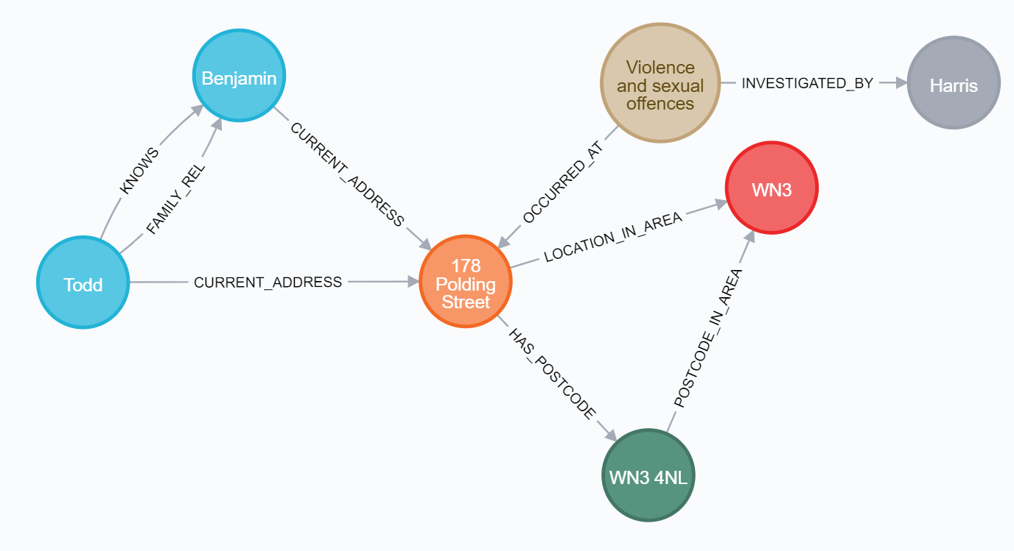
Other types of databases – Graph Database Neo4j
It is possible to query direct relationships and expand from there

Slide 41
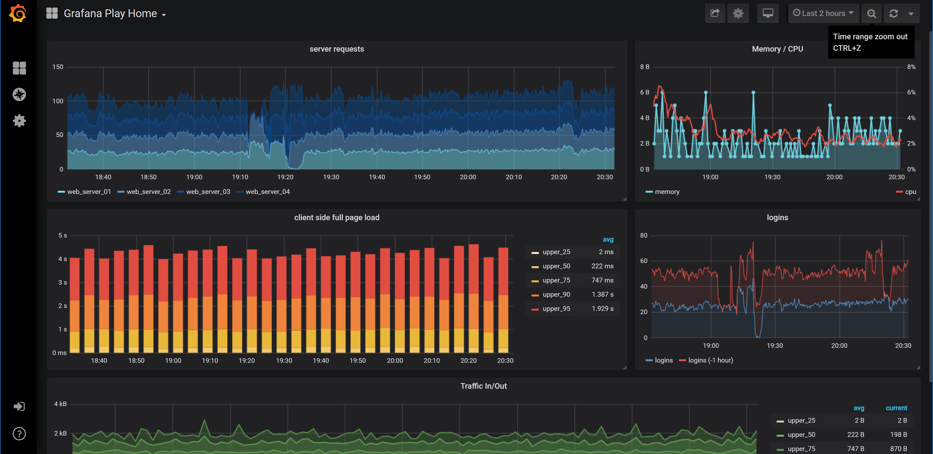
Other types of databases – Time-series Database InfluxDB
Functions optimized for management of time-related data
Build-in functions for handling storage of older data into groupings
In combination with Grafana: powerful visualisation tool

Slide 42
Exercises
A: SELECT FROM WHERE
B: JOIN
C: COUNT
D: GROUP BY
E: WITH
Table Customer
A
Get the customers where there is no support employee (SupportRepId)
Get the customers with a company.
Get the Customers for the support employee (SuportRepId) equal to 1
B
Get the EmployeeId and FirstName of the employee associated with a customer
Get the number of customers for each employee. Report with EmployeeId and FirstName
C
Get the number of rows in the table

Slide 43
Exercises
A: SELECT FROM WHERE
B: JOIN
C: COUNT
D: GROUP BY
E: WITH
Table Invoice
D
Get the number of invoices Total for each CustomerId
Get the sum of the Invoices Total for each CustomerId
Get the sum of the Invoices Total for each BillingCountry
Get the sum of the Invoices Total for each Customer Country

Slide 44
Exercises
A: SELECT FROM WHERE
B: JOIN
C: COUNT
D: GROUP BY
E: WITH
Table Track
A
Get the longest track
The Name for the tracks in AlbumId 1
The genre names for the tracks in AlbumId 1
C
Get the number of rows in the table
D
Get the maximum track length (Milliseconds) for each AlbumId
Get the maximum track length (Milliseconds) for each AlbumId for GenreId which Name starts with ‘R’
E
Collect the names of the tracks which had the longest length per album (problem D1)

Slide 45
Exercises
Querying and collecting the data in Python
Copy the database and the .ipynb file
Explore a database in the Neo4j Sandbox:
Graph database – Neo4j Sandbox: https://neo4j.com/sandbox-v2/
Check the features in Grafana:
Time-series database companion – Grafana Sandbox: https://play.grafana.org

