Slide 1
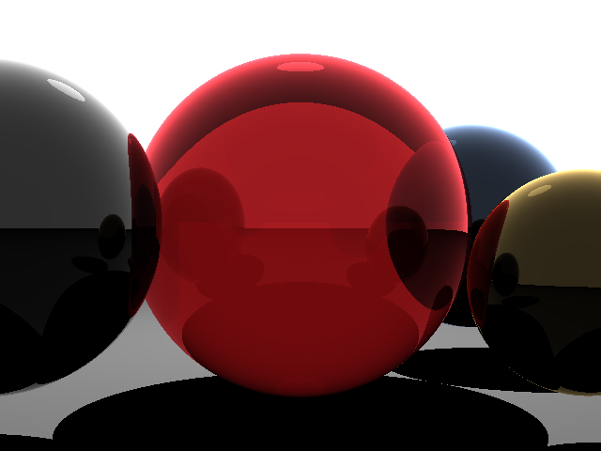
Testing Ray Tracers
Brian Labrum

Slide 2
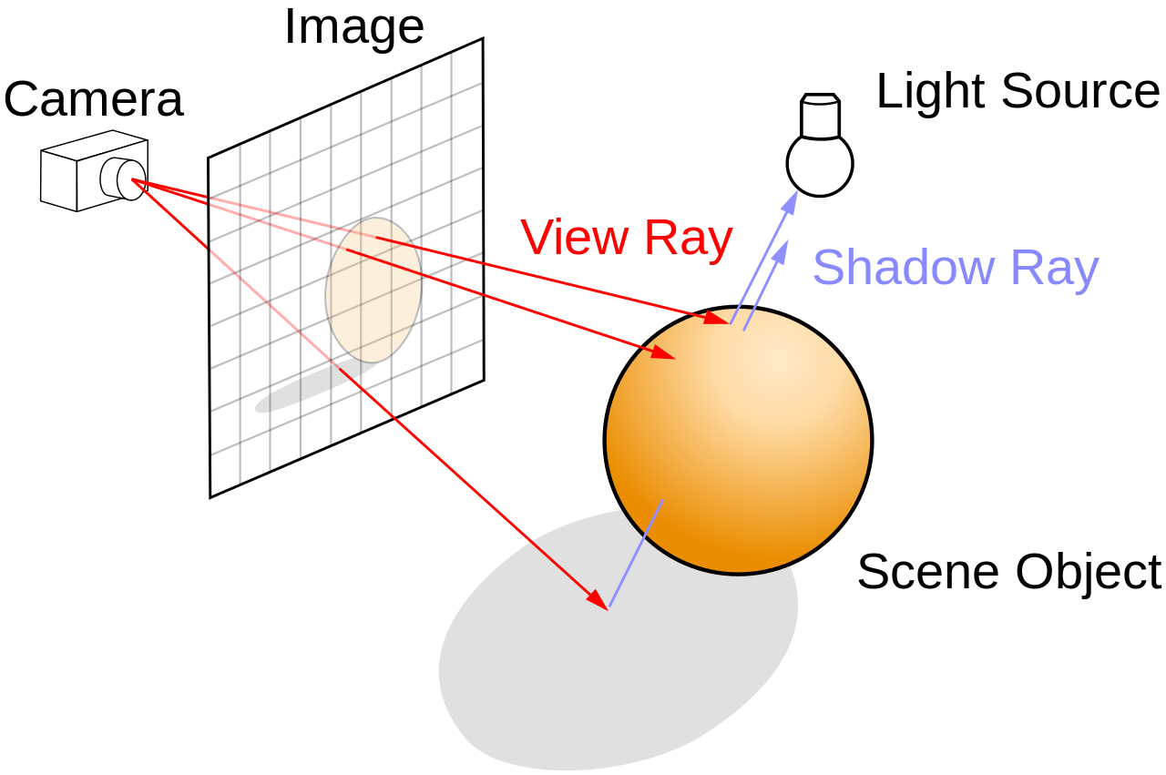
Ray tracing

Slide 3
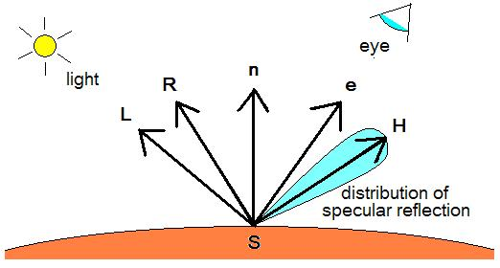
Ray test generator
Clip space
disabled lighting
test (test number)(args)
512x512 image
Fov 45
image resolution 512 x 512
s1 location<-0.46875000000000000,-0.46875000000000000,-20> color<1.0,0.0,0.0> radius 5
s2 location<-0.23437500000000000,-0.23437500000000000,-10> color<0.0,1.0,0> radius 0.00351562490686774
(250,262) <0.0,1.0,0.0>

Slide 4
Pixel color checker
Checks if pixel is correct color
Takes file location and pixel coordinates
Only checks if pixel is green

Slide 5
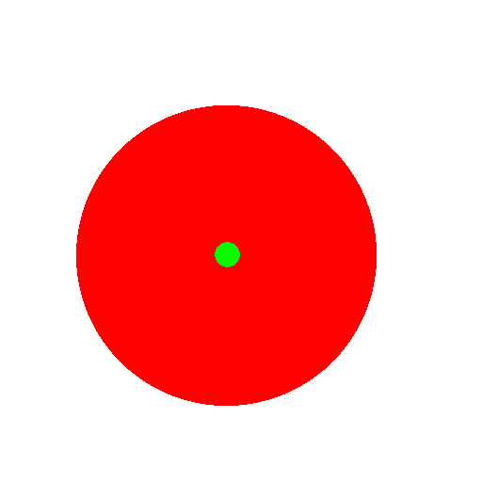
Test 1 two spheres
Test generates 2 spheres 1 large the other small
Takes in scale value p for smaller sphere where
Test 1 (float p)

Slide 6

Test 1 results
C++ tracer
P = | Pixel check | visible
55 | y | y
50 | n | y
5 | n | y
1 | n | y
.5 | n | n

Slide 7
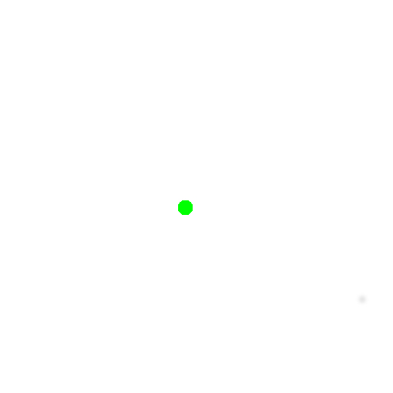
Test 2 distant sphere
Test generates one sphere
Takes in distance value d that determines how far away sphere is
test 2 (int d)

Slide 8
Test 2 results
C++ tracer
d = | Pixel check | visible
100 | y | y
125 | n | y
500 | n | y
1250 | n | y
1300 | n | n

Slide 9

Test 3 sphere edge
Test generates one sphere
Takes in distance value p that determines how large the sphere is
test 3 (float p)

Slide 10
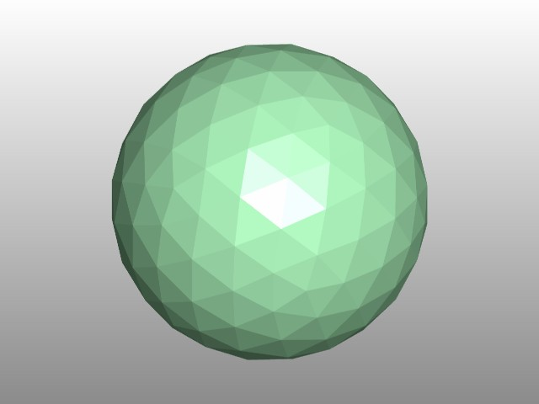
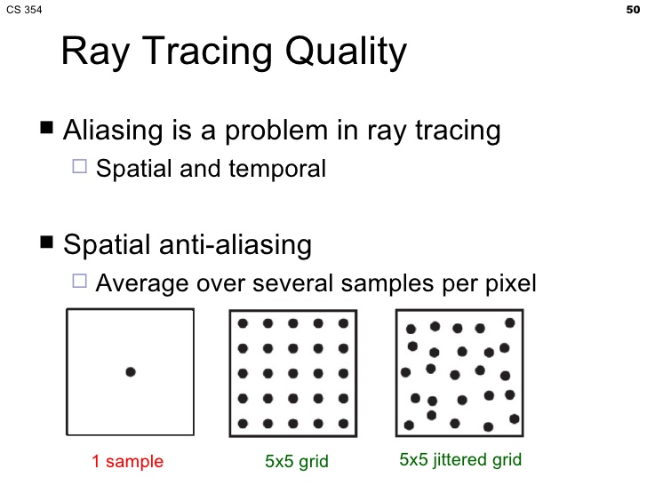
Guaranteed to fail

Slide 11
What's next
Arbitrary image resolution
Nested spheres
Reflections
Refraction
generate multiple tests at once

Slide 12
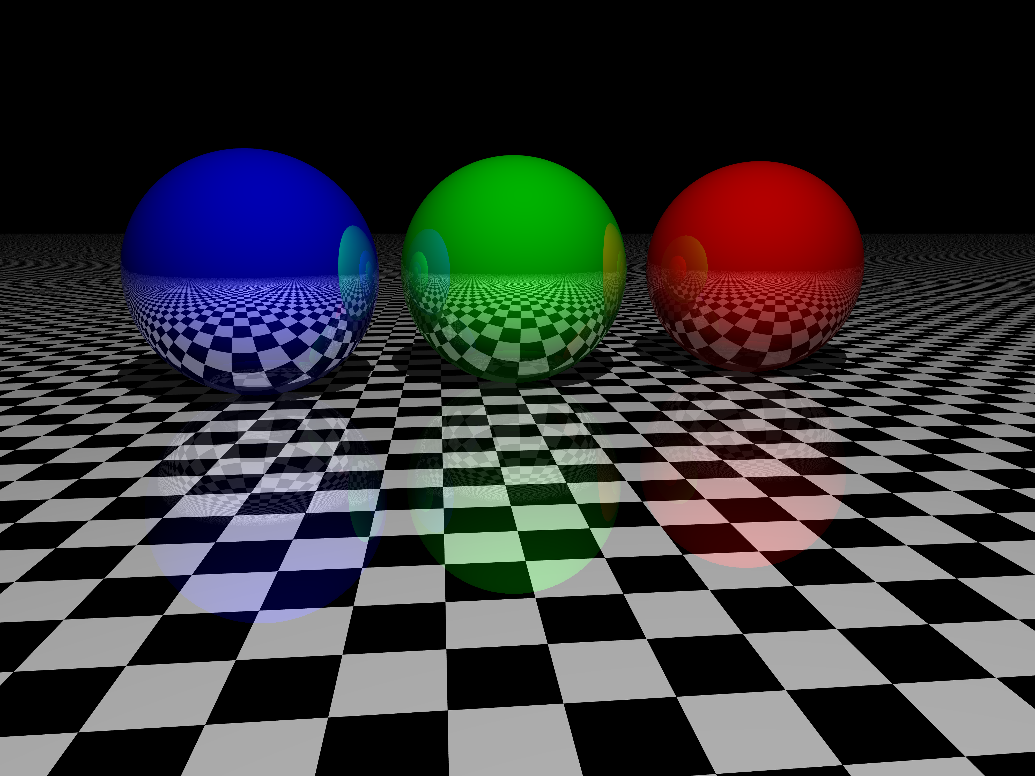
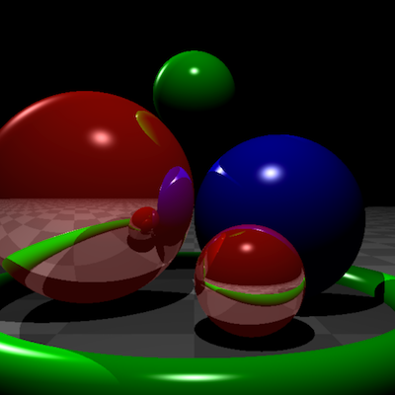
Useful?

