Slide 1
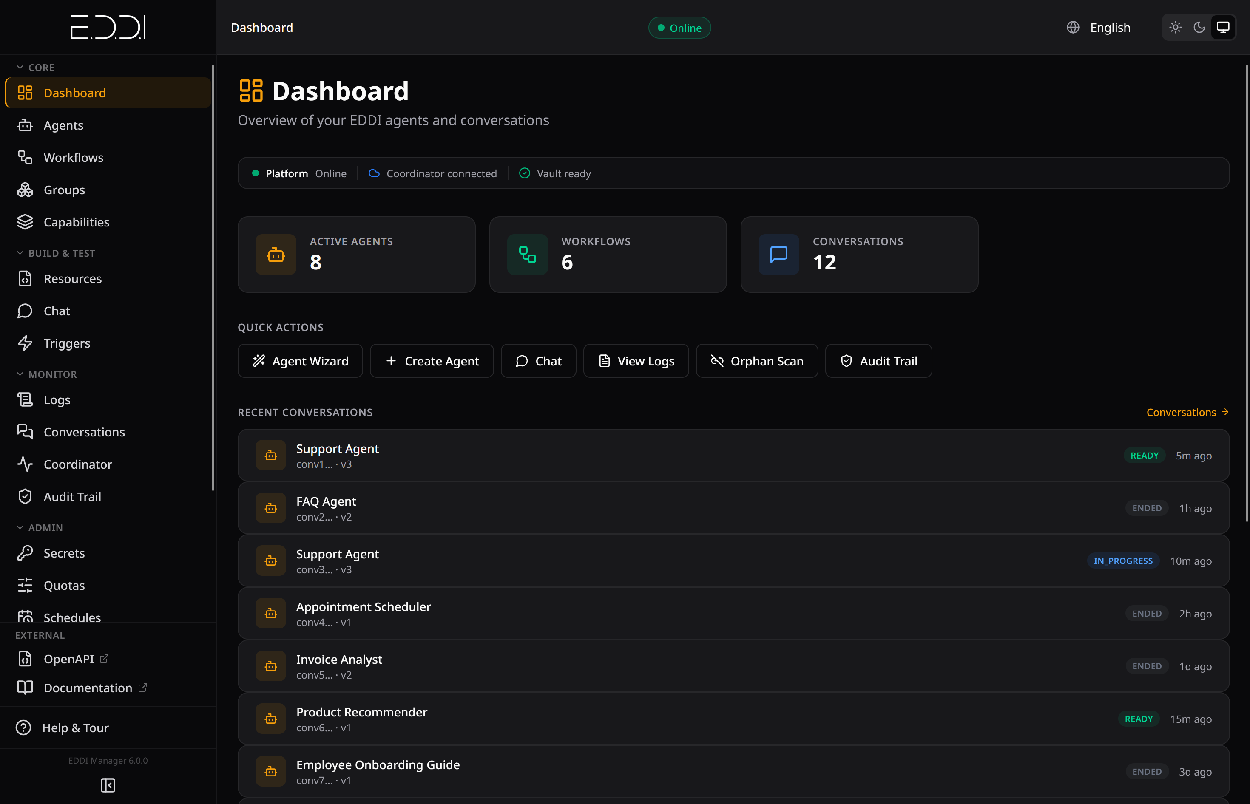
🏆 UNIDO Trusted Partner for Industrial AI
E.D.D.I
Enhanced Dialog Driven Interface
Multi-Agent Orchestration Middleware
for Industrial AI
12
60+
9,000+
LLM Providers
MCP Tools
Tests >90% Coverage
labs.ai · eddi.labs.ai · Open Source · Apache 2.0

Slide 2
The Challenge
Most AI agent frameworks are great for prototyping — hard to govern in production.
Dimension
Typical Frameworks
E.D.D.I
Concurrency
GIL / single-threaded
Java 25 Virtual Threads
Agent Logic
Embedded in code
Versioned JSON configs
Security
Sandboxed code execution
No dynamic code execution
Compliance
Custom implementation
GDPR, HIPAA, EU AI Act built-in
Audit Trail
Application logging
HMAC-SHA256 immutable ledger
Deployment
pip/npm + manual infra
One-command Docker install
"The engine is strict so the AI can be creative." — Project Philosophy

Slide 3
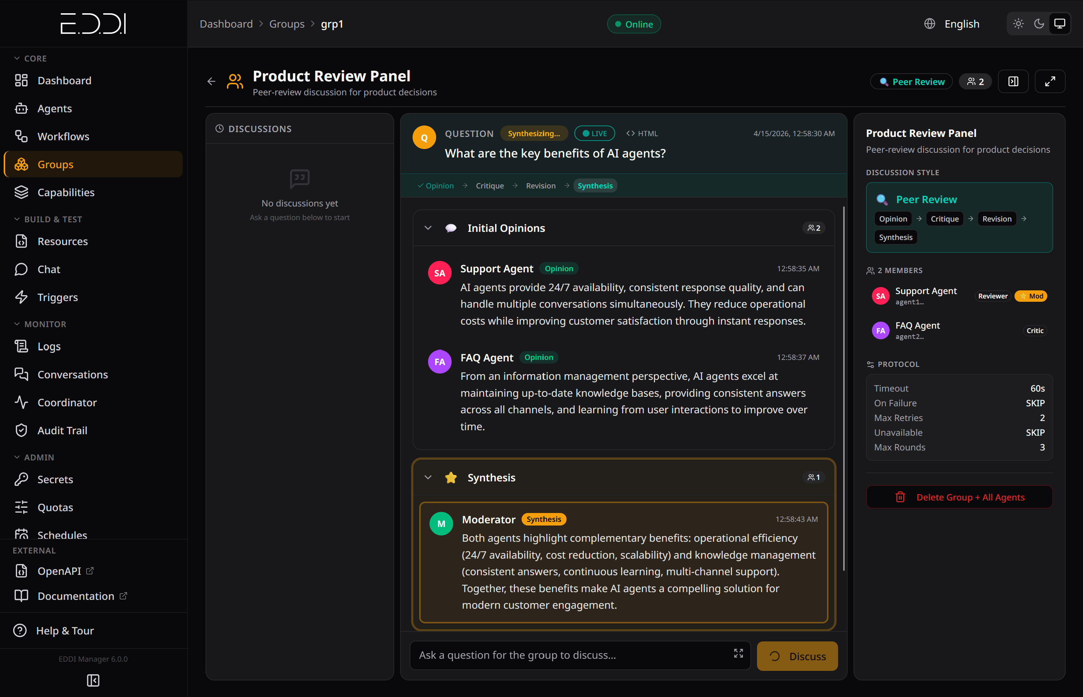
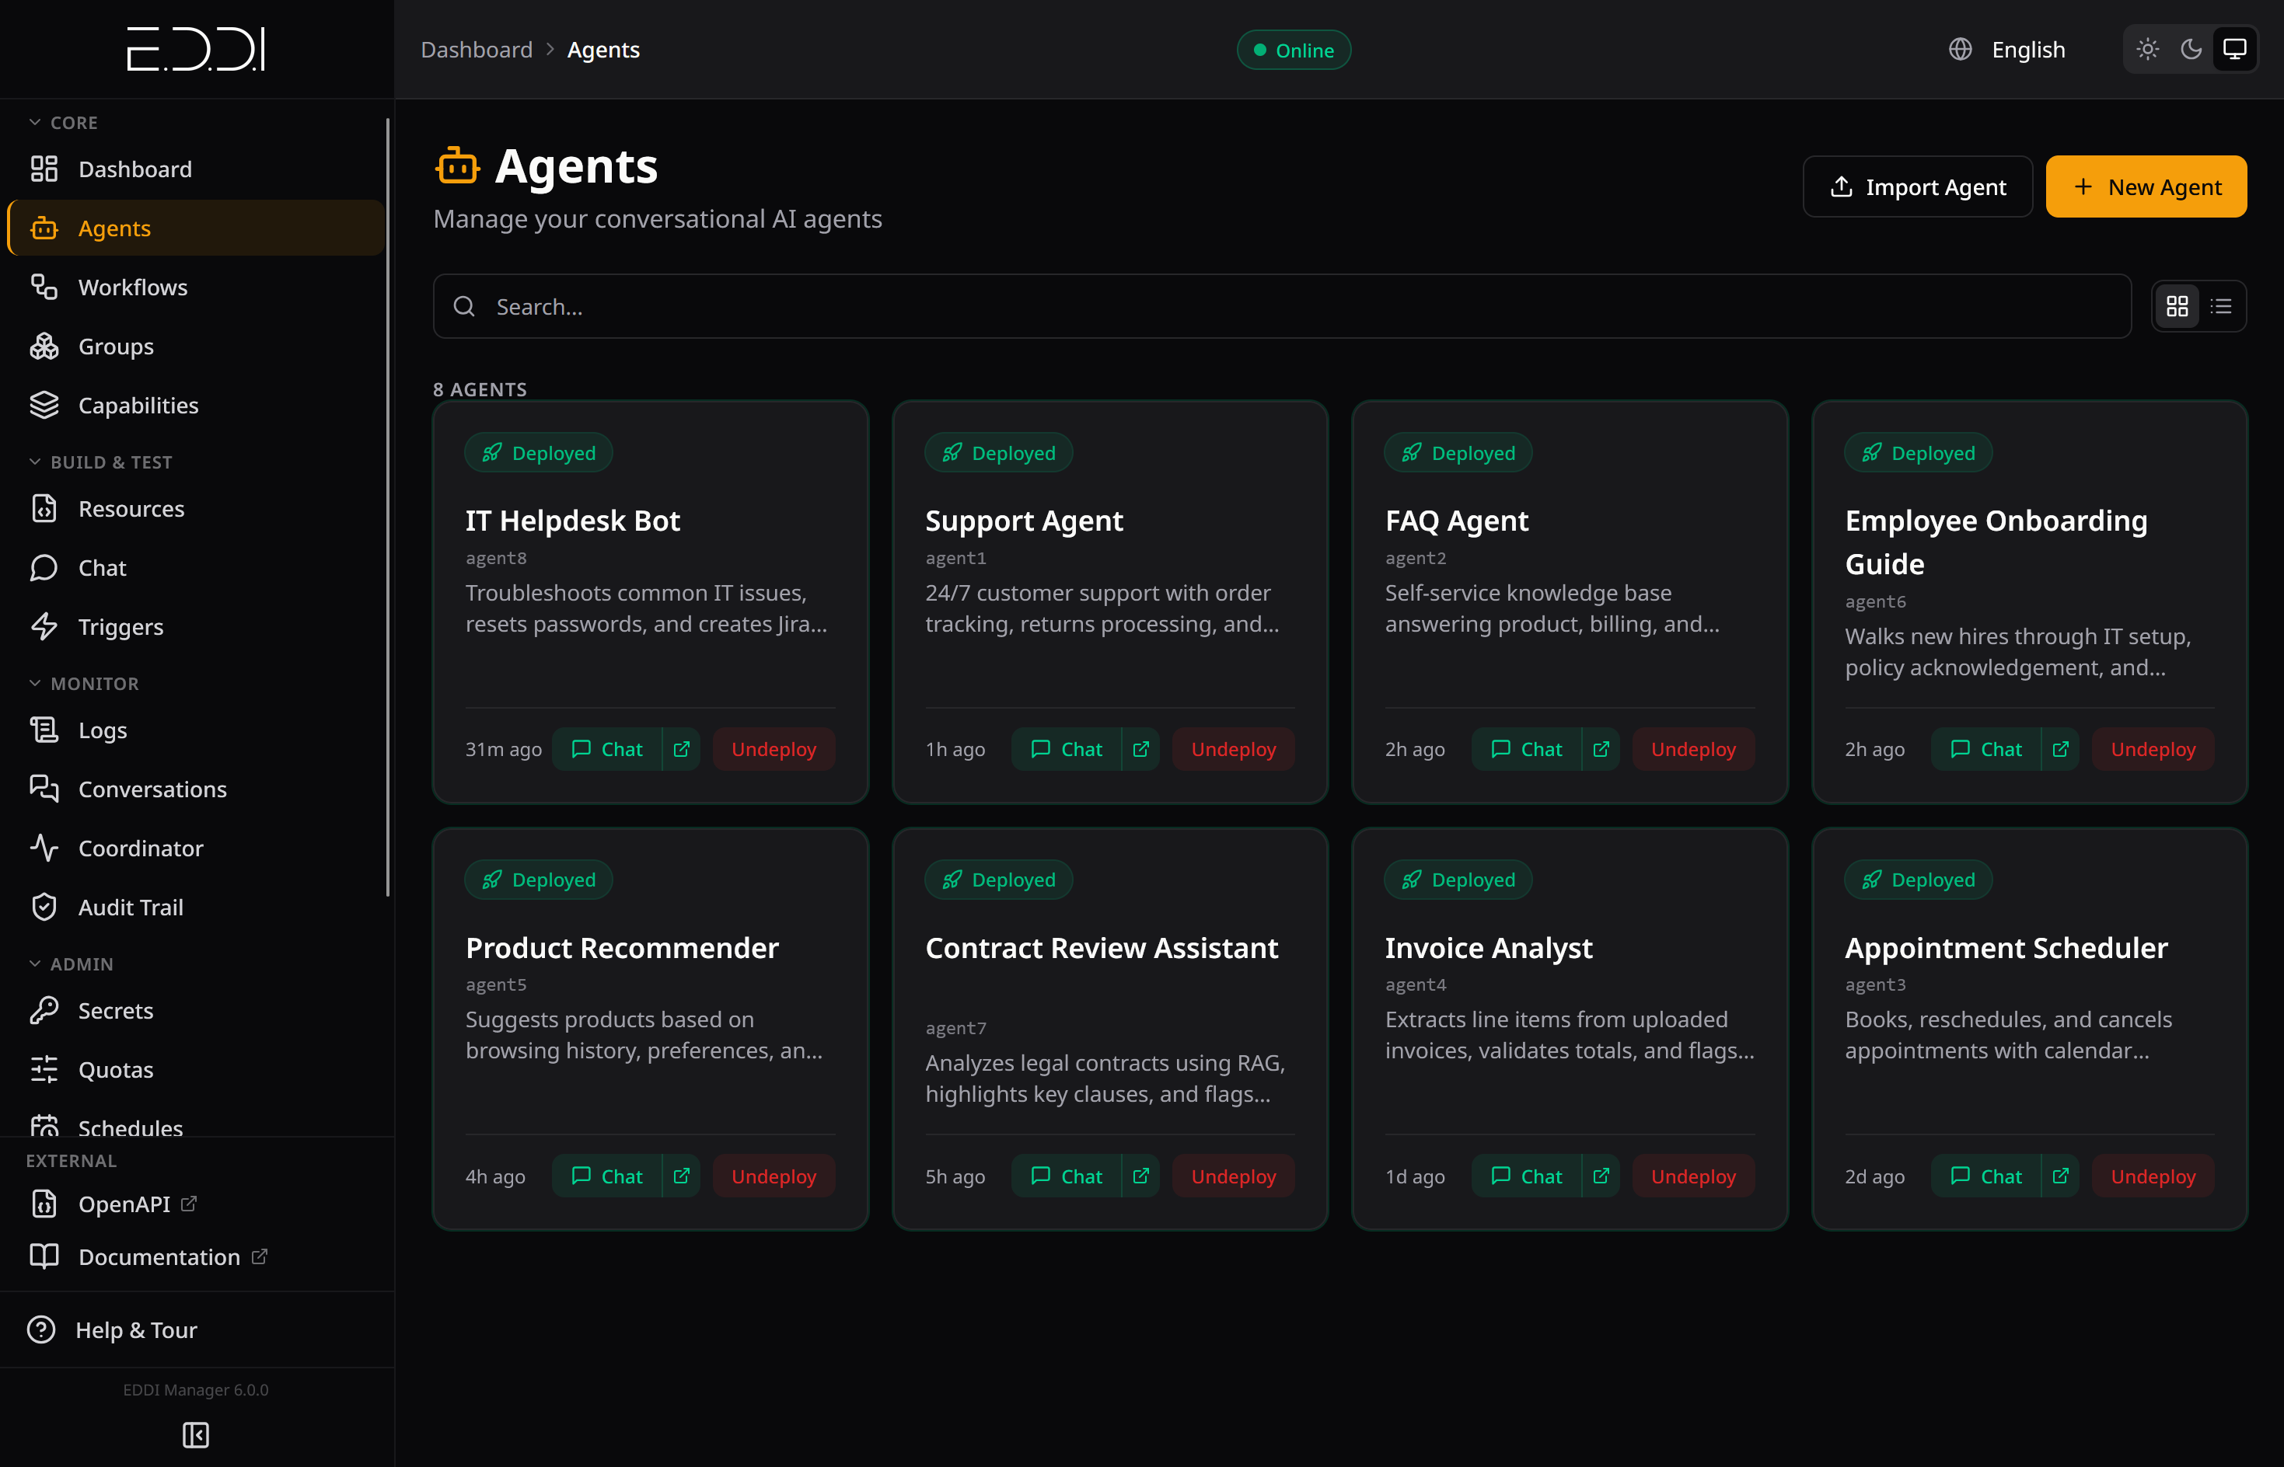
Multi-Agent Orchestration
🔀 Intelligent Routing
Direct conversations to agents based on context, rules, and intent
🗣️ Group Conversations
6 debate styles: Round Table, Peer Review, Devil's Advocate, Delphi, Debate, Task Force
🤖 Dynamic Agents
Create, recruit, and delegate to new agents at runtime
🎯 Capability Matching
Discover and route to agents by skill and confidence score
🧙 Agent Father
Meta-agent that creates other agents through conversation
🪆 Nested Groups
Groups of groups for tournament brackets and panel reviews

Slide 4
Open Standards & Interoperability
MCP
Server (60+ tools) + Client — control EDDI from Claude, Cursor, Windsurf, or any MCP client
Model Context Protocol
A2A
Cross-platform agent communication, Agent Cards, and skill discovery
Agent-to-Agent Protocol
OpenAPI
Auto-generated spec — paste any OpenAPI spec → fully deployed API-calling agent
3.1 Specification
OAuth 2.0
Multi-tenant authentication, authorization, and role-based access control
OIDC / Keycloak
SSE
Real-time streaming for chat, group discussions, and live log feeds
Server-Sent Events
12 LLM Providers: OpenAI · Anthropic · Google Gemini · Mistral · Azure OpenAI · Bedrock · Oracle GenAI · Vertex AI · Ollama · Jlama · HuggingFace · Any OpenAI-compatible

Slide 5
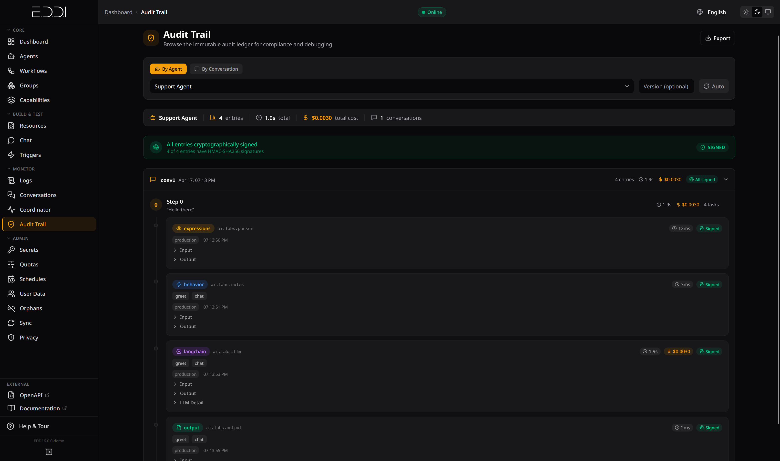
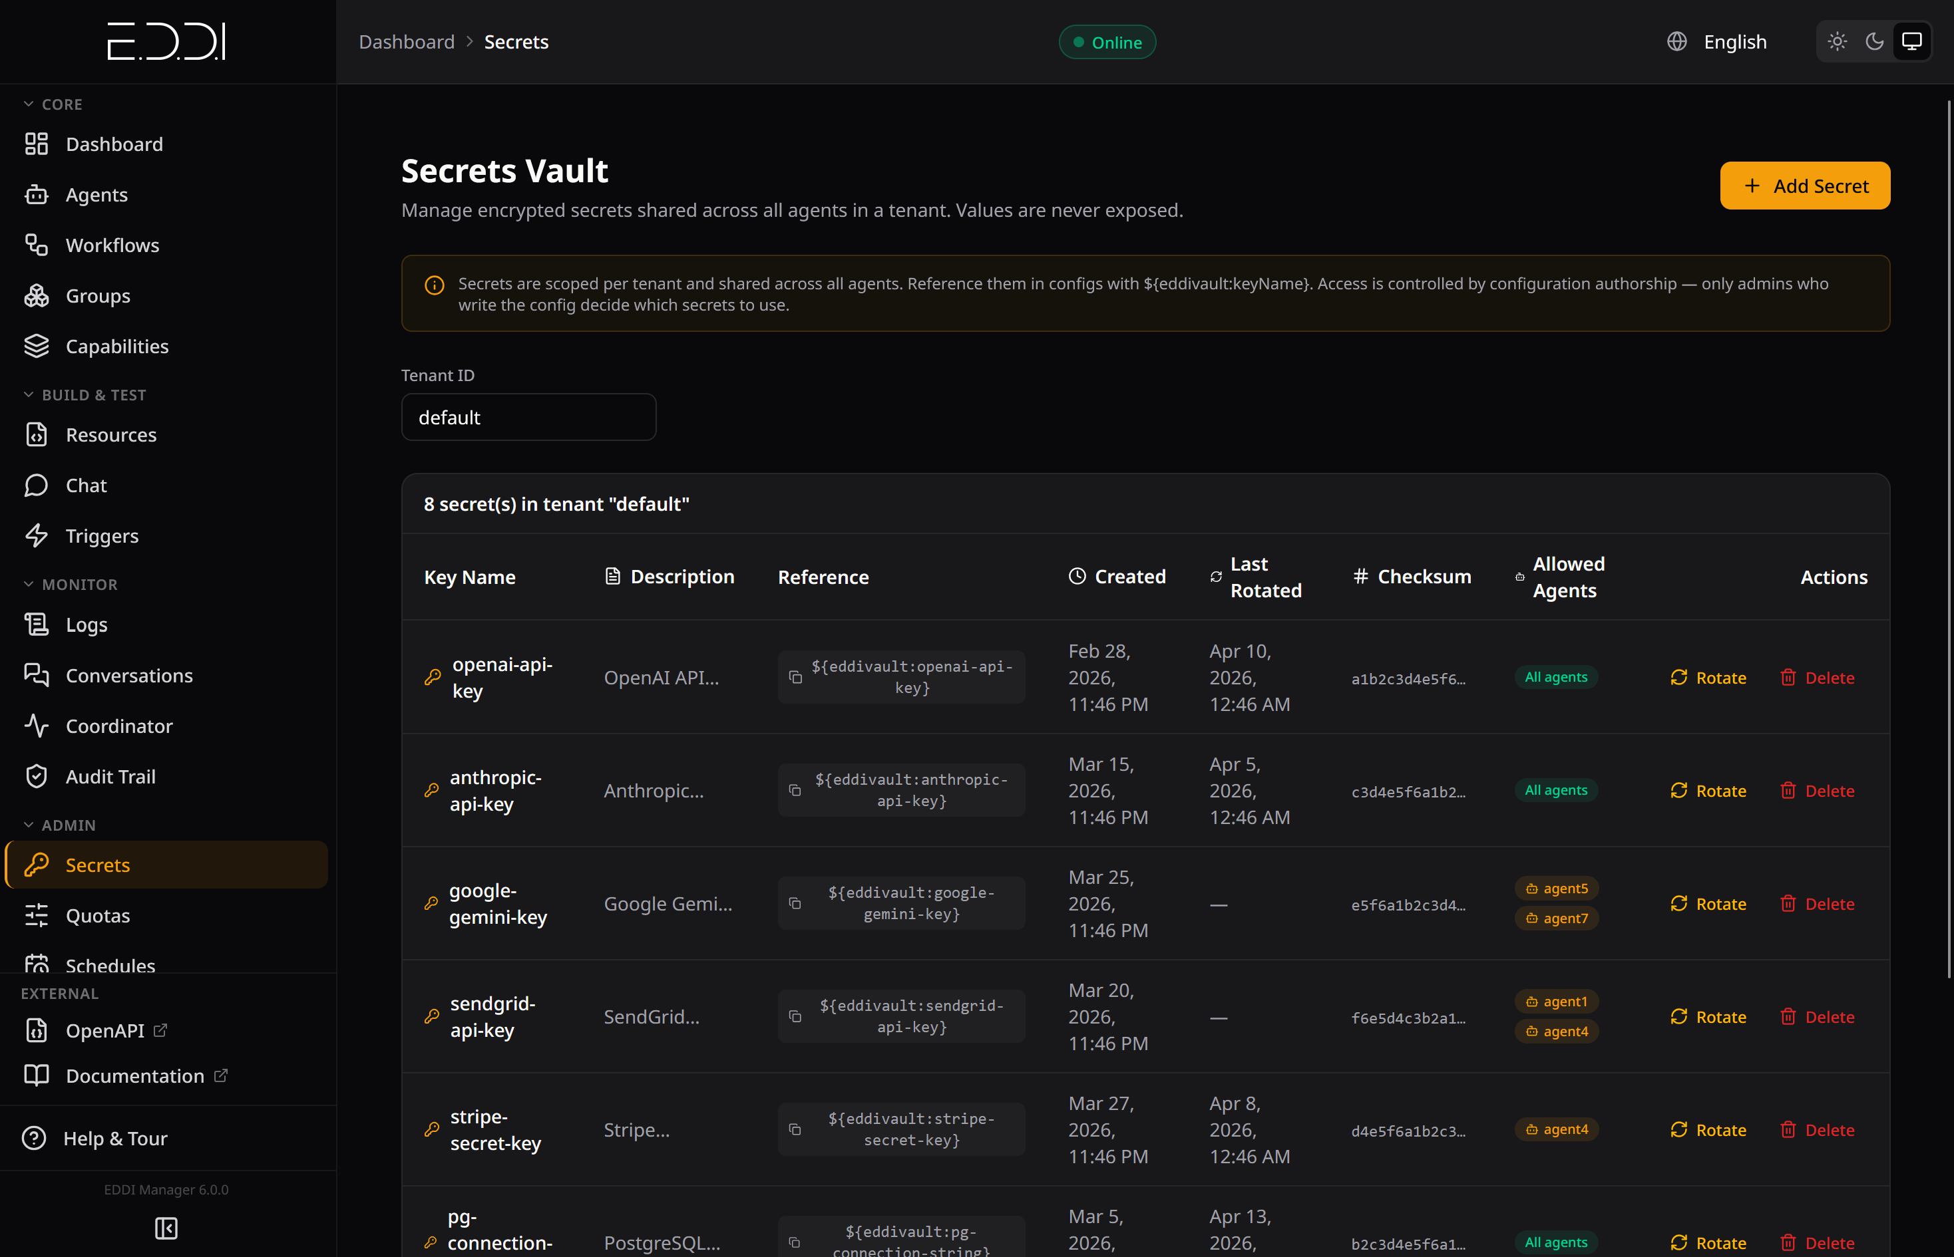
Enterprise Security & Compliance
Regulatory Compliance
🏦 Secrets Vault
AES-256 envelope encryption, tenant-scoped key rotation
EU AI Act
Immutable HMAC-SHA256 audit ledger, decision traceability
🛡️ SSRF Protection
All tools validate URLs against private IPs and internal hosts
GDPR
🔒 No Code Execution
Cascading erasure, data portability, restriction of processing
Recursive-descent math parser only — no eval(), no reflection
HIPAA
✍️ Agent Signing
Deployment guide, BAA template, provider BAA matrix
Ed25519 cryptographic identity per agent
International
PIPEDA 🇨🇦 · LGPD 🇧🇷 · APPI 🇯🇵 · POPIA 🇿🇦 · PDPA 🇸🇬 · PIPL 🇨🇳

Slide 6
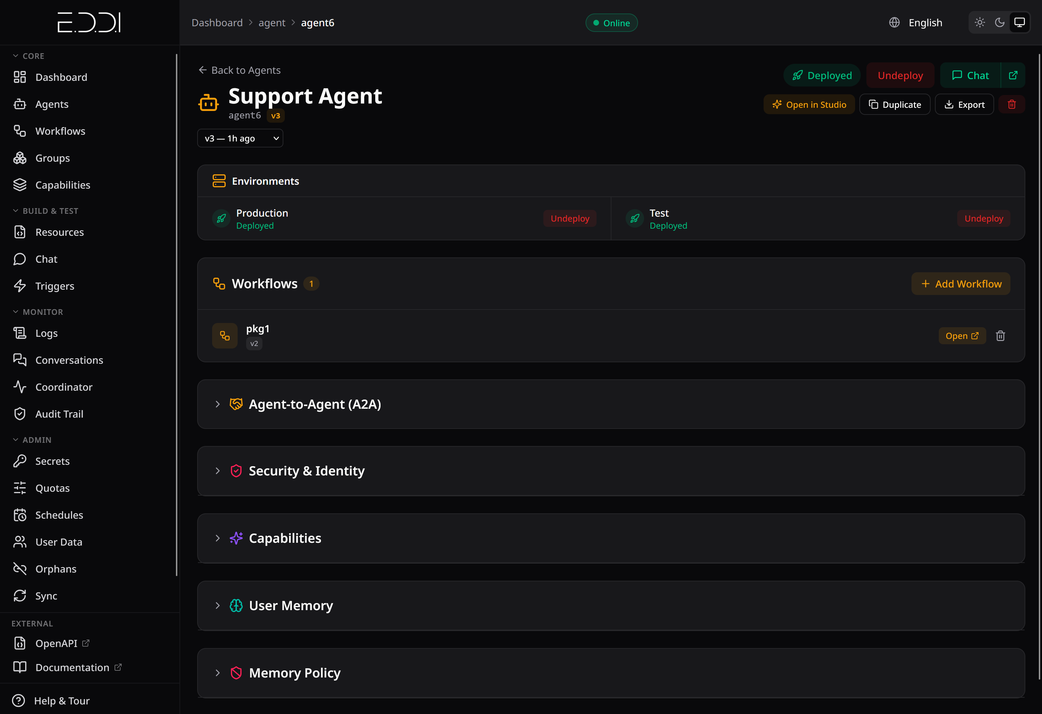
Config-Driven Architecture & Persistent Memory
Memory & Context Management
📄 Agent behavior in versioned, diffable JSON — not compiled code
💾 Persistent User Memory
🔧 Pluggable lifecycle pipeline: Input → Parse → Rules → LLM/API → Output
Facts, preferences across sessions
📦 Composable agents from reusable, version-controlled workflows
💤 Dream Consolidation
📤 Import/Export as ZIP with automatic secret scrubbing
Background pruning & contradiction detection
🔄 Live agent sync between instances with structural matching
🪟 Token-Aware Windowing
Model-specific tokenizer support
📝 Reusable prompt snippets: {{snippets.safety_rules}}
📝 Rolling Summary
Incremental LLM summarization of older turns
📚 RAG
7 embedding providers, 5 vector stores

Slide 7
E.D.D.I
Multi-Agent Orchestration Middleware for Industrial AI
Open Source · Apache 2.0 · Red Hat Certified
Selected as UNIDO Trusted Partner for Industrial AI in the Global South
🌐 Website
📖 Documentation
🐙 GitHub
🐳 Docker Hub
eddi.labs.ai
docs.labs.ai
github.com/labsai/EDDI
hub.docker.com/r/labsai/eddi
"The engine is strict so the AI can be creative."
labs.ai

