Slide 1

Do Mutations of Strongly Subsuming Second-Order Mutants Really Mask Each Other?
João Paulo Diniz, Fischer Ferreira, Fabiano Ferrari, Eduardo Figueiredo
LabSoft Seminar. September 25th, 2023

Slide 2
Outline
Mutation testing
Higher-order mutants
Mutants generation
Strongly Subsuming Second-Order Mutants
Study #1
Study #2
Related work
Conclusion
Notes:
Sumário / agenda; avaliação da viabilidade

Slide 3
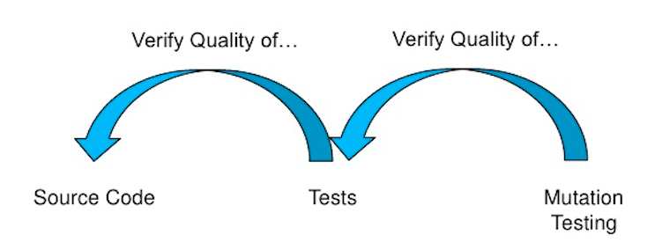

Introduction
Notes:
A forma mais simples de explicar a utilidade (principal aplicação/função) de testes mutantes é:
testes de sw são criados para avaliar a qualidade
Cobertura é uma forma de medir, mas insuficiente. Ex.: objeto null
Investigated over last 4 decades in the academy

Slide 4
Mutation Testing
Introducing artificial changes into the original source code
Syntactic changes ➔ mutations
Changed programs ➔ mutants
Representing real common programming mistakes
Running test cases on mutants
Result different from original: mutant killed
Otherwise: alive

Slide 5
Example of a mutant
Original:
public class Taxes {
double simpleTax(double amount) {
return amount * 0.2;
}
}

Slide 6
Example of a mutant
Mutation place:
public class Taxes {
double simpleTax(double amount) {
return amount * 0.2;
}
}

Slide 7
Example of a mutant
* → +
public class Taxes {
double simpleTax(double amount) {
return amount + 0.2;
}
}

Slide 8
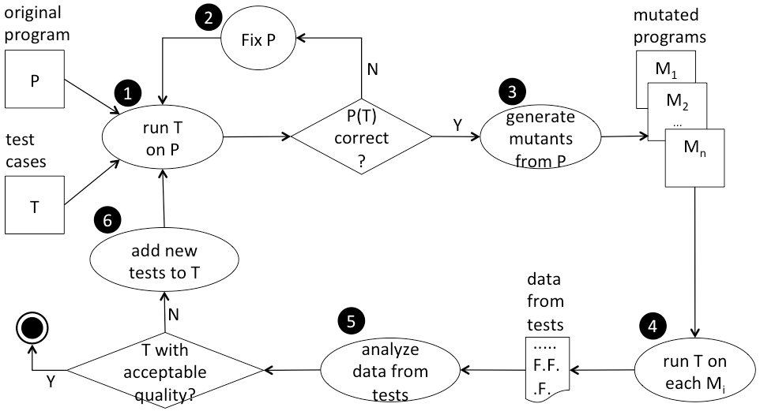
Mutation testing process
Software Testing Process
Notes:
General / generic

Slide 9
Mutation testing drawbacks
Many mutable places
Mutants generation
Compilation
High computational cost
Running tests

Slide 10
Mutation testing drawbacks
Cost reduction techniques
Number of mutants
Number of test cases
Test case prioritization
Higher-order mutation testing

Slide 11
Higher-order Mutants

Slide 12
Higher-order mutants
1 mutation ➔ first-order mutant (FOM)
> 1 mutations ➔ higher-order mutant (HOM)
2 mutations ➔ 2nd order mutant (2OM)
n mutations can generate
~ C( ) 2OMs
~ C( ) 3OMs
~ 2^{n} HOMs (exponential)

Slide 13
Higher-Order Mutants
Most are more likely to be killed than FOMs
But few are harder to be killed
are more representative
represent subtler faults
mutations can (partially) mask each other
Strongly Subsuming Higher-Order Mutants (SSHOMs)
Notes:
Coupling effect

Slide 14
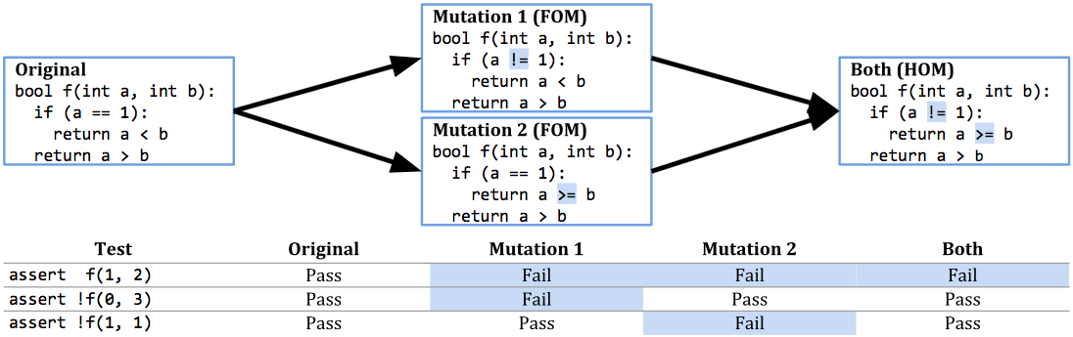
An SS2OM example
⬅t1
⬅t2
⬅t3
t2
t1
t3
Notes:
Então, se eu soubesse antecipadamente que M1_M2 é um SSHOM, seria possível reduzir o esforço computacional de 2 formas:
Rodar suíte de testes somente para M1 e M2 juntos e não isoladamente.
Rodar somente o teste t1

Slide 15
Mutants reduction - example
FOMs
m1
m2
m3
m4
m5
m6
m7
m8

Slide 16
Mutants reduction - example
FOMs | SS2OMs
m1 | [m1,m2]
m2 | [m3,m4]
m3 | [m5,m6]
m4
m5
m6
m7
m8

Slide 17
Mutants reduction - example
FOMs | SS2OMs | Resulting mutants
m1 | [m1,m2] | [m1,m2]
m2 | [m3,m4] | [m3,m4]
m3 | [m5,m6] | [m5,m6]
m4
m5
m6
m7
m8

Slide 18
Mutants reduction - example
FOMs | SS2OMs | Resulting mutants
m1 | [m1,m2] | [m1,m2]
m2 | [m3,m4] | [m3,m4]
m3 | [m5,m6] | [m5,m6]
m4 |  | m7
m5 |  | m8
m6
m7
m8
non-subsumed FOMs

Slide 19
Mutants reduction - example
FOMs | SS2OMs | Resulting mutants | Reduction
m1 | [m1,m2] | [m1,m2] | 3 out of 8 mutants
m2 | [m3,m4] | [m3,m4] | (37.5%)
m3 | [m5,m6] | [m5,m6]
m4 |  | m7
m5 |  | m8
m6
m7
m8
non-subsumed FOMs
Notes:
Resulting: subsumed and non-subsumed FOMs

Slide 20
SSHOMs research
Exponential search space
Dynamic search (running test suite)
Trends:
Find as many SSHOMs as possible
Evolutionary algorithms
Genetic Algorithms

Slide 21
Goals

Slide 22
Main goal
Understand which characteristics make SSHOMs more difficult to kill than their constituent FOMs
One of the explanations in the literature is that their mutations partially mask the others
Lack of studies
Scope limited to SS2OMs

Slide 23
Research Method

Slide 24
Dataset - Java subject systems
System | Version | LOC | # Tests | JUnit
Vending Machine | Exceptions | ~100 | 35 | 4
Triangle | n/a | 34 | 12 | 4
Monopoly | n/a | 1,181 | 124 | 3
Commons CSV | 1.8 | ~2k | 325 | 4
Commons CLI | 1.4 | 2,699 | 318 | 4
ECal | 2003.10 | 3,626 | 224 | 3
Commons Validator | 1.6 | 7,409 | 536 | 4
Gson | 2.9.0 | > 10k | 1,089 | 3 and 4
Chess | n/a | 4,924 | 930 | 3 and 4

Slide 25
Mutation operators implemented
Operator | Name | Examples
 |  | Original | Mutants
AOR | Arithmetic Operator Replacement | a + b | a – b a * b a / b a % b
ROR | Relational Operator Replacement | a < b | a > b a <= b a >= b a == b a != b
LCR | Logical Connector Replacement | a || b | a && b
SBR | Statement Block Removal | a = b+1; if (…){ … } | Ø Ø
Notes:
3 operadores binários
Replacement: substituição
Ficaram de for a: UOI (unary operator insertion) e ABS

Slide 26
FOMs generated
System | AOR | LCR | ROR | SBR | Total
Vending Machine | 4 | 1 | 40 | 12 | 57
Triangle | 36 | 7 | 85 | 10 | 138
Monopoly | 120 | 8 | 380 | 358 | 866
Commons CSV | 208 | 56 | 250 | 411 | 925
Commons CLI | 108 | 80 | 355 | 539 | 1,082
ECal | 136 | 9 | 315 | 753 | 1,207
Commons Validator | 324 | 174 | 1,675 | 1,024 | 3,197
Gson | 536 | 211 | 1,430 | 1,535 | 3,712
Chess | 1,876 | 244 | 1,890 | 1,309 | 5,287
Overall | 3,348 | 759 | 6,420 | 5,944 | 16,471
Notes:
16,471 FOMs

Slide 27
SS2OMs found
System | FOMs | 2OMs | SS2OMs
Vending Machine | 57 | 1,488 | 25
Triangle | 138 | 9,086 | 393
Monopoly | 866 | 372,885 | 3,324
Commons CSV | 925 | 425,531 | 4,430
Commons CLI | 1,082 | 582,685 | 1,852
ECal | 1,207 | 727,556 | 1,421
Commons Validator | 3,197 | 5,102,330 | 17,546
Gson | 3,712 | 6,880,416 | 6,970
Chess | 5,287 | 13,952,357 | 8,959
44,920
Notes:
16,471 FOMs

Slide 28
Mutants reduction
System | FOMs | Resulting mutants | Mutants reduction
Vending Machine | 57 | 49 | 14.04%
Triangle | 138 | 88 | 36.23%
Monopoli | 866 | 657 | 24.13%
Commons CSV | 925 | 737 | 20.32%
Commons CLI | 1,082 | 856 | 31.05%
ECal | 1,213 | 934 | 22.54%
Commons Validator | 3,197 | 2,408 | 24.52%
Gson | 3,712 | 2,954 | 20.42%
Chess | 5,319 | 4,234 | 20.38%
Overall | 16,471 | 12,928 | 22.37%
Notes:
Linear programming -> ss2oms red.

Slide 29
Study #1

Slide 30
Motivation
While manually inspecting sampling source codes, we discovered:
For some SS2OMs, their killing tests
do not reach both of their mutations

Slide 31
An SS2OM example
⬅t1
⬅t2
⬅t3
t2
t1
t3
Notes:
Então, se eu soubesse antecipadamente que M1_M2 é um SSHOM, seria possível reduzir o esforço computacional de 2 formas:
Rodar suíte de testes somente para M1 e M2 juntos e não isoladamente.
Rodar somente o teste t1

Slide 32
SS2OMs reaching possibilities
SS2OMs | Killing tests size | Tests reaching both mutations | Tests reaching mutation 1 | Tests reaching mutation 2
SS2OM₁ | 9 | 9 | - | -
SS2OM₂ | 10 | - | 8 | 2
SS2OM₃ | 6 | - | 6 | -
SS2OM₄ | 4 | - | - | 4
SS2OM₅ | 8 | 4 | 3 | 1
SS2OM₆ | 7 | 4 | - | 3
SS2OM₇ | 5 | 2 | 3 | -
can mask
cannot
mask

Slide 33
Research questions
RQ1: What is the proportion of SS2OMs so that their mutations can mask each other?
RQ2: What is the reduction achieved by SS2OMs that their mutations can mask or do not mask each other?

Slide 34
SS2OMs reaching definitions
SS2OMs | Killing tests size | Tests reaching both mutations | Tests reaching mutation 1 | Tests reaching mutation 2
SS2OM₁ | 9 | 9 | - | -
SS2OM₂ | 10 | - | 8 | 2
SS2OM₃ | 6 | - | 6 | -
SS2OM₄ | 4 | - | - | 4
SS2OM₅ | 8 | 4 | 3 | 1
SS2OM₆ | 7 | 4 | - | 3
SS2OM₇ | 5 | 2 | 3 | -
Reach_{max}
Reach_{min}
Reach_{int}

Slide 35
Definitions (1/3)
mut_{i}: a mutation in an arbitrary source code
FOM_{i}: a FOM formed by mut_{i} which is part of, at least, one SS2OM
SS2OM_{ij}: an SS2OM formed by mut_{i} and mut_{j} ; i ≠ j
t_{k}: a test case that kills SS2OM_{ij}
KT_{ij}: the killing tests of SS2OM_{ij}

Slide 36
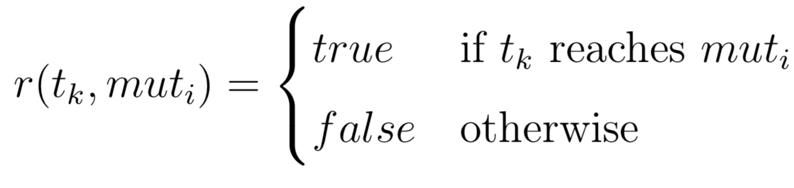
Definitions (2/3)
The reach function: r

Slide 37
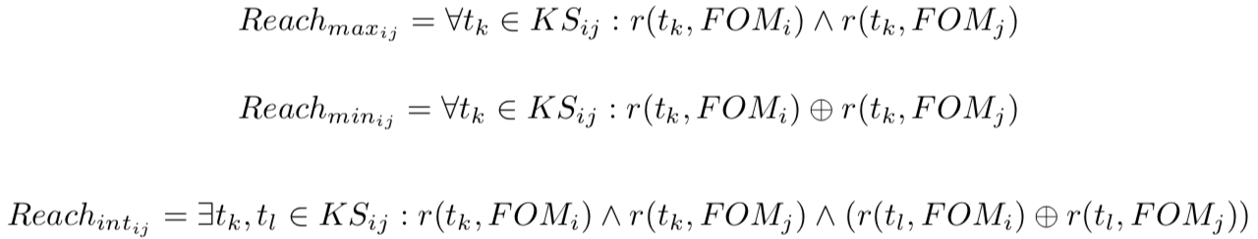
Definitions (3/3)

Slide 38
RQ1: SS2OMs reaching
System | SS2OMs | Reach_{max} % | Reach_{int} % | Reach_{min} %
Vending Machine | 25 | 12 | 8 | 80
Triangle | 393 | 8 | 1 | 91
Monopoly | 3,176 | 65 | 1 | 34
Commons CSV | 4,430 | 80 | 1 | 19
Commons CLI | 1,066 | 23 | 4 | 73
ECal | 1,488 | 48 | 5 | 47
Commons Validator | 17,571 | 55 | 4 | 41
Gson | 6,970 | 47 | 3 | 50
Chess | 8,977 | 48 | 2 | 50
Overall | 44,920 | 53,52% | 3,01% | 43,47%
Notes:
From 25 SS2OMs in Vending, 12% of them have their FOMs reaching classified as Max_{reach}

Slide 39
RQ2: reductions
System | SS2OMs % | Reach_{max} % | Reach_{min} %
Vending Machine | 14.04 | 1.75 | 12.28
Triangle | 36.23 | 13.77 | 34.78
Monopoly | 24.13 | 15.59 | 19.40
Commons CSV | 20.32 | 15.03 | 15.24
Commons CLI | 31.05 | 13.77 | 28.10
ECal | 22.54 | 15.16 | 15.74
Commons Validator | 24.52 | 22.71 | 20.21
Gson | 20.42 | 12.45 | 15.76
Chess | 20.38 | 10.81 | 16.41
Overall | 22.37% | 14.48% | 17.95%
Notes:
From 25 SS2OMs in Vending, 12% of them have their FOMs reaching classified as Max_{reach}

Slide 40
Study #2

Slide 41
Forced Reach Search (FRS)
A novel search strategy for SS2OMs
Considers a 2OM killed, only if a test case execution:
fails
reaches its both mutations

Slide 42
Research questions
RQ3: Are the SS2OMs found by FRS similar to the ones found by the Exhaustive Search (ES), specially the Reach_{max} SS2OMs?
RQ4: What is the potential reduction achieved by the FRS 2OMs?

Slide 43
FRS SS2OMs (RQ3 & RQ4)
System | FRS 2OMs | ES \ FRS | ES ∩ FRS | FRS \ ES | Reduction
Vending Machine | 28 | 20 | 5 | 23 | 12.28%
Triangle | 83 | 359 | 34 | 49 | 15.94%
Monopoly | 8,285 | 1,199 | 2,125 | 6,160 | 34.41%
Commons CSV | 9,946 | 1,061 | 3,369 | 6,577 | 29.30%
Commons CLI | 15,662 | 1,358 | 494 | 15,168 | 36.23%
ECal | 4,275 | 668 | 753 | 3,522 | 25.27%
Commons Validator | 27,540 | 7,111 | 10,435 | 17,105 | 26.62%
Gson | 79,189 | 3,510 | 3,460 | 75,729 | 30.55%
Chess | 20,981 | 4,661 | 4,298 | 16,683 | 18.24%
Overall | 165,989 | 19,947 | 24,973 | 141,016 | 25,75%
Notes:
From 25 SS2OMs in Vending, 12% of them have their FOMs reaching classified as Max_{reach}

Slide 44
Next steps

Slide 45
Validate FRS SS2OMs
generate test cases for the original test suite until it kills all non-equivalent FOMs;
replace the subsumed FOMs with the necessary FRS SS2OMs (from Step 5);
select test cases from current test suite and generate new ones until it kills all resulting mutants;
run the new test suite against the FOMs and verify its effectiveness via the mutation score.

Slide 46


Slide 47

Questions?

Slide 48
Related work

Slide 49
Masking
We did not find related works about SSHOMs reaching and masking
Although there is about faults masking: [Gopinath et al., 2017]

Slide 50
2nd order mutation testing
2OMs sampling
Random
LastToFirst
Different operators
etc.
[Polo et al., 2009], [Kintis et al., 2010], [Madeisky et al., 2013] …

Slide 51
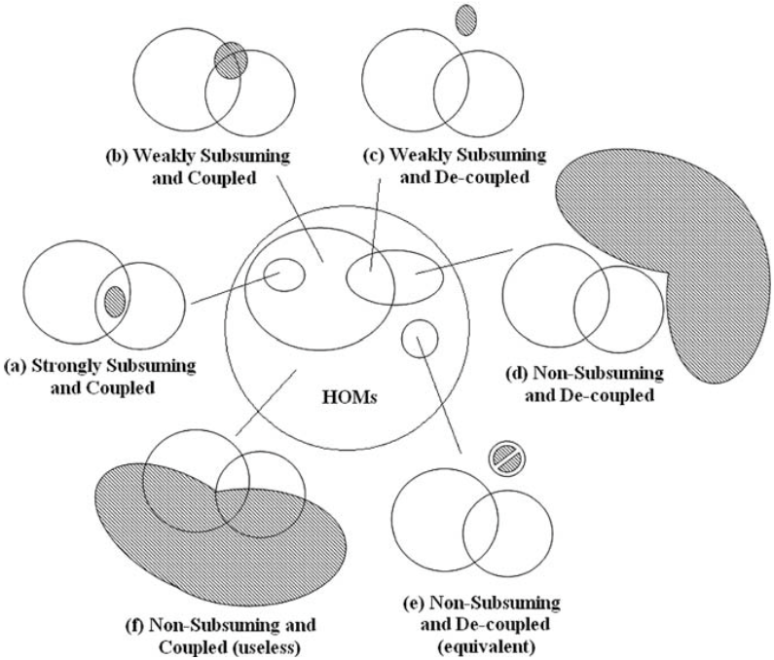
All HOMs
Strongly
Subsuming
HOMs –
SSHOMs
[Jia et al., 2009]

Slide 52
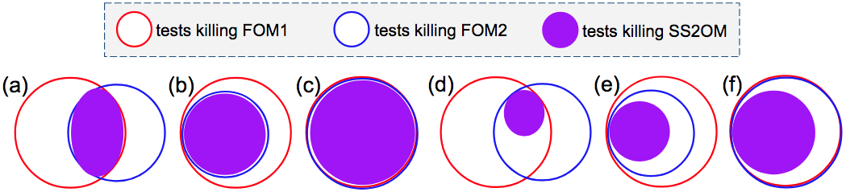
Venn Diagram “shapes”

Slide 53
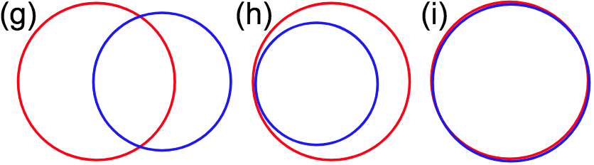
Venn Diagram “shapes”
Subtle 2OMs ≠ SS2OMs
Notes:
Regular, strict and subtle

Slide 54
RQ3: Venn
86.42%
Vending Machine | - | 7 | 18 | - | - | - | - | - | -
Triangle | 38 | 143 | 207 | - | 4 | 1 | - | - | 13
Monopoli | 1 | 414 | 2,851 | 1 | 2 | 55 | - | - | 46
Commons CSV | - | 116 | 4,299 | - | 1 | 14 | 3 | - | 8
Commons CLI | 9 | 429 | 1,373 | - | 30 | 11 | 5 | - | 3
ECal | 8 | 223 | 1,164 | - | 11 | 15 | - | - | -
Commons Validator | 32 | 1,526 | 15,867 | - | 20 | 101 | 18 | - | 36
Gson | 60 | 1,079 | 5,691 | - | 73 | 67 | 25 | - | 54
Chess | 265 | 1,674 | 6,847 | 5 | 83 | 85 | 172 | - | 132
Notes:
[TODO]

