Slide 1
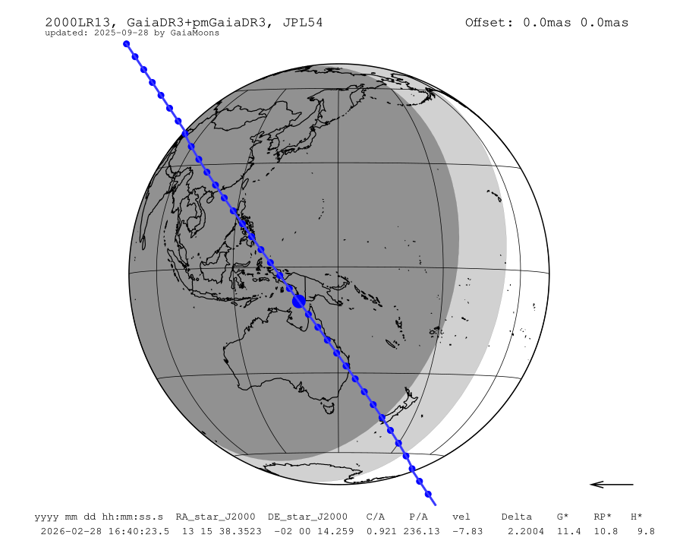
No observations.
Not because no one had a camera.
Because no one thought they could time it.
NTP Timing for Occultations — April 2026

Slide 2
The assumed path
Most people researching occultation timing find this:
1. “You need a GPS timing device…”
2. “Or an analog camera and VTI…”
3. “Or a dedicated camera…”
4. Hardware cost: $500 – $1,200+ US
5. → They close the tab.
There is a Step 0 they were never told about.

Slide 3
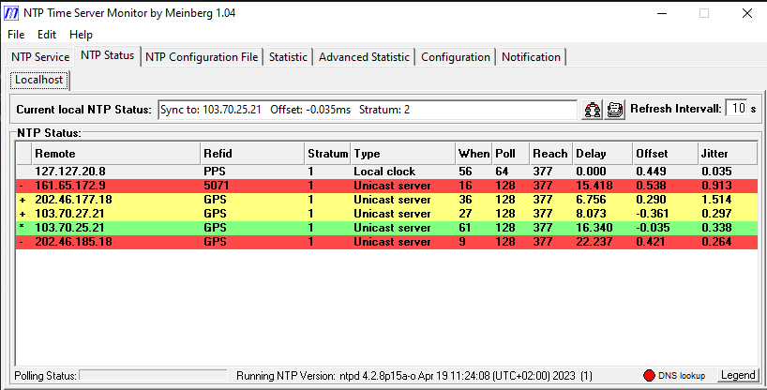
What NTP actually delivers
Home observatory PC — domestic fibre
Offset: −0.035 ms — that is 35 microseconds, not milliseconds. All active servers GPS-referenced at Stratum 1. Reach 377 — every poll responded.
The “±100 ms” fear = Windows default time service, not configured NTP.

Slide 4
Is 5 ms good enough?
For a typical main-belt occultation, mag 12–13, 100 ms exposure:
Source | Uncertainty
NTP clock (PIT estimate from logs) | ~5 ms
Camera line delay (measured) | ~1 ms
Camera frame delay (estimated) | ~2 ms
Total (RSS) | ~6 ms
“About 5 ms is accurate enough for most observing situations. Reliability and traceability are more important than the raw accuracy number.”
— Dave Herald, IOTA worldwide coordinator

Slide 5
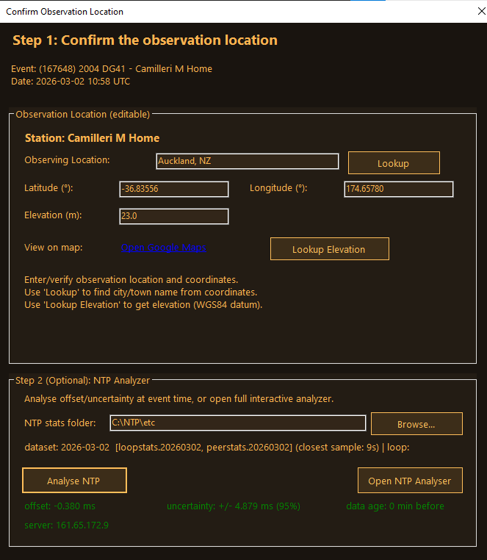
You can verify it — exactly
NTP Clock Accuracy in Occultation Manager
Event: 2004 DG41 — 2026-03-02 10:58 UTC
Offset: −0.380 ms
Uncertainty: ±4.879 ms (95%)
Data age: 0 min before event
“My clock was −0.38 ms off at disappearance.”
That number goes directly into the observation report.
Most GPS-camera users never document this at all.

Slide 6
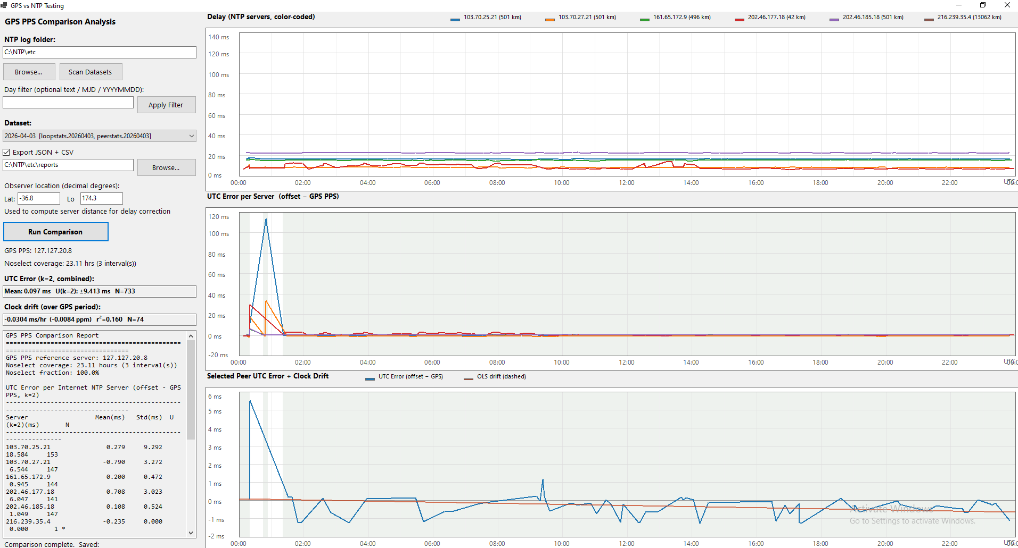
GPS ground-truth verification
GPS vs NTP Testing — 23 hours against GPS PPS reference
Mean UTC error: 0.097 ms
U(k=2): ±9.4 ms
Best servers: ±0.5–1 ms of GPS
The calibration chain:
UTC ← GPS PPS ← NTP servers ← your clock

Slide 7
10-minute install.
Free.
Everything configured automatically.

Slide 8
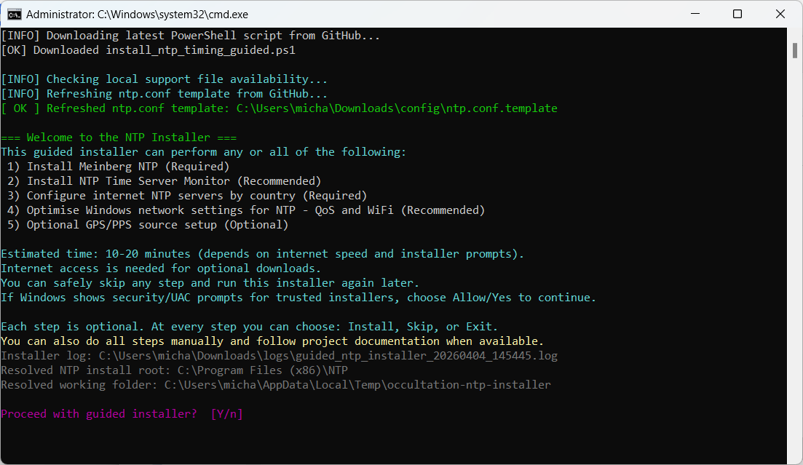
The NTP Installer
One run configures everything:
Meinberg NTP + Time Server Monitor
National standards servers for 35 countries
Windows network QoS optimisation (DSCP 46)
Optional GPS PPS receiver setup
Estimated time: 10–20 minutes
“You can set this up in the time it takes to make a toasted cheese sandwich.”
github.com/labstercam/occultation-ntp-installer

Slide 9
Camera delays — estimated without a flasher
per_line_delay = (1 / max_fps) / ROI_height × 1000 ms — Occultation Manager calculates this automatically
ZWO ASI462MM, 408×411 ROI, binning ×2 — Per-line: −0.0287 ms | Frame delay (Line 0): 13.8 ms
Frame delay for small sensors, small ROI: typically < 2 ms
Use community-shared calibrations for your camera
Not suitable: USB 2.0 cameras; sensors ≥4/3″ with full-frame ROI

Slide 10
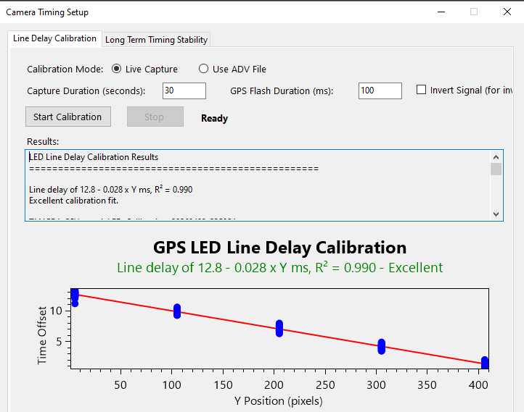
Camera delays — measured with a flasher
A $10 GPS receiver is all you need
HiLetgo VK172, Beitian BN-180, or similar
Camera Timing Setup — Line Delay Calibration
Result: “Line delay: 12.8 − 0.028 × Y ms”
R² = 0.990 — Excellent
Clean linear fit across the full sensor height.
Even a cheap receiver produces sub-millisecond calibration precision.

Slide 11
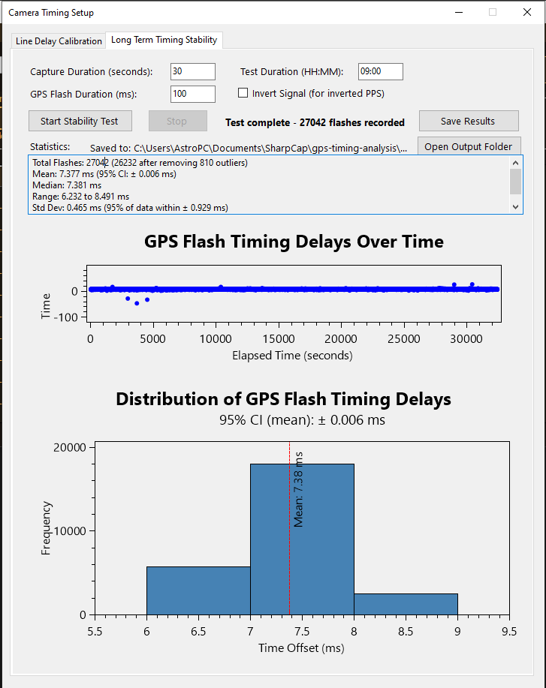
Camera delay is stable
27,042 GPS flashes — 9 continuous hours
Stat | Value
Mean | 7.377 ms
95% CI | ± 0.006 ms
Std Dev | 0.465 ms
Range | 6.2 – 8.5 ms
“How do you know the camera delay doesn’t drift?”
27,000 measurements over 9 hours say: it doesn’t.
Measure once per camera/ROI/settings combination. Use with confidence.

Slide 12
What it costs
Component | What | Cost
Windows PC | Already own | $0
USB3 camera | Already own / ToupTek G3M662M | $0 or ~$US 179
SharpCap Pro | Capture software | ~$US 20/yr
Meinberg NTP | Clock discipline | Free
NTP Installer | All-in-one setup | Free
Occultation Manager | Events, sequences, reports | Free
Total new cost |  | ~$US 20
Optional upgrades:
Item | Via | Approx. | Benefit
GPS PPS receiver + flasher | DIY | ~$50–80 AUD | Sub-ms clock + measured delays
Dedicated flash timer | Aarts Timers, StampOfApproval | ~$80–200 AUD | Most versatile

Slide 13
The upgrade path
Start today. Upgrade when you’re ready.
Level | Clock | Camera delays | Typical cost
0 — NTP only | ~5 ms | Estimated from max FPS | ~$20
1 — + GPS PPS + flasher | < 1 ms | Measured ± 1 ms | + $50–120
2 — TimeBox / GPS NTP server | < 1 ms | Measured ± 1 ms | + $150–250
3 — Dedicated camera | Built-in GPS | Built-in | $700–1,200+
Level 0 covers the majority of events. Level 3 is the destination, not the entry requirement.
“Start at Level 0 today and learn how to do occultations. Upgrade later when you need to.”

Slide 14
Start tonight
New observers
Experienced observers & clubs
Campaign coordinators
Download and run the installer. Check NTP status in the morning.
If the numbers look good — you can do occultations.
NTP is free, works, and accuracy is verifiable and traceable to UTC.
Help your members start — every new observer adds chords to every campaign.
NTP observers expand multi-station coverage at zero hardware cost.
Let’s get this listed formally.

Slide 15
Links
NTP Installer
github.com/labstercam/occultation-ntp-installer
Tools & docs
github.com/labstercam/occultation-tools
NTP Timing for Occultations — April 2026

