Slide 1

XaaS — Export-as-a-Service
An export-decision engine for European SMEs
Capstone Midterm — Progress Monitoring
Ieva Labutyte · Danielius Zarkich · Dominykas Baronas
VU Business School · DeepTech Entrepreneurship · June 2026

Slide 2

The opportunity
XaaS is one tool that helps a European SME decide where to export, what shipping will cost, and how to stay compliant — instead of stitching together five or more tools and consultants.
≈ 51%
of Lithuania's exports come from SMEs
15+
EU trade-tech firms — none integrate the SME export decision end-to-end
Beachhead: SMEs exporting within Europe — where the single market is most navigable.
Expansion: distant, high-value markets, where the gap is widest.
5+ → 1
tools and advisers replaced by a single interface
Sources: Statistics Lithuania (2024); Eurostat ext_tec10.

Slide 3
Research & development logic
Research question
Can an orchestration engine give SMEs more accurate market recommendations and more reliable compliance guidance than a single general-purpose AI model?
Why it is deep-tech
Not a chatbot wrapper - it coordinates specialised components and adds a verification step before returning high-stakes compliance answers.
Scope of the thesis
Design and empirically evaluate the engine against a single-model baseline. The architecture choice and meta-learning are deliberately deferred to the build phase.

Slide 4
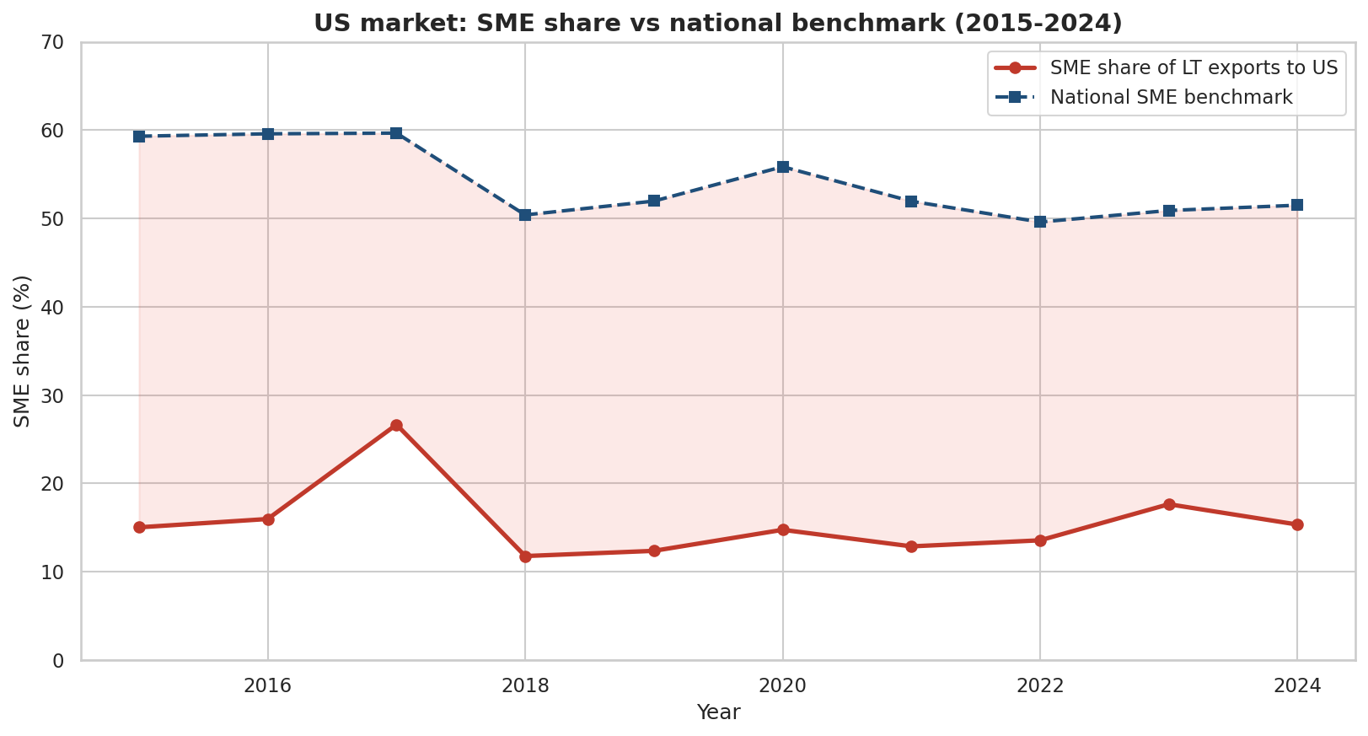
Where SMEs are under-served
Beachhead - Europe
Even inside the single market, an SME without an export team juggles market research, logistics, customs and VAT across separate tools. Cost and risk fall hardest on them.
Expansion - distant markets
The under-representation gap is widest far from home — our clearest quantified signal (right).
Source: Eurostat ext_tec10 (trade by enterprise size), WORLD basis.

Slide 5
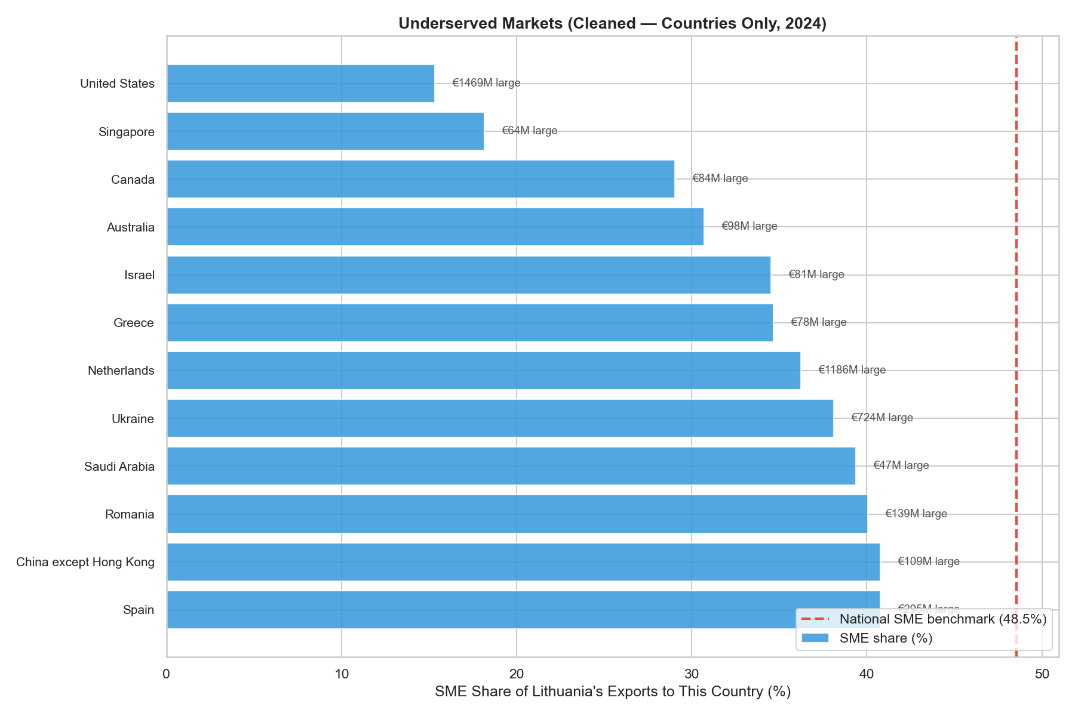
Research base and the gap
Verified baseline (open data): Lithuania goods exports €36.8bn in 2024; SMEs ≈ 51% of exports.
Under-representation is concentrated in distant markets, not nearby European ones.
Competitive scan of 15+ EU trade-tech firms (freight, visibility, compliance, full-stack): none integrate the SME export decision end-to-end.
That fragmentation is the gap an SME-focused decision layer can fill.
Sources: Eurostat; Statistics Lithuania; XaaS competitive analysis (2026).

Slide 6
The innovation: an orchestration engine
Specialised components
Market screening · logistics estimate · compliance rules
Orchestrator + verification
Coordinates them, then checks high-stakes compliance answers
Reliable recommendation
Where to export, est. cost & time, compliance to meet
Innovation type: process and technology - the advance is reliability, not just generation.
Evaluation: measured against a single-model baseline on (1) market-recommendation accuracy and (2) compliance reliability, using open data and a curated compliance test set.
Honest limit: there is no perfect ground truth for the “best” market, so compliance is the cleaner objective test.

Slide 7
Initial validation
Done
Secondary-data analysis on open EU sources (Eurostat, Comtrade), fully reproducible in the project repository.
Designed
~10–12 semi-structured interviews and a survey using a Van Westendorp price test, structured discovery-before-concept to avoid priming, analysed thematically.
Next (before the midterm)
Recruit and run the first 2–3 discovery interviews; track perceived usefulness, intent to use and pay, and recommendation accuracy.

Slide 8
Business model: methodology
Chosen methods: the Business Model Canvas for our own model, plus benchmarking for the comparison.
Why it fits: the canvas makes each assumption explicit and maps onto the required final business-plan appendix.
Benchmarking learns from real winners and failures in the European trade-tech market.
Output: a first-pass canvas with every block tagged validated or hypothesis, and a competitor benchmark.

Slide 9
Business Model Canvas
Key partners
Key activities
Value propositions
Customer relationships
Customer segments
Eurostat / Comtrade data
Freight & customs brokers
Chambers, EEN
AI / compute providers
Build & test the engine
Keep data current
Onboard SMEs
One tool: markets + shipping cost/time + compliance
Replaces 5+ tools & consultants
Reliable on compliance — checked, not guessed
Self-serve + onboarding
Expert help on compliance
Knowledge base
EU SMEs that export, no in-house export team
Manufacturing & machinery first
Later: distant markets (US)
Key resources
Channels
The orchestration engine
Open data + rules
The team
Web app (self-serve)
Chambers / EEN / associations
Cost structure
Revenue streams
Engineering build
AI / compute per query — watch this
Compliance expertise, hosting, marketing
Monthly subscription (main)
Premium reports · partner referral fees
Tagged validated vs hypothesis in docs/BUSINESS_MODEL.md.

Slide 10
How our model compares
Model archetype | Revenue model | Lesson for XaaS
Freight execution (sennder, Forto) | Margin on freight | Capital-heavy & cyclical - avoid; stay in the decision layer
Visibility SaaS (Shippeo, project44) | Subscription | Subscription works; target SMEs, not enterprise
Compliance tech (Digicust) | Subscription | Real pain - integrate it, don't be compliance-only
Full-stack (E2open, Flexport) | Enterprise licences | Integrated proven at the top; gap = SME-affordable
Generic AI assistants | Subscription / usage | Cheap but unreliable; our verification is the moat
Positioning: a subscription, SME-focused, integrated decision layer, differentiated by verified reliability. To test: subscription willingness-to-pay, compliance trust, and orchestration unit economics.

Slide 11
Where the project is heading
How it has evolved
We started from “exports are declining,” found the data didn't support a simple decline story, and reframed to “SMEs are under-served in distant markets,” with Europe as the feasible beachhead.
Next steps
Run interviews and the survey; restore the SME-barrier statistic from a reproducible EIB source; choose the architecture; build the MVP (summer–autumn); grow the canvas into the full business plan.
Use of AI tools
AI (Claude) was used for data-correction support, drafting, and research design; every output was verified against official sources. Full disclosure and transcripts are kept per VU BS AI guidelines.

